Slide 1

邊緣人工智慧
Edge AI
Basics of Artificial Intelligence (AI) and Deep Learning (DL)
吳凱強
Kai-Chiang Wu

Slide 2






Deep Learning Continues to Scale
The demand of computation grows exponentially
1000
MT-NLG
 |  | GPT-3 175B | 530B
 |  | T-NLG 17B
 | Me | gatronLM 8.3B
 | GPT-2 1.5B BERT
GP Transformer ^{0.} 0.05B | 0.34B T 11B | As | Model Size sume data are FP16.
Model Size (#Params in Billion)
100
10
1
0.1
0.01
2017
2018
2020
2021
2022
2

Slide 3


Problem: DL Models Outgrow Hardware
Moore’s Law: 2x every 2 years; DL models: 4x every 2 years
1000
MT-NLG
GPT-3 175B
530B
Model Size (#Params in Billion)
100
T-NLG 17B
A100 80GB
10
A100 40GB
TPUv2 16GB
V100 32GB
TPUv3 32GB
MegatronLM 8.3B
1
GPT-2 1.5B
0.1
BERT
0.34B
Model Size GPU Memory
GPT 0.11B
Transformer 0.05B
Assume data are FP16.
2021 2022
0.01
2017
2018
2020
3

Slide 4
Efficient Deep Learning Techniques are Essential
Bridges the gap between the supply and demand of computation
1000
MT-NLG 530B
GPT-3 175B
Model compression bridges the gap.
Model Size (#Params in Billion)
100
T-NLG 17B
A100 80GB
10
A100 40GB
TPUv2 16GB
V100 32GB
TPUv3 32GB
MegatronLM 8.3B
1
GPT-2 1.5B
0.1
BERT
0.34B
Model Size GPU Memory
GPT 0.11B
Transformer 0.05B
Assume data are FP16.
2021 2022
0.01
2017
2018
2020
4

Slide 5
Lecture Plan
Review the terminology of neural networks
Review popular building blocks in a neural network
Review convolutional neural networks’ architecture
Introduce popular efficiency metrics for neural netowrks

Slide 6








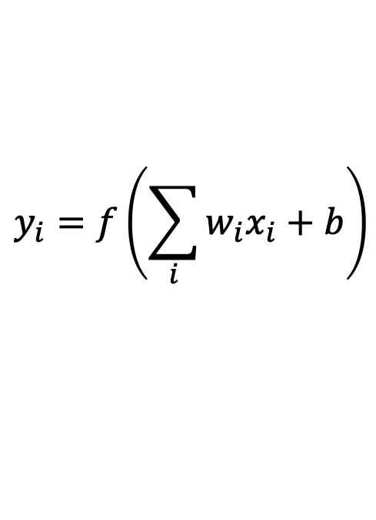


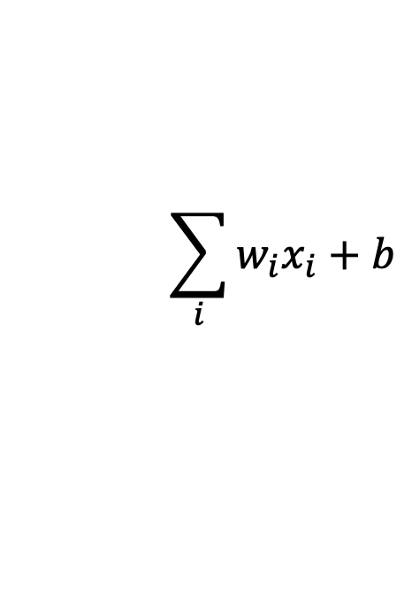

Neuron and Synapse
Synapse
Synapse
Dendrite
$$x_{0}$$
Synaptic Terminals
Input Axon
$$w_{0}x_{0}$$
$$y_{i}=f\left(\sum_{i}{w_{i}x_{i}+b}\right)$$
Axon
$$x_{1}$$
$$w_{1}x_{1}$$
$$\sum_{i}{w_{i}x_{i}+b}$$
$$f$$
Output Axon
Cell Body
$$x_{2}$$
$$w_{2}x_{2}$$
Activation Function
Impulse
Dendrite
Cell Body

Slide 7
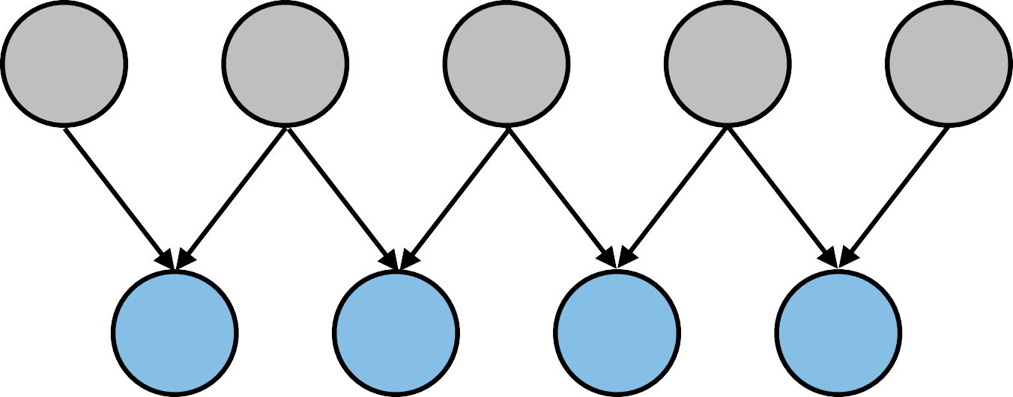




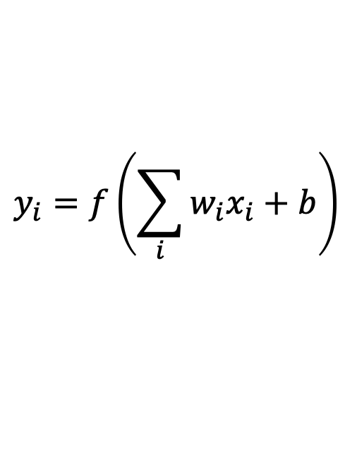


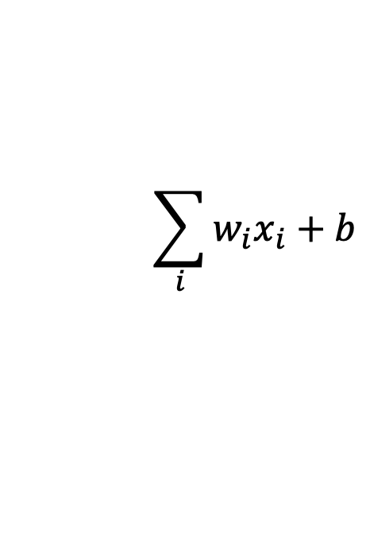

Deep Neural Network
3-Layer Neural Network With 2 Hidden Layers
Inputs
Synapses / Weights / Parameters
Layer 0
Neurons / Features / Activations
Hidden Layer 1
Synapse
$$x_{0}$$
Input Axon
$$w_{0}x_{0}$$
$$y_{i}=f\left(\sum_{i}{w_{i}x_{i}+b}\right)$$
Hidden Layer 2
$$x_{1}$$
$$w_{1}x_{1}$$
$$\sum_{i}{w_{i}x_{i}+b}$$
$$f$$
Outputs
The dimensionality of these hidden layers determines the width of the model.
Output Axon
$$x_{2}$$
$$w_{2}x_{2}$$
Activation Function
Dendrite
Cell Body

Slide 8
Popular Neural Network Layers

Slide 9
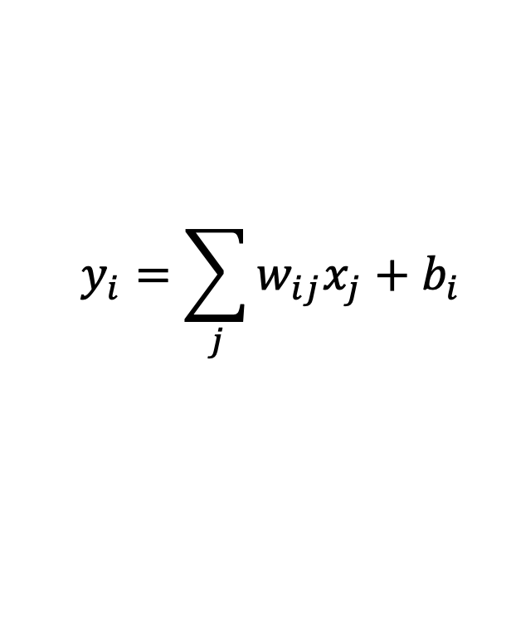
Fully-Connected Layer (Linear Layer)
The output neuron is connected to all input neurons.
  Shape of Tensors:
    Input Features X : (n, c_{i})
    Output Features Y : (n, c_{o})
    Weights W : (c_{o,} c_{i})
    Bias b : (c_{o})
x₀ x₁ x₂
x₃
x₄
w
00
w
42
y₀
y₁
y₂
$$y_{i}=\sum_{j}{w_{ij}x_{j}+b_{i}}$$
Notations
c_{i} | Input Channels
c_{o} | Output Channels
c_{i}
c_{o}
c_{o}
=
c_{i}
X
_{W}T
Y

Slide 10
Fully-Connected Layer (Linear Layer)
The output neuron is connected to all input neurons.
  Shape of Tensors:
    Input Features X : (n, c_{i})
    Output Features Y : (n, c_{o})
    Weights W : (c_{o,} c_{i})
    Bias b : (c_{o})
x₀ x₁ x₂
x₃
x₄
w
00
w
42
y₀
y₁
y₂
$$y_{i}=\sum_{j}{w_{ij}x_{j}+b_{i}}$$
Notations
n | Batch Size
c_{i} | Input Channels
c_{o} | Output Channels
c_{i}
c_{o}
= n
c_{o}
n
c_{i}
X
_{W}T
Y

Slide 11
Fully-Connected Layer (Linear Layer)
The output neuron is connected to all input neurons.
  Shape of Tensors:
    Input Features X : (n, c_{i})
    Output Features Y : (n, c_{o})
    Weights W : (c_{o,} c_{i})
    Bias b : (c_{o})
x₀ x₁ x₂
x₃
x₄
w
00
w
42
y₀
y₁
y₂
z
z
Notations
n | Batch Size
c_{i} | Input Channels
c_{o} | Output Channels
0 1
Multilayer Perceptron (MLP)
c_{i}
c_{o}
= n
c_{o}
n
c_{i}
X
_{W}T
Y

Slide 12
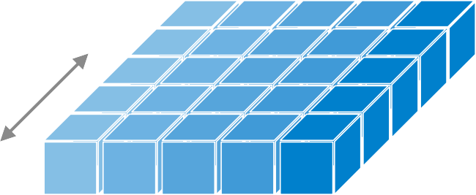
Convolution Layer
.
The output neuron is connected to input neurons in the receptive field
  Shape of Tensors:
    Input Features X : (n, c_{i})
    Output Features Y : (n, c_{o})
    Weights W : (c_{o,} c_{i})
    Bias b : (c_{o})
1D Conv
(n=1, c_{i}, w_{i})
(n=1, c_{o}, w_{o})
spatial dimension(s)
Notations
n | Batch Size
c_{i} | Input Channels
c_{o} | Output Channels
w_{i,} w_{o} | Input/Output Width
channel dimension

Slide 13
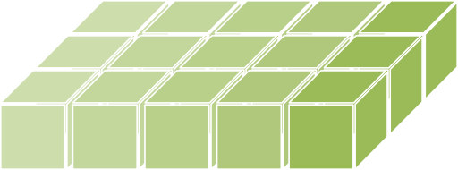
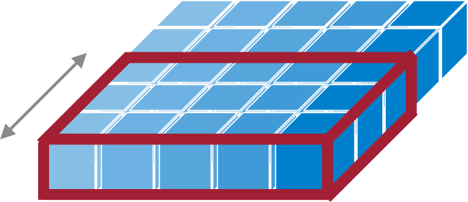
Convolution Layer
.
The output neuron is connected to input neurons in the receptive field
  Shape of Tensors:
    Input Features X : (n, c_{i})
    Output Features Y : (n, c_{o})
    Weights W : (c_{o,} c_{i})
    Bias b : (c_{o})
1D Conv
(n=1, c_{i}, w_{i})
(n=1, c_{o}, w_{o})
(c_{o}, c_{i}, k_{w})
k_{w}
Filter
c
i
spatial dimension(s)
Notations
n | Batch Size
c_{i} | Input Channels
c_{o} | Output Channels
w_{i}, w_{o} | Input/Output Width
k_{w} | Kernel Width
channel dimension

Slide 14

Convolution Layer
.
The output neuron is connected to input neurons in the receptive field
  Shape of Tensors:
    Input Features X : (n, c_{i})
    Output Features Y : (n, c_{o})
    Weights W : (c_{o,} c_{i})
    Bias b : (c_{o})
1D Conv
(n=1, c_{i}, w_{i})
(n=1, c_{o}, w_{o})
(c_{o}, c_{i}, k_{w})
k_{w}
Filter
c
i
spatial dimension(s)
Notations
n | Batch Size
c_{i} | Input Channels
c_{o} | Output Channels
w_{i}, w_{o} | Input/Output Width
k_{w} | Kernel Width
channel dimension

Slide 15

Convolution Layer
.
The output neuron is connected to input neurons in the receptive field
  Shape of Tensors:
    Input Features X : (n, c_{i})
    Output Features Y : (n, c_{o})
    Weights W : (c_{o,} c_{i})
    Bias b : (c_{o})
1D Conv
(n=1, c_{i}, w_{i})
(n=1, c_{o}, w_{o})
(c_{o}, c_{i}, k_{w})
k_{w}
Filter
c
i
spatial dimension(s)
Notations
n | Batch Size
c_{i} | Input Channels
c_{o} | Output Channels
w_{i}, w_{o} | Input/Output Width
k_{w} | Kernel Width
channel dimension
c_{o}

Slide 16
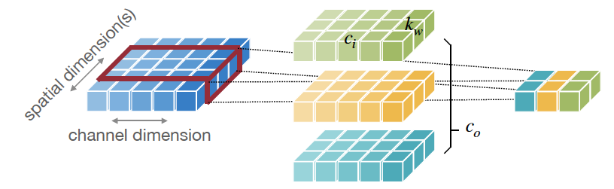
Convolution Layer
.
The output neuron is connected to input neurons in the receptive field
  Shape of Tensors:
    Input Features X : (n, c_{i})
    Output Features Y : (n, c_{o})
    Weights W : (c_{o,} c_{i})
    Bias b : (c_{o})
1D Conv
(n=1, c_{i}, w_{i})
(n=1, c_{o}, w_{o})
(c_{o}, c_{i}, k_{w})
Notations
n | Batch Size
c_{i} | Input Channels
c_{o} | Output Channels
w_{i}, w_{o} | Input/Output Width
k_{w} | Kernel Width

Slide 17
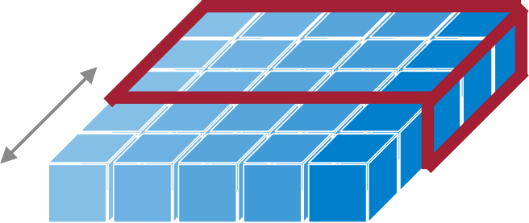

Convolution Layer
The output neuron is connected to input neurons in the receptive field
  Shape of Tensors:
    Input Features X : (n, c_{i})
    Output Features Y : (n, c_{o})
    Weights W : (c_{o,} c_{i})
    Bias b : (c_{o})
1D Conv
(n=1, c_{i}, w_{i})
(n=1, c_{o}, w_{o})
(c_{o}, c_{i}, k_{w})
k_{w}
c_{i}
spatial dimension(s)
Notations
n | Batch Size
c_{i} | Input Channels
c_{o} | Output Channels
w_{i}, w_{o} | Input/Output Width
k_{w} | Kernel Width
channel dimension
c_{o}

Slide 18
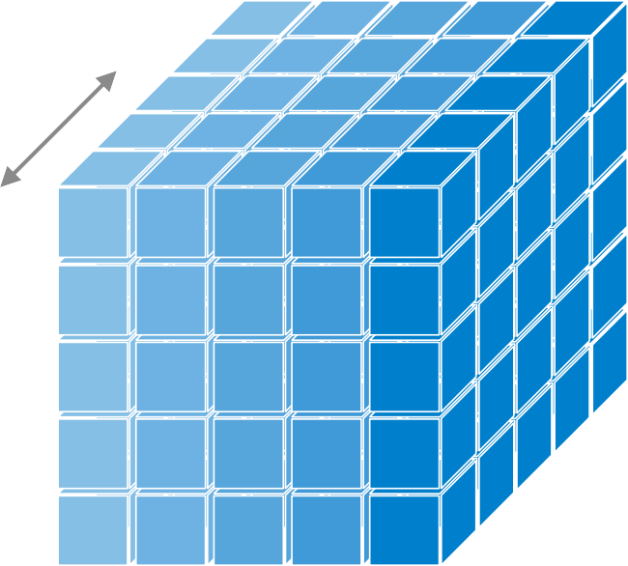

Convolution Layer
.
The output neuron is connected to input neurons in the receptive field
  Shape of Tensors:
    Input Features X : (n, c_{i})
    Output Features Y : (n, c_{o})
    Weights W : (c_{o,} c_{i})
    Bias b : (c_{o})
1D Conv
(n, c_{i}, w_{i})
2D Conv
(n=1, c_{i}, h_{i,} w_{i})
(n, c_{o}, w_{o})
(n=1, c_{o}, h_{o}, w_{o})
(c_{o}, c_{i}, k_{w})
(c_{o}, c_{i}, k_{h}, k_{w})
spatial dimension(s)
Notations
n | Batch Size
c_{i} | Input Channels
c_{o} | Output Channels
w_{i}, w_{o} | Input/Output Width
h_{i}, h_{o} | Input/Output Height
Activation Map / Feature Map
h$×$w
channel dimension

Slide 19
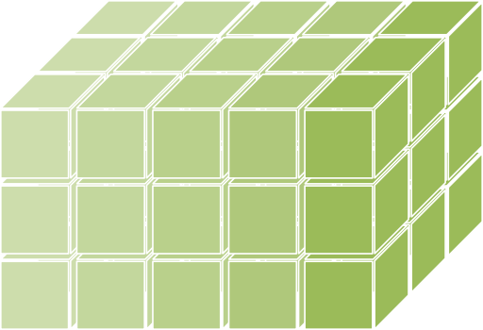
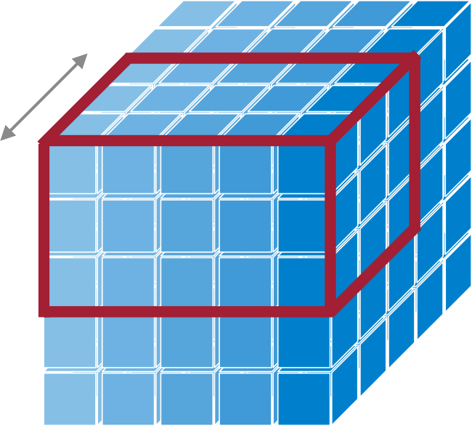
Convolution Layer
.
The output neuron is connected to input neurons in the receptive field
  Shape of Tensors:
    Input Features X : (n, c_{i})
    Output Features Y : (n, c_{o})
    Weights W : (c_{o,} c_{i})
    Bias b : (c_{o})
1D Conv
(n, c_{i}, w_{i})
2D Conv
(n=1, c_{i}, h_{i,} w_{i})
(n, c_{o}, w_{o})
(n=1, c_{o}, h_{o}, w_{o})
(c_{o}, c_{i}, k_{w})
(c_{o}, c_{i}, k_{h}, k_{w})
k_{w}
Filter
k_{h}
c_{i}
Notations
n | Batch Size
c_{i} | Input Channels
c_{o} | Output Channels
w_{i}, w_{o} | Input/Output Width
h_{i}, h_{o} | Input/Output Height
k_{h} | Kernel Height
k_{w} | Kernel Width
spatial dimension(s)
channel dimension

Slide 20
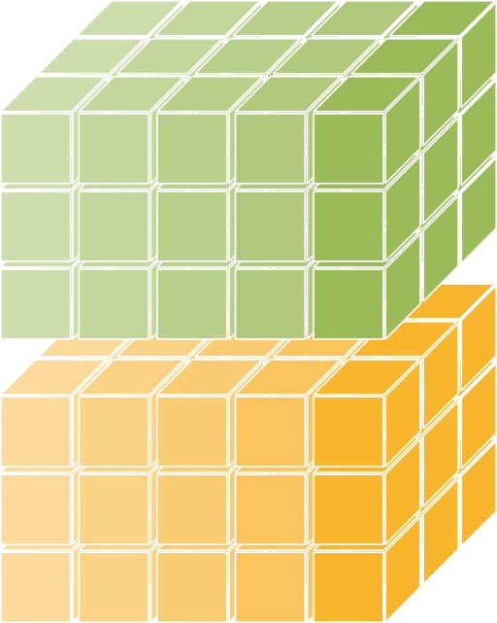
Convolution Layer
.
The output neuron is connected to input neurons in the receptive field
  Shape of Tensors:
    Input Features X : (n, c_{i})
    Output Features Y : (n, c_{o})
    Weights W : (c_{o,} c_{i})
    Bias b : (c_{o})
1D Conv
(n, c_{i}, w_{i})
2D Conv
(n=1, c_{i}, h_{i,} w_{i})
(n, c_{o}, w_{o})
(n=1, c_{o}, h_{o}, w_{o})
(c_{o}, c_{i}, k_{w})
(c_{o}, c_{i}, k_{h}, k_{w})
k_{w}
Filter
k_{h}
c_{i}
Notations
n | Batch Size
c_{i} | Input Channels
c_{o} | Output Channels
w_{i}, w_{o} | Input/Output Width
h_{i}, h_{o} | Input/Output Height
k_{h} | Kernel Height
k_{w} | Kernel Width
spatial dimension(s)
channel dimension

Slide 21
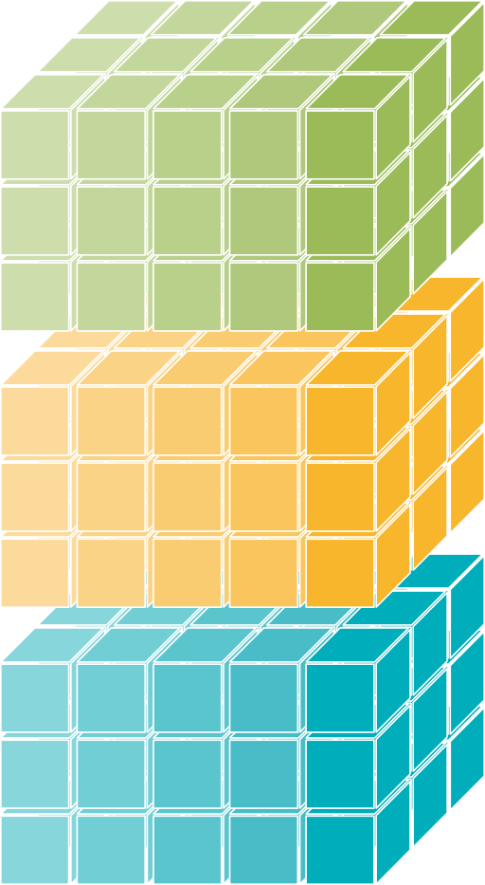

Convolution Layer
.
The output neuron is connected to input neurons in the receptive field
  Shape of Tensors:
    Input Features X : (n, c_{i})
    Output Features Y : (n, c_{o})
    Weights W : (c_{o,} c_{i})
    Bias b : (c_{o})
1D Conv
(n, c_{i}, w_{i})
2D Conv
(n=1, c_{i}, h_{i,} w_{i})
(n, c_{o}, w_{o})
(n=1, c_{o}, h_{o}, w_{o})
(c_{o}, c_{i}, k_{w})
(c_{o}, c_{i}, k_{h}, k_{w})
k_{w}
Filter
k_{h}
c_{i}
c_{o}
Notations
n | Batch Size
c_{i} | Input Channels
c_{o} | Output Channels
w_{i}, w_{o} | Input/Output Width
h_{i}, h_{o} | Input/Output Height
k_{h} | Kernel Height
k_{w} | Kernel Width
spatial dimension(s)
channel dimension

Slide 22
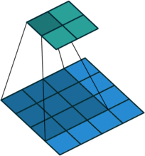
Convolution Layer
.
The output neuron is connected to input neurons in the receptive field
  Shape of Tensors:
    Input Features X : (n, c_{i})
    Output Features Y : (n, c_{o})
    Weights W : (c_{o,} c_{i})
    Bias b : (c_{o})
1D Conv
(n, c_{i}, w_{i})
2D Conv
(n=1, c_{i}, h_{i,} w_{i})
w_{o}
h_{o}
(n, c_{o}, w_{o})
(n=1, c_{o}, h_{o}, w_{o})
(c_{o}, c_{i}, k_{w})
(c_{o}, c_{i}, k_{h}, k_{w})
h_{i}
w_{i}
k_{w}
k_{h}
c_{i}
Notations
n | Batch Size
c_{i} | Input Channels
c_{o} | Output Channels
w_{i}, w_{o} | Input/Output Width
h_{i}, h_{o} | Input/Output Height
k_{h} | Kernel Height
k_{w} | Kernel Width
spatial dimension(s)
c_{o}
channel dimension
Weight Sharing

Slide 23
Convolution Layer
.
The output neuron is connected to input neurons in the receptive field
  Shape of Tensors:
    Input Features X : (n, c_{i})
    Output Features Y : (n, c_{o})
    Weights W : (c_{o,} c_{i})
    Bias b : (c_{o})
1D Conv
(n, c_{i}, w_{i})
2D Conv
(n=1, c_{i}, h_{i,} w_{i})
w_{o}
h_{o}
(n, c_{o}, w_{o})
(n=1, c_{o}, h_{o}, w_{o})
(c_{o}, c_{i}, k_{w})
(c_{o}, c_{i}, k_{h}, k_{w})
h_{i}
w_{i}
k_{w}
k_{h}
c_{i}
Notations
n | Batch Size
c_{i} | Input Channels
c_{o} | Output Channels
w_{i}, w_{o} | Input/Output Width
h_{i}, h_{o} | Input/Output Height
k_{h} | Kernel Height
k_{w} | Kernel Width
spatial dimension(s)
c_{o}
channel dimension

Slide 24

Convolution Layer
.
The output neuron is connected to input neurons in the receptive field
  Shape of Tensors:
    Input Features X : (n, c_{i})
    Output Features Y : (n, c_{o})
    Weights W : (c_{o,} c_{i})
    Bias b : (c_{o})
1D Conv
(n, c_{i}, w_{i})
2D Conv
(n=1, c_{i}, h_{i,} w_{i})
w_{o}
h_{o}
(n, c_{o}, w_{o})
(n=1, c_{o}, h_{o}, w_{o})
(c_{o}, c_{i}, k_{w})
(c_{o}, c_{i}, k_{h}, k_{w})
h_{i}
w_{i}
spatial dimension(s)
Notations
n | Batch Size
c_{i} | Input Channels
c_{o} | Output Channels
w_{i}, w_{o} | Input/Output Width
h_{i}, h_{o} | Input/Output Height
k_{h} | Kernel Height
k_{w} | Kernel Width
spatial dimension(s)
c_{i}
c_{o}
channel dimension

Slide 25

Convolution Layer
.
The output neuron is connected to input neurons in the receptive field
  Shape of Tensors:
    Input Features X : (n, c_{i})
    Output Features Y : (n, c_{o})
    Weights W : (c_{o,} c_{i})
    Bias b : (c_{o})
1D Conv
(n, c_{i}, w_{i})
2D Conv
(n=1, c_{i}, h_{i,} w_{i})
w_{o}
h_{o}
(n, c_{o}, w_{o})
(n=1, c_{o}, h_{o}, w_{o})
(c_{o}, c_{i}, k_{w})
(c_{o}, c_{i}, k_{h}, k_{w})
h_{i}
w_{i}
Notations
n | Batch Size
c_{i} | Input Channels
c_{o} | Output Channels
w_{i}, w_{o} | Input/Output Width
h_{i}, h_{o} | Input/Output Height
k_{h} | Kernel Height
k_{w} | Kernel Width
spatial dimension(s)
c_{i}
c_{o}
channel dimension
Image source: 1

Slide 26

Convolution Layer
.
The output neuron is connected to input neurons in the receptive field
  Shape of Tensors:
    Input Features X : (n, c_{i})
    Output Features Y : (n, c_{o})
    Weights W : (c_{o,} c_{i})
    Bias b : (c_{o})
1D Conv
(n, c_{i}, w_{i})
2D Conv
(n=1, c_{i}, h_{i,} w_{i})
w_{o}
h_{o}
(n, c_{o}, w_{o})
(n=1, c_{o}, h_{o}, w_{o})
(c_{o}, c_{i}, k_{w})
(c_{o}, c_{i}, k_{h}, k_{w})
h_{i}
w_{i}
spatial dimension(s)
Notations
n | Batch Size
c_{i} | Input Channels
c_{o} | Output Channels
w_{i}, w_{o} | Input/Output Width
h_{i}, h_{o} | Input/Output Height
k_{h} | Kernel Height
k_{w} | Kernel Width
spatial dimension(s)
c_{i}
c_{o}
channel dimension

Slide 27

Convolution Layer
.
The output neuron is connected to input neurons in the receptive field
  Shape of Tensors:
    Input Features X : (n, c_{i})
    Output Features Y : (n, c_{o})
    Weights W : (c_{o,} c_{i})
    Bias b : (c_{o})
1D Conv
(n, c_{i}, w_{i})
2D Conv
(n=1, c_{i}, h_{i,} w_{i})
w_{o}
h_{o}
(n, c_{o}, w_{o})
(n=1, c_{o}, h_{o}, w_{o})
(c_{o}, c_{i}, k_{w})
(c_{o}, c_{i}, k_{h}, k_{w})
h_{i}
w_{i}
Notations
n | Batch Size
c_{i} | Input Channels
c_{o} | Output Channels
w_{i}, w_{o} | Input/Output Width
h_{i}, h_{o} | Input/Output Height
k_{h} | Kernel Height
k_{w} | Kernel Width
spatial dimension(s)
c_{i}
c_{o}
channel dimension
Image source: 1

Slide 28

Convolution Layer
.
The output neuron is connected to input neurons in the receptive field
  Shape of Tensors:
    Input Features X : (n, c_{i})
    Output Features Y : (n, c_{o})
    Weights W : (c_{o,} c_{i})
    Bias b : (c_{o})
1D Conv
(n, c_{i}, w_{i})
2D Conv
(n=1, c_{i}, h_{i,} w_{i})
w_{o}
h_{o}
(n, c_{o}, w_{o})
(n=1, c_{o}, h_{o}, w_{o})
(c_{o}, c_{i}, k_{w})
(c_{o}, c_{i}, k_{h}, k_{w})
h_{i}
w_{i}
Notations
n | Batch Size
c_{i} | Input Channels
c_{o} | Output Channels
w_{i}, w_{o} | Input/Output Width
h_{i}, h_{o} | Input/Output Height
k_{h} | Kernel Height
k_{w} | Kernel Width
spatial dimension(s)
c_{i}
c_{o}
channel dimension

Slide 29

Convolution Layer
.
The output neuron is connected to input neurons in the receptive field
  Shape of Tensors:
    Input Features X : (n, c_{i})
    Output Features Y : (n, c_{o})
    Weights W : (c_{o,} c_{i})
    Bias b : (c_{o})
1D Conv
(n, c_{i}, w_{i})
2D Conv
(n=1, c_{i}, h_{i,} w_{i})
w_{o}
h_{o}
(n, c_{o}, w_{o})
(n=1, c_{o}, h_{o}, w_{o})
(c_{o}, c_{i}, k_{w})
(c_{o}, c_{i}, k_{h}, k_{w})
h_{i}
w_{i}
Notations
n | Batch Size
c_{i} | Input Channels
c_{o} | Output Channels
w_{i}, w_{o} | Input/Output Width
h_{i}, h_{o} | Input/Output Height
k_{h} | Kernel Height
k_{w} | Kernel Width
spatial dimension(s)
c_{i}
c_{o}
channel dimension

Slide 30
Convolution Layer
.
The output neuron is connected to input neurons in the receptive field
  Shape of Tensors:
    Input Features X : (n, c_{i})
    Output Features Y : (n, c_{o})
    Weights W : (c_{o,} c_{i})
    Bias b : (c_{o})
1D Conv
(n, c_{i}, w_{i})
2D Conv
(n=1, c_{i}, h_{i,} w_{i})
w_{o}
h_{o}
Feature map size becomes smaller.
(n, c_{o}, w_{o})
(n=1, c_{o}, h_{o}, w_{o})
(c_{o}, c_{i}, k_{w})
(c_{o}, c_{i}, k_{h}, k_{w})
h_{i}
w_{i}
k_{w}
k_{h}
c_{i}
c_{o}
Notations
n | Batch Size
c_{i} | Input Channels
c_{o} | Output Channels
w_{i}, w_{o} | Input/Output Width
h_{i}, h_{o} | Input/Output Height
k_{h} | Kernel Height
k_{w} | Kernel Width
spatial dimension(s)
channel dimension
Image source: 1

Slide 31

Convolution Layer: Padding
w_{o}
h
Padding can be used to keep the output feature map size is the same as input feature map size
  Zero Padding pads the input boundaries with zero.
  Other Paddings: Reflection Padding, Replication Padding, Constant Padding
o
h_{o} = h_{i} + 2p − k_{h} + 1
h_{i} = w_{i} = 5 k_{h} = k_{w} = 3 h_{o} = w_{o}
= 5 + 2 × 1 − 3 + 1
= 5
p is padding
h
i
w
i
Zero Padding
Reflection Padding
Replication Padding
Notations
n | Batch Size
c_{i} | Input Channels
c_{o} | Output Channels
w_{i}, w_{o} | Input/Output Width
h_{i}, h_{o} | Input/Output Height
k_{h} | Kernel Height
k_{w} | Kernel Width
0 | 0 | 0 | 0 | 0 | 0 | 0
0 | 0 | 0 | 0 | 0 | 0 | 0
0 | 0 | 1 | 2 | 3 | 0 | 0
0 | 0 | 4 | 5 | 6 | 0 | 0
0 | 0 | 7 | 8 | 9 | 0 | 0
0 | 0 | 0 | 0 | 0 | 0 | 0
0 | 0 | 0 | 0 | 0 | 0 | 0
9 | 8 | 7 | 8 | 9 | 8 | 7
6 | 5 | 4 | 5 | 6 | 4 | 5
3 | 2 | 1 | 2 | 3 | 2 | 1
6 | 5 | 4 | 5 | 6 | 5 | 4
9 | 8 | 7 | 8 | 9 | 8 | 7
6 | 5 | 4 | 5 | 6 | 5 | 4
3 | 2 | 1 | 2 | 3 | 2 | 1
1 | 1 | 1 | 2 | 3 | 3 | 3
1 | 1 | 1 | 2 | 3 | 3 | 3
1 | 1 | 1 | 2 | 3 | 3 | 3
4 | 4 | 4 | 5 | 6 | 6 | 6
7 | 7 | 7 | 8 | 9 | 9 | 9
7 | 7 | 7 | 8 | 9 | 9 | 9
7 | 7 | 7 | 8 | 9 | 9 | 9

Slide 32
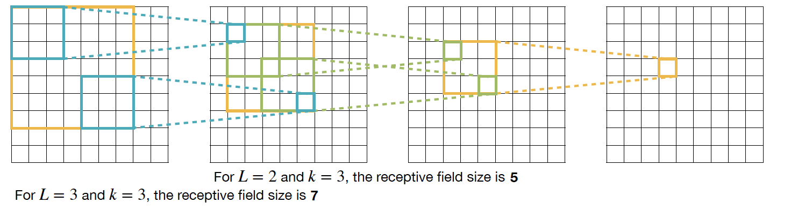
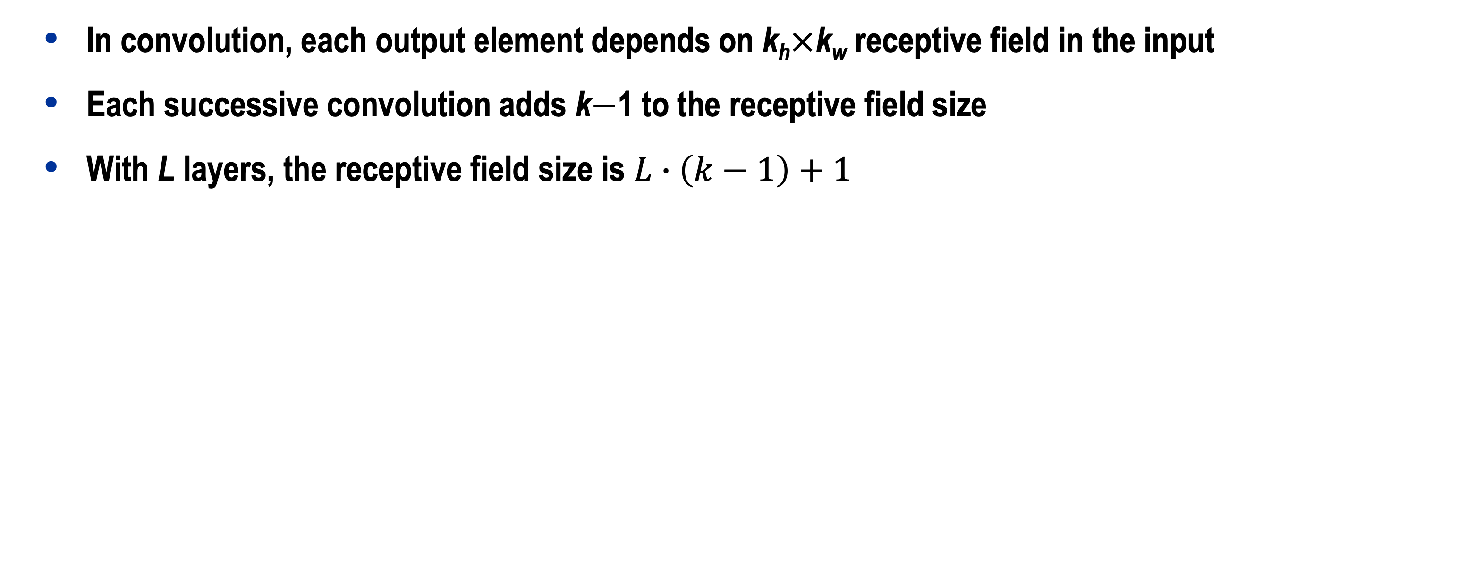
Convolution Layer: Receptive Field
  In convolution, each output element depends on k_{h}$×$k_{w} receptive field in the input
  Each successive convolution adds k$−$1 to the receptive field size
  With L layers, the receptive field size is $L∙\left(k−1\right)+1$
Problem: For large images, we need many layers for each output to “see” the whole image Solution: Downsample inside the neural network
36

Slide 33
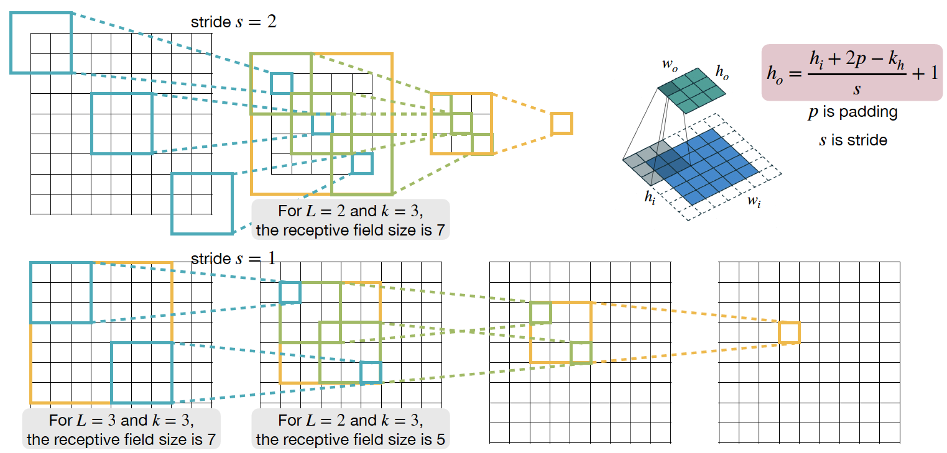
Strided Convolution Layer

Slide 34
Grouped Convolution Layer
A group of narrower convolutions
  Shape of Tensors:
    Input Features X : (n, c_{i}, h_{i,} w_{i})
    Output Features Y : (n, c_{o}, h_{o}, w_{o})
    Weights W : (c_{o}, c_{i}, k_{h}, k_{w})
    Bias b : (c_{o})
(g ⋅ c_{o}/g, c_{i}/g, k_{h}, k_{w})
c
i
c
i
channel
Notations
n | Batch Size
c_{i} | Input Channels
c_{o} | Output Channels
w_{i}, w_{o} | Input/Output Width
h_{i}, h_{o} | Input/Output Height
k_{h} | Kernel Height
k_{w} | Kernel Width
g | Groups
g = 1
g = 2
c_{o}
c_{o}

Slide 35
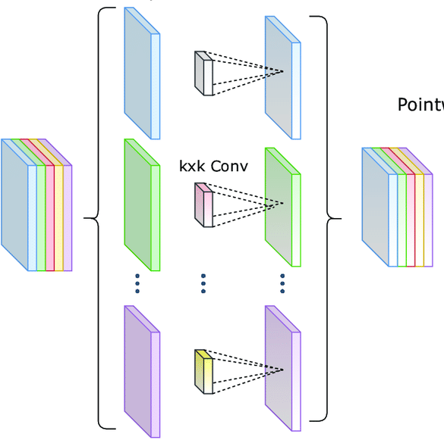
Depthwise Convolution Layer
Independent filter for each channel: g = c_{i} = c_{o} in grouped convolution
  Shape of Tensors:
    Input Features X : (n, c_{i}, h_{i,} w_{i})
    Output Features Y : (n, c_{o}, h_{o}, w_{o})
    Weights W : (c_{o}, c_{i}, k_{h}, k_{w})
    Bias b : (c_{o})
(c_{i}, k_{h}, k_{w})
c
i
Notations
n | Batch Size
c_{i} | Input Channels
c_{o} | Output Channels
w_{i}, w_{o} | Input/Output Width
h_{i}, h_{o} | Input/Output Height
k_{h} | Kernel Height
k_{w} | Kernel Width
g | Groups
c_{o}

Slide 36
Pooling Layer
Downsample the feature map to a smaller size
  The output neuron pools the features In the receptive field, similar to convolution.
    Usually, the stride is the same as the kernel size: s = k
  Pooling operates over each channel independently
    No learnable parameters
Max Pooling
stride = kernel size = 2
5 | 7
8 | 3
5 | 0 | 1 | 7
2 | 1 | 3 | 5
0 | 2 | 3 | 1
2 | 8 | 1 | 3
Average Pooling
2 | 4
3 | 2
Input Feature Map
Output Feature Map

Slide 37
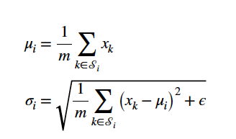


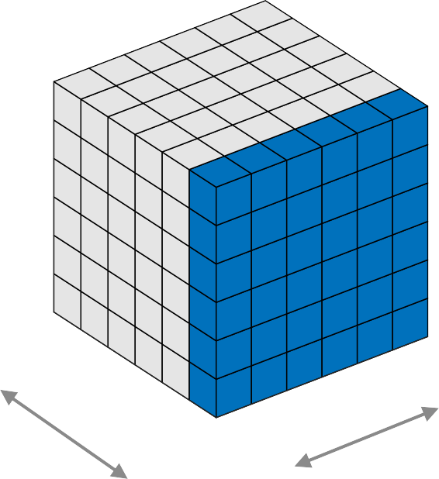
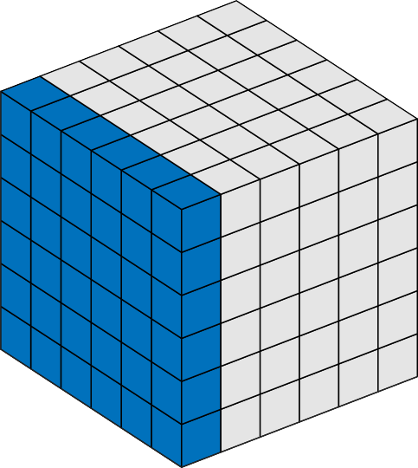
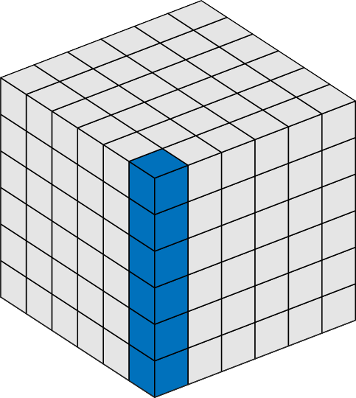
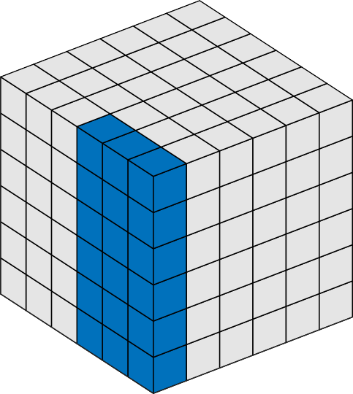
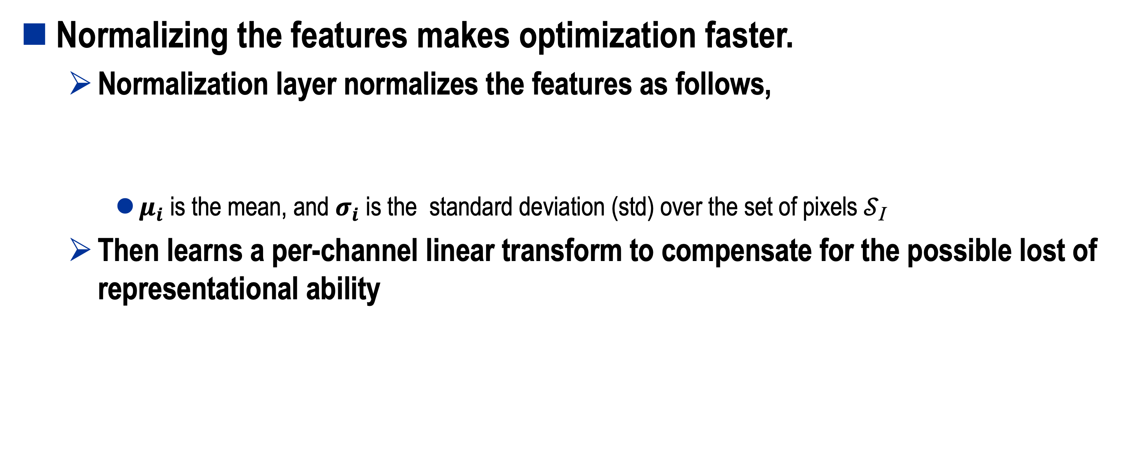
Normalization Layer
Normalizing the features makes optimization faster.
  Normalization layer normalizes the features as follows,
    $μ_{i}$ is the mean, and $σ_{i}$ is the standard deviation (std) over the set of pixels 𝒮_{I}
  Then learns a per-channel linear transform to compensate for the possible lost of representational ability
Batch Norm
Layer Norm
Instance Norm
Group Norm
h × w
h × w
Different normalizations use different definitions of the set 𝒮_{i}
(color in the blue)
spatial dim
h × w
h × w
channel dim
batch dim

Slide 38




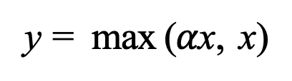
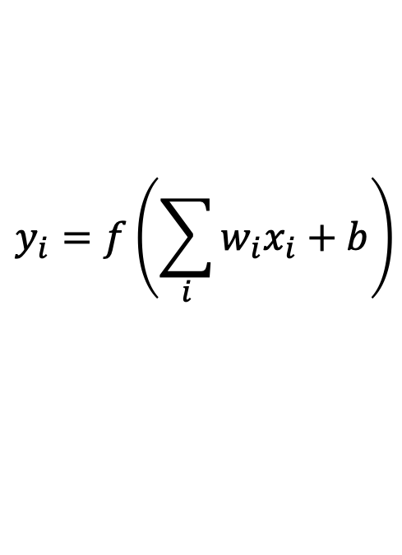

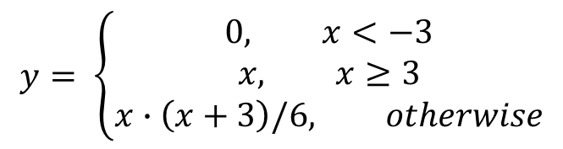

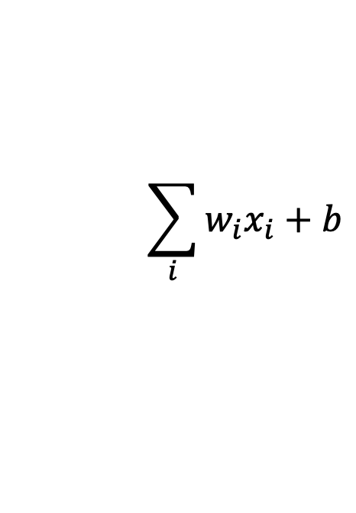

Activation Function
Activation functions are typically non-linear functions
Sigmoid
ReLU
ReLU6
Synapse
1
10
10
$$x_{0}$$
Input Axon
$$w_{0}x_{0}$$
0
0
0
$$y_{i}=f\left(\sum_{i}{w_{i}x_{i}+b}\right)$$
$$w_{1}x_{1}$$
$$\sum_{i}{w_{i}x_{i}+b}$$
-1
-10
-10 0 10
-10
$$x_{1}$$
$$f$$
-10 0 10
-10 0 10
Output Axon
y = 1/ (1 + e^{−x})
y = max (0, x)
y = min(max (0, x), 6)
$$x_{2}$$
$$w_{2}x_{2}$$
Activation Function
Leaky ReLU
Swish
Hard Swish
Dendrite
Cell Body
5
5
5
0
0
0
-5
-5
-5
Other Activation Functions: Tanh, GELU, ELU, Mish…
-5 0 5
-5 0 5
-5 0 5
y = max ($α$x, x)
$$y= \left\{\begin{aligned}0, x<−3 \\ &x, x≥3 \\ x∙\left(x+3\right)/6, otherwise\end{aligned}\right.$$
y = x / (1 + e^{−x})

Slide 39
Popular Neural Network

Slide 40
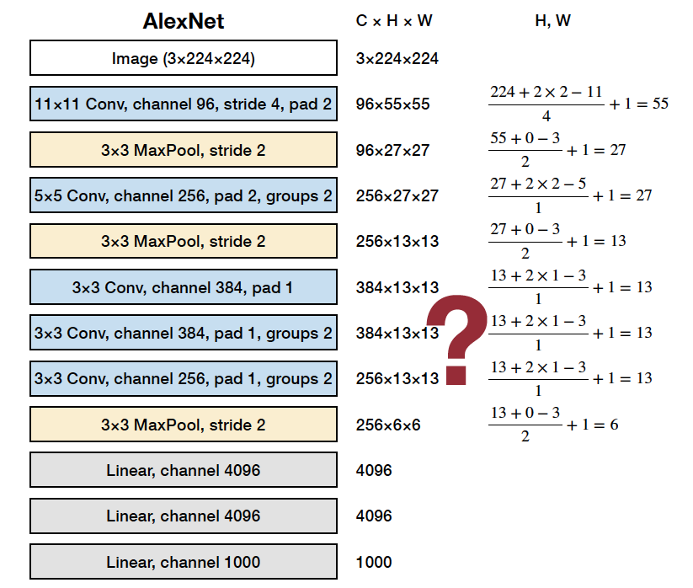
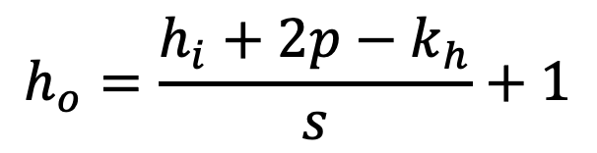
AlexNet
Convolution Layer / Pooling Layer
w_{o}
h
o
$$h_{o}=\frac{h_{i}+2p−k_{h}}{s}+1$$
p is padding
s is stride
h_{i}
w
i
Linear Layer
c_{i}
c_{o}
= n
c_{o}
n
c_{i}
X
_{W}T
Y

Slide 41
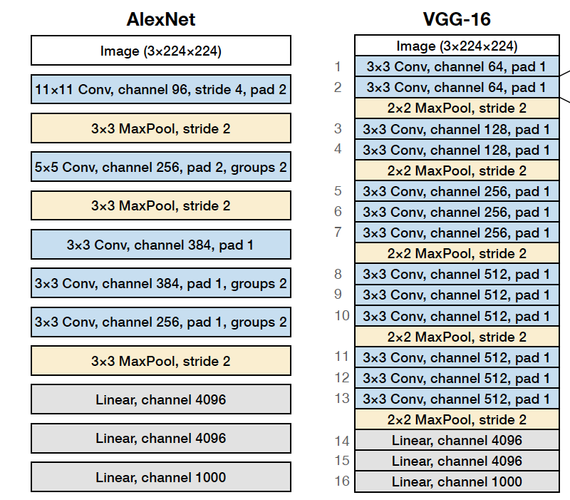
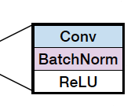
VGG 16
Convolution Layer / Pooling Layer
w_{o}
h
o
$$h_{o}=\frac{h_{i}+2p−k_{h}}{s}+1$$
p is padding
s is stride
h_{i}
w
i
Linear Layer
c_{i}
c_{o}
= n
c_{o}
n
c_{i}
X
_{W}T
Y

Slide 42
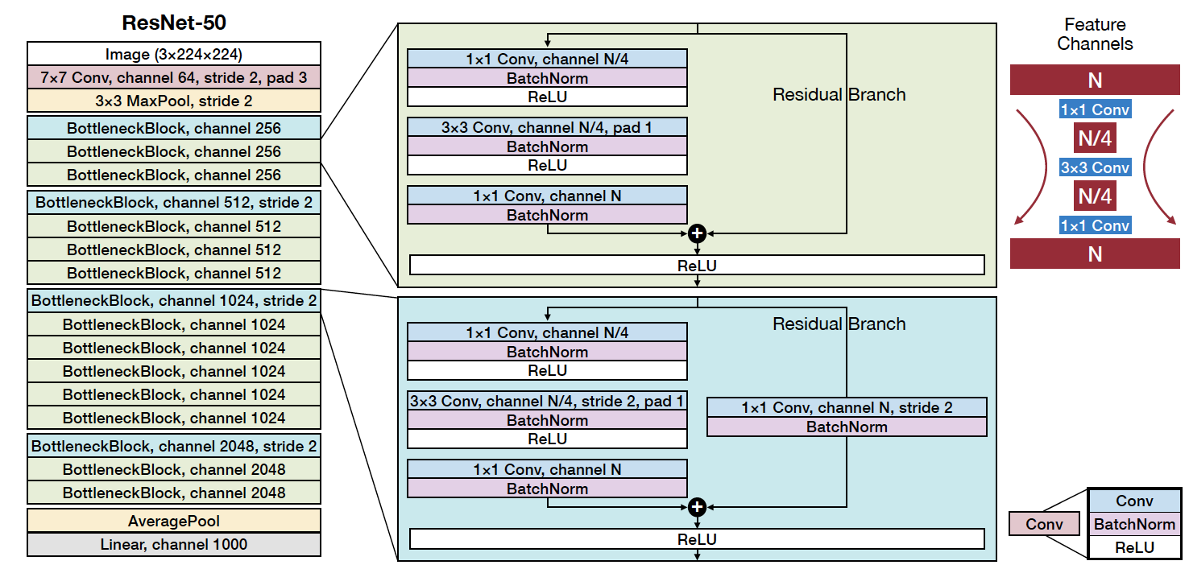
ResNet-50
48

Slide 43
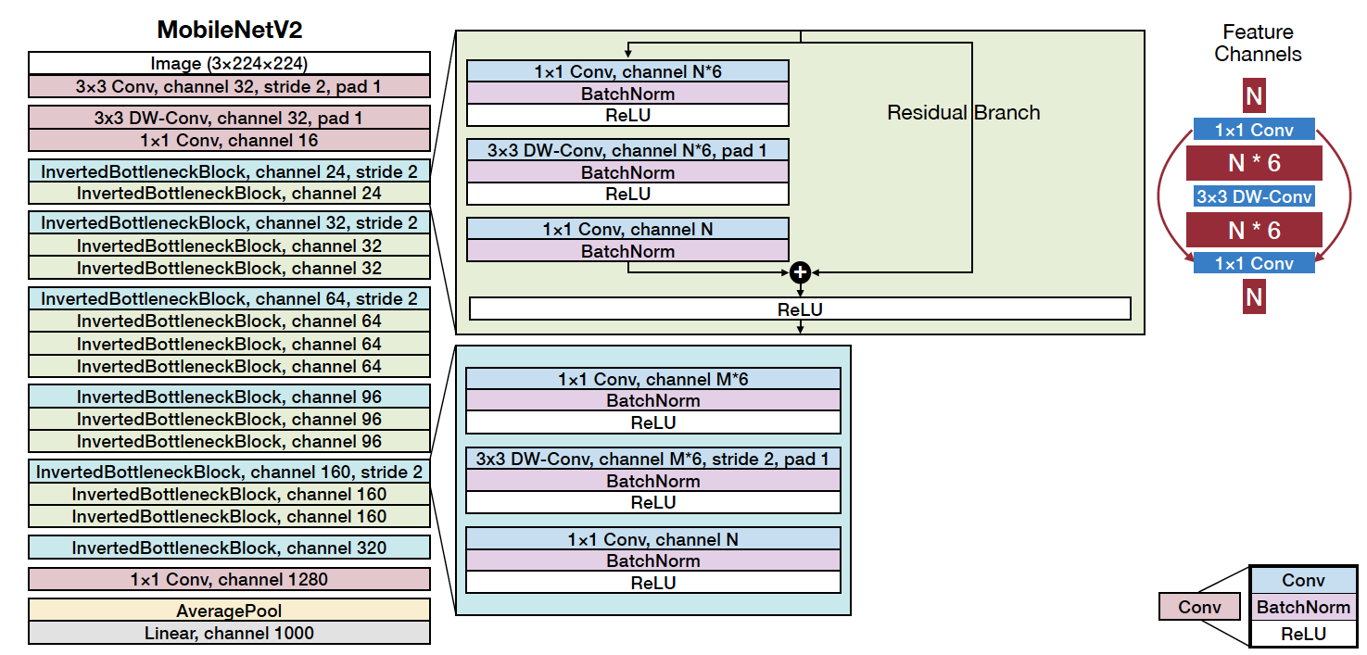
MobileNetV2

Slide 44
Efficiency Metrics
How should we measure the efficiency of neural networks?

Slide 45


Efficiency of Neural Networks
Smaller
Efficiency Metrics
Faster
Greener

Slide 46
Efficiency of Neural Networks
Smaller
Efficiency Metrics
Memory-Related #parameters
model size
total/peak #activations
Computation-Related
MAC
FLOP, FLOPS
OP, OPS
Storage
Computation
Memory
Latency
Energy
Faster
Greener

Slide 47
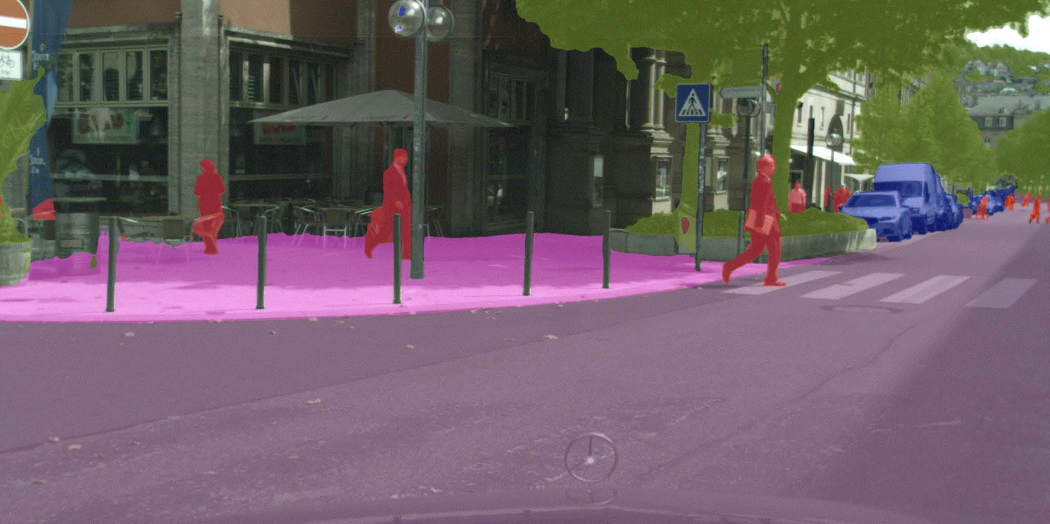
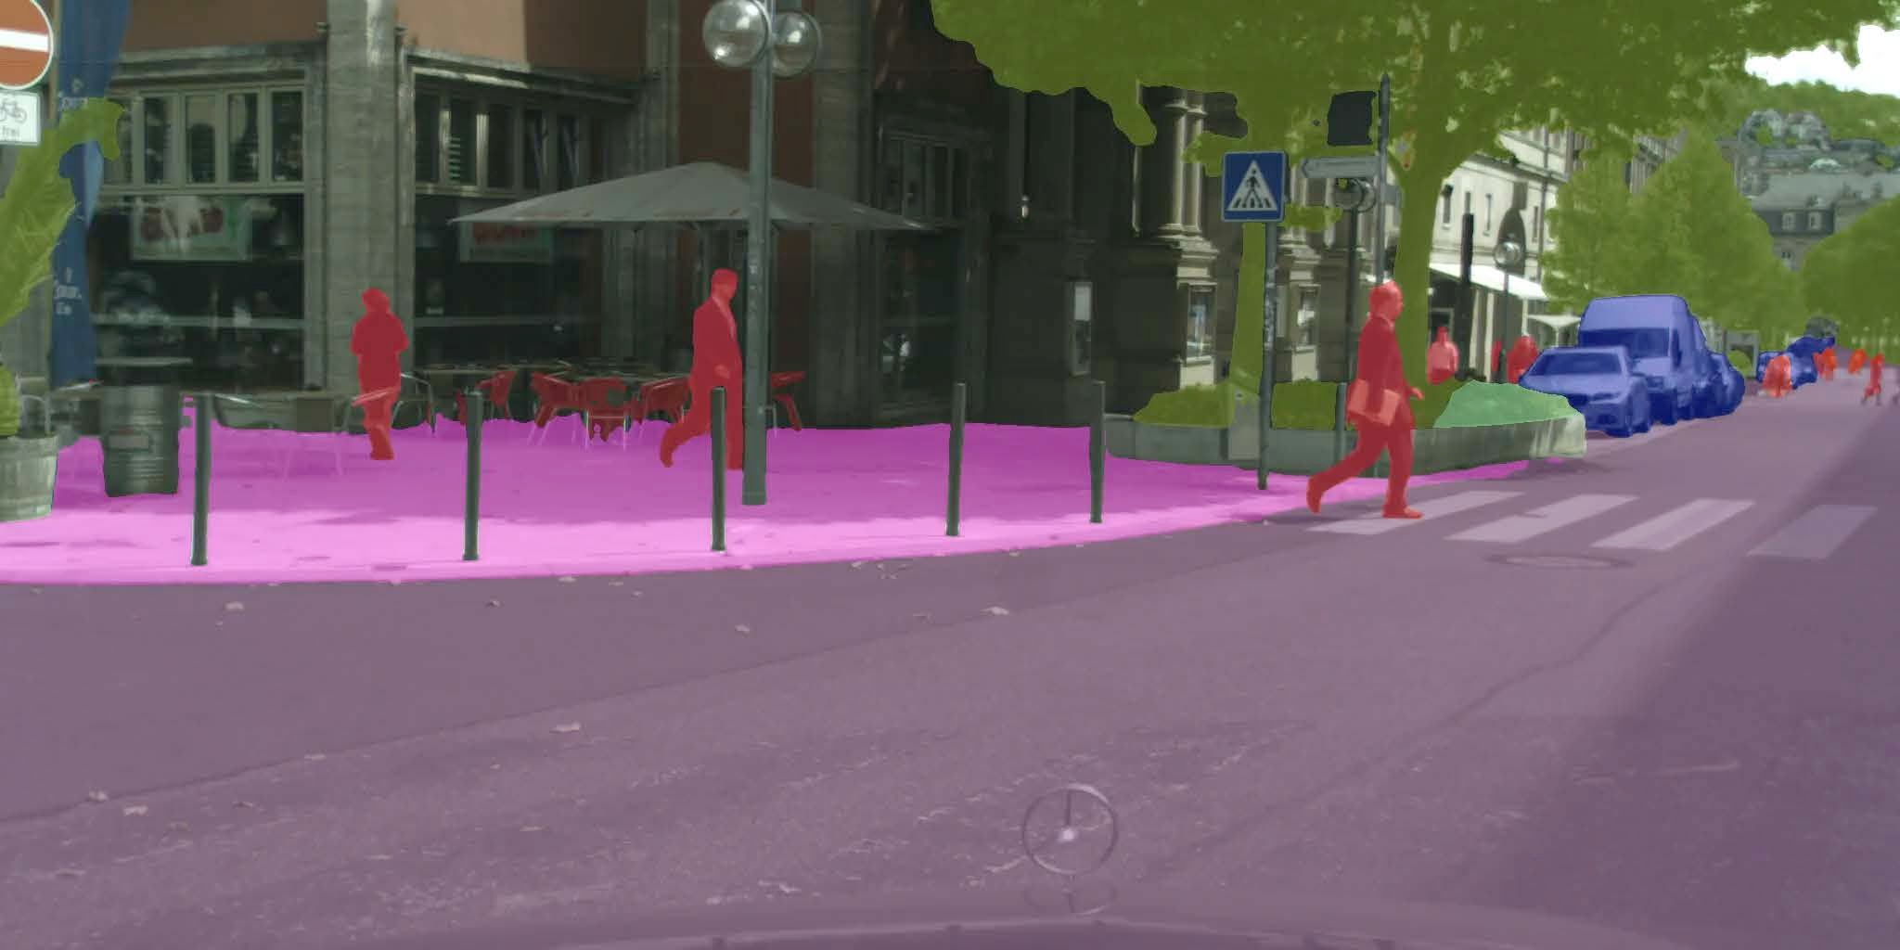
Latency
Measures the delay for a specific task
High Latency 638ms
Low Latency 46ms
Speed is measured on Nvidia Jetson AGX Orin with TensorRT, fp16, batch size 1.

Slide 48

Throughput
Measures the rate at which data is processed
Low Throughput = 6.1 video/s
High Throughput = 77.4 video/s

Slide 49




Latency vs. Throughput
Does higher throughput translate to lower latency? Why?
Does lower latency translate to higher throughput? Why?
100 ms
100 ms
50 ms
50 ms
100 ms
100 ms
Design 1
Latency: 50 ms
Throughput: 20 image/s
Design 2
Latency: 100 ms
Throughput: 40 image/s

Slide 50
Latency
Load Input
Load Weight
Compute |  |  | Store Output
Load Input | Load Weight |  | Compute
Data Movement and
Computation can be overlapped.
Store Output
t
^{Latency ≈ max} (^{T}computation^{, T}memory)
NN Specification
Number of Operations in Neural Network Model
^{T}computation ≈
Number of Operations that Processor can Process Per Second
Hardware Specification
^{T}memory ^{≈ T}data movement of activations ^{+ T}data movement of weights
Neural Network Model Size NN Specification
^{T}data movement of weights ≈
Memory Bandwidth of Processor
Hardware Specification
Input Activation Size + Output Activation Size
^{T}data movement of activations ≈
NN Specification
Memory Bandwidth of Processor Hardware Specification

Slide 51
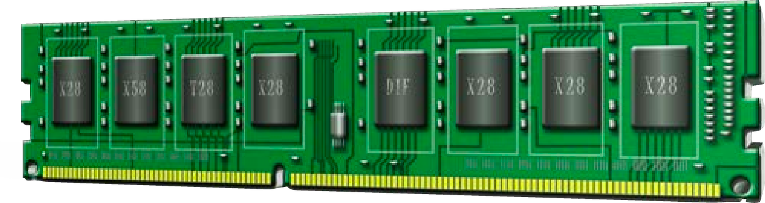
Energy Consumption
Data movement → more memory reference → more energy
Operation | Energy [pJ]
32 bit int ADD | 0.1
32 bit float ADD | 0.9
32 bit Register File | 1
32 bit int MULT | 3.1
32 bit float MULT | 3.7
32 bit SRAM Cache | 5
32 bit DRAM Memory | 640
Relative Energy Cost
200 ✕
Rough Energy Cost For Various Operations in 45nm 0.9V
1
= 200
10
100 1000 10000
1

Slide 52




Energy Consumption
Data movement → more memory reference → more energy
Operation | Energy [pJ]
32 bit int ADD | 0.1
32 bit float ADD | 0.9
32 bit Register File | 1
32 bit int MULT | 3.1
32 bit float MULT | 3.7
32 bit SRAM Cache | 5
32 bit DRAM Memory | 640
Relative Energy Cost
200 ✕
1
10
100 1000 10000
Rough Energy Cost For Various Operations in 45nm 0.9V

Slide 53

Efficiency of Neural Networks
Efficiency Metrics
Smaller
Memory-Related #parameters
model size
total/peak #activations
Computation-Related
MAC
FLOP, FLOPS
OP, OPS
Storage
Computation
Memory
Latency
Energy
Faster
Greener
Image source: 1
https://eﬃcientml.ai

Slide 54
Efficiency of Neural Networks
Efficiency Metrics
Smaller
Memory-Related #parameters
model size
total/peak #activations
Computation-Related
MAC
FLOP, FLOPS
OP, OPS
Storage
Computation
Memory
Latency
Energy
Faster
Greener
Image source: 1
https://eﬃcientml.ai

Slide 55
Number of Parameters (#Parameters)
#Parameters is the parameter (synapse/weight) count of the given neural network, i.e., the number of elements in the weight tensors.

Slide 56
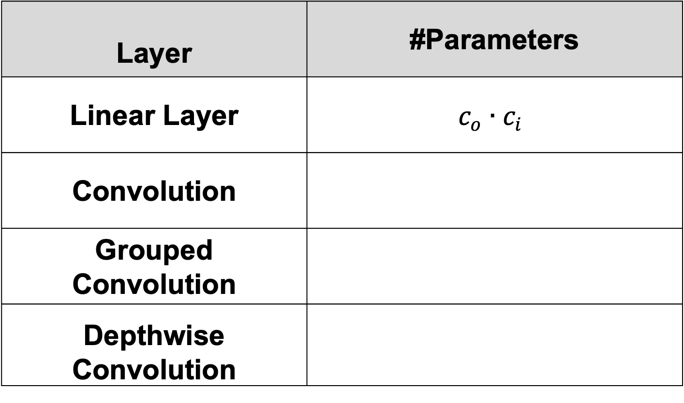
Number of Parameters (#Parameters)
Layer | #Parameters
Linear Layer | $$c_{o}∙c_{i}$$
Convolution
Grouped Convolution
Depthwise Convolution
x₀ x₁ x₂
x₃
x₄
w
00
w
42
y₀
y₁
y₂
c_{i}
c_{o}
=
c_{o}
c_{i}
Notations
n | Batch Size
c_{i} | Input Channels
c_{o} | Output Channels
w_{i}, w_{o} | Input/Output Width
h_{i}, h_{o} | Input/Output Height
k_{h,} k_{w} | Kernel Height/Width
g | Groups
X
_{W}T
Y

Slide 57
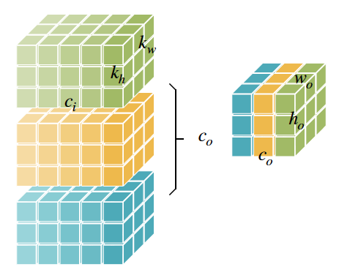
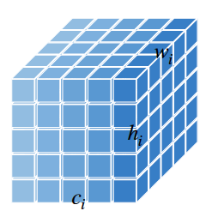
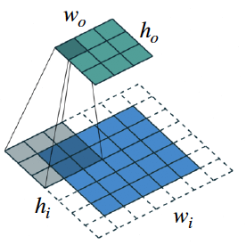

Number of Parameters (#Parameters)
Layer | #Parameters
Linear Layer | $$c_{o}∙c_{i}$$
Convolution | $$c_{o}∙c_{i}∙k_{h}∙k_{w}$$
Grouped Convolution
Depthwise Convolution
Notations
n | Batch Size
c_{i} | Input Channels
c_{o} | Output Channels
w_{i}, w_{o} | Input/Output Width
h_{i}, h_{o} | Input/Output Height
k_{h,} k_{w} | Kernel Height/Width
g | Groups

Slide 58
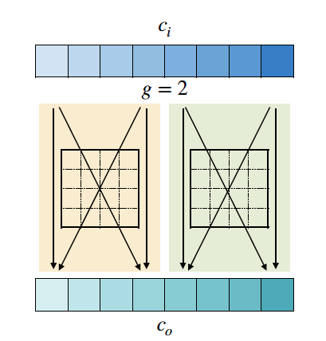
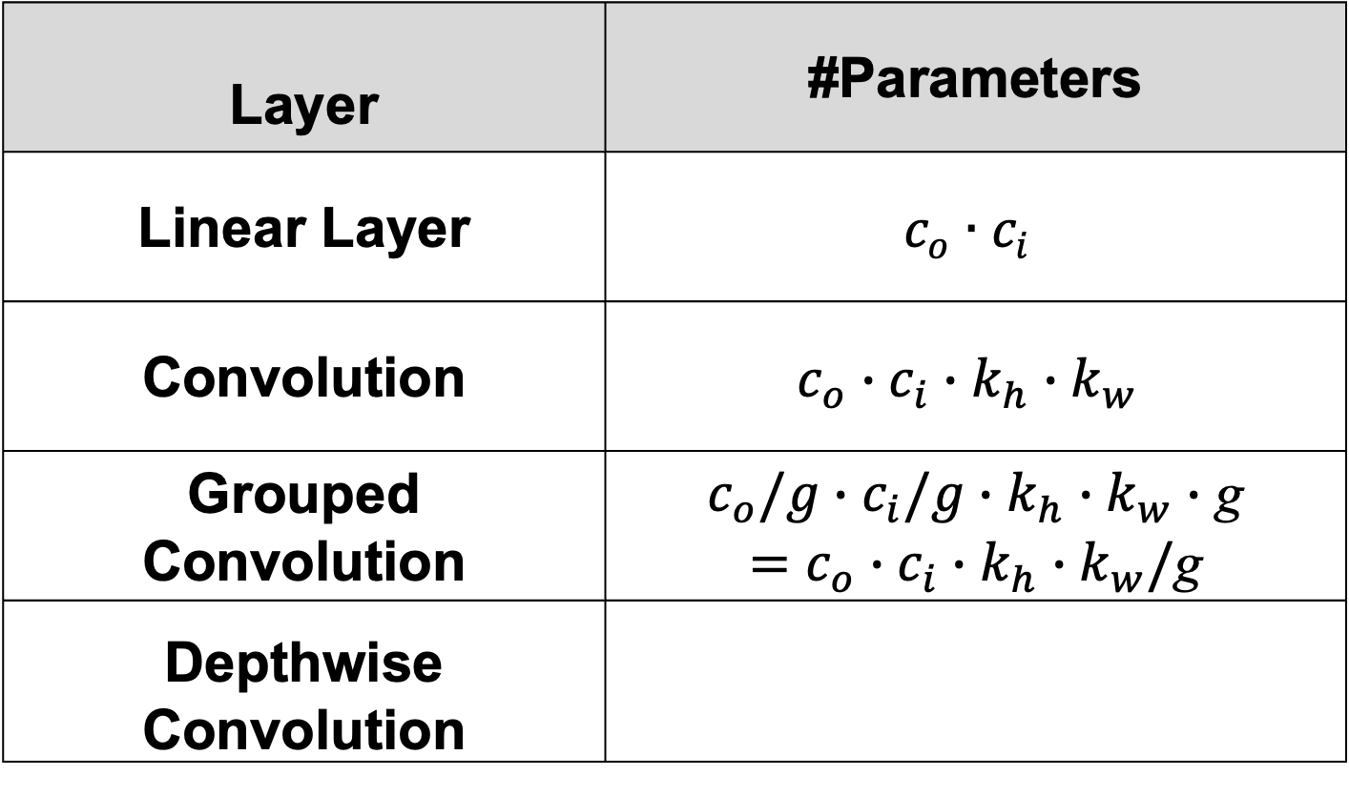
Number of Parameters (#Parameters)
Layer | #Parameters
Linear Layer | $$c_{o}∙c_{i}$$
Convolution | $$c_{o}∙c_{i}∙k_{h}∙k_{w}$$
Grouped Convolution | $c_{o}/g∙c_{i}/g∙k_{h}∙k_{w}∙$ g $=c_{o}∙c_{i}∙k_{h}∙k_{w}/$g
Depthwise Convolution
Notations
n | Batch Size
c_{i} | Input Channels
c_{o} | Output Channels
w_{i}, w_{o} | Input/Output Width
h_{i}, h_{o} | Input/Output Height
k_{h,} k_{w} | Kernel Height/Width
g | Groups

Slide 59

Number of Parameters (#Parameters)
c
Layer | #Parameters
Linear Layer | $$c_{o}∙c_{i}$$
Convolution | $$c_{o}∙c_{i}∙k_{h}∙k_{w}$$
Grouped Convolution | $c_{o}∙c_{i}∙k_{h}∙k_{w}/$g
Depthwise Convolution | $$c_{o}∙k_{h}∙k_{w}$$
i
Notations
n | Batch Size
c_{i} | Input Channels
c_{o} | Output Channels
w_{i}, w_{o} | Input/Output Width
h_{i}, h_{o} | Input/Output Height
k_{h,} k_{w} | Kernel Height/Width
g | Groups
c_{o}

Slide 60
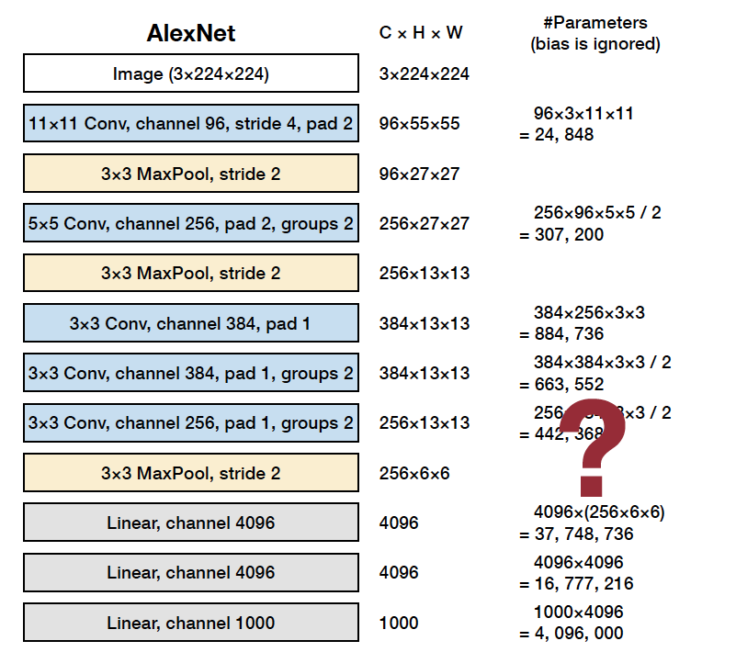
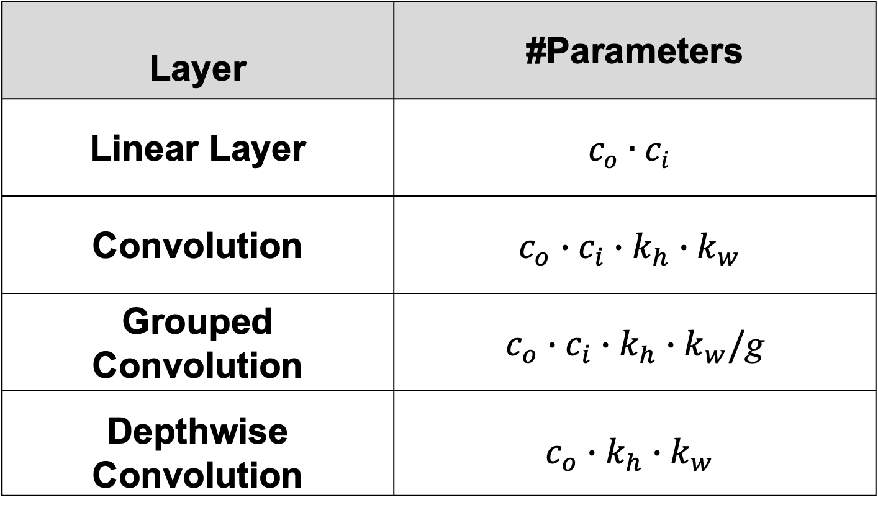
AlexNet: #Parameters
Layer | #Parameters
Linear Layer | $$c_{o}∙c_{i}$$
Convolution | $$c_{o}∙c_{i}∙k_{h}∙k_{w}$$
Grouped Convolution | $c_{o}∙c_{i}∙k_{h}∙k_{w}/$g
Depthwise Convolution | $$c_{o}∙k_{h}∙k_{w}$$
61M in total
66

Slide 61
Efficiency of Neural Networks
Efficiency Metrics
Smaller
Memory-Related #parameters
model size
total/peak #activations
Computation-Related
MAC
FLOP, FLOPS
OP, OPS
Storage
Computation
Memory
Latency
Energy
Faster
Greener

Slide 62
Model Size
Model size measures the storage for the weights of the given neural network.
  The common units for model size are: MB (megabyte), KB (kilobyte), bits.
  In general, if the whole neural network uses the same data type (e.g., floating-point),
Model Size = #Parameters ∙ Bit Width
  Example: AlexNet has 61M parameters.
If all weights are stored with 32-bit numbers, total storage will be about
  61M × 4 Bytes (32 bits) = 228 MB
If all weights are stored with 8-bit numbers, total storage will be about
  61M × 1 Bytes (32 bits) = 61 MB

Slide 63
Efficiency of Neural Networks
Efficiency Metrics
Smaller
Memory-Related #parameters
model size
total/peak #activations
Computation-Related
MAC
FLOP, FLOPS
OP, OPS
Storage
Computation
Memory
Latency
Energy
Faster
Greener

Slide 64
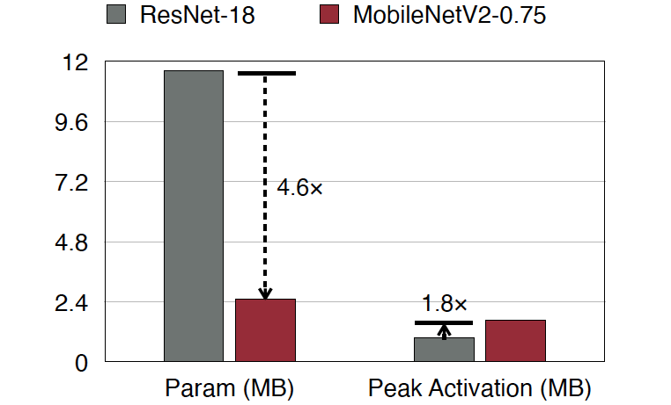
Number of Activations (#Activations)
#Activation is the memory bottleneck in inference on IoT, not #Parameters
MIT 6.5940: TinyML and Eﬃcient Deep Learning Computing

Slide 65
Number of Activations (#Activations)
#Activation didn’t improve from ResNet to MobileNet-v2
MIT 6.5940: TinyML and Eﬃcient Deep Learning Computing

Slide 66
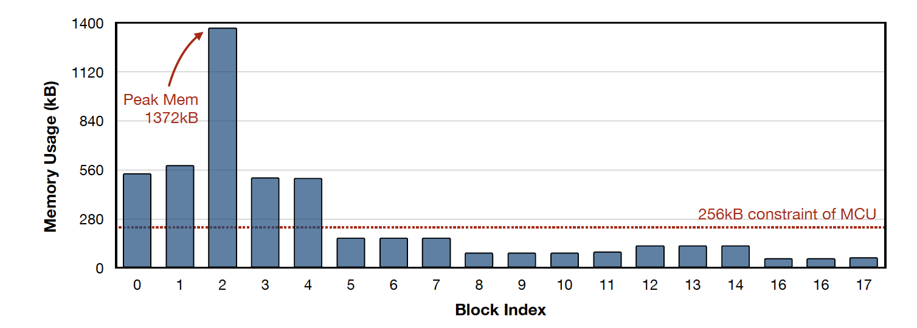
Number of Activations (#Activations)
Imbalanced memory distribution of MobileNetV2

Slide 67

Number of Activations (#Activations)
#Activation is the memory bottleneck in training, not #Parameters.

Slide 68

Number of Activations (#Activations)
Activation and weight memory distribution of MCUNet

Slide 69

AlexNet: #Activations
Total #Activation: 932,264 Peak #Activation:
≈ #input activation + #output activation
= 150,528 + 290,400 = 440,928
75

Slide 70
Efficiency of Neural Networks
Efficiency Metrics
Smaller
Memory-Related #parameters
model size
total/peak #activations
Computation-Related
MAC
FLOP, FLOPS
OP, OPS
Storage
Computation
Memory
Latency
Energy
Faster
Greener

Slide 71

Number of Multiply-Accumulate Operations
Multiply-Accumulate Operation (MAC)
  𝑎←𝑎+𝑏∙𝑐
Matrix-Vector Multiplication (MV)
  𝑀𝐴𝐶𝑠=𝑚∙𝑛
General Matrix-Matrix Multiplication (GEMM)
  𝑀𝐴𝐶𝑠=𝑚∙𝑛∙𝑘

Slide 72
Number of Multiply-Accumulate Operations
Layer | #Parameters
Linear Layer | $$c_{o}∙c_{i}$$
Convolution | $$c_{o}∙c_{i}∙k_{h}∙k_{w}$$
Grouped Convolution | $c_{o}∙c_{i}∙k_{h}∙k_{w}/$g
Depthwise Convolution | $$c_{o}∙k_{h}∙k_{w}$$
x₀ x₁ x₂
x₃
x₄
w
00
w
42
y₀
y₁
y₂
c_{i}
c_{o}
=
c_{o}
Notations
n | Batch Size
c_{i} | Input Channels
c_{o} | Output Channels
w_{i}, w_{o} | Input/Output Width
h_{i}, h_{o} | Input/Output Height
k_{h,} k_{w} | Kernel Height/Width
g | Groups
c_{i}
X
_{W}T
Y

Slide 73

Number of Multiply-Accumulate Operations
Layer | #MACs
Linear Layer | $$c_{o}∙c_{i}$$
Convolution | $$c_{i}∙c_{o}∙k_{h}∙k_{w}∙h_{o}∙w_{o}$$
Grouped Convolution
Depthwise Convolution
Notations
n | Batch Size
c_{i} | Input Channels
c_{o} | Output Channels
w_{i}, w_{o} | Input/Output Width
h_{i}, h_{o} | Input/Output Height
k_{h,} k_{w} | Kernel Height/Width
g | Groups

Slide 74

Number of Multiply-Accumulate Operations
Layer | #MACs
Linear Layer | $$c_{o}∙c_{i}$$
Convolution | $$c_{i}∙k_{h}∙k_{w}∙h_{o}∙w_{o}∙c_{o}$$
Grouped Convolution | $$c_{i}/g∙k_{h}∙k_{w}∙h_{o}∙w_{o}{∙c}_{o}$$
Depthwise Convolution
Notations
n | Batch Size
c_{i} | Input Channels
c_{o} | Output Channels
w_{i}, w_{o} | Input/Output Width
h_{i}, h_{o} | Input/Output Height
k_{h,} k_{w} | Kernel Height/Width
g | Groups

Slide 75

Number of Multiply-Accumulate Operations
c
Layer | #MACs
Linear Layer | $$c_{o}∙c_{i}$$
Convolution | $$c_{i}∙k_{h}∙k_{w}∙h_{o}∙w_{o}∙c_{o}$$
Grouped Convolution | $$c_{i}/g∙k_{h}∙k_{w}∙h_{o}∙w_{o}{∙c}_{o}$$
Depthwise Convolution | $$c_{o}∙k_{h}∙k_{w}∙h_{o}∙w_{o}$$
c_{i}
Notations
n | Batch Size
c_{i} | Input Channels
c_{o} | Output Channels
w_{i}, w_{o} | Input/Output Width
h_{i}, h_{o} | Input/Output Height
k_{h,} k_{w} | Kernel Height/Width
g | Groups
c_{o}

Slide 76


AlexNet: #MACs
Layer | #Parameters
Linear Layer | $$c_{o}∙c_{i}$$
Convolution | $$c_{i}∙k_{h}∙k_{w}∙h_{o}∙w_{o}∙c_{o}$$
Grouped Convolution | $$c_{i}/g∙k_{h}∙k_{w}∙h_{o}∙w_{o}{∙c}_{o}$$
Depthwise Convolution | $$c_{o}∙k_{h}∙k_{w}∙h_{o}∙w_{o}$$
724M in total !!
82

Slide 77
Efficiency of Neural Networks
Efficiency Metrics
Smaller
Memory-Related #parameters
model size
total/peak #activations
Computation-Related
MAC
FLOP, FLOPS
OP, OPS
Storage
Computation
Memory
Latency
Energy
Faster
Greener

Slide 78

Number of Floating Point Operations (FLOP)
A multiply is a floating-point operation
An add is a floating-point operation
One multiply-accumulate operation is two floating-point operations (FLOPs)
  Example: AlexNet has 724M MACs, total number of floating-point operations will be
    724M x 2 = 1.4G FLOPs
Floating-Point Operations Per Second (FLOPS)
  $FLOPS= \frac{FLOPs}{second}$

Slide 79

Number of Operations (OP)
Activations/weights in neural network computing are not always floating-point
To generalize, number of operations is used to measure the computation amount
  Example: AlexNet has 724M MACs, total number of floating-point operations will be
    724M x 2 = 1.4G OPs
Similarly, Operations Per Second (OPS)
  $OPS= \frac{OPs}{second}$

Slide 80
Roofline Model for Performance Analysis

Slide 81
Process of DNN Inference on Hardware
Step 2 (Compute):
Perform the operations
(e.g. Linear, Convolution…etc)
GPU/CPU
Caches (On-Chip)
Memory (Off-Chip)
Step 1 (Memory Access):
Moving Input/Weights
from memory onto GPU/CPU
Step 3 (Memory Access):
Writing the computed
activation back to memory

Slide 82





Systolic Array – Overview
Matrix multiply unit in Google Tensor Processing Unit (TPU)
Balancing computation with I/O
Simple and regular

Slide 83







Systolic Array – Example

Slide 84

Operational Intensity
Measure of data locality (data reuse)
Ratio of Total FLOPs performed to Total Bytes moved
  $I= \frac{C (Computations, FLOPs)}{M (Memory Access, Bytes)}$
Compute Intensive Operation
  High computations (usually high operational intensity)
  Example: Convolution, Fully-Connected
Memory Intensive Operation
  High memory access (usually low operational intensity)
  Example: Activation
Compute
Caches (On-Chip)
DRAM (Off-Chip)

Slide 85


Transformer Block & Attention

Slide 86



Performance Roofline: Memory Bandwidth
Performance is bounded by the bandwidth of memory
Attainable
Performance ($P$)
FLOPS
Operational
Intensity $(I)$
FLOPs/Bytes
Memory
Bandwidth$(β)$
Caches (On-Chip)
DRAM (Off-Chip)

Slide 87

Performance Roofline: Computation Capability
Performance is bounded by the computation capability of hardware
Attainable
Performance ($P$)
FLOPS
Peak Hardware
Performance $(π)$
Compute
Bound
Operational
Intensity $(I)$
FLOPs/Bytes
Caches (On-Chip)
DRAM (Off-Chip)

Slide 88


Roofline Model
Performance roofline is bounded by “memory” or “compute”
  $P=min(β×I, π)$
Attainable
Performance ($P$)
FLOPS
Memory
Bound
Compute
Bound
Peak Hardware
Performance $(π)$
Operational
Intensity $(I)$
FLOPs/Bytes
Memory
Bandwidth$(β)$
$$\frac{π}{β}$$
Caches (On-Chip)
DRAM (Off-Chip)

Slide 89






Estimated Execution Time
The execution time is the number of operations divided by performance
  $T=\frac{C}{P}=\frac{C}{min(β×I, π) }$
Memory Bound
  $T= \frac{C}{β×I}=\frac{C}{β×\frac{C}{M}}=\frac{M}{β}$
Compute Bound
  $T= \frac{C}{π}$
Attainable
Performance ($P$)
FLOPS
Memory
Bound
Compute
Bound
$$π$$
$$\frac{π}{β}$$
Operational
Intensity $(I)$
FLOPs/Bytes
$$β$$

Slide 90


Example Usage of Roofline Model
Higher Operational Intensity → Higher Hardware Utilization
Attainable
Performance ($P$)
FLOPS
Fully utilize the computation capability of hardware (Compute Bound)
4608 GFLOPS
4608 GFLOPS
4608 GFLOPS
4608 GFLOPS
Operation | #FLOPs (M) | #Memory Access (MB)
op1 | 57.8M | 25MB
op2 | 51.4M | 2.3MB
op3 | 925M | 25MB
op4 | 236M | 3.7MB
op5 | 172M | 1.3MB
op6 | 231M | 1.3MB
3617 GFLOPS
Bandwidth = 96 GB/s
2157 GFLOPS
Low data reuse, dominated by memory access (Memory Bound)
227 GFLOPS
Operational
Intensity $(I)$
FLOPs/Bytes
2.4
(op1)
22.5
(op2)
37.7
(op3)
48
64
(op4)
132
(op5)
174
(op6)

Slide 91
Insight from Roofline Model
Reduce #Memory Access when it’s memory bound (op1 vs. op2)
  Reducing #FLOPs results in no speedup (op1 vs. op3)
  Smaller #FLOPs does not imply faster execution
Operation | #FLOPs (M) | #Memory Access (MB) | Operational Intensity | Attainable Performance (GFLOPS) | Theoretical Inference Time
op1 | 57.8M | 24.5MB | 2.4 | 226.5 | 255
op2 | 51.4M | 2.3MB | 22.5 | 2156.7 | 23.8
op3 | 925M | 24.5MB | 37.7 | 3622.6 | 255

Slide 92
Insight from Roofline Model
Reduce #FLOPs when it’s compute bound (op5 vs. op6)
  Reducing #Memory Access results in no speedup (op4 vs. op6)
  Smaller #Memory Access does not imply faster execution
Operation | #FLOPs (M) | #Memory Access (MB) | Operational Intensity | Attainable Performance (GFLOPS) | Theoretical Inference Time
op4 | 236M | 3.7MB | 64 | 4608 | 51.2
op5 | 172M | 1.3MB | 132 | 4608 | 37.3
op6 | 231M | 1.3MB | 174 | 4608 | 50.3

Slide 93

Different Hardware Platforms, Different Rooflines
TPUv4: https://dl.acm.org/doi/pdf/10.1145/3579371.3589350

Slide 94

Memory Wall
Memory Wall and AI: https://medium.com/riselab/ai-and-memory-wall-2cb4265cb0b8

Slide 95

摩爾定律 (Moore’s Law)

Slide 96

黃氏定律 (Huang’s Law)

Slide 97

In Between AI Models and AI Chips – An Analogue
HW: AI chip
SW: AI model

Slide 98
Middleware for Efficient Deep Learning
涵蓋主題
  AI accelerators (general-purpose/GPU vs. custom/xPU)
  AI compilers, system runtime (e.g., TensorRT, TensorRT-LLM)
  Pruning: unstructured vs. structured NN model compression
  Sparsity: semi-structured NN model compression
  Quantization (PTQ vs. QAT)
  Neural architecture search (NAS)
  ========
  FlashAttention^{(1.7K, 2022)}, PagedAttention^{(1.3K, 2023)}, KV-Cache (compression and quantization)
  Speculative decoding, lookahead decoding, offloading
  Efficient fine-tuning: LoRA^{(11.1K, 2021)} and DoRA^{(0.2K, 2024)}
  Knowledge distillation and transfer learning
  LLM re-architectured: Mixture-of-Experts, DeepSeek, Mamba^{(2.2K, 2023)}
  Distributed training, federated learning
  On-device training, privacy-aware model customization/personalization

Slide 99




Taiwan’s Opportunities and Advantages
成也工具鏈！敗也工具鏈！
做自己的AI晶片，
必定需要有自己的工具鏈；
即使不做自己的AI晶片，
仍會有優化現有工具鏈的需求。
NVIDIA的工具鏈不僅完整、可靠供使用者易於操作GPU來執行AI模型，還有友善的介面(CUDA, Triton)供開發者進一步優化AI模型的執行。
你認為NVIDIA目前獨占市場的原因是硬體還是軟體（工具鏈）？
Accelerators … DeepSeek?
Compilers … DeepSeek?
Compression
Quantization
NAS
FlashAttention
KV-Cache
Speculative decoding
Efficient fine-tuning (LoRA)
Efficient distillation (Liger Kernel)
Build AI models? Perhaps.
Build AI chips? Definitely.
What kind of AI chips? xPU (flexible, adaptable, and even configurable)
Build xPU’s middleware (toolchain), some tools applicable across various xPUs
Cloud
N
N
K
N
S
Fine-tuning/distillation
Inference
AI PC
Training
K
S
S
Edge

