Slide 1
LLM-driven Attack Lifecycle Completion using Causal Graph-based Correlation from Multi-source Logs
Student:
Ching-Yao Su (Tom)
Advisor:
Ying-Dar Lin, Yuan-Cheng Lai, Ren-Hung Hwang
High Speed Network Lab
National Yang Ming Chiao Tung University, Taiwan

Slide 2
Issues
Impact of Malicious Log Extraction: with vs. without
How many logs we can reduce through Malicious Log Extraction?
How precise is Malicious Log Extraction? Accuracy/Precision/Recall/F1 Score?
Can LLM detect techniques more accurately on extracted logs?
Lifecycle Completion: LLM vs. Others (ML, DL)
How well can LLM do technique detection on extracted logs?
How well can LLM do lifecycle completion on extracted logs?
Does finetuned LLM outperform non-finetuned LLM?
How much does LLM outperform other models?

Slide 3
Progress (4/24)
Completed:
Issue #1-1: How much can Malicious Log Extraction reduce log count and token count?
Issue #1-2: Can LLM detect techniques more accurately on extracted logs?
Issue #2-1: How well can LLM do single-technique detection from logs?
Issue #2-2: How well can LLM do lifecycle completion from logs?
In progress:
Issue #2-3: How much does LLM outperform other models?
Issue #2-3: How much does finetuned LLM outperforms non-finetuned commercial LLM?

Slide 4
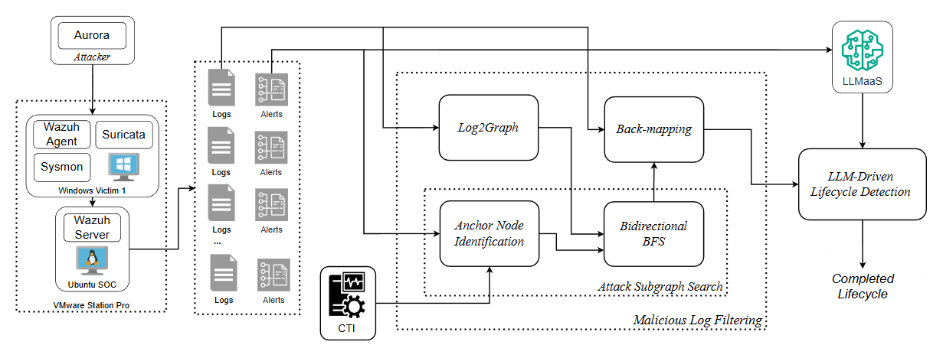
Implementation
Progress Percentage: ● 100% ● 80% ● 60% ● 40% ● 20%
Done
Done
Already finished 250/250 lifecycles
(4) Detect Lifecycle
(1) Perform Attack
Done
(6) Map to Log
Done
(3) Construct Graph
(7) Complete Lifecycle
(7) Complete Lifecycle
Done
(6) Map to Log
Done
(4) Find Anchor Node
(5) Find Attack Subgraph
Achieve F1 score 0.766, keep improving
(2) Collect Data
(5) Find Attack Subgraph
(4) Find Anchor Node
Data Collection
Malicious Log Extraction
Lifecycle Completion

Slide 5
Outline
Motivation
Background
MITRE ATT&CK Framework
Attack Lifecycle
Endpoint Detection and Response Alert
Network Detection and Response Alert
Sysmon log
Suricata log
Causal Graph
Large Language Model (LLM)
Related Works
Issues
Notations
Problem Statements
Attack-Relevant Log Extraction
Attack Lifecycle Completion
Solutions
Graph-based Log Extraction
Log2Graph
Attack Subgraph Search
Graph2Log
LLM-Driven Lifecycle Completion
Single-Technique Detection
Lifecycle Completion
Implementation
Evaluation
Set-based Evaluation
Sequence-based Evaluation
Schedule
References

Slide 6
Motivation
Attack Lifecycle Guides Defense Strategy
Reveals attacker TTPs, enabling security teams to address vulnerabilities
Current Attack Lifecycle Detection is Incomplete
Experts or AI analyze alerts from security tools (e.g., EDR, NDR) to infer lifecycle
Security tools rely on rule-based alert generation
Generated alerts are often inaccurate
Poorly maintained rules lead to missing alerts
Resulting attack lifecycle is only partial
Logs Are the Fundamental Basis for Security Analysis
Systems still record logs even when security tools fail to generate alerts
Logs can potentially fill gaps in partial attack lifecycles
Log volume is tens of thousands times larger than alerts, infeasible to analyze manually
Need for Automated Analysis
Malicious Log Extraction isolates attack-relevant logs, removing benign noise
LLMs provide strong text comprehension for effective log analysis and lifecycle completion

Slide 7
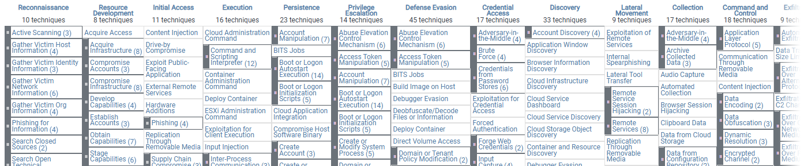
Background - MITRE ATT&CK Framework
A knowledge base of adversary behavior based on real-world observations.
Key components:
Lifecyle: A chain of tactics modeling the attack path.
Tactic: Define the objective of each stage.
Technique: Describe the specific methods used.
Procedure: The specific implementation of a technique.

Slide 8
Background – Attack Lifecycle
What’s Attack Lifecycle?
An ordered sequence of techniques, which shows how hackers achieve a goal
An example of attack lifecycle
T1071.001 → T1566.002 → T1059.001 → T1620 → T1071.001 → T1018 → T1087.001 → T1040 → T1049 → T1071.001 → T1566.002 → T1059.001 → T1547.004 → T1113 → T1005 → T1106 → T1074.001 → T1134 → T1059.001 → T1562.001 → T1059.003 → T1112 → T1112 → T1112 → T1490 → T1112 → T1562.009
Importance for SOC Operations
Reveals attacker intent, not just isolated alerts
Provides full context for incident response and forensics
Challenges
Alert-based reconstruction misses ~60% of techniques
Partial lifecycles limit SOC visibility into attack scenarios

Slide 9
Background - Endpoint Detection and Response Alert
What is Endpoint Detection and Response (EDR)?
Continuous monitoring and advanced threat response for endpoints
Detects malicious behaviors via rules
Generates alerts identify processes and execution responsible for attacks
What information does EDR Alerts provide?
Element | Description
timestamp | Time when the event occurred
technique_id | MITRE ATT&CK Technique ID (e.g., T1059)
tactic | MITRE ATT&CK Tactic (e.g., Execution)
host_ip | IP address of the host where the event occurred
message | Description of the detected event
processGuid | Unique GUID of the suspicious process
image | Executable path of the suspicious process
targetFilename | File path affected by the suspicious process

Slide 10
Background - Network Detection and Response Alert
What is Network Detection and Response (NDR)?
Monitors all devices on the network, including those without EDR agents
Detects lateral movement, C2 communication, and data exfiltration
Generates alerts identify attack techniques involving network activities
What information does NDR Alerts provide?
Element | Description
timestamp | Time when the event occurred
technique_id | MITRE ATT&CK Technique ID (e.g., T1071)
tactic | MITRE ATT&CK Tactic (e.g., Command and Control)
src_ip, src_port | Source IP address and port of the traffic
dest_ip, dest_port | Destination IP address and port of the traffic
proto | Transport protocol (e.g., TCP, UDP)
app_proto | Application protocol (e.g., HTTP, DNS, SSH)
message | Description of the detected event

Slide 11
Background – Sysmon Log
What is Sysmon?
Windows system service capturing kernel-level endpoint activities
Records process creation, file modifications, and network connections, providing detailed sighting for attack forensic and threat analysis
What information does Sysmon Logs provide?
EventID | Event Type. Confirms Process Creation (Value 1).
UtcTime | Event Time. The precise UTC time of execution.
host | Target Host. Machine where the event occurred.
User | User Context. The account that initiated the process.
UserID | User SID. Security identifier for the executing user.
ProcessId | Child PID. Numeric ID of the newly created process.
ProcessGuid | Child GUID. Unique, non-recycled ID for the child process.
CommandLine | Execution Command. Full arguments used to launch the child process.
ParentProcessId | Parent PID. Numeric ID of the initiating process.
ParentProcessGuid | Parent GUID. Unique ID for the initiating parent process.
ParentImage | Parent Path. Full path to the parent executable.
ParentCommandLine | Parent Arguments. Full command line of the parent process.
Image | Child Path. Full path to the child executable file.
Hashes | File Checksums. Cryptographic hashes for threat matching.

Slide 12
Background – Suricata Log
What is Suricata?
Open-source network threat detection engine for real-time traffic analysis
Record network activities (logs) and also identify malicious network patterns via rule-based signatures
What information does Suricata Log provide?
Element | Description
timestamp | Time when the network event occurred
event_type | Log category (e.g., alert, flow, dns, http)
src_ip, src_port | Source IP address and port of the traffic
dest_ip, dest_port | Destination IP address and port of the traffic
proto | Transport protocol (e.g., TCP, UDP)
app_proto | Application protocol (e.g., HTTP, DNS, SSH)
flow.bytes_toserver | Bytes sent from source to destination
flow.bytes_toclient | Bytes sent from destination back to source

Slide 13
Background – Causal Graph
What is Causal Graph?
Directed graph: nodes = entities (processes, files, sockets)
Edges = causal events (read, execute, network connect)
Why Causal Graph?
Constructs causality chains
Preserves temporal ordering of multi-step attack events
Enables attack graph reconstruction from logs
Relevance to Our Approach
A good data structure that enables Malicious Log Extraction
Causal-based analysis
Outlook.exe
powershell.exe
connect
10.0.0.5:443
T1059.001 PowerShell
Log
execute
execute
execute
Log
write
Log
WINWORD.EXE
Log
secret.zip
Loader.dll
Rundll32.exe
read
T1105 Ingress Tool Transfer
…
…
…
execute
execute
write
whoami
net.exe
HKLM\...\Run
T1033 System Owner/User Discovery
T1547.001 Registry Run Keys

Slide 14
Background - Large Language Model (LLM)
What is LLM?
AI model trained on vast text datasets for language understanding and generation
Built on Transformer architecture with long-range context modeling
Why LLM?
Understands complex intent without explicit pre-programmed rules
Acts as reasoning engine: decomposes tasks, makes decisions, uses tools
MITRE ATT&CK knowledge embedded in training data
Relevance to Our Approach
Analyzes filtered logs to detect MITRE ATT&CK techniques
Completes partial attack lifecycles through iterative detection

Slide 15
Related Works
Paper | Year | Input |  |  | Output |  |  |  | Approach
 |  | System Log | Network Log | Alert | Alert | Tactic | Technique | Lifecycle | Causal Graph | Rule | ML | DL | LLM
POIROT [12] | 2019 | V |  |  | V |  |  |  | V | V
ANUBIS [13] | 2022 | V |  |  | V |  |  |  | V |  |  | V
Graph-Based APT [14] | 2021 | V |  | V | V |  |  |  | V | V |  | V
SHIELD [17] | 2025 | V |  |  | V | V |  |  | V |  |  |  | V
RADAR [15] | 2024 |  | V |  |  |  | V |  |  | V | V
Two-stage [16] | 2024 | V | V |  |  |  | V |  |  |  | V
SFM [19] | 2025 | V |  |  |  |  | V |  |  |  |  | V
LANCE [18] | 2025 |  |  | V |  |  | V |  |  |  |  |  | V
Ours | 2026 | V | V | V |  |  | V | V | V |  |  |  | V

Slide 16
Issues
Impact of Malicious Log Extraction: with vs. without
How many logs we can reduce through Malicious Log Extraction?
How precise is Malicious Log Extraction? Accuracy/Precision/Recall/F1 Score?
Can LLM detect techniques more accurately on extracted logs?
Lifecycle Completion: LLM vs. Others (ML, DL)
How well can LLM do technique detection on extracted logs?
How well can LLM do lifecycle completion on extracted logs?
Does finetuned LLM outperform non-finetuned LLM?
How much does LLM outperform other models?

Slide 17
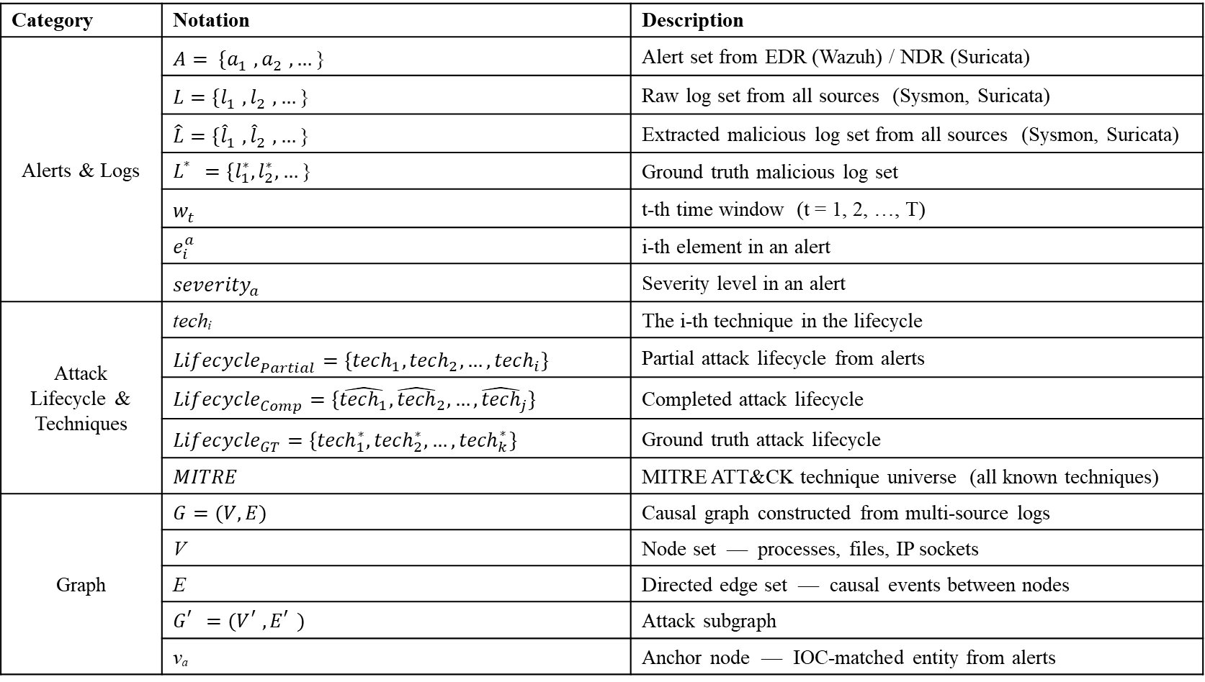
Notations
Category | Notation | Description
Alerts & Logs | $$A= \{a_{1}^{},a_{2}^{},…\text{\}}$$ | Alert set from EDR (Wazuh) / NDR (Suricata)
 | $$L=\{l_{1}^{},l_{2}^{},…\text{\}}$$ | Raw log set from all sources (Sysmon, Suricata)
 | $$\hat{L}=\{{\hat{l}}_{1}^{},{\hat{l}}_{2}^{},…\text{\}}$$ | Extracted malicious log set from all sources (Sysmon, Suricata)
 | $$L_{}^{∗}=\{l_{1}^{∗},l_{2}^{∗},…\text{\}}$$ | Ground truth malicious log set
 | $$w_{t}^{}$$ | t-th time window (t = 1, 2, …, T)
 | $$e_{i}^{a}$$ | i-th element in an alert
 | $${severity}_{a}^{}$$ | Severity level in an alert
Attack Lifecycle & Techniques | techᵢ | The i-th technique in the lifecycle
 | $${Lifecycle}_{Partial}^{}=\{{tech}_{1},{tech}_{2},…,{tech}_{i}\}$$ | Partial attack lifecycle from alerts
 | $${Lifecycle}_{Comp}^{}=\{\hat{{tech}_{1}},{\hat{tech}}_{2},…,{\hat{tech}}_{j}\}$$ | Completed attack lifecycle
 | $${Lifecycle}_{GT}^{}=\{{tech}_{1}^{∗},{tech}_{2}^{∗},…,{tech}_{k}^{∗}\}$$ | Ground truth attack lifecycle
 | $$MITRE$$ | MITRE ATT&CK technique universe (all known techniques)
Graph | $$G=(V, E)$$ | Causal graph constructed from multi-source logs
 | V | Node set — processes, files, IP sockets
 | E | Directed edge set — causal events between nodes
 | $$G_{}^{′}=(V_{}^{′}, E_{}^{′})$$ | Attack subgraph
 | vₐ | Anchor node — IOC-matched entity from alerts

Slide 18
Problem Overview
Log Denoising:
Task: Extracts malicious logs and filter out benign logs
Goal: Maximizes Recall Rate(RR), and also Minimize False Positive Rate(FPR)
Attack Lifecycle Completion:
Task: Detect missed techniques in partial lifecycle from correlated malicious logs
Goal: Maximize the F1-Score, and also Minimize the Edit Distance

Slide 19
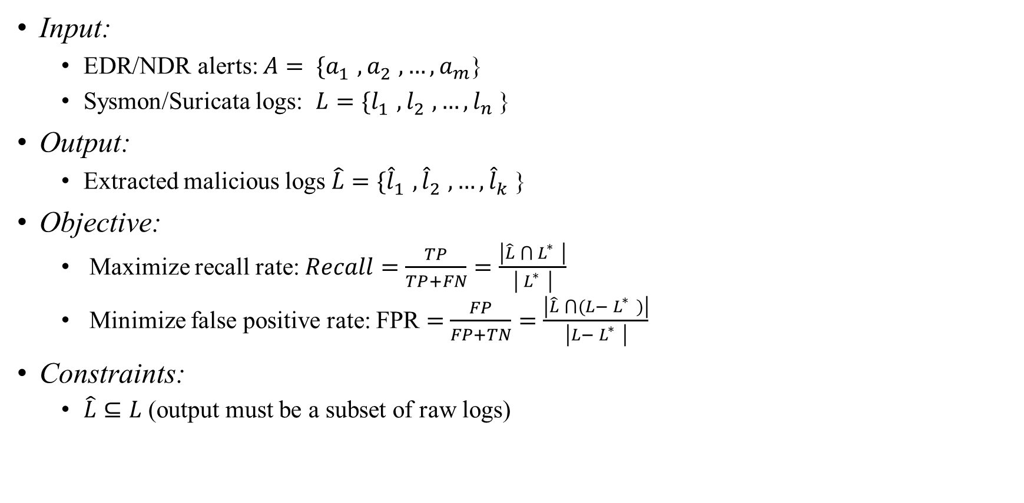
Problem Statements – Log Denoising
Input:
EDR/NDR alerts: $A= \{a_{1}^{},a_{2}^{},…,a_{m}^{}$}
Sysmon/Suricata logs: $L=\{l_{1}^{},l_{2}^{},…,l_{n}^{}$}
Output:
Extracted malicious logs $\hat{L}=\{{\hat{l}}_{1}^{},{\hat{l}}_{2}^{},…,{\hat{l}}_{k}^{}$}
Objective:
Maximize recall rate: $Recall=\frac{TP}{TP+FN}=\frac{\left|\hat{L} ⋂{ L}_{}^{∗}\right|}{\left|{ L}_{}^{∗}\right|}$
Minimize false positive rate: FPR $=$ $\frac{FP}{FP+TN}=\frac{\left|\hat{L} ⋂(L−{ L}_{}^{∗})\right|}{\left|L−{ L}_{}^{∗}\right|}$
Constraints:
$\hat{L}⊆L$ (output must be a subset of raw logs)

Slide 20
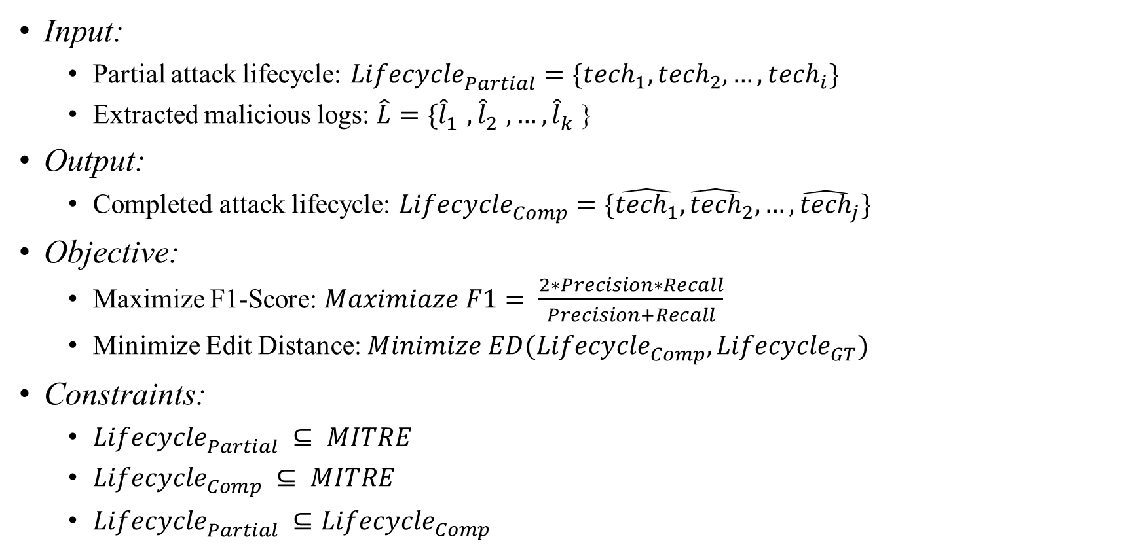
Problem Statements – Attack Lifecycle Completion
Input:
Partial attack lifecycle: ${Lifecycle}_{Partial}^{}=\{{tech}_{1},{tech}_{2},…,{tech}_{i}\}$
Extracted malicious logs: $\hat{L}=\{{\hat{l}}_{1}^{},{\hat{l}}_{2}^{},…,{\hat{l}}_{k}^{}$}
Output:
Completed attack lifecycle: ${Lifecycle}_{Comp}^{}=\{\hat{{tech}_{1}},{\hat{tech}}_{2},…,{\hat{tech}}_{j}\}$
Objective:
Maximize F1-Score: $Maximiaze F1= \frac{2∗Precision∗Recall}{Precision+Recall}$
Minimize Edit Distance: $Minimize ED({Lifecycle}_{Comp}^{},{Lifecycle}_{GT}^{})$
Constraints:
${Lifecycle}_{Partial}^{} ⊆ MITRE$
${Lifecycle}_{Comp}^{} ⊆ MITRE$
${Lifecycle}_{Partial}^{} ⊆{Lifecycle}_{Comp}^{}$

Slide 21
Outline
Motivation
Background
MITRE ATT&CK Framework
Attack Lifecycle
Endpoint Detection and Response Alert
Network Detection and Response Alert
Sysmon log
Suricata log
Causal Graph
Large Language Model (LLM)
Related Works
Issues
Notations
Problem Statements
Log Denoising
Attack Lifecycle Completion
Solutions
Graph-based Malicious Log Extraction
Log2Graph
Attack Subgraph Search
Graph2Log
LLM-Driven Lifecycle Completion
Single-Technique Detection
Lifecycle Completion
Implementation
Evaluation
Set-based Evaluation
Sequence-based Evaluation
Schedule
References

Slide 22
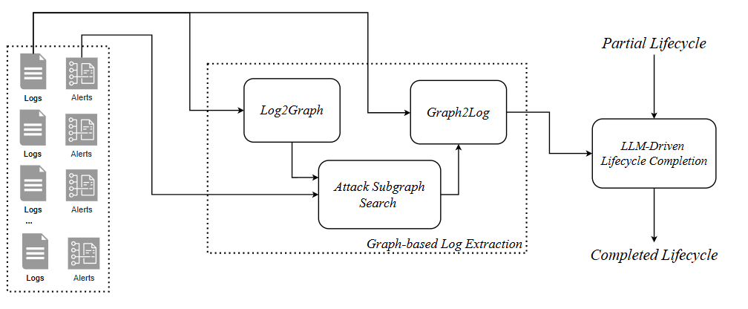








Solution Overview
Graph-based Malicious Log Extraction:
Log2Graph – Converts logs into a causal graph
Attack Subgraph Search – Identifies attack-related nodes and edges on the causal graph
Graph2Log – Maps attack subgraph back to extracted malicious logs
LLM-Driven Lifecycle Completion:
Single-Technique Detection – Iteratively detects a single technique from each log segment partitioned by time windows
Lifecycle Completion – Performs deduplication on the output results from the previous module
(4) ${LC}_{P}^{}$
(1) L$ogs L$
(4) Extracted Malicious Logs $\hat{L}$
(3) L$ogs L$
(2) Causal Graph $G^{}$
(3) Attack
Subgraph $G^{′}$
(2) $Alerts A$
(5) ${LC}_{C}^{}$

Slide 23
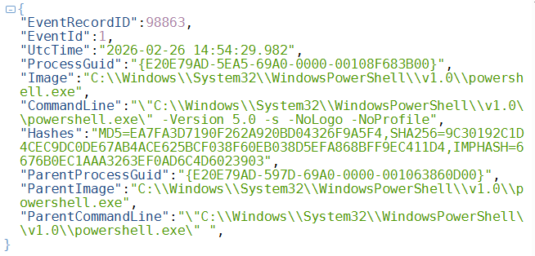
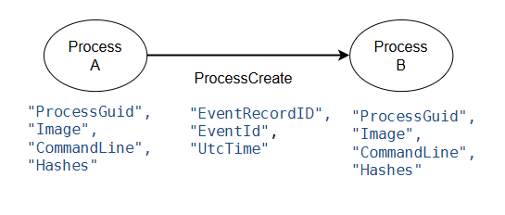
Solution – Graph-based Malicious Log Extraction: Log2Graph (1/2)
Function:
Converts logs into a causal graph
Nodes: represent system entities recorded in logs (Process, File, IP)
Edges: represent causal interaction events between entities (ProcessCreate, FileWrite, etc.)
→ Edge
(ProcessCreate)
→ Node
(Process B)
→ Node
(Process A)
Fig. An example of Causal Graph
Fig. An example of Sysmon Log

Slide 24
Solution – Graph-based Malicious Log Extraction: Log2Graph (2/2)
Formal Definitions of Nodes and Edges in the Causal Graph:
Node definition:
Edge definition:
Node Type | Feature | Description
Process | Host | The device that this process run on
 | User | The user that has this process
 | ProcessGuid | The unique id of process
 | CommandLine | The command that creates this process
 | Image | The image that this process loads
 | Timestamp | The moment when this process was created
File | Host | The device that this file belongs to
 | Filename | The full path of this file
 | Timestamp | The moment when this file was created
IP | Host | The device that this IP address belongs to
 | IP address
 | Port
Source Node Type | Edge | Target Node Type
Process | ProcessCreate | Process
Process | ProcessInject | Process
Process | FileCreate | File
Process | FileWrite | File
Process | FileDelete | File
Process | FileLoad | File
Process | NetworkListen | Socket(IP:Port)
Socket(IP:Port) | NetworkConnect | Socket(IP:Port)
Socket(IP:Port) | NetworkSent | Socket(IP:Port)
Socket(IP:Port) | NetworkReceive | Socket(IP:Port)

Slide 25
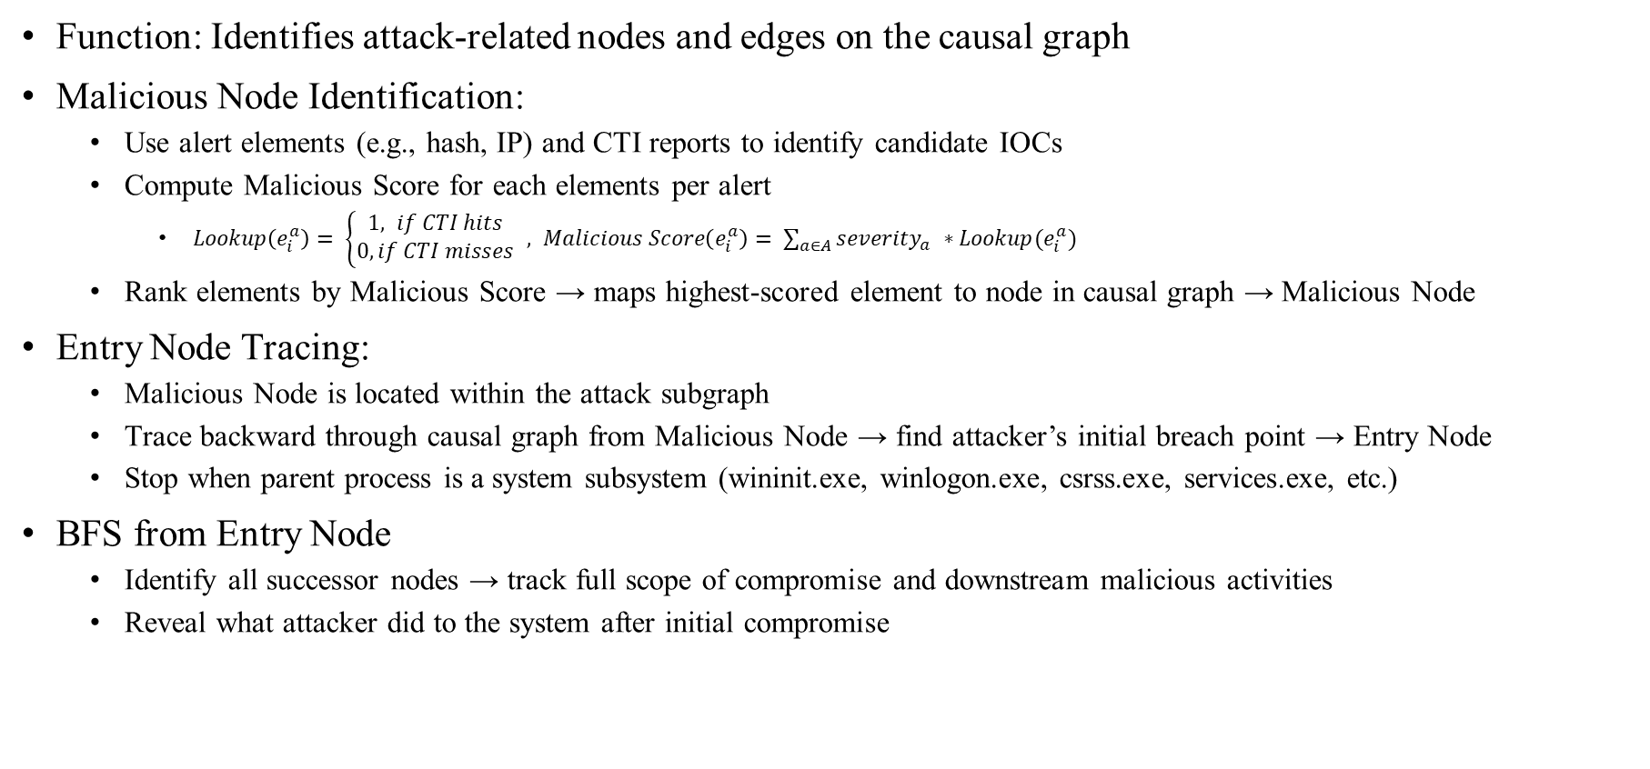
Solution – Graph-based Malicious Log Extraction: Attack Subgraph Search
Function: Identifies attack-related nodes and edges on the causal graph
Malicious Node Identification:
Use alert elements (e.g., hash, IP) and CTI reports to identify candidate IOCs
Compute Malicious Score for each elements per alert
$Lookup\left(e_{i}^{a}\right)= \left\{\begin{aligned}1, if CTI hits \\ 0, if CTI misses\end{aligned}\right. ,$ $Malicious Score\left(e_{i}^{a}\right)= \sum_{a∈A}{{severity}_{a}^{}∗Lookup(e_{i}^{a}) }$
Rank elements by Malicious Score → maps highest-scored element to node in causal graph → Malicious Node
Entry Node Tracing:
Malicious Node is located within the attack subgraph
Trace backward through causal graph from Malicious Node → find attacker’s initial breach point → Entry Node
Stop when parent process is a system subsystem (wininit.exe, winlogon.exe, csrss.exe, services.exe, etc.)
BFS from Entry Node
Identify all successor nodes → track full scope of compromise and downstream malicious activities
Reveal what attacker did to the system after initial compromise

Slide 26
Solution – Graph-based Malicious Log Extraction: Graph2Log
Function: Maps attack subgraph back to extracted malicious logs
Back-Mapping Mechanism:
Each edge in Log2Graph stores both the event type and the originating log ID
Retrieve the corresponding raw log entry using the stored log ID
Fig. An example of Causal Graph
Fig. An example of Sysmon Log

Slide 27
Solution – LLM-Driven Lifecycle Completion: Time-Window based Single-Technique Detection
Function: Iteratively detects a single technique from each log segment partitioned by time windows
How Time-Window partition logs into segment:
Time-Window’s size is a hyperparameter
Output: detected techniques across all windows
Start time
End time
Start time
End time
Start time
End time
Start time
End time
Start time
End time
Start time
End time
Ground-Truth
Lifecycle
T1071.001
T1566.002
T1059.001
T1620
T1134
T1059.001
Alert-based
Reconstructed Lifecycle
T1071.001
Miss
Miss
Miss
Miss
T1059.001
Log
Log
Log
Log
Log
Log
Log
Log
Log
Log
Log
Log Sighting
After Extraction
Log
Log
Log
Log
Log
Log
Log
Log
Log
Log
Log
Log
Log
Log
Log
Log
Log
Log
Log
Log
Log
Log
Log
Log
Log
Log
Log
Log
Log
Log
Log
Log
Log
Input
Input
Input
Input
Input
Input

Slide 28
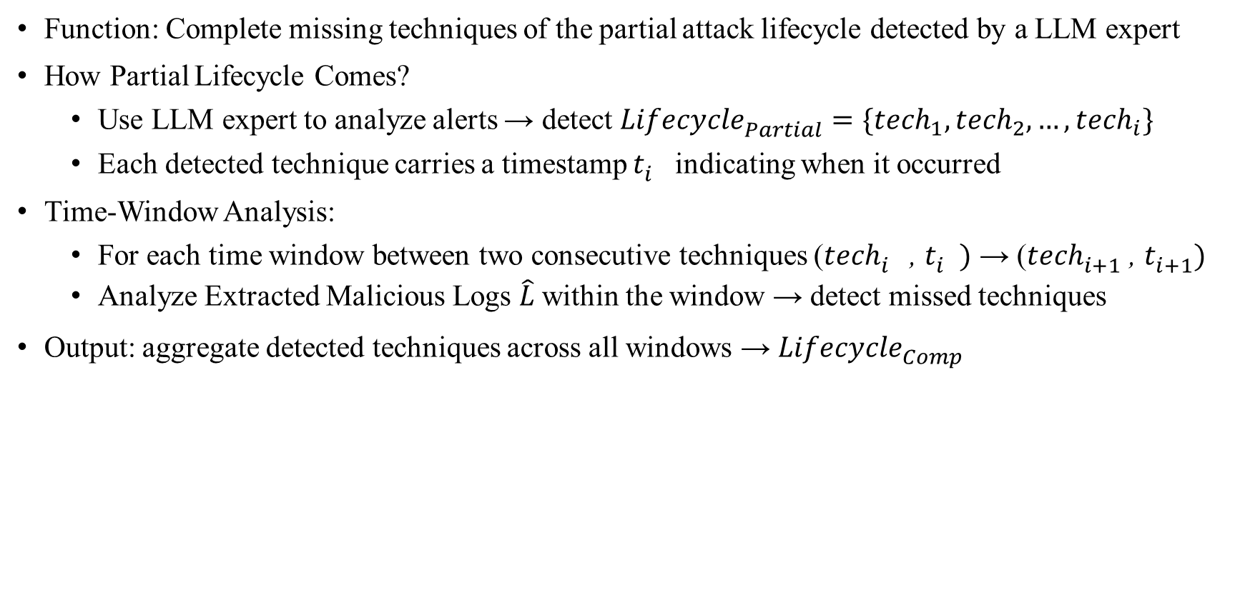
Solution – LLM-Driven Lifecycle Completion: Lifecycle Completion
Function: Complete missing techniques of the partial attack lifecycle detected by a LLM expert
How Partial Lifecycle Comes?
Use LLM expert to analyze alerts → detect ${Lifecycle}_{Partial}^{}=\{{tech}_{1},{tech}_{2},…,{tech}_{i}\}$
Each detected technique carries a timestamp $t_{i}^{}$ indicating when it occurred
Time-Window Analysis:
For each time window between two consecutive techniques (${tech}_{i}^{}$ , $t_{i}^{})$ → (${tech}_{i+1}^{}$ , $t_{i+1}^{})$
Analyze Extracted Malicious Logs $\hat{L}$within the window → detect missed techniques
Output: aggregate detected techniques across all windows → ${Lifecycle}_{Comp}^{}$

Slide 29
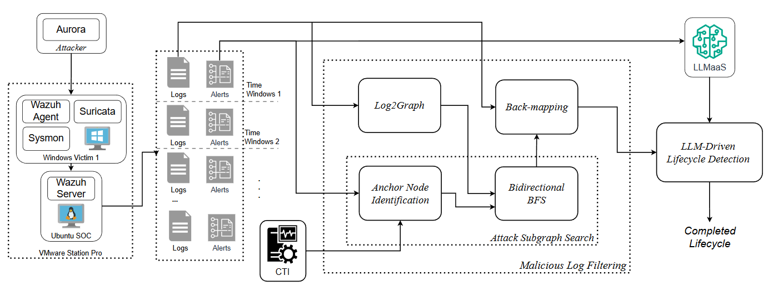
Implementation
(4) Detect Lifecycle
(1) Perform Attack
(6) Map to Log
(3) Construct Graph
(7) Lifecycle
Completion
(6) Map to Log
(7) Lifecycle
Completion
(4) Find Anchor Node
(5)
(2) Collect Data
(5) Find Attack Subgraph
(4) Find Anchor Node

Slide 30
Implementation – Open-Source Tools and Libraries
Category | Name | Description & Functionality
Virtualization Tools | Virtualbox | Runs isolated virtual environments for testing.
Operating System | Windows server 2008 R2 | Run as a victim machine
 | Kali | Run as a attacker machine
 | Ubuntu 22.04 | Run as a data central to collect logs and alerts
Security Tools | Wazuh | Monitors endpoints, generates security alerts.
 | Suricata
 | Sysmon | Logs detailed system activity for analysis.
Attacking Tools | Aurora | Replay attacks based on MITRE ATT&CK.
LLM | Pytorch | A platform for developing AI model.
 | Hugging Face | Provides pre-trained LLM models.
 | Unsloth

Slide 31
Implementation: Single-Technique Detection Finetuning
Description:
Comparing the accuracy of models with different sizes
Data source:
Sysmon logs and Suricata logs
Each log is labeled with {malicious, technique_id} or {benign, none}
Multiple consecutive logs may be labeled with the same technique
Dataset:
5112 samples (Train/Valid/Test split: 80%/10%/10%)
Contains 200 lifecycles and 36 techniques
Average depth of lifecycles is 24.6 (techniques)
Each sample is represented by {instruction, input, output}
Instruction: system prompt
Input: logs (can be entirely malicious or entirely benign)
Output: {malicious, technique_id} or {benign, none}
Ground-Truth
Lifecycle
T1071.001
T1566.002
T1059.001
Log
Log
Log
Log
Log
Log Sighting
Log
Log
Log
Log
Log
Log
Log
Log
Log
Log
Log
Log
Log
Log
Log
Sample
Sample
Sample
Sample
Sample

Slide 32
Evaluation
LLM vs. others (ML, DL)
Metrics:
Technique detection accuracy
Malicious Log Extraction vs. without Extraction
Metrics:
Log/Token count reduction
Technique detection accuracy across ML, DL, and LLM
Notes:
Precision: The fraction of predicted TTPs that are actually present in the ground-truth.
Recall: The fraction of ground-truth TTPs that the model successfully identified.
F1 score: The harmonic mean of Precision and Recall, providing a single score that balances the trade-off between them.

Slide 33
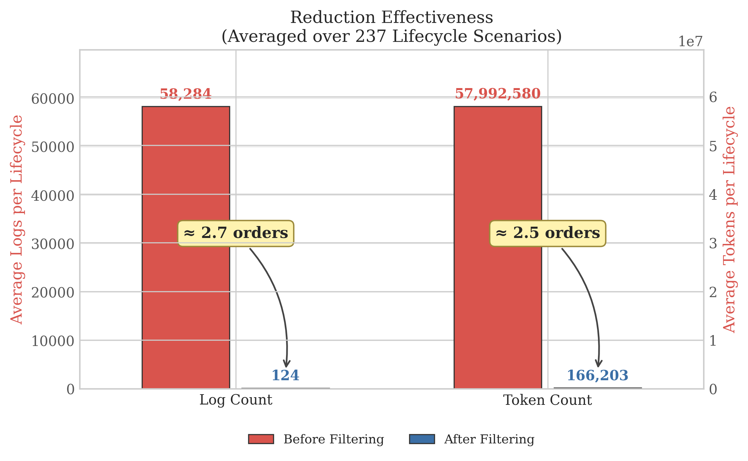
Evaluation 1: Extraction Effectiveness - Reduction Rate? Our solution Stage 1 achieved a two-order-of-magnitude reduction in log volume
Description:
Average per-lifecycle log count and token count, before vs. after filtering (237 scenarios).
Results:
Logs: 58,284 → 124 (↓ two-order-of-magnitude reduction)
Tokens: 57,992,580 → 166,203 (↓ two-order-of-magnitude reduction)
Discussion:
Why it matters:
Raw logs ≈ 57M tokens — exceeds most LLM context windows.
After filtering ≈ 166K tokens — fits in most LLM.

Slide 34
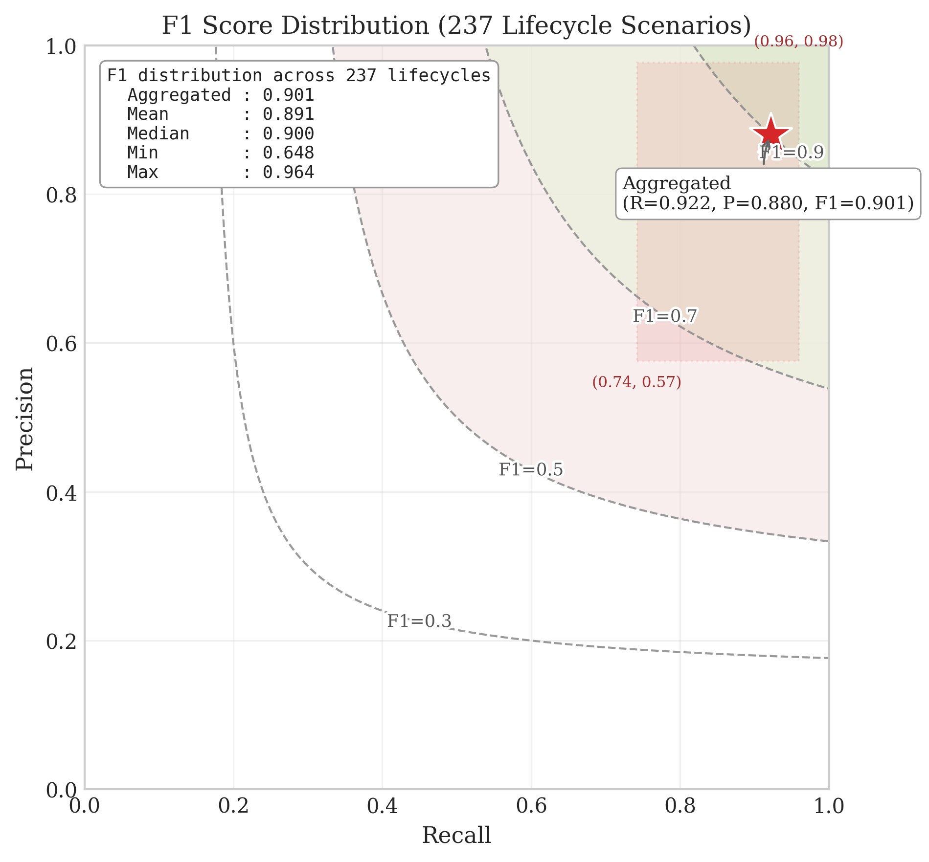
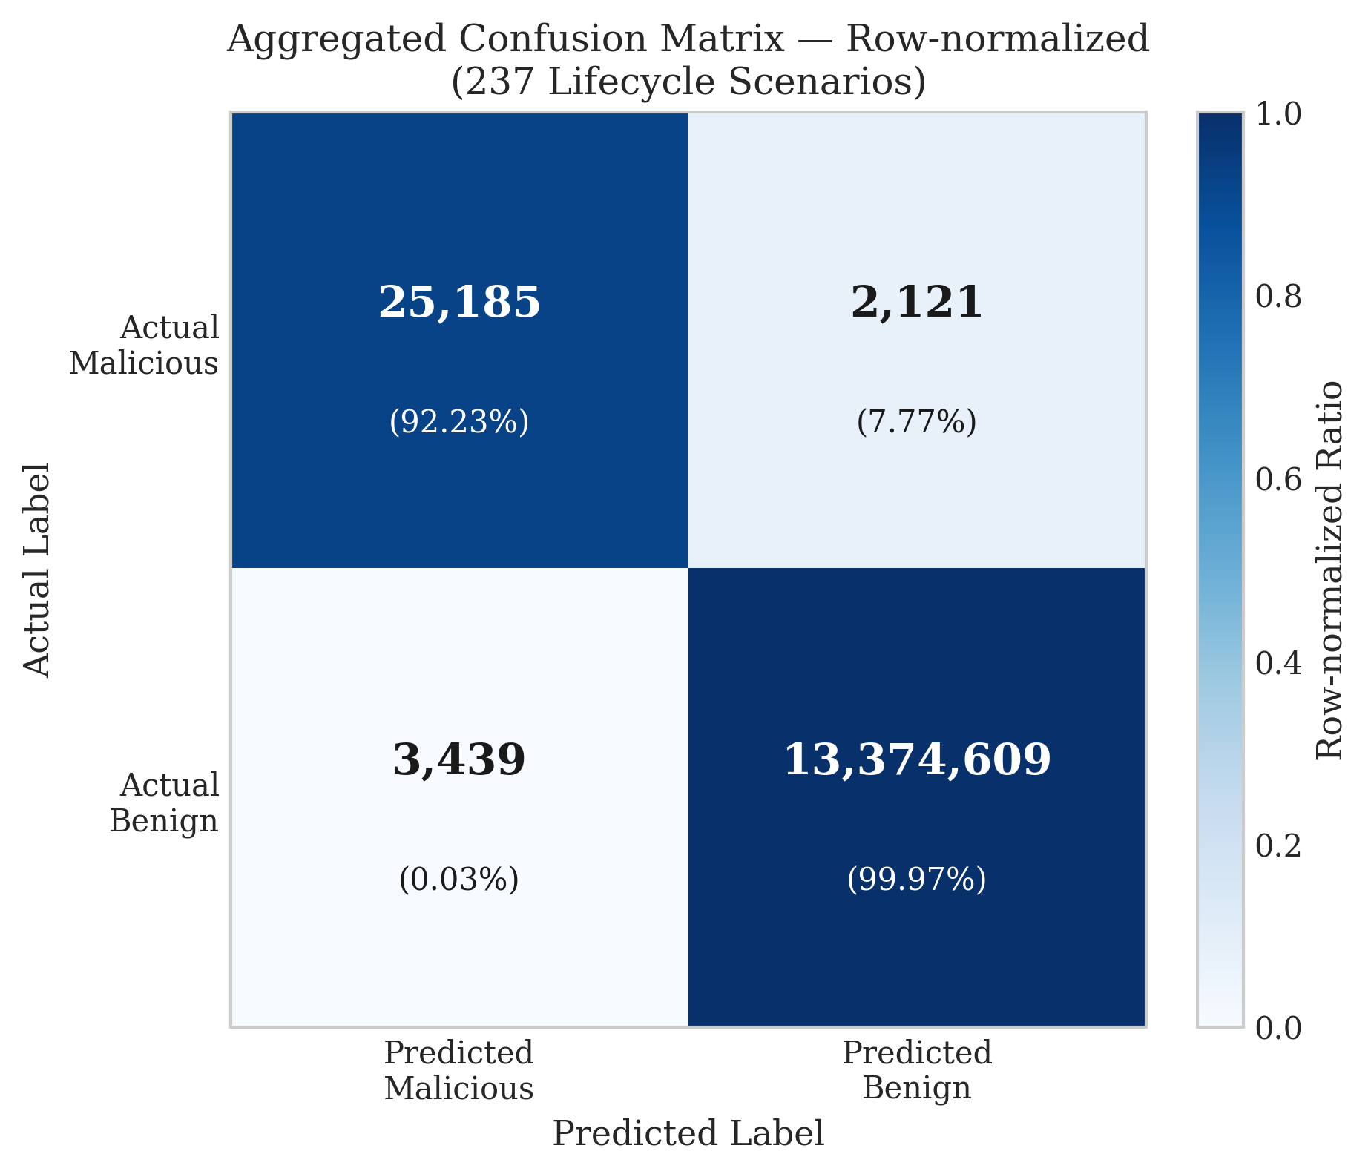
Evaluation 1: Extraction Correctness – FP/FN/TN? Our solution Stage 1 achieved 0.901 F1-score
Results:
TP rate: 92.23% — majority of malicious logs correctly identified
FN rate: 7.77% — some malicious logs missed
FP rate: 0.003% — negligible benign logs
TN rate: 99.97% — near-perfect benign log retention
Average F1-Score: 0.901
Discussion:
Why it matters:
garbage in, garbage out → make sure that inputs are high quality for LLM to detect

Slide 35
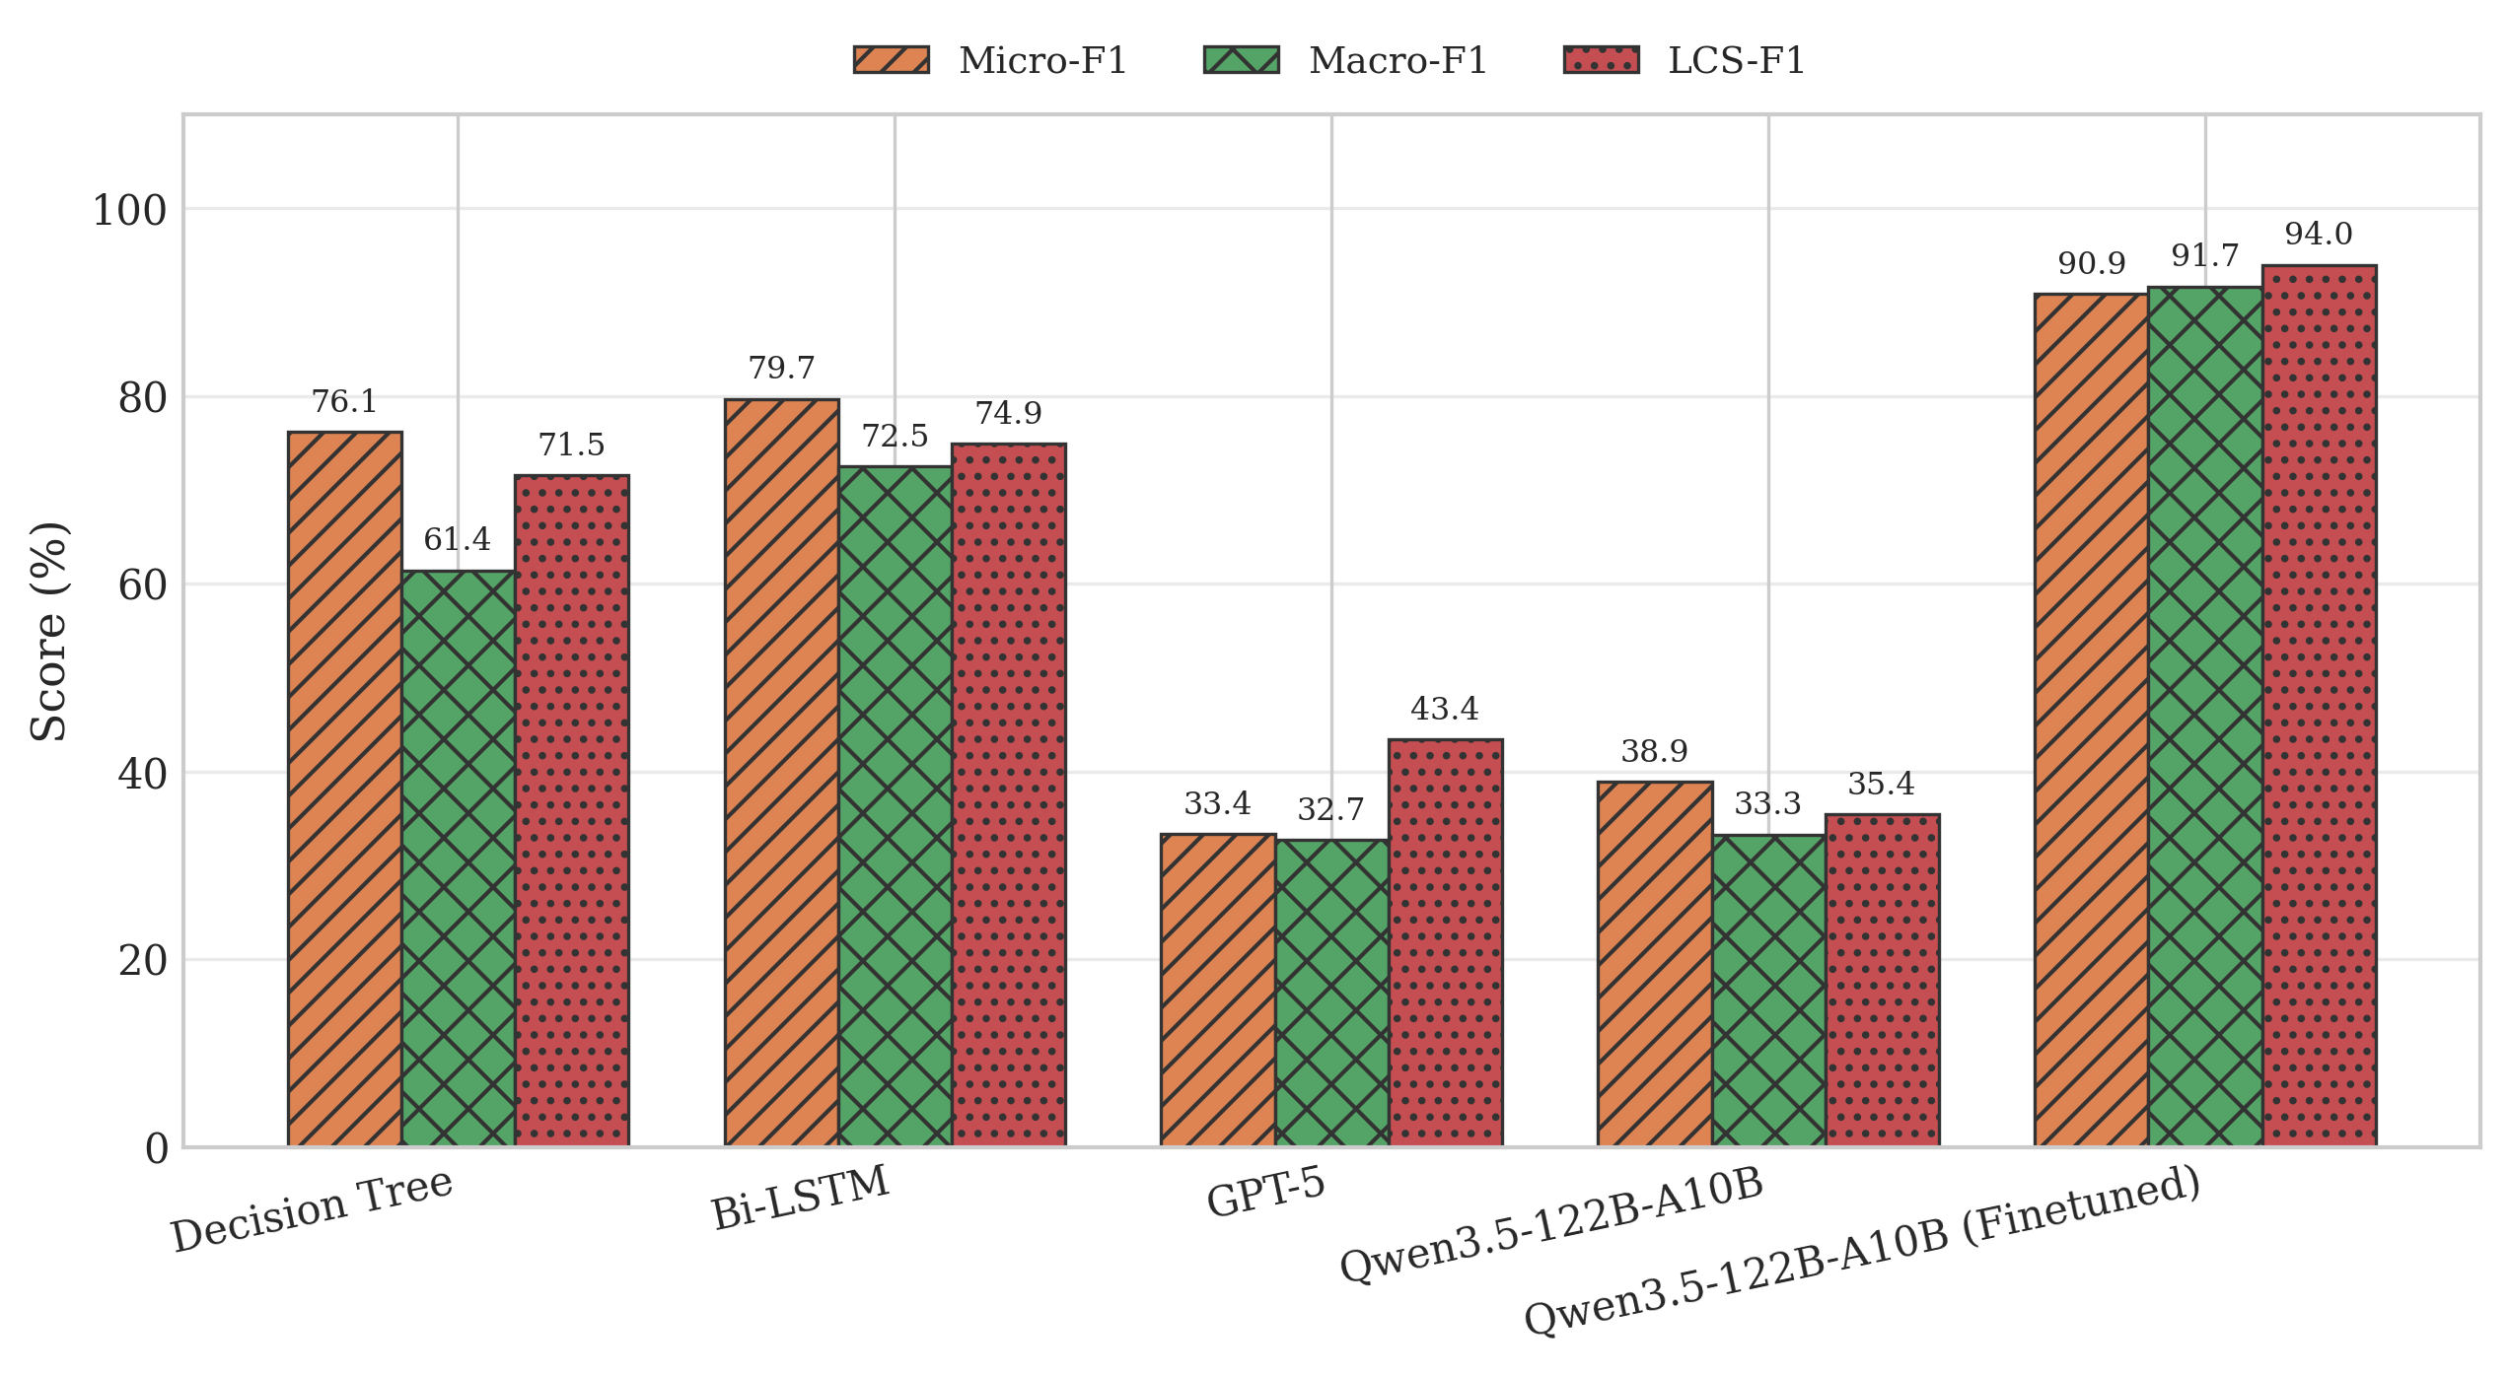
Evaluation 2: Multi-Technique Detection – How much Better are Finetuned LLM? Finetuned LLM outperforms all traditional models and even Non-Finetuned LLMs
Observation and Insight:
F1 score:
One Technique, Multiple Implementation → Numerical features failed → Finetuned LLM wins (90.9% vs. 76.1%~79.7)
Pre-train data does include logs data → Finetuned LLM wins (90.9% vs. 33.4%~38.9 Non-Finetuned LLMs )
Some techniques in dataset are uniquely implemented → Traditional Models win (76.1%~79.7 vs. 33.4%~38.9 Non-Finetuned LLMs )
.

Slide 36
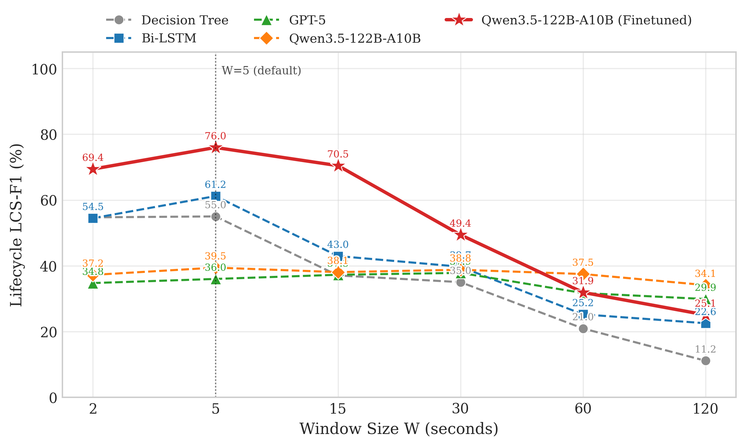
Evaluation 2: Lifecycle Completion – How much Better are Finetuned LLM? Finetuned LLM outperforms all traditional models and even Non-Finetuned LLMs when W=5s
Observation and Insight:
F1 score:
Considering order → Traditional Models fail
W=5s → almost all samples contain up to one technique → Traditional Models still good
W=>5s → some samples contain more than one technique → Traditional Models collapse
Finetuned LLM starts to decrease when W>30s → Distribution Shift
Non-Finetuned LLMs are stable
.

Slide 37
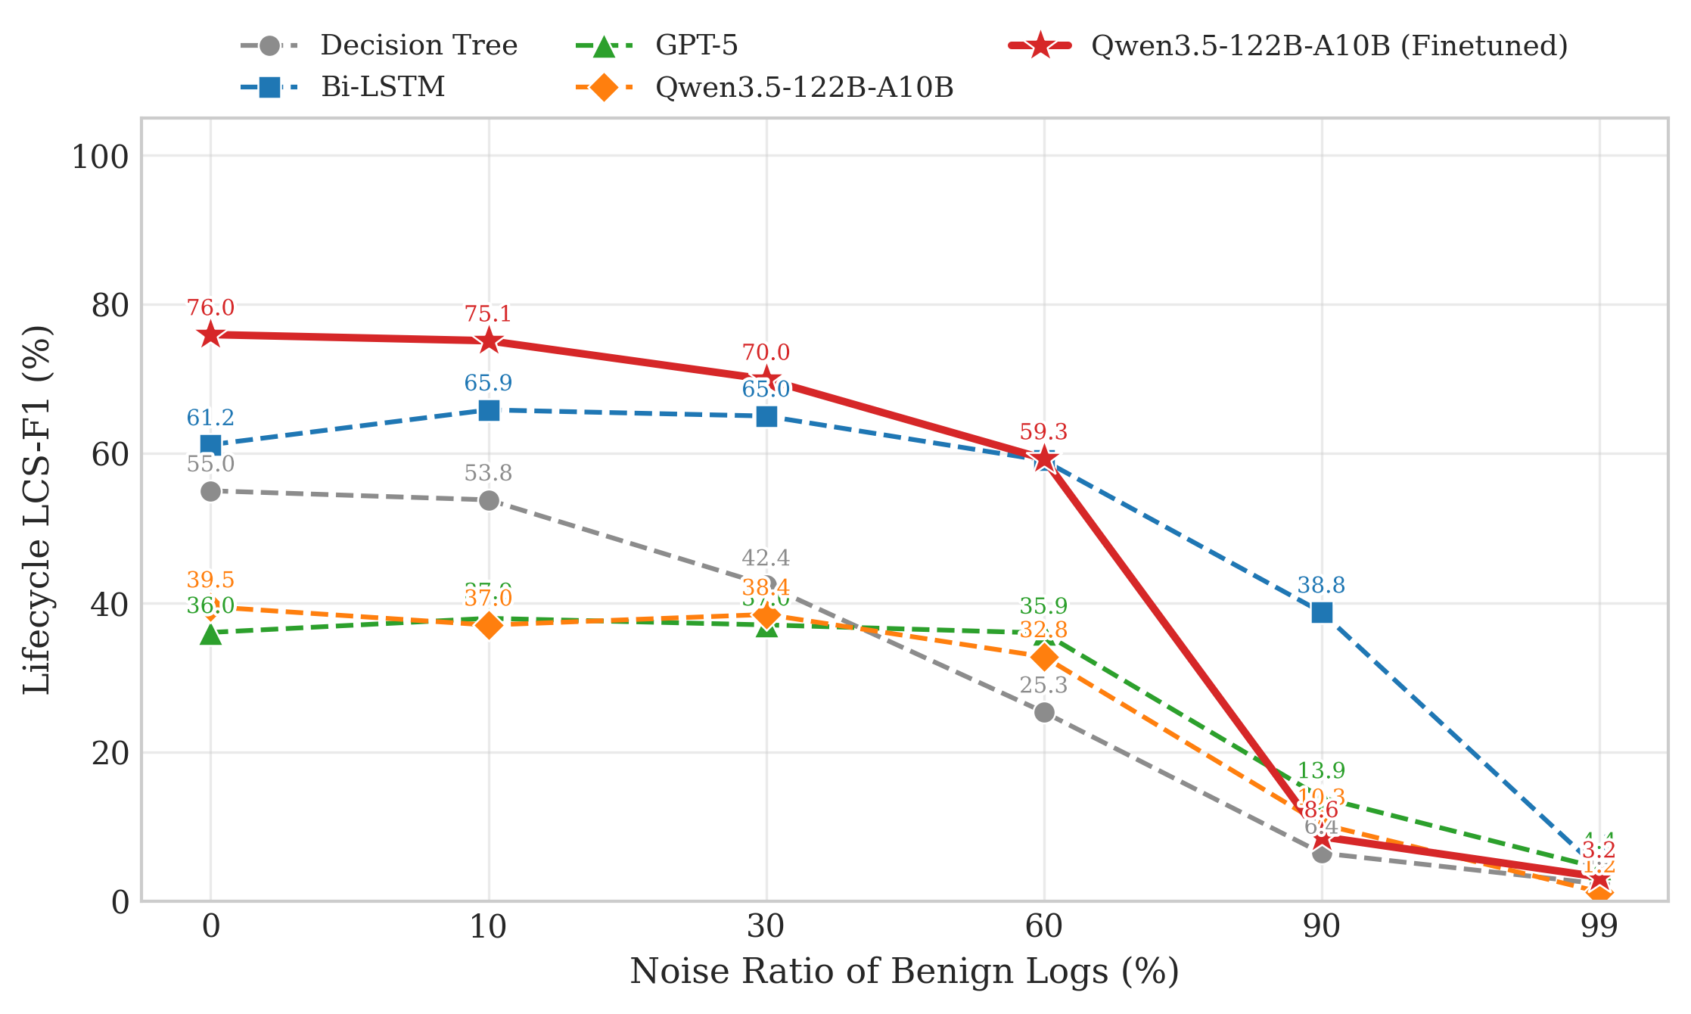
Evaluation 3: Does Benign Logs Affect? Yes, and no model can complete the lifecycles when noise ratio more than 99%
Observation and Insight:
Model can be tolerant of a certain amount of noise → Features still obvious
When benign logs more than malicious logs → Finetuned LLM drops dramatically → Distribution Shift
.

Slide 38
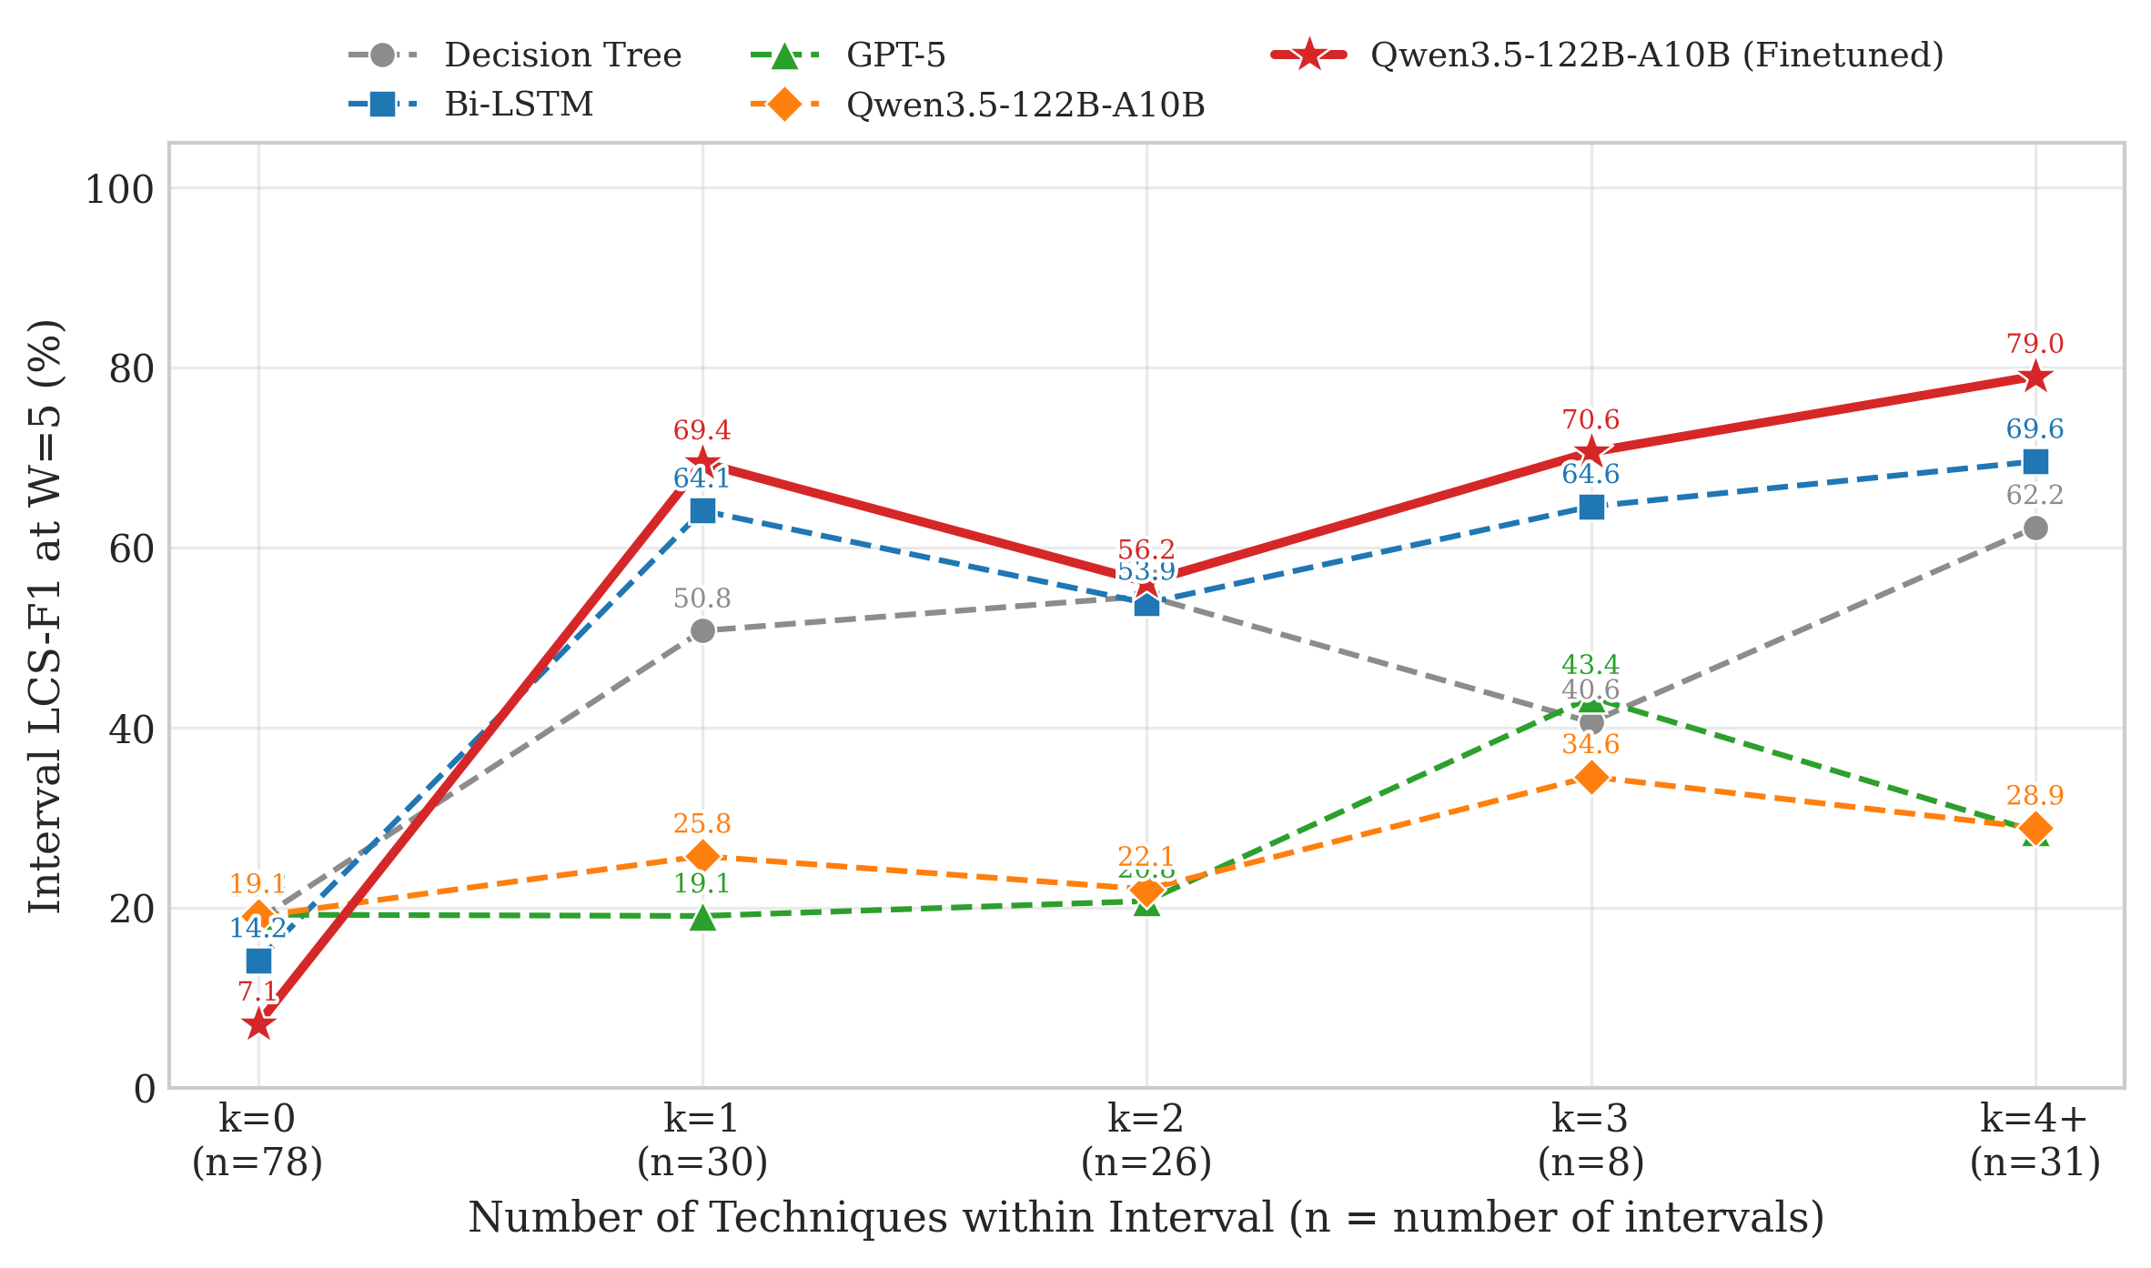
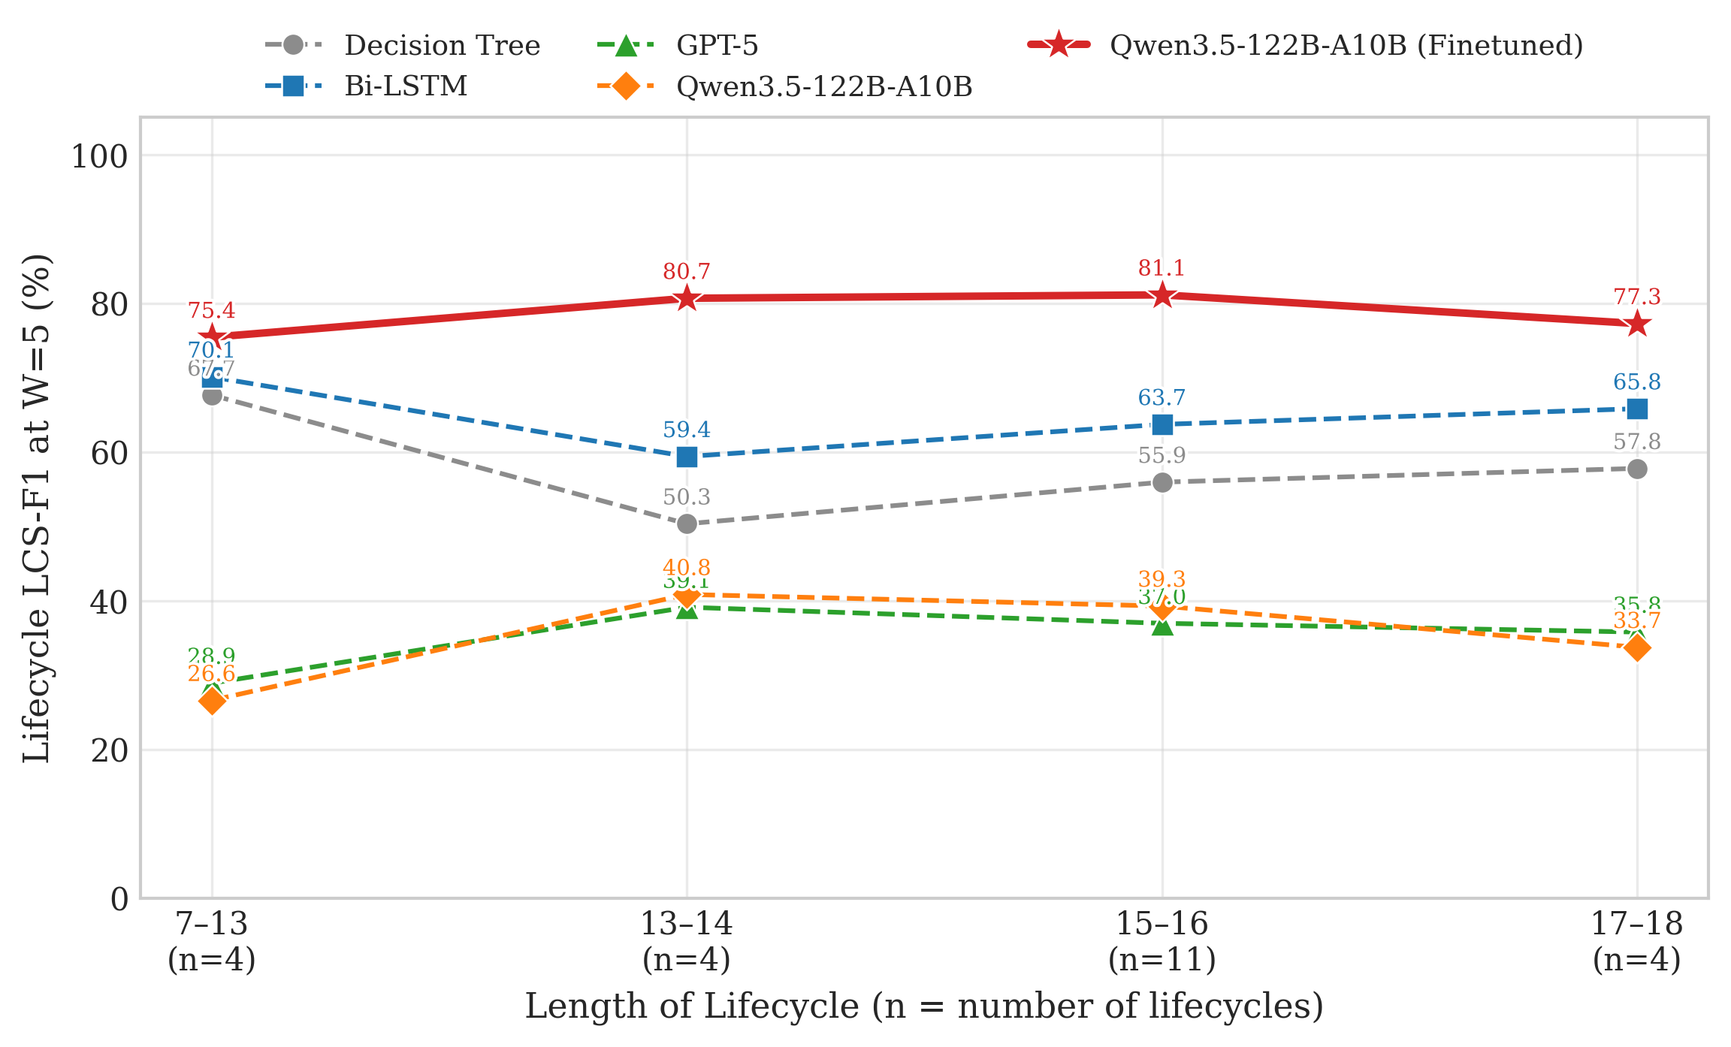
Evaluation 4: Does Length of Interval Affect? Does Length of lifecycle Affect? No, model detects on the same time window
Fig. Performance comparison across different models on Single-Technique Detection
Fig. Performance comparison across different models on Single-Technique Detection
Observation and Insight:
Big Intervals are not more difficult to detect → W=5s, whatever how long is the intervals
Long Lifecycle are not more difficult to detect → W=5s, whatever how long is the intervals

Slide 39
References
[1]
[2]
[3]
[4]
[5]
[6]
[7]
Anjum, Md Monowar, Shahrear Iqbal, and Benoit Hamelin. "ANUBIS: for advanced persistent threat detection." Proceedings of the 37th ACM/SIGAPP Symposiuma causal graph-based framework on Applied Computing. 2022.
Benabderrahmane, Sidahmed, et al. "APT-LLM: Embedding-Based Anomaly Detection of Cyber Advanced Persistent Threats Using Large Language Models." 2025 13th International Symposium on Digital Forensics and Security (ISDFS). IEEE, 2025.
Milajerdi, Sadegh M., et al. "Holmes: real-time apt detection through correlation of suspicious information flows." 2019 IEEE symposium on security and privacy (SP). IEEE, 2019.
Gandhi, Parth Atulbhai, et al. "Shield: Apt detection and intelligent explanation using llm." arXiv preprint arXiv:2502.02342 (2025).
Lin, Ying-Dar, et al. "Two-stage multi-datasource machine learning for attack technique and lifecycle detection." Computers & Security 142 (2024): 103859.
Milajerdi, Sadegh M., et al. "Poirot: Aligning attack behavior with kernel audit records for cyber threat hunting." Proceedings of the 2019 ACM SIGSAC conference on computer and communications security. 2019.
Ying-Dar Lin, Chun-Yi Chang, Didik Sudyana, Yuan-Cheng Lai, Ren-Hung Hwang, Po-Ching Lin “ LLM-driven Alert Correlation and Lifecycle Prediction with Threat Intelligence for Attack Forensics”

Slide 40
Thank you!

