Slide 1
RL-LLM Based Co-evolving Multi-generational Red-team and Blue-team AI Agents in a Cyber Range
Student: Aniket Aggarwal
Advisor: Professor Ying-Dar Lin
High Speed Network Lab
National Yang Ming Chiao Tung University, Taiwan
Notes:
Good morning, respected professors and committee members. My name is Aniket Aggarwal, and today I will present my master’s thesis titled “RL-LLM Based Co-evolving Multi-generational Red-team and Blue-team AI Agents in a Cyber Range.” This work focuses on automated cyber defense training. In particular, I study how Red-team attacker agents and Blue-team defender agents can improve together across multiple generations inside a Cyber Range.

Slide 2
Outline
Motivation
Background
Cybersecurity Training
MITRE ATT&CK
RL + Parameterized Cyber Actions
Related works
AI-Based Red-Blue Teaming
Issues
Notations
Problem Statement
Solution
Overview
Blue Agent Process
Red Agent Process
Implementation
Evaluation
Conclusion
References
2

Slide 3
Motivation
Why AI Based Red/Blue Team?
Human exercises → Costly, slow, expert-dependent
AI agents → Scalable, fast, repeatable training
Automates both attack (Red) & defense (Blue)
Why Co-evolve Red and Blue Agents?
Fixed Red/Blue training → overfitting to static opponent
Red ↔ Blue adaptation → Adaptive, robust strategies
Avoids outdated attacker/defender behavior
Why Multi-generation?
Simultaneous training → Red & Blue change together → unstable
Multi-generation → stronger opponent each round → stable evolution
Why RL-based?
Cyber kill chains → Sequential + Multi-stage decision problems
RL → Learns long-term attack/defense over time beyond rule-based or heuristic systems.
3
Notes:
Traditional red/blue team exercises rely on human experts → costly, slow, hard to scale
Cyber threats keep evolving → need a repeatable, scalable training method
AI agents can fill this gap: Red simulates multi-step attacks; Blue monitors logs, detects threats, picks defenses
Problem 1: training Blue vs. a fixed Red → overfits to one attacker, fails on unseen attacks
Problem 2: training Red and Blue together → unstable (both policies shift at once)
My solution: multi-generational co-evolution — one side trains against a stable opponent, gets promoted, then becomes the tougher opponent for the other side
Why RL: attack/defense is sequential → early actions shape later outcomes → agent must learn long-term strategy, not just immediate moves

Slide 4
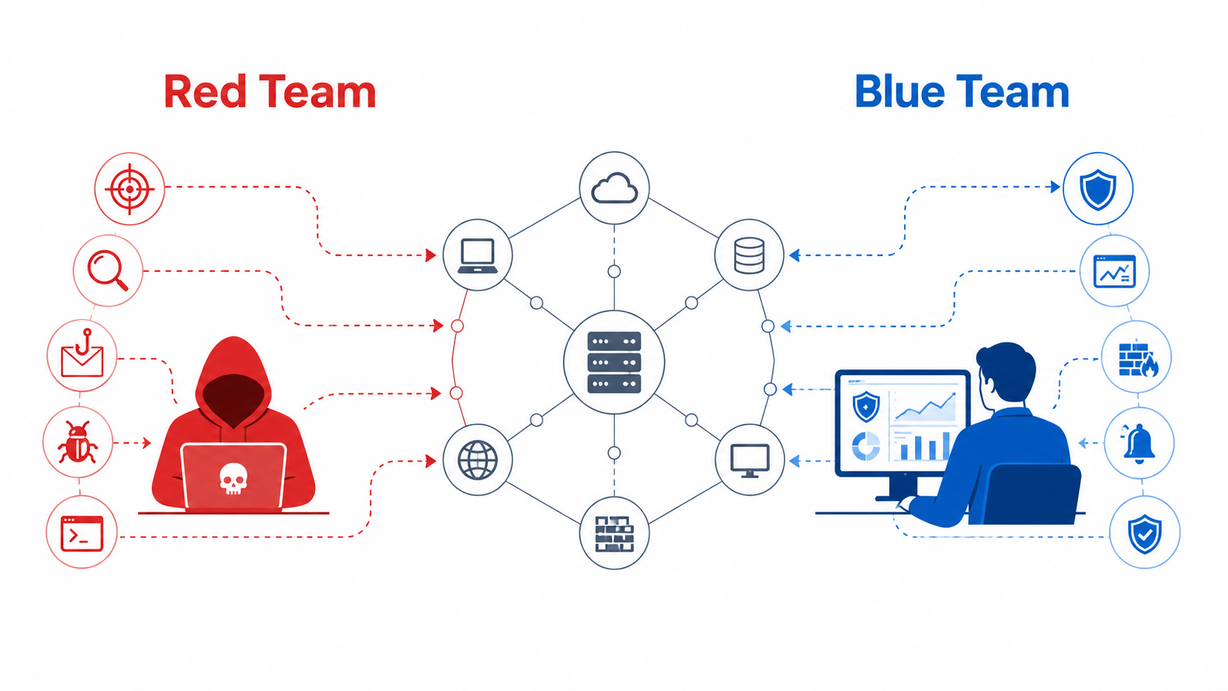
Background: Cybersecurity Training
Red Team: Attacker Simulation
Emulates attacker behavior
Performs multi-step attack campaigns
Tests defensive capability
Blue Team: Defender Operations
Monitors system/network activity
Detects suspicious behavior from logs/alerts
Applies defensive actions to stop attacks
Cyber Range Training
Safe controlled environment
Repeatable Red–Blue interaction
Supports automated attack–defense evaluation
4
Notes:
[Slide 3] In cybersecurity training, the Red Team represents the attacker. It performs multi-step attack campaigns, such as gaining access, escalating privilege, moving laterally, and reaching a target. The Blue Team represents the defender. It monitors logs and alerts, detects suspicious behavior, and applies defensive responses to stop the attack. In this thesis, both sides interact inside a Cyber Range, which provides a safe and repeatable environment for automated Red–Blue training.

Slide 5
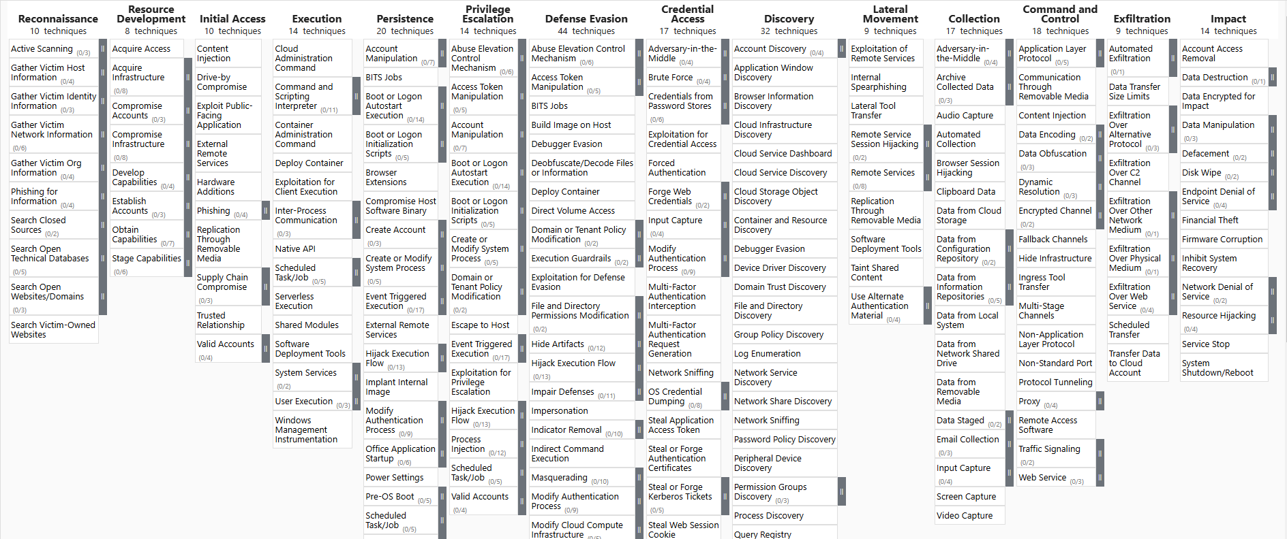
Background – MITRE ATT&CK
MITRE ATT&CK Framework:
Defines attacker Tactics, Techniques, Procedures (TTPs)
Tactics → attacker goals
Techniques → methods to achieve goals
Procedures → real-world implementation
Kill chain → sequence of techniques
Provides structured attack lifecycle modeling
For Enterprise:
14 tactics,
222 techniques,
475 sub-techniques
Figure 1 : MITRE ATT&CK For Enterprise
5
Notes:
[Slide 5] MITRE ATT&CK is used to model the attack lifecycle. It organizes attacker behavior into tactics, which represent attacker goals, and techniques, which represent the methods used to achieve those goals. In my work, the Red-team agent does not choose random attack actions. Instead, it builds kill chains as sequences of ATT&CK techniques. This makes the attack behavior more realistic, structured, and easier to analyze.

Slide 6





Background: RL + Parameterized Cyber Actions
RL: Sequential Decision-Making
Agent observes state → selects action → receives reward → Next State
Learns policy through repeated interaction
Parameterized Cyber Actions
Cyber action = action type + parameters
Red: technique + target/port/credential/command
Blue: response + host/user/process/IP
DDQN: Double Deep Q-Network
Two networks → Online Q-network + Target Q-network
Separate roles → Online selects action, Target evaluates action
Benefit → less overestimation + more stable learning
Received Reward $r_{t}$
Agent
Action $a_{t}$
State $s_{t}$
Next State $s_{t+1}$
Environment
Immediate Reward $r_{t+1}$
Figure 2 : Reinforcement learning loop
6
Notes:
RL fits because attack/defense = sequential decision-making
The loop: observe state → pick action → get reward → move to next state
Goal: not just immediate reward, but actions that pay off long-term
Actions are parameterized, not just a single choice:
Red: technique + target host, port, credential, command
Blue: response + which host, user, process, or IP to act on
I use DDQN over standard DQN → more stable value estimation, especially in long multi-step episodes (reduces overestimation bias)

Slide 7
Related work: AI-Based Red-team–Blue-team
Study | Red Team AI | Blue Team AI | RL Algorithm | RL Algorithm (Blue) | Training Method |  |  | Multi-Generation
 |  |  | Red | Blue | Fixed Opponent | Sim. CoE | Alt. CoE
[4] | Scripted | LLM + RL | – | PPO | ✓ | – | – | –
[5] | Scripted | RL-based | – | DQN, PPO | ✓ | – | – | –
[3] | RL-based | Scripted | PPO | – | ✓ | – | – | –
[15] | RL-based | Scripted | DQN variants | – | ✓ | – | – | –
[6] | Scripted | RL-based | – | DQN | ✓ | – | – | –
[8] | RL-based | RL-based | PPO, A2C | PPO, A2C | – | ✓ | – | –
MG-CoE (Ours) | RL + LLM | RL + LLM | DDQN | DDQN | – | – | ✓ | ✓
Table 1: Related Work on AI-Based Red-team–Blue-team.
7
MG : Multi-generational ; CoE : Co-Evolution ; Sim : Simultaneous ; Alt : Alternating
Notes:
Table compares related work on 4 aspects: AI-based Red? AI-based Blue? RL algorithm? Training method?
Existing work falls into two training styles:
1. Fixed-opponent training
One side learns, other stays scripted/fixed (e.g., Blue vs. scripted Red, or Red vs. scripted defender)
✓ Stable target → easier to converge
✗ Fails against stronger or unseen strategies
2. Simultaneous co-evolution
Both Red and Blue update together
✓ Both sides adapt
✗ Environment becomes non-stationary → opponent keeps shifting → unstable, hard to tell if an agent is truly improving
My proposal: MG-CoE (multi-generational alternating co-evolution)
Train one side while the other stays fixed
Promote the learner only after improvement is verified
Then switch roles
→ Keeps fixed-opponent stability and lets both sides evolve across generations

Slide 8
Issues
Training Setup Effectiveness
How can Red–Blue agents be trained to avoid both static-opponent overfitting and unstable joint learning?
Multi-Generation Evolution
How can agent performance improve progressively as generations increase?
Cross-Generation performance
How can agents remain effective against adversaries from different generations, not only the one they trained against?
8
Notes:
[Slide 8] From the related work, this thesis focuses on three issues. First is training setup effectiveness. We need a method that avoids both fixed-opponent overfitting and unstable simultaneous learning. Second is multi-generation evolution. It is not enough for one final agent to perform well; we need to verify that performance improves progressively from one generation to the next. Third is cross-generation performance. A good Blue-team agent should not only work against the exact Red-team generation it trained against. It should also remain effective against weaker, stronger, and unseen generations. These three issues lead to the problem formulation: Red-team kill-chain completion and Blue-team kill-chain disruption.

Slide 9
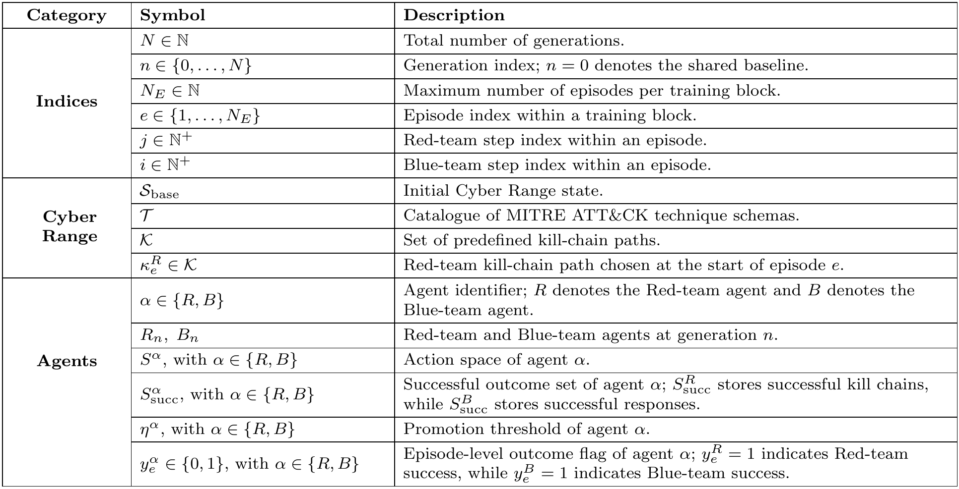
Notations (1/2)
9
Table 2 : Notation Table (1/2)
Notes:
[Slide 9] Before defining the problem, I will briefly introduce the main notation Training is organized at three levels. The first level is the generation, denoted by n. Each generation contains a Red-team agent Rn and a Blue-team agent Bn. Generation 0 is the shared baseline. The second level is the episode, denoted by e. One episode means one complete Red-team and Blue-team interaction inside the Cyber Range.

Slide 10
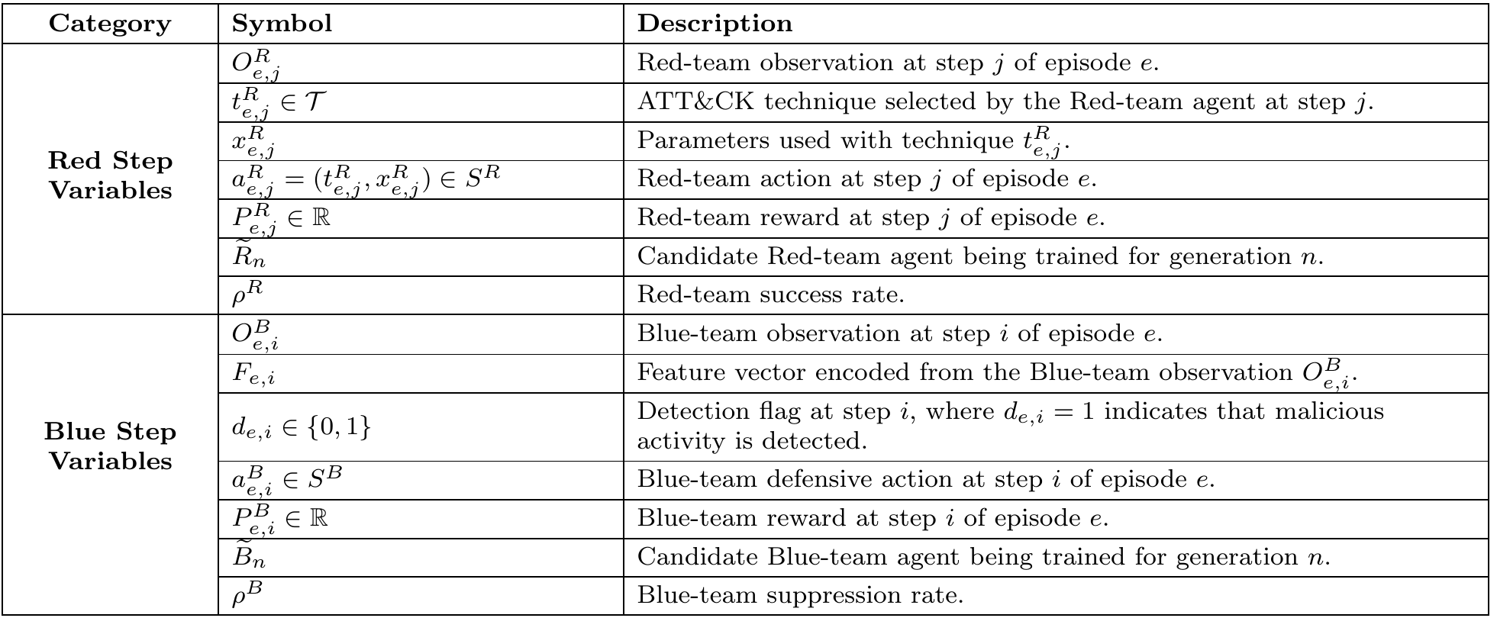
Notations (2/2)
Table 2 : Notation Table (2/2)
10
Notes:
The third level is the step, where the Red-team step is indexed by j, and the Blue-team step is indexed by i

Slide 11
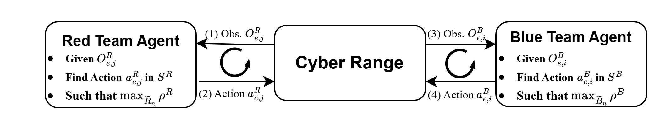
Problem Overview
Red Team Problem: Kill Chain Completion
How do Red Agent move from one technique to the next technique in order to complete the kill chain?
Blue Team Problem: Kill Chain Disruption
How do Blue Agent detect and respond with action to stop the kill chain?
Figure 3 : Red-team and Blue-team decision problem
11
Notes:
[Slide 11] The core problem is a sequential adversarial decision-making problem. The Red-team agent wants to complete a kill chain. Blue-team agent has the opposite objective. Therefore, this thesis formulates two problems: first, how the Red team completes the kill chain; and second, how the Blue team disrupts the kill chain.

Slide 12
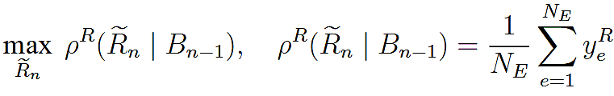
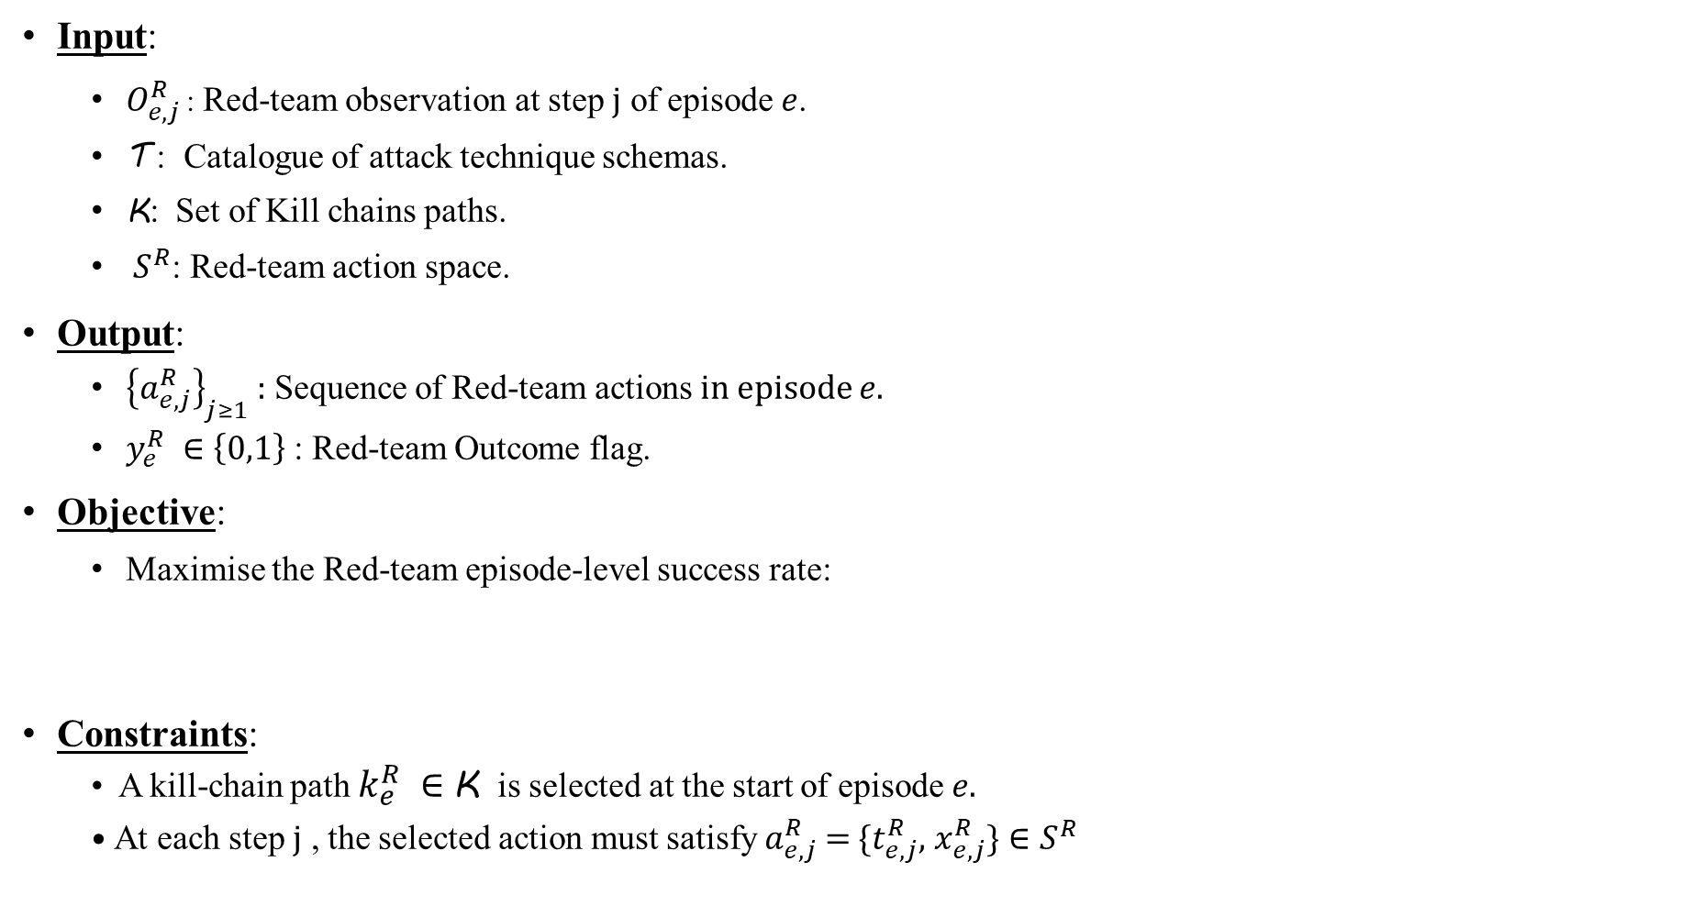
Red Team Problem: Kill Chain Completion
Input:
$O_{e,j}^{R}$ : Red-team observation at step $j$ of episode $e$.
$\text{T}$ : Catalogue of attack technique schemas.
K: Set of Kill chains paths.
${ S}^{R}$: Red-team action space.
Output:
${\left\{a_{ⅇ,j}^{R}\right\}}_{j≥1}$ : Sequence of Red-team actions in episode $e$.
$y_{ⅇ}^{R} ∈\left\{0,1\right\}$: Red-team Outcome flag.
Objective:
Maximise the Red-team episode-level success rate:
Constraints:
A kill-chain path $k_{e}^{R} ∈$K is selected at the start of episode $e$.
At each step $j$ , the selected action must satisfy $a_{ⅇ,j}^{R}$ =$\{t_{ⅇ,j}^{R}$, $x_{ⅇ,j}^{R}\}∈S^{R}$
12
Notes:
Red-team goal: kill-chain completion (reach the goal host)
Inputs to the Red agent:
current observation
ATT&CK technique schemas (catalogue)
set of possible kill-chain paths
Red-team action space
At each step: pick one ATT&CK technique and bind concrete parameters
e.g., lateral movement isn't enough → must also choose target IP, port, credential (if required)
Outputs:
a sequence of Red actions across the episode
outcome flag yeRy^R_e
yeR​ → if yeR=1y^R_e = 1
yeR​=1, goal host reached
Objective: maximize episode-level success rate → over many episodes, learn attack chains that reach the goal more often
Constraints (keep actions valid/meaningful):
must pick a kill-chain path at episode start
each technique must follow the current tactic position in that path
technique must satisfy its schema preconditions before execution

Slide 13
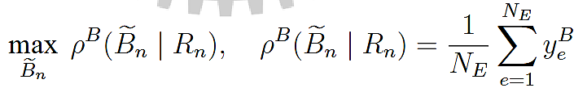
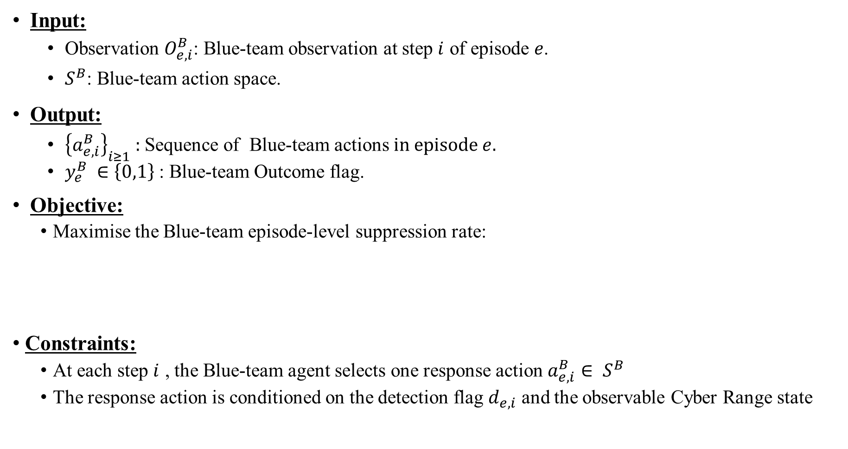
Blue Team Problem: Kill Chain Disruption
Input:
Observation $O_{e,i}^{B}$: Blue-team observation at step $i$ of episode $e$.
$S^{B}$: Blue-team action space.
Output:
${\left\{a_{ⅇ,i}^{B}\right\}}_{i≥1}$ : Sequence of Blue-team actions in episode$e$.
$y_{ⅇ}^{B} ∈\left\{0,1\right\}$: Blue-team Outcome flag.
Objective:
Maximise the Blue-team episode-level suppression rate:
Constraints:
At each step $i$ , the Blue-team agent selects one response action $a_{ⅇ,i}^{B}∈ S^{B}$
The response action is conditioned on the detection flag $d_{e,i}$ and the observable Cyber Range state
13
Notes:
Blue-team goal: kill-chain disruption (stop the attack before it completes)
Inputs: observations from the Cyber Range → logs, alerts
Detection step: judge whether the evidence indicates malicious behavior → output detection flag de,id_{e,i}
de,i​
Response step: if malicious activity detected → select a response action from the Blue action space
Outputs:
a sequence of Blue-team actions
outcome flag yeBy^B_e
yeB​ → if yeB=1y^B_e = 1
yeB​=1, Blue disrupts the kill chain before Red succeeds
Objective: maximize suppression rate
detect and respond early enough to stop the attack
but avoid unnecessary disruptive responses (don't over-react / over-block

Slide 14
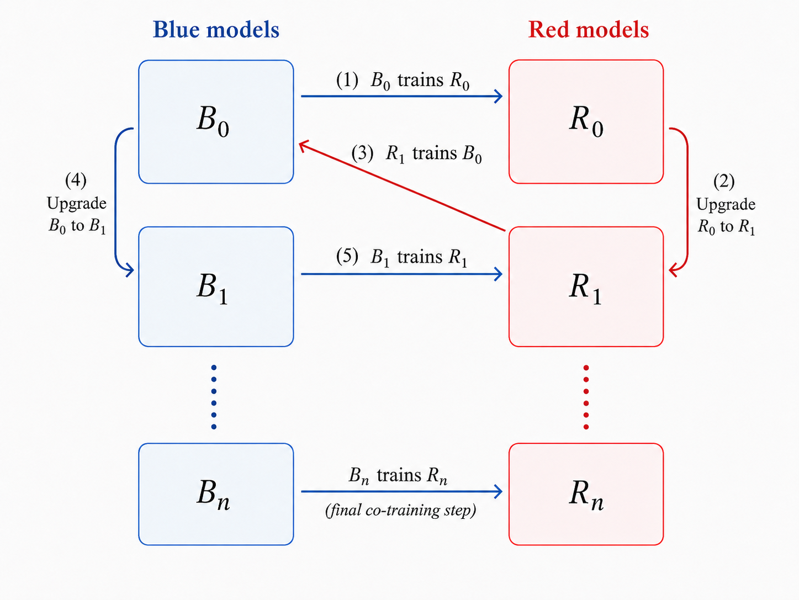
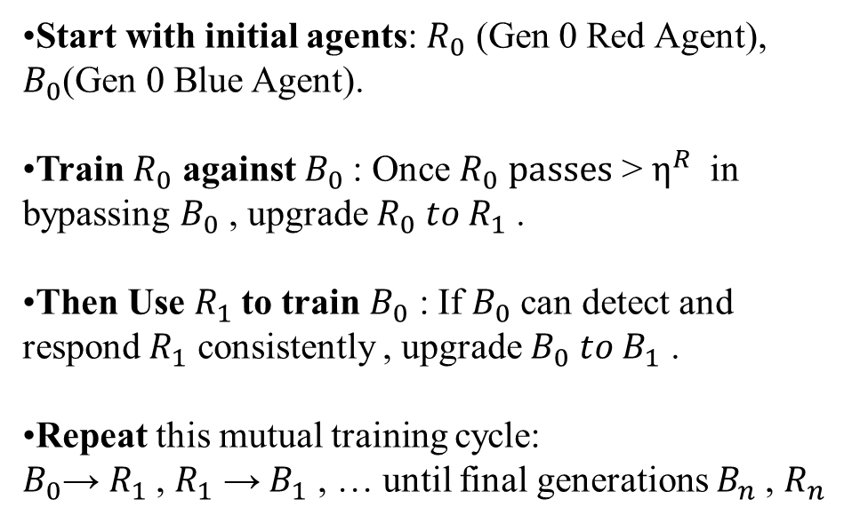
Solution overview
Start with initial agents: $R_{0}$ (Gen 0 Red Agent), $B_{0}$(Gen 0 Blue Agent).
Train $R_{0}$ against $B_{0}$: Once $R_{0} passes$ > $η^{R}$ in bypassing $B_{0}$ , upgrade${ R}_{0} to R_{1}$.
Then Use $R_{1}$to train $B_{0}$ : If $B_{0}$ can detect and respond $R_{1}$ consistently , upgrade $B_{0} to B_{1}$ .
Repeat this mutual training cycle: $B_{0}$→ $R_{1}$, $R_{1}$ → $B_{1}$ , … until final generations $B_{n}$, $R_{n}$
Figure 4 : Multi-generation alternating training.
14
Notes:
[Slide 14] To solve the, I propose the Multi-generational Co-Evolution framework, or MG-CoE. The main idea is to train Red and Blue agents in an alternating way instead of updating both agents at the same time. We start with the initial Red-team agent, R0, and Blue-team agent, B0. First, the Blue-team agent is fixed, and the Red-team candidate trains against it. If the Red-team candidate shows enough improvement over the previous Red generation, it is promoted to the next generation, for example from R0 to R1. Then the direction is reversed. The promoted Red-team agent is fixed, and the Blue-team candidate trains against it. If the Blue-team candidate improves enough in suppression rate, it is promoted, for example from B0 to B1. This process repeats across generations. So each agent always trains against a stable opponent, but the opponent becomes stronger over time. This gives us both stability and evolution.

Slide 15
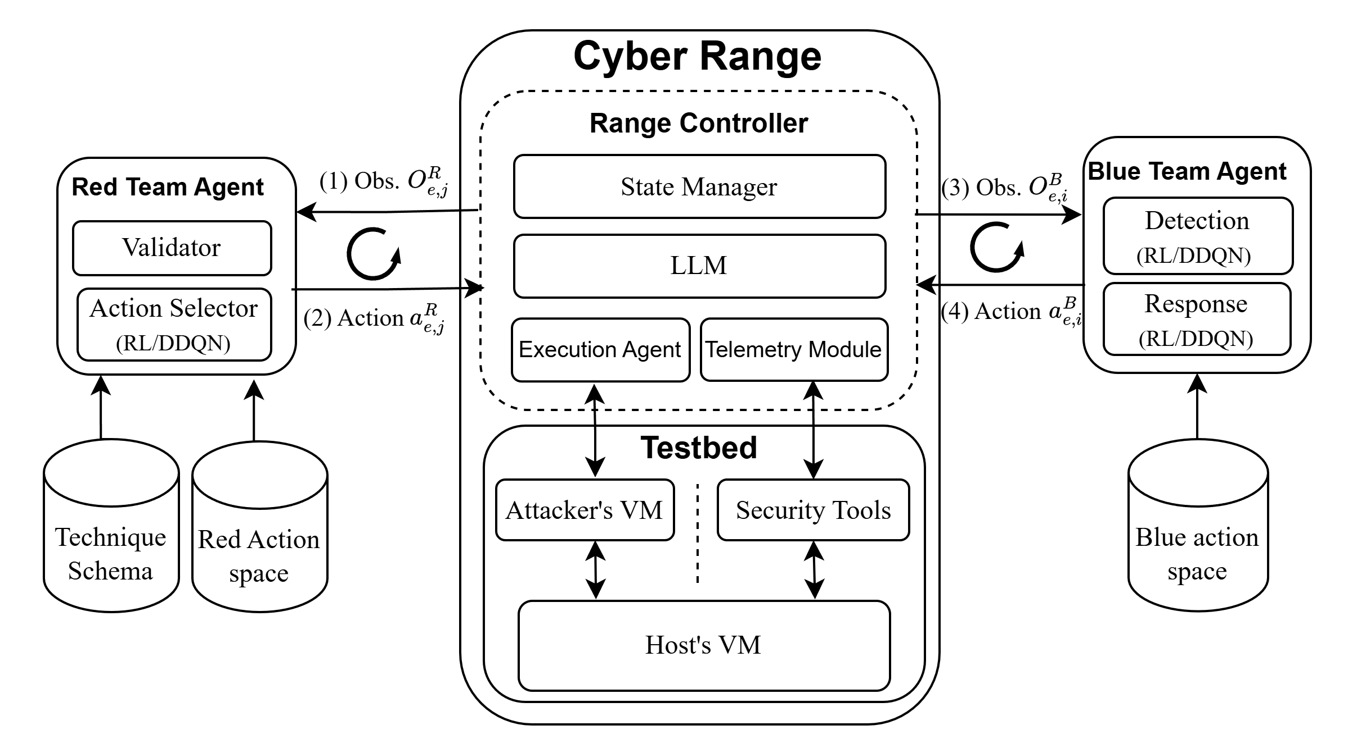
Solution overview
Figure 5 : Step-level Red-team–Blue-team interaction loop
15
Notes:
This figure shows the step-level interaction between the Red-team agent, the Cyber Range, and the Blue-team agent. At each step, the Red-team agent first observes the current Cyber Range state. Based on this observation, it selects an ATT&CK technique and also resolves the required parameters, such as the target host, credential, port, or command. This Red-team action is sent to the Cyber Range. The Cyber Range validates the action, executes the corresponding state transition, updates the environment state, and generates telemetry. The telemetry is then given to the Blue-team agent. The Blue-team agent first performs detection. If it detects suspicious or malicious activity, it selects a defensive response, The Cyber Range then applies the Blue-team response, updates the state again, computes rewards, and checks whether the episode ends. The episode ends when the Red team reaches the goal host, the Blue team suppresses the attack, or the maximum episode length is reached.

Slide 16
Red Team Agent : Action Space
Tactic | No. | Representative techniques
Reconnaissance | 16 | T1595 Active Scanning; T1592 Gather Victim Host Information; T1590 Gather Victim Network Information.
Execution | 16 | T1059.001 PowerShell; T1059.003 Windows Command Shell; T1059.006 Python.
Persistence | 56 | T1098 Account Manipulation; T1547.001 Registry Run Keys; T1053 Scheduled Task/Job.
Privilege Escalation | 33 | T1548.002 Bypass UAC; T1134.001 Token Impersonation; T1543.003 Windows Service.
Defense Evasion | 12 | T1027 Obfuscated Files; T1562 Impair Defenses; T1070 Indicator Removal.
Credential Access | 35 | T1003.001 LSASS Memory; T1555 Credential Stores; T1557.001 SMB Relay.
Discovery | 38 | T1087 Account Discovery; T1046 Network Service Discovery; T1057 Process Discovery.
Lateral Movement | 6 | T1021 Remote Services; T1021.002 SMB/Admin Shares; T1080 Taint Shared Content.
Collection | 18 | T1005 Data from Local System; T1560.001 Archive via Utility; T1113 Screen Capture.
Command and Control | 21 | T1071.001 Web Protocols; T1105 Tool Transfer; T1572 Protocol Tunneling.
Exfiltration | 8 | T1041 Exfiltration over C2; T1048 Alternative Protocol; T1020 Automated Exfiltration.
Impact | 20 | T1485 Data Destruction; T1486 Data Encrypted for Impact; T1561.002 Disk Wipe.
16
Table 3 : Red-team action space
Notes:
The Red-team action space is organized according to MITRE ATT&CK tactics. A realistic cyber attack follows a lifecycle: for example, execution, credential access, lateral movement, and impact. Each tactic contains a set of possible ATT&CK techniques. For example, under Execution, the agent may choose PowerShell, Windows Command Shell, or Python. Under Credential Access, it may choose LSASS dumping or credential stores. In this way, the Red-team agent learns to build structured kill chains instead of isolated attack steps.

Slide 17
Red Team Agent – Technique Schema
technique_id: T1021.002
technique_name: SMB/Windows Admin Shares
tactic: LateralMovement
tool: metasploit
required_state: # Preconditions (must be true in state)
- has_valid_creds
- has_port_445
- os_family == Windows
required_params: # Parameters selected by RL (after preconditions pass)
target_ip:
source: discovered_hosts
credential_id:
source: credential_store
port:
fixed: 445
expected_state_updates: # What the environment updates after execution
on_success:
- session_established = true
- compromised_hosts += target_ip
- new_host_access_level = admin
on_failure:
- failed_lateral_attempts += 1
evidence: # Observable artifacts (logs / signals)
- session_established
- smb_auth_success
- new_process_created
risk: # Risk level for Blue Team detection
detectability: high
Problem- Wasted exploration on impossible actions.
The agent selects techniques even if needed conditions (like credentials or open ports) are not met.
Solution- Defines each ATT&CK technique in structured form.
The schema checks whether a selected technique is valid in the current cyber-range observation, so Red cannot execute meaningless actions.
Each technique has a schema with
technique_id
technique_name
tactic
tool
Execution flow:
RL selects technique → Validator checks required_state → if valid, RL selects required parameters → Send action to cyber range → execute.
required_state,
required_params,
expected stage change,
evidence, risk
17
Figure 6 : Technique Schema Example
Notes:
A technique schema defines how each ATT&CK technique behaves inside the Cyber Range. The problem is that many cyber actions are only meaningful under certain conditions. For example, SMB lateral movement cannot be executed unless the agent has valid credentials, port 445 is open, and the target host is Windows. Therefore, each technique schema contains several parts. It includes the technique ID, technique name, tactic, required state, required parameters, expected state updates, observable evidence, and detectability risk. For example, for T1021.002, SMB or Windows Admin Shares, the required state includes valid credentials and port 445. The required parameters include the target IP and credential ID as SMB authentication success or new process creation is generated for the Blue-team agent. This schema prevents wasted exploration. The Red team cannot execute meaningless actions, and the Blue team can receive realistic telemetry evidence from Red-team activity.

Slide 18
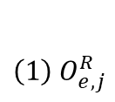

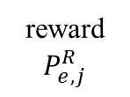



Solution : Red Team Agent – Action Selection
Action Selection and Validation:
Technique selection: choose $t_{e,j}^{R}$ based on current tactic-matched set in ​$k_{e}^{R}$.
Validation: check valid($t_{e,j}^{R}$,$O_{r,j}^{R}$) = 1 before execution.
Parameter resolving: ​assign $x_{e,j}^{R}$ and form $a_{e,j}^{R}=(t_{e,j}^{R},x_{e,j}^{R})$
Goal: Progress through kill chain → Maximize kill chain completion and success rate.
Red Team Agent
$${\left(1\right) O}_{e,j}^{R}$$
Action Selector
Technique Selector
(RL/DDQN)
Parameter Selector
(RL/DDQN)
Red Action Space
Validator
Technique Schema
reward
$$P_{e,j}^{R}$$
$$P_{e,j+1}^{R}$$
Cyber Range
Action${ a}_{e,j}^{R}$
$$O_{e,j+1}^{R}$$
18
Figure 7 : Red-team agent action-selection workflow
Notes:
The Red-team action selection process has three main stages: technique selection, validation, and parameter resolution. First, at the beginning of an episode, the Red-team agent selects a kill-chain path. This path defines the order of tactics that the agent should follow. At each step, the current tactic is used to form a candidate set of techniques. In other words, the agent only chooses from techniques whose tactic matches the current position in the kill-chain path. Then the DDQN-based technique selector chooses one candidate technique. However, the selected technique is not executed immediately. The validator checks whether the technique satisfies the required state conditions in the current Cyber Range observation. If the technique is valid, the parameter selector resolves the required parameters, such as target IP, credential, port, or command. Finally, the Red-team action is formed as a pair: selected technique plus parameters. This design makes the Red-team policy both learnable and operationally meaningful

Slide 19
Red Team Agent – Reward Design
Event | Reward
Successful technique execution | +5
Failed technique execution | −20
Access gain | +5 per level
Privilege gain | +10 per level
Credential harvesting | +30 per credential
Phase advancement | +10 per phase
First high-value host access | +15
Persistence established | +80
Vulnerability exploitation | +4 per hit
Low detectability | +2
Medium detectability | −5
High detectability | −10
Detected by Blue-team agent | −50
Host blocked or isolated | −100
Step-success bonus | +10j
Hard-containment penalty | −min(20 + 4j, 60)
Red-team agent reaches goal host | +1200
Blue-team agent suppresses attack | −min(40 + 5j, 140)
Episode timeout | −50
Reward Design Idea
Progress- weighted rewards (credential +30, persistence +80, goal +1200) → agent builds coherent kill-chain, not random technique spam
Stealth penalties (high detectability −10, detected −50, isolated −100) → agent learns evasion naturally without hardcoding it
Failure costly (−20 per fail) → forces valid technique selection over blind exploration
19
Table 4 : Red-team Rewards
Notes:
The Red-team reward is designed to encourage meaningful attack progress rather than random technique execution. A small positive reward is given for successful technique execution, but larger rewards are assigned when the agent achieves important attacker-side progress. The reward also includes stealth. Low-detectability actions receive a small bonus, while high-detectability actions receive penalties. If the Blue team detects or contains the attack, the Red-team agent receives a negative reward. This means the Red-team agent learns not only to complete the kill chain, but also to avoid noisy actions when possible.

Slide 20
Blue Team Agent - Action Space
Action | Level | Purpose | Cost
none | None | No response when evidence is insufficient. | 0.0
investigate | Low | Gather evidence without changing reachability. | 0.3
kill_process | Medium | Stop a suspicious process. | 2.0
force_sign_out | Medium | Terminate active sessions. | 2.0
revoke_credentials | Medium | Invalidate credentials used by Red. | 3.0
block_ip | High | Block communication from a host or address. | 20.0
isolate_host | High | Remove the host from reachable interaction. | 30.0
Table 5 : Blue-team action space
20
Notes:
The Blue-team action space contains defensive responses with different levels of operational impact. Then there are low- and medium-impact responses, such as investigation, killing a suspicious process, forcing sign-out, or revoking credentials. Stronger actions include blocking an IP address and isolating a host. Therefore, the Blue-team agent must learn proportional response.it should choose the least disruptive action that is still sufficient to stop the attack. Here, isolate_host is hard containment.

Slide 21
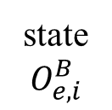
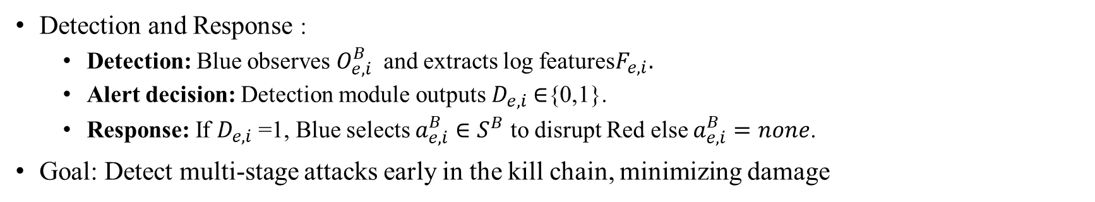
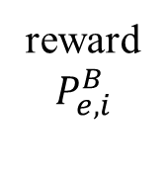



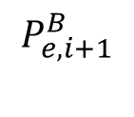



Blue Team Agent - Detection and Response
Detection and Response :
Detection: Blue observes $O_{e,i}^{B}$​ and extracts log features$F_{e,i}.$
Alert decision: Detection module outputs $D_{e,i}$∈{0,1}.
Response: If $D_{e,i}$=1, Blue selects $a_{e,i}^{B}∈S^{B}$ to disrupt Red else $a_{e,i}^{B}=none$.
Goal: Detect multi-stage attacks early in the kill chain, minimizing damage
Blue Team Agent
Detection
$$D_{e,i}$$
${Yes:F}_{e,i}$, $O_{e,i}^{B}$
Response
$$D_{e,i}=1$$
state
$$O_{e,i}^{B}$$
$${No: a}_{e,i}^{B}=none$$
Blue Action Space
reward
$$P_{e,i}^{B}$$
$$P_{e,i+1}^{B}$$
action $a_{e,i}^{B}$
Cyber Range
$$O_{e,i+1}^{B}$$
21
Figure 8 : Blue-team agent detection and response workflow
Notes:
The Blue-team agent has two components: detection and response. First, the Blue-team agent receives telemetry from the Cyber Range. This telemetry may include logs, alerts, process events. The detection component converts this observation into a feature vector and outputs a binary detection flag. If the flag is zero, the agent selects none, because there is not enough evidence for response. If the detection flag is one, the response component selects a defensive action from the Blue-team action space. For example, if the evidence only shows suspicious process execution, killing the process may be enough. But if the evidence shows credential access, then revoking credentials may be more appropriate. If the attacker is moving laterally or reaching a high-value host, stronger actions such as block IP or isolate host may be needed. So the Blue-team agent learns both when to respond and how strongly to respond.

Slide 22
Blue Team Agent - Reward Design
Reward Design Idea
Detection asymmetry (false negative penalised hardest) → missing attack is worse than false alarm → agent stays alert
Proportionality enforced (precise remediation +35 vs unjustified isolation −40~−120) → agent learns least-disruptive sufficient response
Operational cost per action → biases policy toward minimal intervention, avoids alert fatigue
Event | Reward
Precise remediation restores Normal state | +35
Hard containment restores Normal state | +12
Investigation restores Normal state | +8
Investigation on Compromised with detection | +10
Hard containment on Compromised with detection | +3
No action on Compromised host | −8
No action on Normal host | +1
Hard containment on Normal host | −max(40, 120 − 15i)
Red-team agent reaches goal host | −1200
Blue-team agent suppresses attack | max(80 − 4(i − 1), 0)
Episode timeout | +50
Table 6 : Blue-team Response rewards
22
Notes:
First, detection is asymmetric — a false negative is penalized the hardest. The idea is that missing a real attack is much worse than raising a false alarm, so this naturally pushes the agent to stay alert and lean toward catching threats rather than ignoring them.
Second, I enforce proportionality. A precise, well-justified remediation earns a positive reward, around plus thirty-five, but an unjustified isolation is punished heavily, anywhere from minus forty to minus a hundred and twenty. So the agent learns to pick the least-disruptive response that's still sufficient — kill a process when that's enough, revoke credentials when there's credential access, and only isolate a host when the threat really justifies it
And third, every action carries an operational cost. This biases the policy toward minimal intervention, so the agent doesn't over-react or flood the system with responses — which in a real SOC would cause alert fatigue..

Slide 23
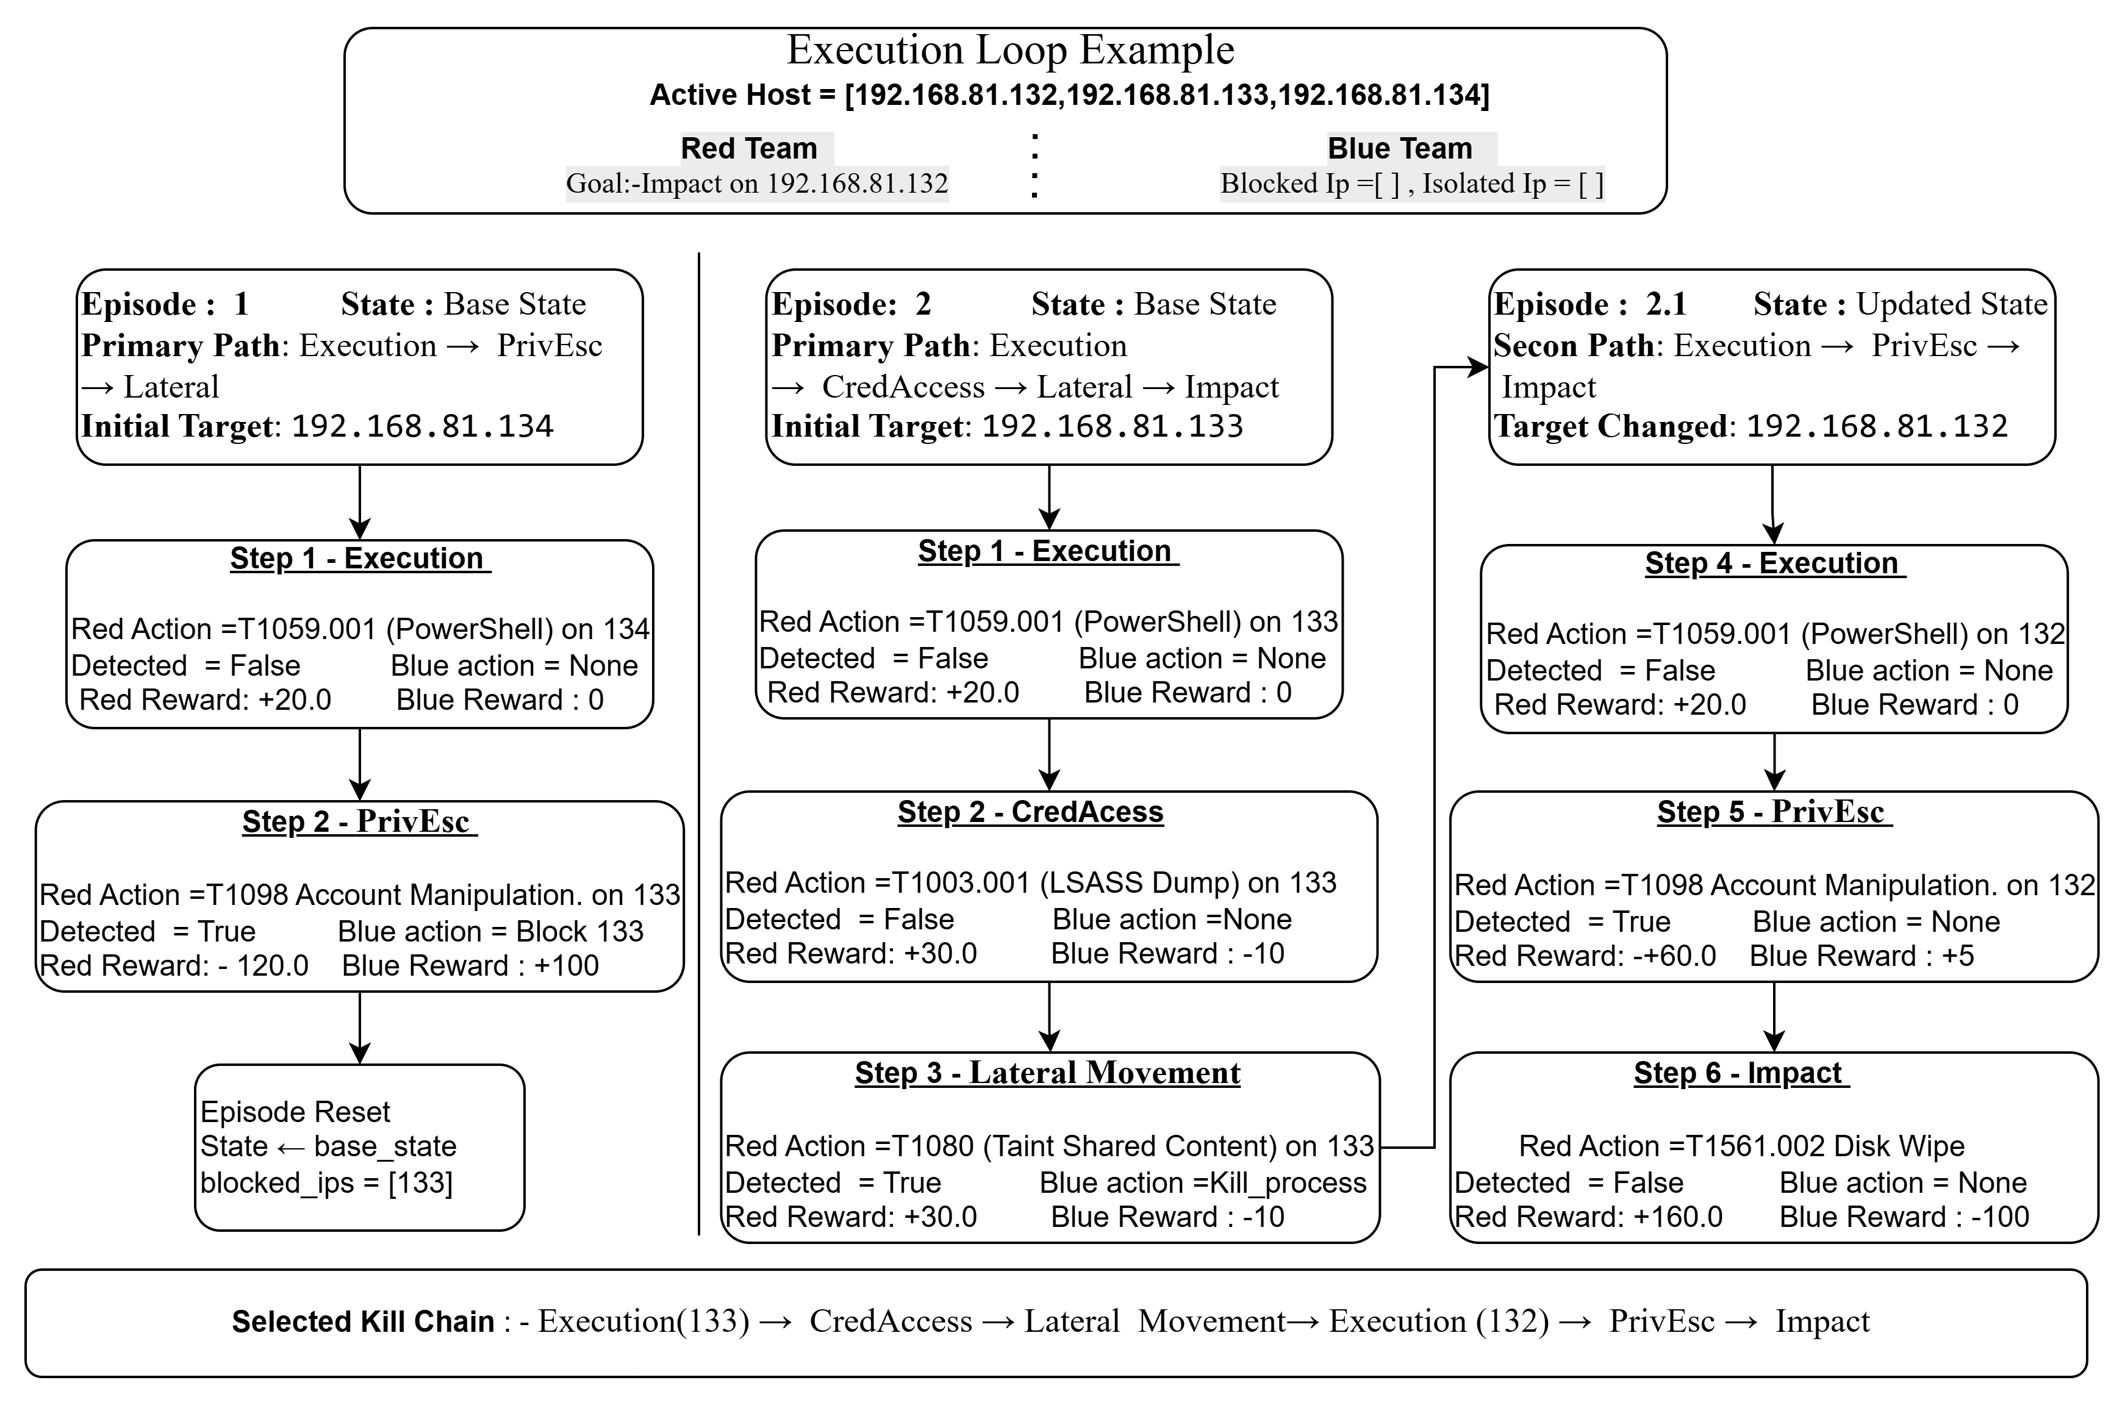
Solution : Running Example
Blue-team Wins
Red-team Wins
23

Slide 24
Implementation: Modules
Module | Responsibility
technique_selector.py | Encodes Red-team observations and selects techniques using DDQN.
technique_validator.py | Checks tactic matching, schema conditions, and feasible targets
param_selector.py | Resolves Red-team action parameters such as host, credential , port, etc.
state_persistence.py | Stores, updates, and resets the Cyber Range state.
reward_calculator.py | Computes Red-team, Blue-team, and terminal rewards.
telemetry_module.py | Collects, generates, and stores telemetry for Blue-team observation
blue_detection_agent.py | Encodes telemetry and performs binary alert detection.
blue_response_agent.py | Selects defensive responses from the Blue-team action space
Table 7 : Python Modules and Responsibilities.
24

Slide 25
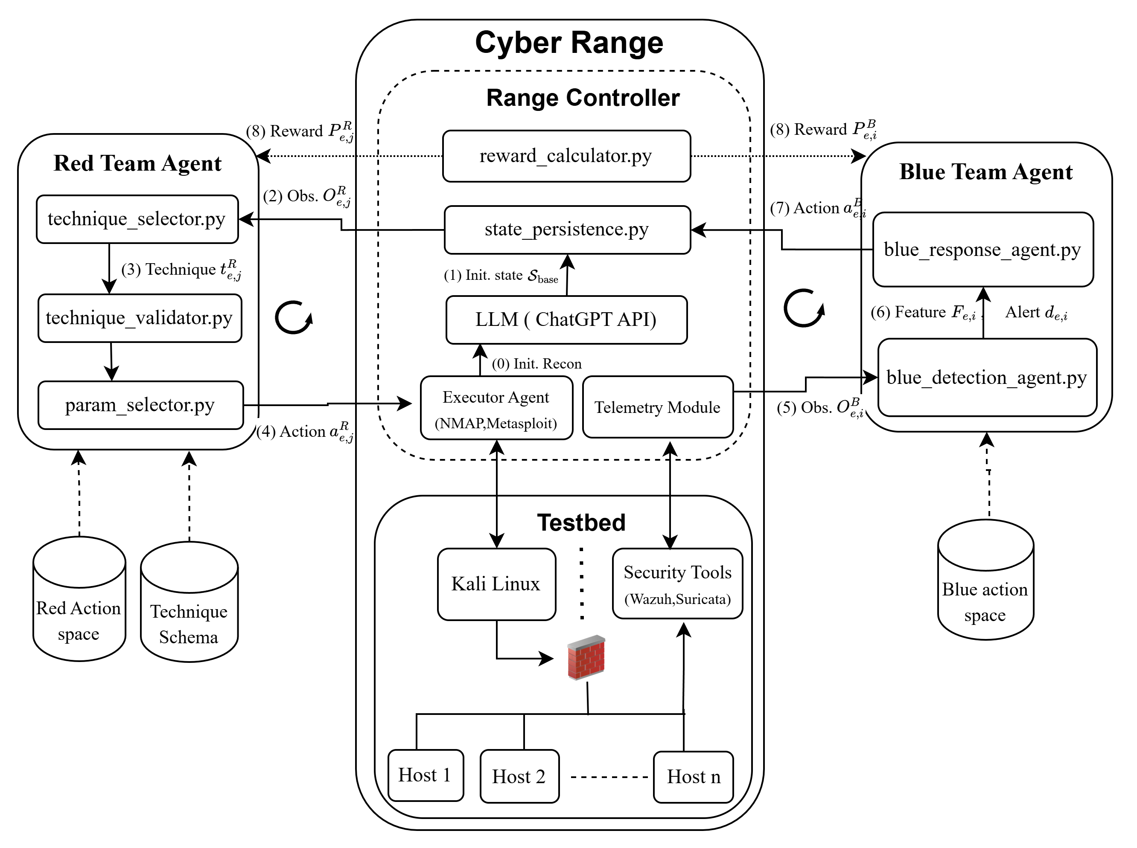
Implementation: System Architecture
25
Figure 9 : System architecture
Notes:
This figure shows the implemented system architecture. The central component is the Range Controller. It connects the Red-team agent, Blue-team agent, State Manager, Execution Agent, Telemetry Module, LLM support component, and Testbed. At the beginning, the Execution Agent can perform reconnaissance on the Testbed to collect host and service information. This information is used to construct the base Cyber Range state. During each episode, the Red-team agent selects an action, the Range Controller validates and applies the action, the State Manager updates the environment, and the Telemetry Module generates Blue-team observations. Then the Blue-team agent detects and responds, and the Range Controller updates the state again and computes rewards. This loop continues until Red succeeds, Blue suppresses the attack, or the episode reaches the maximum length.

Slide 26
Implementation: Open-Source Tools and Libraries
Category | Tools / Libraries | Role
Programming | Python | Main implementation language.
Deep Learning | PyTorch | DDQN networks and replay-buffer training.
Data Processing | NumPy, Pandas | State vectors, telemetry features, and results
Visualisation | Matplotlib | Training and evaluation plots.
Virtualisation | VMware | Local Cyber Range Testbed.
Execution Agent | Nmap, Metasploit | Host and network enumeration.
Security Monitoring | Wazuh, Suricata | Telemetry sources for Blue-team observation.
LLM | OpenAI API | Structured state and security-knowledge support
Table 8 : Tools and libraries
26

Slide 27
Implementation: Network Architecture
Network | Input | Encoder | Hidden Layers | Output Layer | Final Action (1 via argmax)
Action Selection | Environment State (S_global + S_hosts) | 32-dim | 32 → 256 → 256 | N Q-values techniques (N=304) | 1 technique to execute
Detection | Raw Execution Logs | 16-dim | 16 → 64 → 32 | 2 Q-values (none / alert) | Alert or No-alert
Response | Observation (Logs × State × Context) | 34-dim | 34 → 128 → 128 | 7 Q-values (Defensive Action) | 1 defensive action
Table 9 : Red-team and Blue-team network architectures
27

Slide 28
Evaluation
Alternating Co-Evolution vs Fixed opponent Training vs Simultaneous Co-Evolution
Which training setup produces the most robust agents?
Setup Comparison: Does co-evolution outperform fixed/simultaneous training? → Fix Red opponent; compare ACE vs SCE vs FOT suppression at matched gen
Behavioral Diversity: Does co-evolution produce richer defense strategies? → Compare action type distribution & kill chain length across all setups vs same Red opponent
ACE Generational dynamics
Does each setup improve over its own generations?
Multi-Gen Evolution: Does Blue suppression ↑ each gen against a stronger Red? → Track suppression rate Gen1→Gen3 per setup
Cross-Gen Performance: Do agents generalize beyond their trained opponent? → Evaluate every Blue gen × every Red gen; measure performance gap vs unseen opponents
28
Notes:
The evaluation has two parts. First, I compare ACE, FOT, and SCE to answer the question: which training setup produces the most robust Blue-team defense? For this, I evaluate Blue-team suppression against both a weaker Red-team generation and a stronger evolved Red-team generation. Second, I analyze the internal behavior of ACE. Here I ask whether Blue-team suppression improves across generations, whether the Red-team agent continues discovering new kill chains, and whether later Blue-team agents generalize across Red-team generations. The main metric is Blue-team suppression rate, which measures how often the Blue team prevents the Red team from reaching the goal host

Slide 29
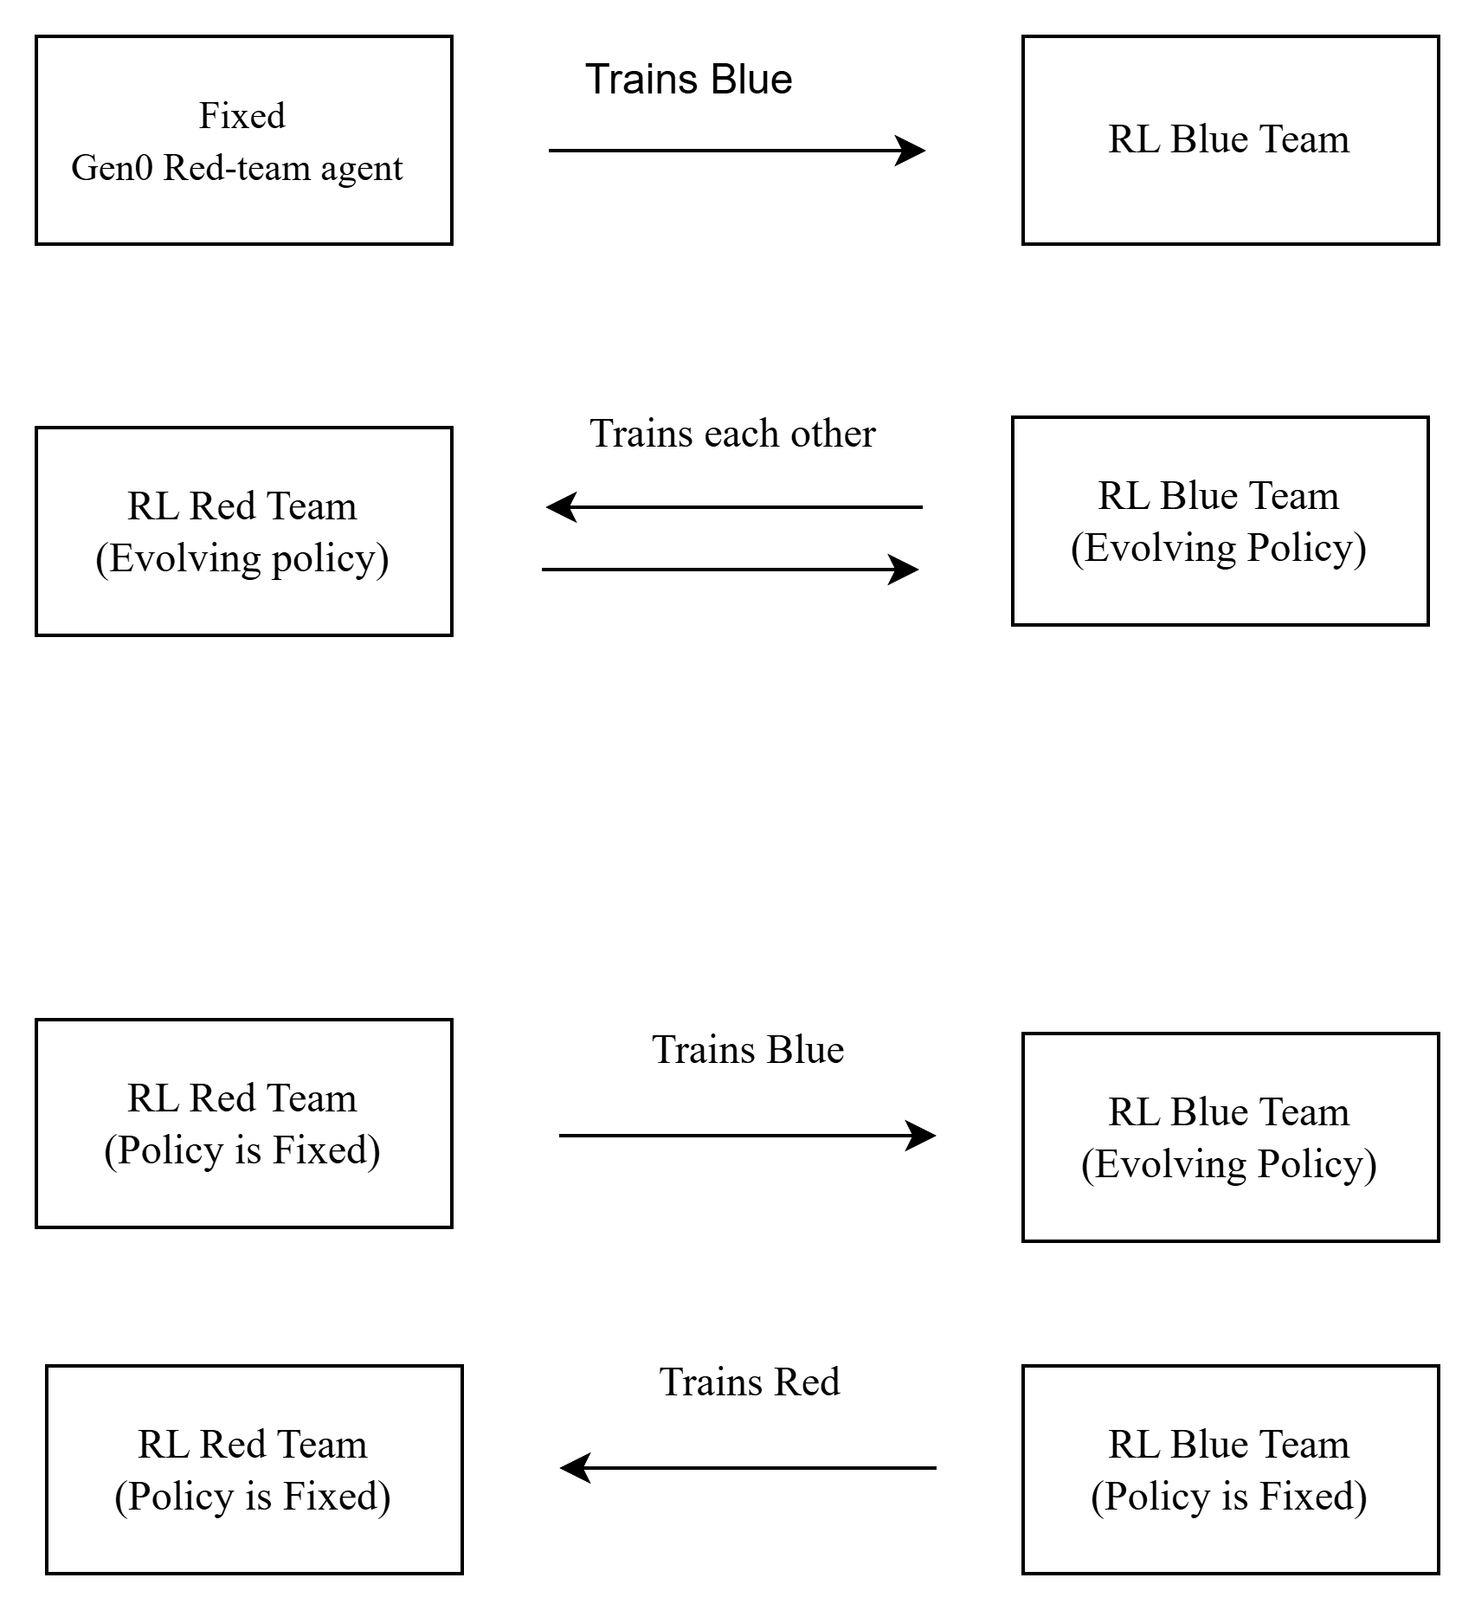

Experimentation Setup
Setup | Red Agent | Blue Agent | Learning Setup | Generations | Illustration
Gen0 Baseline | RL/LLM (initialized) | RL/LLM (initialized) | Both, jointly trained (1,500 episodes) | — (baseline) | -
Fixed Opponent Training (FOT) | RL/LLM (frozen, Gen0) | RL/LLM (learning) | Blue only — Red stays fixed | Until convergence
Simultaneous Co-evolution (SCE) | RL/LLM (evolving) | RL/LLM (evolving) | Both, at the same time | 3
Alternating Co-evolution (ACE) | RL/LLM (alternates: frozen ↔ evolving) | RL/LLM (alternates: frozen ↔ evolving) | One at a time, then swap | 3
Table 10 : Training Setups
29

Slide 30
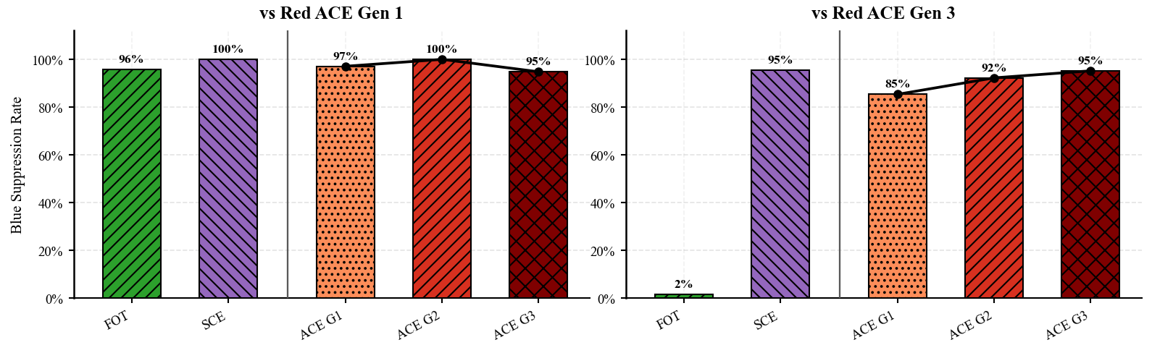
ACE vs FOT vs SCE (1/4) : Blue-team Suppression
FOT collapses vs strong Red (2%), SCE performs high; ACE improves steadily (85% → 92% → 95%).
Observation | Why | Insight
Red G1: all ≈ 96–100% | Early Red is easy → all methods can stop it | FOT fails on evolved Red; SCE performs high; ACE matches SCE while showing clearer step-by-step improvement.
Red G3: FOT 2%, SCE 95%, ACE 85→92→95% | FOT fails on evolved Red; SCE is strong; ACE reaches same level while improving step-by-step | ACE = most reliable; FOT brittle; ACE > SCE for consistent growth
30
Notes:
early-generation Red-team agent is relatively easy to stop
However, the difference becomes clear against Red-team Gen 3, which is the stronger evolved attacker. FOT drops to only about 2 percent suppression. This shows that fixed-opponent training overfits to the earlier Red-team behavior and fails when the Red-team strategy evolve
This shows that ACE reaches the same strong defense level as SCE, but with a more stable and verifiable generation-by-generation improvement.

Slide 31
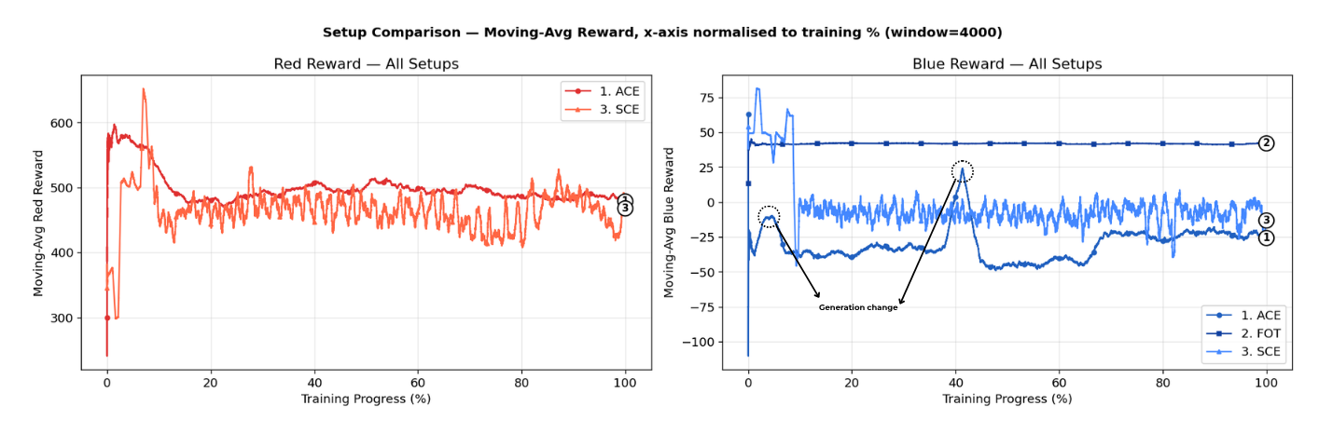
ACE vs FOT vs SCE (2/4) : Reward Stability
ACE shows the most reliable training behavior: controlled drops, fast recovery, and stable improvement
Observation | Why | Insight
ACE: dips at gen change → recovers → stable | New stronger Red introduced, then fixed → learning target becomes stable | ACE = controlled dips → recovery → stable learning; SCE = chronic oscillation; FOT = false stability.
FOT: flat ≈ +40 but false stability; SCE: oscillates ↕ | FOT overfits fixed Red; SCE has both policies changing together | ACE instability bounded & recovers; SCE instability chronic→harder to optimize
31
Notes:
This slide compares training reward stability across the three methods
FOT — false stability
Reward curve looks smooth → seems stable
But opponent is fixed → Blue learns shortcuts against one attacker
Smooth ≠ generalizable
SCE — continuous oscillation
Red and Blue update at the same time
From Blue's view, Red's policy keeps shifting → unstable learning target → chronic instability
ACE — controlled adaptation
Temporary drops at generation changes (a stronger opponent is introduced)
But within each generation the opponent is fixed → learning recovers and stabilizes
→ confirms ACE's design goal: controlled adaptation, not chronic instability

Slide 32
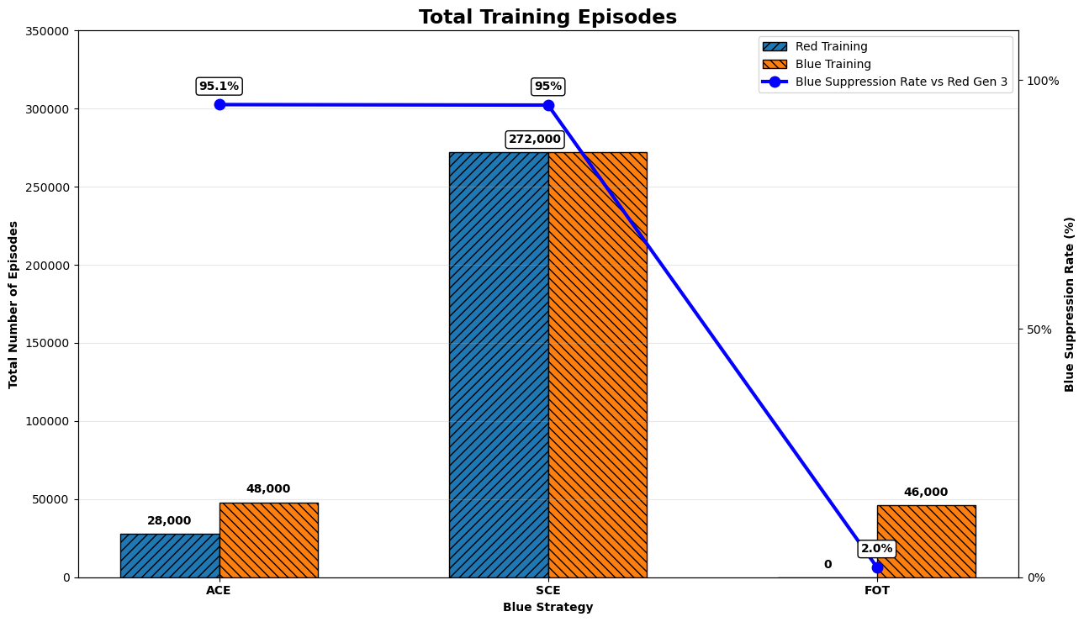
ACE vs FOT vs SCE (3/4) : Training Efficiency
ACE uses ~3.6× fewer episodes than SCE while reaching similar performance.
Observation | Why | Insight
ACE: 76k eps → 95.1% vs SCE: 272k eps → 95.0% | ACE: fixed opponent → faster learning SCE: both update together → more episodes needed | ACE is more efficient: similar suppression with 3.6× (196k) fewer episodes than SCE.
32
Notes:
ACE reaches comparable defensive performance with about 3.6 times fewer episodes. The reason is that ACE trains against a fixed opponent within each generation, so the learning target is more stable and the agent can learn more efficiently

Slide 33
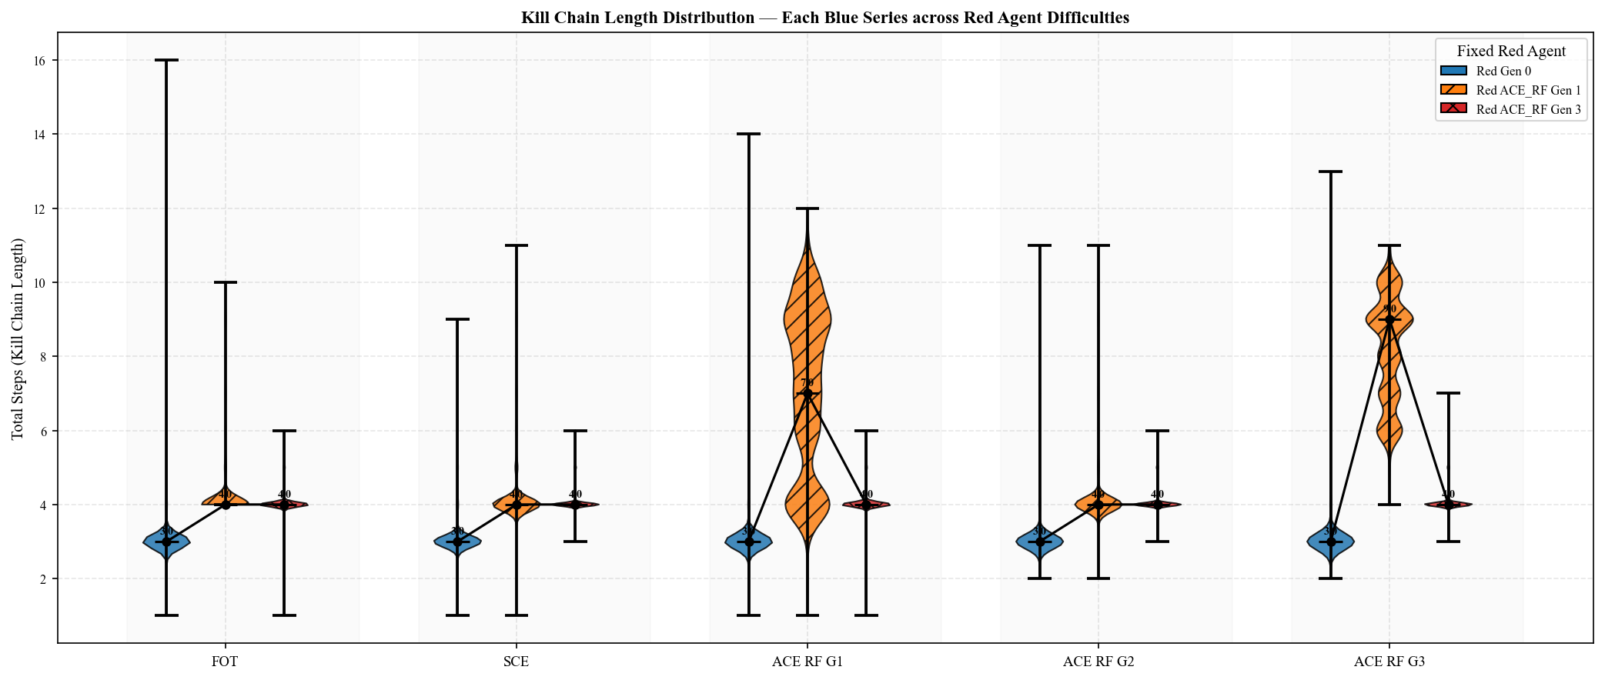
ACE vs FOT vs SCE (4/4) : Kill-Chain Length Behavior
ACE increasingly shortens Red Gen 1 kill chains, while Red Gen 3 maintains short, efficient chains across setups .
Pattern | Observation | Why
ACE_RF G1: Red Gen1 violin wide/tall (median~7); FOT/SCE Red Gen1 flat (median~4) | FOT/SCE Blue weak → Red Gen1 stopped early by chance not skill; ACE_RF G1 Blue still learning → Red Gen1 runs longer before stopped | Wider distribution = Blue inconsistent; not yet reliably terminating Red early
ACE_RF G2→G3: Red Gen1 violin narrows & compresses toward median~4; Red Gen3 stays compressed~4 all setups | ACE_RF Blue matures → consistently stops Red Gen1 earlier; Red Gen3 sophisticated → finds short efficient paths, terminated quickly regardless | Compression = Blue improving; short Red Gen3 chains = strong Red evades fast, not Blue winning
33

Slide 34
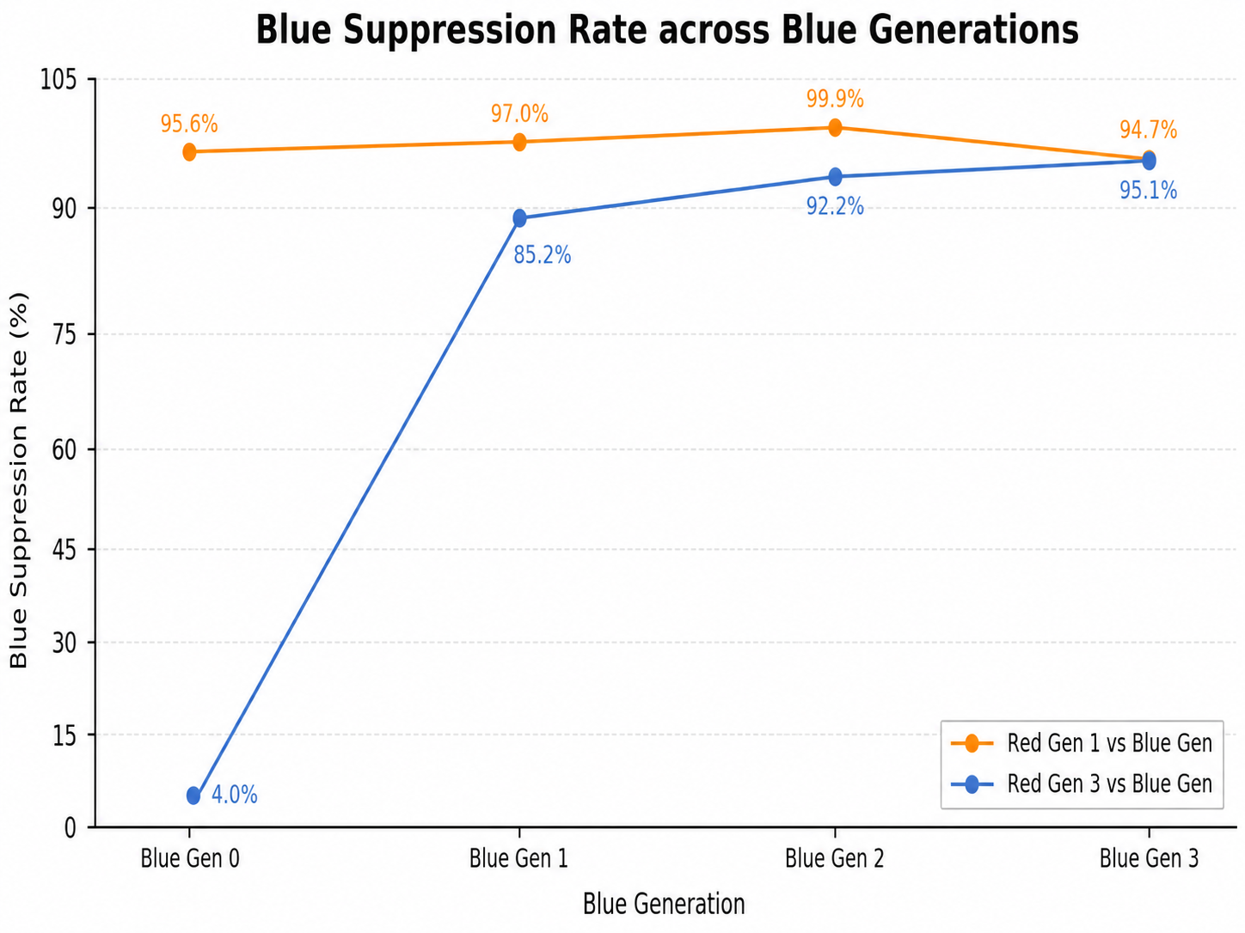
ACE (1/5) : Multi-Generation Evolution - Blue Suppression
Blue Suppression rate increases across generation ,4%→95.1% vs Red Gen3; ≥95.6% vs Red Gen1
Observation | Why | Insight
vs Red Gen3: 4% → 95.1% (+91.1pp) | Blue Gen0 untrained → each gen more capable | Blue Suppression rate increases across generation showing evolution.
vs Red Gen1: ≥95.6% flat all gens | Red Gen1 too weak to differentiate Blue gens | Weak opponent = not a meaningful eval benchmark
34
Notes:
This result is important because it shows monotonic improvement. Each generation becomes stronger than the previous one against the evolved Red-team agent. Against Red Gen 1, suppression stays above 95 percent across generations. This means the Blue team does not forget how to stop weaker attacks while learning to defend against stronger ones.

Slide 35
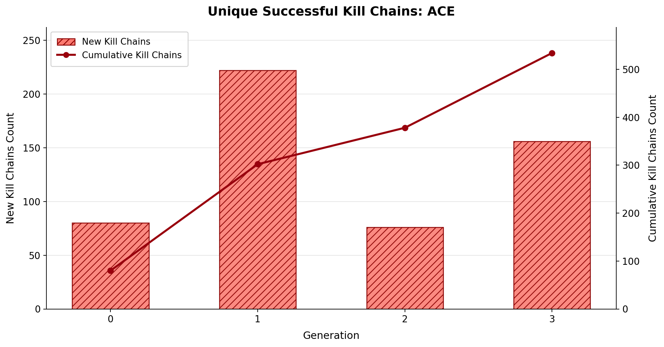
ACE (2/5) : Multi-Generation Evolution - Kill-Chain Diversity
Cumulative kill chains ↑ every gen (0→533) ,confirming Red continuously discovers new attack paths
Observation | Why | Insight
New kill chains: Gen0=80, Gen1=222 (peak), Gen2=75 (↓), Gen3=156 (↑); cumulative: →533 | Blue blocks old paths → Red explores new chains each gen. | Red never stagnates; attack repertoire expands continuously.
35
Notes:
the Red-team agent does not stagnate. As the Blue team becomes stronger and blocks older attack paths, the Red team is forced to explore and discover new attack sequences. Therefore, ACE creates a real arms race: Blue improves its defense, and Red responds by diversifying its attack behavior.

Slide 36
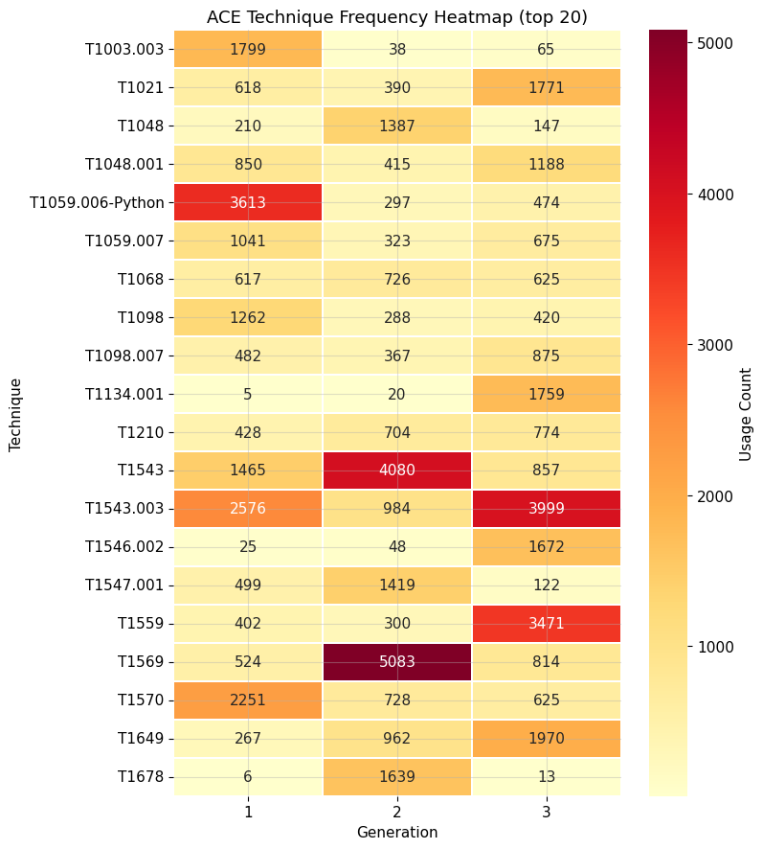
ACE (3/5) : Multi-Generation Evolution - Technique Rotation
Techniques rotate each gen, confirming strategic adaptation not repetition.
Observation | Why | Insight
Gen1: T1059.006=3613; Gen2: T1569=5083; Gen3: T1543.003=3999 , peaks rotate each gen | Blue suppresses prior dominant techniques → Red shifts strategy | Red adapts per gen; Blue broadens defense every gen
T1134.001: 5→1759; T1559: 402→3471 — near-zero Gen1 → dominant Gen3 | Red discovers novel paths as Blue hardens | Genuine co-evolution; expanding attack surface each gen
36

Slide 37
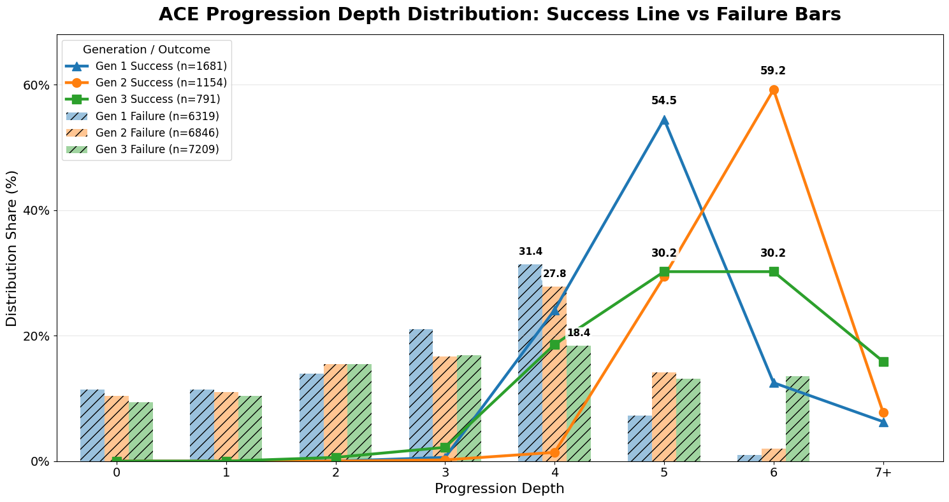
ACE (4/5) : Multi-Generation Evolution – Success & Depth Variation
Success peaks at deeper depths each gen (5→6→5&7), while failures cluster shallow; Blue forces Red deeper to succeed.
Observation | Why | Implication
Success peak shifts deeper each gen: Gen1=5, Gen2=6, Gen3=5&7; failures dominate depths 0–4. | Blue blocks shallow paths → Red must go deeper to succeed. | Blue strengthens each gen, forcing Red into deeper kill chains while successes decline
Fail n↑: 6319→6846→7209; success rate↓ across gens | Co-evolution matures → Blue suppresses Red at early stages increasingly well. | Deeper success requirement + fewer successes = Blue genuinely improving, not Red getting weaker
37
Notes:
This slide analyzes kill-chain progression depth. In earlier generations, successful Red-team attacks occur at shallower depths. As Blue-team defense improves, shallow attack paths are blocked more often, so successful Red-team attacks must go deeper into the kill chain. The success peak shifts from around depth 5 to depth 6, and by Gen 3, successful attacks are spread across deeper positions. At the same time, failure counts increase, showing that the Blue team is stopping more attacks before completion. This means Blue-team improvement does not simply reduce Red-team success. It also changes the kind of Red-team success that remains possible: successful attacks become harder and require deeper sequences.

Slide 38
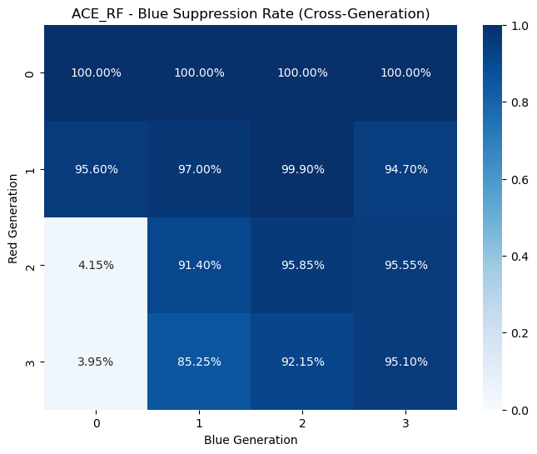
ACE (5/5) : Cross-Generation Generalization
Blue defense ↑ across rows; Red success ↑ across cols; bidirectional arms race
Pattern | Observation | Why | Insight
Defense row ↑ (left→right) | Blue Gen0 vs Red2/3: ~4%; Blue Gen3 vs Red2/3: 92–95%; row avg ↑ each gen | Blue trains on all prior Red → accumulates defense history | Blue improvement cumulative , later gens carry forward learned history Older Blue can't counter newer Red.
Attack col ↑ (top→bottom) | Red0=100% all Blue; Red3 col: Blue Gen0=4% → Blue Gen3=95%; upper-right always darkest | Red trains on all prior Blue → progressively harder attacks | Older Blue can't counter newer Red; arms race is rea
38

Slide 39
Conclusion
1. Alternating Co-Evolution vs FOT vs SCE
Issue: Static-opponent overfitting vs unstable joint learning
MG-CoE’s ACE solves the training setup issue
FOT: stable but overfits → 2% vs Red Gen3
SCE: high peak but unstable → non-stationary learning
ACE: stable + adaptive → 95.1% vs Red Gen3
2. Multi-Generation Evolution
Issue: How to achieve progressive improvement across generations?
Agents improve progressively across generations
Blue suppression: 4.0% → 85.2% → 92.2% → 95.1%
Red evolves too: 533 unique successful kill chains
3. Cross-Generation Performance
Issue: Can agents remain effective against unseen generations?
Later agents remain effective across generations
Blue Gen3 generalizes against Red Gen1–Gen3
Shows transferable defense, not one-opponent overfitting
39

Slide 40
References
[1] O. Valea and C. Oprisa, “Towards pentesting automation using the Metasploit Framework,” in 2020 IEEE 16th International Conference on Intelligent Computer Communication and Processing (ICCP), 2020, pp. 171–178.
[2] Red Canary, “Atomic Red Team,” 2024. [Online]. Available: https://atomicredteam.io/
[3] H. P. T. Nguyen, K. Hasegawa, K. Fukushima, and R. Beuran , “ PenGym: Realistic training environment for reinforcement learning pentesting agents,” Computers & Security, vol. 148, p. 104140, 2025.
[4] S. R. Castro, R. Campbell, N. Lau, O. Villalobos, J. Duan, and A. A. Cardenas , “ Large language models are autonomous cyber defenders,” in 2025 IEEE Conference on Artificial Intelligence (CAI). IEEE, May 2025, p. 1125–1132. [Online].
[5] H. Emerson, L. Bates, C. Hicks, and V. Mavroudis, “ CybORG++: An enhanced gym for the development of autonomous cyber agents,” Oct. 2024.
[6] S. Oesch, A. Chaulagain, P. Austria, B. Weber, A. Sadovnik , C. Watson, M. Dixson, and B. Roberson, “Towards a high fidelity training environment for autonomous cyber defense agents,” in Workshop on Cyber Security Experimentation and Test (CSET), 2024, pp. 1–9.
[7] L. Li, J.-P. S. El Rami, A. Taylor, J. H. Rao, and T. Kunz, “ CyGIL: Enabling a network AI gym for autonomous cyber agents,” in International Conference on Computational Science and Computational Intelligence (CSCI), 2022, pp. 172–179.
[8] T. Kunz, C. Fisher, J. L. Novara-Gsell, C. Nguyen, and L. Li, “A multiagent CyberBattleSim for RL cyber operation agents,” 2023. [Online]. Available: https://arxiv.org/abs/2304.11052
[9] H. van Hasselt, A. Guez , and D. Silver, “Deep reinforcement learning with double Q-learning,” in Proceedings of the AAAI Conference on Artificial Intelligence, vol. 30, no. 1, 2016, pp. 2094–2100.
40
Notes:
Attacker Discovery and Connection:
An attacker discovers the honeypot through network scanning or via exposed services. They might identify what appears to be a vulnerable system through services like HTTP, SNMP, or Modbus exposed by your honeypot setup.
Service Interaction:
The attacker interacts with the exposed services. For example:
HTTP: The attacker might attempt to exploit a web application.
SNMP: They could try to fetch system information.
Modbus: Interaction might involve attempting to command a simulated PLC device.
Scripting and Response Simulation:
Py Scripts: These scripts can be used to automate responses to common queries or actions that an attacker might take, enhancing the realism of the honeypot.
s7comm and snap7 Server: Specifically handle industrial communication protocols, simulating realistic interactions with industrial control systems.
Honeyd and PLC Simulation:
Honeyd: Acts as the primary honeypot daemon, managing and simulating the responses of various network services and devices.
PLC TCP/IP Stack Simulation: Specifically simulates the network stack of a PLC, making it seem as if the attacker is interacting with a real industrial control system.
Data Logging:
Logs from Services: Captures all the interactions at the service level, such as commands issued, responses sent, and any anomalies detected.
Logs from Interaction: Focuses more on the behavior of the attacker, like sequences of actions, times, and potential strategies deduced from their activity.
LLM Agent:
Analyzes the interaction logs using advanced machine learning models to generate insights into the attacker’s methods and objectives.
Potentially adjusts the honeypot’s responses in real-time to continue engaging the attacker or to adapt to new tactics observed.
Security Analysis and Reporting:
All captured data is analyzed to determine the nature of the attack, the potential threat it poses, and the effectiveness of the honeypot’s deception.
Detailed reports can be generated to inform security strategy adjustments and enhance overall defensive measures.

Slide 41
References
[10] A. Nelson, S. Rekhi, M. Souppaya , and K. Scarfone , “Incident response recommendations and considerations for cybersecurity risk management: A CSF 2.0 community profile,” National Institute of Standards and Technology, Special Publication 800-61 Rev. 3, Apr. 2025. [Online]. Available: https://doi.org/10.6028/NIST.SP.800-61r3
[11] B. Strom et al., “MITRE ATT&CK: Design and Philosophy,” The MITRE Corporation, 2018. [Online]. Available: https://www.mitre.org/sites/default/files/2021-11/prs-19-01075-28-mitre-attack-design-and-philosophy.pdf
[12] R. S. Sutton and A. G. Barto, Reinforcement Learning: An Introduction, 2nd ed. Cambridge, MA: MIT Press, 2018.
[13] M. A. Wiering and M. van Otterlo, “Reinforcement learning,” Adaptation, Learning, and Optimization, vol. 12, no. 3, p. 729, 2012.
[14] W. Masson, P. Ranchod, and G. Konidaris, “Reinforcement learning with parameterized actions,” 2015.
[15] R. Kuppa, S. Poudel, C. E. Hughes, M. F. Alzaben, and P. Tague, “Adversarial reinforcement learning for ransomware attack path generation and defense evaluation,” Apr. 2024.
[16] F. Motlagh, M. Hajizadeh, M. Majd, P. Najafi, F. Cheng, and C. Meinel, “Large Language Models in Cybersecurity: State-of-the-Art,” 2024. [Online]. Available: https://arxiv.org/abs/2402.00891
[17] Microsoft, “CyberBattleSim,” 2021. [Online]. Available: https://github.com/microsoft/CyberBattleSim
[18] A. Paszke et al., “PyTorch: An imperative style, high-performance deep learning library,” in Advances in Neural Information Processing Systems, vol. 32, 2019, pp. 8024–8035.
[19] C. R. Harris et al., “Array programming with NumPy,” Nature, vol. 585, no. 7825, pp. 357–362, 2020.
[20] W. McKinney, “Data structures for statistical computing in Python,” in Proceedings of the 9th Python in Science Conference, 2010, pp. 56–61.
41
Notes:
Attacker Discovery and Connection:
An attacker discovers the honeypot through network scanning or via exposed services. They might identify what appears to be a vulnerable system through services like HTTP, SNMP, or Modbus exposed by your honeypot setup.
Service Interaction:
The attacker interacts with the exposed services. For example:
HTTP: The attacker might attempt to exploit a web application.
SNMP: They could try to fetch system information.
Modbus: Interaction might involve attempting to command a simulated PLC device.
Scripting and Response Simulation:
Py Scripts: These scripts can be used to automate responses to common queries or actions that an attacker might take, enhancing the realism of the honeypot.
s7comm and snap7 Server: Specifically handle industrial communication protocols, simulating realistic interactions with industrial control systems.
Honeyd and PLC Simulation:
Honeyd: Acts as the primary honeypot daemon, managing and simulating the responses of various network services and devices.
PLC TCP/IP Stack Simulation: Specifically simulates the network stack of a PLC, making it seem as if the attacker is interacting with a real industrial control system.
Data Logging:
Logs from Services: Captures all the interactions at the service level, such as commands issued, responses sent, and any anomalies detected.
Logs from Interaction: Focuses more on the behavior of the attacker, like sequences of actions, times, and potential strategies deduced from their activity.
LLM Agent:
Analyzes the interaction logs using advanced machine learning models to generate insights into the attacker’s methods and objectives.
Potentially adjusts the honeypot’s responses in real-time to continue engaging the attacker or to adapt to new tactics observed.
Security Analysis and Reporting:
All captured data is analyzed to determine the nature of the attack, the potential threat it poses, and the effectiveness of the honeypot’s deception.
Detailed reports can be generated to inform security strategy adjustments and enhance overall defensive measures.

Slide 42
References
[21] J. D. Hunter, “Matplotlib: A 2D graphics environment,” Computing in Science & Engineering, vol. 9, no. 3, pp. 90–95, 2007.
[22] Broadcom, “VMware Workstation Pro Documentation,” 2026. [Online]. Available: https://techdocs.broadcom.com/us/en/vmware-cis/desktop-hypervisors/workstation-pro/17-0.html. Accessed: May 27, 2026.
[23] G. Lyon, Nmap Network Scanning: The Official Nmap Project Guide to Network Discovery and Security Scanning. Insecure.Com LLC, 2008. [Online]. Available: https://nmap.org/book/
[24] Wazuh, “Wazuh Documentation,” 2026. [Online]. Available: https://documentation.wazuh.com/current/index.html. Accessed: May 27, 2026.
[25] Open Information Security Foundation, “Suricata User Guide,” 2026. [Online]. Available: https://docs.suricata.io/. Accessed: May 27, 2026.
[26] OpenAI, “OpenAI API Reference,” 2026. [Online]. Available: https://developers.openai.com/api/reference/overview/. Accessed: May 25, 2026.
42
Notes:
Attacker Discovery and Connection:
An attacker discovers the honeypot through network scanning or via exposed services. They might identify what appears to be a vulnerable system through services like HTTP, SNMP, or Modbus exposed by your honeypot setup.
Service Interaction:
The attacker interacts with the exposed services. For example:
HTTP: The attacker might attempt to exploit a web application.
SNMP: They could try to fetch system information.
Modbus: Interaction might involve attempting to command a simulated PLC device.
Scripting and Response Simulation:
Py Scripts: These scripts can be used to automate responses to common queries or actions that an attacker might take, enhancing the realism of the honeypot.
s7comm and snap7 Server: Specifically handle industrial communication protocols, simulating realistic interactions with industrial control systems.
Honeyd and PLC Simulation:
Honeyd: Acts as the primary honeypot daemon, managing and simulating the responses of various network services and devices.
PLC TCP/IP Stack Simulation: Specifically simulates the network stack of a PLC, making it seem as if the attacker is interacting with a real industrial control system.
Data Logging:
Logs from Services: Captures all the interactions at the service level, such as commands issued, responses sent, and any anomalies detected.
Logs from Interaction: Focuses more on the behavior of the attacker, like sequences of actions, times, and potential strategies deduced from their activity.
LLM Agent:
Analyzes the interaction logs using advanced machine learning models to generate insights into the attacker’s methods and objectives.
Potentially adjusts the honeypot’s responses in real-time to continue engaging the attacker or to adapt to new tactics observed.
Security Analysis and Reporting:
All captured data is analyzed to determine the nature of the attack, the potential threat it poses, and the effectiveness of the honeypot’s deception.
Detailed reports can be generated to inform security strategy adjustments and enhance overall defensive measures.

Slide 43
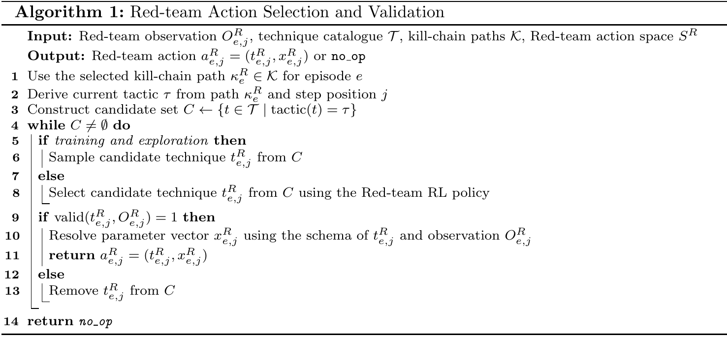
Appendix: Red Team Agent – Algorithm
43

Slide 44
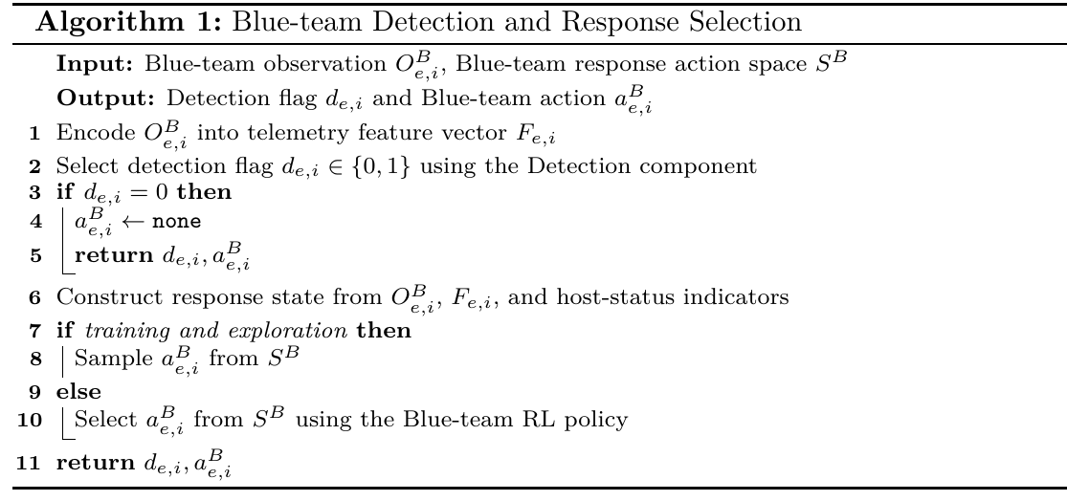
Appendix: Blue Team Agent: Algorithm
44

Slide 45
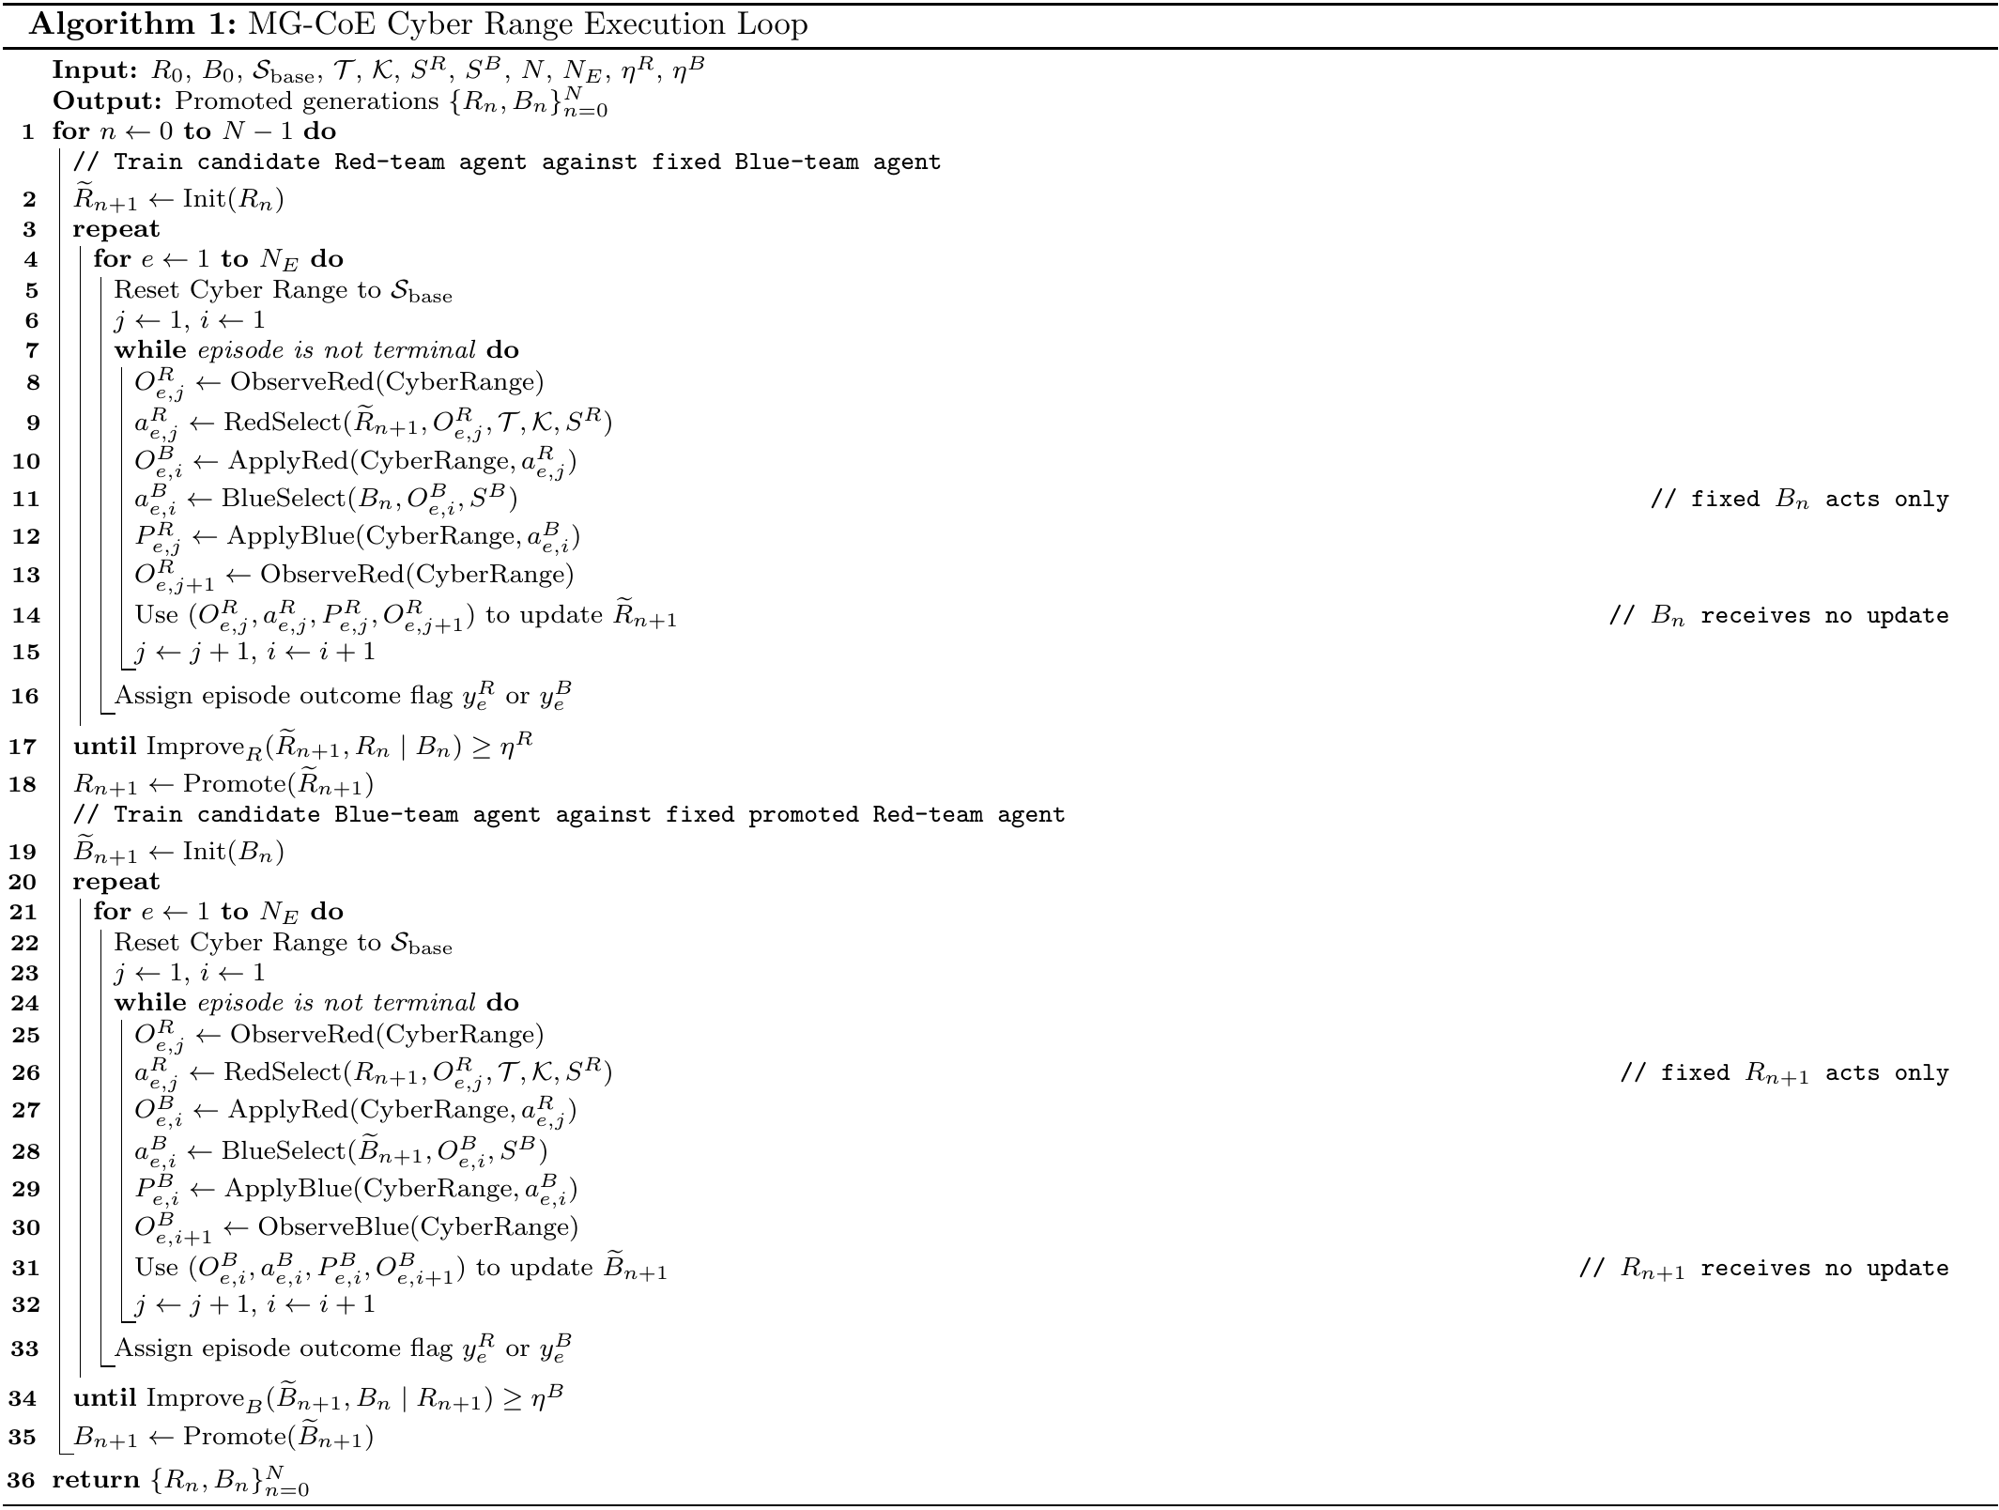
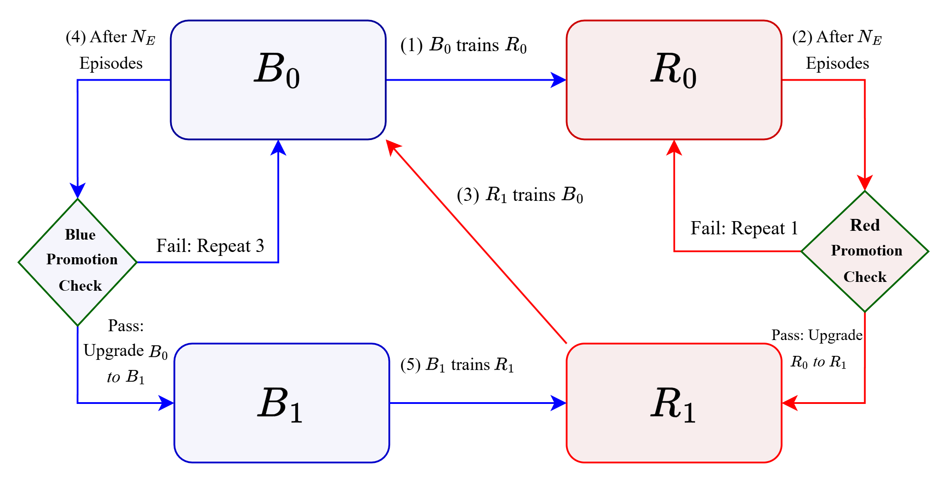
Appendix: MG-CoE Execution Loop : Algorithm
Figure : Generation-level promotion check in MG-CoE
45

Slide 46
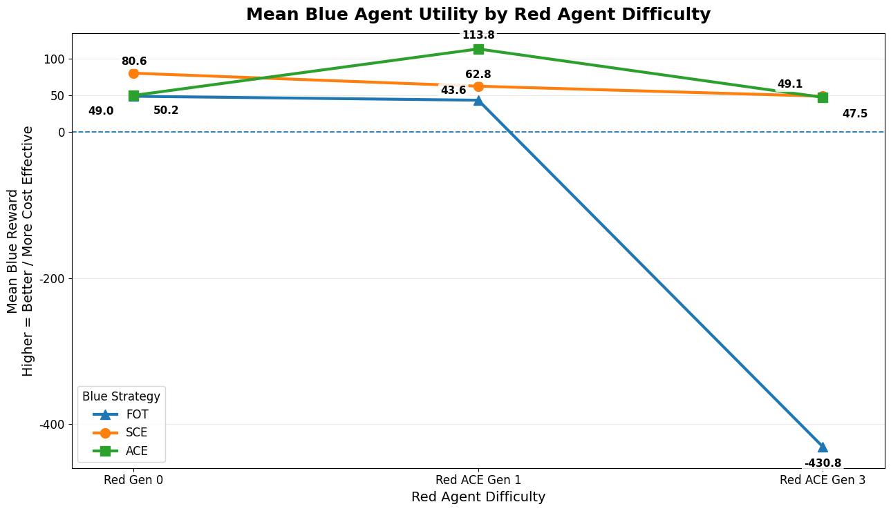
Appendix: ACE vs FOT vs SCE – Mean Blue-team Utility
ACE keeps positive utility vs Red Gen 3 (47.5), while FOT collapses (-430.8).
Observation | Why | Insight
FOT collapses vs strong Red: 49.0 → -430.8 | Trained on fixed weak Red → cannot handle evolved Red Gen 3 | Poor generalization
ACE strongest vs Red Gen 1: 113.8 | Alternating training exposes Blue to stronger Red over generations | Best adaptive defense
SCE stable but lower than ACE: 49.1 vs 47.5 on Red Gen 3 | SCE stable but lower than ACE: 49.1 vs 47.5 on Red Gen 3 | SCE stable but lower than ACE: 49.1 vs 47.5 on Red Gen 3
46

Slide 47
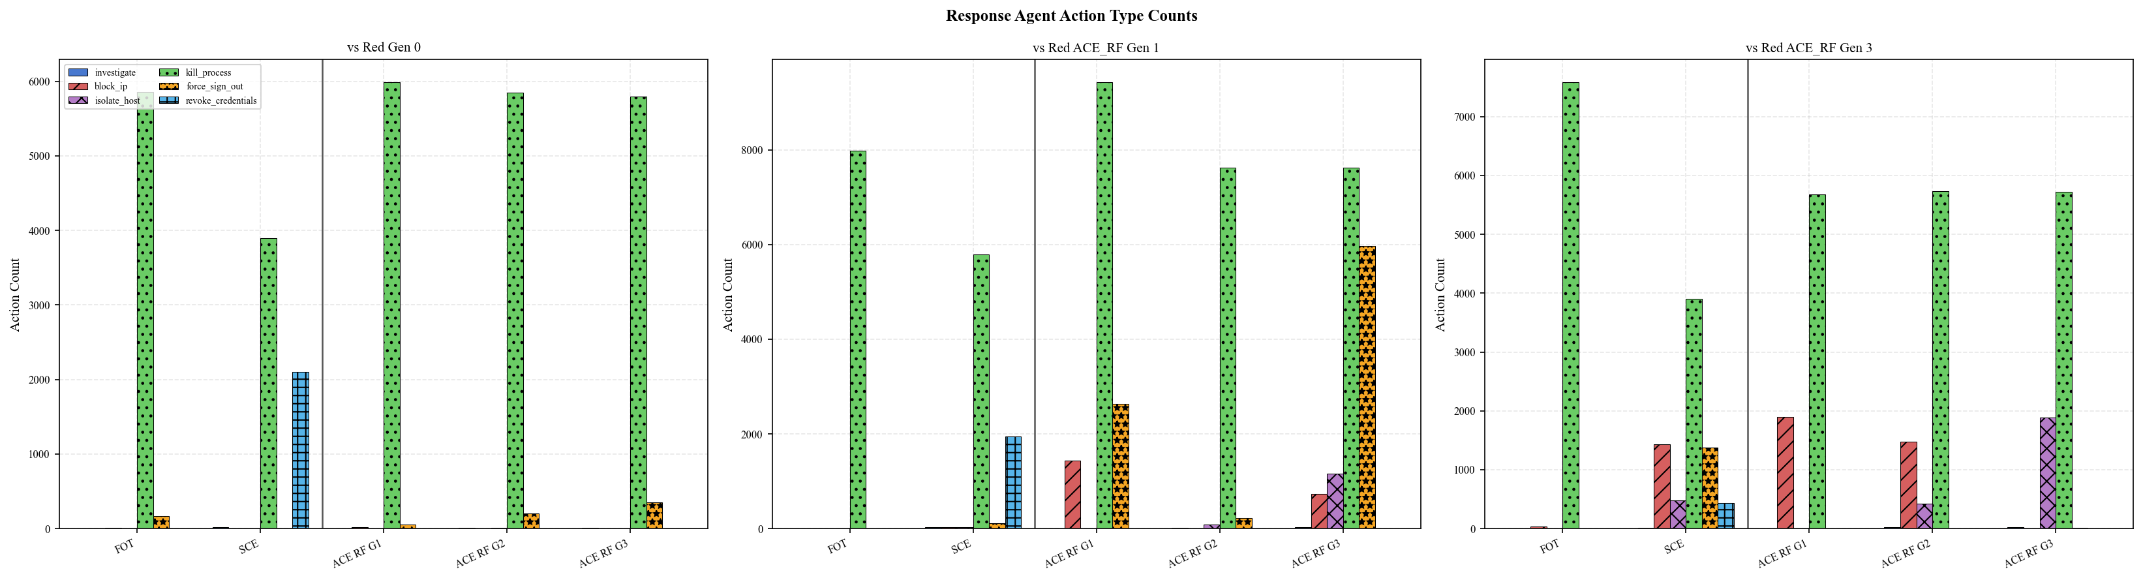
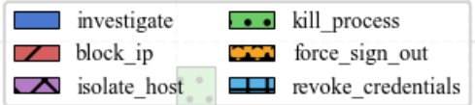
Appendix: ACE vs FOT vs SCE: Blue action Analysis
FOT over-relies on kill_process; ACE develops diverse multi-action strategy
Pattern | Observation | Why
FOT: kill_process dominant (~8000 vs Red1; ~7500 vs Red3); all other actions ~0 | FOT Red fixed & weak → Blue learns one effective shortcut; no pressure to diversify | Single-action over-reliance = brittle; collapses vs Red Gen3 (2% suppression)
ACE_RF G3: kill_process~7750 + force_sign_out~6000 + block_ip~1000 + isolate_host~1000 vs both Red gens | Alternating co-evolution → Red adapts → Blue forced to develop complementary action repertoire | ACE_RF Blue = richest action diversity → more robust, adaptable defense strategy
47

Slide 48
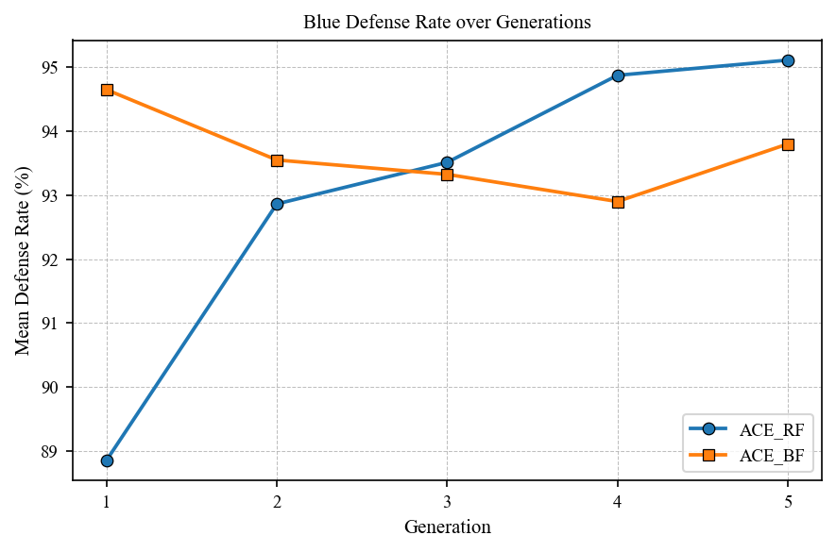
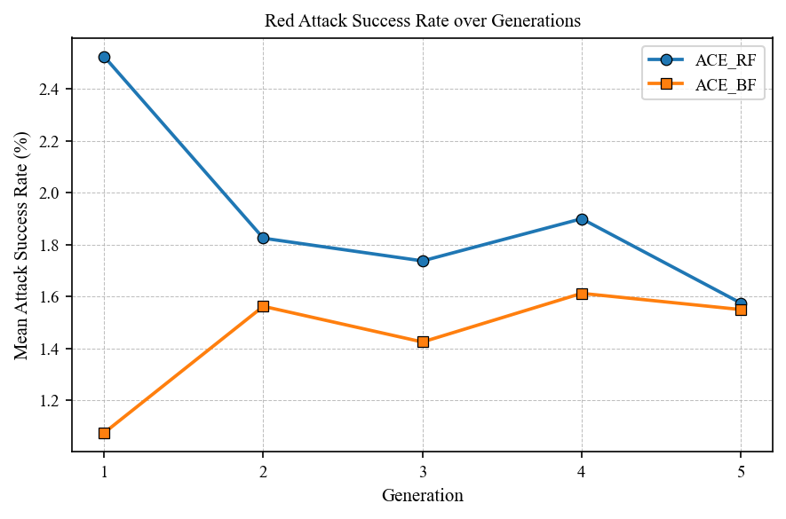
Appendix : ACE - Training Order (ACE_BF vs ACE_RF)
ACE_RF produces the strongest, most consistent generational growth. Meaningful pressure > early performance.
Observation | Why | Implication
ACE_RF Blue: 88.8% → 95.1% (+6.3pp) ACE_BF Blue: 94.7% → 93.8% (+0.9pp) | ACE_RF Blue trains after Red inherits a harder opponent each generation → forced adaptation ACE_BF Blue starts strong vs weak Red → pressure insufficient for further growth | Adversarial pressure, not early advantage, drives long-term improvement Slow start (ACE_RF) → superior trajectory
ACE_RF Red: 2.5% → 1.6% by Gen5 (−0.9pp) ACE_BF Red: 1.1% → 1.6% (fluctuates) | ACE_RF Red starts high (trains first vs weak Blue) but Blue catches up and suppresses it genuine arms race | Declining Red success = Blue is genuinely improving, not just facing weaker attackers
48

