Slide 1

Engage-Agent: A 2-Layer MITRE Engage-driven LLM Agent in a Honeynet
Student:
Shih-Yang Wang
Advisor:
Professor Ying-Dar Lin
High Speed Network Lab
National Yang Ming Chiao Tung University, Taiwan
Notes:
我們的目標是做一個能主動與攻擊者互動、又足夠真實的防禦系統。
傳統的 adaptive honeypot 雖然可以根據攻擊者行為動態回應，但通常只模擬一台主機，環境太單一，這樣很難觀察到橫向移動或網域探索，也容易讓攻擊者懷疑這是一個honeypot環境。
因此我們把honeypot擴展成 honeynet，模擬一個完整的企業網路，裡面包含 AD、web server、sql sever 等常見服務，既能提升真實性，也能收集到更完整的攻擊行為。
但是目前adaptive honeynet的研究重點都放在該把honeypot放在一個網路環境的什麼位置或放什麼種類的honeypot，沒有一個決策者監控整個系統動態與攻擊者交戰的研究。
而adaptive honeypot有這個機制，以RL作為決策者且用修改或生成系統回覆的方式，這些方法不適合直接套用到honeynet上，honeynet環境複雜會造成RL的state、action設計困難，修改或生成回覆會有….的問題
而修改回覆其實就是模擬修改環境的結果，那我們為什麼不直接修改環境呢。所以我們的目標確定為設計一個決策者監控整個環境並根據攻擊者行為動態產生腳本修改環境進而改變攻擊者看到的系統回覆並影響攻擊者，這種語意分析並修改環境的任務非常適合使用llm agent，所以我們選擇llm agent作為決策者。但是如果讓llm自由生成腳本很容易出錯造成執行失敗影響效能，因此我們提前根據mitre engage以及honeynet包含的主機的role設計了一個toolkit，toolkit包含35個腳本模板並挖空一些重要參數，這樣llm agent就不用從零生成腳本而是選擇工具並生成參數就好。但是目前llm的任務非常複雜，需要分析指令、判斷攻擊意圖、產生交戰策略、選擇工具、生成參數，如果只用一個llm一次完成這些任務那效果會因為….的原因非常差，所以我們根據任務把llm agent拆成兩個layer：strategist llm以及planner llm，strategist llm負責判斷攻擊意圖、產生交戰策略、選擇工具這些跟….有關的工作，planner llm則根據上一步的輸出去操作工具，也就是產生需要的工具參數，這樣做可以用…..的好處
第一個是 Realism。
Ours is over 4× higher than QRASSH and about 2.5× higher than LLM honeypot
One-layer, two-layer, and ours are all close to 80%
第二個是 Attack depth。
相比 QRASSH，我們的方法超過 5 倍；相比 LLM-based honeypot，提升約 71%；相比 one-layer agent，也提升約 9%。
第三個是 Planner quality。
FT two-layer 相比 one-layer，提升約 67%；相比未 fine-tuned 的 two-layer，提升約 18%。
第四個是 Behavior diversity。
我們的方法相比 QRASSH 超過 4 倍，相比 LLM-based honeypot 超過 2 倍。和 one-layer 相比，差距不到 5%。
最後是 Lateral movement

Slide 2
Outline
Solution
Solution Overview
LLM Agent Design
Strategist LLM Design
Planner LLM and MCP Execution
MCP ToolKit Design
Implementation
System Architecture
Dataset Generation
MCP ToolKit Generation
Attacker Interaction Simulation
Evaluation
Experiment
Reference
Motivation
Background
MITRE ENGAGE
LLM Agent
Model Context Protocol (MCP)
LLM Agent
Active Directory
Notations
Problem Statement
Related Work
Issues

Slide 3
Motivation
Challenges in Existing Adaptive Honeypots/Honeynets
Can only emulate a single host; cannot represent a full enterprise network
Existing honeynet research mainly focuses on deployment rather than active attacker engagement
Adaptive honeypot methods provide dynamic interaction, but cannot be directly extended to honeynets
Notes:
只能模擬一台電腦，無法模擬整個企業網路環境
交戰策略多為靜態，無法根據攻擊者意圖動態產生交戰策略
交戰策略只作用在一台電腦上，無法實現橫跨多台電腦的複雜策略
Traditional honeypots simulate only a single host, making them insufficient for multi-stage and cross-host enterprise attacks.
Existing honeynet research improves environment realism, but mainly focuses on deployment and passive observation rather than active attacker engagement.
Adaptive honeypot methods provide dynamic interaction, but cannot be directly extended to honeynets because cross-host engagement requires globally coordinated decisions.

Slide 4
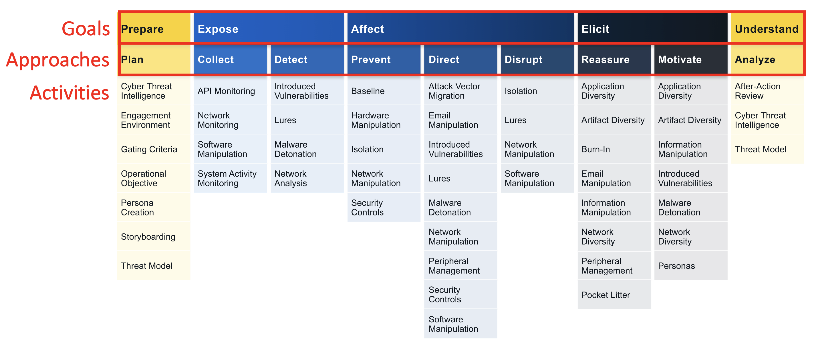
Background - MITRE ENGAGE
MITRE Engage define how to engage with Hackers
They also define which engage activity corresponding to technique

Slide 5
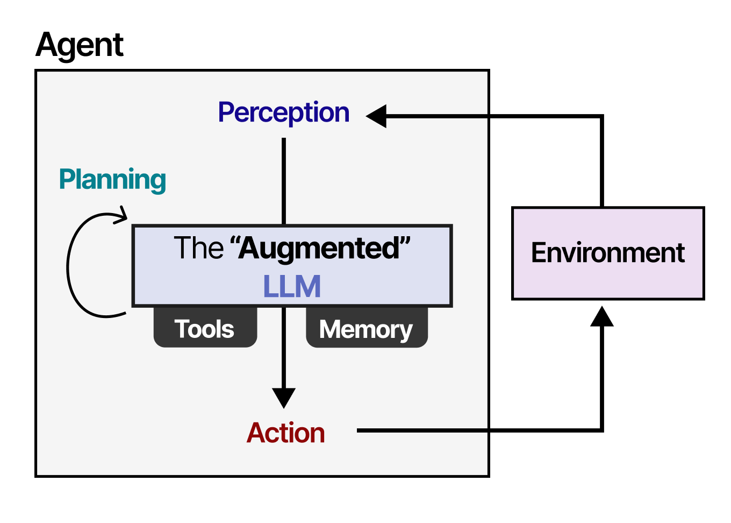
Background - LLM Agent
Extends LLMs from generating text to taking actions
Operates in a loop: Reasoning -> Tool Use -> Observation
Uses tools like APIs and code to perform complex tasks

Slide 6
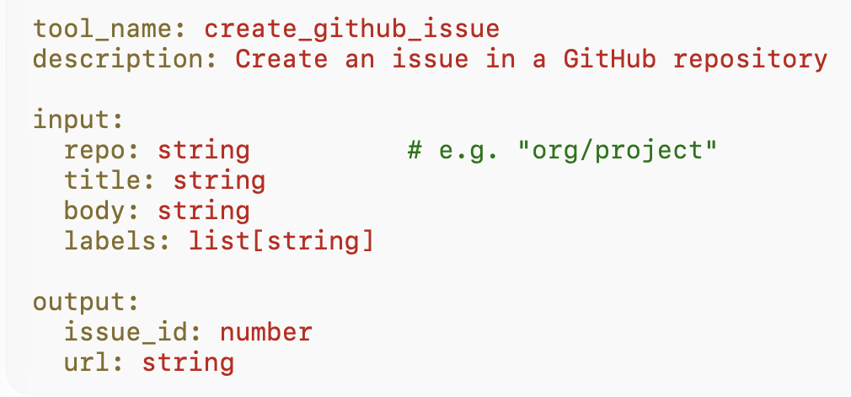
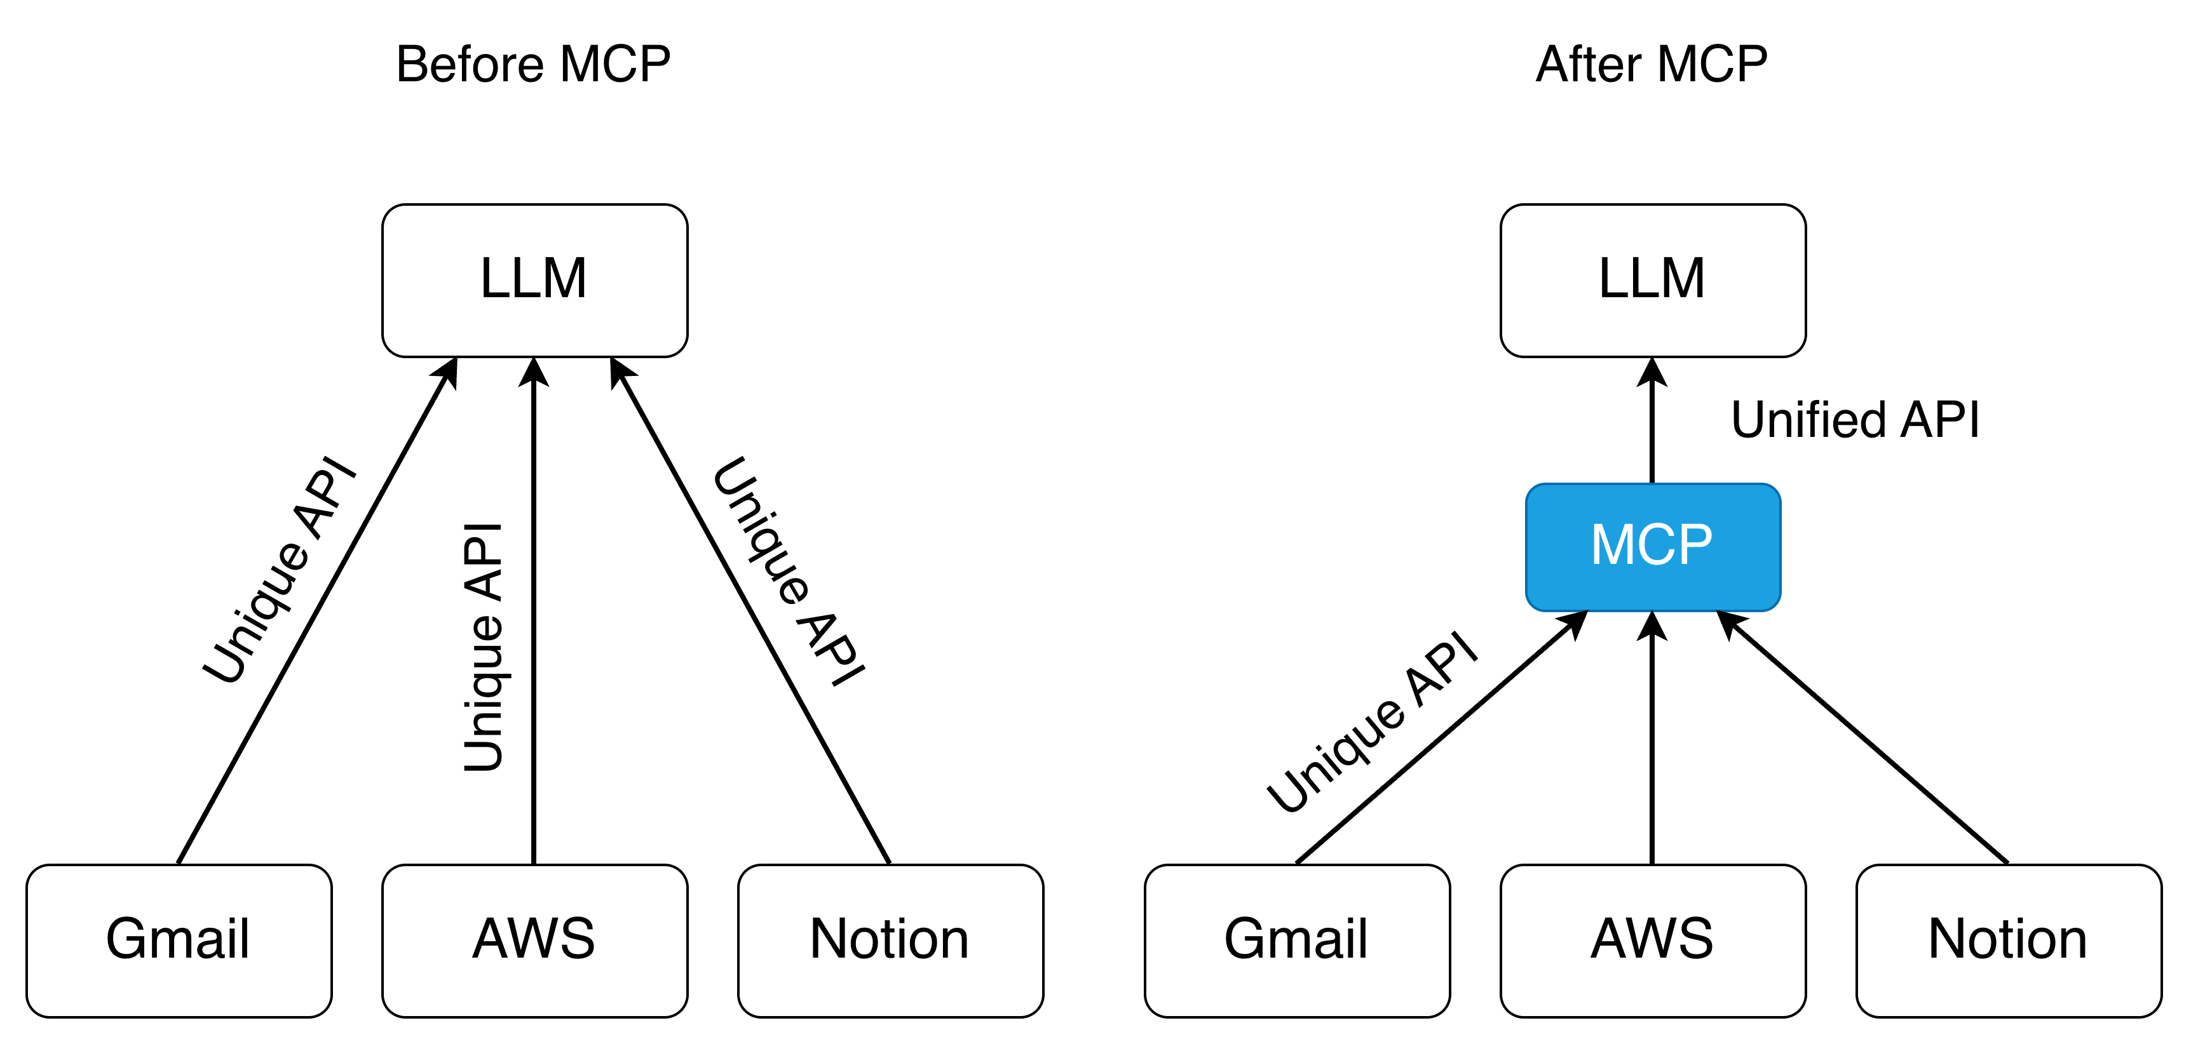
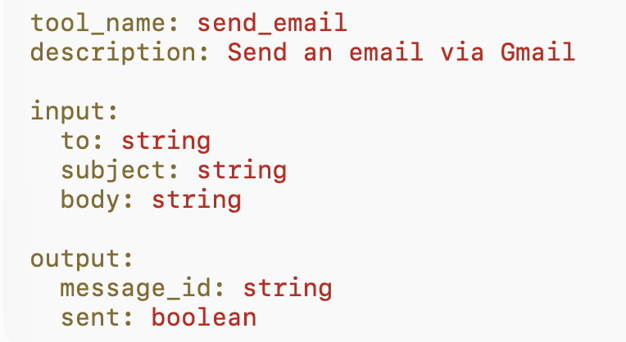
Background - Model Context Protocol (MCP)
MCP provides a standardized interface for supplying system context to LLMs
Improving the reliability and correctness of actions generated by LLMs

Slide 7
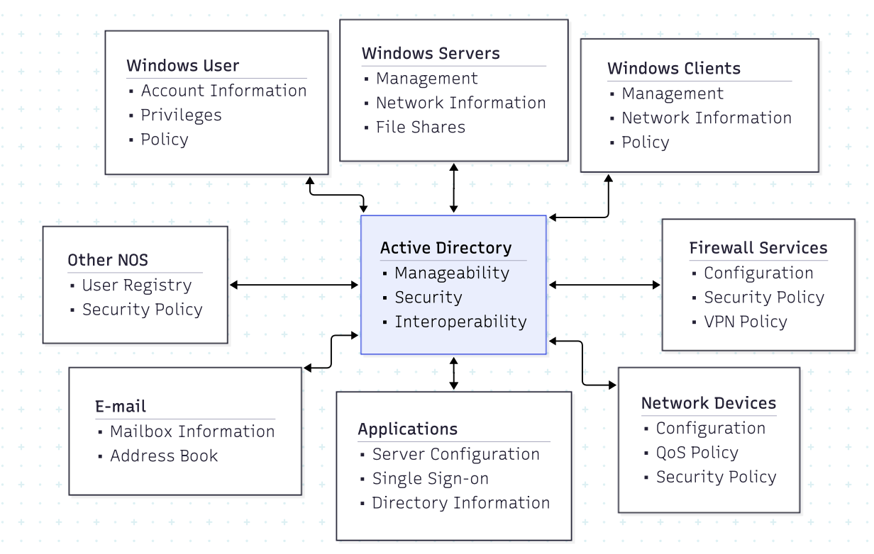
Background - Active Directory (AD)
Microsoft's directory service for Windows networks
A cornerstone of IT infrastructure, adopted by the vast majority of enterprises
Provides centralized Identity and Access Management (IAM)

Slide 8
Why Honeynet? A Comparison
Category | Monitoring scope | Kill chain visibility | Detection capability
Honeypot | Single Host | Captures only the initial intrusion | Partial, Single-Point
Honeynet | Entire Network Environment | Reveal full attack chain | End-to-End TTPs
Notes:
Honeypot:
Captures the initial intrusion on a single host, but the attack chain ends when lateral movement is attempted
Honetnet:
Enables lateral movement across a network of decoys, revealing the complete, end-to-end attack chain and attacker TTPs

Slide 9
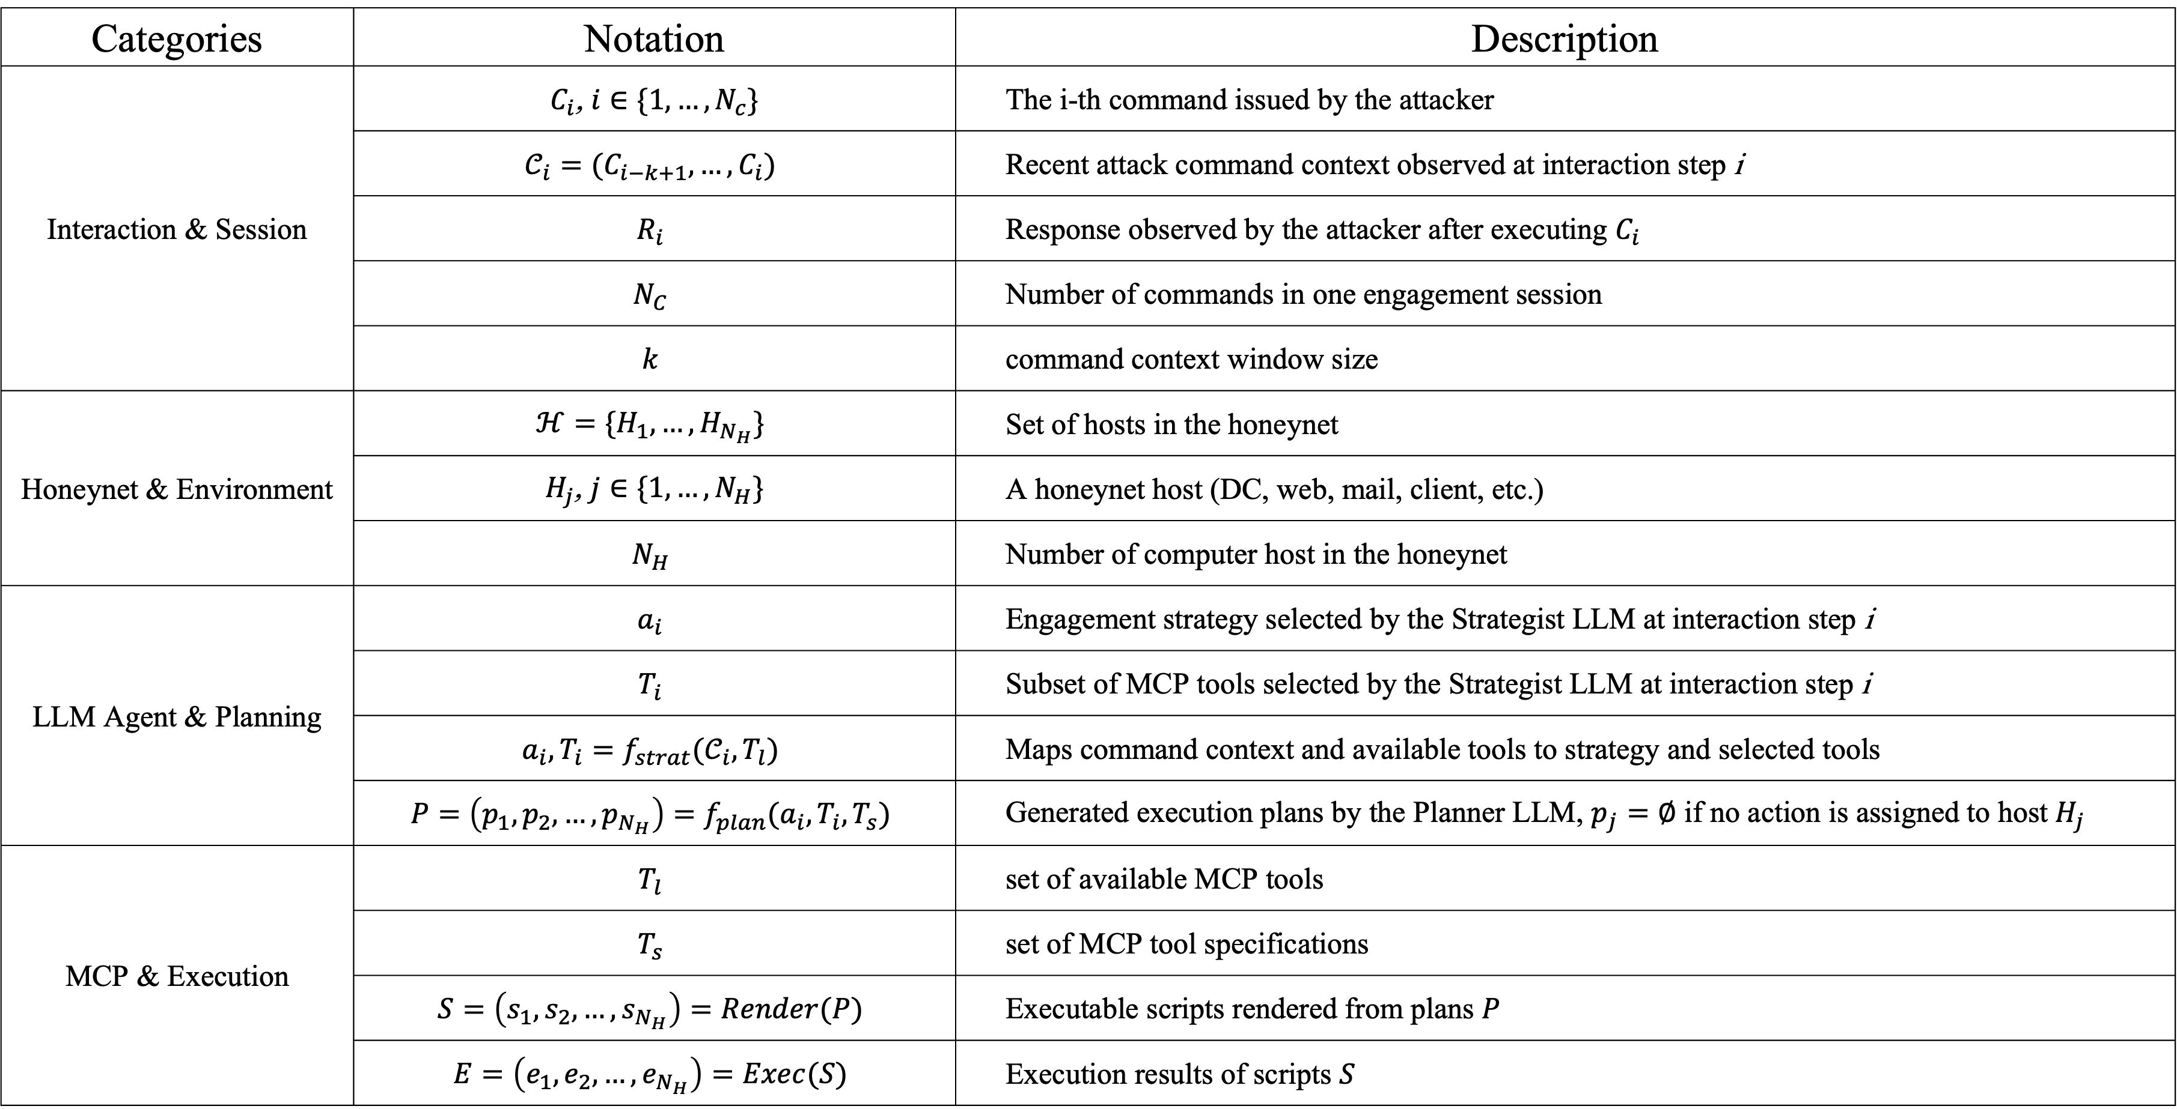
Notations
Categories | Notation | Description
Interaction & Session | $C_{i}$, $i∈\{1,…,N_{c}\}$ | The i-th command issued by the attacker
 | $$𝒞_{i}=(C_{i−k+1},…,C_{i})$$ | Recent attack command context observed at interaction step i
 | $$R_{i}$$ | Response observed by the attacker after executing $C_{i}$
 | $$N_{C}$$ | Number of commands in one engagement session
 | $$k$$ | command context window size
Honeynet & Environment | $$ℋ=\{H_{1},…,H_{N_{H}}\}$$ | Set of hosts in the honeynet
 | $H_{j}$, $j∈\{1,…,N_{H}\}$ | A honeynet host (DC, web, mail, client, etc.)
 | $$N_{H}$$ | Number of computer host in the honeynet
LLM Agent & Planning | $$a_{i}$$ | Engagement strategy selected by the Strategist LLM at interaction step i
 | $$T_{i}$$ | Subset of MCP tools selected by the Strategist LLM at interaction step i
 | $$a_{i}, T_{i}=f_{strat}(𝒞_{i}, T_{l})$$ | Maps command context and available tools to strategy and selected tools
 | $$P=\left(p_{1},p_{2},…,p_{N_{H}}\right)=f_{plan}(a_{i}, T_{i},T_{s})$$ | Generated execution plans by the Planner LLM, $p_{j}=∅$ if no action is assigned to host $H_{j}$
MCP & Execution | $$T_{l}$$ | set of available MCP tools
 | $$T_{s}$$ | set of MCP tool specifications
 | $$S=\left(s_{1},s_{2},…,s_{N_{H}}\right)=Render(P)$$ | Executable scripts rendered from plans $P$
 | $$E=\left(e_{1},e_{2},…,e_{N_{H}}\right)=Exec(S)$$ | Execution results of scripts $S$
Notes:
沒有寫到llm 處理的一段command的部分，policy應該是對應沒寫到的一段command

Slide 10
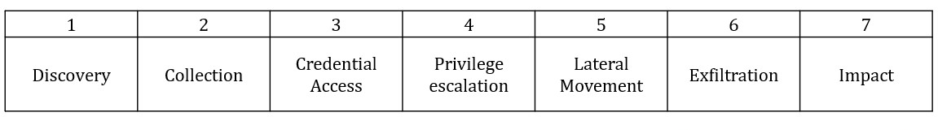
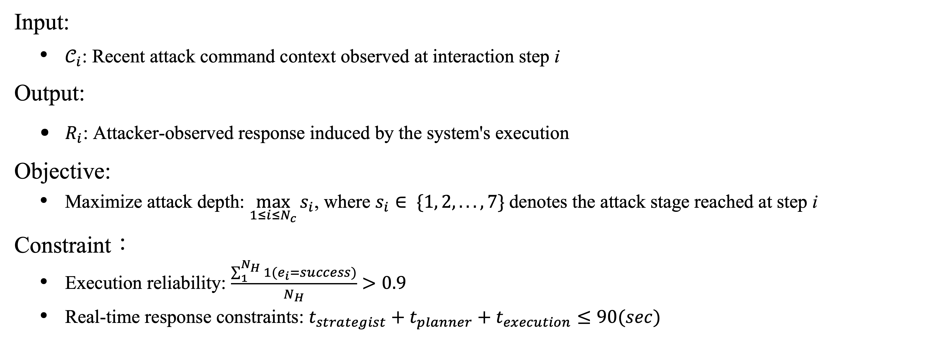
Problem Statement – Engage Driven Honeynet
Input:
$𝒞_{i}$: Recent attack command context observed at interaction step i
Output:
$R_{i}$: Attacker-observed response induced by the system's execution
Objective:
Maximize attack depth: $\max_{1≤i≤N_{c}}{s_{i}}$, where $s_{i}∈ \{1, 2, . . . , 7\}$denotes the attack stage reached at step i
Constraint：
Execution reliability: $\frac{\sum_{1}^{N_{H}}{1}(e_{i}=success)}{N_{H}}>0.9$
Real-time response constraints: $t_{strategist}+t_{planner}+t_{execution}≤90(sec)$

Slide 11
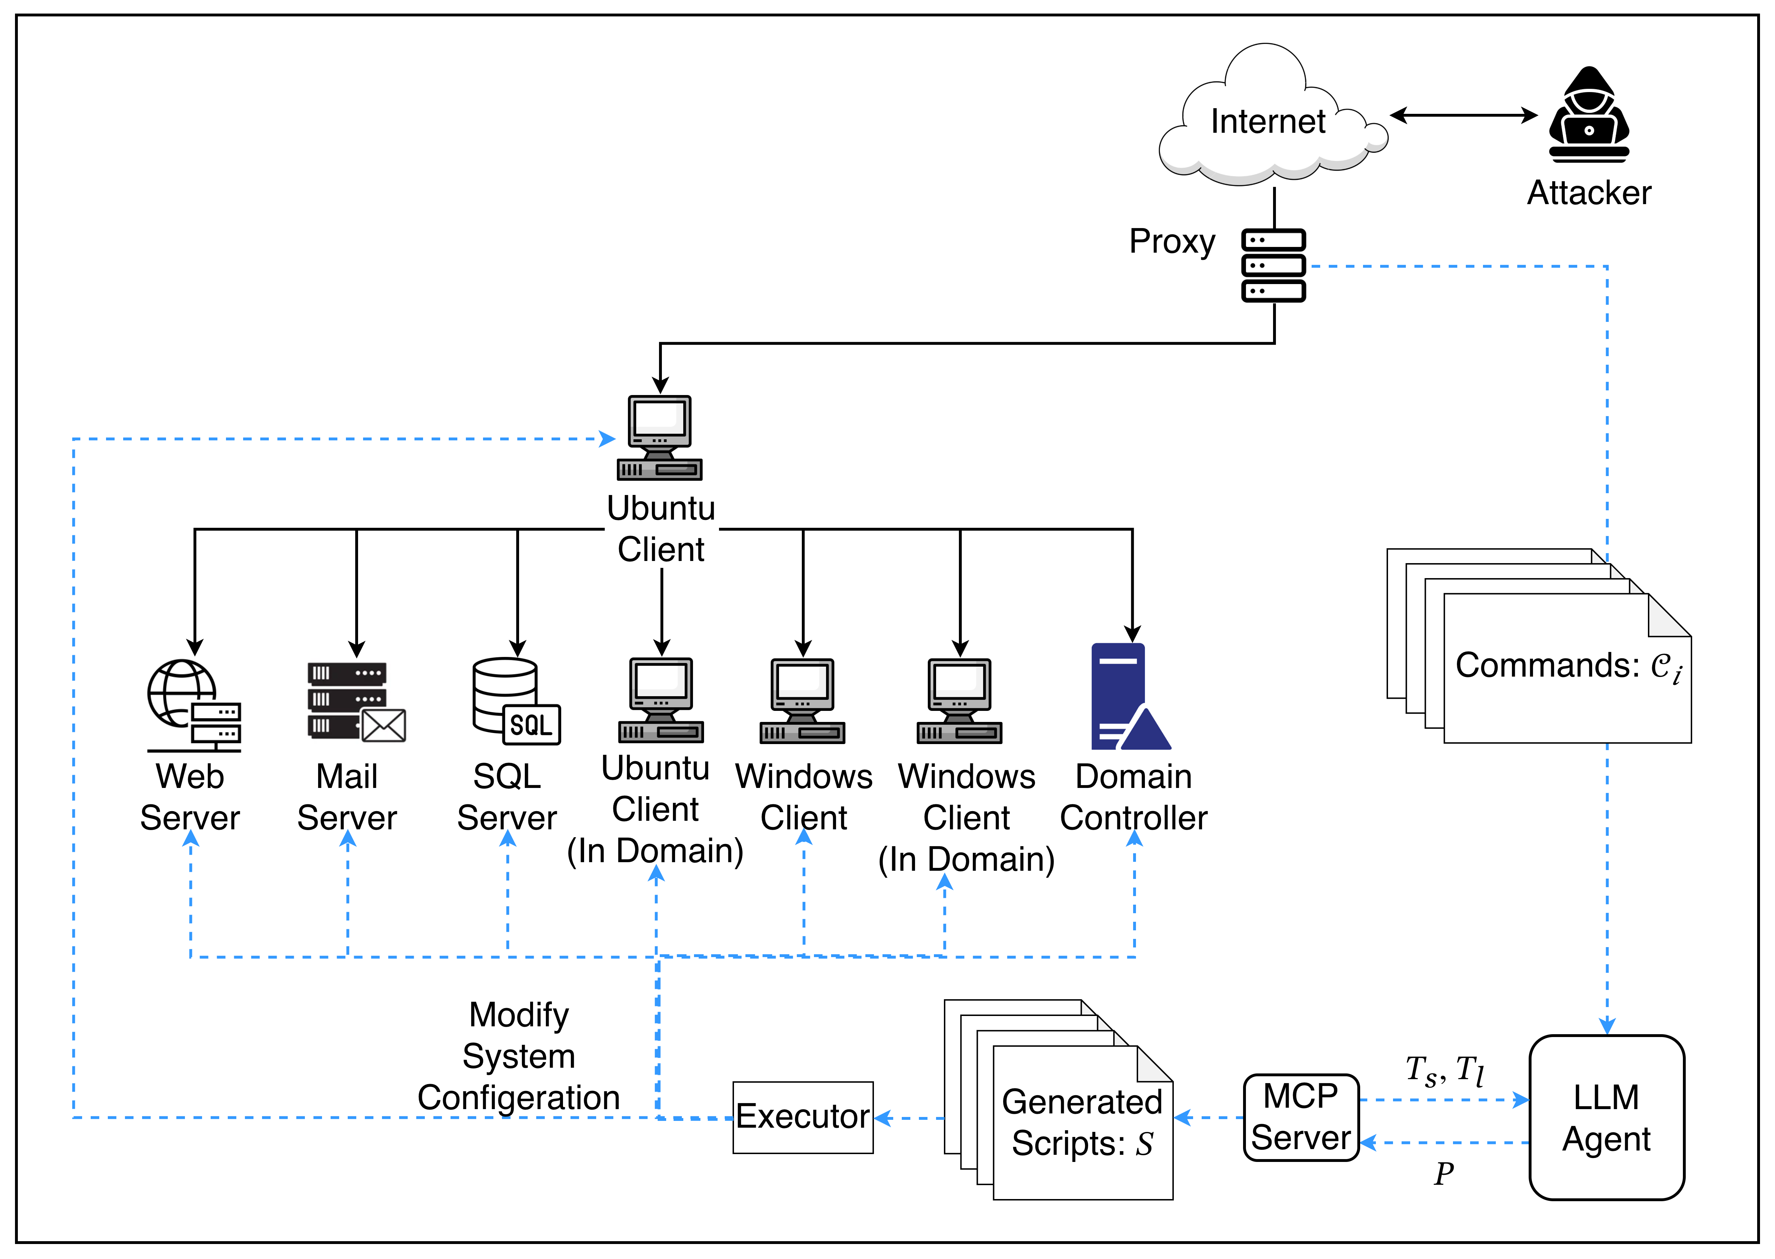
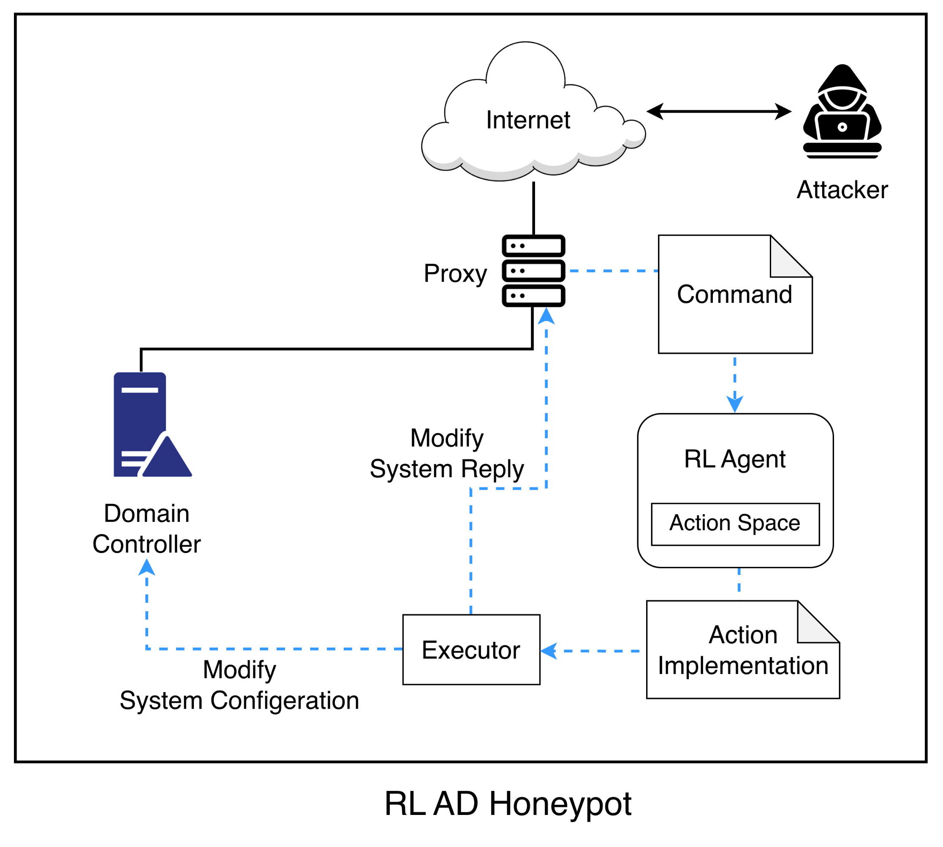
Problem Statement – Engage Driven Honeynet
Notes:
Action區塊不一致，不是資料，箭頭要改

Slide 12
Related Work on Honeypot / Honeynet
Category | Paper | Real System | Active Directory | Objective |  |  | Strategist Method | Action Design
 |  |  |  | Engagement Depth | Interaction Realism | Behavioral Diversity
Honeypot | QRASSH [8] | - | - | V | - | - | RL | Response manipulation
 | HoneyGPT [9] | - | - | V | V | V | LLM | Response generation
 | Senior [10] | V | V | V | V | V | RL | Response manipulation
Honeynet | HoneyFactory [11] | V | - | - | V | - | Rule-based | Honeynet generation
 | ADLAH [12] | - | - | - | V | - | RL | Honeypot deployment
Honeynet | HoneyICS [13] | V | - | - | V | - | Rule-based | ICS network emulation
 | Mirage [14] | V | V | - | - | - | Rule-based | File system modification
 | Ours | V | V | V | V | V | LLM | MITRE Engage–guided environment manipulation
Comparison of representative honeypot and honeynet systems in terms of engagement depth, interaction realism, and behavioral diversity.
Notes:
字大一點

Slide 13
Issues
Realism: Response-level Honeypot vs. Environment-level Honeynet
Reply-level deception may look plausible but lacks persistent system state
Environment-level deception should remain verifiable across steps and hosts
Attack Depth: RL-based Adaptive Honeypot vs. LLM-based Honeynet
Single-host interaction cannot support full enterprise attack progression
LLM-based honeynet should guide attackers toward later stages
Behavior Diversity: RL-based Adaptive Honeypot vs. LLM-based Honeynet
Static or single-host setups expose limited attack opportunities
Adaptive honeynet should trigger more varied attacker behaviors
Notes:
Issue放最終結果attack depth，但是這樣畫圖沒有意義，想圖怎麼畫，中間結果可到evaluation討論
Realism: 改回覆 honeynet vs 改環境 honeynet
用llm-agent去直接修改系統回覆或只修改系統環境
Using LLM to judge is honeypot or not
Attack Depth: Other RL-based honeypot vs. LLM-based honeynet
使用llm 攻擊者根據目標產生攻擊指令
讓llm 攻擊者根據系統回覆決定是否繼續攻擊並統計session深度
Behavior Diversity: Static honeynet vs. LLM-based honeynet
使用llm-agent根據攻擊指令放上吸引攻擊者的decoy檔案或設定
根據攻擊指令判斷llm 攻擊者有沒有嘗試更多樣的攻擊手法
Lateral Movement: honeypot vs. honeynet
使用llm 攻擊者根據目標產生攻擊指令
分析攻擊指令判斷攻擊者有沒有嘗試更多橫向移動和移動方向

Slide 14
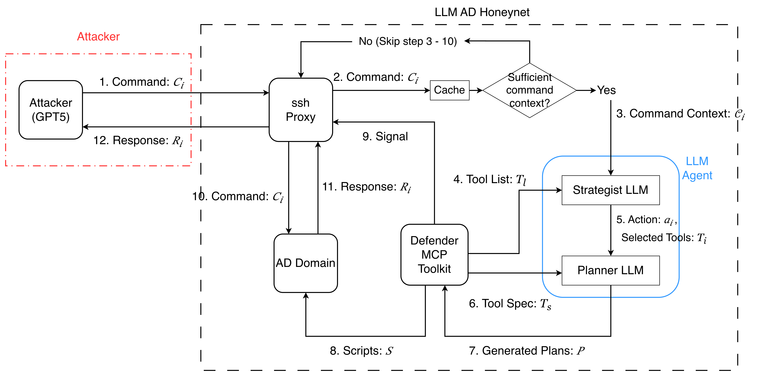
Solution Overview
Notes:
標註哪裡有改哪裡沒改

Slide 15
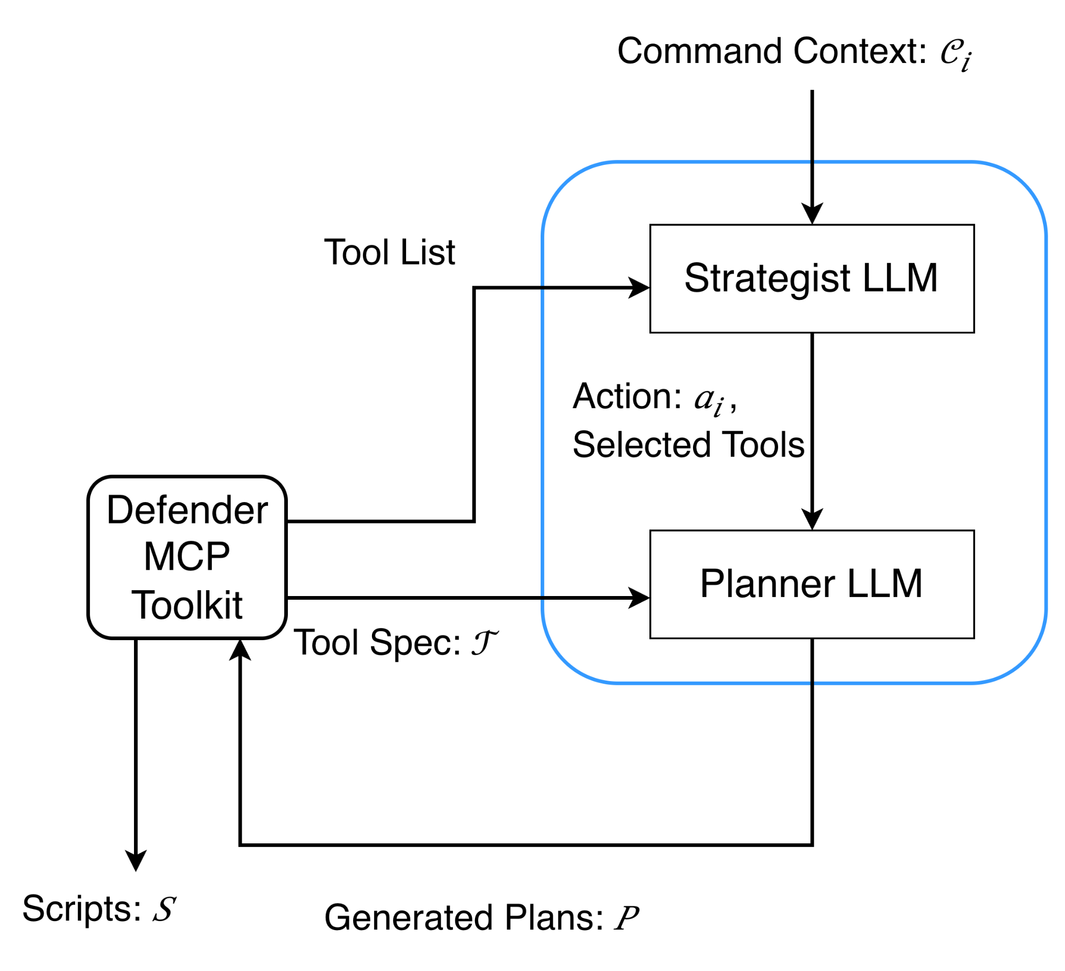
Solution - LLM Agent Design
Why Two LLMs?
Separate attacker-intent reasoning from execution planning
Why MCP?
Restrict LLM actions to validated, executable environment operations
Why fine-tune the Planner?
Improve schema-compliant arguments and cross-tool consistency
Why Environment-level modifications?
Persistent state changes support deeper and verifiable attacks
Notes:
增加敘述做了什麼滿足objective

Slide 16
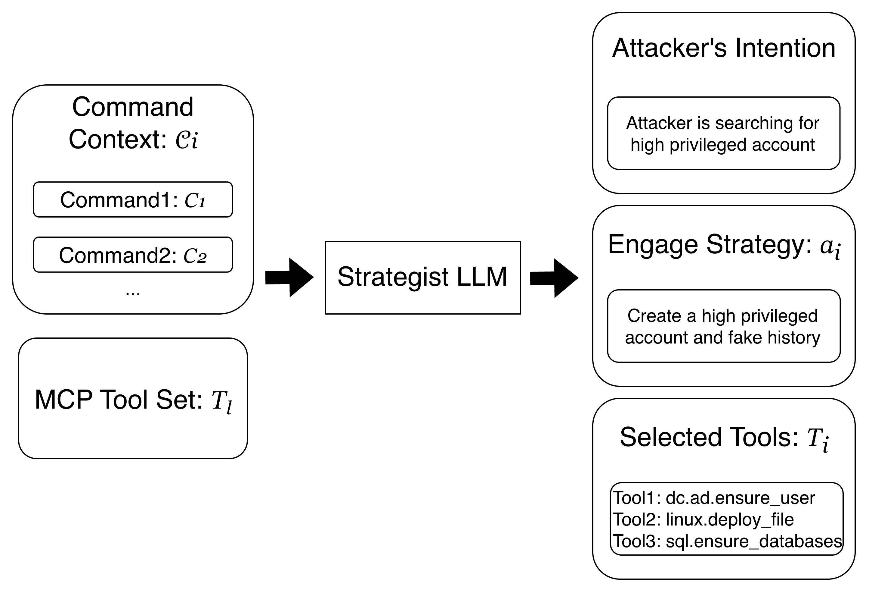
Solution - Strategist LLM Design
Why infer intent from command context?
Single commands are ambiguous; intent appears across multiple steps
Why use an LLM here?
Attacker behavior is open-ended and semantic, making handcrafted RL states brittle
Why select tools in the Strategist?
Tool choice should stay coupled with attacker understanding and engagement strategy
Why stop before execution?
Execution details would mix semantic reasoning with host-level deployment complexity
Notes:
增加敘述做了什麼滿足objective

Slide 17
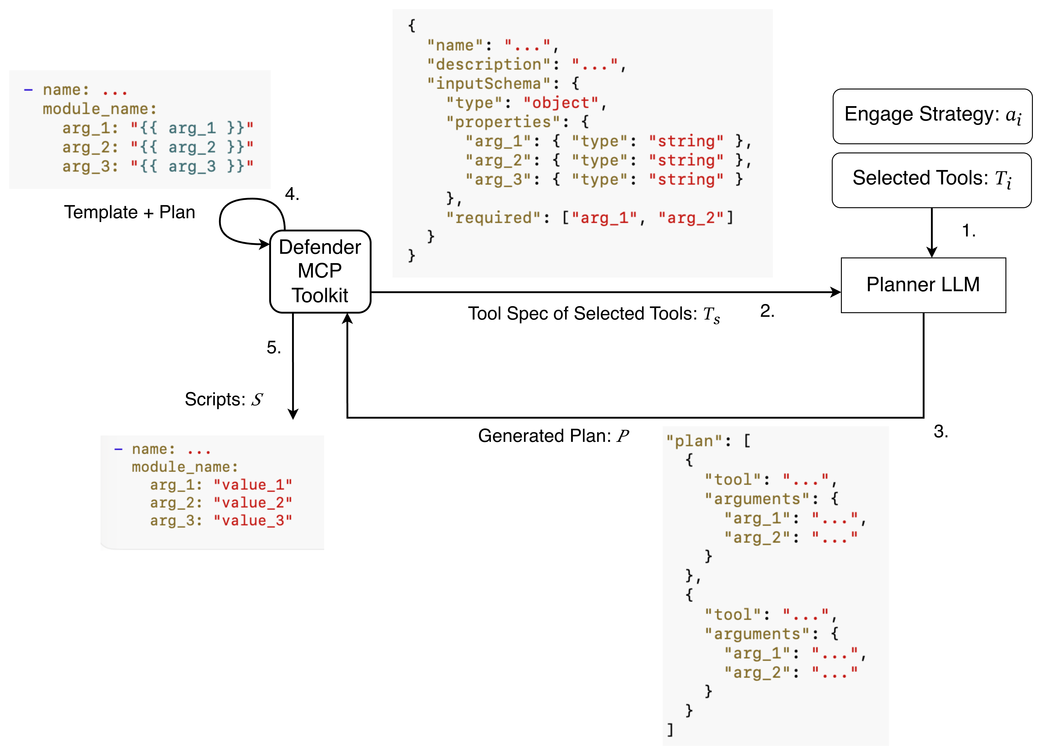
Solution - Planner LLM and MCP Execution
Why not generate replies?
Reply-level deception breaks when attackers verify files, accounts, services, or hosts
Why not use fixed scripts?
Fixed scripts are reliable but cannot adapt to different attacker contexts
Why not let LLM write scripts?
Free-form script generation is flexible but unstable and hard to debug
Why Planner + MCP?
Planner generates structured arguments; MCP validates and renders executable templates
Notes:
圖的字放大

Slide 18
Solution - MCP ToolKit Design
Tool Group | #Tools | Inspired from Engage Affect Activity
Action |  | Lures | Personas | Artifact Diversity | Information Manipulation | Introduced Vulnerabilities | Network Manipulation | Email Manipulation
Identity and Account Exposure | 3 | V | V |  | V
Credential Bait | 3 | V |  | V | V |  |  | V
Artifact and Data Decoys | 11 | V |  | V
Breadcrumb and Misdirection | 5 | V |  |  | V |  | V
Privilege Escalation Lures | 2 | V |  |  |  | V
Service and Endpoint Lures | 3 | V |  |  |  |  | V | V
Controlled Failure Induction | 7 |  |  |  | V | V |  | V
Cross-host Movement Bait | 1 | V |  |  | V |  | V

Slide 19
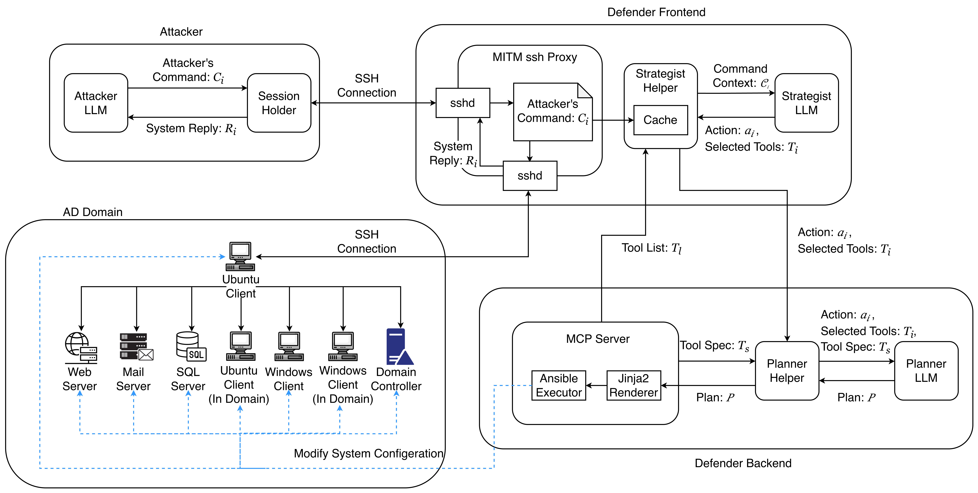
Implementation - System Architecture
Notes:
用heat map表示什麼做完了什麼還沒做完

Slide 20
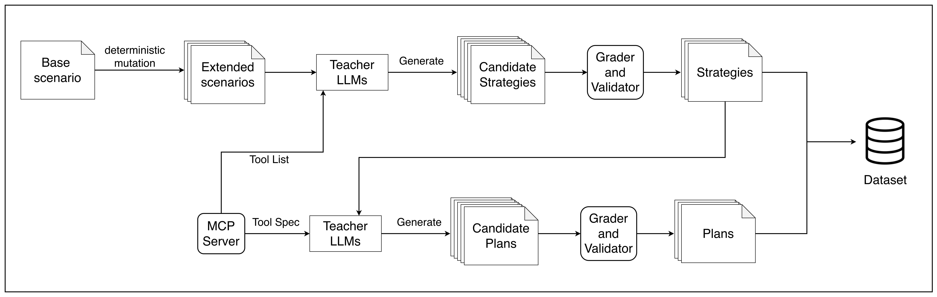
Implementation - Dataset Generation
Base scenarios are expanded into controlled variants
Teacher LLMs generate multiple candidate strategies and plans
Graders and validators select schema-valid outputs
Final data pairs strategy/tool context with validated Planner plans

Slide 21
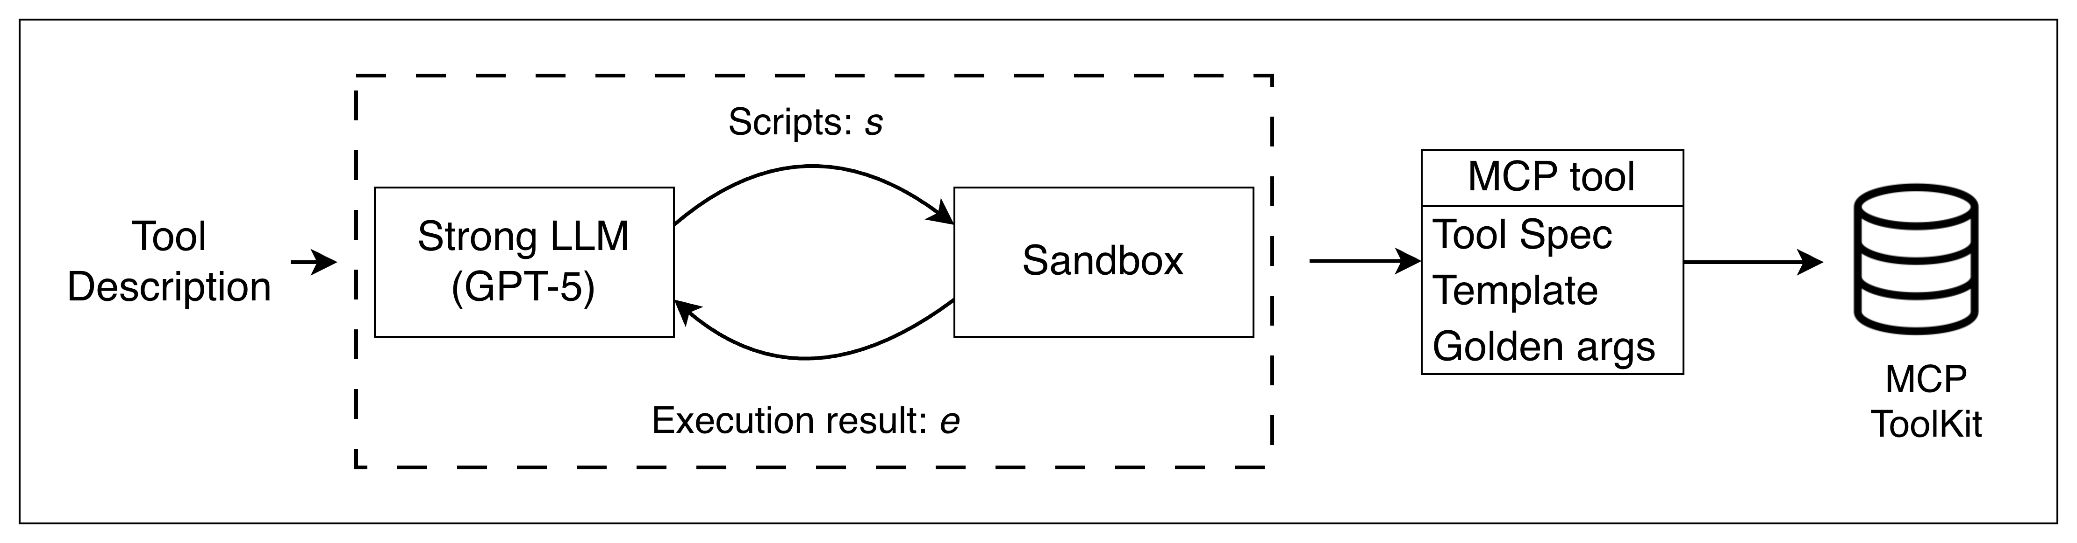
Implementation - MCP ToolKit Generation
Tool capability is first defined from the AD honeynet role
A strong LLM generates the tool spec, Ansible template, and golden arguments
The generated template is executed in the sandbox or real test environment
Only successfully validated tools are stored in the MCP toolkit registry

Slide 22
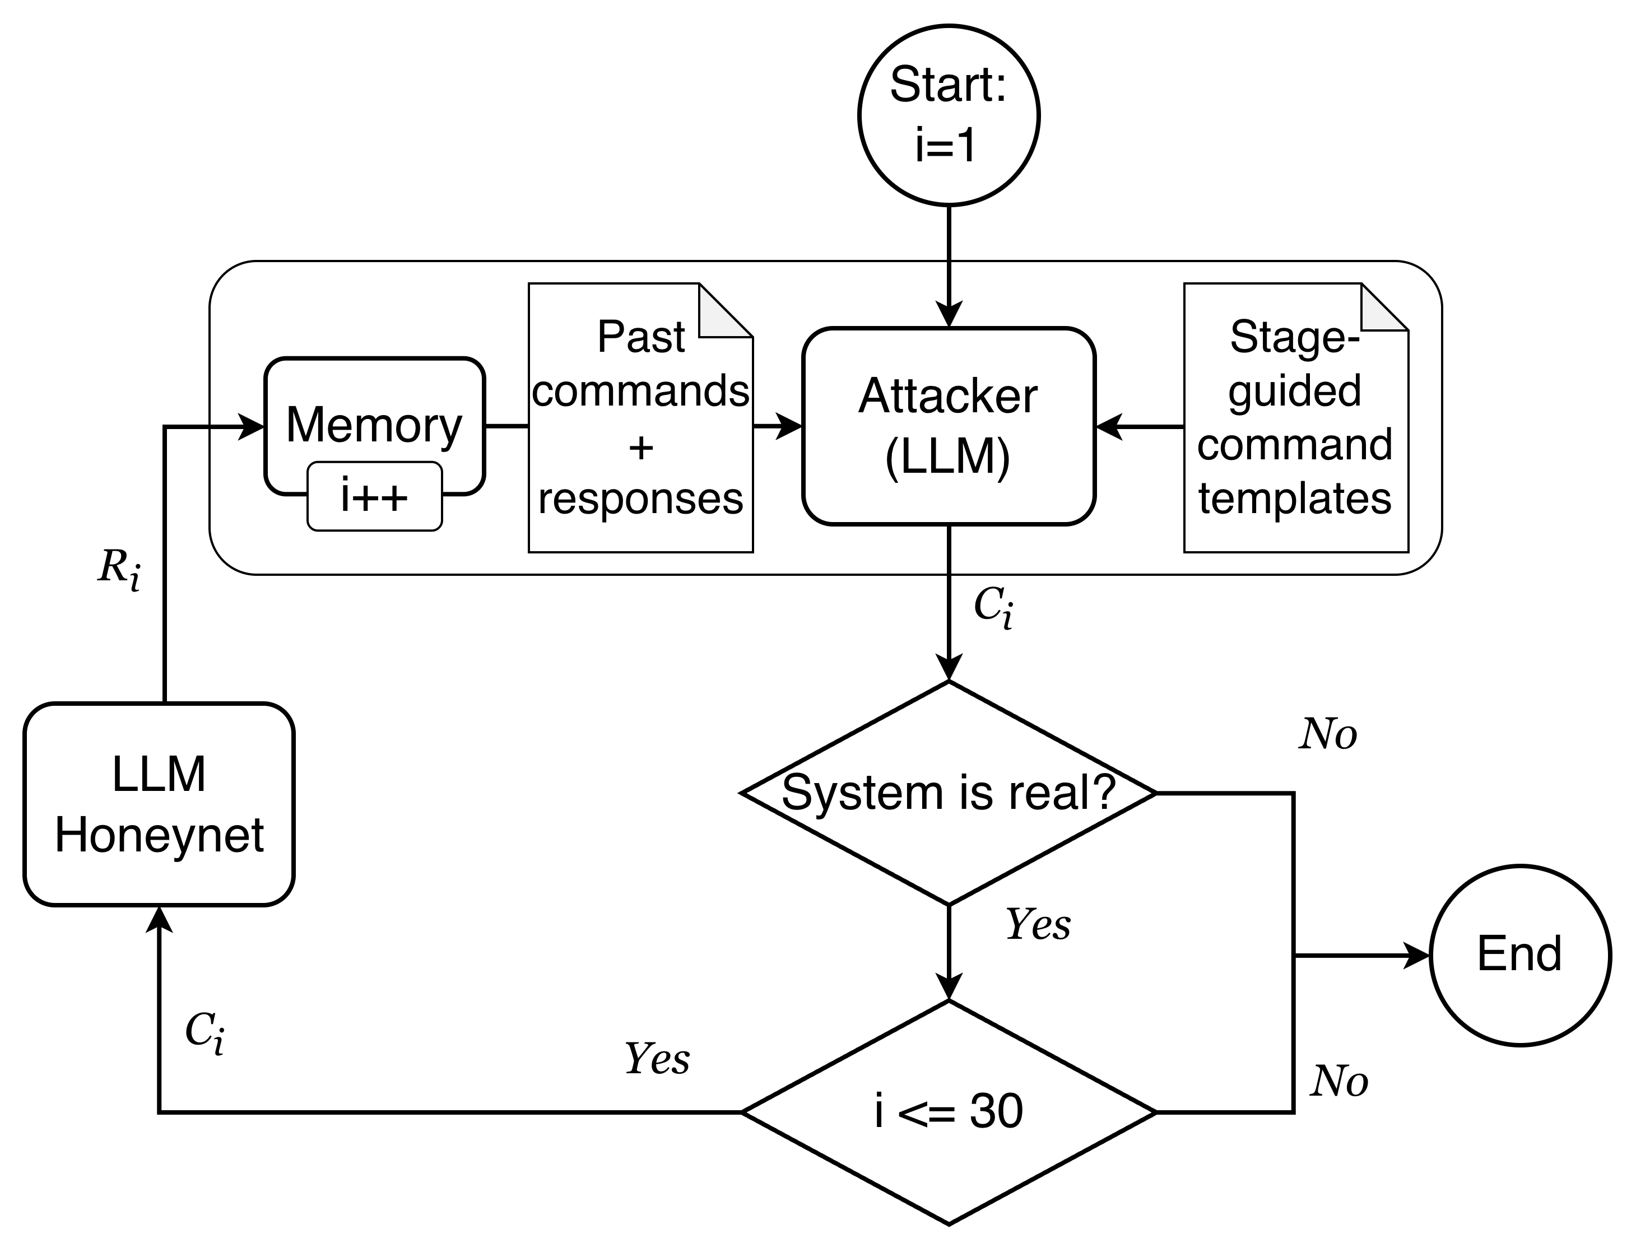
Implementation - Attacker Interaction Simulation
Commands are generated from previous observations
Templates guide attack stages but do not fix the path
The loop measures whether the honeynet can induce deeper behavior

Slide 23
Implementation - Tools and Models
Category | Name | Functionality
LLM | GPT-5-mini | Teacher model for dataset generation and tool generation
 | Qwen3-8b | Strategist LLM
 | Phi4-15b | Planner LLM
 | GPT-5-mini | Attacker model for attacker interaction simulation
Tool | Proxmox | Virtualization platform for honeynet VMs
 | Ansible | Automation framework for script deployment
Python | Unsloth | Efficient fine-tuning framework
 | paramiko | Capture attacker commands

Slide 24
Evaluation
Realism: Response-level vs. Environment-level
Use an LLM judge to classify whether observed outputs look like real system behavior
Compare reply-only deception with environment-state adaptation
Attack Depth: RL-based vs. LLM-based
Run LLM-driven attack sessions and record the highest attack stage reached
Compare average attack depth across defender designs
Behavior Diversity: Static Honeynet vs. LLM-based Honeynet
Classify attacker commands into behavior categories and count unique techniques per session
Compare whether adaptive deployment exposes broader attack opportunities
Notes:
加一個橫向移動成功率？橫向移動捕捉成功比例，表示honeynet真的可以比honeypot好
Issue, key number, why
問題
原因
key number
why

Slide 25
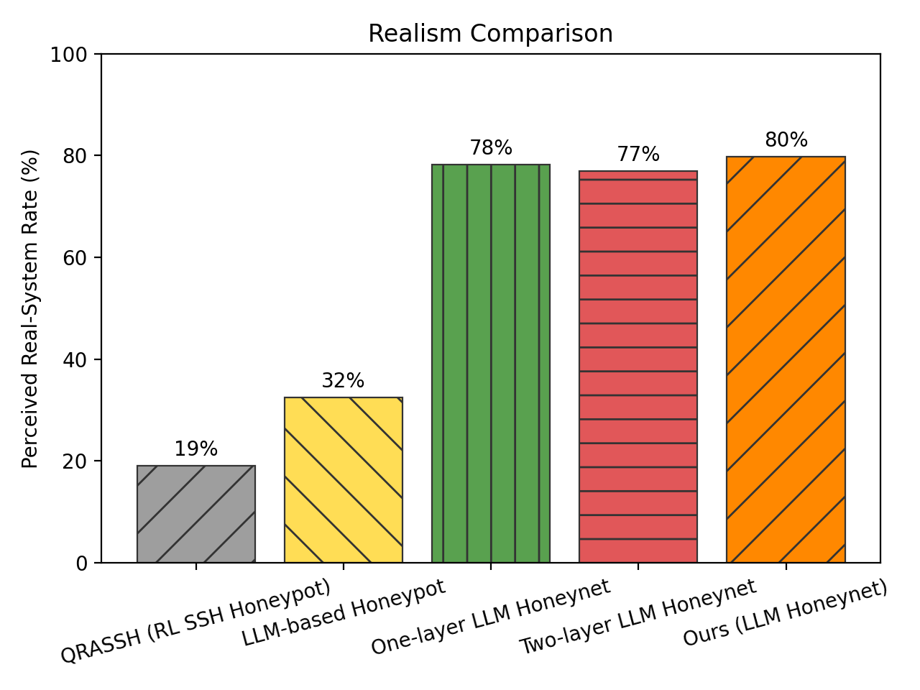
Experiment - Realism Environment-level honeynet is the main source of realism
Ours is over 4× higher than QRASSH and about 2.5× higher than LLM honeypot
Real environment changes are more believable than static behavior or generated replies
One-layer, two-layer, and ours are all close to 80%
The main realism gain comes from environment-level adaptation, not the LLM architecture alone
Simulate Success Rate
QRASSH: 19%
LLM-based Honeypot: 32%
One-layer LLM Honeynet: 78%
Two-layer LLM Honeynet: 77%
Two-layer LLM Honeynet(FT): 80%
Notes:
title是issue
subtitle直接寫簡短的答案直接的回覆
右邊寫結論縮排寫原因
replay level vs environment level：32% to 80%
名詞改一致
subtitle抓出重要的1-2個數字

Slide 26
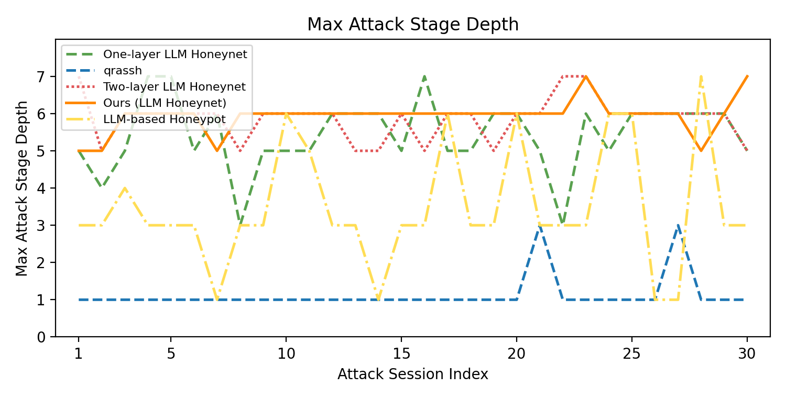
Experiment - Attack Depth Ours reaches the deepest and most stable attack progression
Honeynet methods reach much deeper stages than honeypot baselines
They provide real multi-host paths for credential access, privilege escalation, and lateral movement
Ours improves over one-layer by about 9% and reaches the highest average depth
Separating strategy reasoning from tool planning makes deep-stage progression more stable
Average Depth of Episode
QRASSH: 1.13
LLM-based Honeypot: 3.47
One-layer LLM honeynet: 5.43
Two-layer LLM honeynet: 5.87
Two-layer LLM honeynet (FT) : 5.93

Slide 27
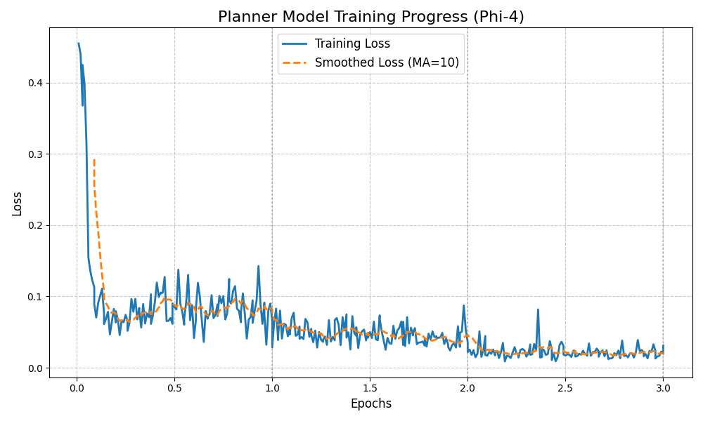
Experiment - Attack Depth Training converge in 3 epochs
Rapid early convergence: loss falls from ~0.45 to <0.1 at the beginning of training
Stable optimization: the smoothed curve keeps decreasing with only minor fluctuations
Final outcome: loss reaches ~0.02 after 3 epochs, indicating effective planner fine-tuning
Notes:
subtitle寫說訓練過程
圖上加一條線練壞的結果

Slide 28
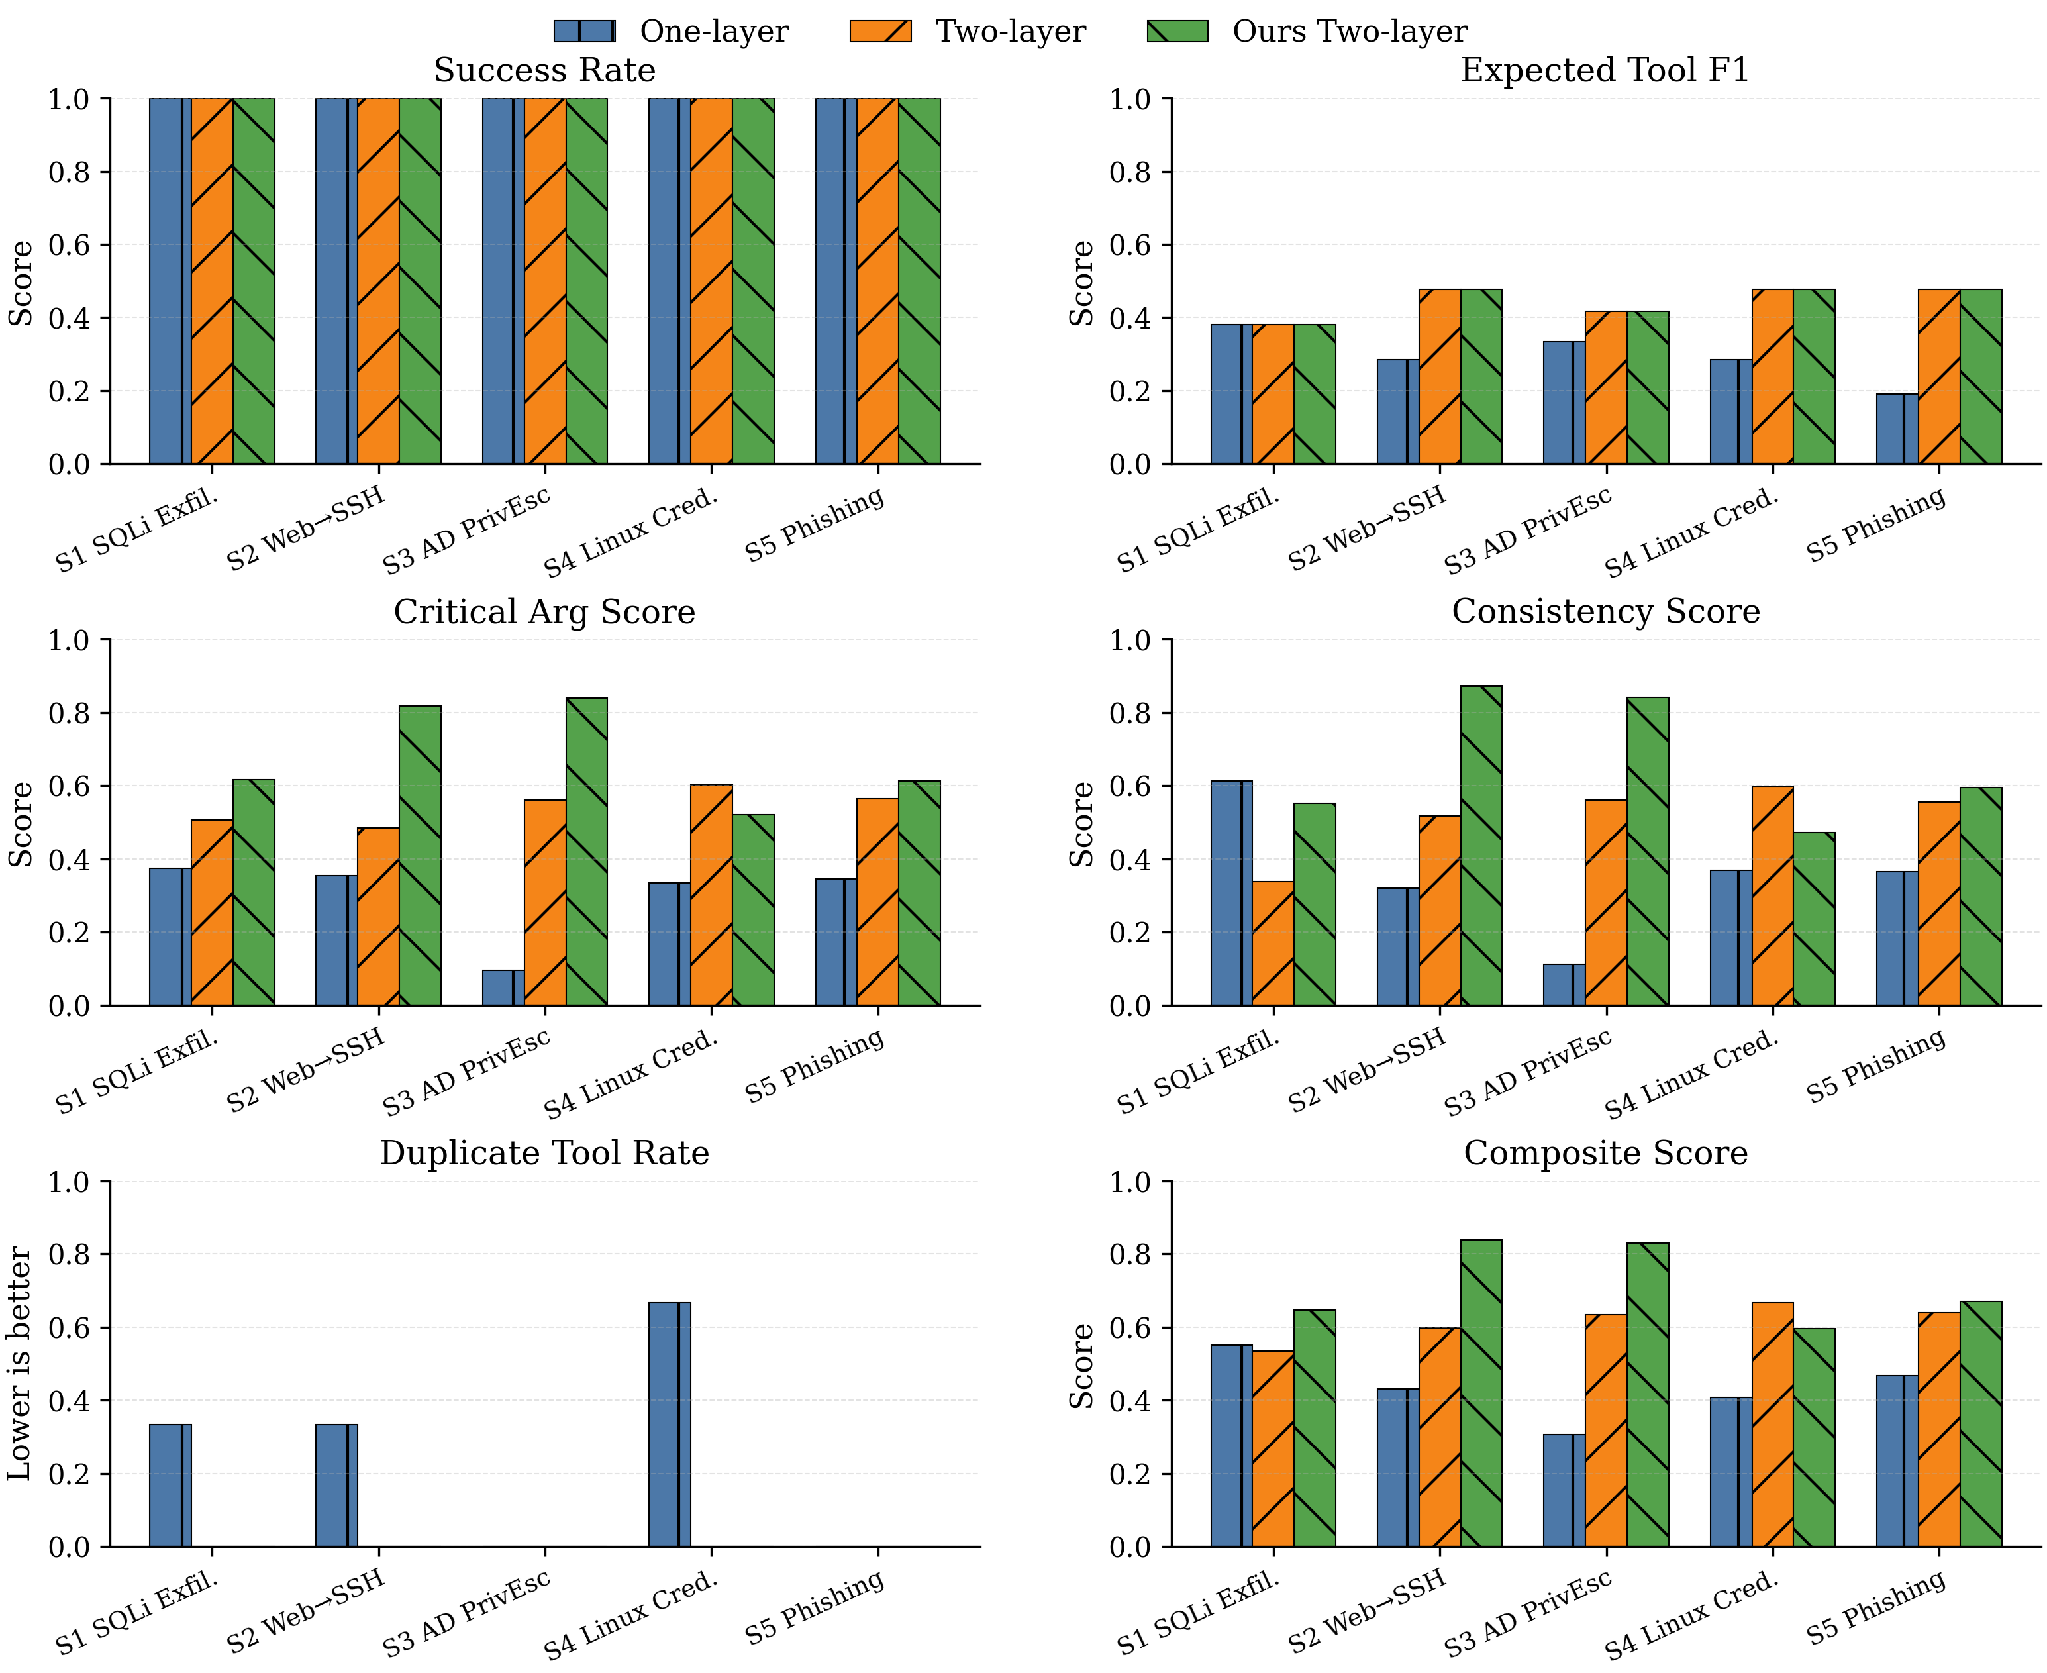
Experiment - Attack Depth Ours gives the best overall plan quality
Ours improves the overall score by about 67% over one-layer
Separating strategy reasoning from tool-argument planning improves plan quality
Ours improves the overall score by about 18% over non-FT two-layer
Fine-tuning mainly improves argument quality and cross-tool consistency
Duplicate-tool behavior almost disappears after moving beyond one-layer.
Two-layer planning avoids repeatedly using redundant tools in the same scenario.
Overall score
One-layer LLM honeynet: 0.43
Two-layer LLM honeynet: 0.61
Two-layer LLM honeynet (FT) : 0.72
Notes:
可以放分析defender行為選的工具分布等等

Slide 29
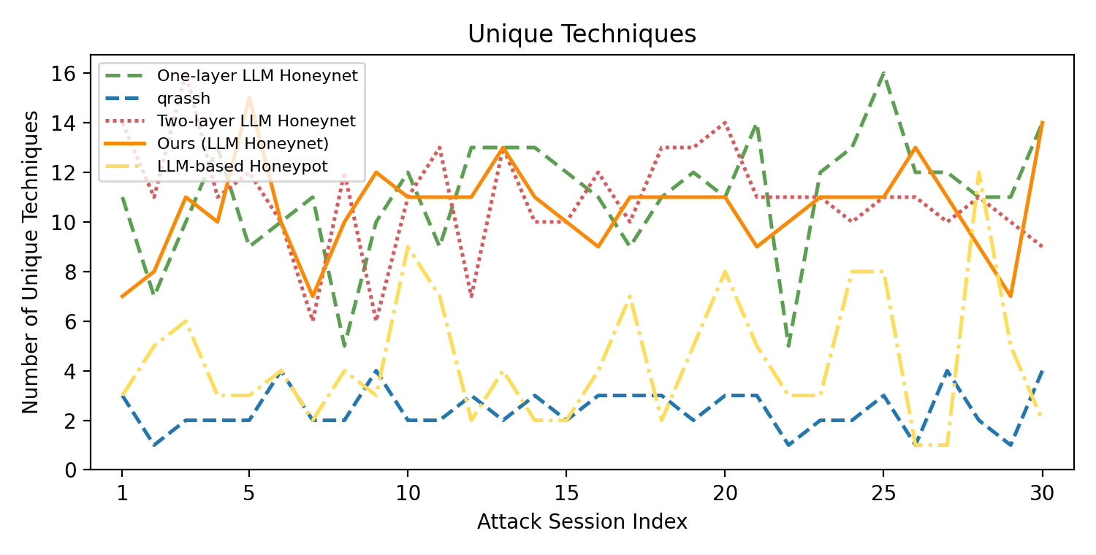
Experiment - Behavior Diversity Honeynet variants keep behavior diversity high across sessions
Honeynet variants are over 4× higher than QRASSH and over 2× higher than LLM honeypot
Multi-host state provides more attack opportunities than single-host interaction
One-layer, two-layer, and FT stay in the same high-diversity range.
Environment-level honeynet design is the main factor behind diverse attacker behavior.
Average Diversity of Episode
QRASSH: 2.43
LLM-based Honeypot: 4.43
One-layer LLM Honeynet: 11.07
Two-layer LLM Honeynet : 10.96
Two-layer LLM honeynet (FT) : 10.53

Slide 30
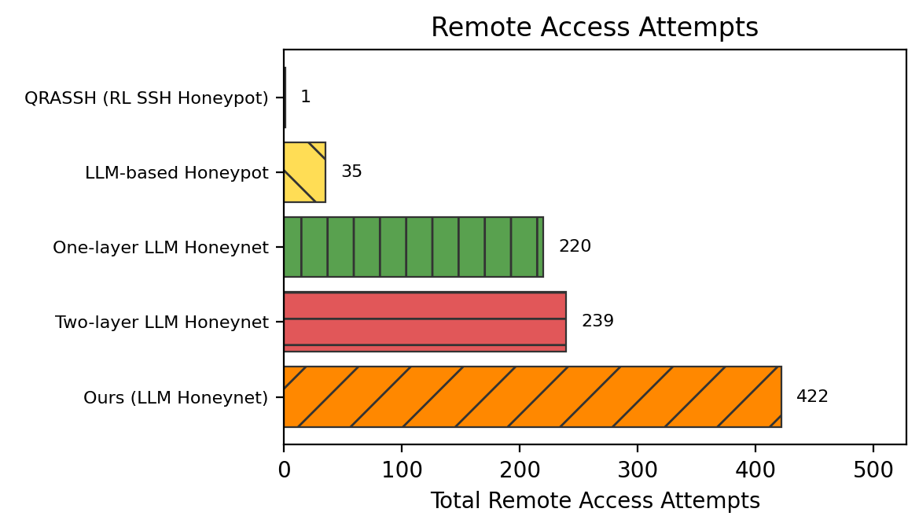
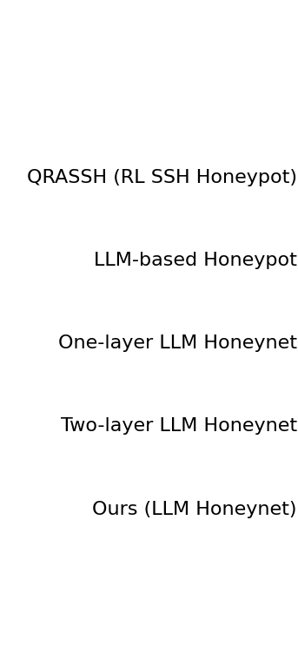

Experiment - Lateral Movement Ours creates the most attempts with real cross-host success
Ours produces far more remote access attempts than all baselines
The AD honeynet exposes real hosts, accounts, credentials, and services for attackers to try
LLM honeypot has the highest success rate but only 35 attempts
Its success is inflated by generated replies, not real cross-host execution
Ours reaches 36.3% success with 422 attempts
This shows stronger effective support for realistic lateral movement
Average Diversity of Episode
QRASSH: 1 attempts, 0.0% success
LLM-based Honeypot: 35 attempts, 54.3% success
One-layer LLM Honeynet: 220 attempts, 11.8% success
Two-layer LLM Honeynet: 239 attempts, 14.6% success
Two-layer LLM honeynet (FT) : 422 attempts, 36.3% success

Slide 31
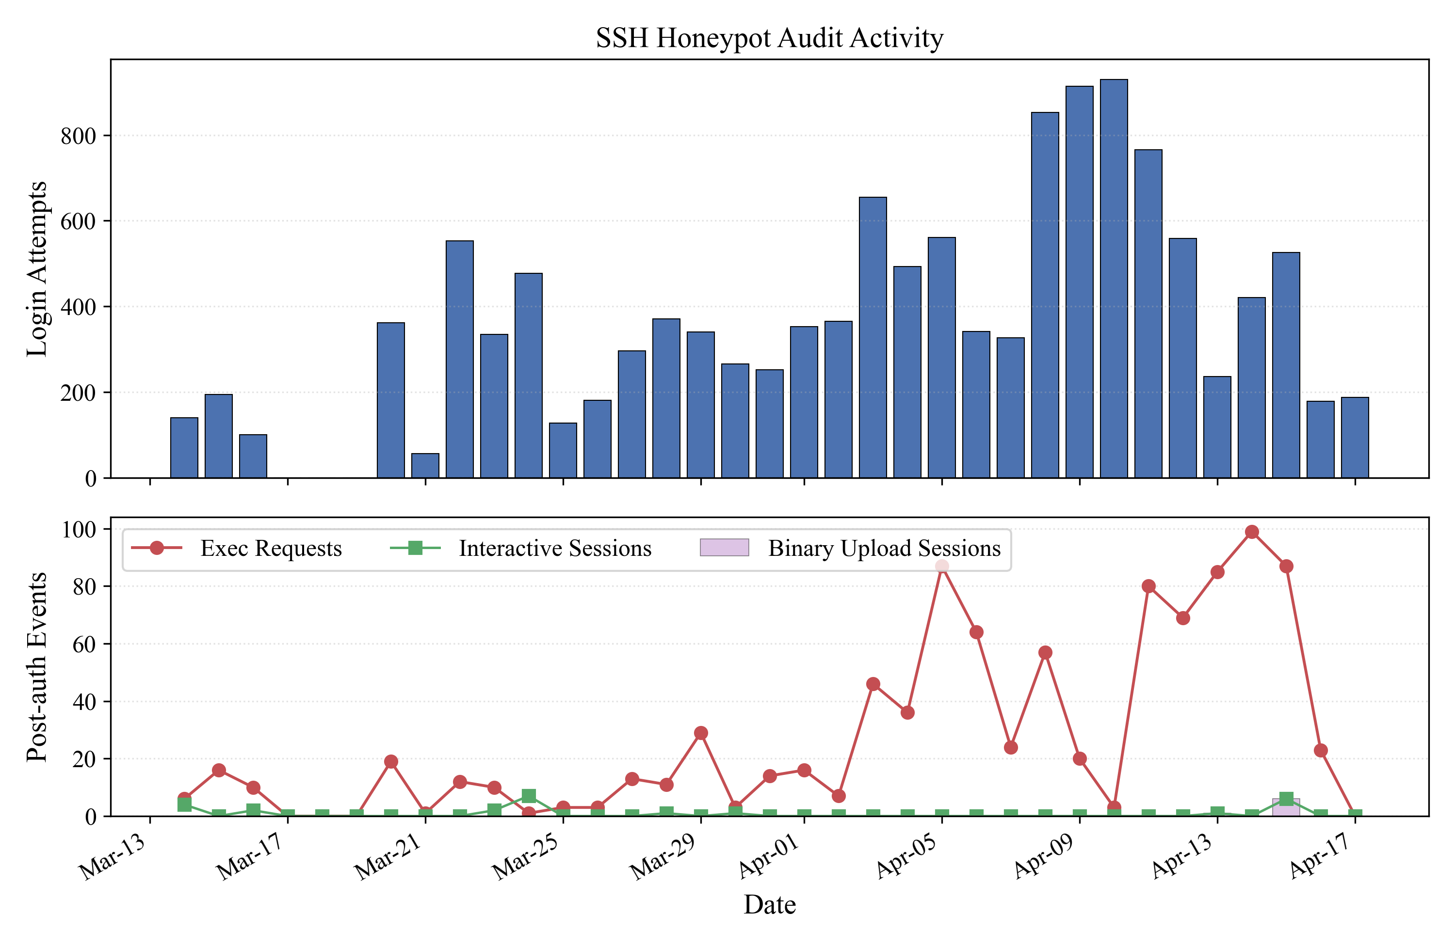
Experiment - Real-world SSH Attack Activity
The honeypot received continuous login attempts after deployment.
This shows the deployed entry point successfully attracted real SSH attack traffic.
Several days reached hundreds of login attempts.
The environment was exposed enough to collect non-trivial attacker activity.
Exec requests dominate the post-auth behavior.
Most successful interactions were command-execution attempts rather than long manual sessions.

Slide 32
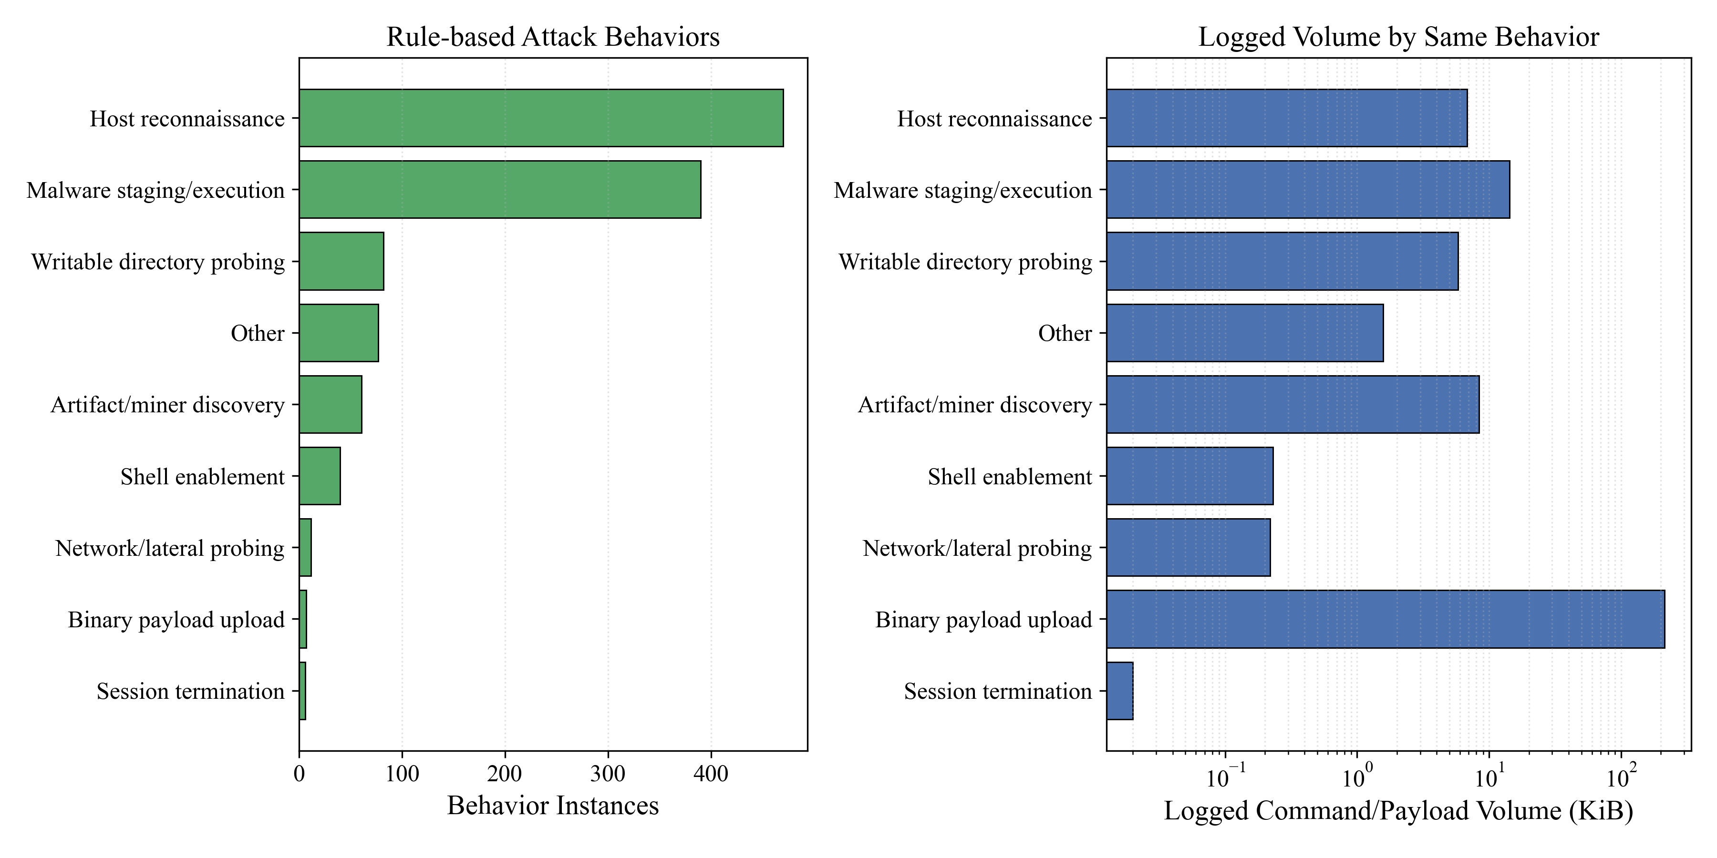
Experiment - Real-world SSH Attack Activity
Host reconnaissance is the most frequent behavior
Attackers first try to understand the host, environment, and available commands
Malware staging / execution is the second major behavior
Many attackers quickly move from probing to preparing or running payloads
Binary payload upload has low frequency but high volume
Few sessions upload binaries, but each upload contributes much larger data size

Slide 33
Reference
S. Liu, J. Sun, and K. Sun, Catch Me if You Can: Effective Honeypot Placement in Dynamic AD Attack Graphs. Fairfax, VA, USA: George Mason University, 2024.
D. Blazakis, J. S. Lee, and J. A. Harder, HoneyWin: High-Interaction Windows Honeypot in Enterprise Environment, Proc. 2020 IEEE European Symposium on Security and Privacy Workshops (EuroS&PW), Genoa, Italy, 2020, pp. 236–243, doi: 10.1109/EuroSPW51379.2020.00045.
J. Sun, S. Liu, and K. Sun, “A Scalable High Fidelity Decoy Framework against Sophisticated Cyber Attacks,” in Proc. 6th ACM Workshop on Moving Target Defense (MTD’19), London, U.K., Nov. 2019, pp. 37–46, doi: 10.1145/3338468.3356826.
Y. Aoike, M. Kamizono, M. Eto, N. Matsumoto, and N. Yoshida, “Decoy-File-Based Deception without Usability Degradation,” in Proc. 2021 IEEE Asia-Pacific Conference on Computer Science and Data Engineering (CSDE), 2021, pp. 971–978, doi: 10.1109/CSDE53843.2021.9718420.
V. S. N. Tinnaluri and N. Shaik, “A Comprehensive Approach: Developing A Honeypot System To Thwart Cyber Attackers,” Educational Administration: Theory and Practice, vol. 30, no. 5, pp. 9093–9099, 2024, doi: 10.53555/kuey.v30i5.4517.
Y.-D. Lin, Y.-H. Lu, R.-H. Hwang, Y.-C. Lai, D. Sudyana, and W.-B. Lee, “Evolving ML-Based Intrusion Detection: Cyber Threat Intelligence for Dynamic Model Updates,” IEEE Transactions on Machine Learning in Communications and Networking, vol. 3, pp. 605–612, 2025, doi: 10.1109/TMLCN.2025.3564587.
O. Rehnbäck, A Case Study of Unauthorized Login Attempts Against Honeypots via Remote Desktop, M.Sc. thesis, Luleå University of Technology, Sweden, July 2023.QRASSH: A Self-Adaptive SSH Honeypot Driven by Q-Learning

Slide 34
Reference
A. Pauna, A.-C. Iacob, and I. Bica, “QRASSH: A Self-Adaptive SSH Honeypot Driven by Q-Learning,” in Proc. 2018 IEEE International Conference on Communications (ICC), 2018, pp. 1–6, doi: 10.1109/ICC.2018.8422876.
Z. Wang, J. You, H. Wang, T. Yuan, S. Lv, Y. Wang, and L. Sun, “HoneyGPT: Breaking the Trilemma in Honeypots with Large Language Models,” arXiv preprint arXiv:2406.01882v2, Feb. 2025.
C.-Y. Hsieh, “Active Directory Deception: A Reinforcement Learning Honeypot Aligned with MITRE Engage,” M.S. thesis, Inst. of Computer Science and Engineering, National Yang Ming Chiao Tung University, Hsinchu, Taiwan, Jun. 2025.
T. Yang, C. Zhang, and Y. Xu, “HoneyFactory: A Honeynet Generation Architecture for Capturing Multi-Stage Network Attacks,” Electronics, vol. 13, no. 2, p. 361, Jan. 2024.
L. J. Möller, “An Adaptive Multi-Layered Honeynet Architecture for Threat Behavior Analysis via Deep Learning,” arXiv preprint arXiv:2512.07827, Dec. 2025.
F. Lucchese, F. Zago, M. Polino, and S. Zanero, “HoneyICS: A High-Interaction Honeynet for Industrial Control Systems,” in Proceedings of the 18th International Conference on Availability, Reliability and Security (ARES), Aug. 2023.
M. Kouremetis et al., “Mirage: Cyber Deception Against Autonomous Cyber Attacks in Emulation and Simulation,” Annals of Telecommunications, vol. 79, pp. 803–817, Mar. 2024, doi: 10.1007/s12243-024-01018-4.
S. Suratkar, K. Shah, A. Sood, A. Loya, D. Bisure, U. Patil, and F. Kazi, “An Adaptive Honeypot Using Q-Learning with Severity Analyzer,” Journal of Ambient Intelligence and Humanized Computing, vol. 13, pp. 4865–4876, 2022, doi: 10.1007/s12652-021-03229-2.
R.-H. Hwang, J.-C. Huang, Y.-C. Lai, and Y.-D. Lin, “Leveraging Reinforcement Learning for LLM-Based Generic Honeypots with MITRE Engage Framework,” M.S. thesis, Inst. of Computer Science and Engineering, National Yang Ming Chiao Tung University, Hsinchu, Taiwan, Jun. 2025.

Slide 35
Reference
N. Lee, T. Wattanawong, S. Kim, K. Mangalam, S. Shen, G. Anumanchipalli, M. W. Mahoney, K. Keutzer, and A. Gholami, “LLM2LLM: Boosting LLMs with Novel Iterative Data Enhancement,” arXiv preprint, arXiv:2403.15042v2, July 2024.
J. Chen, X. Han, Y. Ma, X. Zhou, and L. Xiang, “Unlock the Correlation Between Supervised Fine-Tuning and Reinforcement Learning in Training Code Large Language Models,” arXiv preprint, arXiv:2406.10305v2, Dec. 2024.
A. Pareja, N. S. Nayak, H. Wang, K. Killamsetty, S. Sudalairaj, W. Zhao, S. Han, A. Bhandwaldar, G. Xu, K. Xu, L. Han, L. Inglis, and A. Srivastava, “Unveiling the Secret Recipe: A Guide for Supervised Fine-Tuning Small LLMs,” arXiv preprint, arXiv:2412.13337v1, Dec. 2024.
M. Nădaş, L. Dioşan, and A. Tomescu, “Synthetic Data Generation Using Large Language Models: Advances in Text and Code,” arXiv preprint, arXiv:2503.14023v2, July 2025.
S. Pujar, L. Buratti, X. Guo, N. Dupuis, B. Lewis, S. Suneja, A. Sood, G. Nalawade, M. Jones, A. Morari, and R. Puri, “Automated Code Generation for Information Technology Tasks in YAML through Large Language Models,” arXiv preprint arXiv:2305.02783 (v4), May 2023.
L. Fan, Z. Liu, H. Wang, L. Bao, X. Xia, and S. Li, “FGIT: Fault-Guided Fine-Tuning for Code Generation,” arXiv preprint arXiv:2503.16913 v3, Sept. 2025.
H. Li, W. Feng, X. Zhou, and Z. Shen, “GiFT: Gibbs Fine-Tuning for Code Generation,” Proceedings of the 63rd Annual Meeting of the Association for Computational Linguistics (Volume 1: Long Papers), pp. 12271–12285, July 27–Aug. 1, 2025, doi:10.18653/v1/2025.acl-long.692.
X. Jiang, Y. Dong, Z. Jin, and G. Li, “SEED: Customize Large Language Models with Sample-Efficient Adaptation for Code Generation,” arXiv preprint arXiv:2403.00046 v2, Mar. 2024.

Slide 36
Thank You

Slide 37
Schedule
 | 7 | 8 | 9 | 10 | 11 | 12 | 1 | 2 | 3 | 4 | 5 | 6
Thesis Survey
Proposal Writing
Dataset Generation
SFT, RFT Implementation
Experiment
Thesis Writing

Slide 38
Problem Statement – Fine tuned LLM Agent
Input:
𝑀 : Mitre Engage activity
Output:
𝑃 = (𝑆₁, 𝑆₂, ..., 𝑆ₙ) : executable scripts, where 𝑆i is ran on 𝐻𝑜𝑠𝑡i, and can be empty
Objective:
Maximize Testing-Dataset Accuracy
Maximize script execution success rate
Constraint：
LLM must run inside the honeynet
Response time < 10 seconds

Slide 39
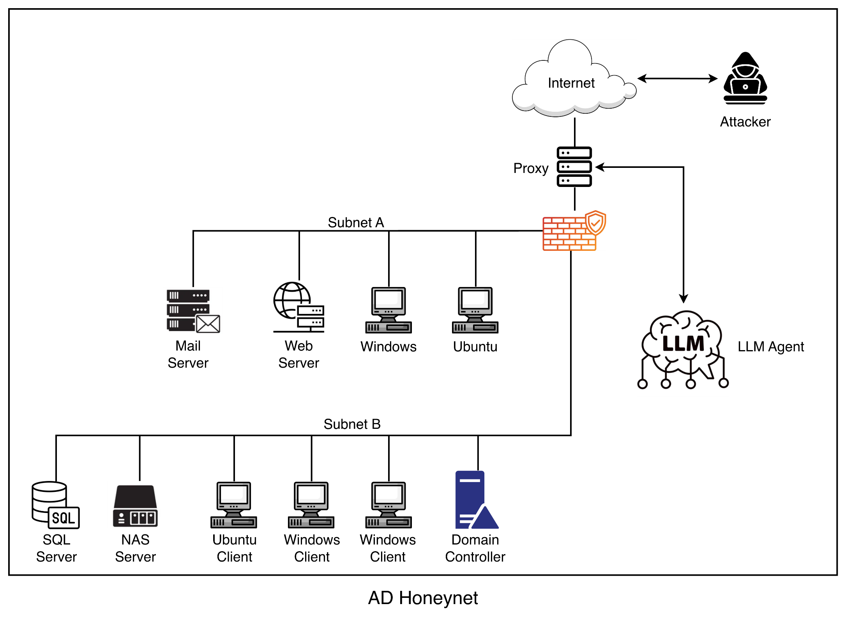
Background - AD Honeynet
A cybersecurity deception network built to emulate a real Active Directory
To detect, deceive, and delay attackers targeting AD infrastructure
Allows security teams to safely study attacker TTPs
Notes:
加上honeypot架構對比，需放honeypot llm (commands->action->script) 與honeynet llm (commands->action->tasks->scripts)(要有數量的感覺) 的流程
移到problem下一頁

Slide 40
Related Work on Honeypot / Honeynet
Category | Paper | Real System | Active Directory | Objective |  |  | Strategist | Action Design
 |  |  |  | Interaction | Deception | Defense
Honeypot | QRASSH [8] | - | - | V | - | - | RL | ABDSI
 | HoneyBog [9] | V | - | - | - | V | Rule-based | RFS
 | HoneyGPT [10] | - | - | V | V | - | LLM | S
 | Senior [11] | V | V | V | - | - | RL | ABSG^{U}G^{F}
Honeynet | Mirage [12] | V | V | - | - | V | Rule-based | M^{F}
 | Ours | V | V | V | V | V | LLM | MITRE Engage–guided Tools (stored in MCP server)
A=Allow, B=Block, D=Delay, S=Substitute(Fake), I=Insult, R=Redirect, F=File Synchronize, G^{U}=Generate user, G^{F}=Generate File, M^{F}=Modify File System

Slide 41
Solution - LLM Agent Design (cont.)

Slide 42
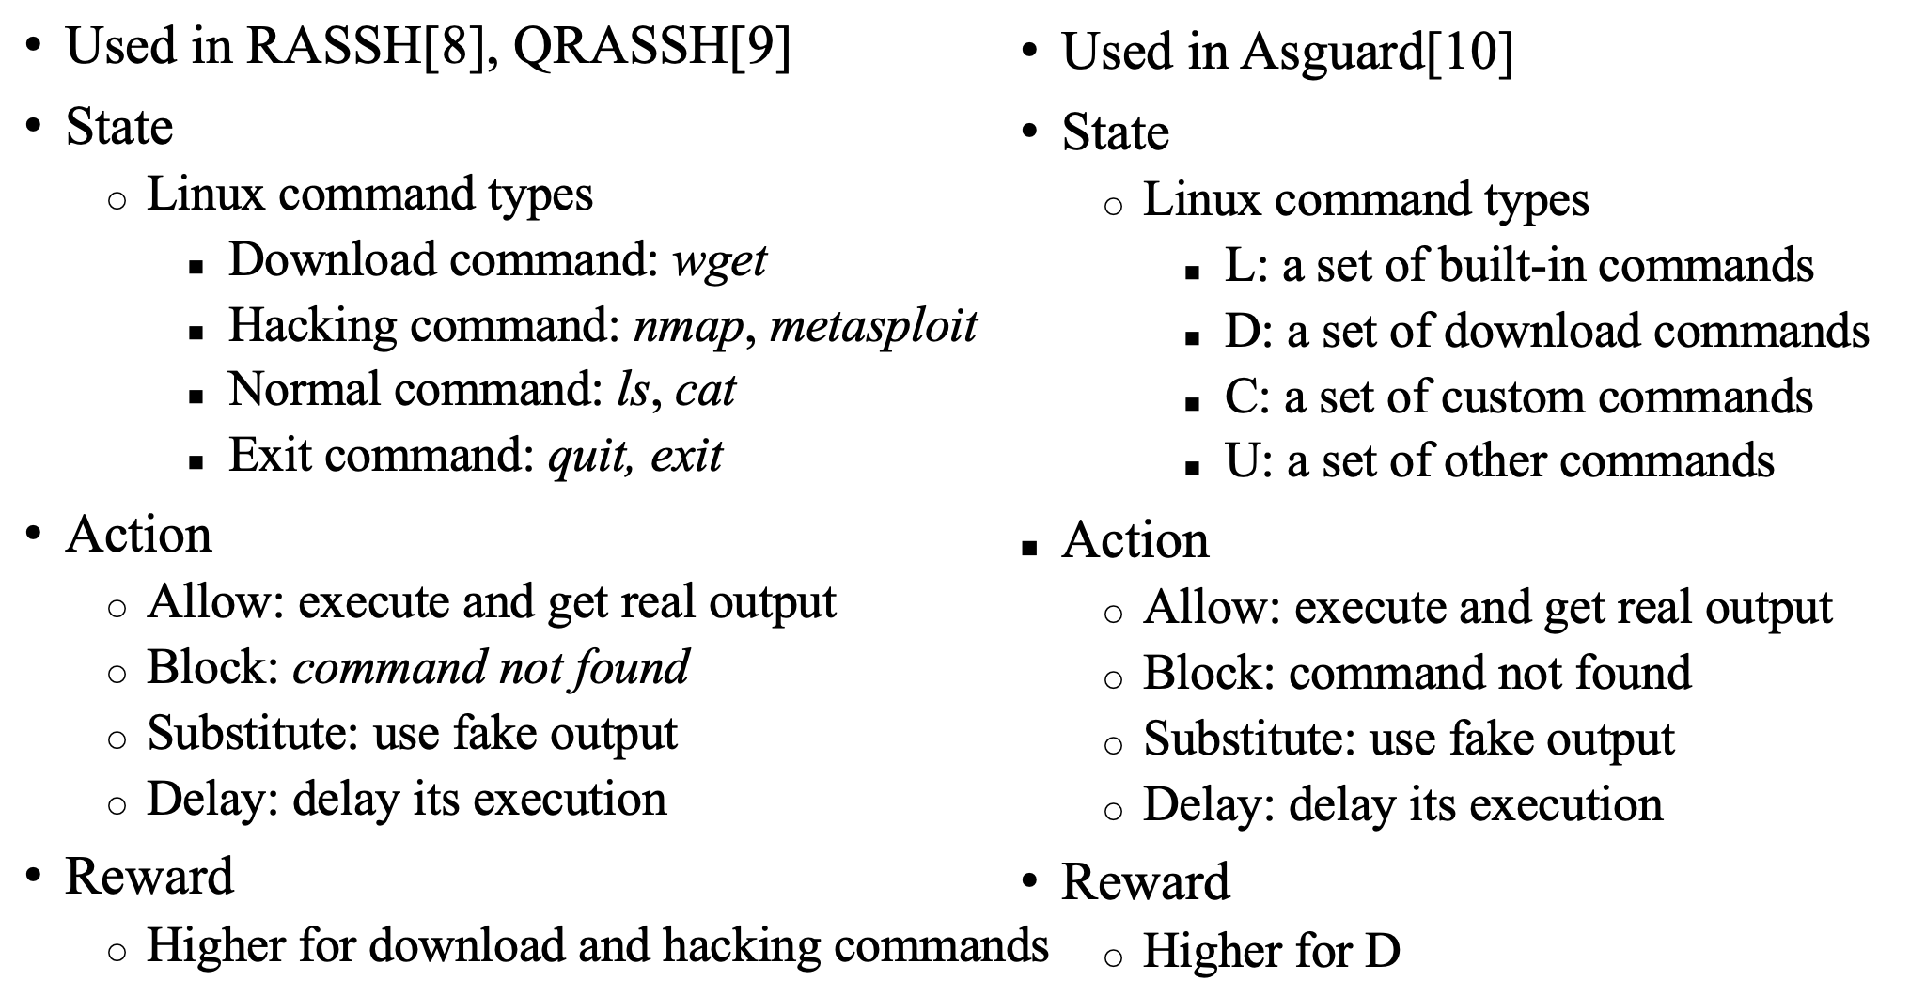
Background - RL-based Adaptive Honeypot

Slide 43
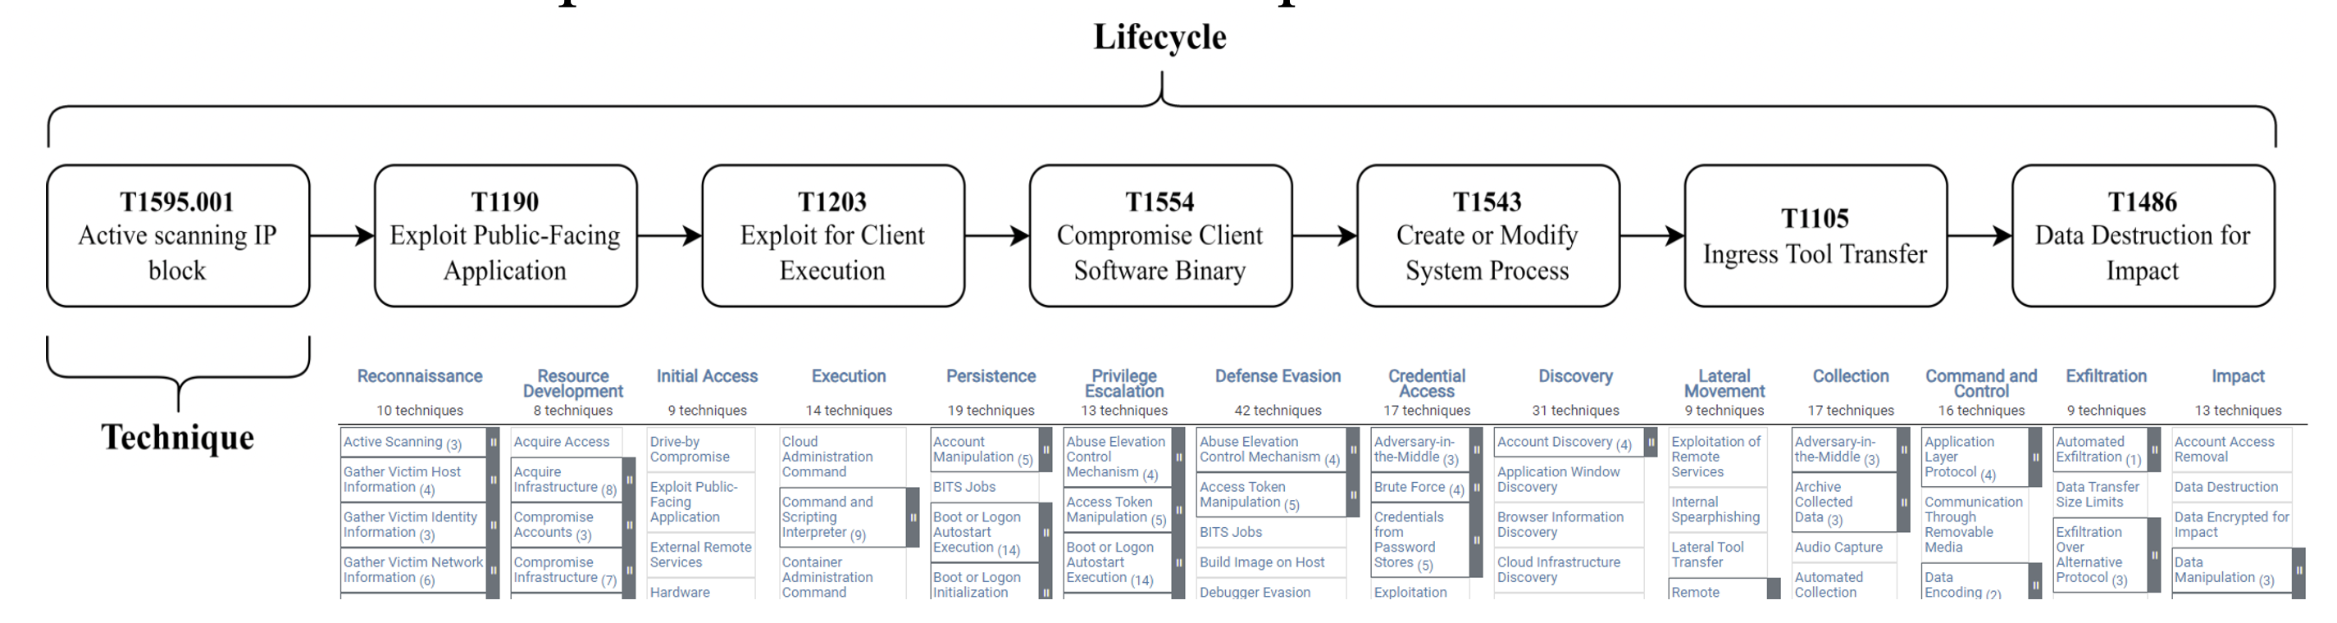
Background - MITRE ATT&CK
Lifecycle: a sequence of techniques
Tactic: an attacking phase
Technique: an attacking approach for a specific tactic
Procedure: implementation of a technique

Slide 44
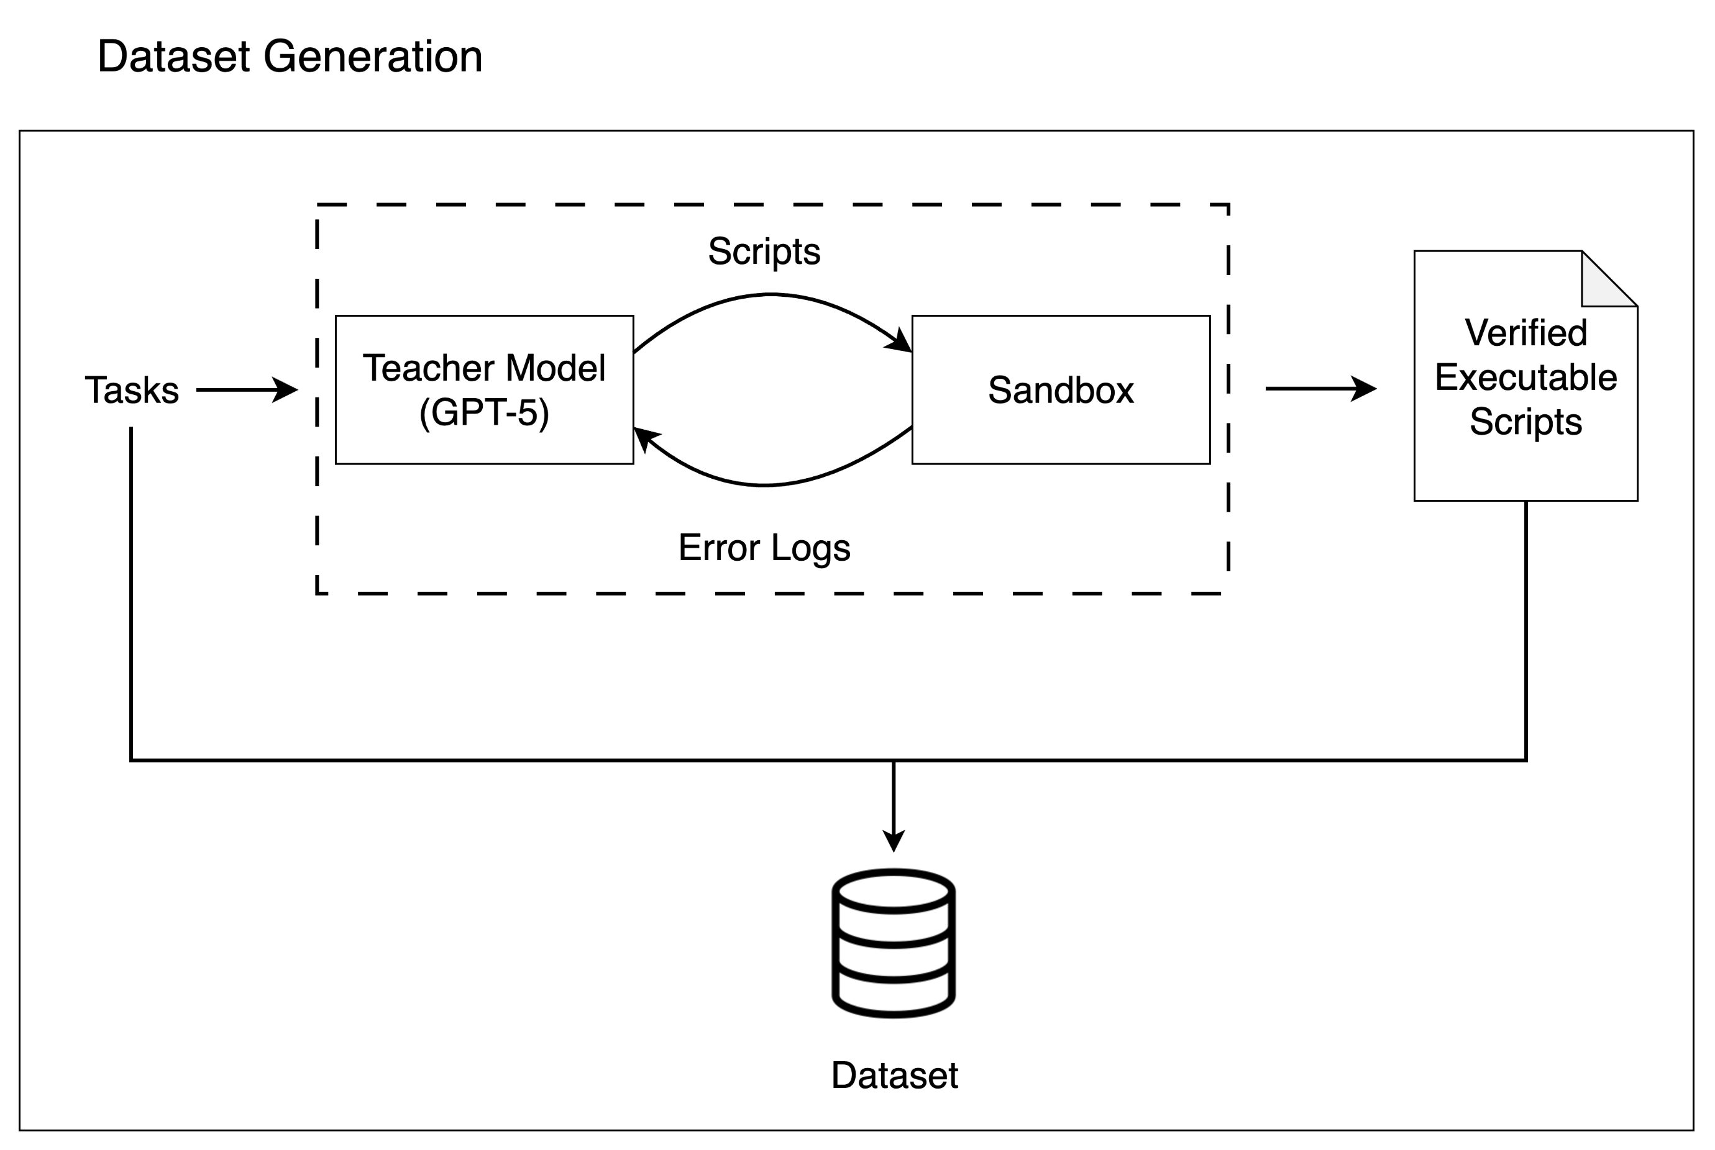
Solution - Dataset Generation
Generate a synthetic dataset using a "teacher" LLM to create scripts
Validated via execution in a closed-loop sandbox

Slide 45
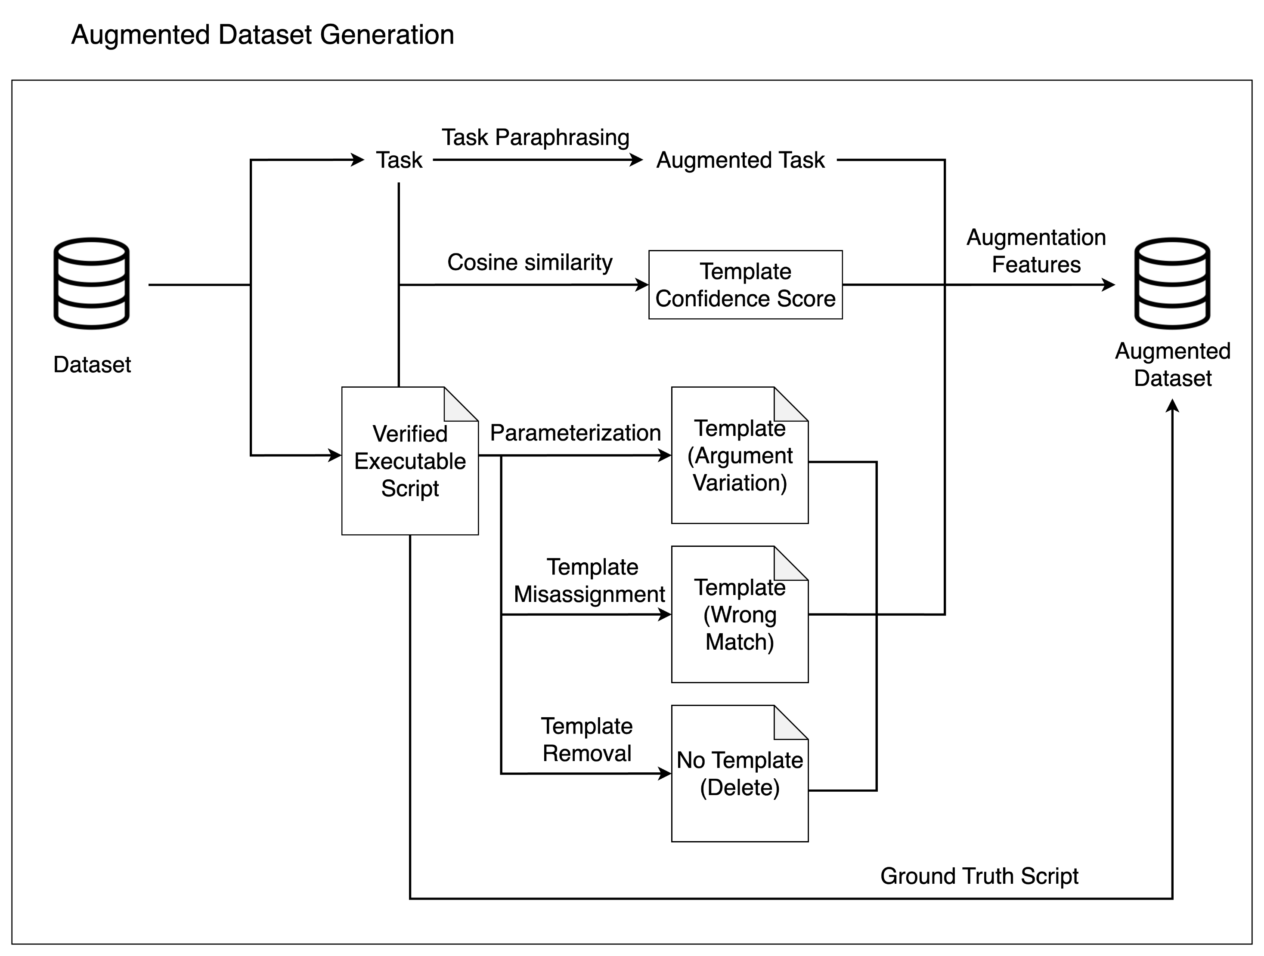
Solution - Augmented Dataset Generation
Enhance model generalization
Improve tolerance to RAG template mismatch

Slide 46
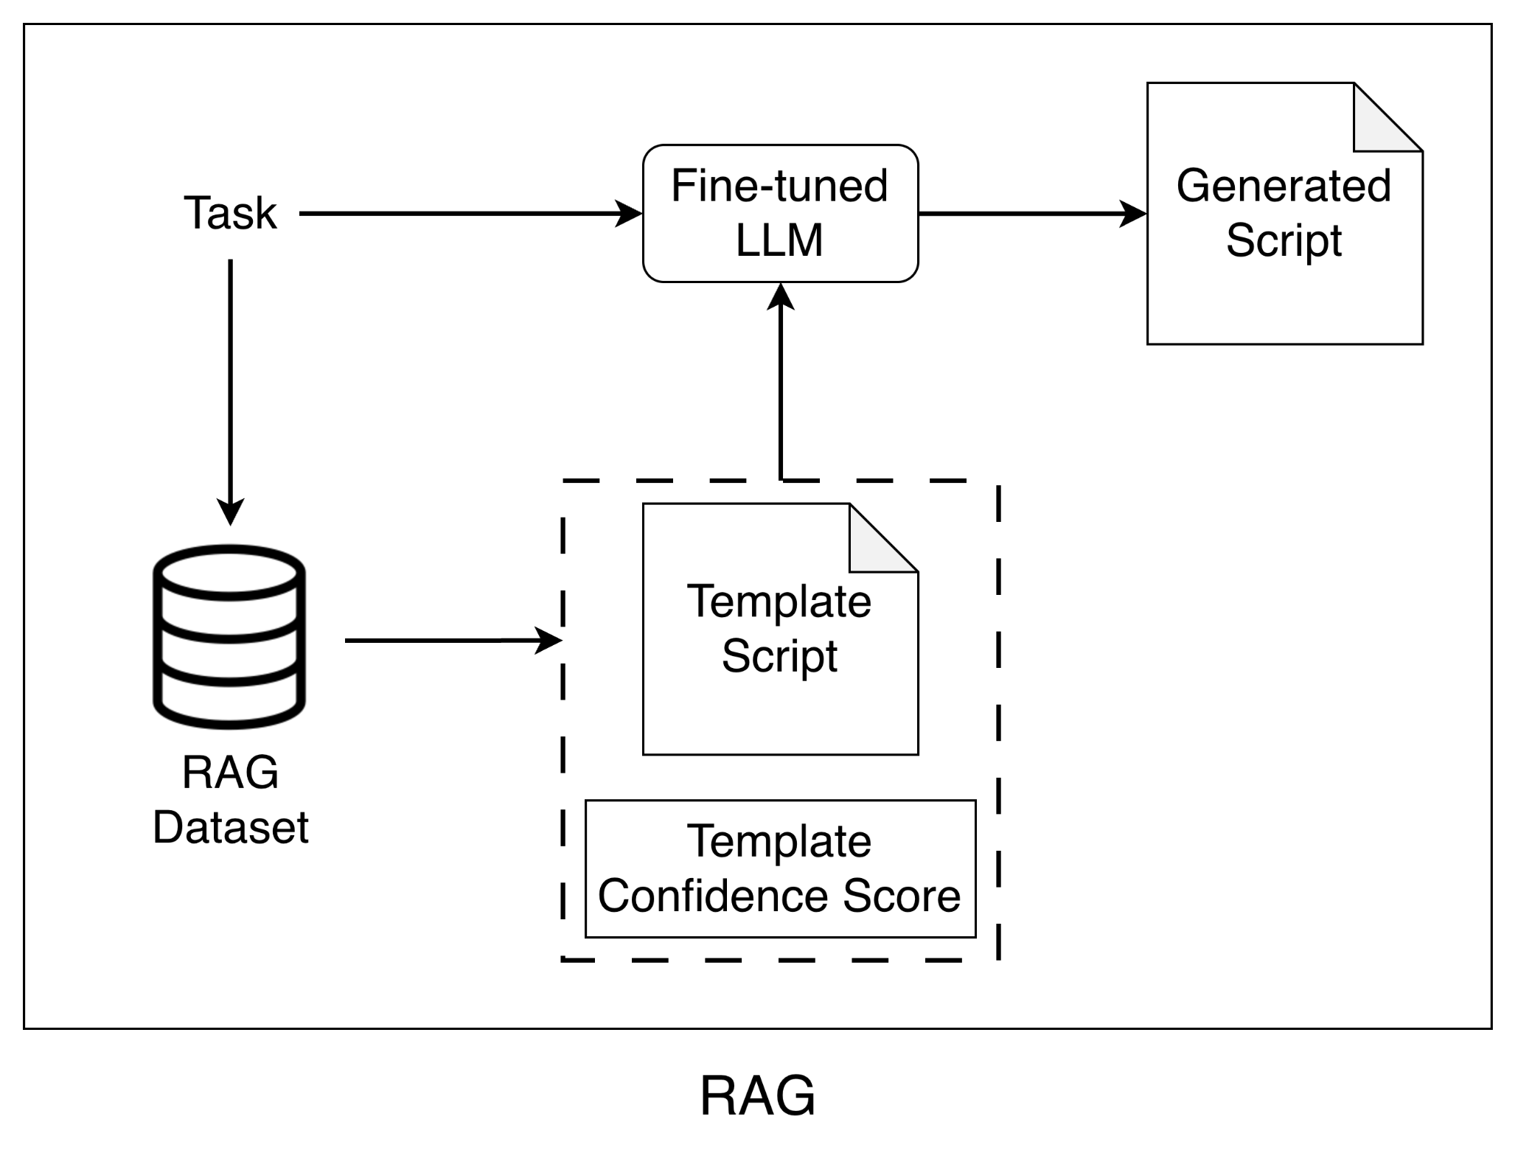
Background - RAG
Improve the quality and accuracy of model generation

Slide 47
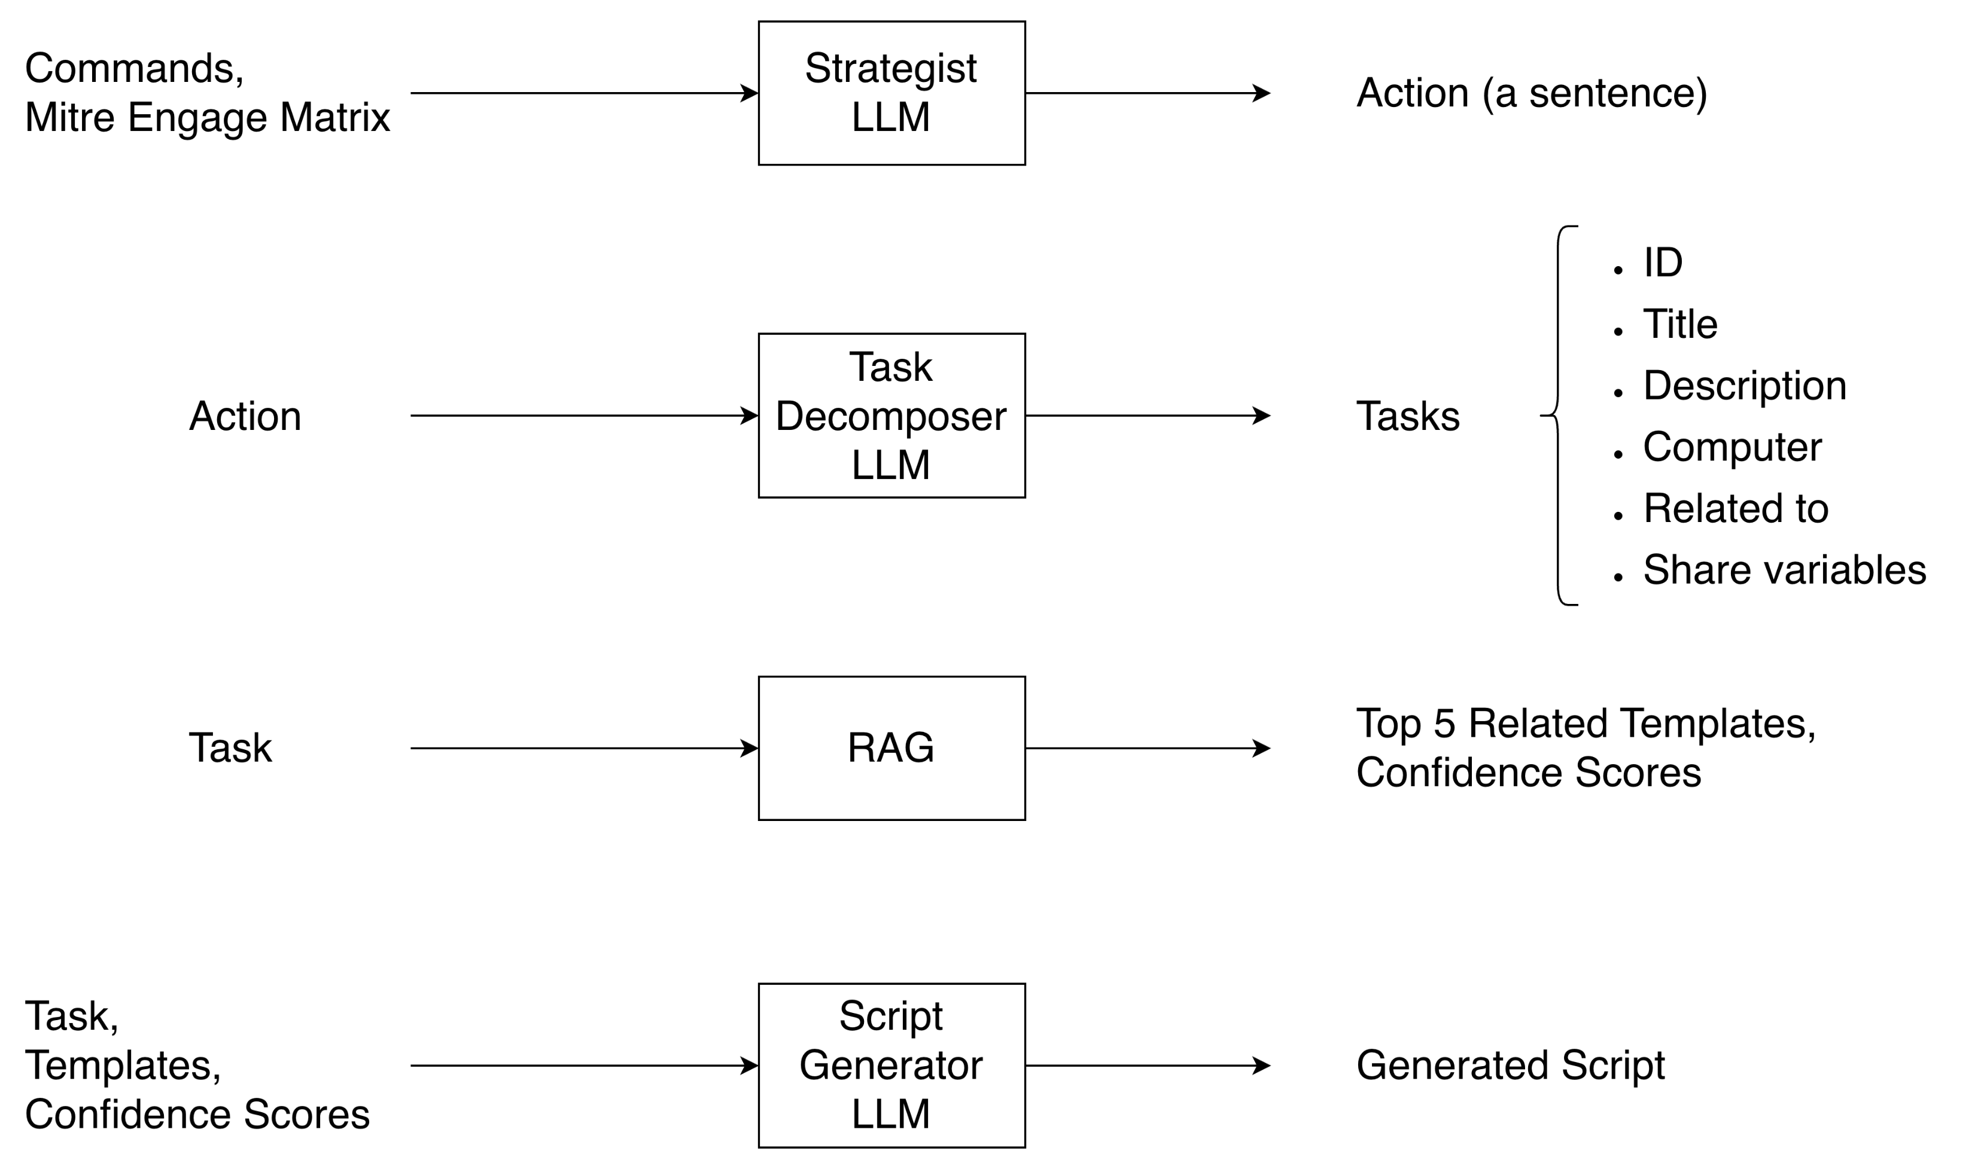
Background
Notes:
Commands -> technique -> activity -> action -> tasks -> scripts -> system response
Strategist llm -> action to tasks llm -> task to script llm
移到ad honeynet那頁，可刪除

Slide 48
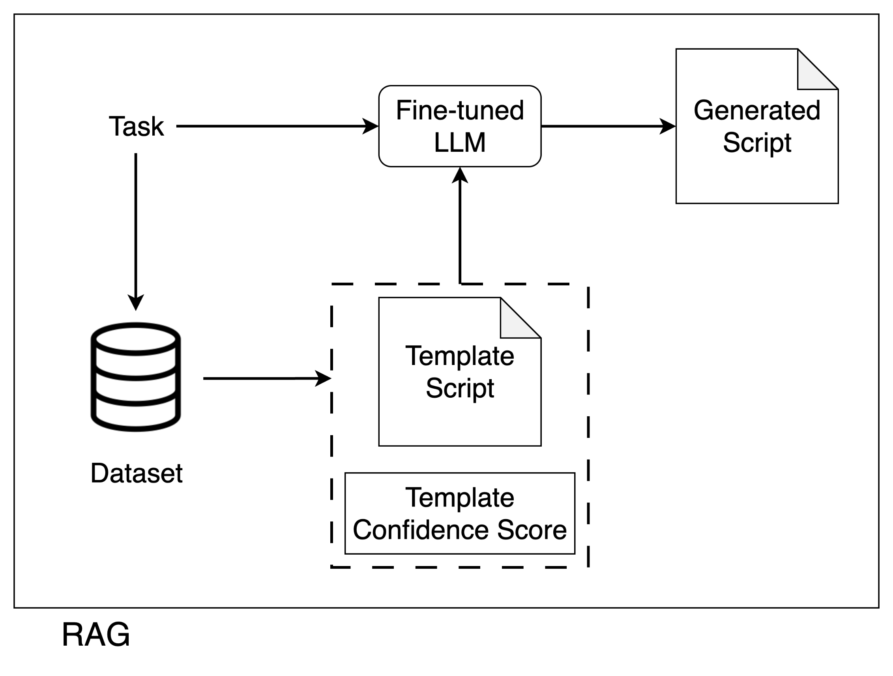
Solution - Retrieval-Augmented Generation
Improve the quality and accuracy of model generation
Output a confidence score for the model to assess template reliability

Slide 49
Solution - Augmented Dataset Generation
Enhance model generalization
Improve tolerance to RAG template mismatch

Slide 50
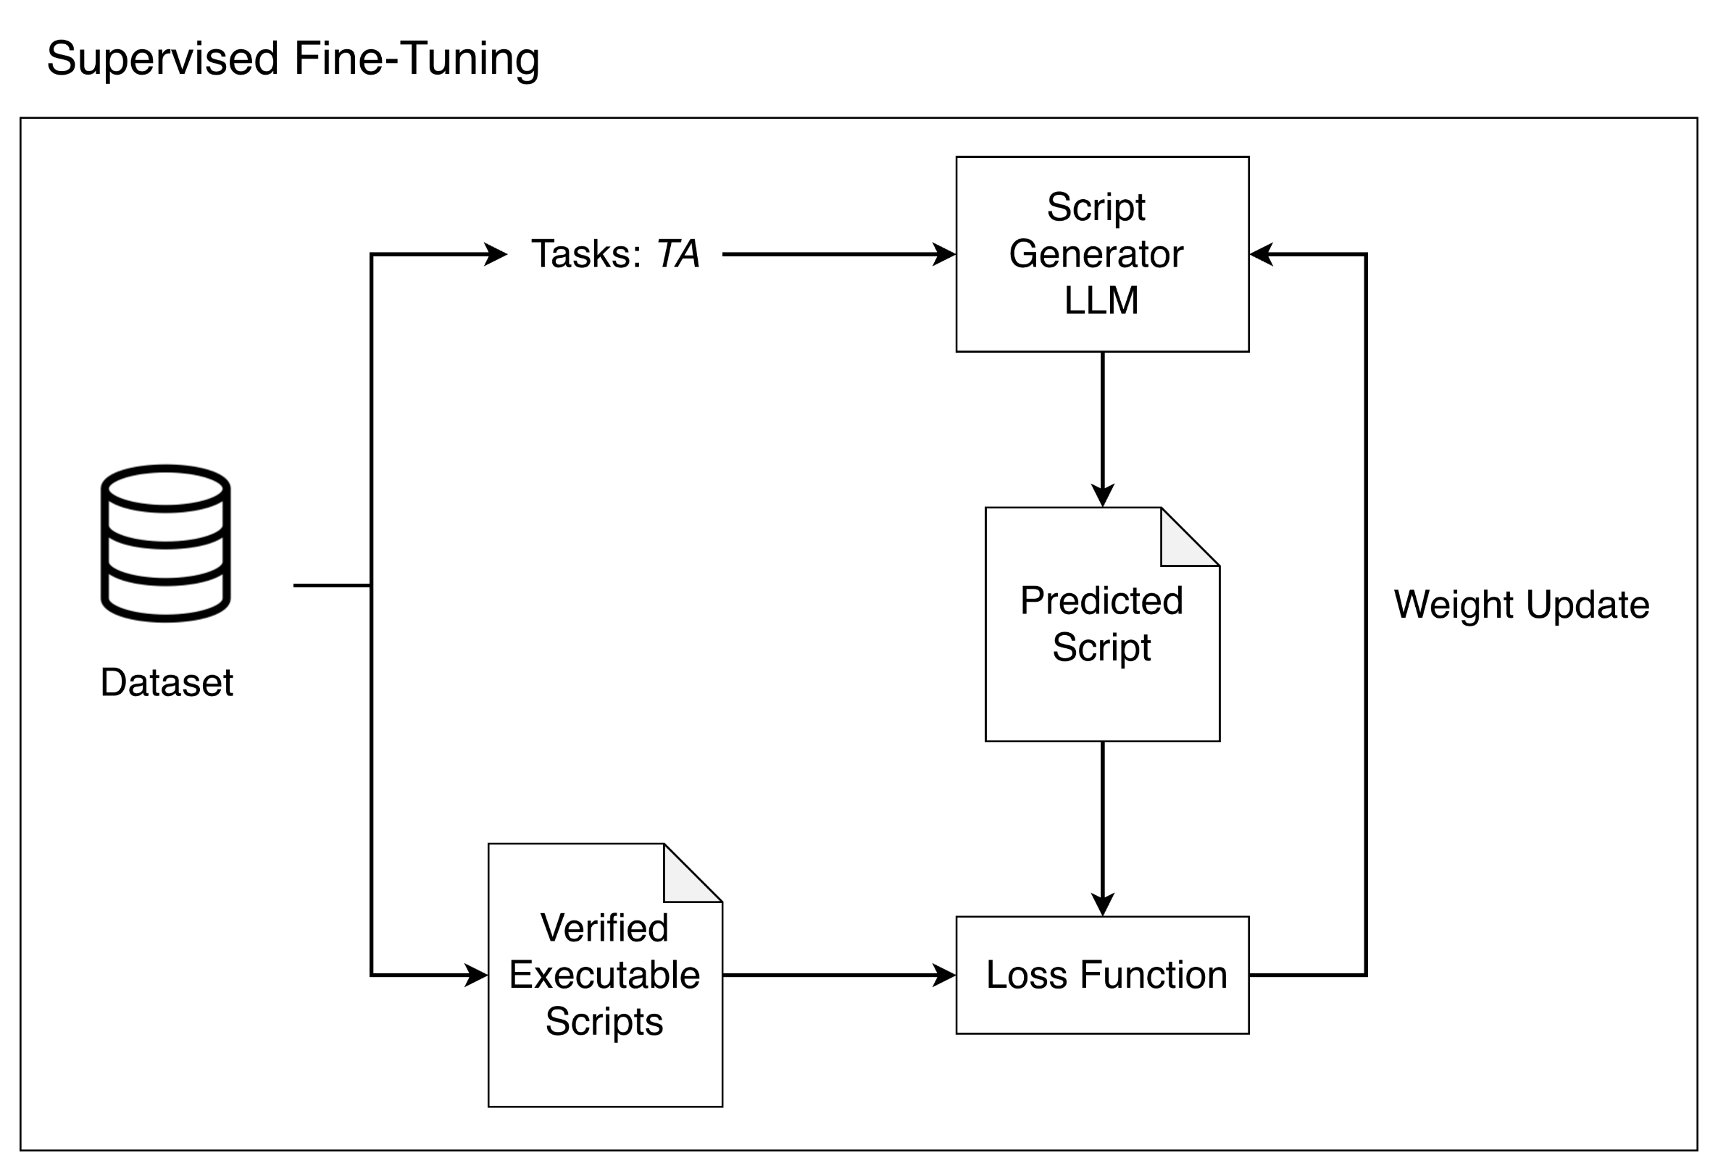
Solution – Supervised Fine-Tuning
A smaller LLM is then fine-tuned for script generation

Slide 51
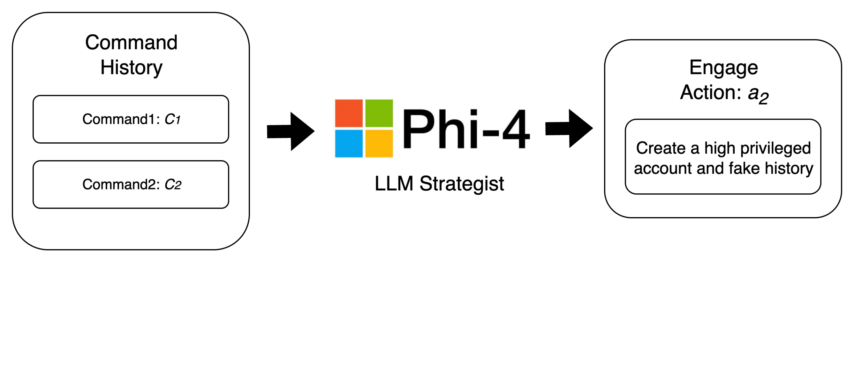
Solution - Strategist Design
Using LLM to detect intention
Command Context
Using LLM to determine engage action
Base on Mitre Engage activities
Dynamic and Infective

Slide 52
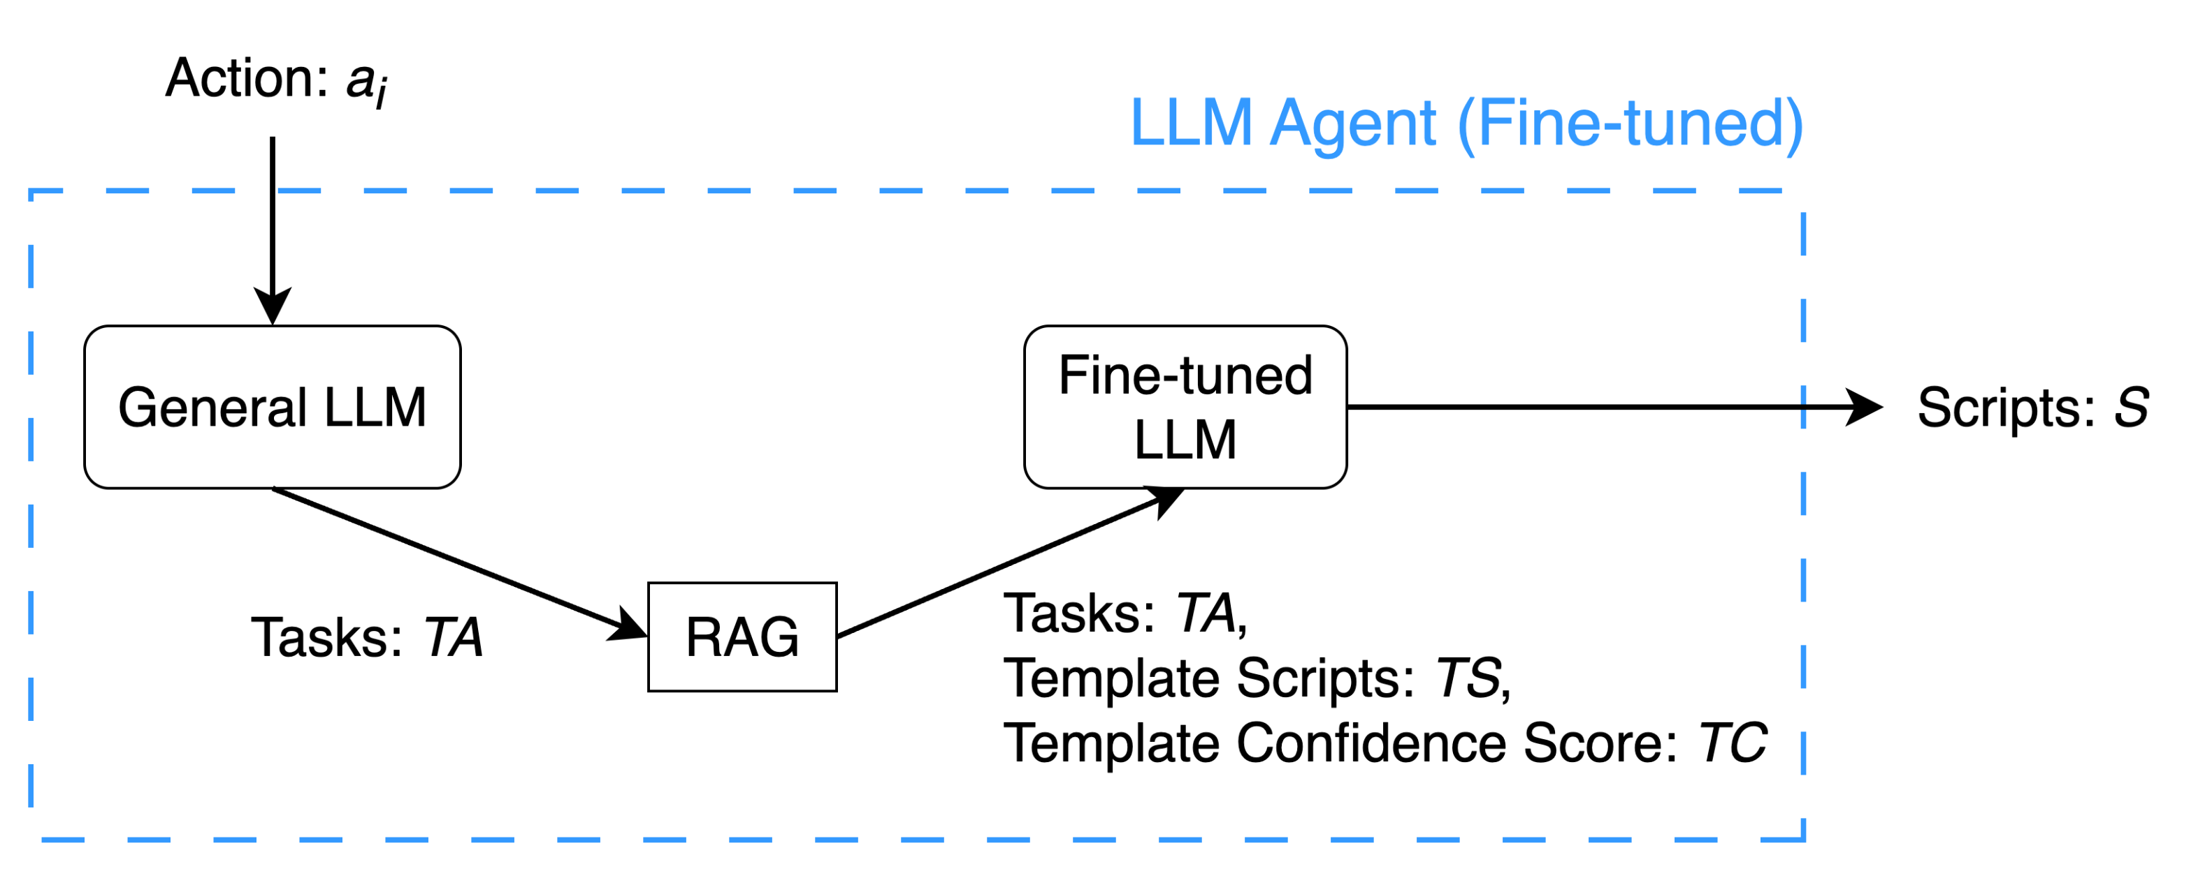
Solution - LLM Agent Design
Dual-LLM Architecture
Action-to-Task Decomposition
Task-to-Script Generation
RAG-based Script Templating
Quality Improvement
Accuracy Enhancement

Slide 53
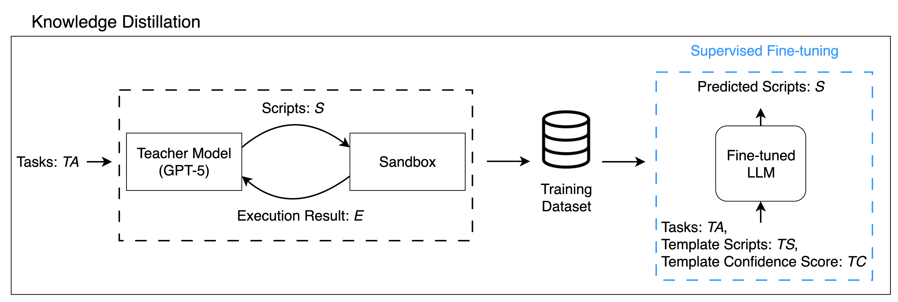
Solution - Knowledge Distillation
Dataset Generation: A powerful LLM creates the task-to-script dataset
Supervised Fine-Tuning: A smaller LLM is then fine-tuned for script modification

Slide 54
Related Work on Adaptive Honeypot / Honeynet
Category | Paper | Real System | Active Directory | Objective |  |  | Strategist | Action Design | Dynamic Action Implementation
 |  |  |  | Interaction | Deception | Defense
Honeypot | QRASSH [8] | - | - | V | - | - | RL | ABDSI | -
 | HoneyBog [9] | V | - | - | - | V | Rule-based | RFS | -
 | HoneyGPT [10] | - | - | V | V | - | LLM | S | V (LLM-generated Reply)
 | Senior [11] | V | V | V | - | - | RL | ABSG^{U}G^{F} | -
Honeynet | Mirage [12] | V | V | - | - | V | Rule-based | M^{F} | -
 | Ours | V | V | V | V | V | LLM | MITRE Engage–guided scripts (stored in RAG) | V (LLM-modified Scripts)
A=Allow, B=Block, D=Delay, S=Substitute(Fake), I=Insult, R=Redirect, F=File Synchronize, G^{U}=Generate user, G^{F}=Generate File, M^{F}=Modify File System

Slide 55
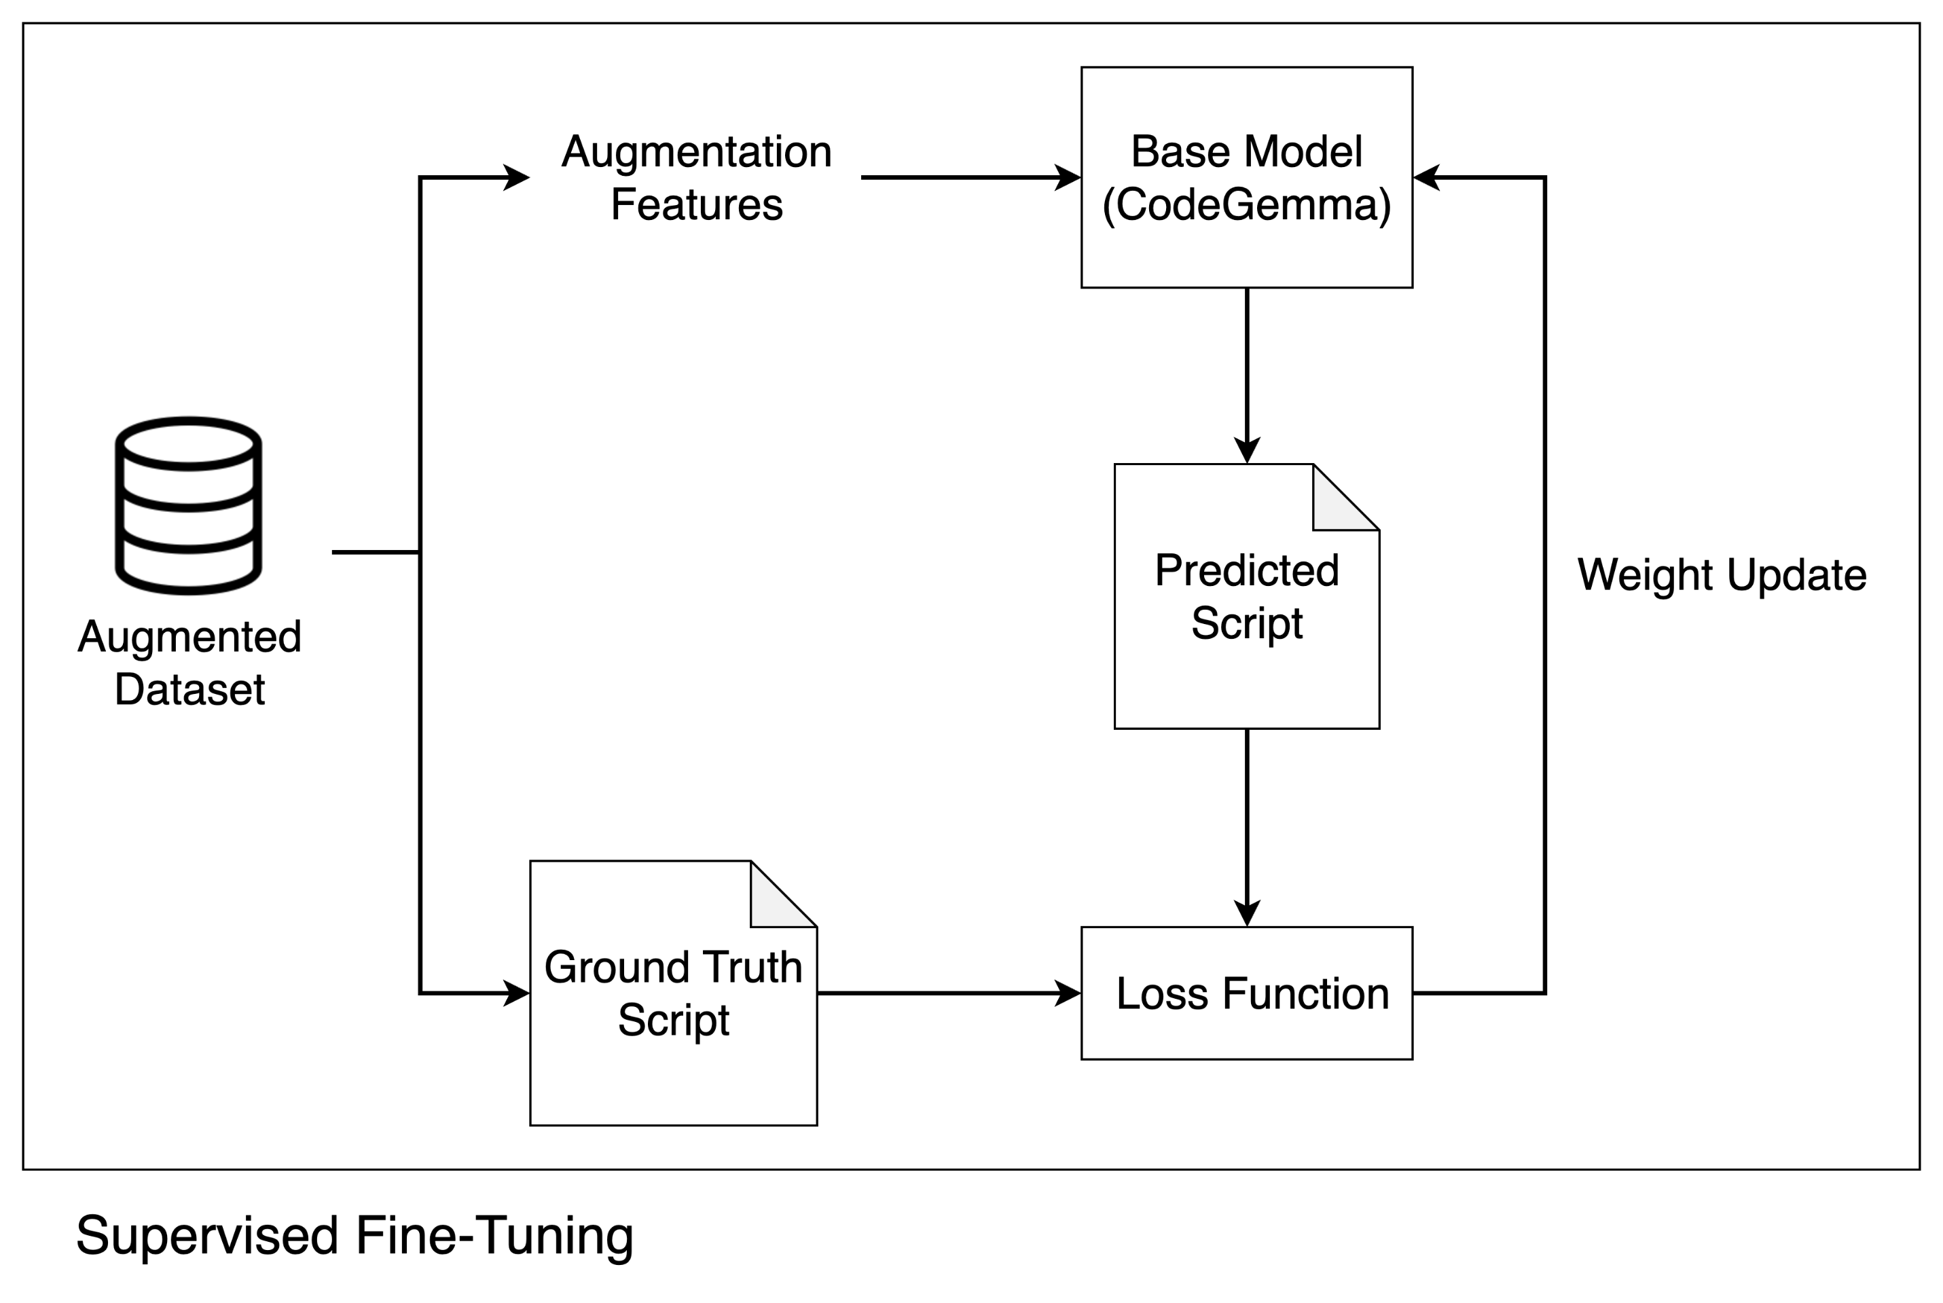
Solution - Supervised Fine-Tuning
Fine-tune smaller LLM with teacher-generated dataset
Achieve faster inference with reliable accuracy

Slide 56
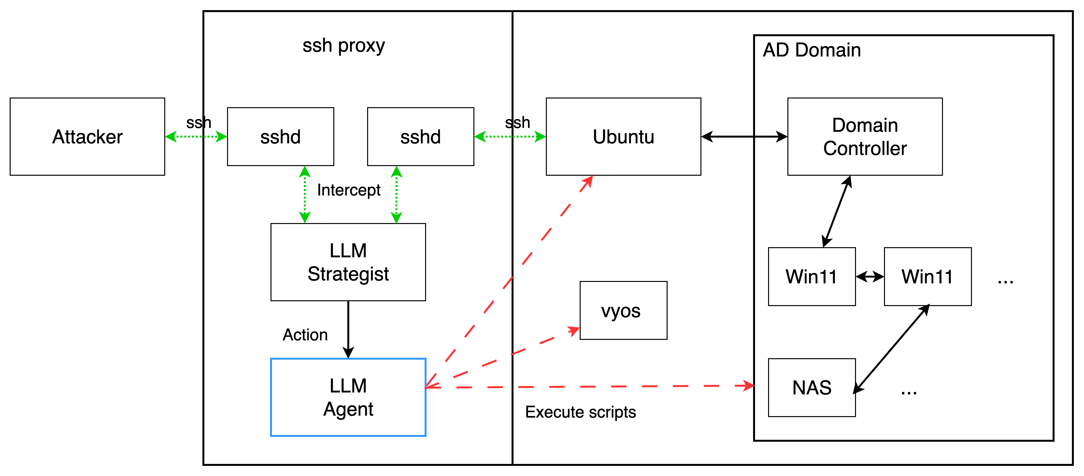
System Overview

Slide 57
Reference
Catch Me if You Can: Effective Honeypot Placement in Dynamic AD Attack Graphs
HoneyWin: High-Interaction Windows Honeypot in Enterprise Environment
A Scalable High Fidelity Decoy Framework against Sophisticated Cyber Attacks
Decoy-File-Based Deception without Usability Degradation
A Comprehensive Approach: Developing A Honeypot System To Thwart Cyber Attackers
Evolving ML-Based Intrusion Detection: Cyber Threat Intelligence for Dynamic Model Updates
A Case Study of Unauthorized Login Attempts Against Honeypots via Remote Desktop
QRASSH: A Self-Adaptive SSH Honeypot Driven by Q-Learning
HoneyBog: A Hybrid Webshell Honeypot Framework against Command Injection
HoneyGPT: Breaking the Trilemma in Terminal Honeypots with Large Language Model
Active Directory Deception: A Reinforcement Learning Honeypot Aligned with MITRE Engage
Mirage: Cyber Deception Against Autonomous Cyber Attacks in Emulation and Simulation
Increasing Attacker Engagement on SSH Honeypots Using Semantic Embeddings of Cyber-Attack Patterns and Deep Reinforcement Learning
An Adaptive Honeypot Using Q-Learning with Severity Analyzer ￼
Leveraging Reinforcement Learning for LLM-based GenericHoneypots with MITRE Engage Framework

Slide 58
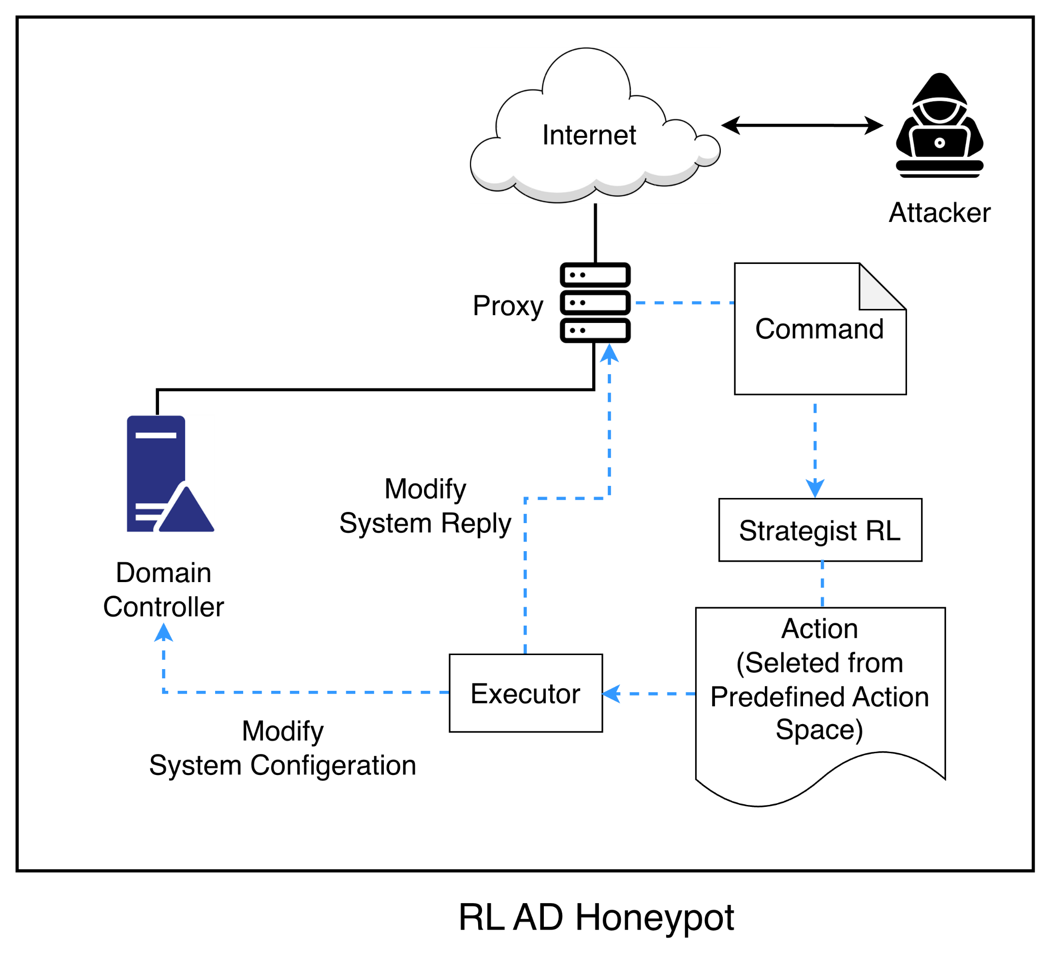
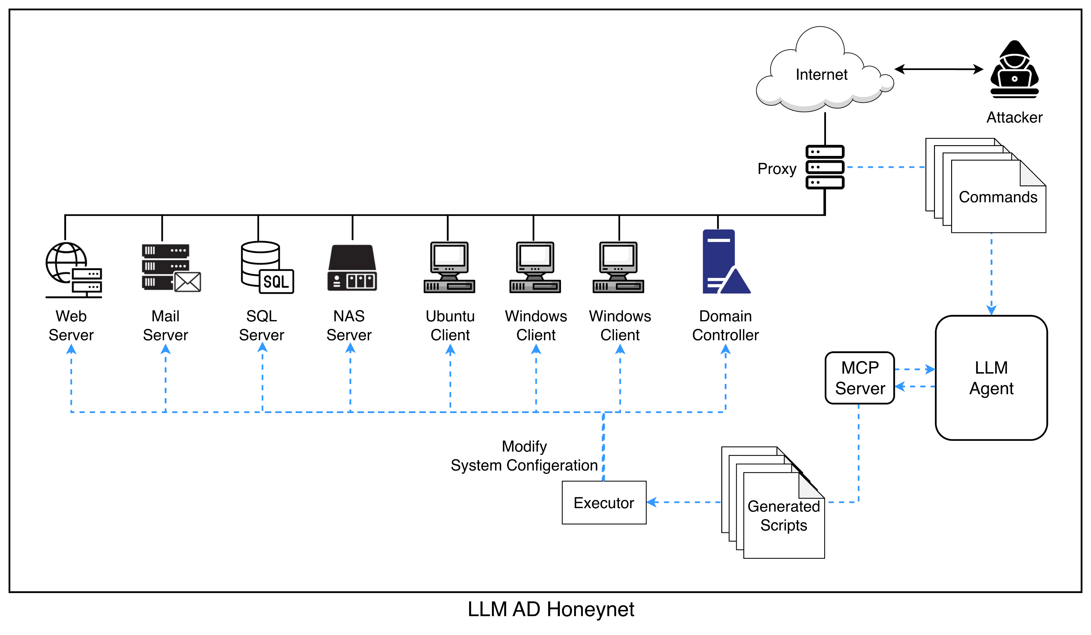
Problem Statement – Engage Driven Honeynet
Notes:
Action區塊不一致，不是資料，箭頭要改

Slide 59
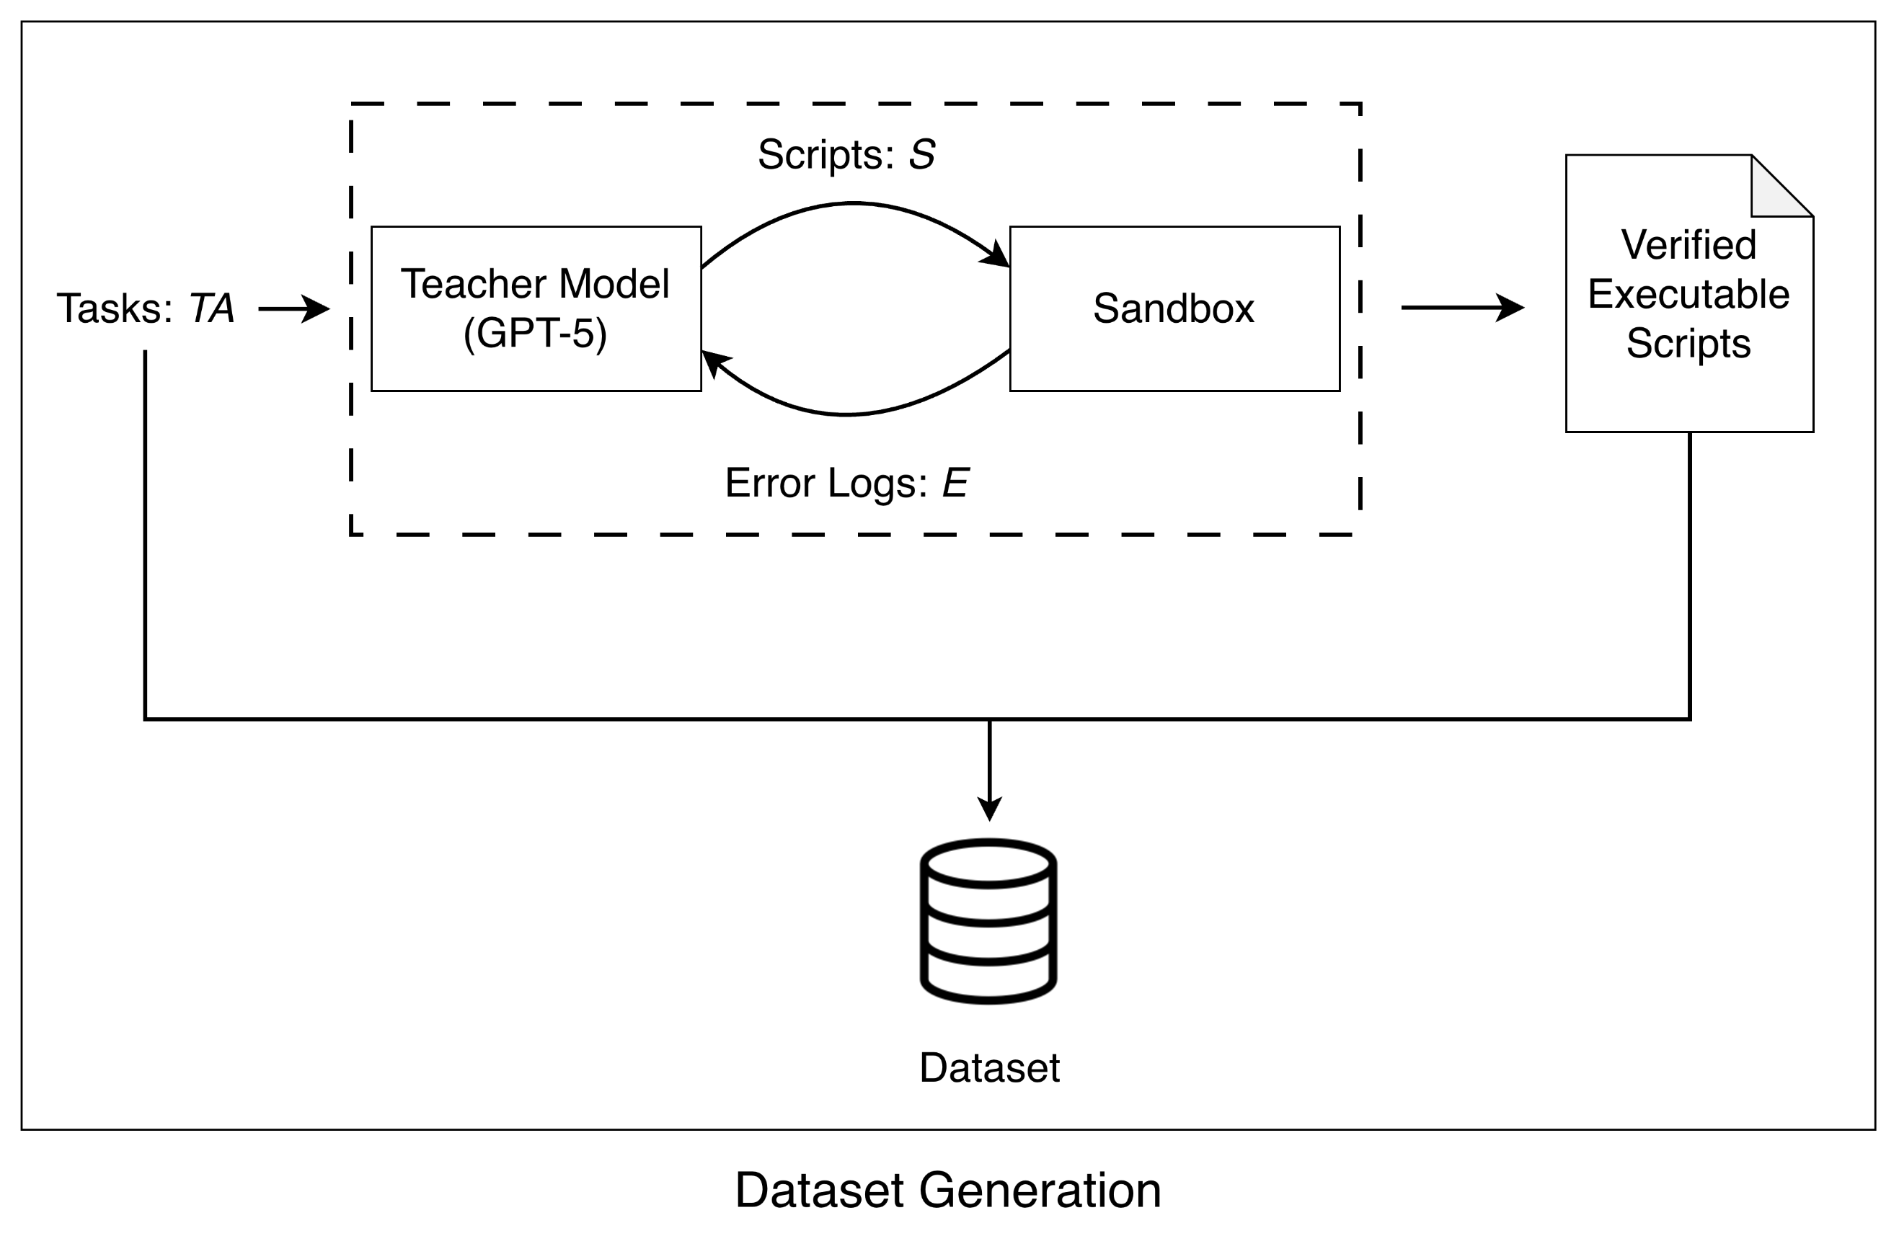
Solution – Dataset Generation
Why generate the dataset with an LLM?
Environment-specific: Public scripts don’t fit our AD/NAS/SQL/Windows/Ubuntu setup
Executable: All scripts can be sandbox-verified
Scalable: Manual creation is too slow for the needed volume

Slide 60
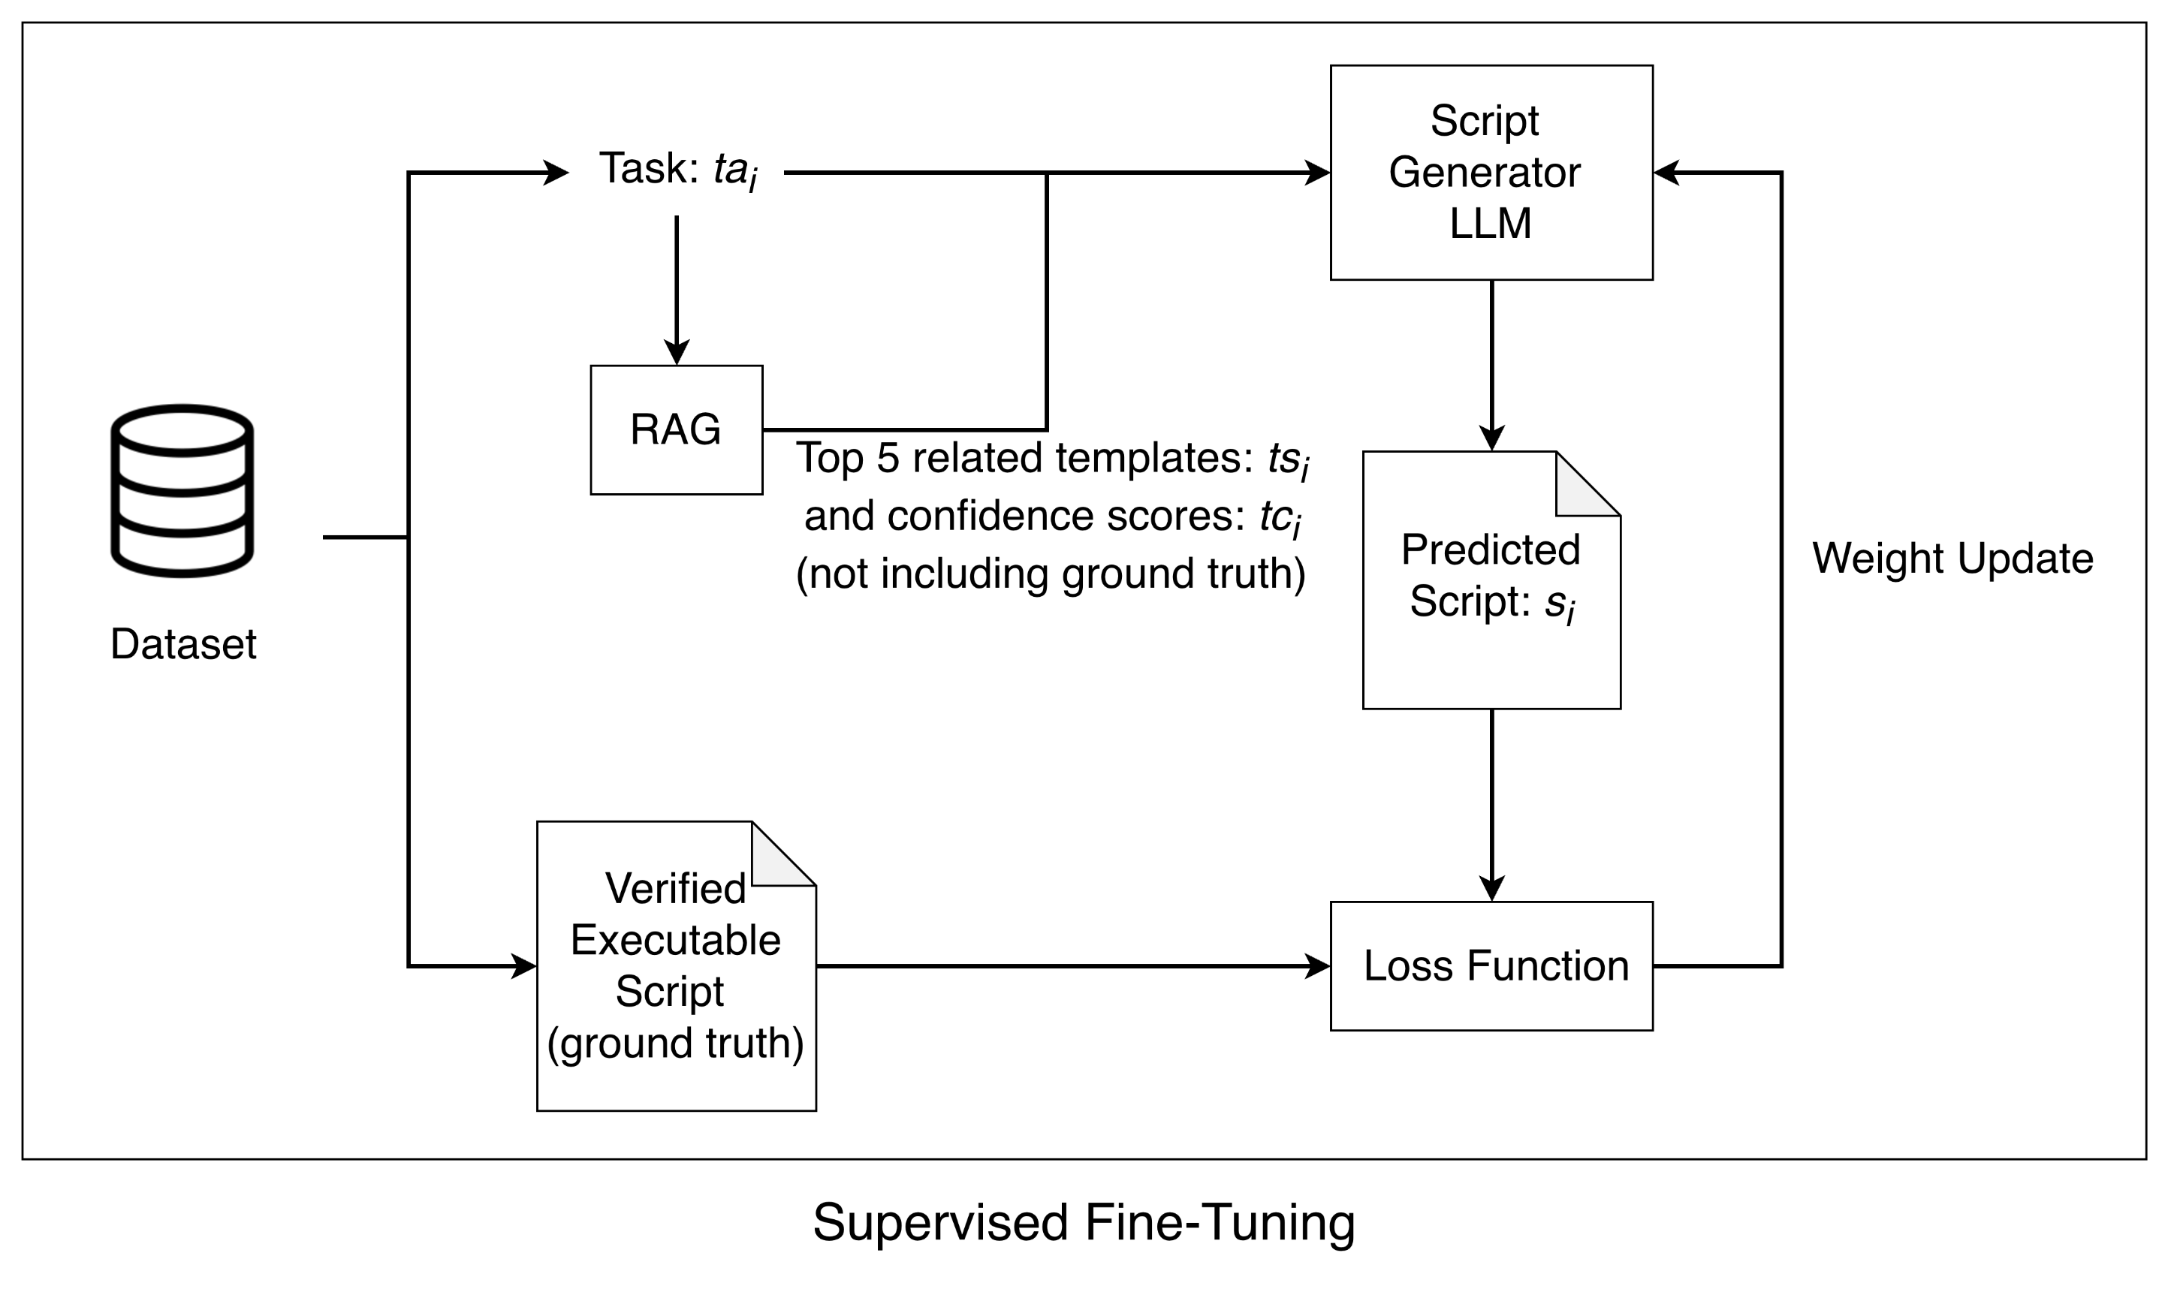
Solution – Supervised Fine-Tuning (SFT)
Why fine-tune the Script Generator?
Learns our environment: SFT teaches the model patterns specific to our verified scripts
More reliable: SFT enables effective use of RAG content, RAG alone may not
Compact model: Enables a smaller, cheaper model to reach high accuracy

Slide 61
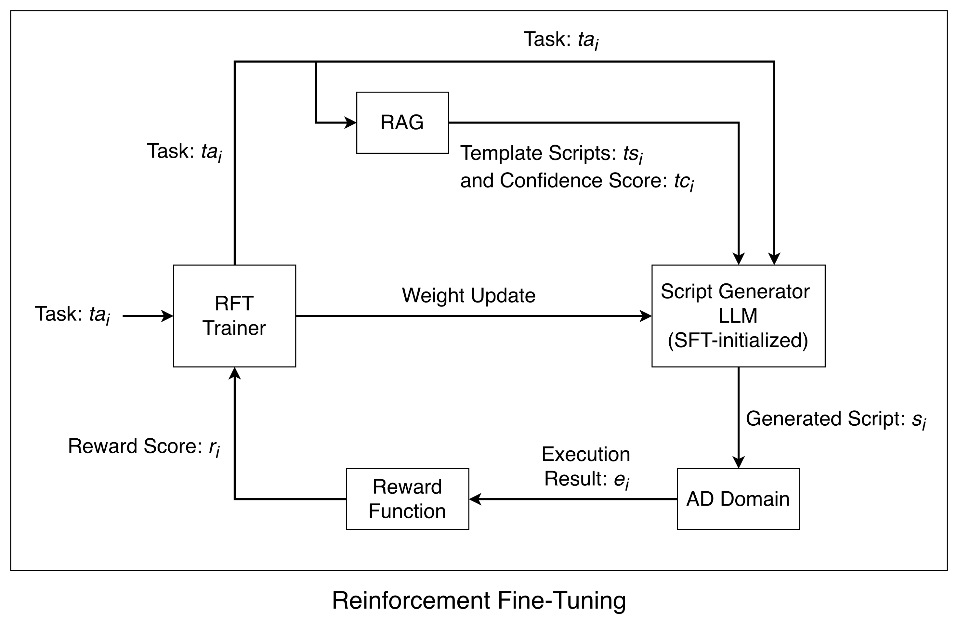
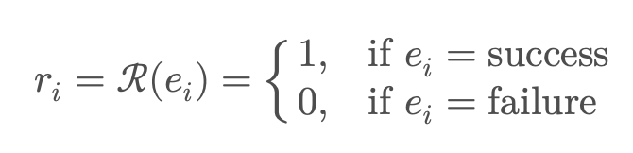
Solution - Reinforcement Fine-Tuning (RFT)
Why RFT after SFT?
SFT teaches correct patterns, but not guaranteed execution
RFT learns from actual AD feedback, improving real execution success

Slide 62
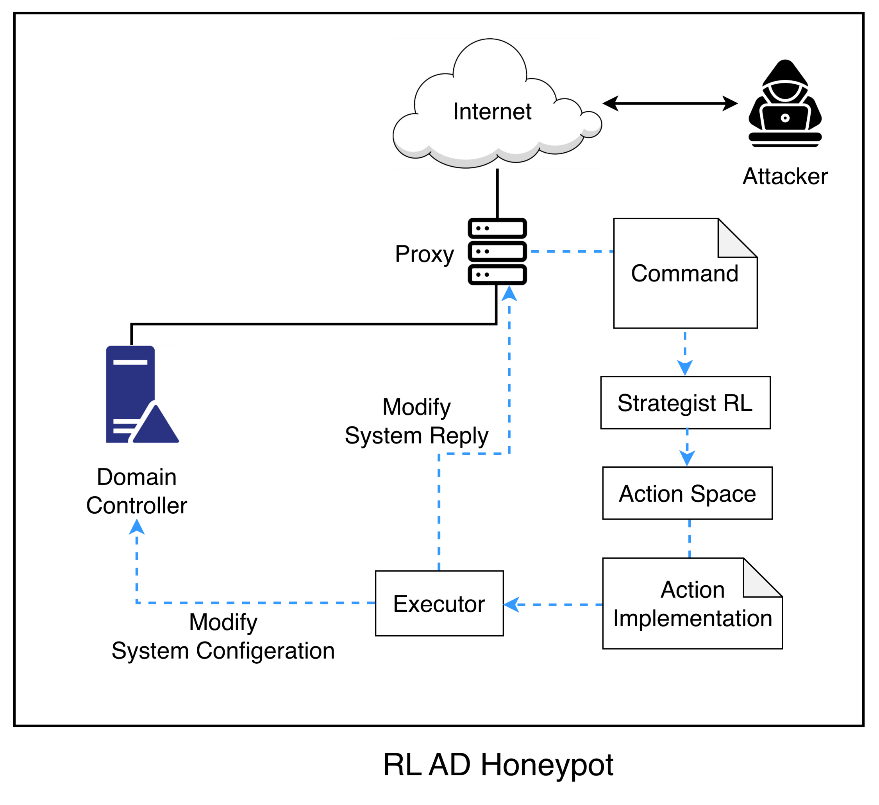
Problem Statement – Engage Driven Honeynet
Notes:
Action區塊不一致，不是資料，箭頭要改

Slide 63
Reference
Exploring LLM-based Automated Repairing of Ansible Script in Edge-Cloud Infrastructures
Automated Program Repair in the Era of Large Pre-trained Language Models
5GPT: 5G Vulnerability Detection by Combining Zero-Shot Capabilities of GPT-4 With Domain Aware Strategies Through Prompt Engineering
LLM2LLM: Boosting LLMs with Novel Iterative Data Enhancement
Unlock the Correlation Between Supervised Fine-Tuning and Reinforcement Learning in Training Code Large Language Models
UNVEILING THE SECRET RECIPE: A Guide for Supervised Fine-Tuning Small LLMs
Synthetic Data Generation Using Large Language Models: Advances in Text and Code
Integrating Machine Learning and Large Language Models to Advance Exploration of Inorganic Materials
Layer-Aware Task Arithmetic: Disentangling Task-Specific and Instruction-Following Knowledge
COMAT: A Cybersecurity Ontology based on MITRE ATT&CK
Reproducing ATT&CK Techniques and Lifecycles to Train Machine Learning Classifier
TRACE: Relationship Analysis and Causal Factor Extraction in Cyber Threat Intelligence Reports
From Flow to Packet: A Unified Machine Learning Approach for Advanced Intrusion Detection
ML-Based Intrusion Detection as a Service: Traffic Split Offloading and Cost Allocation in a Multi-Tier Architecture
Reinforcement Learning for AI as a Service: CPU-GPU Task Scheduling for Preprocessing, Training, and Inference Tasks
Synergistic Utilization of LLMs for Program Synthesis

Slide 64
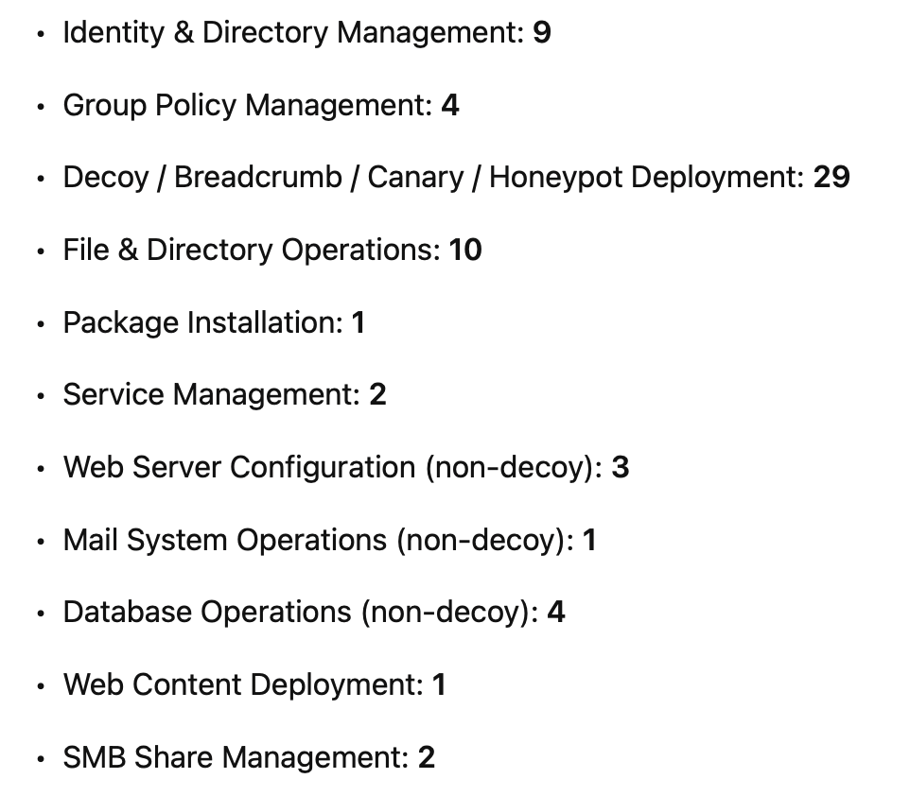
Progress
MCP Tooling
Automated GPT API–based implementation completed.
A total of 66 tools have been developed, categorized as follows:
Notes:
MCP tool使用自動化gpt api實作完成，有66個tool，可分為Identity/Directory Management: 9, Group Policy Management: 4, Decoy/Breadcrumb/Canary/Honey Deployment: 29, File/Directory Operations: 10, Package Installation: 1, Service Management: 2, Web Server Configuration (non-decoy): 3, Mail System Operations (non-decoy): 1, Database Operations (non-decoy): 4, Web Content Deployment: 1, SMB Share Management: 2
Host上的tool分佈，dc: 16, linux: 19, mail: 5, sql: 6, web: 6, win: 14
在task decomposer產生的100個task上的資料集做測試，script generator生成的腳本成功率為24.24%，planner生成plan的執行成功率為83.06%，task成功率76.77%
目前同步支援mcp- planner mode和script generator mode

Slide 65
Progress (cont.)
Tool Distribution by Host
Domain Controller (DC): 16
Linux Hosts: 19
Mail Servers: 5
Evaluation Results
Tested on a dataset of 99 tasks generated by the Task Decomposer:
Script Generator success rate: 24.24%
Planner execution success rate: 83.06%
Overall task success rate: 76.77%
Simultaneous support for MCP-Planner Mode and Script Generator Mode
SQL Servers: 6
Web Servers: 6
Windows Hosts: 14

Slide 66
TODO
Improve Tool Quality
Enhance robustness, reliability, and consistency across all tools.
Generate Task–Plan Dataset
Build a structured dataset of tasks and corresponding execution plans for training and evaluation.
Design Evaluation Methodology and Metrics
Define clear evaluation procedures, benchmarks, and quantitative metrics to measure performance and effectiveness.

Slide 67


TODO - Attack Depth
Notes:
先畫這兩個圖

Slide 68


TODO - Behavior Diversity

Slide 69


TODO - Lateral Movement

Slide 70


TODO - Planner & Stability

Slide 71

Notations
Categories | Notation | Description
Interaction & Session | $$N_{H}$$ | Number of computer host in the honeynet
 | $$N_{C}$$ | Number of command in one session
 | $$N_{T}$$ | Number of attack tactics
 | $ℋ=\{H_{1},…,H_{N_{H}}$} | Set of honeynet hosts
 | $$C_{i},i∈\{1,…,N_{c}\}$$ | Command issued by the attacker (derived from technique $T_{i}$)
 | $$R_{i},i∈\{1,…,N_{c}\}$$ | Response observed by the attacker after executing command $C_{i}$
 | $$π=(a_{1},a_{2},…,a_{N_{c}})$$ | The action decide by the LLM strategist for the $ith$input command $C_{i}$; may be empty
 | $$S=(s_{1},s_{2},…,s_{N_{H}})$$ | Executable script assigned to host $H_{i}$; may be empty
 | $$E=(e_{1},e_{2},…,e_{N_{H}})$$ | Execution result from host $H_{i}$; may be empty
 | $$TA=({ta}_{1},{ta}_{2},…,{ta}_{N_{H}})$$ | Decomposed tasks corresponding to honeynet hosts. Each ${ta}_{i}$ is a textual task description
 | $$TS=({ts}_{1},{ts}_{2},…,{ts}_{N_{H}})$$ | Retrieved template script for each task ${ta}_{i}$
 | $$TC=({tc}_{1},{tc}_{2},…,{tc}_{N_{H}})$$ | Confidence scores for each retrieved template script (relevance between task ${ta}_{i}$ and template ${ts}_{i}$)
 | $$N_{\hat{T}}$$ | Number of attack tactics observed during an engagement session
 | $$\hat{T}=({\hat{t}}_{1},{\hat{t}}_{2},…,{\hat{t}}_{N_{\hat{T}}})$$ | Set of attack tactics observed during an engagement session (mapped to MITRE ATT&CK)
Notes:
沒有寫到llm 處理的一段command的部分，policy應該是對應沒寫到的一段command

Slide 72

Problem Statement – Engage Driven Honeynet
Input:
$C_{i}$: Attack command issued by the attacker
Output:
$R_{i}$: Honeynet response selected by the system
Objective:
Maximize engagement tactic depth: $\max_{π}{E[N_{\hat{T}}]}$, where${ N}_{\hat{T}}$ is the number of unique attack tactics
Constraint：
LLM must run locally inside the honeynet
Limited response time
Limited context size

Slide 73
Issues
Realism: Does the honeynet present enterprise-plausible artifacts and environments?
Attack Depth: Does the defender induce longer and more complete attack progressions?
Behavior Diversity: Does the system elicit a wider range of attacker behaviors?
Lateral Movement: Does the honeynet shape broader and more structured lateral movement?
Stability: Can the defender operate reliably without breaking the environment?
Notes:
Issue放最終結果attack depth，但是這樣畫圖沒有意義，想圖怎麼畫，中間結果可到evaluation討論

Slide 74
Evaluation
Realism
Use an LLM judge to score artifact plausibility given host roles and deployed artifacts.
Attack Depth
Measure session length and number of distinct attack stages per session.
Compare how far attacks progress under different defender designs.
Behavior Diversity
Classify commands into predefined behavior categories.
Measure unique categories and behavior entropy per session.
Notes:
新增有一個可變系統變量x，一個baseline一條線的圖（自變量、環境變因） 圖包含的內容不多，
比較別人的方法

Slide 75
Evaluation
Lateral Movement
Measure host coverage and unique cross-host movement edges.
Compare the shape and breadth of lateral movement paths
Stability
Measure defender tool execution success rate.
Ensure dynamic defense does not disrupt system availability.

Slide 76

Experiment - Collected After Deployment
Notes:
新增有一個可變系統變量x，一個baseline一條線的圖（自變量、環境變因） 圖包含的內容不多，
比較別人的方法

Slide 77


Experiment - Collected After Deployment
Notes:
新增有一個可變系統變量x，一個baseline一條線的圖（自變量、環境變因） 圖包含的內容不多，
比較別人的方法

Slide 78

Experiment - Collected After Deployment
Notes:
新增有一個可變系統變量x，一個baseline一條線的圖（自變量、環境變因） 圖包含的內容不多，
比較別人的方法

