Slide 1
Operating System Principles - 3
Shyan-Ming Yuan
CS Department, NYCU
smyuan@gmail.com

Slide 2
Virtual Memory Management
Virtual memory is a technique that separates user logical address space from physical memory.
When executing a program, only part of logical address space needs to be in physical memory for execution.
Logical address space can therefore be much larger than physical address space.
Allows physical memory to be shared by several processes.
Allows using less memory for more efficient process creation.
Demand paging is a most common virtual memory implementation.

Slide 3

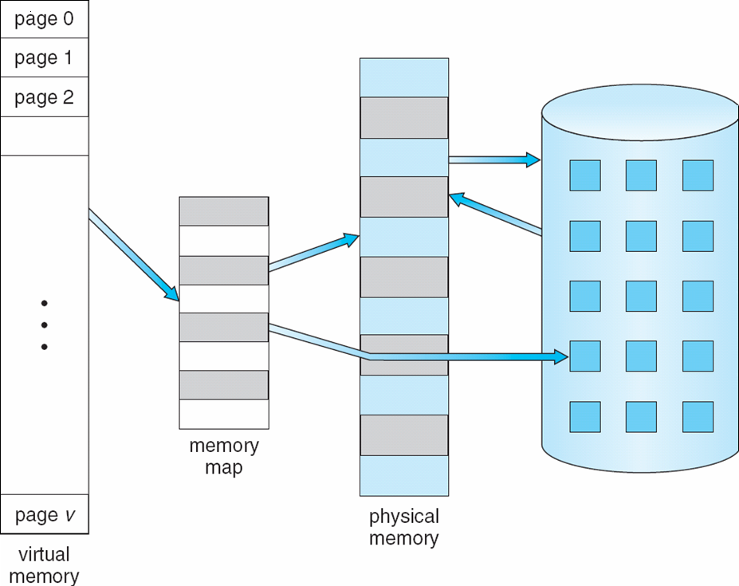
Virtual Memory > Physical Memory
process logical address space
process physical address space

Slide 4
Demand Paging
Bring a page into memory only when it is needed.
Use valid bit in page table entry
Valid: the page is in memory (“valid” mapping)
Invalid: invalid reference or page is not in memory
Trap to OS for page fault exception, the OS check PCB to find out
Invalid reference raises a out-of-bound exception and abort the process.
Not-in-memory swaps in the missing page.
Lazy swapper never swaps a not-needed page into memory.
A swapper that deals with pages is also called a pager.

Slide 5
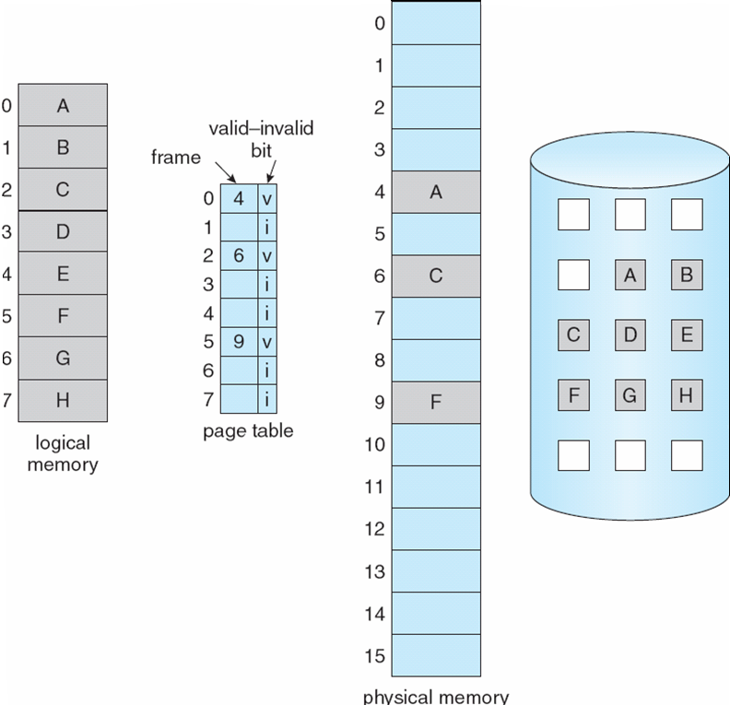
Address Space of A Process

Slide 6

Page Fault Handling Steps
on invalid reference, abort the process
3
4
2
1
7
6
v
5

Slide 7
Page Replacement
What happens if there is no free frame to page in the needed page?
Page replacement is the process of finding a page to page out onto disk to create a free frame for the needed page.
The main objective of a page replacement algorithm is to minimize the total number of paging activities.
Paging is to shuffle page contents between memory and the disk.
It is common to use modify (dirty) bit to reduce overhead of paging.
Only modified pages need to be written back (page out) to disk.

Slide 8
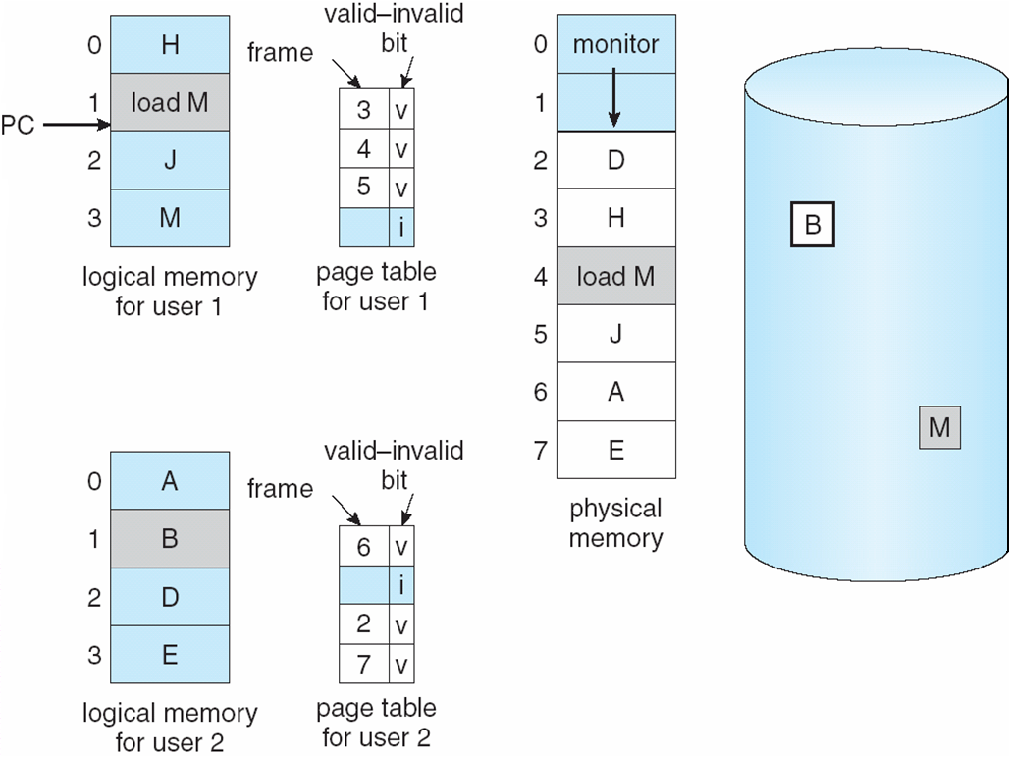
Need For Page Replacement

Slide 9
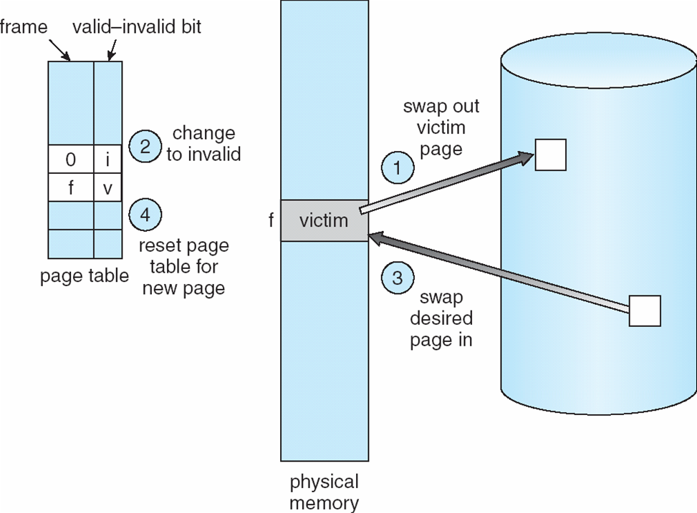
Page Replacement Steps

Slide 10
Page Replacement Algorithms
First-In-First-Out (FIFO) Algorithm:
Replace the page that exists in the memory for the longest time.
Optimal Algorithm:
Replace the page that will not be used for the longest period of time.
It is an ideal case if the reference sequence is known in prior.
Least Recently Used (LRU) Algorithm:
Replace the page with the farthest time from the last reference.
The clock algorithm (also known as the second chance algorithm:)
Arrange in-memory pages as a circular list.
On selecting a victim, it starts at its current position and looks for pages whose referenced bits are 0. As it does this, it sets the referenced bits of pages it skipped over to 0.

Slide 11
The Belady’s Anomaly in FIFO
Reference string: 1, 2, 3, 4, 1, 2, 5, 1, 2, 3, 4, 5
3 frames: 1, 2, 3, 4, 1, 2, 5, 1, 2, 3, 4, 5
4 frames: 1, 2, 3, 4, 1, 2, 5, 1, 2, 3, 4, 5
Belady’s Anomaly: more frames => more page faults
time
1
1
4
5
4
5
2
2
1
3
1
3
9 page faults
3
3
2
4
2
4
time
1
1
5
4
5
4
2
2
1
5
1
5
10 page faults
3
3
2
2
2
4
4
3
3
3

Slide 12
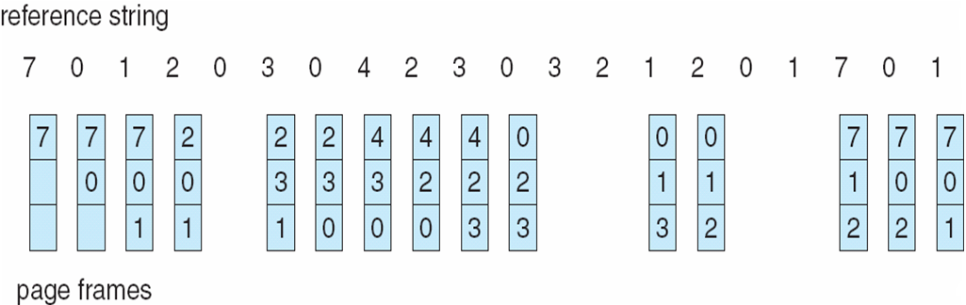
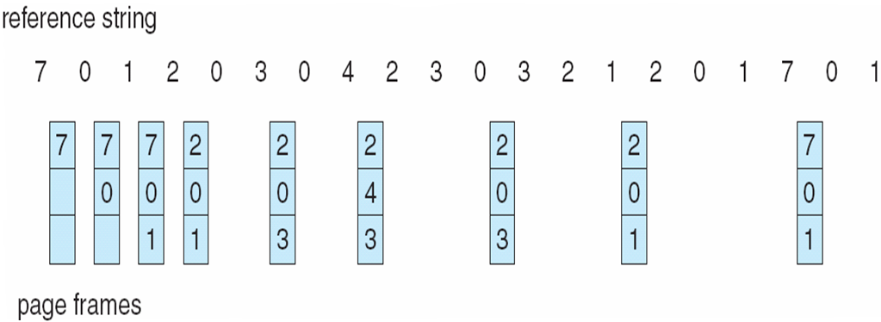
FIFO and Optimal Replacements
The FIFO has 15 page faults
The Optimal has 9 page faults

Slide 13
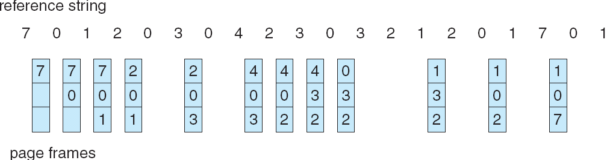
The LRU & Clock Replacements
The LRU has 12 page faults
The clock has 14 page faults
7 0 1 2 0 3 0 4 2 3 0 3 2 1 2 0 1 7 0 1
7₁
7₁
7₁
2₁
2₁
2₁
2₁
4₁
4₁
4₁
4₀
3₁
3₁
3₀
3₀
0₁
0₁
0₀
0₁
0₁
0₁
0₁
0₀
0₁
0₀
0₁
0₀
2₁
2₁
2₀
2₀
2₁
1₁
1₁
1₁
1₁
7₁
7₁
7₁
1₁
1₀
1₀
3₁
3₁
3₀
3₀
3₁
0₁
0₁
0₁
0₀
2₁
2₁
2₁
2₀
2₀
1₁

Slide 14
How Many Frames for Each Process?
Each process needs a minimum number of frames for proper instruction execution
Example: IBM 370 needs 6 pages to handle SS MOVE instruction:
A 6-byte instruction might span 2 pages,
where the from address and to address both might also span 2 pages
Fixed allocation:
Equal allocation assigns each process same number of frames.
Proportional allocation assigns frames based on the size of each process.
Priority allocation is a proportional allocation of priorities.
It may select replacement frames from lower priority processes as well.
Local replacement: each process selects from only its own set of allocated frames.
Global replacement: a process may select a replacement frame from the set of all memory frames.

Slide 15
Locality Principle
In general, a process tends to reference the same set of pages over and over before moving on to another set of pages.
This set of pages that is currently used is known as the process‘s working set.
Some processes may have bigger working sets than others.
A process‘s resident set is the set of pages that is currently in physical memory frames.
If a process‘s working set is not a subset of it’s resident set then the system will exhibit frequent page swapping between the physical memory and the backing store.
It is also called thrashing.
Thrashing is defined as that a process is busy swapping pages in and out. This leads to:
low CPU utilization =>
OS will increase the degree of multiprogramming to boots CPU utilization =>
more processes are added to the system=> more page faults => severer thrashing

Slide 16
Resident Set Management
The locality characteristics of a process is utilized by the working set model to make the resident set of a process covering its working set and avoid thrashing.
However, its difficult to recognize the working set of a process in prior.
Another way to manage the resident set is by monitoring page fault frequency.
If a process does not have its working set in memory, it will generate page faults.
This is an indication that it needs more memory.
If a process is never generating page faults, that could be an indication that it has too much memory allocated to it.
Thresholds of page fault frequency can be set to decide how many physical frames should be allocated to a specific process.

Slide 17
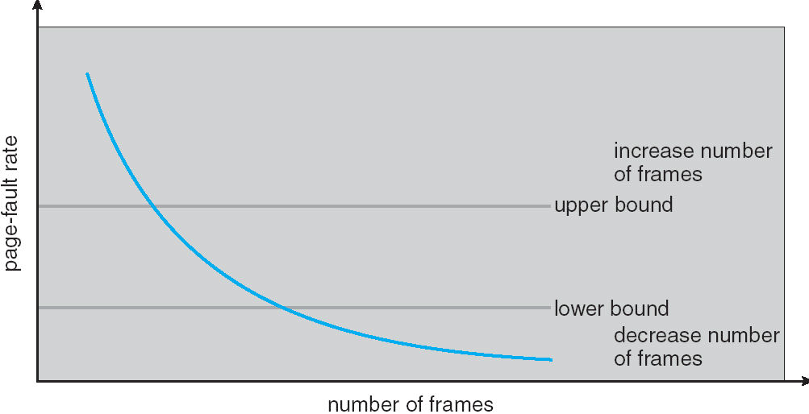
Page-Fault Frequency Scheme
Establish “acceptable” page-fault rate
If the actual rate is too low, the process loses a frame
If the actual rate is too high, the process gains a frame

Slide 18
File Systems
A file is an abstract data type which consists of a contiguous logical address space for storing persistent information.
A file system is a container for files. It provides the mechanism to
organize, create, store, retrieve, and delete information stored in files.
The actual data maintained by files are stored on block devices: disk (or flash.)
A file system used on a block device defines the data structures on the disk blocks.
It also defines how directories, files, free space information, and permissions are stored.
Multiple individual file systems can be combined into an abstract view of a single hierarchical name space (directory tree) via a mount mechanism.
To support multiple file systems transparently, a layer of abstraction called the Virtual File System (VFS) is used in most modern OSs.

Slide 19
File Operations
File is an abstract data type with the following operations:
Create and Open
Open(Fi) searches the directory structure on disk for entry Fi, and move the content of entry (file attributes of Fi) to memory. The attributes include:
File pointer: points to the per-process the last read/write location.
Access rights: caches per-process access mode information.
File-open count: records the number of times that Fi was opened concurrently.
Disk location information: caches disk addresses and related data access information.
Write and Read
Reposition within file
Delete and Truncate
Close (Fi) stores the content of entry Fi in memory back to directory structure on disk if necessary.

Slide 20
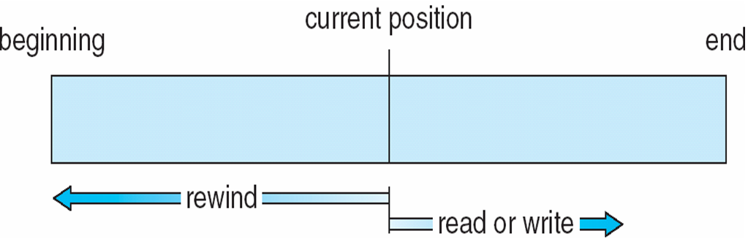
File Access Methods
Sequential Access
Direct Access (Random Access)
read next
write next
rewind
n is a relative block number
read n
write n
position to n
Sequential access | Simulated by direct access
rewind | cp := 0; // position to cp
read next | read cp; cp := cp + 1; // position to cp
write next | write cp; cp := cp+1; // position to cp

Slide 21
Disk Structure
Disk can be subdivided into partitions.
Disks or partitions can be RAID protected against failure
Disk or partition can be used in two modes:
raw without a file system
formatted with a file system
Partitions are also known as minidisks or slices.
An entity containing a file system is known as a volume.
Each volume contains a file system.
It records that file system’s info in device directory or volume table of contents.

Slide 22
Device Directory Structure
A device directory is a collection of entries containing information (file attributes) about all files stored in the device.
Device Directory
Files
F 1
F 2
F 3
F 4
F n

Slide 23
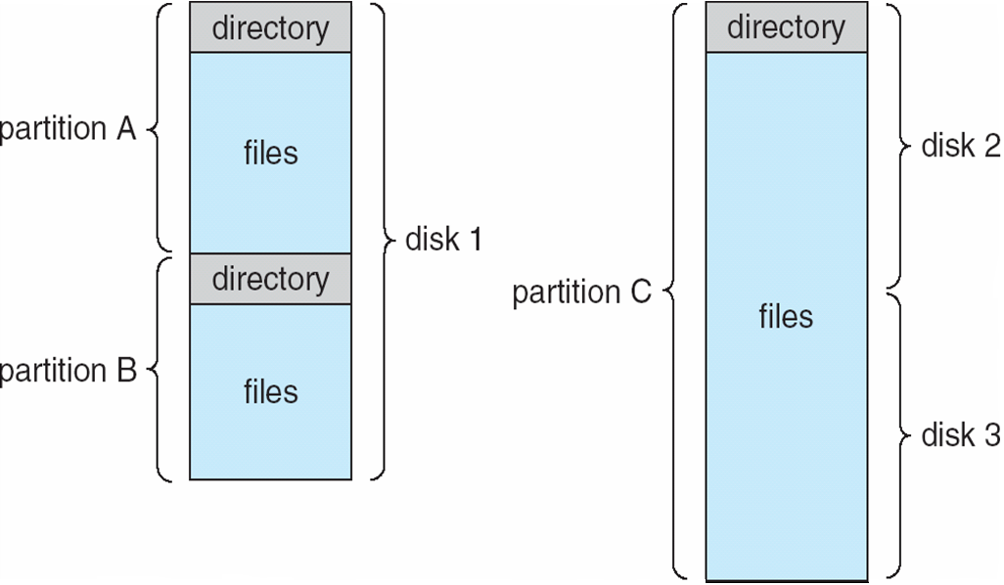
A Typical File-system Organization

Slide 24
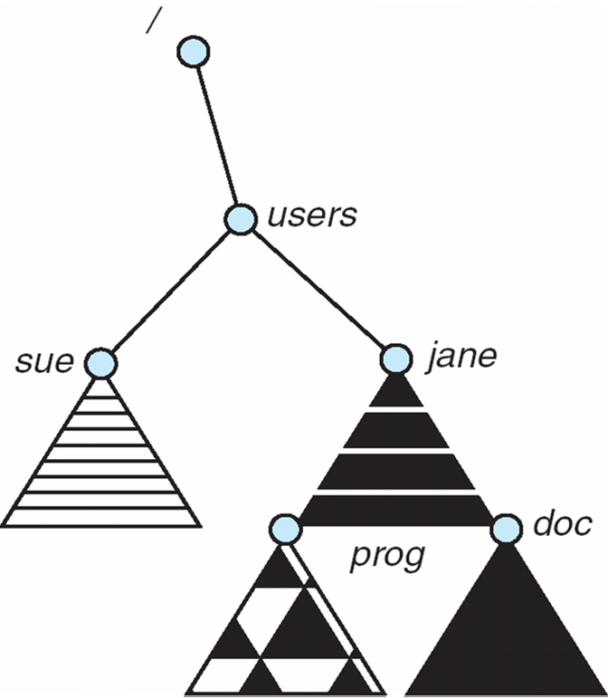
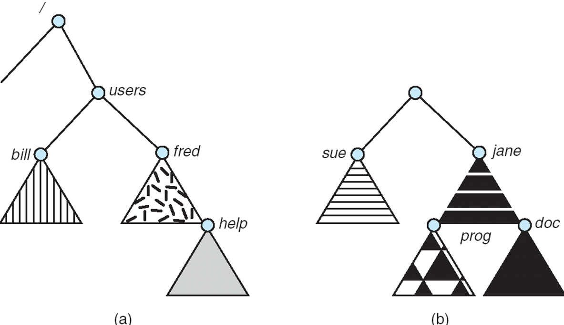
File System Mounting
A file system must be mounted before it can be accessed
A unmounted file system is mounted at a mount point
After mounted in /users
Existing file system
Unmounted partition

Slide 25
Directory is a Special File
Directory operations:
Search a file from a directory
Create and Delete a file entry from a directory
List all files from a directory
Rename a file
Traverse the directory hierarchy
Advantages of directory:
Efficiency – locating a file quickly
Naming – convenient to users
Two users can have same name for different files
The same file can have several different names
Grouping – logical grouping of files by properties, (e.g., all Java programs, all games, …)

Slide 26
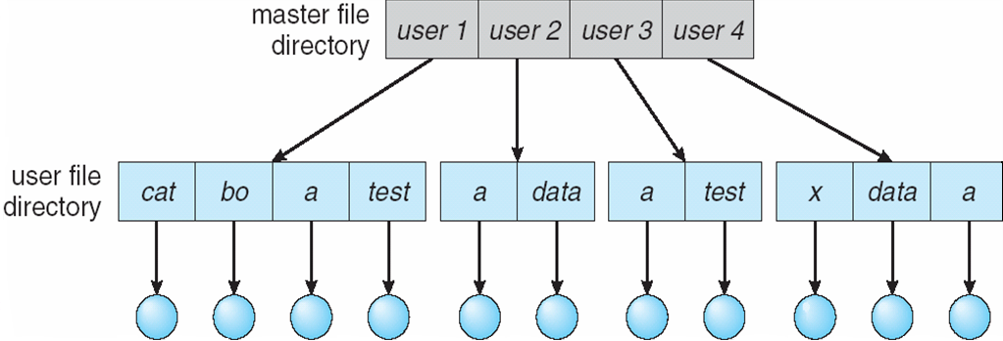
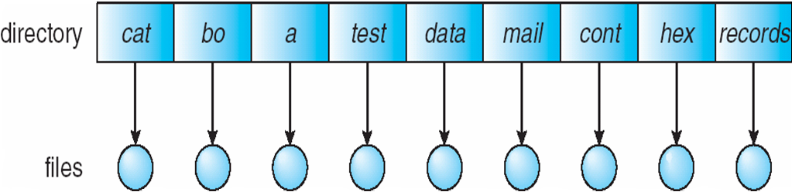
Types of Directory
Single-Level Directory: a single directory for all users (MS-DOS)
Two-Level Directory: separate directory for each user (early time sharing systems)
Tree-Structured Directories: subdirectories can be created by users dynamically
Acyclic-Graph Directories: subdirectories and files can be shared
General Graph Directory: most general and difficult to manage
Single-Level Directory
Two-Level Directory

Slide 27
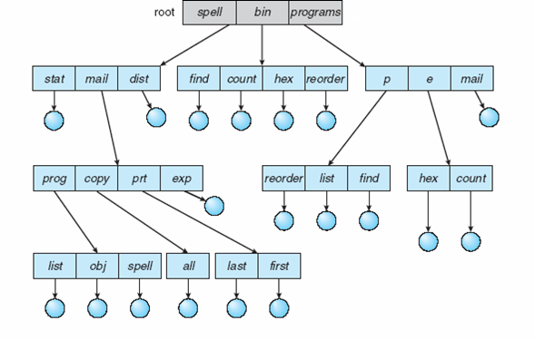
Tree-Structured Directories
Efficient searching
Grouping Capability
Absolute or relative path name
cat /spell/mail/prog/obj (absolute)
Current directory (working directory)
cd /spell/mail/prog
cat obj (relative path name)

Slide 28
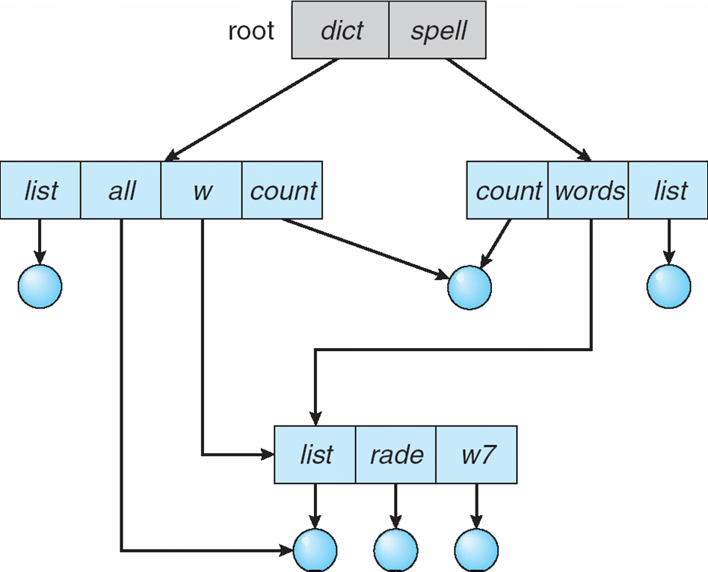
Acyclic-Graph Directories
A file can have two different names (aliasing)
If deletes the file /dict/w/list then
The file /dict/all may be lost
Possible solutions:
Reference count records # of names: Hard Link
Uses a new directory entry type
Soft Link: another name (pointer) to an existing file
A special file containing the real path name of the original file
Resolve the link: follow pointer to locate the file
On deletes /dict/w/list,
Only the reference count is decreased by 1.
If the reference count becomes 0,
then it can be removed from the file system.

Slide 29
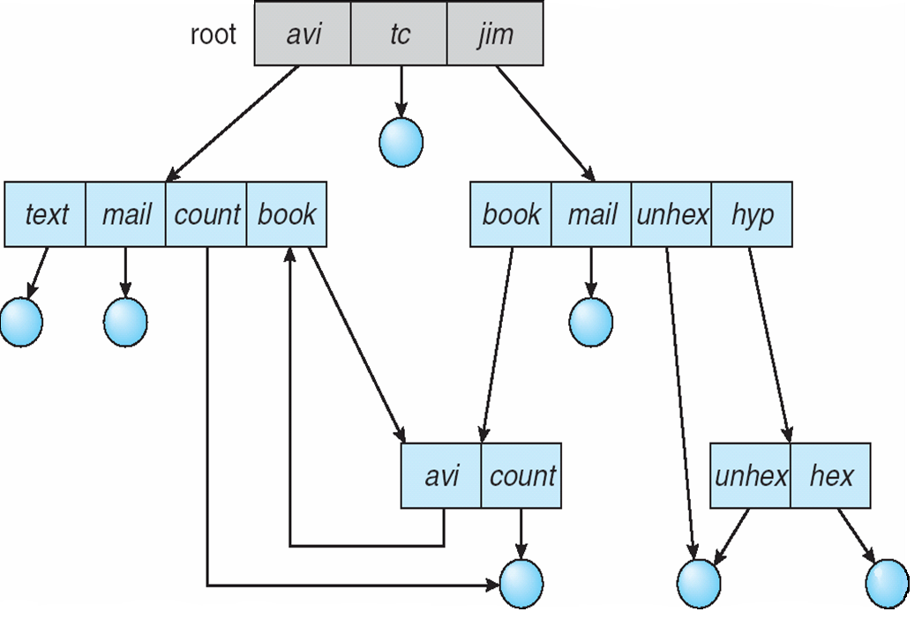
General Graph Directory
Cycle will cause reference count invalid.
On creates /avi/book as /jim/book
Count(B) ← 2
On creates /jim/book/avi as /avi
Count(A) ← 2
After deletes /jim/book and deletes /avi/book
Count(B) is 0 and deleted, where count(A) is 2 but A has only one valid name “/avi” .
To avoid generating cycles
hard links to files not subdirectories
Garbage collection
Before adding a new link,
Check cycle existence.
Soft link instead of hard link.
1
A
2
2
1
B

Slide 30
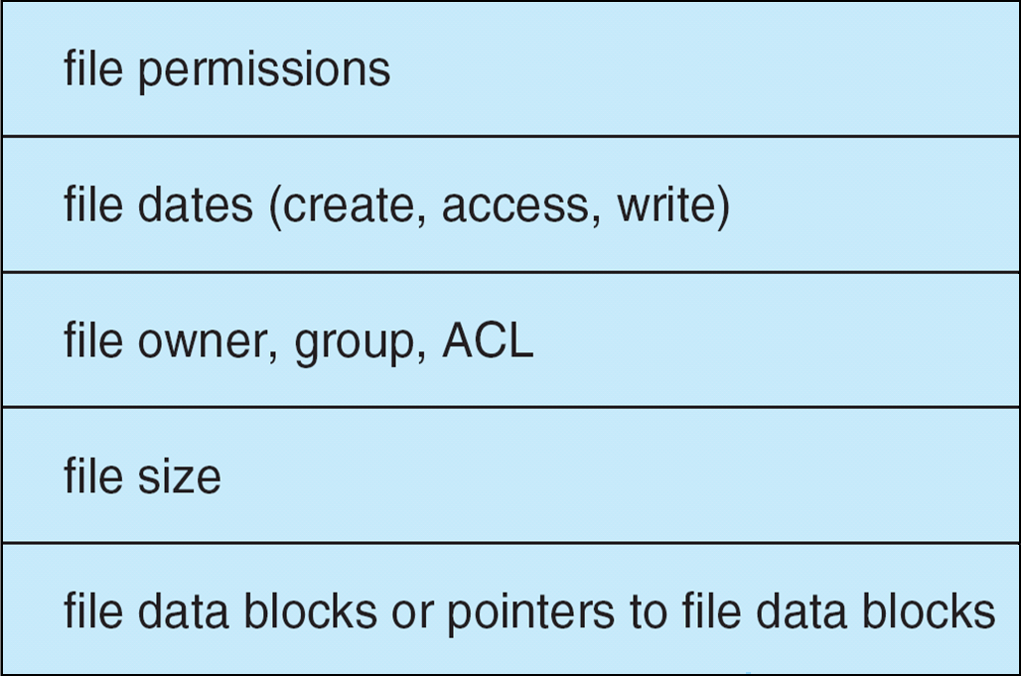
File-System Implementation
A file system usually resides on secondary storage (disks)
It provides easy access to disk by allowing data to be stored, located, and retrieved easily.
It uses per-file file control block (FCB) to store meta information about a file.
Device directory is used to maintain directories and files and store their FCBs.
A typical file control block (FCB)

Slide 31
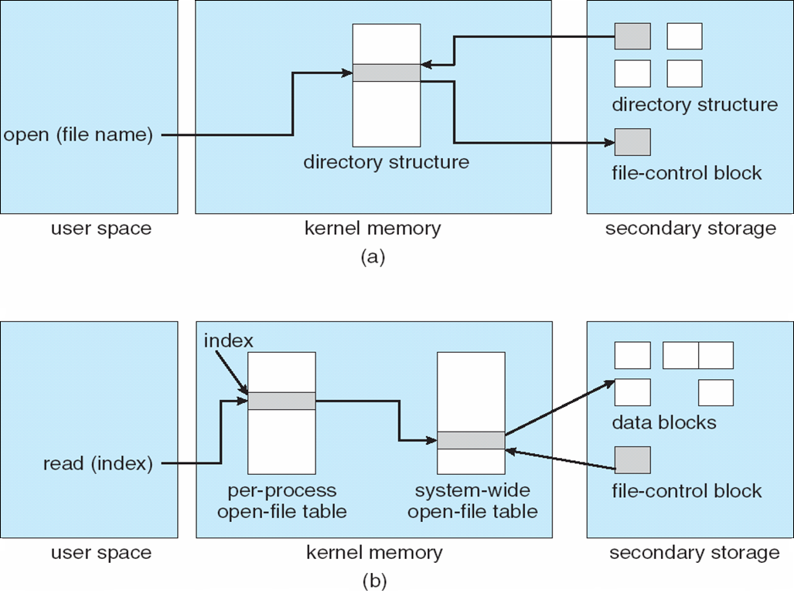
In-Memory File System Structures used in OS
After open

Slide 32
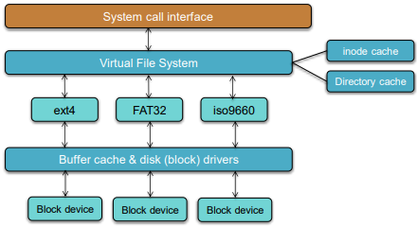
Virtual File System (VFS) Interface
Virtual File Systems (VFS) provide an abstract interface for file system implementations.
VFS allows the same system call interface (the API) to be used for different file systems.
The API is to the VFS interface, rather than any specific type of file system.
Each real file system interface exports the common VFS API.

Slide 33
Directory Organization
A directory is just a file containing entries of (name, reference) pairs.
Name → (metadata, data) Unix (UFS) approach
(Name, metadata) → data MS-DOS (FAT) approach
These entries can be organized either as a Linear list or a Hash Table.
In linear list, searching a large directory is very slow.
It may be improved by caching frequently-used entries.
In linear list with a hash table, directory search time can be decreased.
Hash collisions and fixed hash table size need to be considered.
More complex structures may be used.
B-Tree, Htree, and etc..
Balanced tree with constant depth

Slide 34
Block Allocation Methods
Disk blocks may be allocated to a file by the following methods.
Contiguous allocation: assigns each file a set of contiguous blocks on the disk.
It is a simple mechanism. Only the starting location (block #) and length (number of blocks) are required.
It provides random access to any file position.
Problems: files cannot grow easily and storage may become wasteful.
Compromise solution: uses extents
Allocate a contiguous chunk of space (called extent) at a time.
Keep track of all extents information (location, size)
Linked allocation: links a file’s data blocks into a linked list of blocks.
Directory entry contains a pointer to the first block of the file.
Each block contains a pointer to the next block.
Problems: bad for random access and each block uses space for the pointer to the next block
Compromise solution: uses File-allocation table (FAT)
Indexed allocation: store all block pointers of a file in one place: the index block (inode)

Slide 35
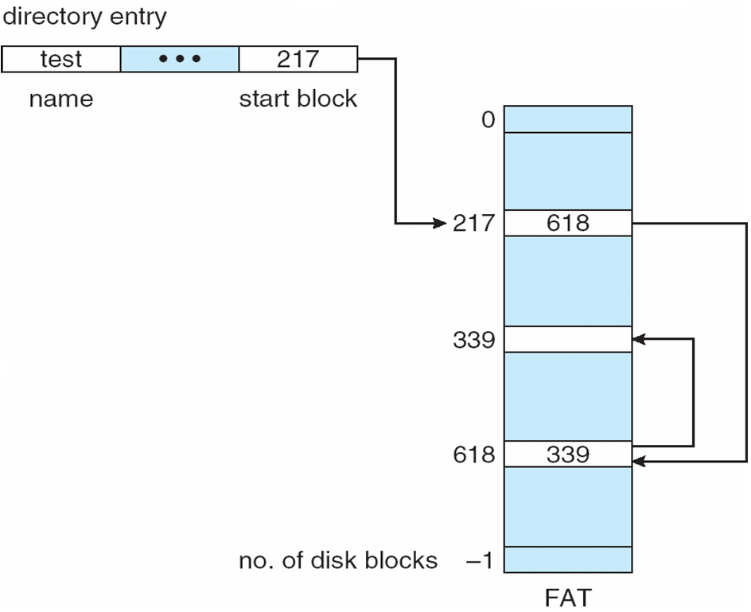
File-Allocation Table (FAT)
It is a variation of Linked Allocation
used in MS-DOS and early MS Windows
Each disk volume contains a FAT table that has one entry for each disk block.
The FAT is shared by all files stored in the disk volume.
Each FAT entry contains the disk location of next logical block in the file.
The directory entry of a file contains the disk location of the 1st logical block.

Slide 36
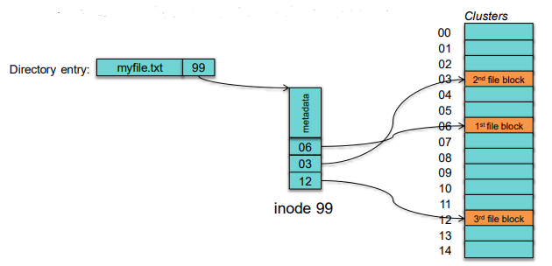
Indexed Allocation
Directory entry contains file name and inode number.
Each inode contains file metadata (length, timestamps, owner, etc.) and a block map.
On file open, read the inode to get the index map
Disk blocks

Slide 37
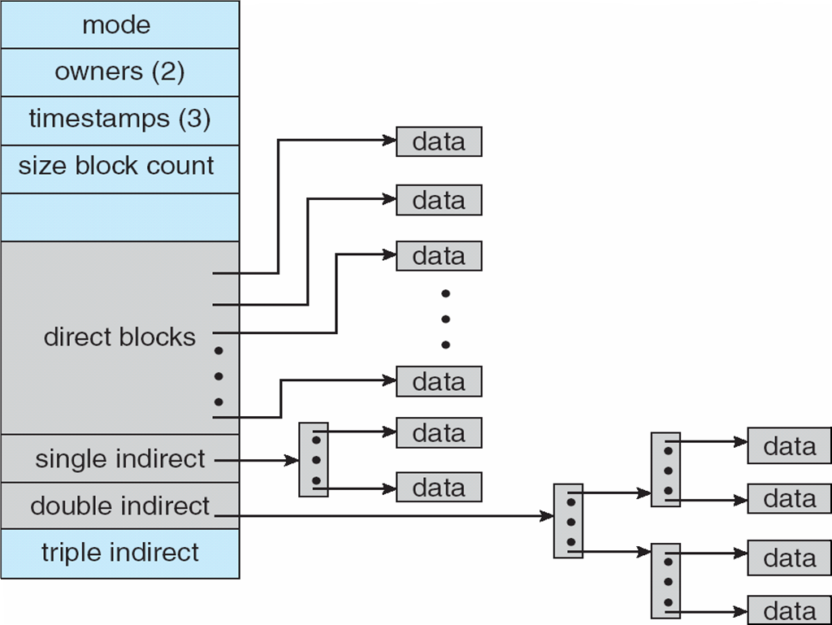
Combined Scheme: UNIX UFS (4K bytes per block)
To avoid variable sized inodes.
An inode may contain different types of block locations.
Locations of data blocks
Location of single indirect block
Location of double indirect block
Location of triple indirect block

Slide 38
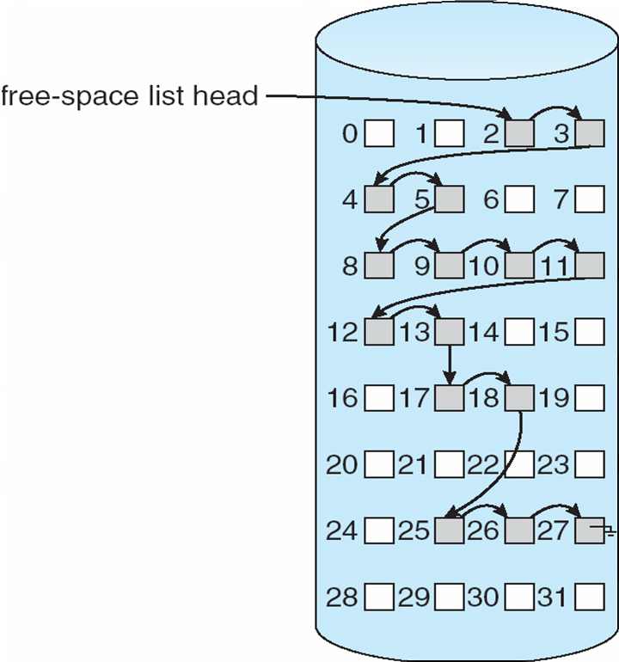
Free-Space Management for disk blocks
Bit vector (n blocks) requires extra space
Example: block size = 2¹² bytes
disk size = 2³⁰ bytes (1 gigabyte)
n = 2³⁰/2¹² = 2¹⁸ bits (or 32K bytes)
Easy to get contiguous files
Linked list (free list)
Cannot get contiguous space easily
No waste of space
Grouping :
Counting :
0
1
2
n-1
…
0 ⇒ block[i] free
1 ⇒ block[i] occupied
bit[i] =


Slide 39
The Grouping and Counting Methods
The Grouping method is the modification of the linked list method.
The first free block (indexing free block) stores the addresses of the next n free blocks.
The first n-1 blocks are normal free blocks.
The last block is another indexing free block which again stores n addresses of free blocks, and so on.
The advantages of the grouping method are
The addresses of a large number of free blocks can be found quickly.
It can allocate a collection of empty disk blocks efficiently.
The Counting method is also a modification of the linked list method.
Each free block in the disk contains two fields:
The address of the next free block.
The number of free contiguous blocks following it.

Slide 40
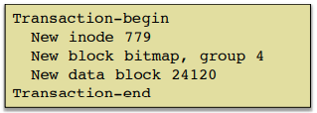
Log Structured (Journaling) File Systems
Journaling file systems record each update to the file system as a transaction.
All transactions are written to a log first.
A transaction is considered committed once it is written to the log.
However, the file system may not yet be updated.
The transactions in the log are then asynchronously written to the file system.
When the file system is modified successful, the transaction is removed from the log.
If the file system crashes, all transactions in the log must be replayed on reboot.
It is also called redo logging.

Slide 41
Unix File System (UFS)
Each inode contains direct, indirect, double-indirect, and triple-indirect blocks.
A disk is divided into 3 parts: superblock, inodes, and data blocks.
Superblock contains:
size of file system, number of free blocks, list of free blocks, pointer to free block lists,
index of the next free block in the free block list, size of the inode list,
number of free inodes in the file system, index of the next free inode in the free inode list,
modified flag (clean/dirty)
Free space is managed as a linked list of free blocks.
Eventually every disk block access will require a seek.

Slide 42
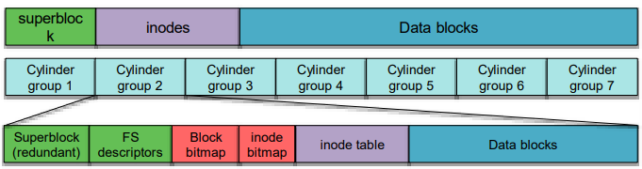
BSD Fast File System (FFS)
It tries to minimize head movement by reduce seek time.
It keeps file data blocks close to its inode to minimize seek time to fetch data.
It also keeps related files and their directories together.
A cylinder is a collection of all blocks on the same disk track on all heads of a disk.
A cylinder group is a collection of blocks on one or more consecutive cylinders
UFS:
FFS:
Cylinder group:

Slide 43
Secondary Storage System
Magnetic disks provide bulk of secondary storage of modern computers
Drives rotate at 60 to 200 times per second
Transfer rate is the rate at which data flow between drive and computer
Positioning time (random-access time) is
time to move disk arm to desired cylinder (seek time) and
time for desired sector to rotate under the disk head (rotational latency)
Head crash results from disk head making contact with the disk surface
Disks can be removable
Drive attached to computer via I/O bus
The usual bus systems are USB, Fiber Channel, SCSI, etc.
Host controller in computer uses bus to talk to disk controller.

Slide 44
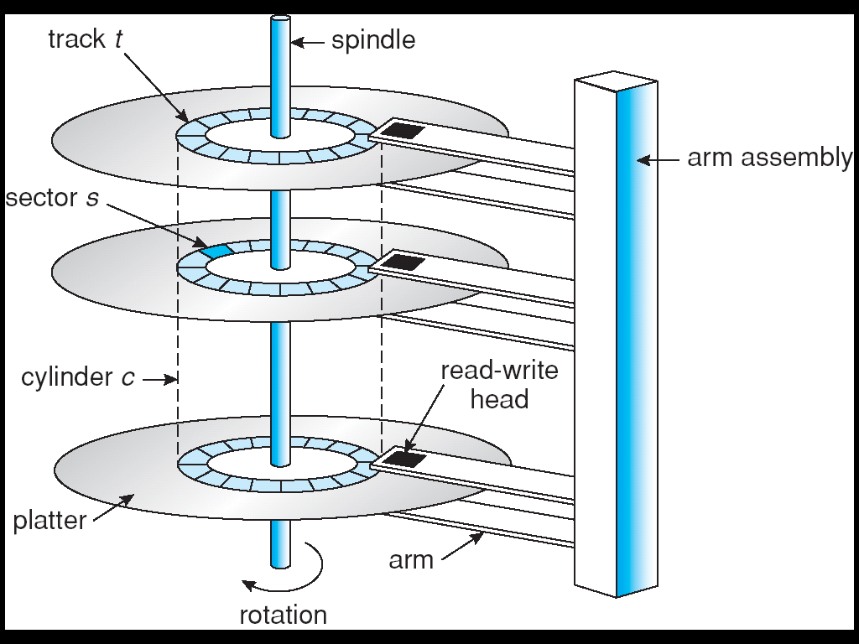
Moving-Head Disk Mechanism

Slide 45
Disk Structure
Disk drives are addressed as large 1-dimensional arrays of logical blocks, where the logical block is the smallest unit of transfer.
The 1-dimensional array of logical blocks is mapped into the sectors of the disk sequentially
Sector 0 is the first sector of the first track on the outermost cylinder
Mapping proceeds in order through that track, then the rest of the tracks in that cylinder, and then through the rest of the cylinders from outermost to innermost
Disks can be attached to a computer in the following ways.
Host-attached storage accessed through I/O ports talking to I/O busses.
SCSI is a commonly used I/O bus that can attach up to 16 devices on one cable.
SCSI initiator requests operation and SCSI targets perform tasks. Each target can have up to 8 disks.
Network-attached storage (NAS) is storage made available over a LAN rather than a local bus.
Storage Area Network (SAN) is common in large storage environments.

Slide 46
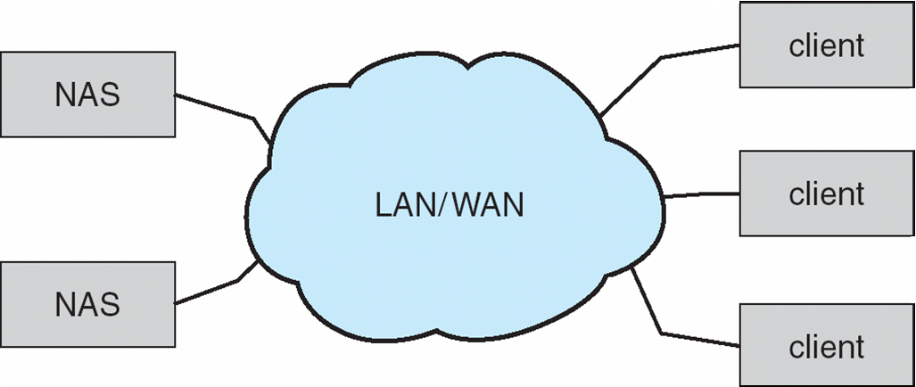
Network-Attached Storage (NAS)
NFS and CIFS are common protocols that were implemented via remote procedure calls (RPCs) between host and storage.
The iSCSI protocol that uses IP network to carry the SCSI protocol is also common,

Slide 47
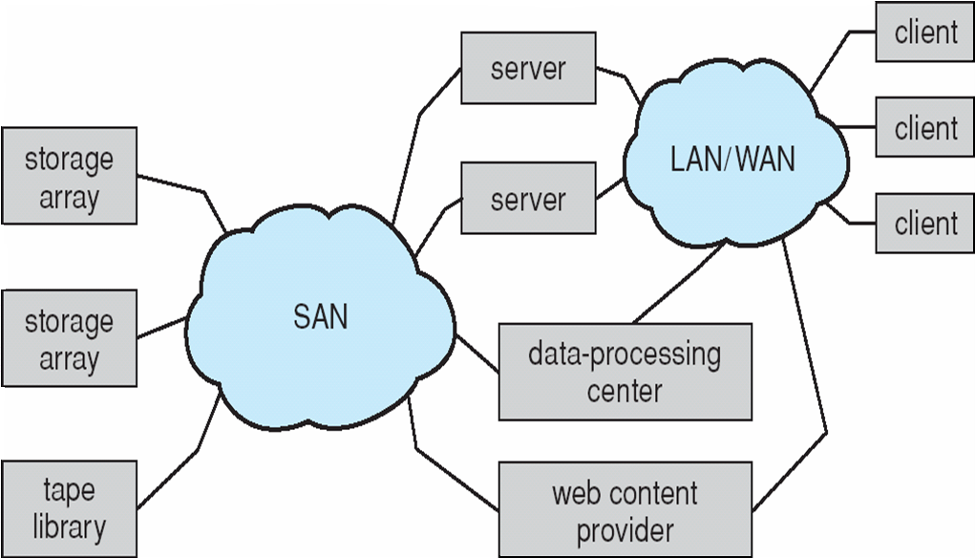
Storage Area Network (SAN)
Multiple hosts can be attached to multiple storage arrays.

Slide 48
Disk Scheduling
The OS is responsible for using hardware efficiently
For the disk drives, this means having a fast access time and high disk bandwidth
Access time has two major components
Seek time is the time for the disk to move the heads to the cylinder containing the desired sector
Rotational latency is the additional time waiting for the disk to rotate the desired sector to the disk head. In average, it is one half of the rotation time of the disk.
The seek time is far larger that the rotational latency ➔ Minimize seek time
Seek time ≈ seek distance (the distance between current and new head positions)
Disk bandwidth is the total number of bytes transferred, divided by the total time between the first request for service and the completion of the last transfer

Slide 49
Disk Scheduling Algorithms
Several algorithms exist to schedule the servicing of disk I/O requests
We illustrate them with a request sequence (cylinder numbers: 0-199) of 98, 183, 37, 122, 14, 124, 65, 67, where the Current head position is 53.
The FCFS handles requests according to their arriving order.
The SSTF (shortest seek time first) selects the request with the minimum seek time from the current head position.
The SCAN schedules pending I/O in the sequence of the current head moving direction. When the head reaches the end, it reverses the moving direction.
In the LOOK schedule, the head only goes as far as the last request in each direction.
The C-SCAN (Circular SCAN) schedules pending I/O in the sequence of the head moving direction. When the head reaches the end, it fast moves the head back to the other end. It serves the requests only in one direction.

Slide 50
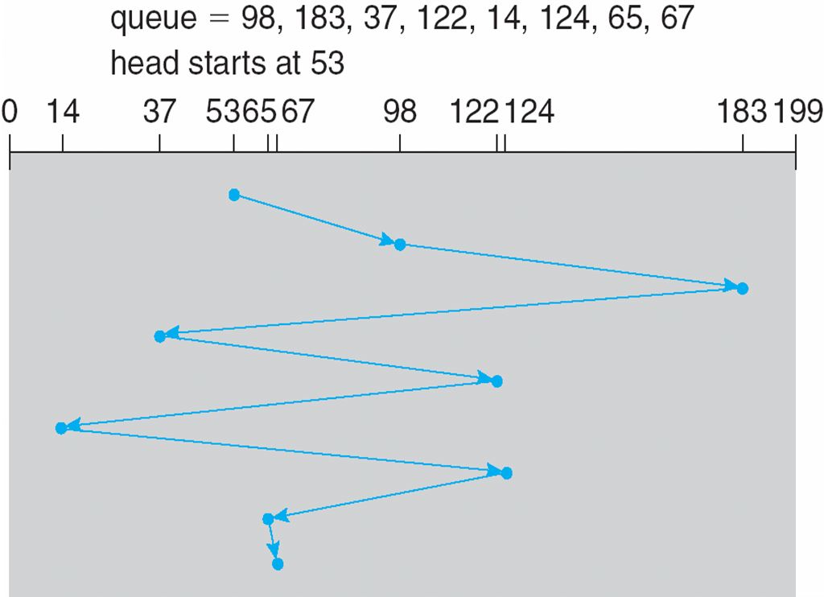
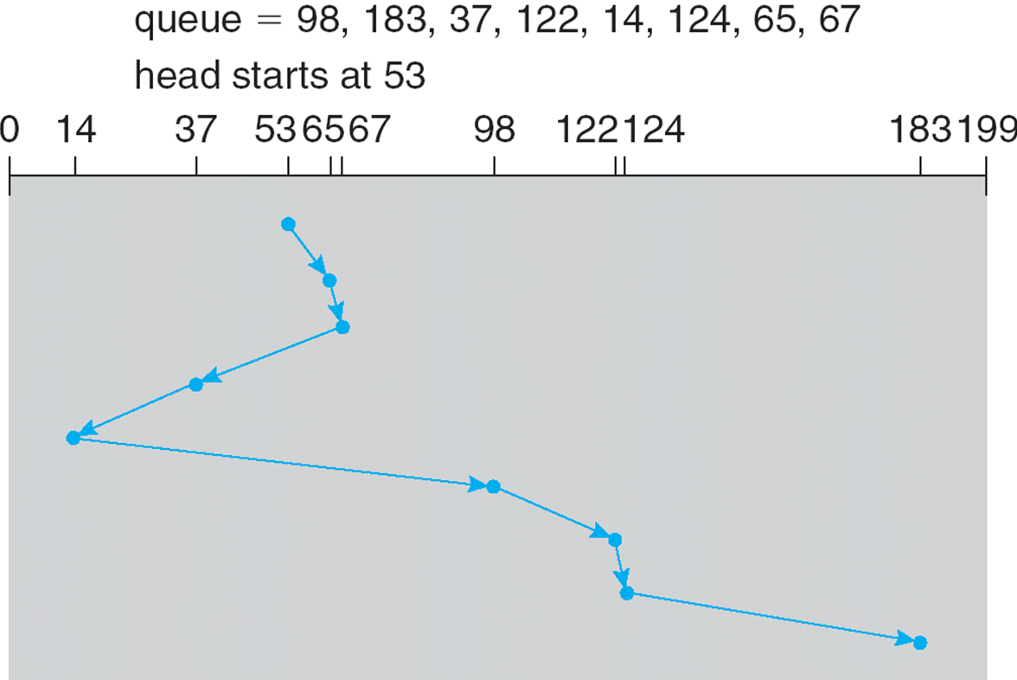
FCFS
SSTF
The total seek time is (98-53) + (183-98) + (183-37) + (122-37) + (122-14) + (124-14) + (124-65) + (67-65) = 45+85+146+85+108+110+57+2= 638
The total seek time is (65-53) + (67-65) + (67-37) + (37-14) + (98-14) + (122-14) + (124-122) + (183-124) = 12+2+30+23+84+108+2+59= 320

Slide 51
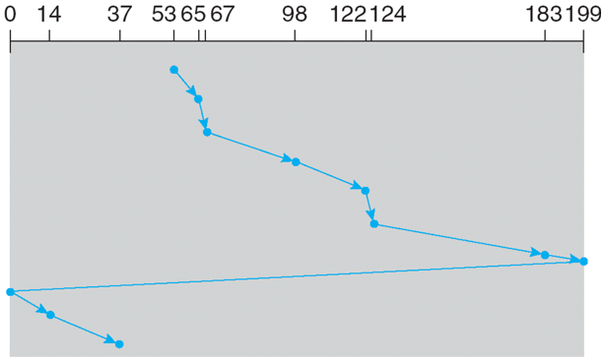
SCAN
C-SCAN
Queue = 98, 183, 37, 122, 14, 124, 65. 67
Head is at 53 and is moving from 0 to 199
Queue = 98, 183, 37, 122, 14, 124, 65. 67
Head is at 53 and is moving from 0 to 199
The time for fast moving back to the 0 can be ignored
The total seek time is (65-53) + (67-65) + (98-67) + (122-98) + (124-122) + (183-124) + (199-183) + (199-37) + (37-14) = (199-53) + (199-14) = 146+185 = 331
The total seek time is (65-53) + (67-65) + (98-67) + (122-98) + (124-122) + (183-124) + (199-183) + (199→0) + (14-0) + (37-14) = (199-53) + (37-0) = 146+37 = 183 + ??

Slide 52
LOOK
Queue = 98, 183, 37, 122, 14, 124, 65. 67
Head is at 53 and is moving from 0 to 199
The total seek time is (65-53) + (67-65) + (98-67) + (122-98) + (124-122) + (183-124) + (183-37) + (37-14) = (183-53) + (183-14) = 130+169 = 299

Slide 53
RAID Structure
RAID stands for Redundant Array of Independent (or Inexpensive) Disks
It contains multiple disk drives to provide reliability via redundancy
It can increases the mean time to failure
There are 7 different levels of RAID: RAID-0 to RAID-6
RAID 0 uses disk striping to group disks into one storage unit.
Mirroring or shadowing (RAID 1) keeps duplicate of each disk.
Striped mirrors (RAID 1+0) or mirrored stripes (RAID 0+1) provides high performance and high reliability
Block interleaved parity (RAID 4, 5, 6) uses much less redundancy
RAID within a storage array can still fail if the array fails, so automatic replication of the data between arrays is common
Frequently, a small number of hot-spare disks are left unallocated, automatically replacing a failed disk and having data rebuilt onto them

Slide 54
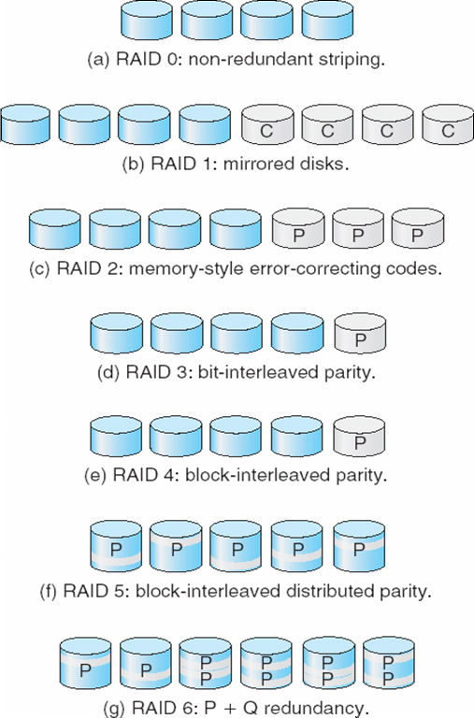
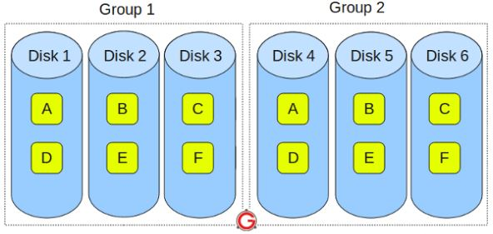
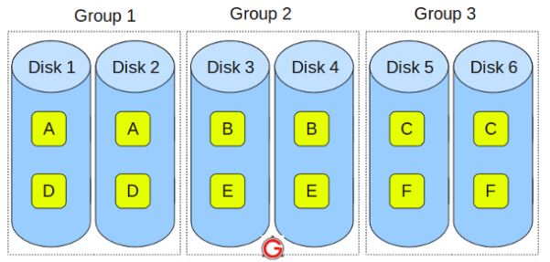
Raid 0+1
Raid 1+0

Slide 55
Raid 1+0 vs Raid 0+1
RAID 1+0 is also called as “stripe of mirrors” has better fault tolerance level. (why?)
It groups the disks in pair of two (for mirror.)
For 6 disks, there will be three groups : Group 1, Group 2, and Group 3.
Within each group, the data is mirrored. Thus, block A written on Disk 1 will be mirrored on Disk 2. Block B written on Disk 3 will be mirrored on Disk 4.
Across the group, the data is striped. Block A is written to Group 1, Block B is written to Group 2, Block C is written to Group 3.
RAID 0+1 is also called as “mirror of stripes”
It groups the disks into two groups (for mirror.)
For 6 disks, it create two groups with 3 disks each.
Within each group, the data is striped. Thus, block A is written to Disk 1, block B to Disk 2, block C to Disk 3.
Across the group, the data is mirrored. The Group 1 and Group 2 will look exactly the same.

