Slide 1
Gridding and Optimization for a Drone Swarm

Slide 2
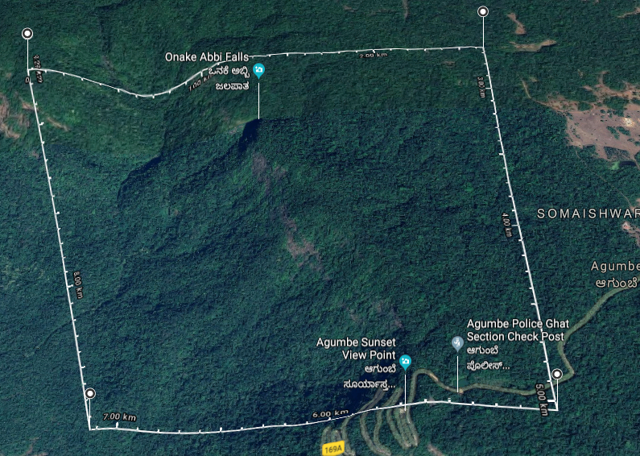

Introduction
Goal is to complete a mission by navigating autonomously and share vital information.
The main purpose of the these drone is to scout the disaster areas or inaccessible terrain areas and report with the relevant data to the Cloud Data Centre for any analytics and processing.
Notes:
Big picture – Nokia – Aim is to conduct a recon mission – mark areas of interest – this is transferred to relevant authorities

Slide 3
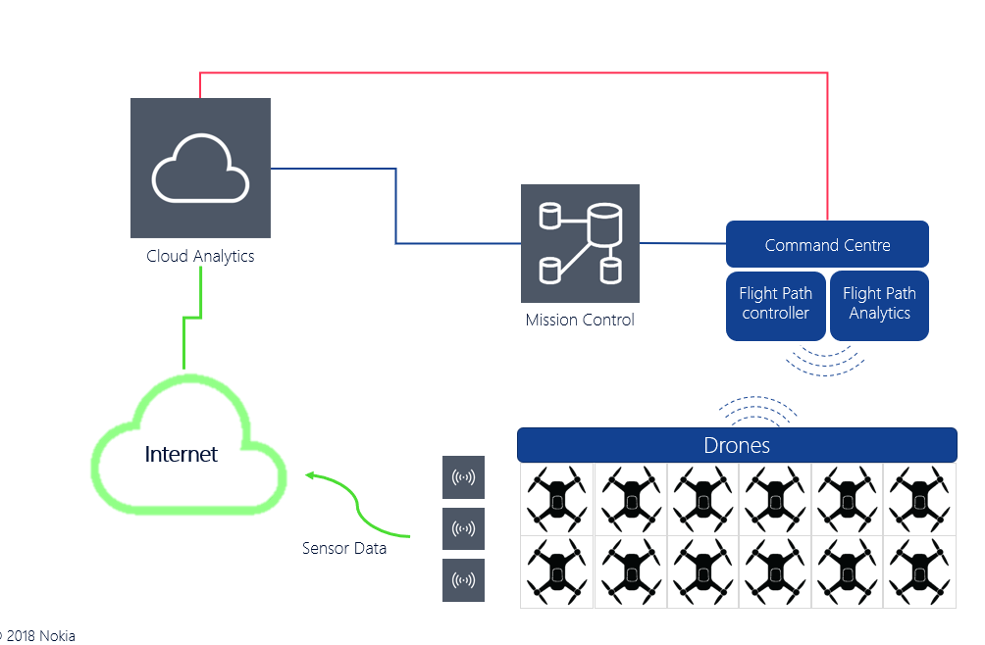
Architecture
Notes:
Basic plan – Mission ctrl – we come there – transfer of data

Slide 4
Literature Review
KML: https://developers.google.com/kml/documentation/kmlreference
DroneCode: https://www.dronecode.org/documentation/
QGIS: https://qgis.org/en/docs/index.html
QGIS in Openstreetmaps: https://wiki.openstreetmap.org/wiki/QGIS
GeoJSON: http://geojson.org/

Slide 5
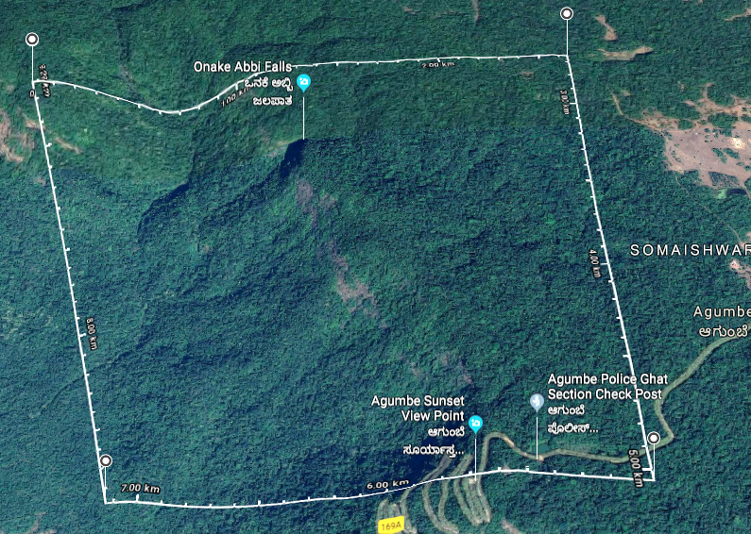
Gridding
1
2
3
4
5
6
7
8
9
10
11
12

Slide 6
Tools used
Dronecode: It is an open source drone simulation software.
It is used to simulate the path of the drone at the end to get the visual understanding of the mathematical model of the flight path
The grids created will be overlaid on the map of the drone code software to see the grids visually
Data sharing between the two nodes is the location i.e. latitude, longitude etc.
As this data is given to google maps or openstreetview maps, hast to be in a standard format. Some of them are KML, GeoJSON, QGIS etc.
KML (Keyhole Mark-up Language): KML is used to pinpoint the location, add image overlay etc. Similar to XML
Have basic non predefined tags like points, co-ordinates etc.

Slide 7
GeoJSON: Similar to KML, but uses JSON format to carry data
Disadvantage: Cannot operate directly on data
No circular geometry or any curve
Some datatypes are not supported
QGIS: Geographic Information System is designed to capture, store geographical data
QGIS is a framework used on top of GIS
This includes an inbuilt map which gives the values like the type of terrain, altitude etc. data at a given location
This can be included in python script and can depict the mathematical modelled values easily on to the map.
This also consists of static map and gridding capabilities
Notes:
Geographical info sys – capture, store manipulate spatial data – terrain and stuff – application for standalone,web apps -

Slide 8
Working Principle
Alert to mission control and status check of all drones.
Check size of master grids. If not able to cover, divide to two or more command centres.
Once the total area is decided, it is divided into smaller grids using a predefined mathematical model.
This must take several parameters and constraints into consideration (number of drones, battery status, the maximum area, no-fly zones, and terrain).

Slide 9
The shape and area of the grids are decided, which can be different for different cases
The edge points of each grid are calculated and exported as a KML or other data sharing format.
The gridding must be optimized depending on the type of terrain and the no-go zones. These areas will be present in the mission control database.

Slide 10
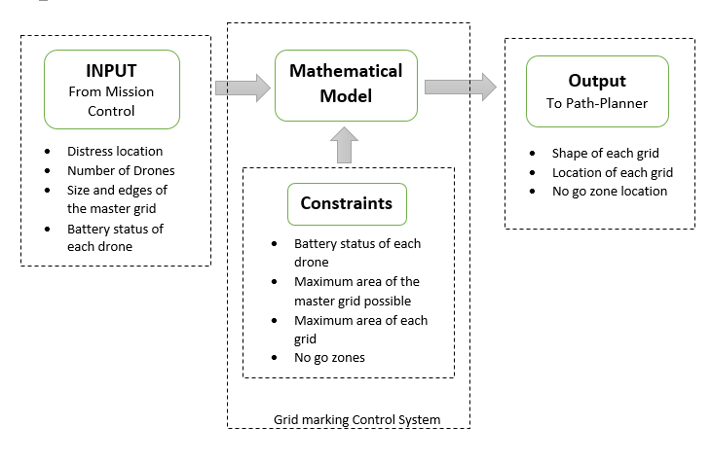
Block Diagram

Slide 11
Applications
Robotic vacuum cleaners – Roombas
Archaeological surveys
Choppers used in rescue missions
Service robots for indoor applications
To place multiple sensors appropriately at a particular place in order to monitor different parameters
Notes:
1.marking grids in unknown environment and classifying objects in it in order to avoid collision2.dividing entire area into smaller grids taking various parameter into consideration.3. Assigning one chopper to each grid to complete the rescue mission faster4.creating grids based on particular services required to be performed in that grid.5.placing sensors in appropriate grids so as to monitor different parameters appropriately

Slide 12
Limitations
Marking of grids is at the simulation level considering ideal situations.
Sufficient drones may not be available all the time at all places.
Accuracy may not be up to the point since measurements are machine based.
Drones have limited coverage area
Drones have a low battery life, usually for 20 minutes
Battery may get further reduced due to weather conditions, flying in hilly areas etc.
Drones cannot cover the no-fly zones

Slide 13
Future Enhancement
This project can be improvised in the future by using better and efficient mathematical models by taking some more parameters and constraints into consideration.
It can also be enhanced to perform real-time gridding task directly by the drones, by recognizing the new constructions and obstacles and learning about it in a built-in neural net of the system so that it can mark that spot as an obstacle to avoid.
It can also learn about disaster-prone areas and can prioritize that region to check for any calamities.

Slide 14
Thank
You

