Slide 1
Preprocessing

Slide 2
Outlines
1. Data Preprocessing: Abstract
2. Data Cleaning
3. Data Integration
4. Data Reduction
5. Data Transformation and Data Discretization
6. Summary

Slide 3
Outlines
1. Data Preprocessing: Abstract
2. Data Cleaning
3. Data Integration
4. Data Reduction
5. Data Transformation and Data Discretization
6. Summary

Slide 4
Why preprocessing?
● Poor data quality negatively affects many data processing efforts
“The most important point is that poor data quality is an unfolding disaster.
  – Poor data quality costs the typical company at least ten percent (10%) of revenue; twenty percent (20%) is probably a better estimate.”
    Thomas C. Redman, DM Review, August 2004
● Data mining example: a classification model for detecting people who are loan risks is built using poor data
  – Some credit-worthy candidates are denied loans
  – More loans are given to individuals by default

Slide 5
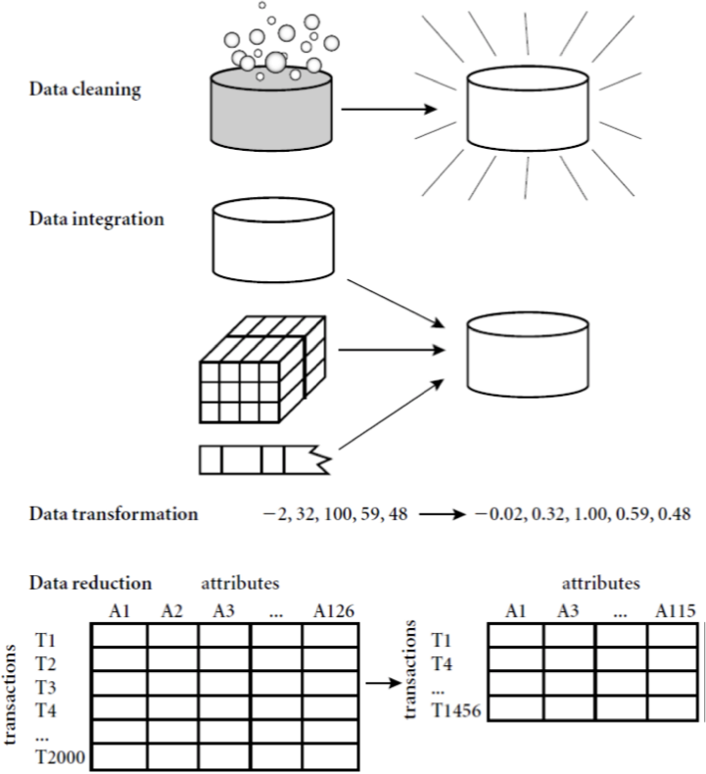
Four Major Steps of Preprocessing
Data clean: to complete missing data, smooth noisy data, recognize and delete discrete points and ensure consistency
Data integration: to integrate data from different databases, files and cubes
Data reduction: data compress and reduction
Data transformation: layer and normalization

Slide 6
Outlines
1. Data Preprocessing: Abstract
2. Data Cleaning
3. Data Integration
4. Data Reduction
5. Data Transformation and Data Discretization
6. Summary

Slide 7
Data Cleaning
What kinds of data quality problems?
How can we detect problems from the data?
What can we do about these problems?
Examples of data quality problems:
  Noise and outliers
  missing values
  duplicate data

Slide 8


Noise
Noise refers to modification of original values
  Examples: distortion of a person’s voice when talking on a poor phone and “snow” on television screen
Two Sine Waves
Two Sine Waves + Noise

Slide 9
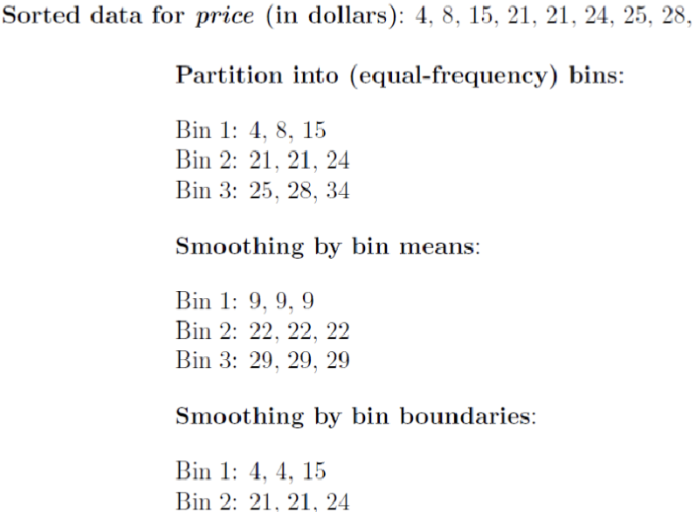
Noise
Firstly, sort the numerical, then divide the data into several equal parts
Each part of the data in the form a "box (bin)
For each case in the data smoothing, replace all data in the same box with the center of measurement
You can also replace the data in the box with the maximum and minimum values of each box without the center measure.

Slide 10
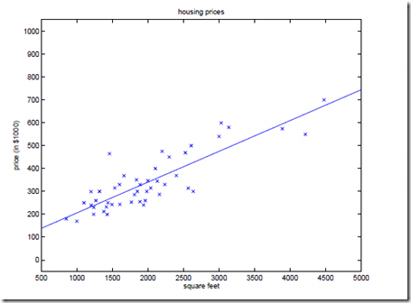
Noise
Use a function, such as a linear function, to fit the existing sample data
When one attribute is determined in a two attribute attribute, the value of another attribute is given by a fitting function.
Use multiple regression to fit the data to a surface of a high dimensional space

Slide 11

Outliers
Outliers are data objects with characteristics that are considerably different than most of the other data objects in the data set

Slide 12
Missing Values
Reasons for missing values
  Information is not collected
  (e.g., people decline to give their age and weight)
  Attributes may not be applicable to all cases
  (e.g., annual income is not applicable to children)
Handling missing values
  Eliminate Data Objects
  Estimate Missing Values
  Ignore the Missing Value During Analysis
  Replace with all possible values (weighted by their probabilities)

Slide 13
Duplicate Data
Data set may include data objects that are duplicates, or almost duplicates of one another
  Major issue when merging data from heterogeous sources
Examples:
  Same person with multiple email addresses
Data cleaning
  Process of dealing with duplicate data issues

Slide 14
Outlines
1. Data Preprocessing: Abstract
2. Data Cleaning
3. Data Integration
4. Data Reduction
5. Data Transformation and Data Discretization
6. Summary

Slide 15
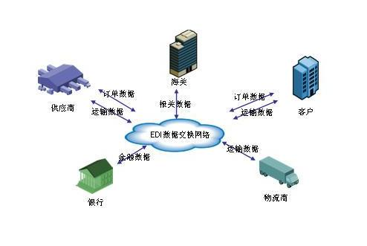
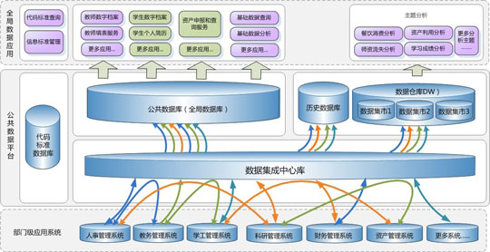
Data Integration
Definition:
  Combines data from multiple sources into a coherent store
Detecting and resolving data value conflicts
  For the same real world entity, attribute values from different sources are different
  Possible reasons: different representations, different scales

Slide 16
Handling Redundancy in Data Integration
Redundant data occur often in integrating multiple databases
  Object identification: The same attribute or object may have different names in different databases
  Derivable data: One attribute may be a “derived” attribute in another table, e.g., annual revenue
Redundant attributes may be able to be detected by correlation analysis and covariance analysis
Careful integration of the data from multiple sources may help reduce/avoid redundancies and inconsistencies and improve mining speed and quality
Notes:
处理冗余

Slide 17
Correlation Analysis
Χ² (chi-square) test
The larger the Χ² value, the more likely the variables are related (>10.828 means obvious related)
The cells that contribute the most to the Χ² value are those whose actual count is very different from the expected count

Slide 18
Chi-Square Calculation: An Example
Χ² (chi-square) calculation (numbers in parenthesis are expected counts calculated based on the data distribution in the two categories)
It shows that like_science_fiction and play_chess are correlated in the group (507.93>10.828)
 | Play chess | Not play chess | Sum (row)
Like science fiction | 250(90) | 200(360) | 450
Not like science fiction | 50(210) | 1000(840) | 1050
Sum(col.) | 300 | 1200 | 1500
Notes:
引入卡方统计检验

Slide 19
Correlation Analysis (Numeric Data)
Correlation coefficient (also called Pearson’s product-moment coefficient)
  where n is the number of tuples, and are the respective means of A and B, σ_{A} and σ_{B} are the respective standard deviation of A and B, and Σ(a_{i}b_{i}) is the sum of the AB cross-product.
If r_{A,B} > 0, A and B are positively correlated (A’s values increase as B’s). The higher, the stronger correlation.
r_{A,B} = 0: independent;
r_{AB} < 0: negatively correlated
Notes:
相关性分析：相关系数

Slide 20

Visually Evaluating Correlation
Scatter plots showing the similarity from –1 to 1.

Slide 21
Correlation (viewed as linear relationship)
Correlation measures the linear relationship between objects
To compute correlation, we standardize data objects, A and B, and then take their dot product

Slide 22

Covariance (Numeric Data)
Covariance is similar to correlation：
  where n is the number of tuples, and are the respective mean or expected values of A and B, σ_{A} and σ_{B} are the respective standard deviation of A and B.
Positive covariance: If Cov_{A,B} > 0, then A and B both tend to be larger than their expected values.
Negative covariance: If Cov_{A,B} < 0 then if A is larger than its expected value, B is likely to be smaller than its expected value.
Independence: Cov_{A,B} = 0 but the converse is not true:
  Some pairs of random variables may have a covariance of 0 but are not independent. Only under some additional assumptions (e.g., the data follow multivariate normal distributions), a covariance of 0 can imply independence
Notes:
协方差

Slide 23
Co-Variance: An Example
Suppose two stocks A and B have the following values in one week: (2, 5), (3, 8), (5, 10), (4, 11), (6, 14).
Question: If the stocks are affected by the same industry trends, will their prices rise or fall together?
  E(A) = (2 + 3 + 5 + 4 + 6)/ 5 = 20/5 = 4
  E(B) = (5 + 8 + 10 + 11 + 14) /5 = 48/5 = 9.6
  Cov(A,B) = (2×5+3×8+5×10+4×11+6×14)/5 − 4 × 9.6 = 4
Thus, A and B rise together since Cov(A, B) > 0.

Slide 24
Outlines
1. Data Preprocessing: Abstract
2. Data Cleaning
3. Data Integration
4. Data Reduction
5. Data Transformation and Data Discretization
6. Summary

Slide 25
Data Reduction
Definition
Obtain a reduced representation of the data set that is much smaller in volume but yet produces the same (or almost the same) analytical results
Why data reduction?
— A database/data warehouse may store terabytes of data. Complex data analysis may take a very long time to run on the complete data set.

Slide 26
Data Reduction Strategies
Data reduction strategies
  Dimensionality reduction, e.g., remove unimportant attributes
    Wavelet transforms
    Principal Components Analysis (PCA)
    Feature subset selection, feature creation
  Numerosity reduction (some simply call it: Data Reduction)
    Regression and Log-Linear Models
    Histograms, clustering, sampling
    Data cube aggregation
  Data compression

Slide 27
Data Reduction 1: Dimensionality Reduction
Curse of dimensionality
  When dimensionality increases, data becomes increasingly sparse
  Density and distance between points, which is critical to clustering, outlier analysis, becomes less meaningful
  The possible combinations of subspaces will grow exponentially
Dimensionality reduction
  Avoid the curse of dimensionality
  Help eliminate irrelevant features and reduce noise
  Reduce time and space required in data mining
  Allow easier visualization
Dimensionality reduction techniques
  Wavelet transforms
  Principal Component Analysis
  Supervised and nonlinear techniques (e.g., feature selection)
Notes:
数据规约：维规约

Slide 28

Mapping Data to a New Space
Fourier transform
Wavelet transform
Two Sine Waves
Two Sine Waves + Noise
Frequency

Slide 29
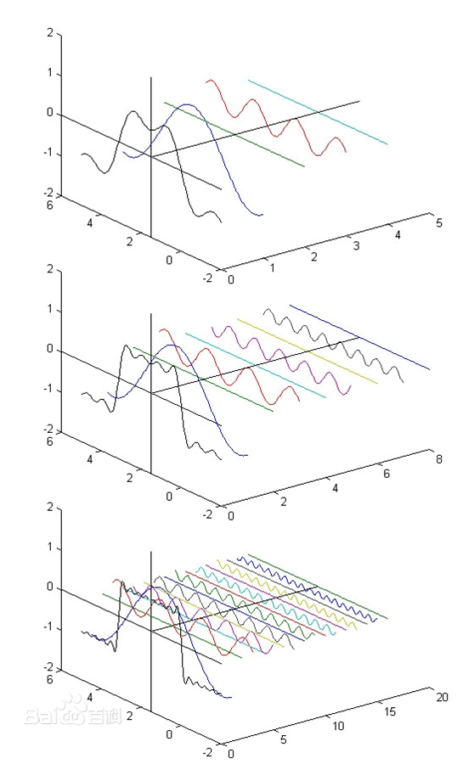
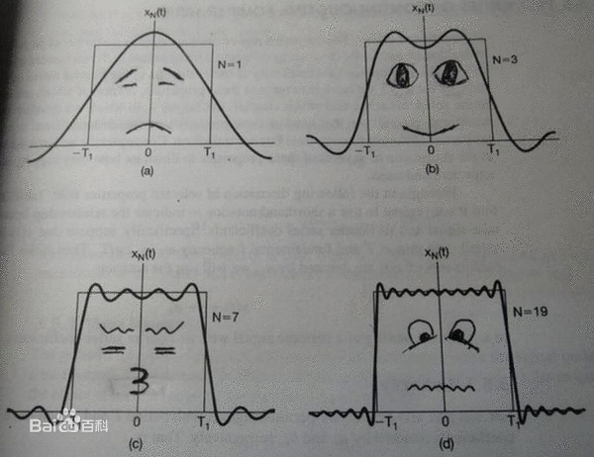
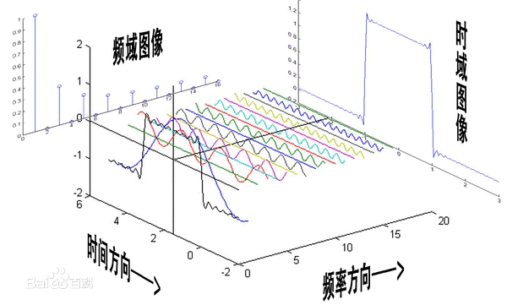
What Is Fourier Transform?

Slide 30

What Is Wavelet Transform?
Decomposes a signal into different frequency subbands
  Applicable to n-dimensional signals
Data are transformed to preserve relative distance between objects at different levels of resolution
Allow natural clusters to become more distinguishable
Used for image compression

Slide 31
Wavelet Transformation
Haar2
Daubechie4
Discrete wavelet transform (DWT) for linear signal processing, multi-resolution analysis
Compressed approximation: store only a small fraction of the strongest of the wavelet coefficients
Similar to discrete Fourier transform (DFT), but better lossy compression, localized in space
Method:
  Length, L, must be an integer power of 2 (padding with 0’s, when necessary)
  Each transform has 2 functions: smoothing, difference
  Applies to pairs of data, resulting in two set of data of length L/2
  Applies two functions recursively, until reaches the desired length

Slide 32

Wavelet Decomposition
Wavelets: A math tool for space-efficient hierarchical decomposition of functions
S = [2, 2, 0, 2, 3, 5, 4, 4] can be transformed to S^ = [2³/₄, -1¹/₄, ¹/₂, 0, 0, -1, -1, 0]
Compression: many small detail coefficients can be replaced by 0’s, and only the significant coefficients are retained

Slide 33
Haar Wavelet Coefficients
Coefficient “Supports”
₊
Hierarchical decomposition structure (a.k.a. “error tree”)
2.75
₋
2.75
₊
+
-1.25
₋
+
-1.25
-
₊
0.5
₋
0.5
0
₊
+
-
+
-
0
₋
0
-1
-1
0
₊
0
₋
+
-
+
-
+
-
+
-
₊
₋
-1
2 2 0 2 3 5 4 4
₊
-1
₋
₊
Original frequency distribution
0

Slide 34
Why Wavelet Transform?
Use hat-shape filters
  Emphasize region where points cluster
  Suppress weaker information in their boundaries
Effective removal of outliers
  Insensitive to noise, insensitive to input order
Multi-resolution
  Detect arbitrary shaped clusters at different scales
Efficient
  Complexity O(N)
Only applicable to low dimensional data

Slide 35
Principal Component Analysis (PCA)
Find a projection that captures the largest amount of variation in data
The original data are projected onto a much smaller space, resulting in dimensionality reduction. We find the eigenvectors of the covariance matrix, and these eigenvectors define the new space
x₂
e
x₁

Slide 36
Principal Component Analysis (Steps)
Given N data vectors from n-dimensions, find k ≤ n orthogonal vectors (principal components) that can be best used to represent data
  Normalize input data: Each attribute falls within the same range
  Compute k orthonormal (unit) vectors, i.e., principal components
  Each input data (vector) is a linear combination of the k principal component vectors
  The principal components are sorted in order of decreasing “significance” or strength
  Since the components are sorted, the size of the data can be reduced by eliminating the weak components, i.e., those with low variance (i.e., using the strongest principal components, it is possible to reconstruct a good approximation of the original data)
Works for numeric data only

Slide 37
Attribute Subset Selection
Another way to reduce dimensionality of data
Redundant attributes
  Duplicate much or all of the information contained in one or more other attributes
  E.g., purchase price of a product and the amount of sales tax paid
Irrelevant attributes
  Contain no information that is useful for the data mining task at hand
  E.g., students' ID is often irrelevant to the task of predicting students' GPA

Slide 38
Heuristic Search in Attribute Selection
There are 2^{d} possible attribute combinations of d attributes
Typical heuristic attribute selection methods:
  Best single attribute under the attribute independence assumption: choose by significance tests
  Best step-wise feature selection:
    The best single-attribute is picked first
    Then next best attribute condition to the first, ...
  Step-wise attribute elimination:
    Repeatedly eliminate the worst attribute
  Best combined attribute selection and elimination
  Optimal branch and bound:
    Use attribute elimination and backtracking

Slide 39
Attribute Creation (Feature Generation)
Create new attributes (features) that can capture the important information in a data set more effectively than the original ones
Three general methodologies
  Attribute extraction
    Domain-specific
  Mapping data to new space (see: data reduction)
    E.g., Fourier transformation, wavelet transformation, manifold approaches (not covered)
  Attribute construction
    Combining features
    Data discretization

Slide 40
Data Reduction 2: Numerosity Reduction
Reduce data volume by choosing alternative, smaller forms of data representation
Parametric methods (e.g., regression)
  Assume the data fits some model, estimate model parameters, store only the parameters, and discard the data (except possible outliers)
  Ex.: Log-linear models—obtain value at a point in m-D space as the product on appropriate marginal subspaces
Non-parametric methods
  Do not assume models
  Major families: histograms, clustering, sampling, …
Notes:
回归模型；直方图、聚类、抽样

Slide 41
Parametric Data Reduction: Regression and Log-Linear Models
Linear regression
  Data modeled to fit a straight line
  Often uses the least-square method to fit the line
Multiple regression
  Allows a response variable Y to be modeled as a linear function of multidimensional feature vector
Log-linear model
  Approximates discrete multidimensional probability distributions

Slide 42
Regression Analysis
y
Y1
Regression analysis: A collective name for techniques for the modeling and analysis of numerical data consisting of values of a dependent variable (also called response variable or measurement) and of one or more independent variables (aka. explanatory variables or predictors)
The parameters are estimated so as to give a "best fit" of the data
Most commonly the best fit is evaluated by using the least squares method, but other criteria have also been used
Y1’
y = x + 1
X1
x
Used for prediction (including forecasting of time-series data), inference, hypothesis testing, and modeling of causal relationships

Slide 43
Regress Analysis and Log-Linear Models
Linear regression: Y = w X + b
  Two regression coefficients, w and b, specify the line and are to be estimated by using the data at hand
  Using the least squares criterion to the known values of Y₁, Y₂, …, X₁, X₂, ….
Multiple regression: Y = b₀ + b₁ X₁ + b₂ X₂
  Many nonlinear functions can be transformed into the above
Log-linear models:
  Approximate discrete multidimensional probability distributions
  Estimate the probability of each point (tuple) in a multi-dimensional space for a set of discretized attributes, based on a smaller subset of dimensional combinations
  Useful for dimensionality reduction and data smoothing

Slide 44
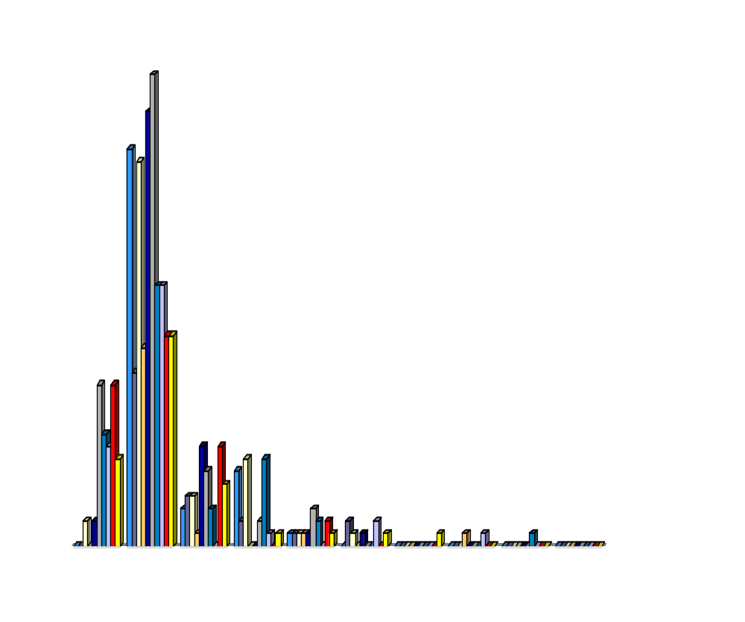
Histogram Analysis
Divide data into buckets and store average (sum) for each bucket
Partitioning rules:
  Equal-width: equal bucket range
  Equal-frequency (or equal-depth)

Slide 45
Clustering
Partition data set into clusters based on similarity, and store cluster representation (e.g., centroid and diameter) only
Can be very effective if data is clustered but not if data is “smeared”
Can have hierarchical clustering and be stored in multi-dimensional index tree structures
There are many choices of clustering definitions and clustering algorithms
Cluster analysis will be studied in depth in Chapter 10

Slide 46
Sampling
Sampling: obtaining a small sample s to represent the whole data set N
Allow a mining algorithm to run in complexity that is potentially sub-linear to the size of the data
Key principle: Choose a representative subset of the data
  Simple random sampling may have very poor performance in the presence of skew
  Develop adaptive sampling methods, e.g., stratified sampling:
Note: Sampling may not reduce database I/Os (page at a time)

Slide 47
Types of Sampling
Simple random sampling
  There is an equal probability of selecting any particular item
Sampling without replacement
  Once an object is selected, it is removed from the population
Sampling with replacement
  A selected object is not removed from the population
Stratified sampling:
  Partition the data set, and draw samples from each partition (proportionally, i.e., approximately the same percentage of the data)
  Used in conjunction with skewed data

Slide 48
Sampling: With or without Replacement
SRSWOR
(simple random
sample without
replacement)
SRSWR
Raw Data

Slide 49
Sampling: Cluster or Stratified Sampling
Raw Data
Cluster/Stratified Sample

Slide 50
Data Cube Aggregation
The lowest level of a data cube (base cuboid)
  The aggregated data for an individual entity of interest
  E.g., a customer in a phone calling data warehouse
Multiple levels of aggregation in data cubes
  Further reduce the size of data to deal with
Reference appropriate levels
  Use the smallest representation which is enough to solve the task
Queries regarding aggregated information should be answered using data cube, when possible

Slide 51
Data Reduction 3: Data Compression
Original Data
Compressed
Data
lossless
Original Data
Approximated
lossy

Slide 52
Data Reduction 3: Data Compression
String compression
  There are extensive theories and well-tuned algorithms
  Typically lossless, but only limited manipulation is possible without expansion
Audio/video compression
  Typically lossy compression, with progressive refinement
  Sometimes small fragments of signal can be reconstructed without reconstructing the whole
Time sequence is not audio
  Typically short and vary slowly with time
Dimensionality and numerosity reduction may also be considered as forms of data compression
Notes:
数据规约：数据压缩

Slide 53
Outlines
1. Data Preprocessing: Abstract
2. Data Cleaning
3. Data Integration
4. Data Reduction
5. Data Transformation and Data Discretization
6. Summary

Slide 54
Data transformation
A function that maps the entire set of values of a given attribute to a new set of replacement values s.t. each old value can be identified with one of the new values
Methods
  Smoothing：Remove noise from data
  Attribute/feature construction
    New attributes constructed from the given ones
  Aggregation：summarization, data cube construction
  Normalization: Scaled to fall within a smaller, specified range
    min-max normalization
    z-score normalization
    normalization by decimal scaling
  Discretization: Concept hierarchy climbing

Slide 55

Normalization
Min-max normalization: to [new_min_{A}, new_max_{A}]
  Ex. Let income range $12,000 to $98,000 normalized to [0.0, 1.0]. Then $73,000 is mapped to
Z-score normalization (μ: mean, σ: standard deviation):
  Ex. Let μ = 54,000, σ = 16,000. Then
Normalization by decimal scaling
Where j is the smallest integer such that Max(|ν’|) < 1

Slide 56
Discretization
Three types of attributes
  Nominal—values from an unordered set, e.g., color, profession
  Ordinal—values from an ordered set, e.g., military or academic rank
  Numeric—real numbers, e.g., integer or real numbers
Discretization: Divide the range of a continuous attribute into intervals
  Interval labels can then be used to replace actual data values
  Reduce data size by discretization
  Supervised vs. unsupervised
  Split (top-down) vs. merge (bottom-up)
  Discretization can be performed recursively on an attribute
  Prepare for further analysis, e.g., classification

Slide 57
Data Discretization Methods
Typical methods: All the methods can be applied recursively
  Binning
    Top-down split, unsupervised
  Histogram analysis
    Top-down split, unsupervised
  Clustering analysis (unsupervised, top-down split or bottom-up merge)
  Decision-tree analysis (supervised, top-down split)
  Correlation (e.g., χ²) analysis (unsupervised, bottom-up merge)

Slide 58
Simple Discretization: Binning
Equal-width (distance) partitioning
  Divides the range into N intervals of equal size: uniform grid
  if A and B are the lowest and highest values of the attribute, the width of intervals will be: W = (B –A)/N.
  The most straightforward, but outliers may dominate presentation
  Skewed data is not handled well
Equal-depth (frequency) partitioning
  Divides the range into N intervals, each containing approximately same number of samples
  Good data scaling
  Managing categorical attributes can be tricky

Slide 59
Binning Methods for Data Smoothing
Sorted data for price (in dollars): 4, 8, 9, 15, 21, 21, 24, 25, 26, 28, 29, 34
  Partition into equal-frequency (equal-depth) bins:
    - Bin 1: 4, 8, 9, 15
    - Bin 2: 21, 21, 24, 25
    - Bin 3: 26, 28, 29, 34
  Smoothing by bin means:
    - Bin 1: 9, 9, 9, 9
    - Bin 2: 23, 23, 23, 23
    - Bin 3: 29, 29, 29, 29
  Smoothing by bin boundaries:
    - Bin 1: 4, 4, 4, 15
    - Bin 2: 21, 21, 25, 25
    - Bin 3: 26, 26, 26, 34

Slide 60




Discretization Without Using Class Labels
(Binning vs. Clustering)
Equal frequency (binning)
K-means clustering leads to better results

Slide 61
Discretization by Classification & Correlation Analysis
Classification (e.g., decision tree analysis)
  Supervised: Given class labels, e.g., cancerous vs. benign
  Using entropy to determine split point (discretization point)
  Top-down, recursive split
  Details to be covered in Chapter 7
Correlation analysis (e.g., Chi-merge: χ²-based discretization)
  Supervised: use class information
  Bottom-up merge: find the best neighboring intervals (those having similar distributions of classes, i.e., low χ² values) to merge
  Merge performed recursively, until a predefined stopping condition

Slide 62
Concept Hierarchy Generation
Concept hierarchy organizes concepts (i.e., attribute values) hierarchically and is usually associated with each dimension in a data warehouse
Concept hierarchies facilitate drilling and rolling in data warehouses to view data in multiple granularity
Concept hierarchy formation: Recursively reduce the data by collecting and replacing low level concepts (such as numeric values for age) by higher level concepts (such as youth, adult, or senior)
Concept hierarchies can be explicitly specified by domain experts and/or data warehouse designers
Concept hierarchy can be automatically formed for both numeric and nominal data. For numeric data, use discretization methods shown.

Slide 63
Concept Hierarchy Generation for Nominal Data
Specification of a partial/total ordering of attributes explicitly at the schema level by users or experts
  street < city < state < country
Specification of a hierarchy for a set of values by explicit data grouping
  {Urbana, Champaign, Chicago} < Illinois
Specification of only a partial set of attributes
  E.g., only street < city, not others
Automatic generation of hierarchies (or attribute levels) by the analysis of the number of distinct values
  E.g., for a set of attributes: {street, city, state, country}

Slide 64
Automatic Concept Hierarchy Generation
Some hierarchies can be automatically generated based on the analysis of the number of distinct values per attribute in the data set
  The attribute with the most distinct values is placed at the lowest level of the hierarchy
  Exceptions, e.g., weekday, month, quarter, year
country
15 distinct values
province_or_ state
365 distinct values
city
3567 distinct values
street
674,339 distinct values

Slide 65
Outlines
1. Data Preprocessing: Abstract
2. Data Cleaning
3. Data Integration
4. Data Reduction
5. Data Transformation and Data Discretization
6. Summary

Slide 66
Summary
  Data cleaning: Process of dealing with duplicate data issues
Data integration: Combines data from multiple sources.
Data reduction: Obtain a reduced representation of the data set that is much smaller in volume but yet produces the same analytical results
Data Transformation and Data Discretization: A function that maps the entire set of values of a given attribute to a new set of replacement values

Slide 67
Summary
  Data cleaning: fill missing value / smooth noise / deal with duplicate data
Data integration: detect & resolve conflicts / correlation analysis / Covariance
Data reduction: Dimensionality reduction / Numerosity reduction / Data Compression
Data transformation: Normalization/ Discretization

