Slide 1
MS Exchange Server 2010
Name: Kulbir Singh Dhindsa
Gurinder Singh Kang
Navdeep Devgan
Manpreet Singh

Slide 2
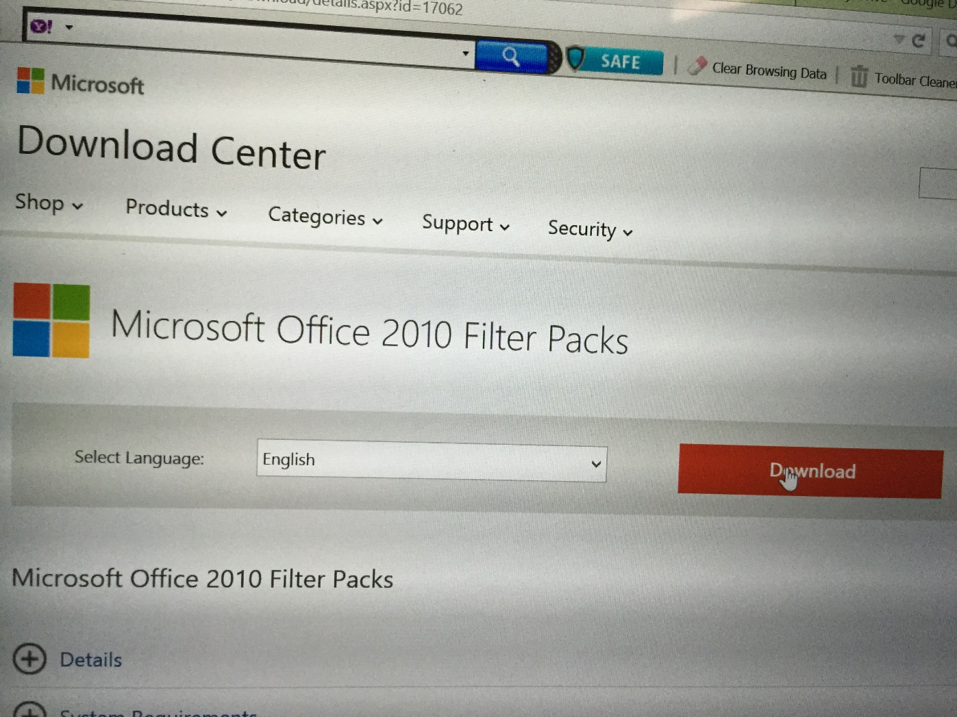
In MS Server 2010, Go to your browser and download all the filter packs from Microsoft website into your computer.

Slide 3
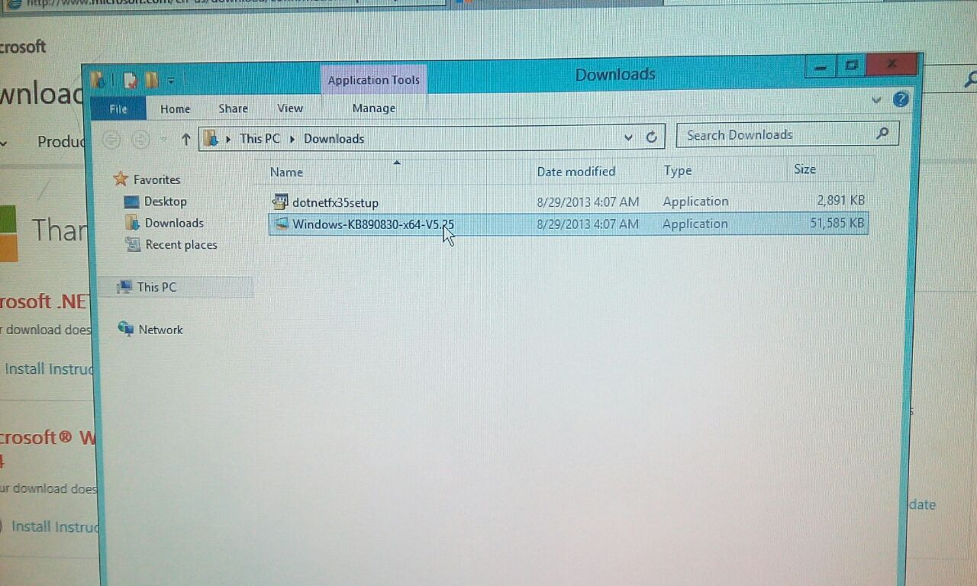
Now navigate to the location of those files, where you downloaded them. Double click to open.

Slide 4
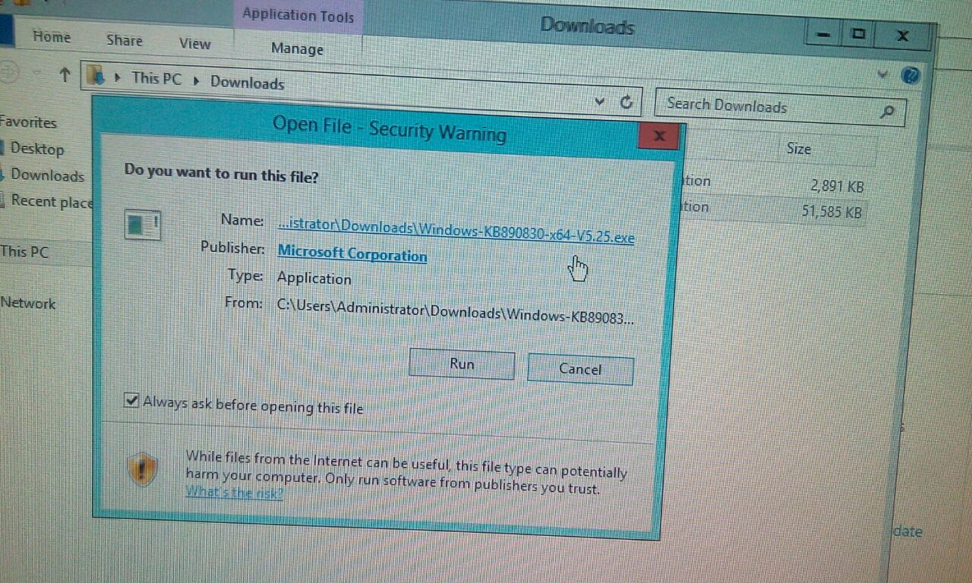
In security warning dialogue box click on run button.

Slide 5
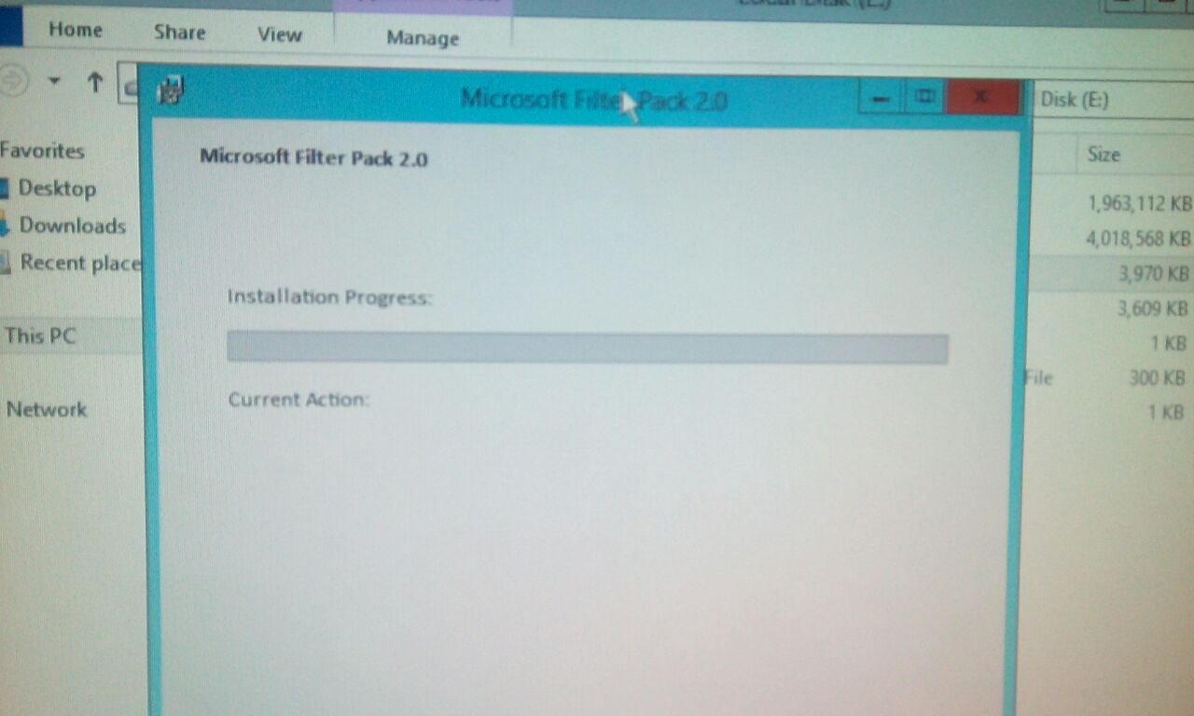
Microsoft Filter Pack 2.0 will start installing on your computer,

Slide 6
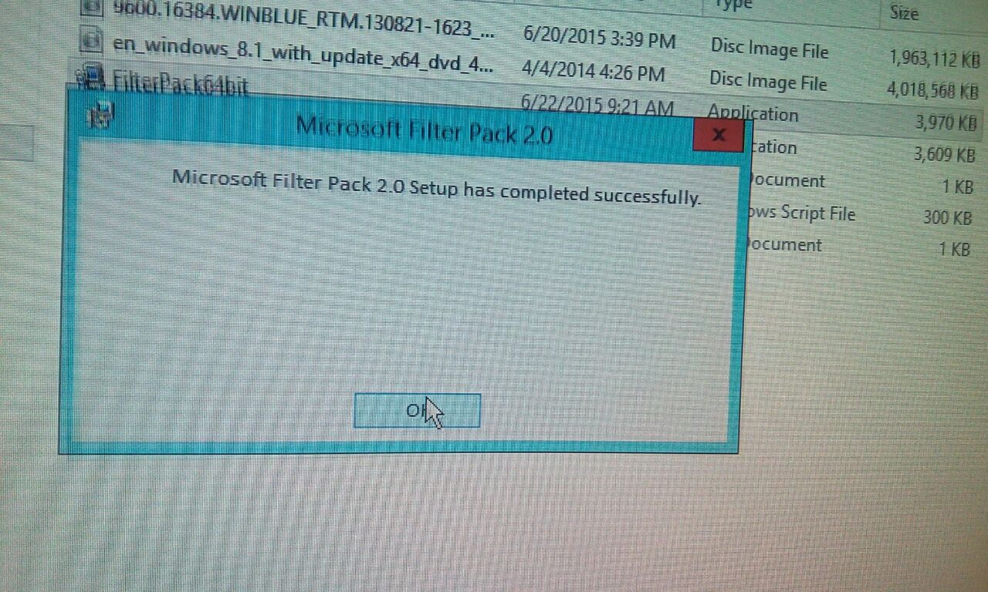
In a few moments MS Filter pack will completely install on your computer.

Slide 7
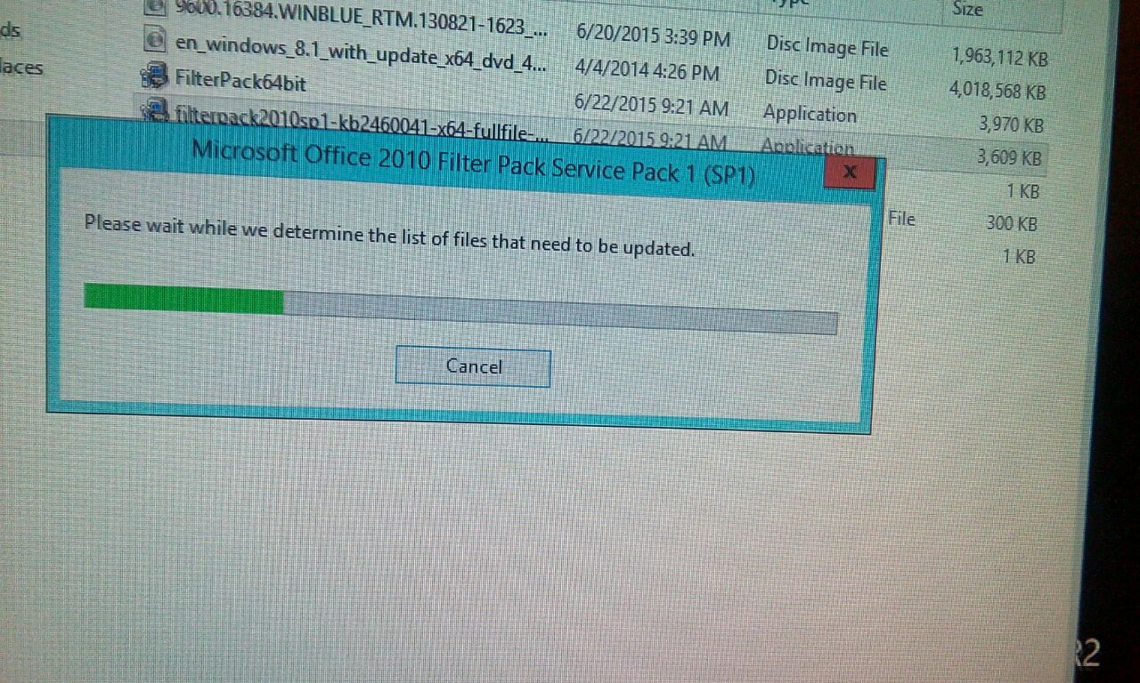
Now start installing the Filter Service Pack 1 in same way.

Slide 8
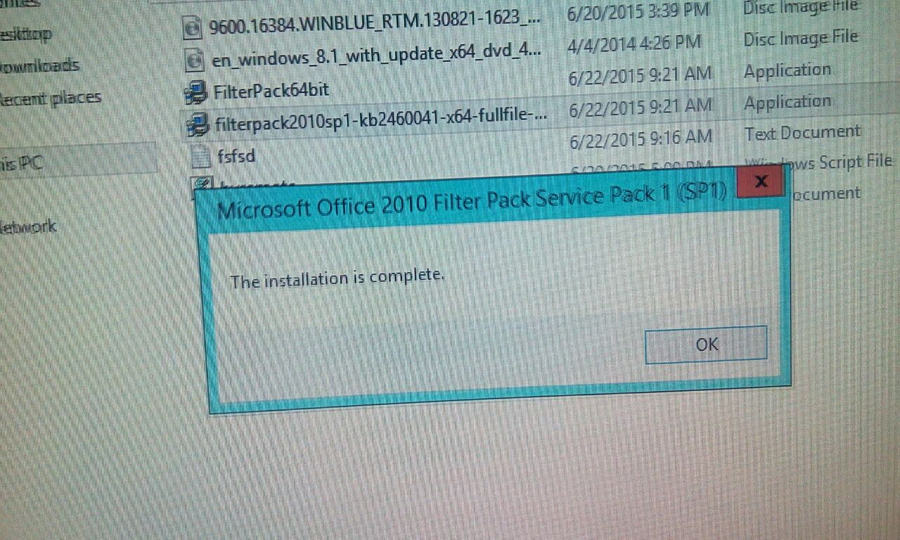
It will also completely install filter Service Pack 1 in your machine.

Slide 9
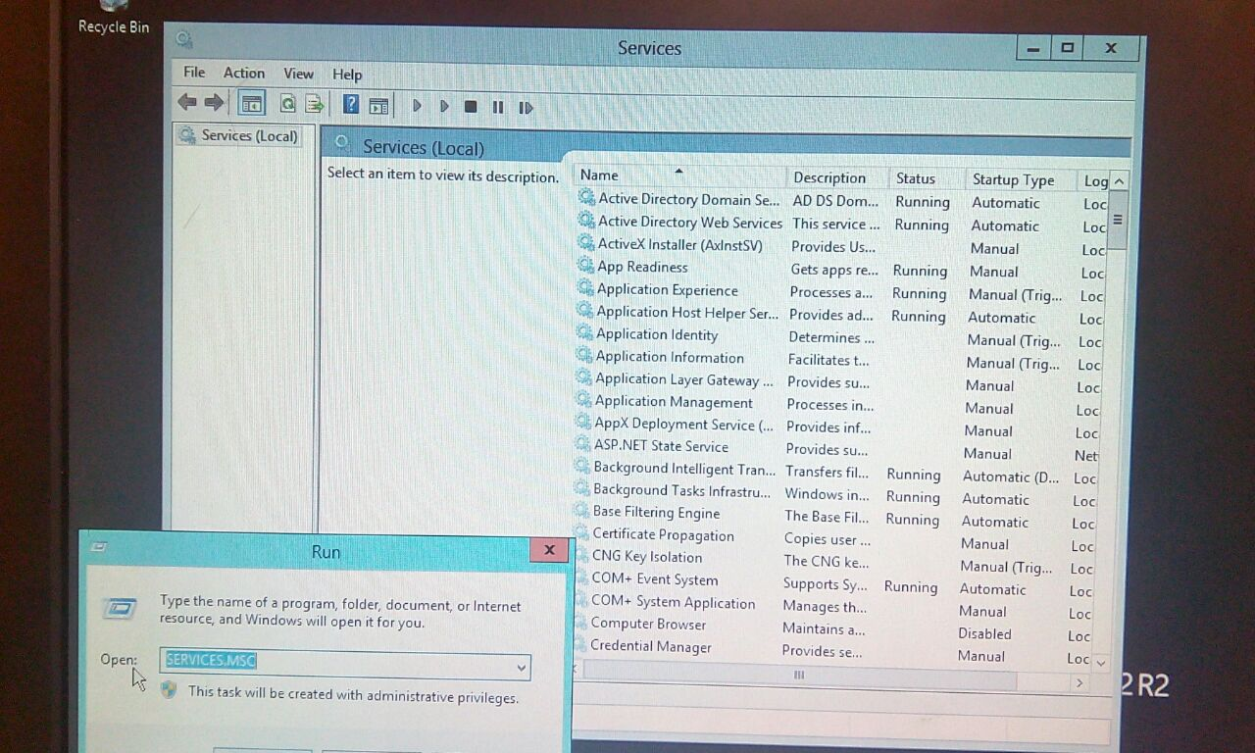
Now open Run and type services.msc to open Services.

Slide 10
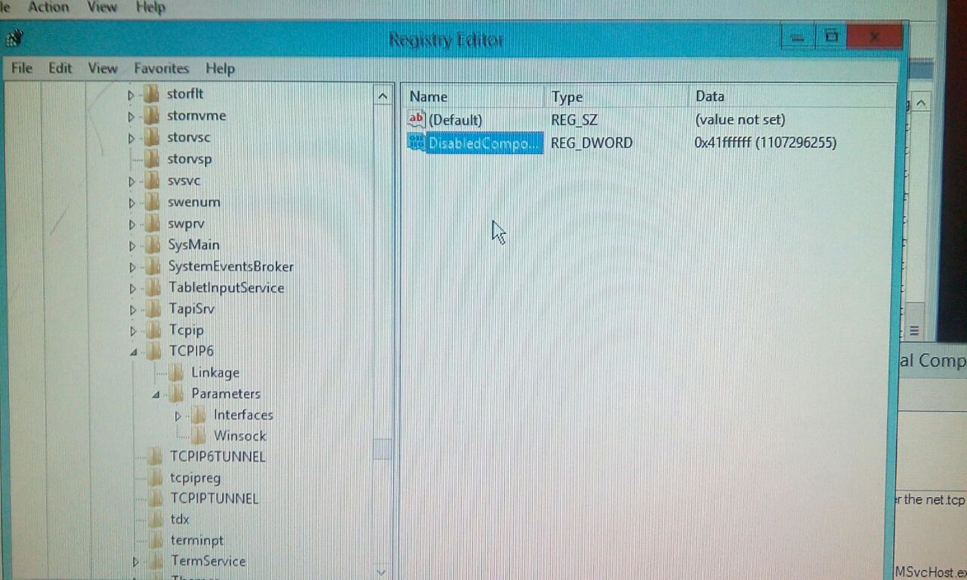
Then open Registry Editor and navigate from HKEY_LOCAL_MACHINE\SYSTEM\CurentControlSet\Services\Tcpip6\Paramters.

Slide 11
Now right click on DisabledComponent and continue with other steps.

Slide 12
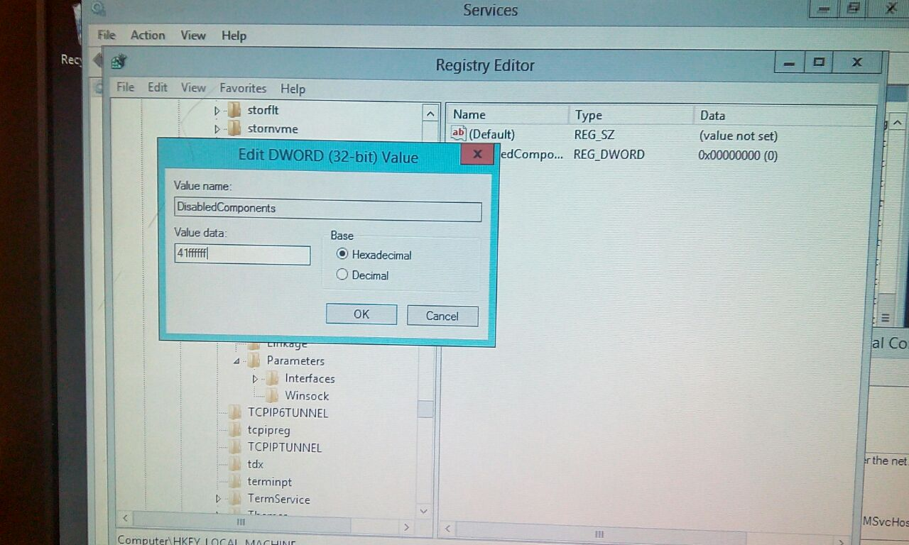
In Edit DWORD enter the value data as 41ffffff and then press OK.

Slide 13
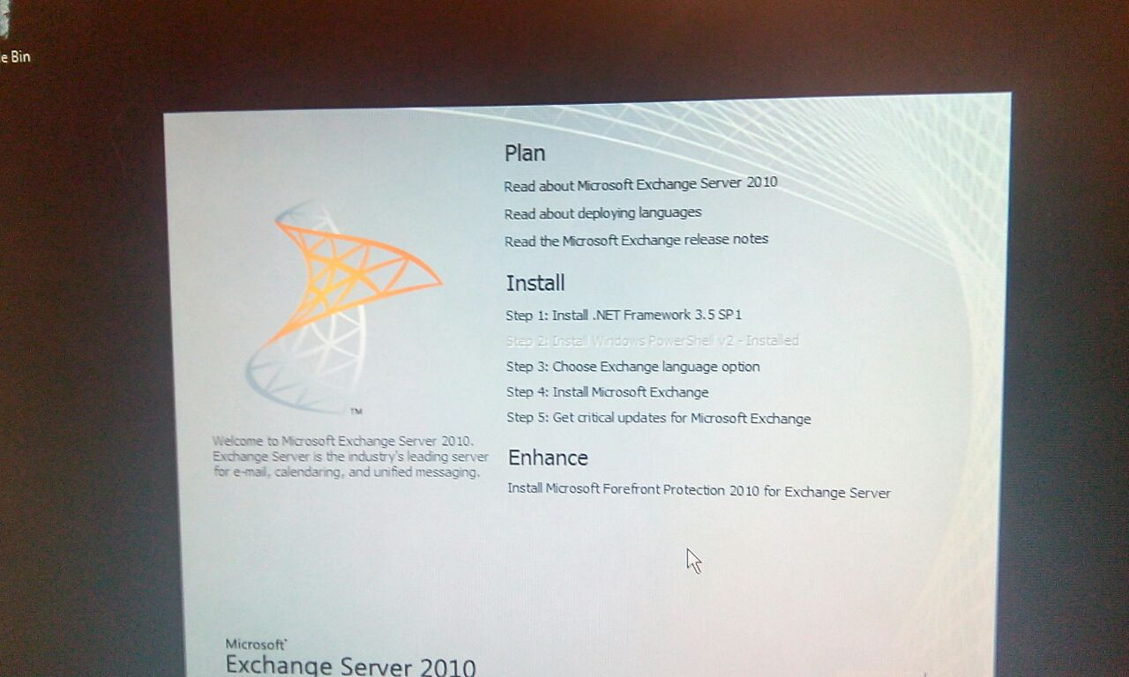
Now insert the Cd of MS Exchange Server 2010 and begin installing it.

Slide 14
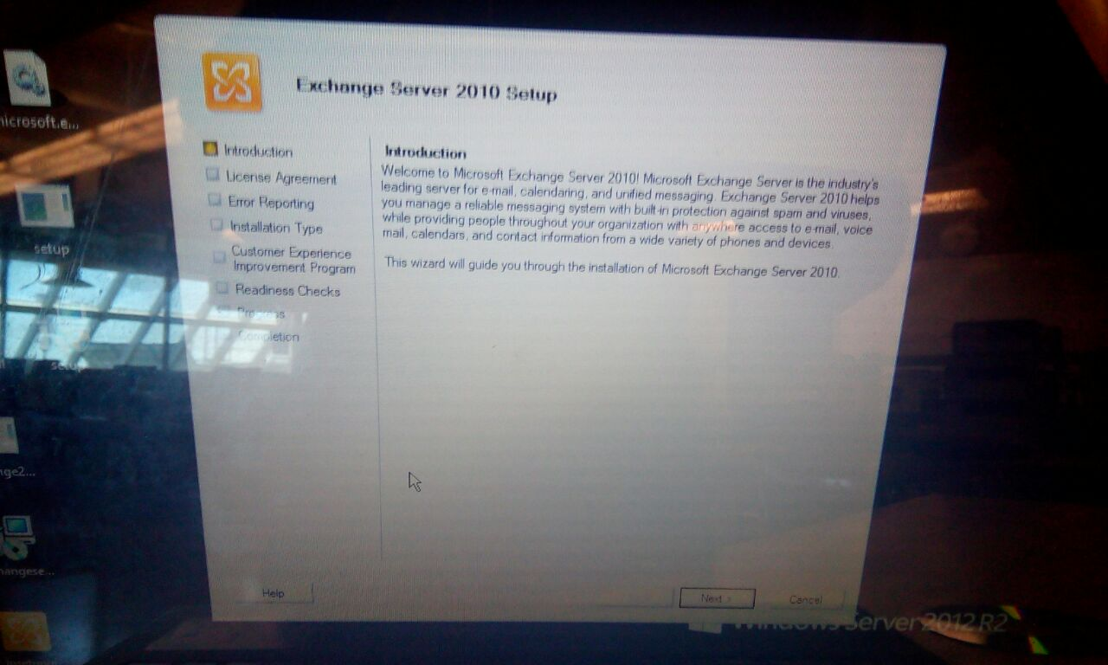
On introduction read the instruction and press next to continue.

Slide 15
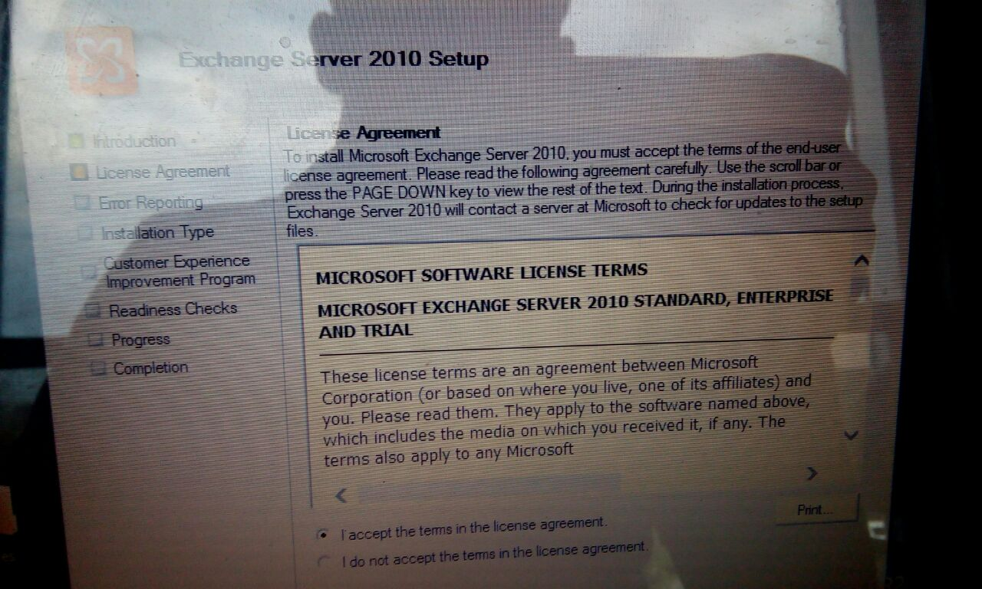
Then on license agreement page check the I agree check box and press enter

Slide 16
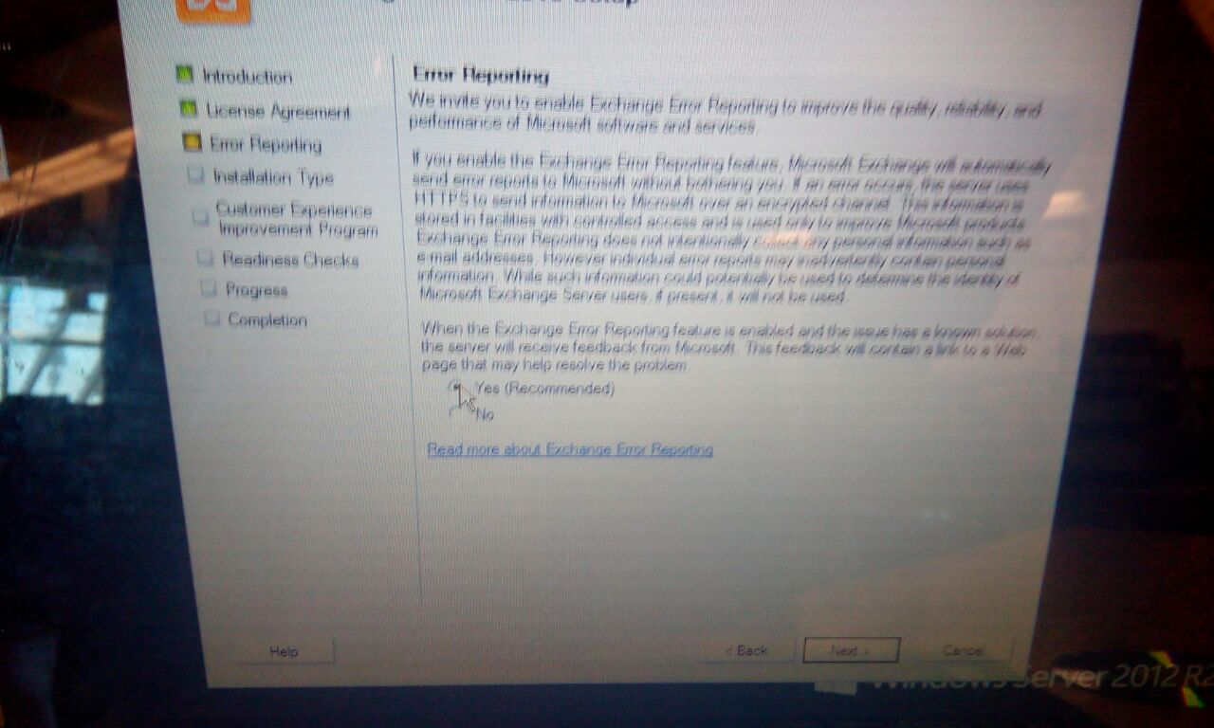
Then on error reporting page click next to continue.

Slide 17
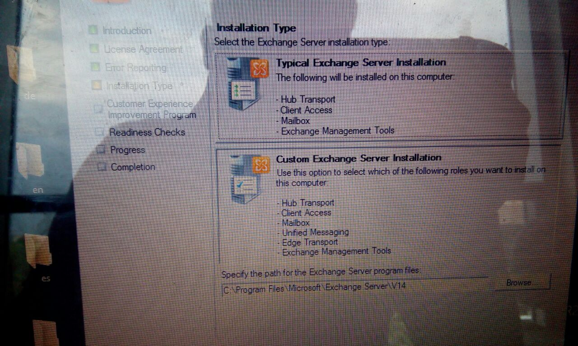
Then you will be asked to select a installation type press and select typical exchange server installation method.

Slide 18
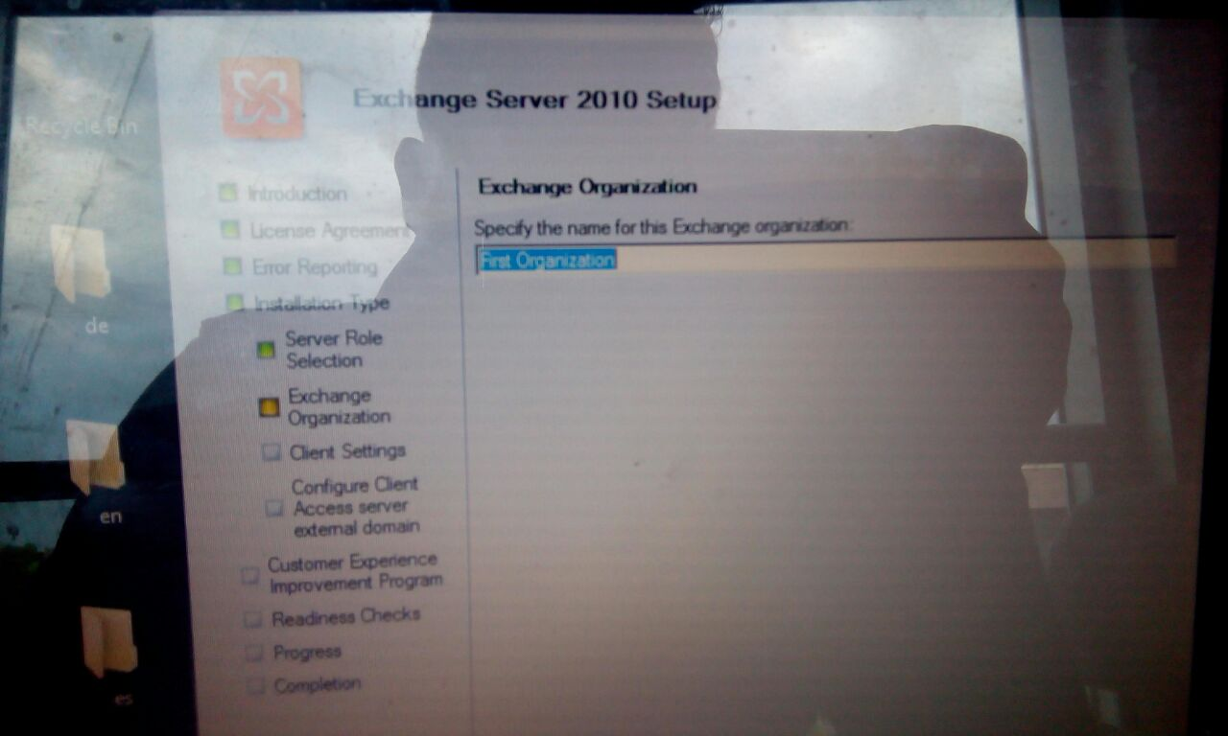
After introduction page you will be prompted to Exchange organisation page.

Slide 19
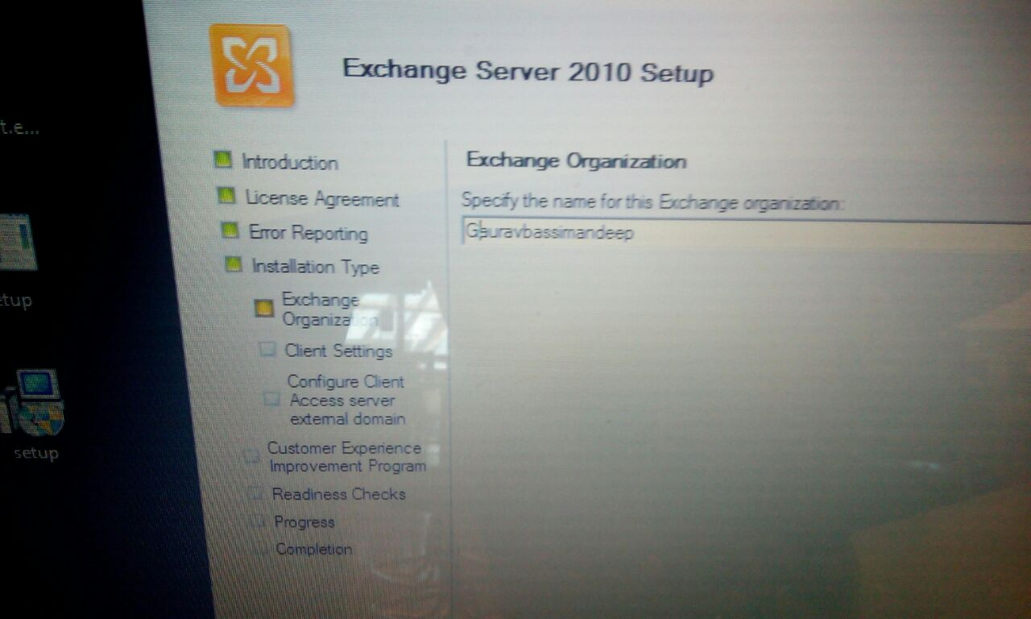
Here you have to provide a name for this exchange server. After entering the name press Next.

Slide 20
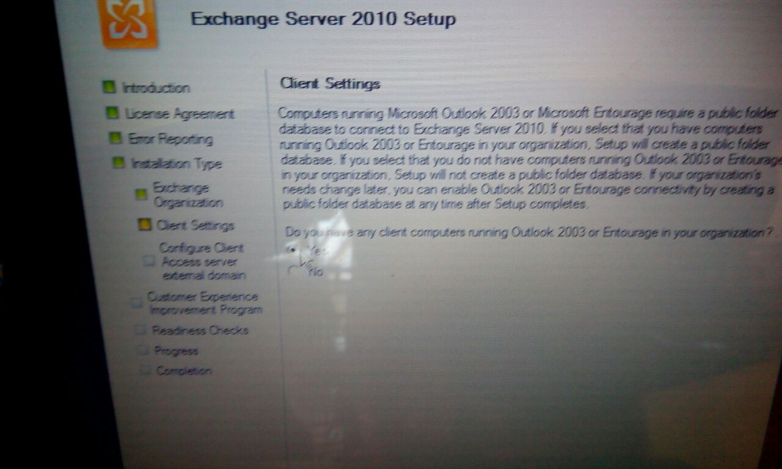
Now in client settings check the yes box and then press next.

Slide 21
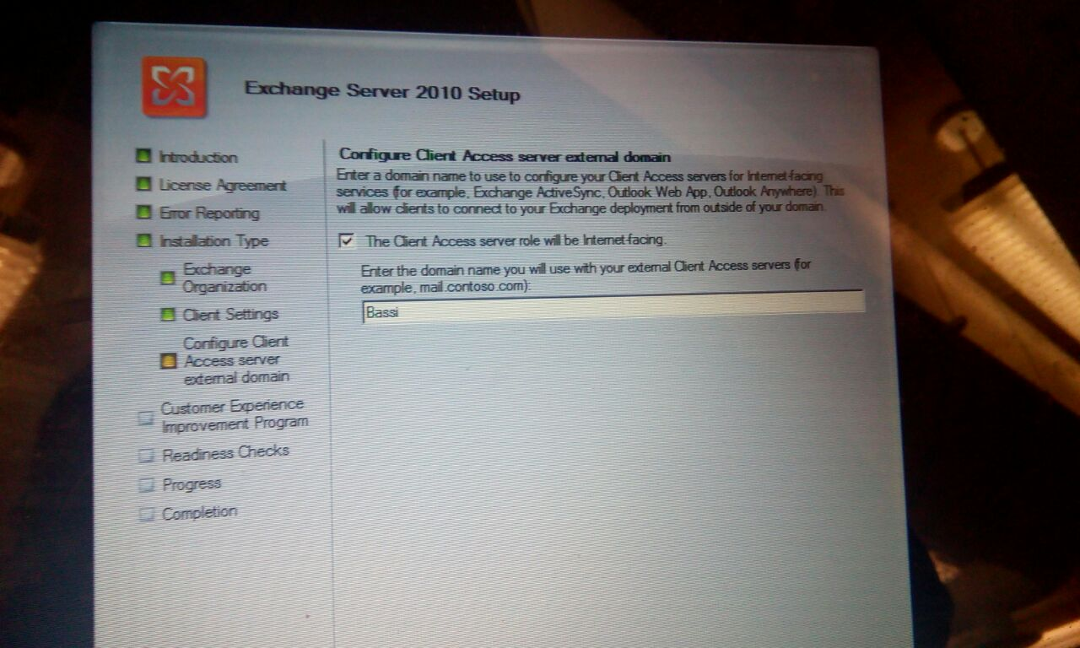
Now in configure clients enter your domain number and then press enter

Slide 22
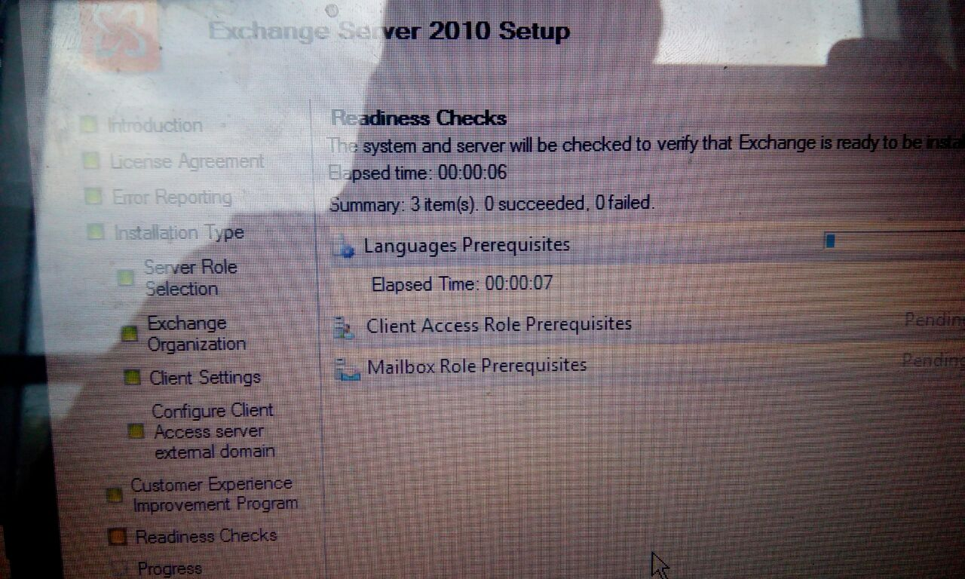
Now you will enter Readiness Checks page in MS exchange server.

Slide 23
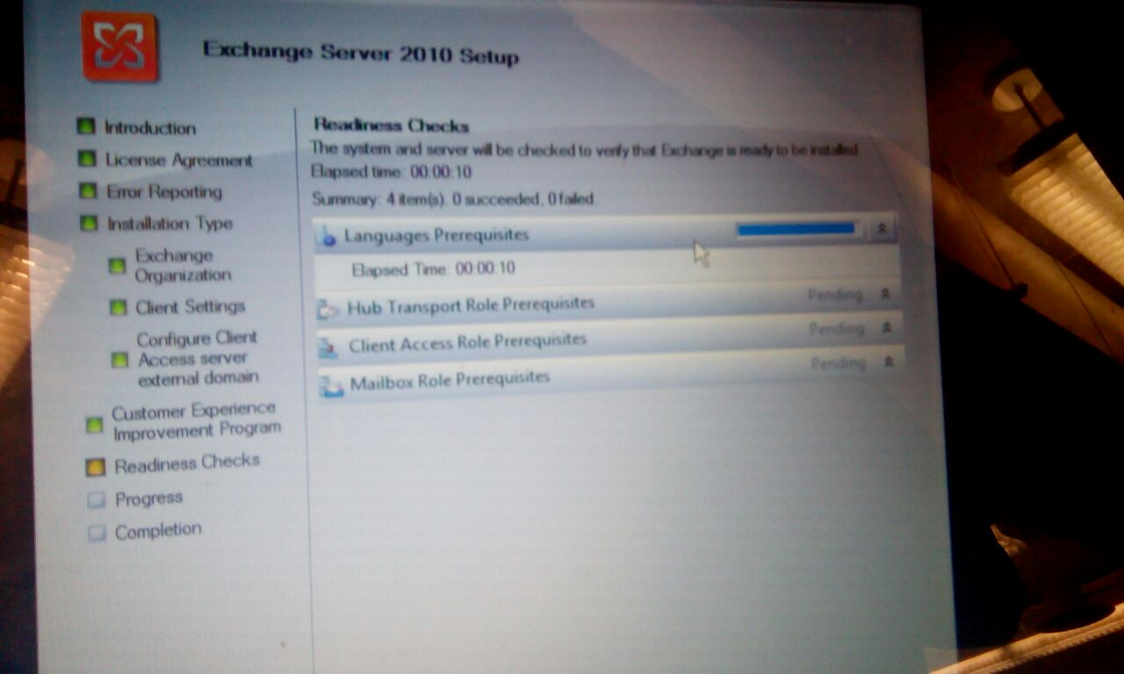
Here system will try to verify some components with exchange server.

Slide 24
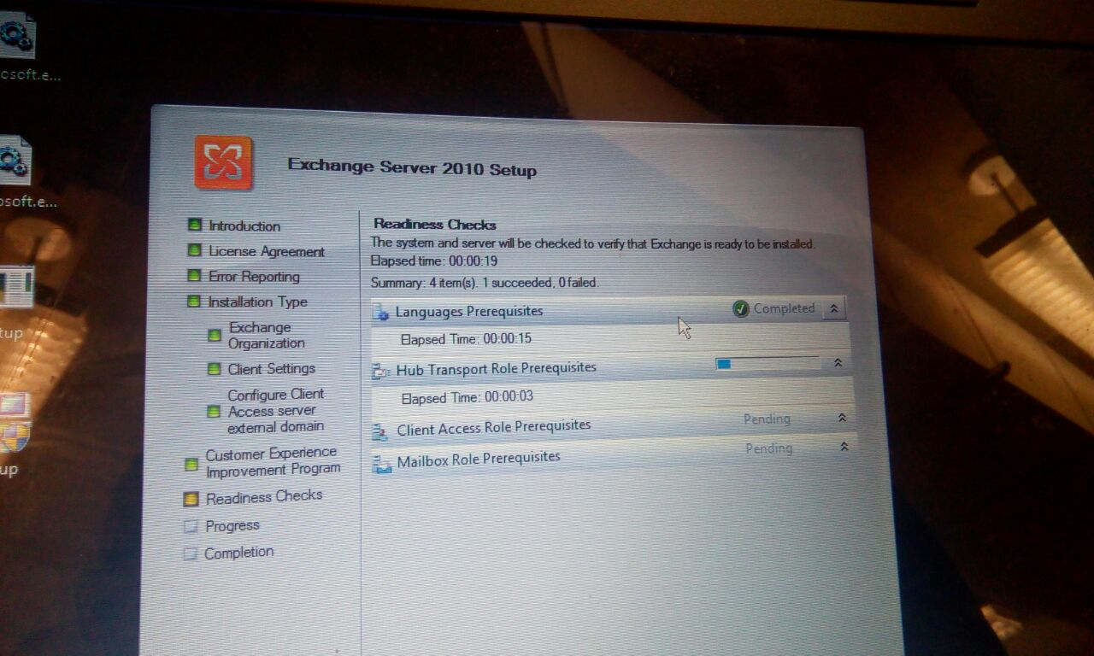
Now you should wait until system and server exchange is ready for you. After each of the steps show complete message restart your computer. And you are ready to open exchange management console.

