Slide 1
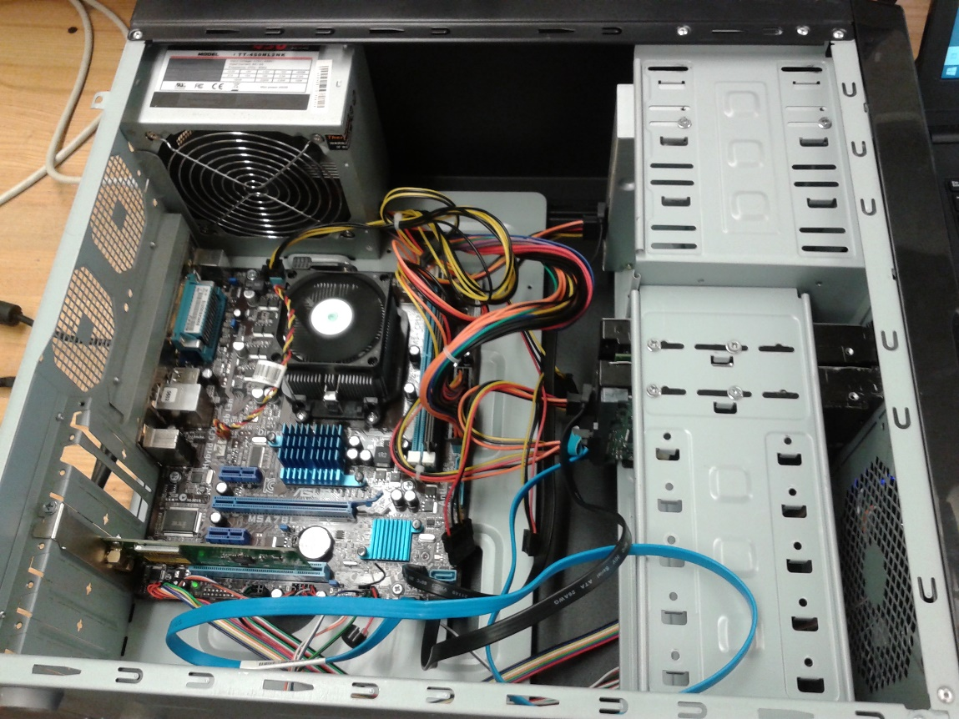
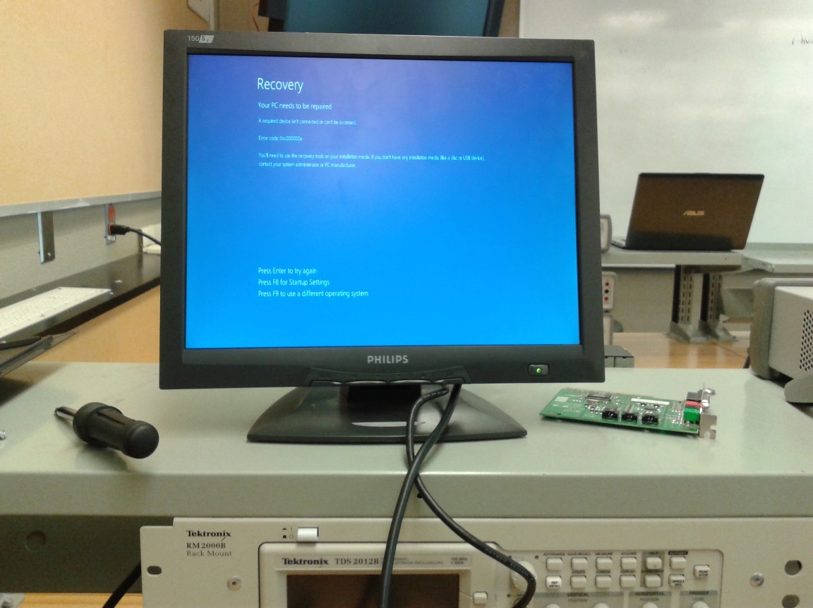
Make sure everything is correctly inserted in the CPU and then start up the computer

Slide 2
LAB 1:Teardown and Restore
Deliverable To:Peter Wheeler
Deliverable By:Kulbir Singh Dhindsa
Gurinder Singh Kang

Slide 3
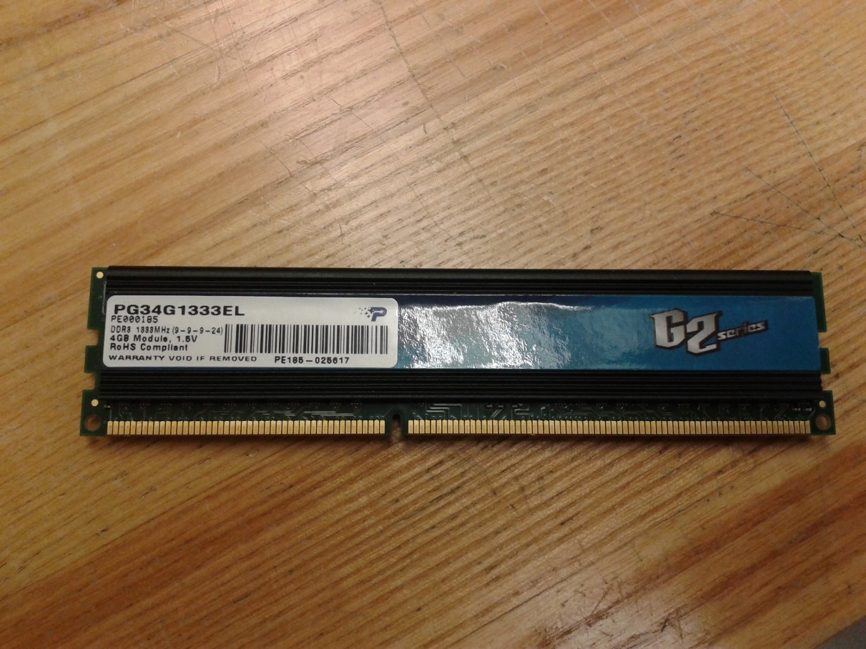
Took out the RAM and note down the values
Values:
PG34G1333EL
PE00185
DDR3 1333MHz(9-9-9-24)
4GB MODULE, 1.5V
RoHS COMPLLANT
PE185-025617

Slide 4
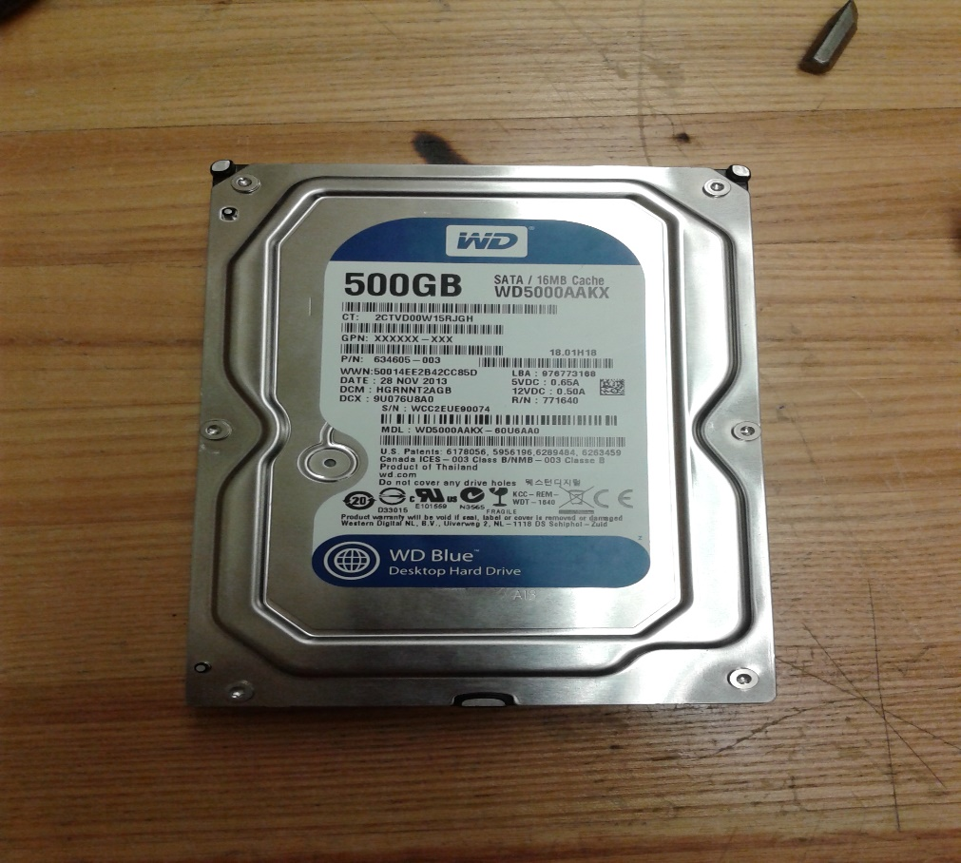
Took out the Hard Disk and note down the values(unplugged the power supply and from Motherboard as well
Values:
MDL: WD5000AAKX-60U6AA0
500GB
SATA/16MB CACHE

Slide 5
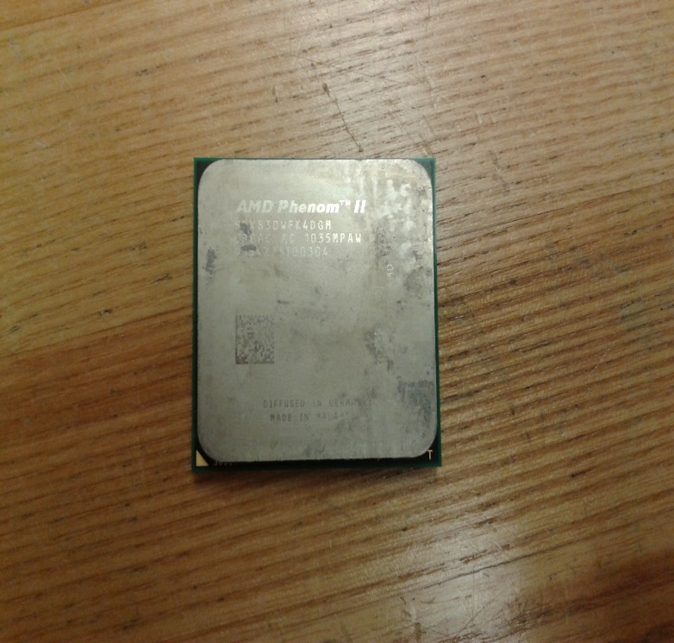
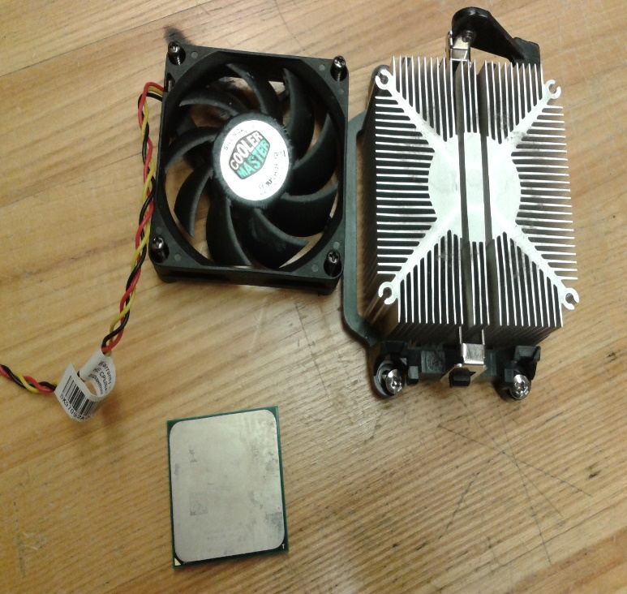
Take out CPU (first you need to remove fan) and then note down values
Values:
Manufacturer- AMD Phenom ii
HDX830WFK4DGM
CACAC AC 1035MPAW
9J54273I00304

Slide 6
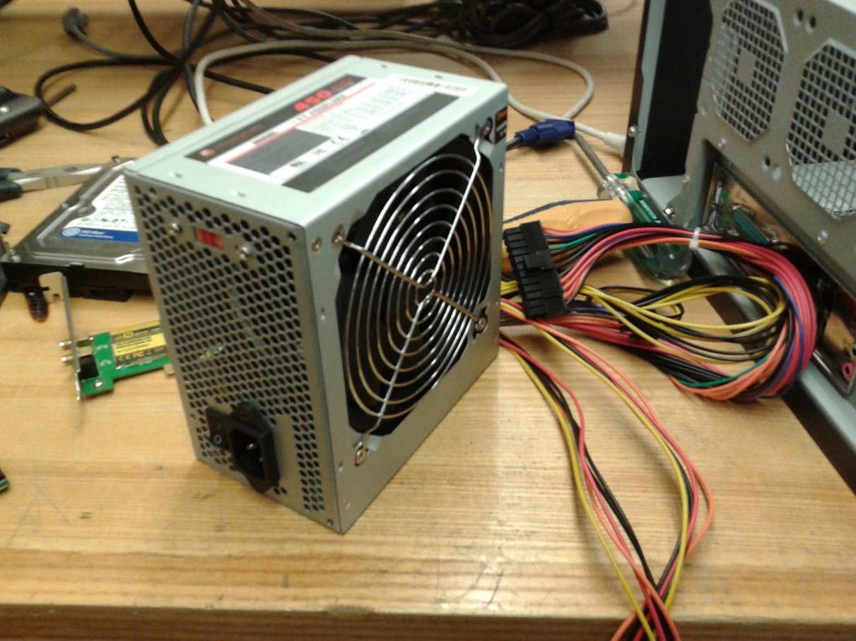
TAKE OUT THE POWER SUPPLY BOX MAKE SURE IT IS UNPUGGED FROM EVERY THING
Values:
MODEL: TT-450NL2NK

Slide 7
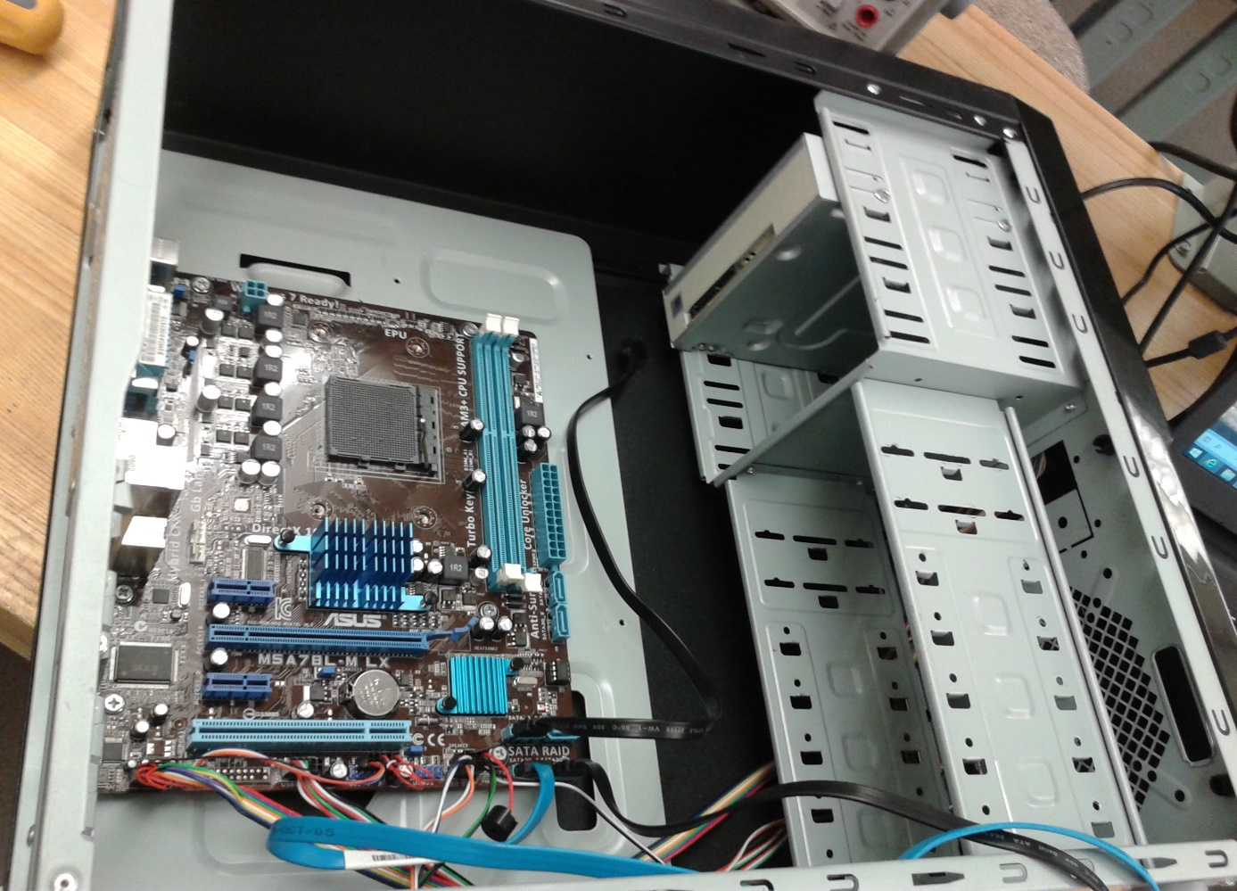
Here CPU, RAM, HDD has taken out and PC is tore down

Slide 8
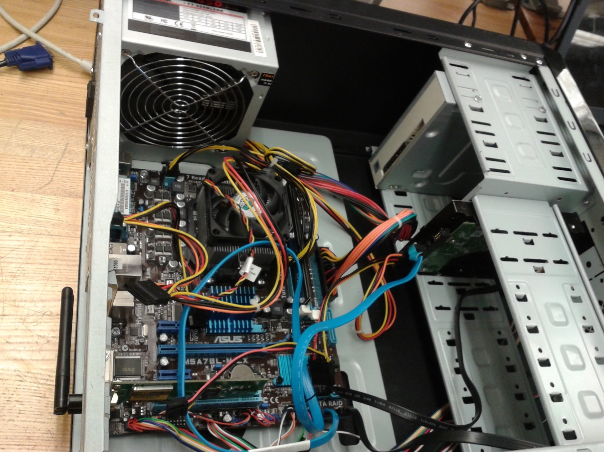
Everything is Resembled Make sure all the parts have power supply and wires are connected correctly

Slide 9
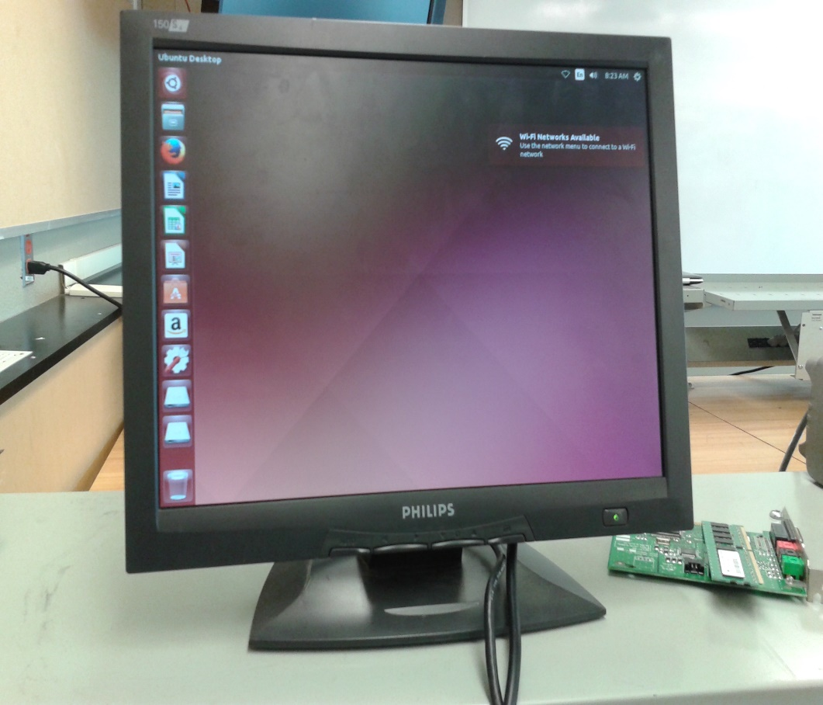
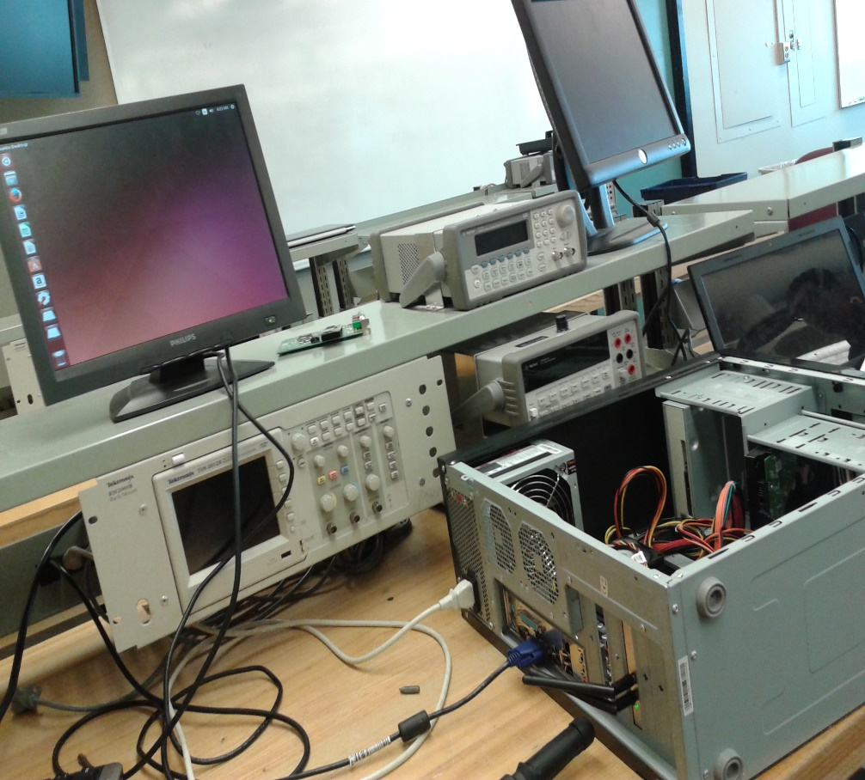
CPU IS RUNNING AND PC is BOOTED

