Slide 1
Deliverable- Magic Number
DELIVERED BY:KULBIR SINGH DHINDSA
STUDENT NUMBER:991389177
DELIVERED TO:PETER WHEELER

Slide 2
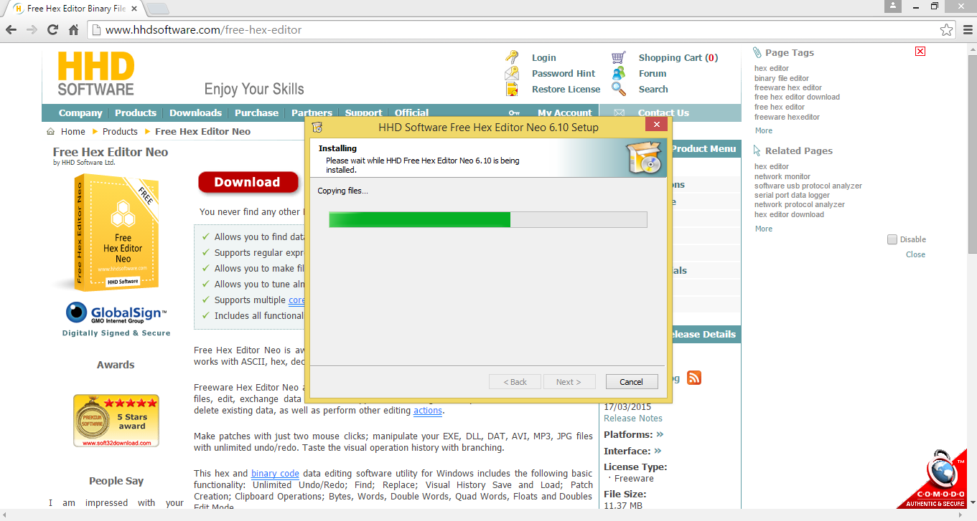
First Download And Install Hex Editor Neo 6.10

Slide 3
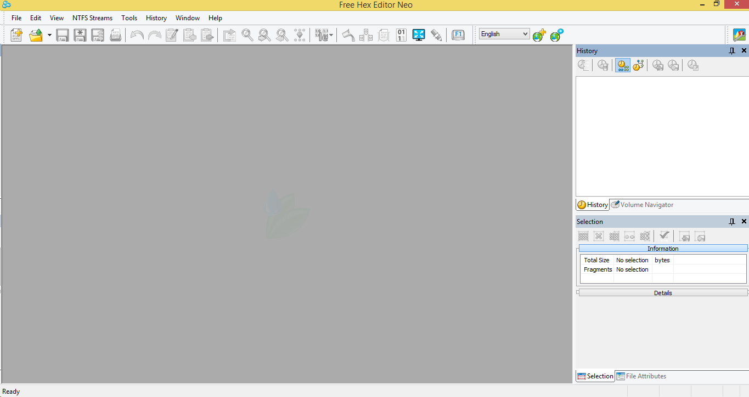
This Is The Environment Of Hex Editor Neo

Slide 4
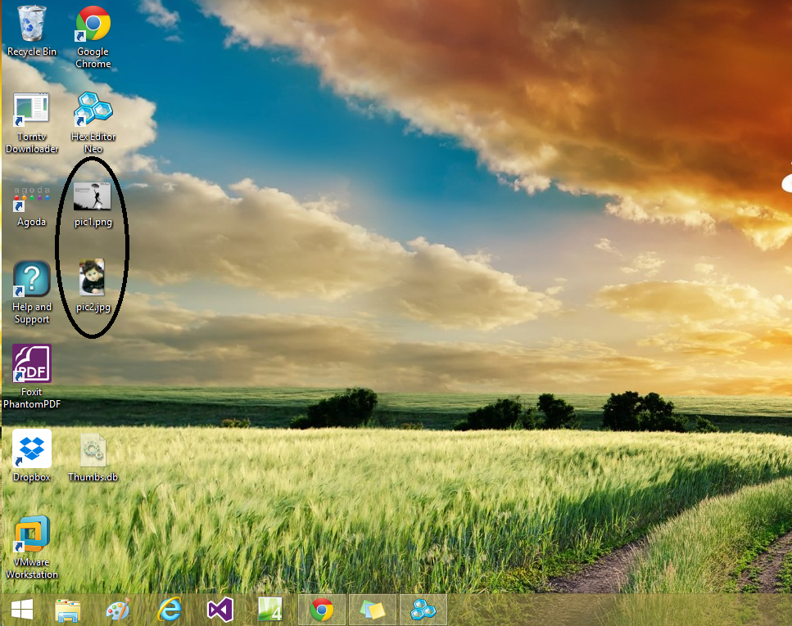
After Downloading Hex Editor Neo, take two images with different extensions- one in .jpg and second is in .png

Slide 5
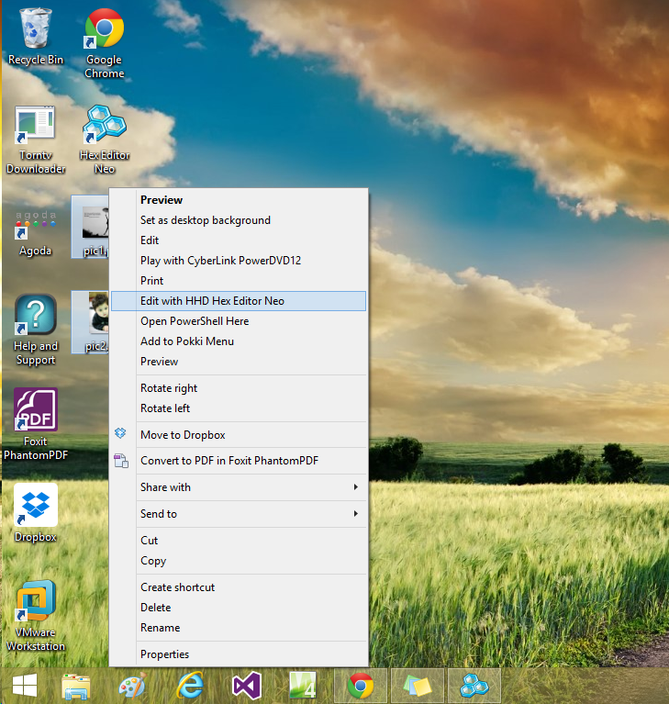
Open both images in Hex Editor Neo.

Slide 6
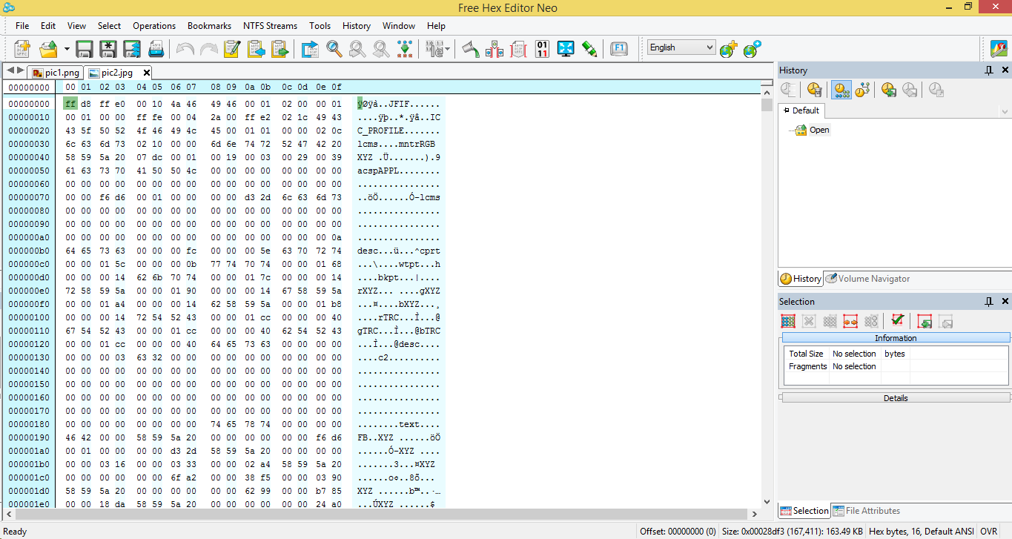
This environment shows hex numbers(magic numbers) of both images.

Slide 7
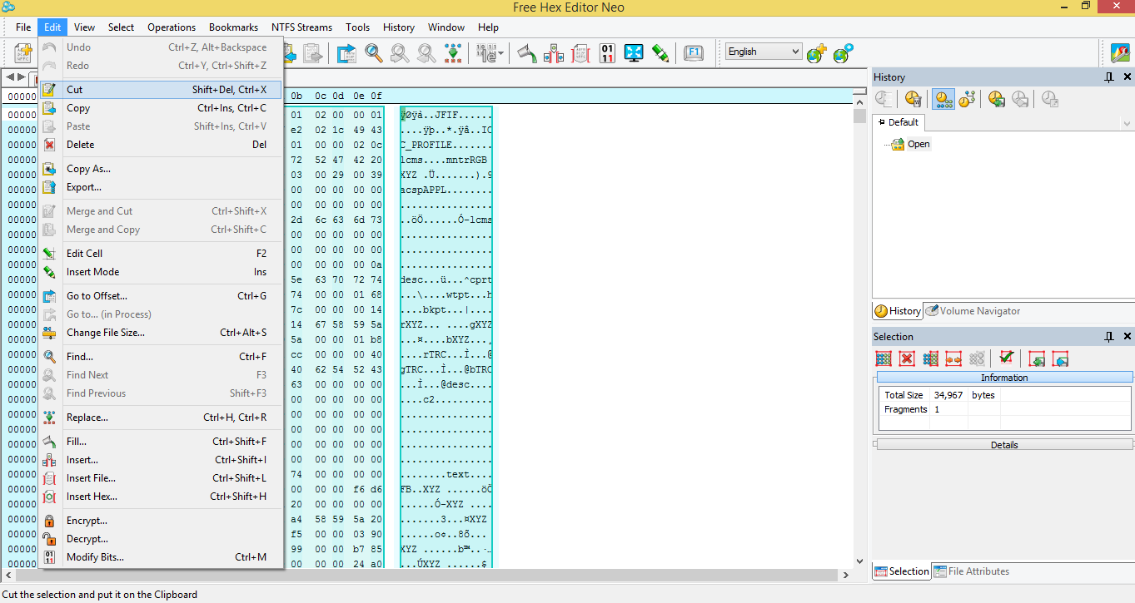
Now copy the hex numbers of .jpg image to .png image

Slide 8
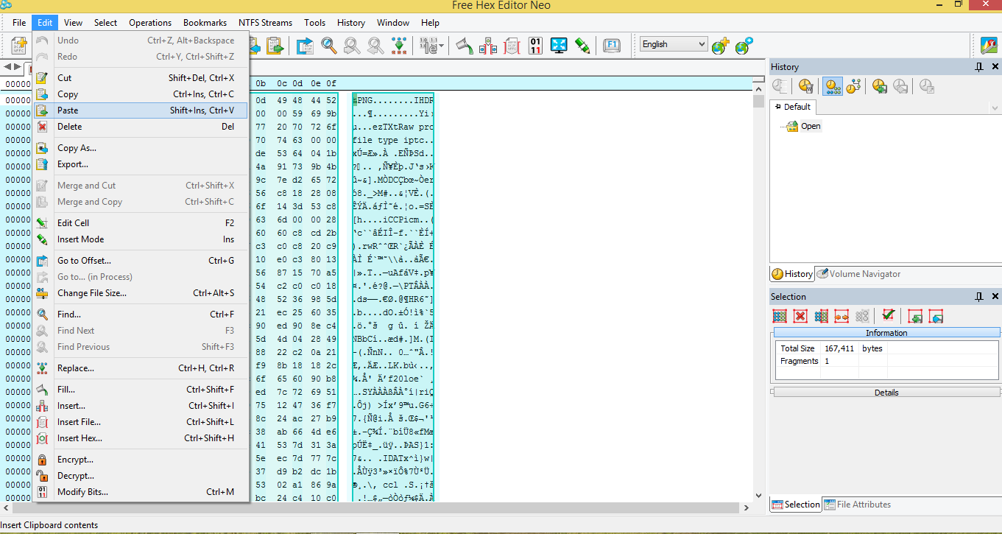
Pasted the jpg image hex numbers to png image.

Slide 9
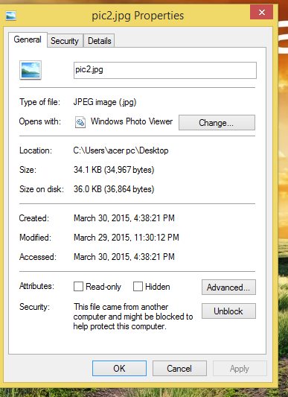
This is the original extension of picture.

Slide 10
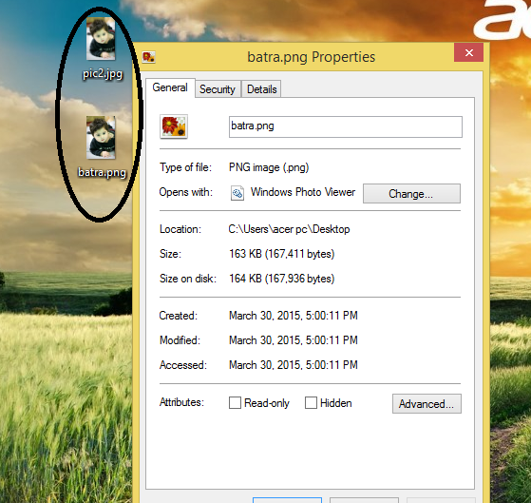
Now I changed the extension of jpg image.

