Slide 1
Permission and Rights - Deliverable 9
In this, we did
Step 1: Create Folder, User Accounts and User Groups
Step 2: Set Permissions for the Local Users
Step 3: Share the folders on the Network
Step 4: Test and Go live

Slide 2
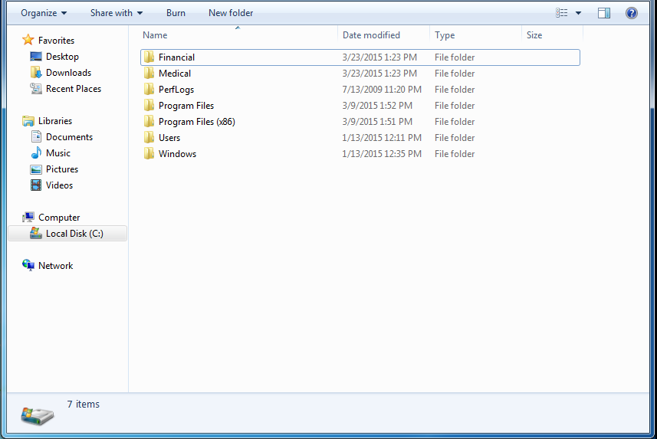
In C: drive, create two folders named Financial and Medical.

Slide 3
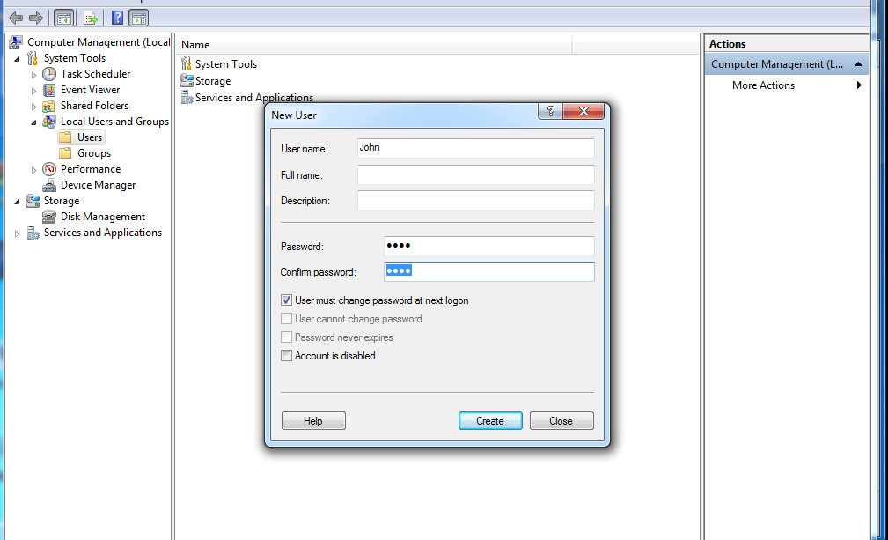

In Computer Management Console, under local users and groups options add new five users

Slide 4
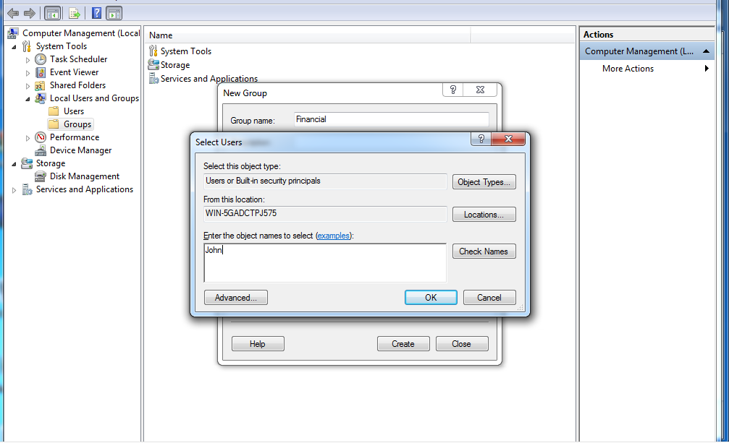
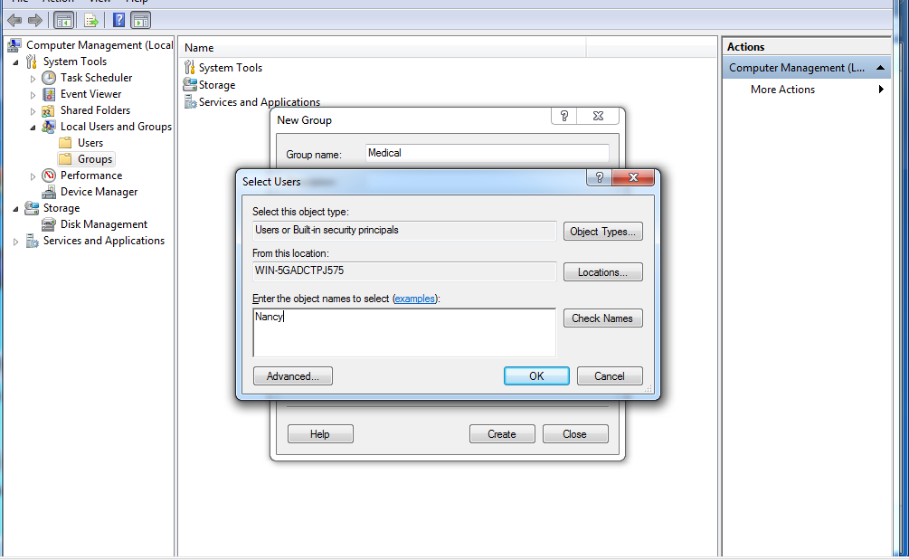
After adding users, we create two groups- Financial and Medical

Slide 5
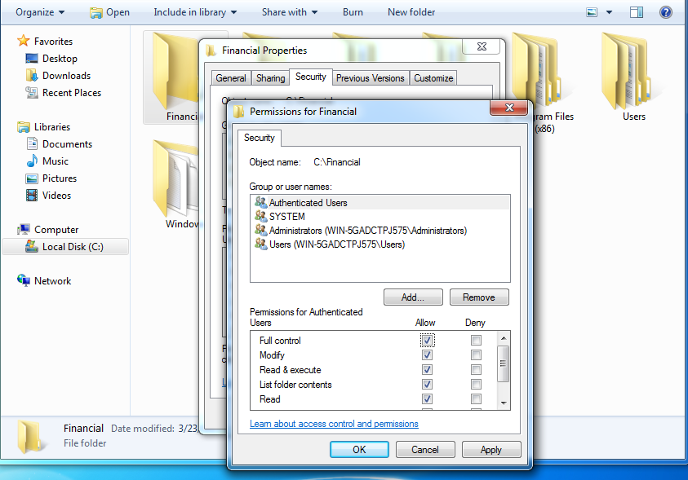
Next Set Permission for Financial Folder that created in C drive

Slide 6
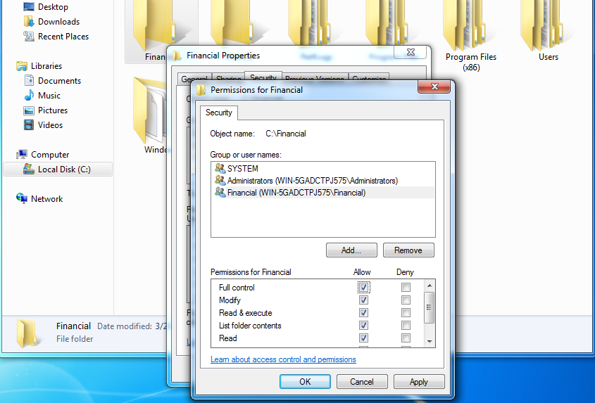

Slide 7
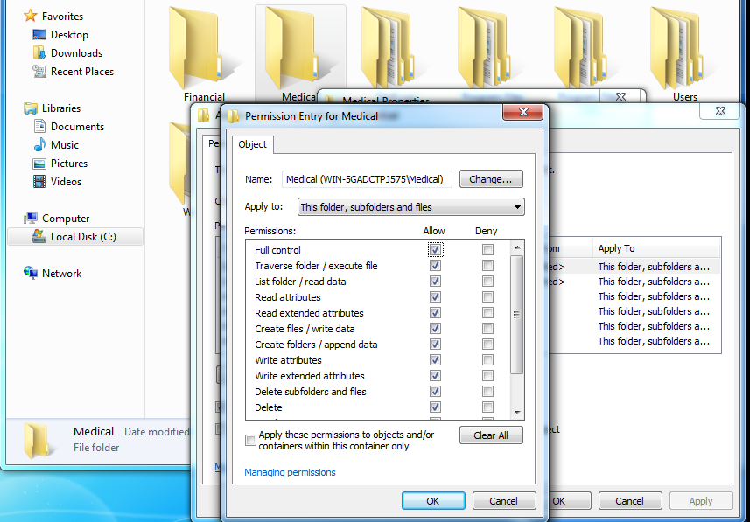
Set Permissions for Medical Folder

Slide 8
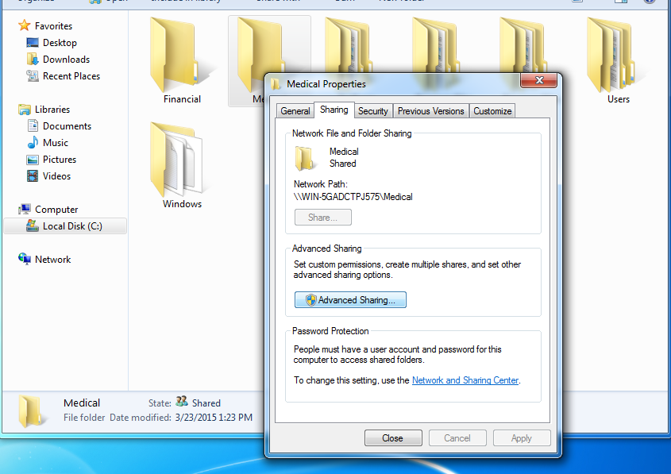
Share Folders according to authentication provided to users

Slide 10
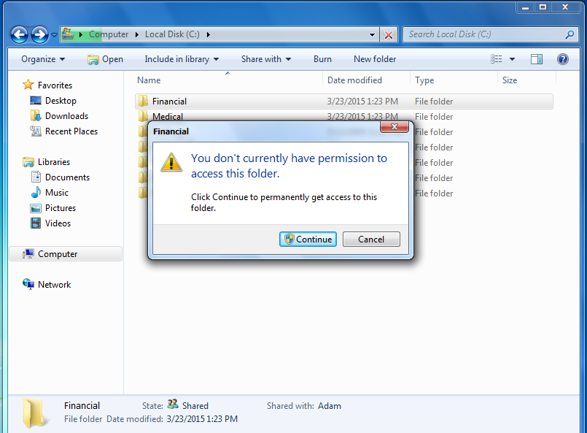
Test Security Measures according to user account in each user groups. The below dialogue box appears when unauthorized user attempts to access the folder. When user click on continue, it will ask to enter password.

