Slide 1
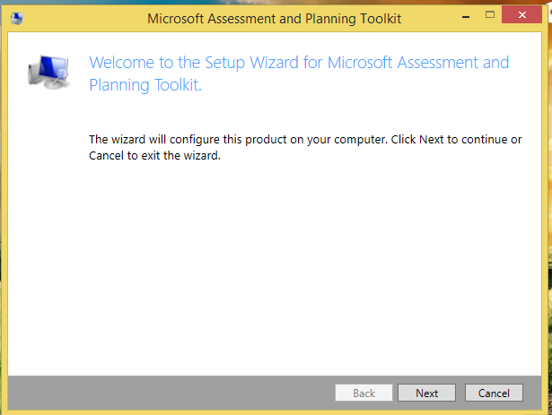
Planning MAP Toolkit 9.1
Download and Install MAP Toolkit 9.1

Slide 2
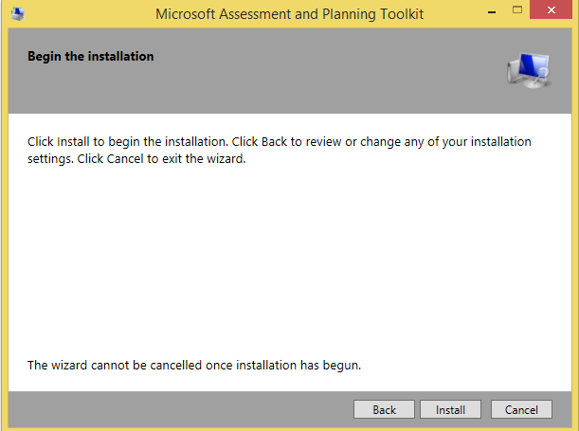
Click on the install button to continue

Slide 3
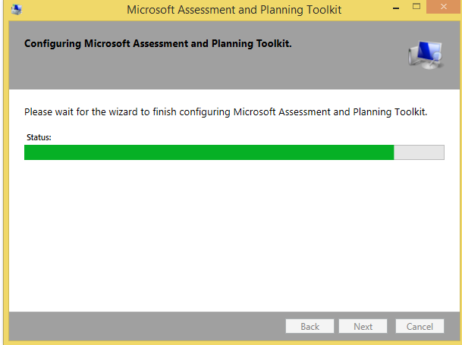
Processing of Installation.

Slide 4
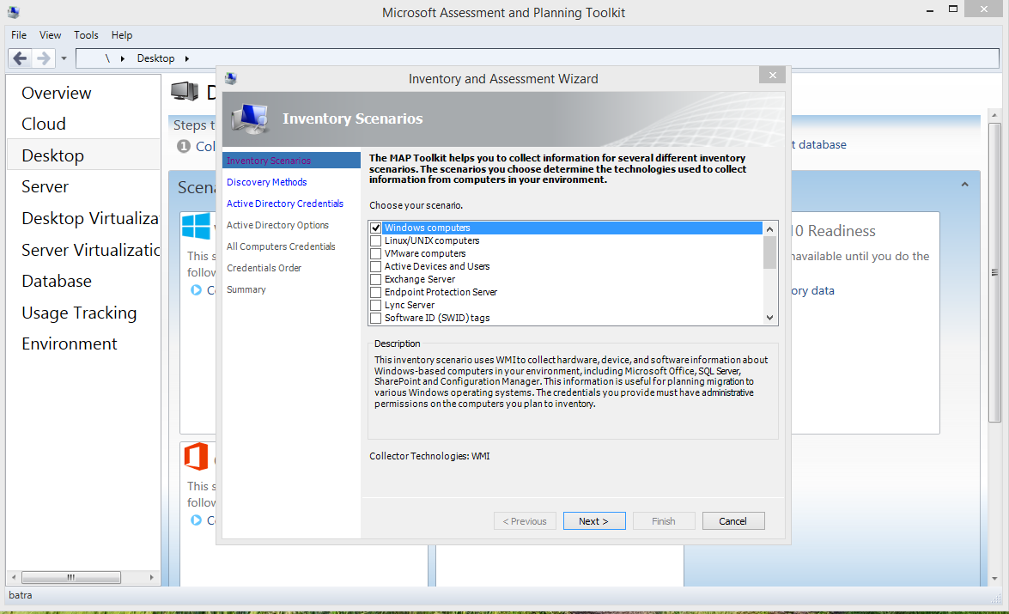
The Wizard for MAP is opened. Click on the Collect Inventory option to collect required data.

Slide 5
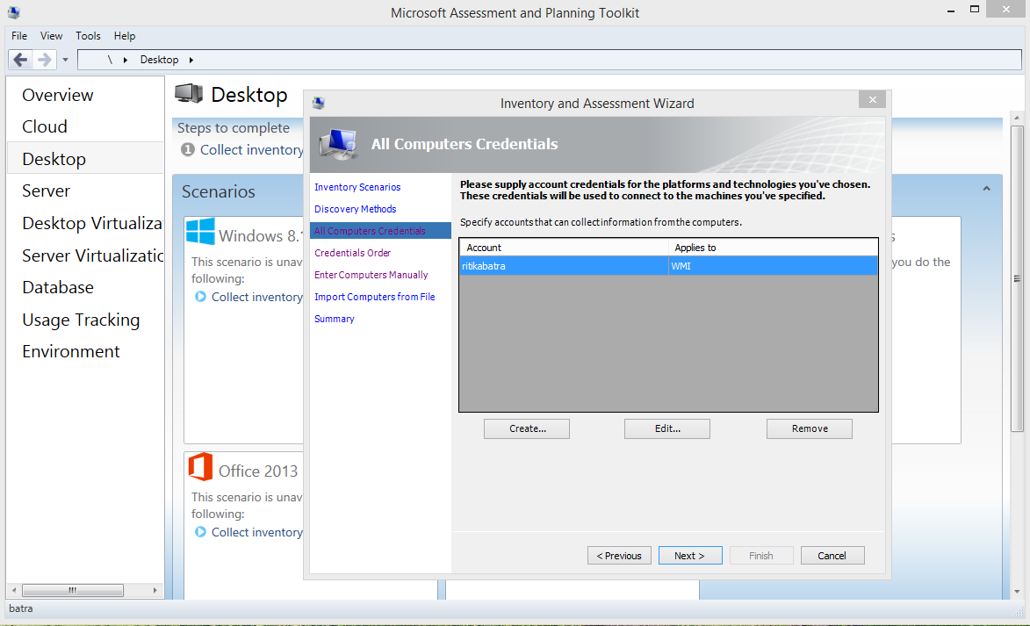
Create new account to collect assessment.

Slide 6
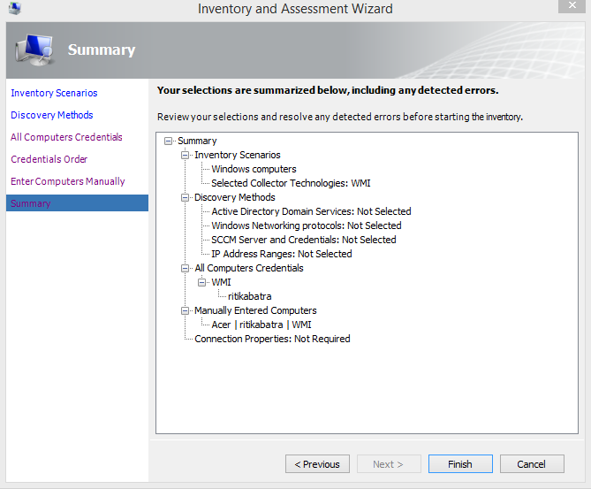
After performing the various steps at the end it will show the summary. Click on the Finish Button.

Slide 7
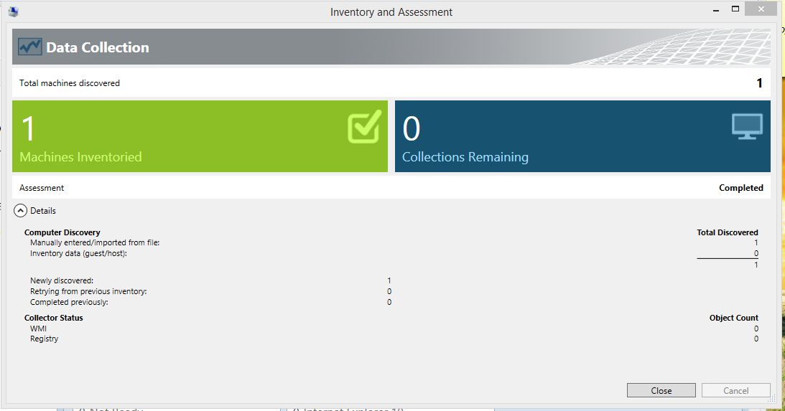
PC is collecting data information. Then performance report is collected.

Slide 8
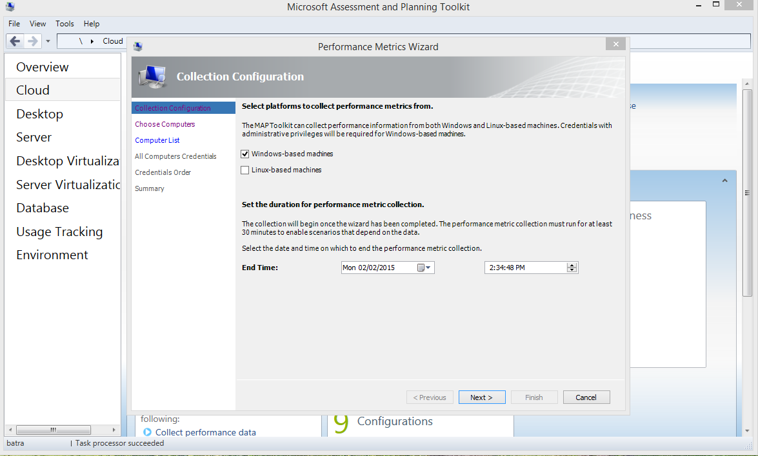
After that go to Performance Metrics Wizard.

Slide 9
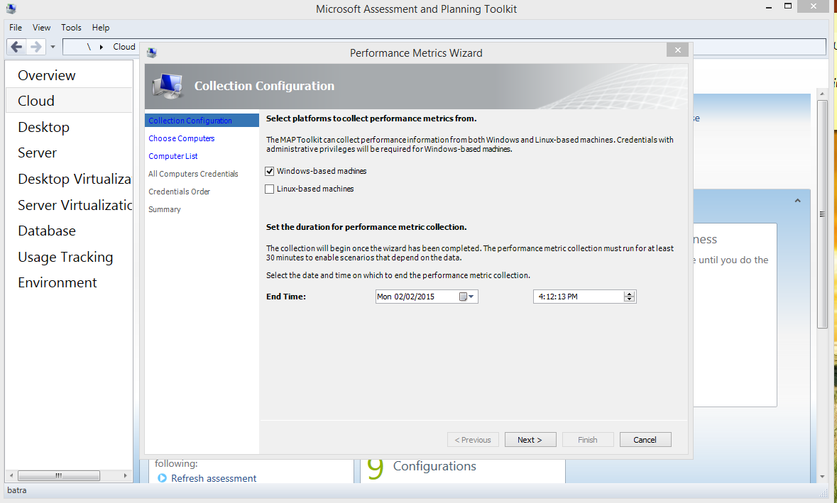

Slide 10
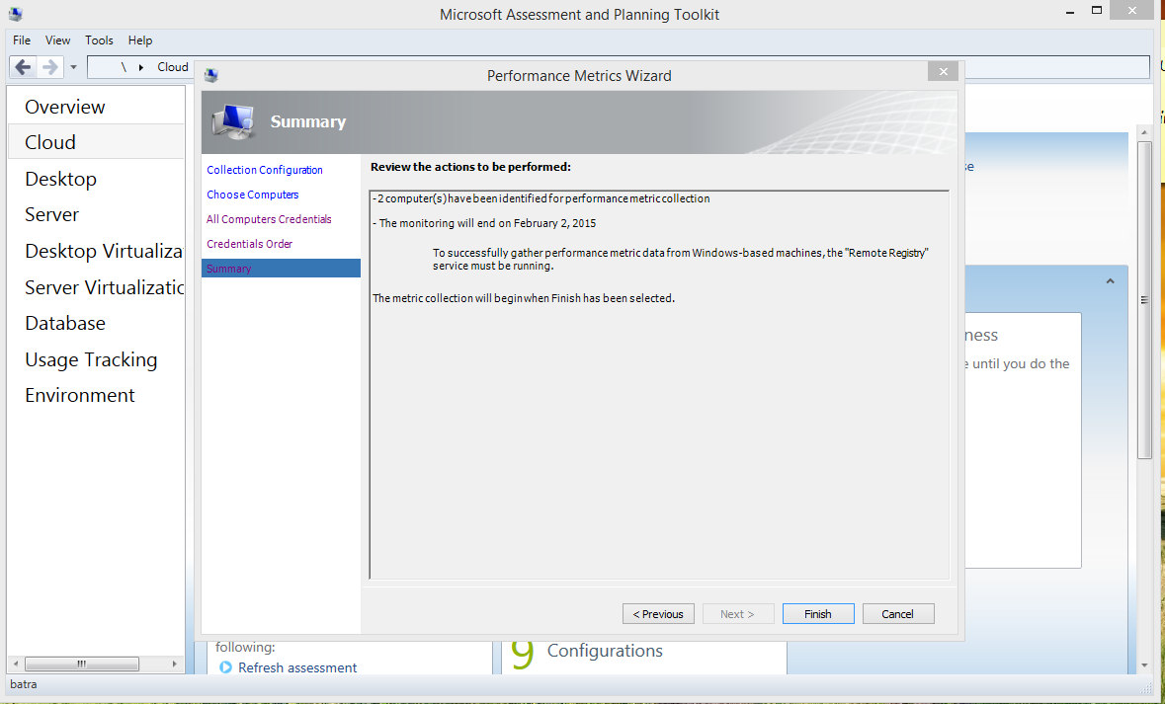

Slide 11
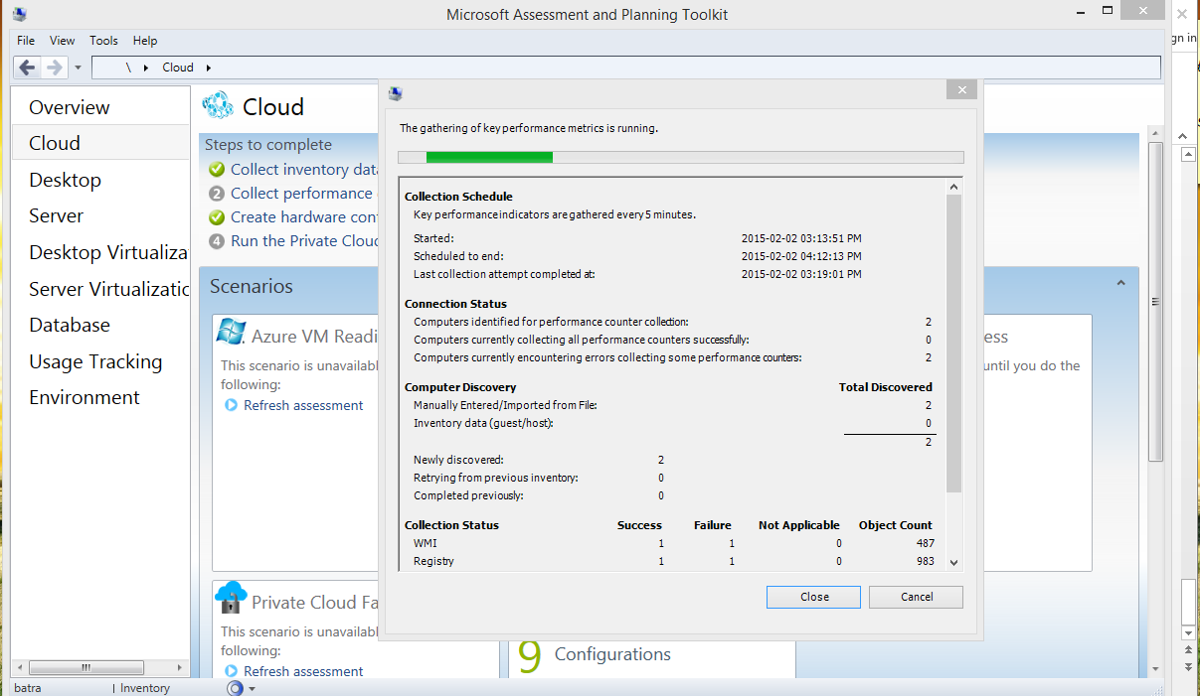
The minimum time of running is 30 minutes. After completing of process it will show the Performance Summary.

Slide 12
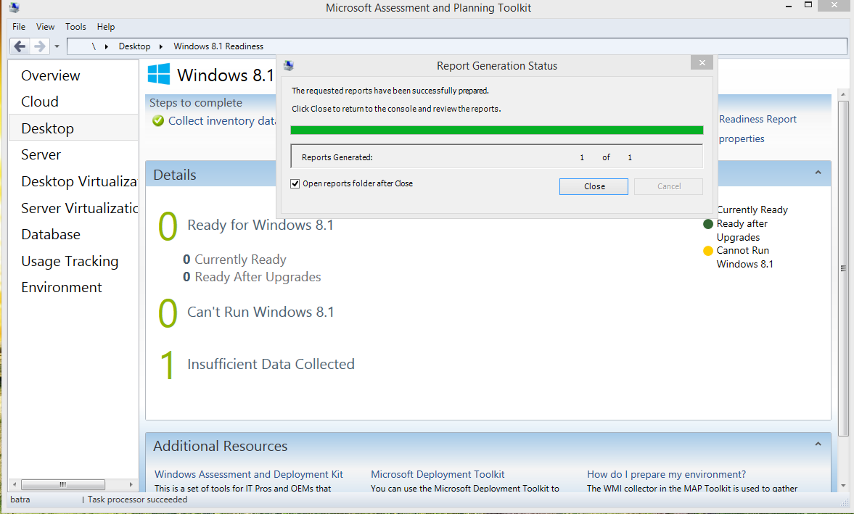
Create the Window readiness.

Slide 13
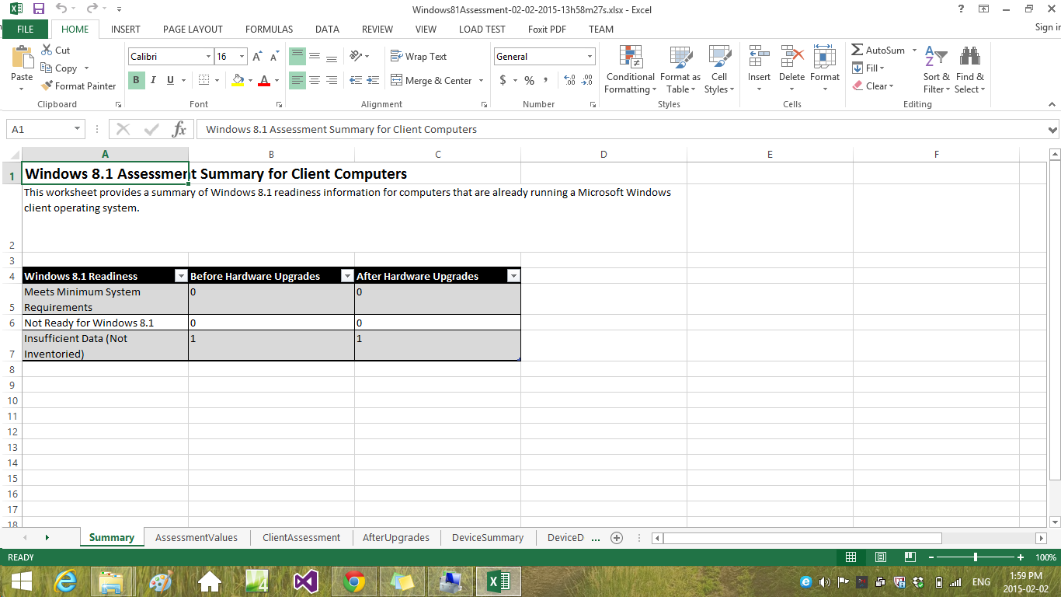
Here we can see the Window 8.1assessment summary for client computers.

