Slide 1
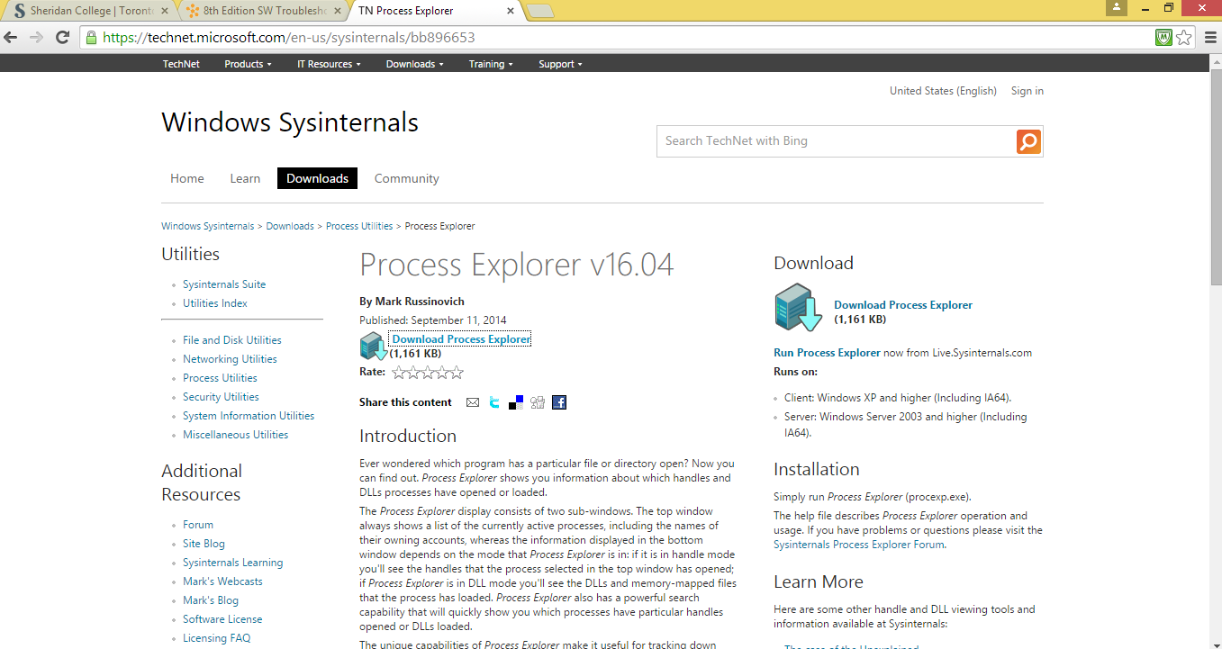
Deliverable 5- Process Explorer
First download and Process Explorer v16.04

Slide 2
Reasons why I like process explorer
We can understand Tree View.
We can understand Colors.
Verify Application Identity.
Use Awesome Tray Icon.
Quickly search Virus.

Slide 3
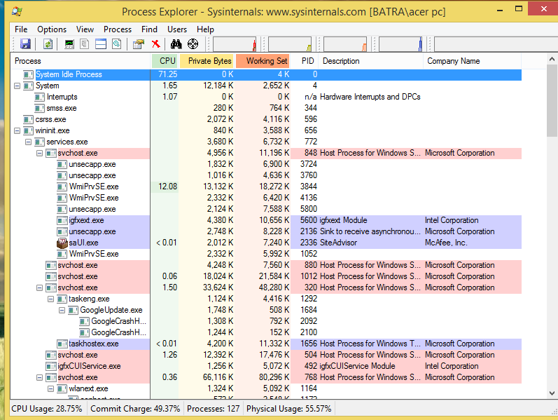
The screen of Process Explorer is opened after accepting the license agreement.

Slide 4
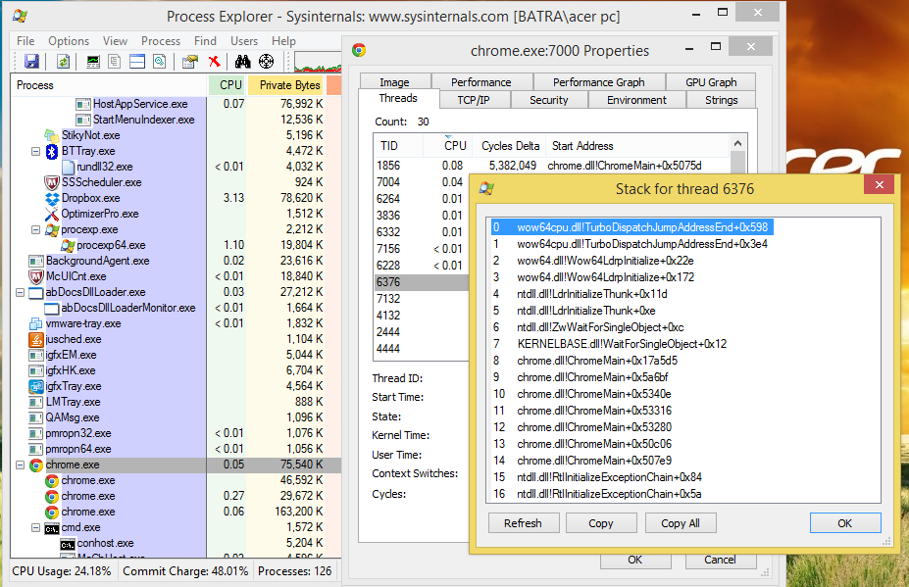
This screen shows the entire stack of one of those threads to see exactly what DLLs and functions are being called.

Slide 5
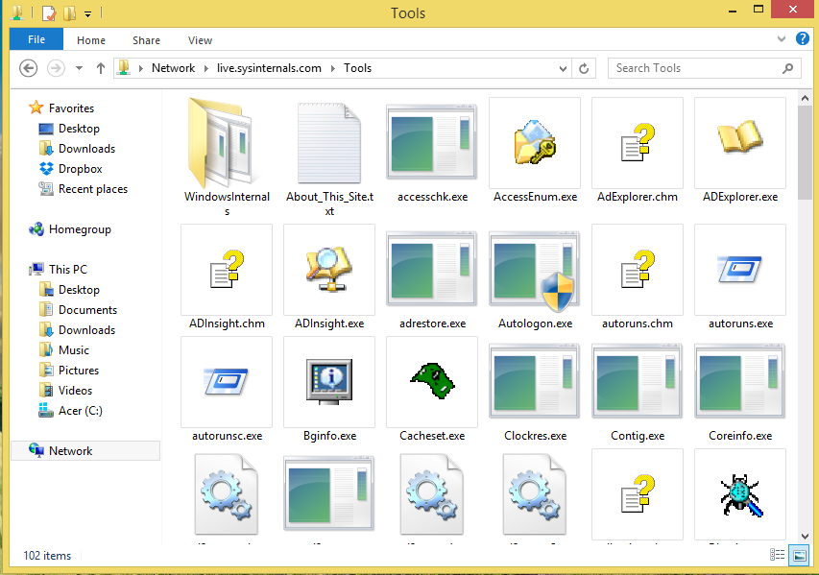
Now open Window Run Box and write on it \\live.sysinternals.com\ then Run that file and open Tools folder. It has all of the different utilities listed.

Slide 6
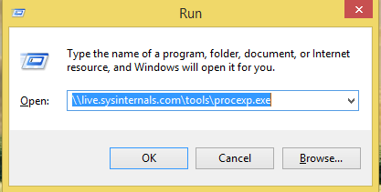
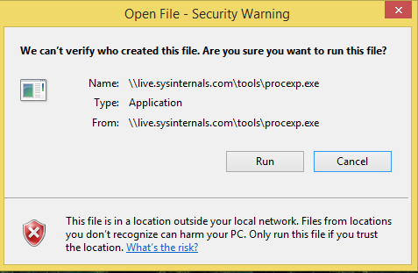
Again type the \\live.sysinternals.com\tools\procexp.exe in Window Run Box and got security warning before actually run.

Slide 7
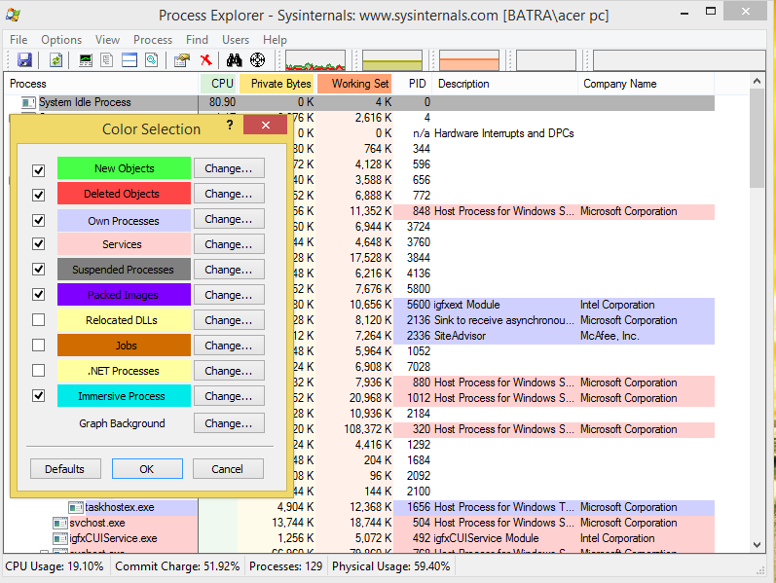
To understand all those colors. Go to Options>Configure Colors on the menu.

Slide 8
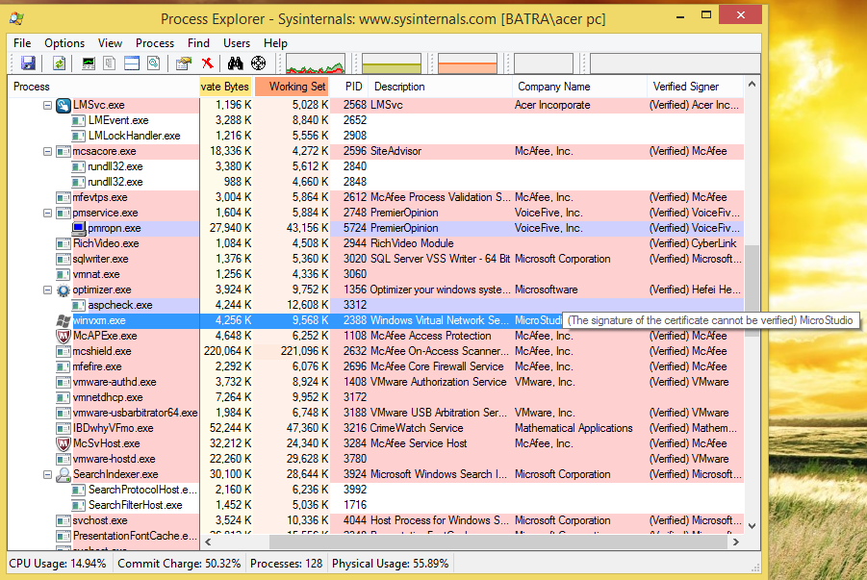
Verifying Application Identity.

