Slide 1
Mini Redis
Member: 耿华 钟梓航 张梓潇
2023 – 9 - 15

Slide 2
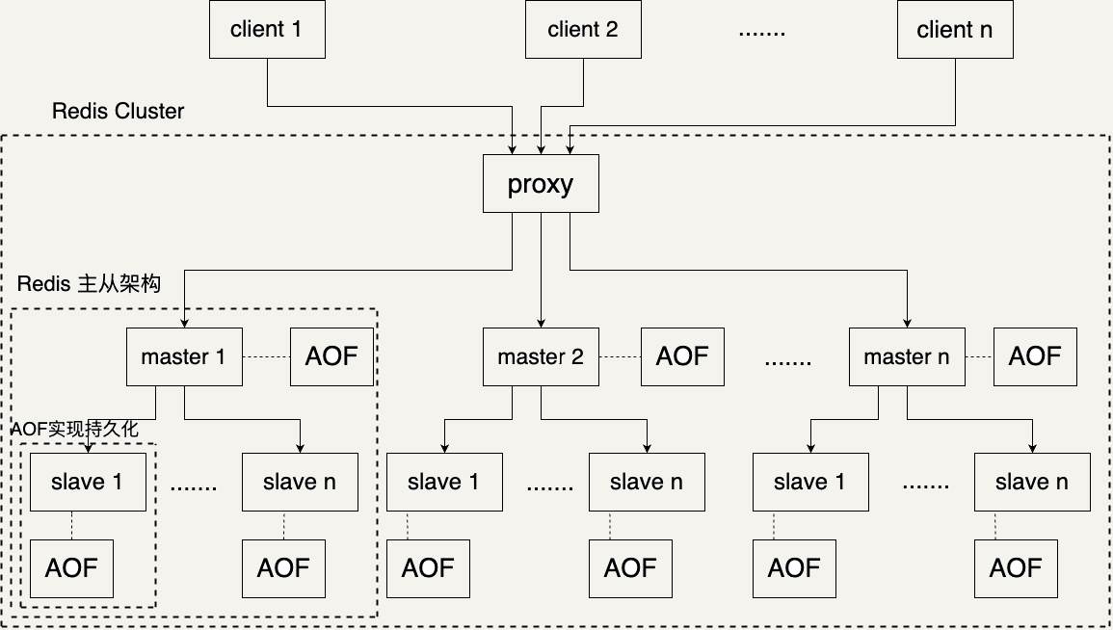
Architecture Diagram

Slide 3
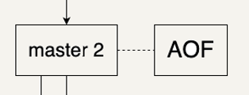
Part 1. AOF
How to Implement AOF
Every Redis-server-node has its own log file to record all the SET and DEL requests.
Redis-server-node logs itself based on the processing result of the valid SET and DEL
requests received.
Redis-server-node can recover the Redis from the log files during servers startup.

Slide 4
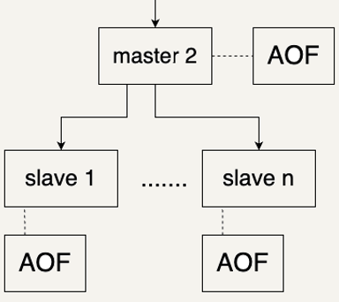
Part 2. Redis Master-Slave Replication
How to Implement Master-Slave Replication
Masters and slaves are all servers, and slaves created when their masters created.
Only GET requests from users or SET and DEL requests from its master are valid for a slave.
All legal requests are valid for a master.
Master maintains a task queue to distribute SET and DEL requests from users
to its slaves asynchronously by using tokio::sync::broadcast.

Slide 5
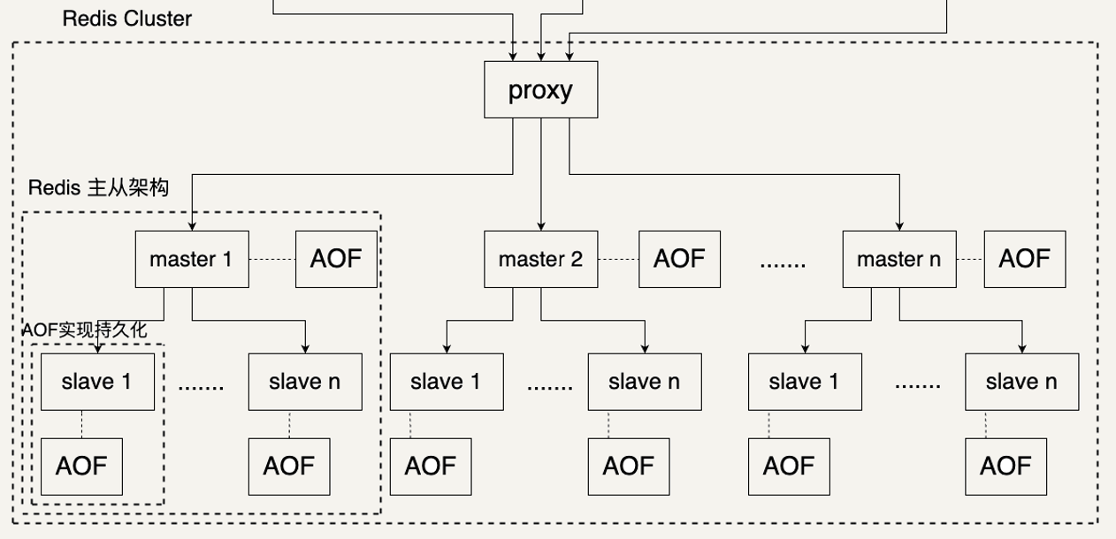
Part 3. Redis Cluster
How to Implement Redis Cluster
Proxy is connected by all the users, and receives all user requests as a server.
Proxy connects all the Redis servers, and receives all server responses as a client.
Proxy assign each request received to the appropriate Redis server by crc16 & mod(group number),
forwards it and returns the server's response to the users requesting it.

Slide 6
What’s More
Implemented transaction management
Support for MULTI EXEC & WATCH.
When WATCH called, server returns a response with a watch_id to mark which key to watch.
When MULTI called, server returns a response with a txn_id to mark the transaction.
Transaction operations will be push into the task queue.
When EXEC called, by popping task queue to do operations.
Try our best to exit the program gracefully.
Send request with exit opcode to sync task to spread exit signal.
Flush the log in buffer to disk.
Code Test

