Slide 1

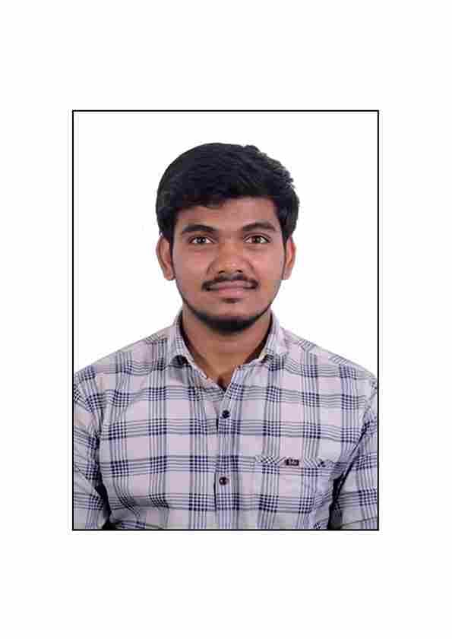



Shahid Shaik
Education
Bachelor of Technlogy, Agricultural Engineering : 2017 - 2021
Skills
Analyst/Software Engineer
Base Location: Mumbai
Email ID: SHAHID.SHAIK@CAPGEMIN.COM
Mobile No: +919849527499
Grade: A4
java | java, OOPS, Collections, Array, Loops, Exceptions.
Database | Postgre SQL
UI Tech | HTML 5 & CSS3, JavaScript,Typescript,Bootsrap
Tools | Git & GitHub, Eclipse, Swagger, Visual Studio Code, SQL shell.
Strengths
Full Stack Developer
Hands on experience on Core java, Postgre SQL.
Proficient in creating Single page Web Application in Angular with Authentication with routing.
Hands on experience in developing web pages using HTML5, CSS3, Object TypeScript.
Ready to learn new technologies and implement them for the Future Knowledge improvement.
Achievement
Incentive System for Car Dealer
Case study of Incentive System for Car Dealers along with Swagger, responsive UI with HTML5, CSS3, Bootstrap and ANGULAR used as User Interface.
Check out my work on GitHub
Presentation Title | Author | Date © Capgemini 2017. All rights reserved | 1

