Slide 1
WELCOME
NAME: P DEEPIKA
DESIGNATION: POWER BI DEVELOPER
EXPERIENCE: 5 YEARS

Slide 2
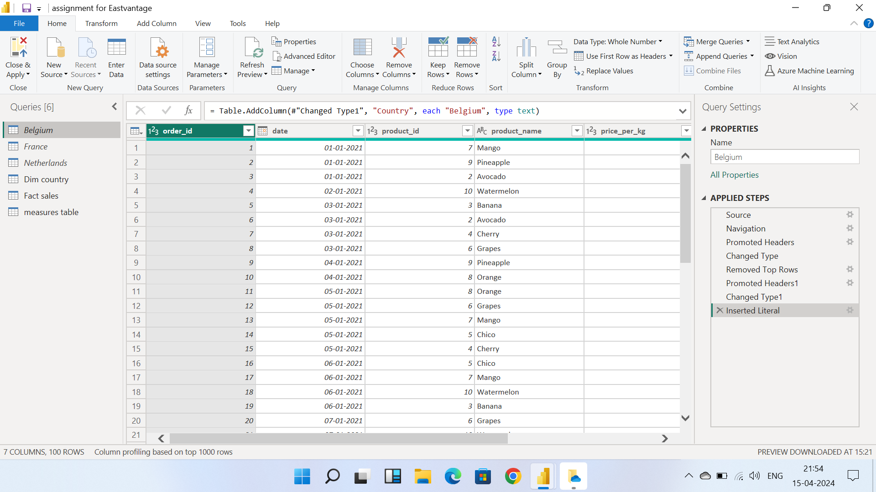
TRANSFORMATIONS:
Step 1: I had loaded three countries data set into the Power BI through GETDATA option.
Step 2: Removed top three unnecessary data rows through remove top rows option and used FIRST ROW AS HEADERS.
Step 3: Append the three countries and named as FACT SALES.

Slide 3
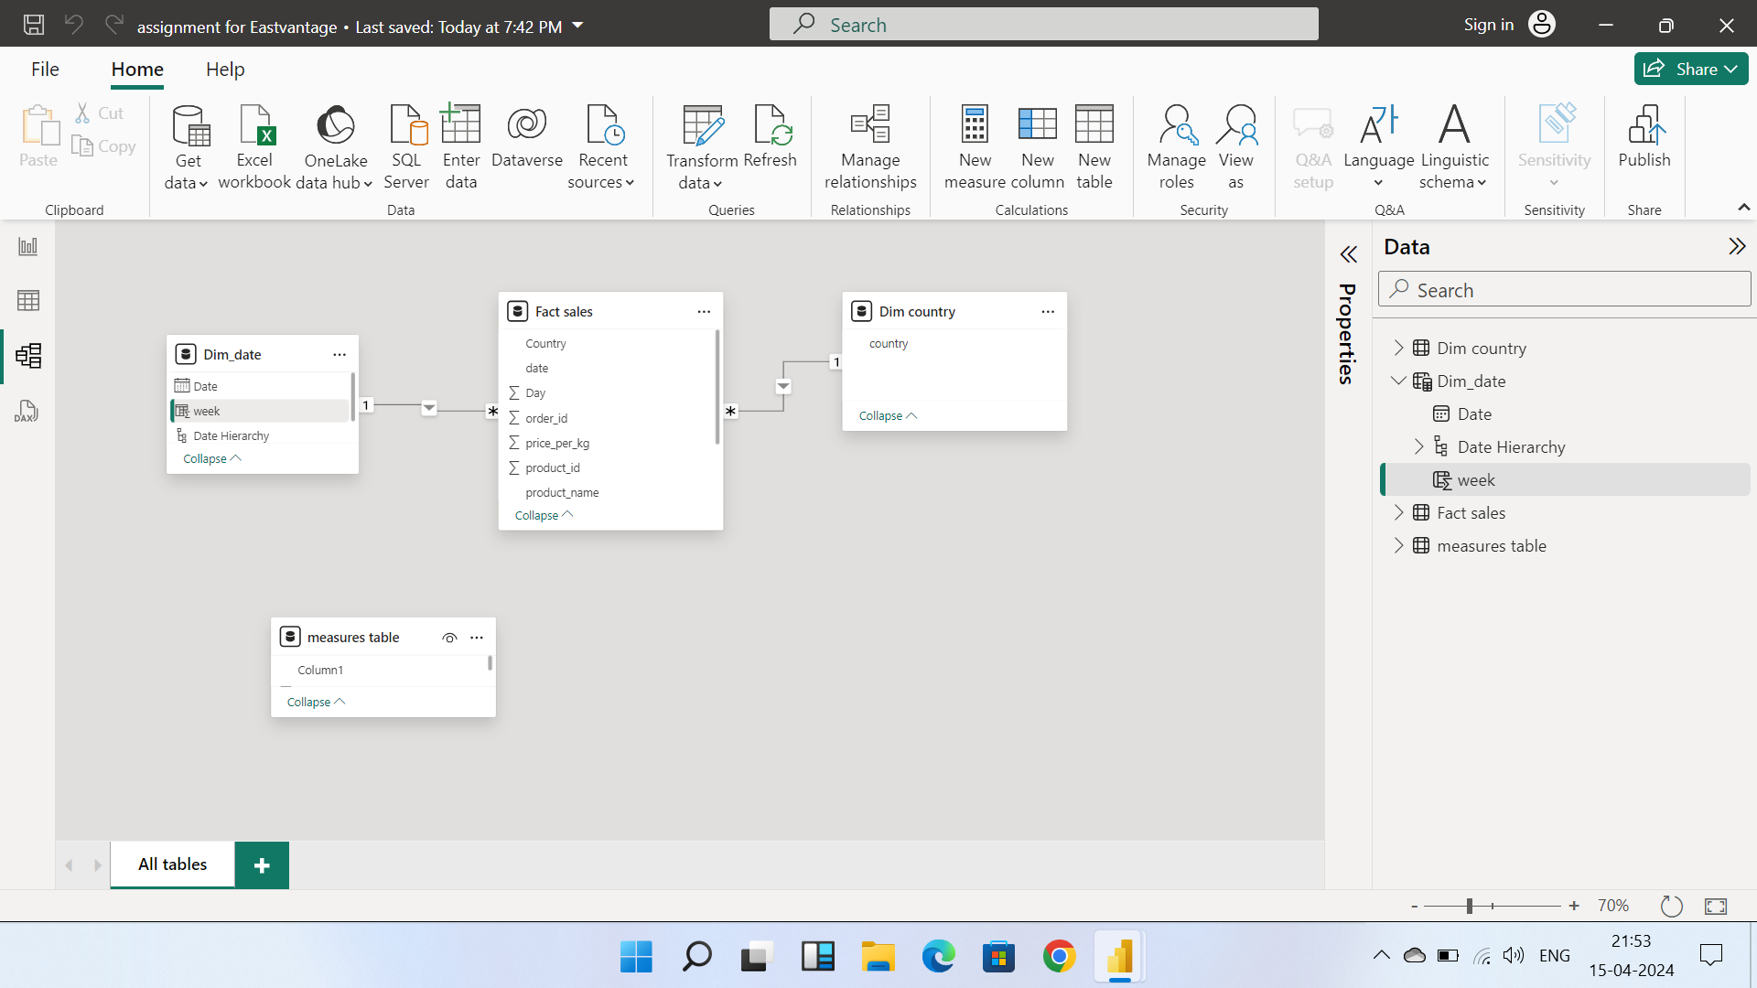
DATA MODELLING:
Step 4: Created manually DIM country because we cannot create reports by using only FACT SALES.
Step 5: I had created DIM date using CALANDER AUTO()FUNCTION
Step6: In modelling created one to many relationships that is data integrity (STAR SCHEMA).

Slide 4
VISUALISATION:
Step7: VISUALISATION: Created sales as follows.
a) Go to the Power Query Editor.
b) Select ADD COLUMN by using CUSTOM COLUMN
(Price *Weight)= SALES.
c) Created Week of the month in Power Query editor.
d) Created Total Weekly sales with Previous and current sales by using DAX Function VAR.
e) Created VOLUME using DAX Function CALUCULATE.
Step 8 : Created KPIS
a) Break down sales per country (PIE chart).
b) Volume of products sold weekly (Column chart).
c) Week over week sales (Line and Column chart).
d) Detailed level of each sales record (Table).

Slide 5
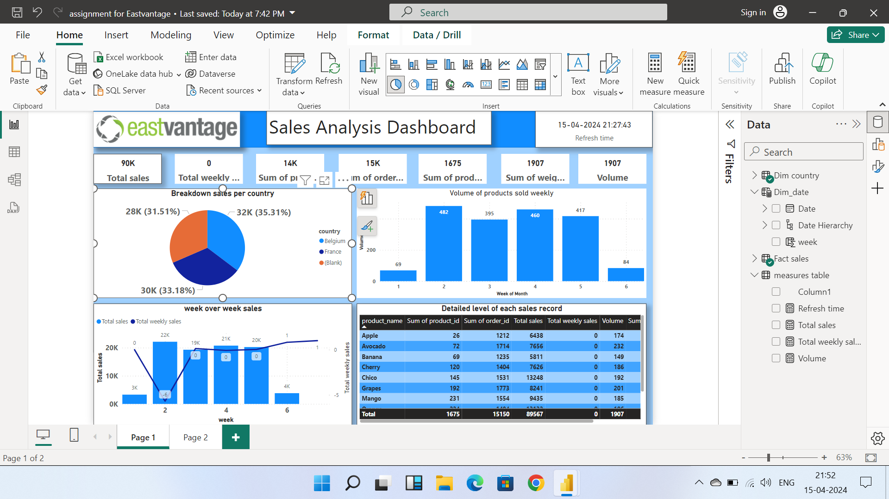

Slide 6
THANK YOU

