Slide 1
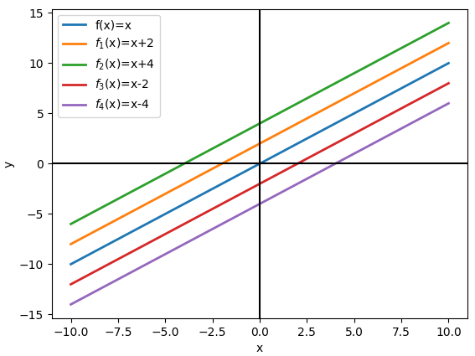
Positive translation
Negative translation

Slide 2
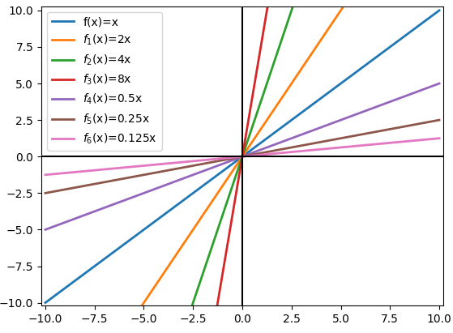
Increasing of the slope
decreasing of the slope

Slide 3
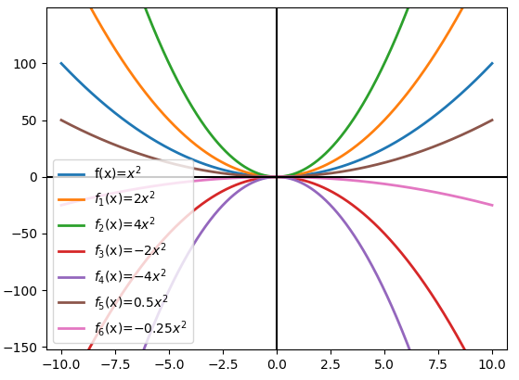

Slide 4
