Slide 1



Data PROTECTION & PRIVACY
Gabriele Taccioli 4234616
Emanuele Venzano 4202431
Anonymization of Transactional data:
CAHD Algorithm Implementation
Personal studies & suggestions for the improvement

Slide 2
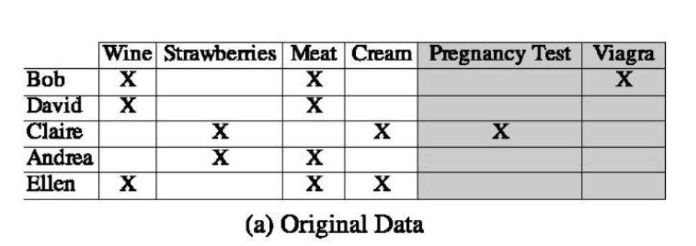
Transactional data
Transactional data are sparse high-dimensional data (E.G. sales of a retail company which offers thousands of different products).
They contain customer spending patterns, which are useful for marketing and planning purposes.
The customer identity are not relevant for purchase pattern studies, so they are suppressed. Despite that, certain patterns could allow to discover purchaser identity and associate they with sensitive information.

Slide 3
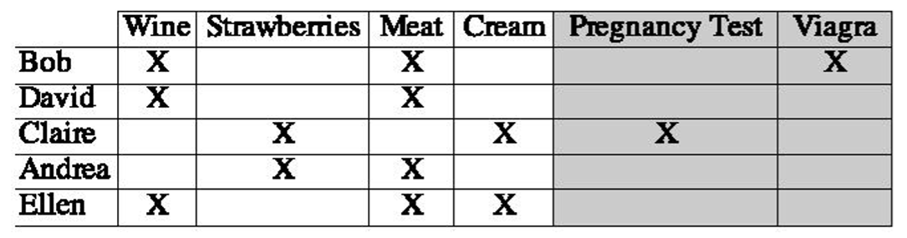
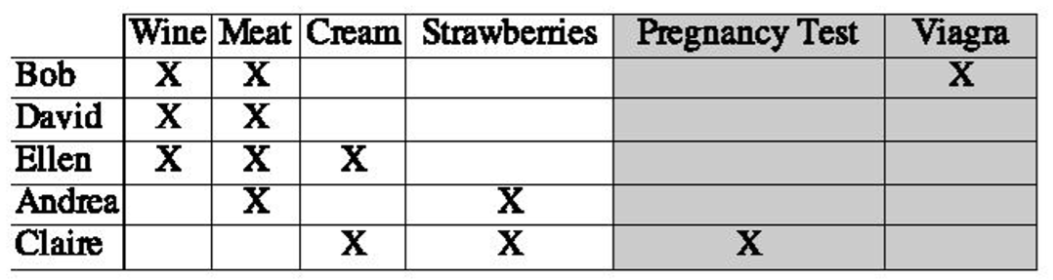
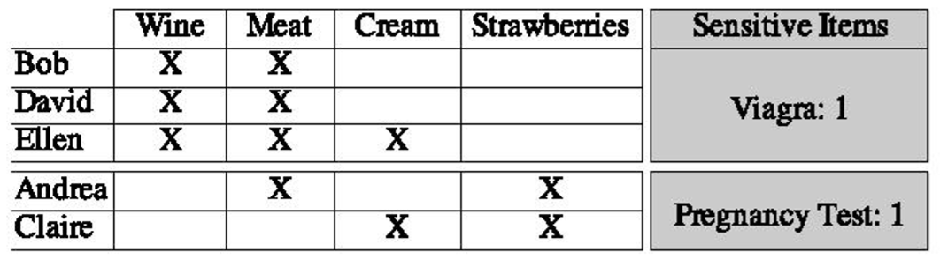
Anonymization algorithm
The algorithm [1] we used is composed by three main phases:
Dataset analysis and data preparation
Implementation of CAHD algorithm
Results analysis via KL-Divergence
[1] G. Ghinita, Y. Tao and p. Kalnis, "On The Anonymization Of Sparse High-dimensional Data", 2008

Slide 4
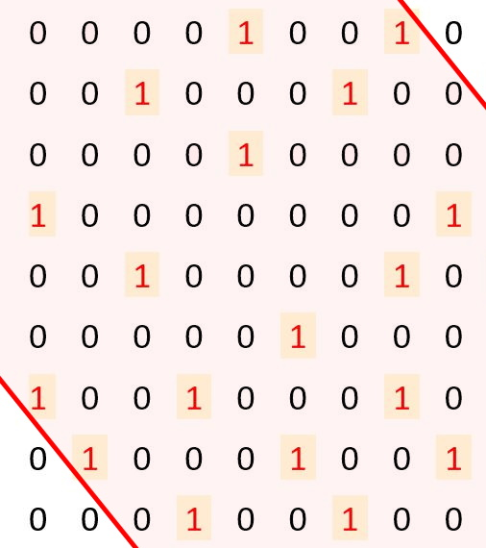
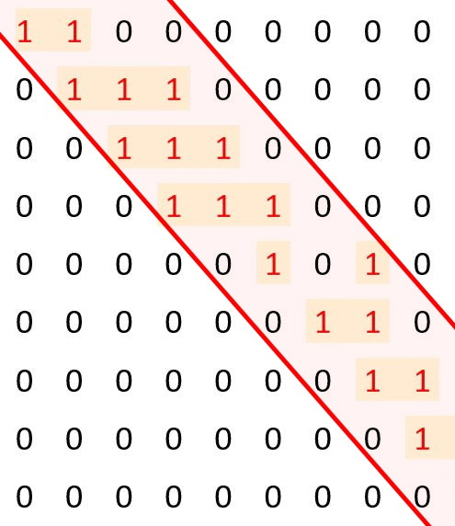
Dataset analysis and data preparation
In the first phase we classified the attributes as QID (which can be published without privacy breach) and Sensitive Atributes (which rapresent a privacy threat). Then we organized data as a Band Matrix by performing a permutation of row and columns from original dataset using the "Reverse Cuthill-McKee" algorithm. In our case the properties of band matrix are very important because more similar data will be closer.
Dataset before RCM transformation
Dataset after RCM transformation

Slide 5
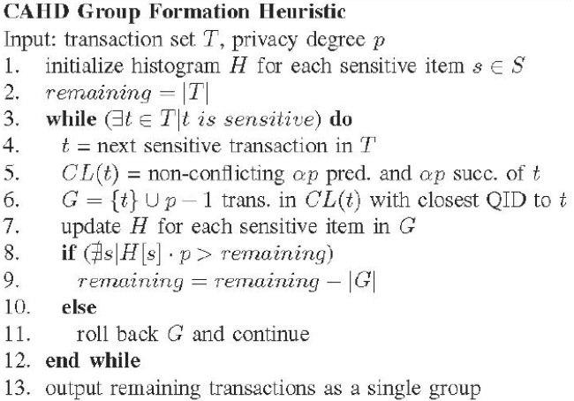
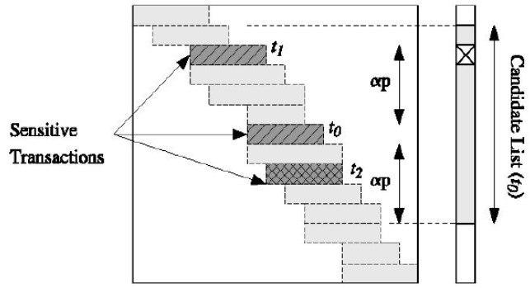
Implementation of CAHD algorithm
In transactional data privacy is intended as the possibility to discover to which transaction belongs a specific Sensitive attribute. The aim of CAHD is to group transactions with same QIDs attributes by similarity, so if there are p transactions grouped with only one Sensitive attribute, the discover possibility will be 1/p.
CAHD Pseudocode
Group Formation Heuristic

Slide 6

Results analysis via KL-Divergence
The last step is rapresented by the study of the results. This is achieved computing KL-Divergence, which is a parameter that tells the possibility to reconstruct the association between a pattern and a sensitive attribute. This is computed by calculating on C different combinations of QIDs:
- the Actual probability distribution function ${Act}_{C}^{s}=\frac{Occurrences of s in C}{Occurrences of s in T}$
the Estimated probability distribution function ${Est}_{c}^{s}$ $=\frac{\sum_{G}{a∗b/|G|}}{Occurrences of s in T}$
where a = occurrences of s in G
and b = number of transactions that match the QID of C
the KL-Divergence value KL_Divergence(Act,Est) = $\sum_{C}{ {Act}_{C}^{s} ∗ }$log$\frac{{Act}_{C}^{s}}{{Est}_{c}^{s}}$

Slide 7
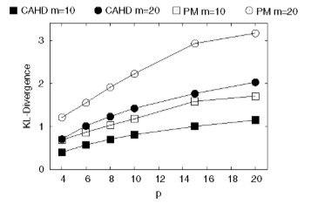
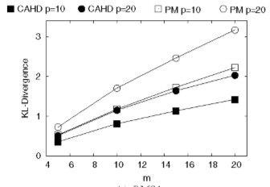
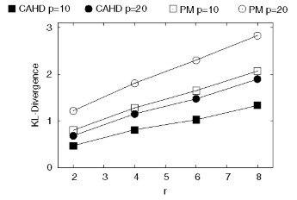
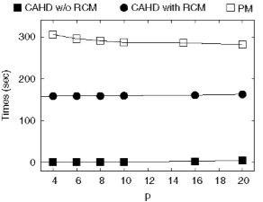
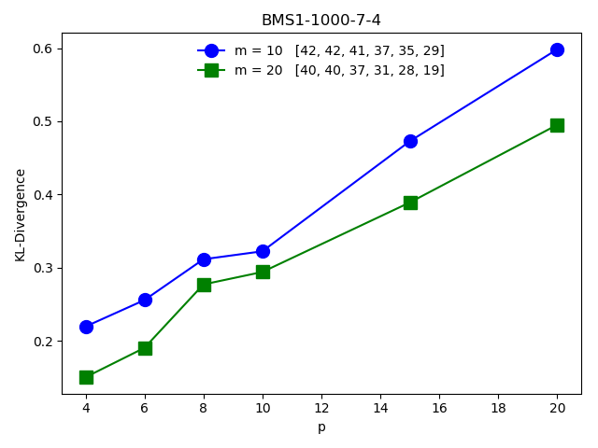
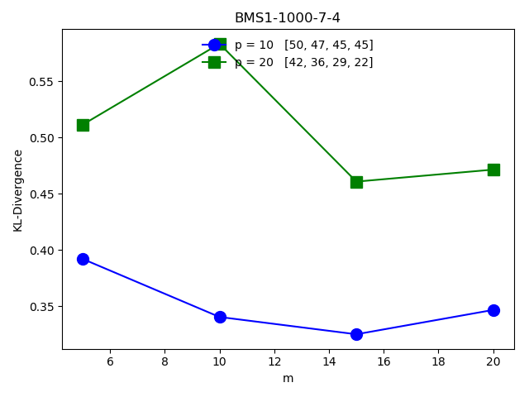
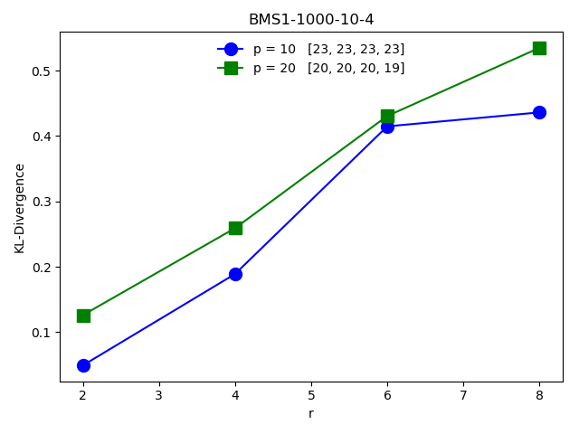
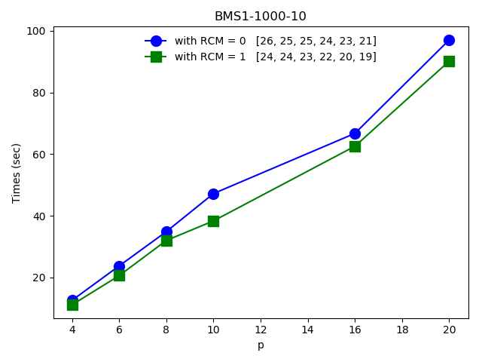
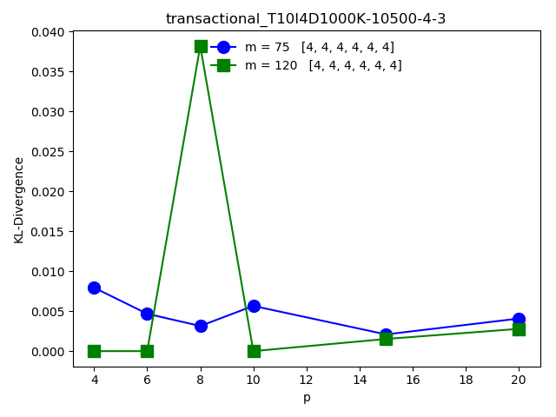
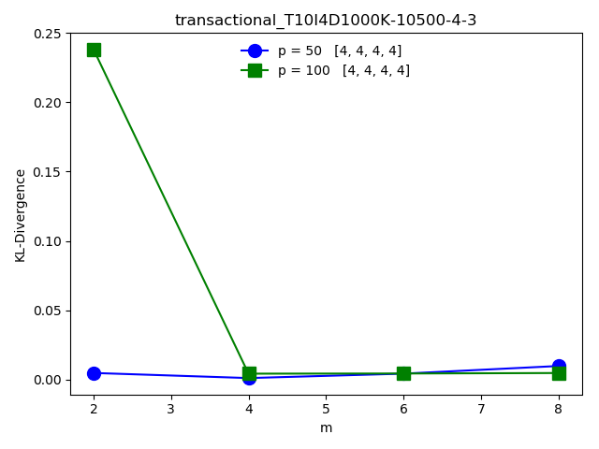
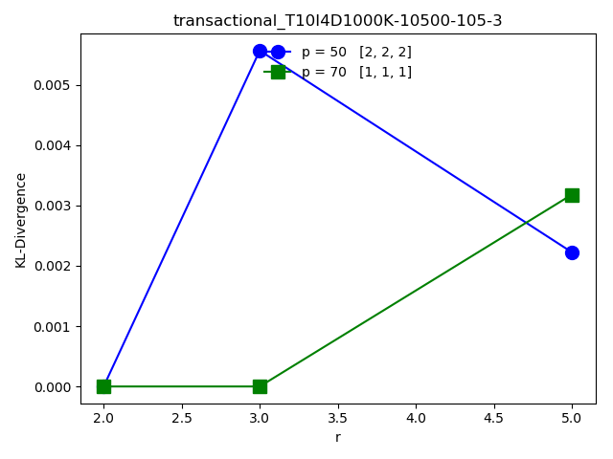
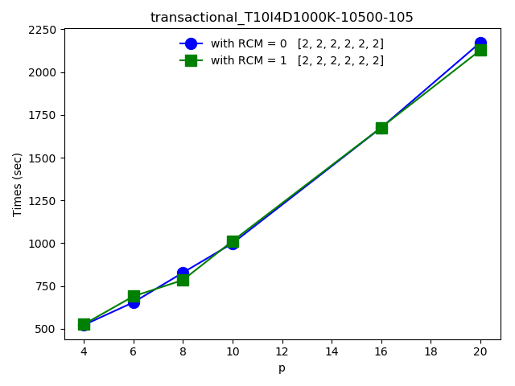
Effectiveness and Efficiency analysis
Down here we present a comparison between our results and the paper ones:

Slide 8
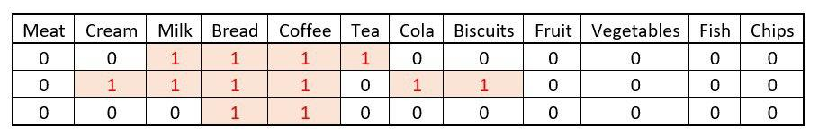
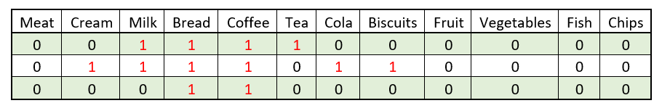
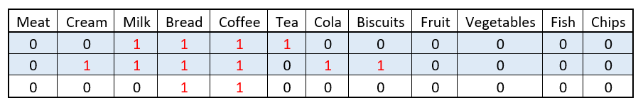
Possible algorithm improvement
We studied a possible improvement for this particular algortihm: we noticed that not only the "ones" in the matrix were important to analyze similarity between lines, but also "zeros", so we decided to add a weigth in the similarity computation between transactions. We called this parameter q.
Similarity = 3 + q * 5
Similarity = 2 + q * 8
We tried several values of q in order to find the balance between the weigth of "ones" and "zeros“.

Slide 9
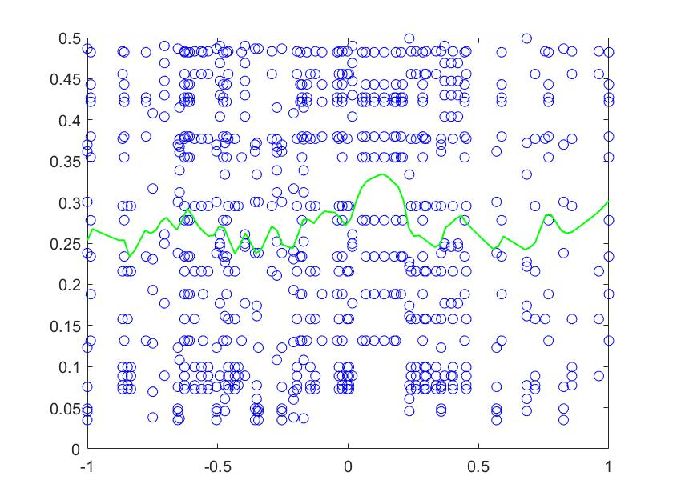
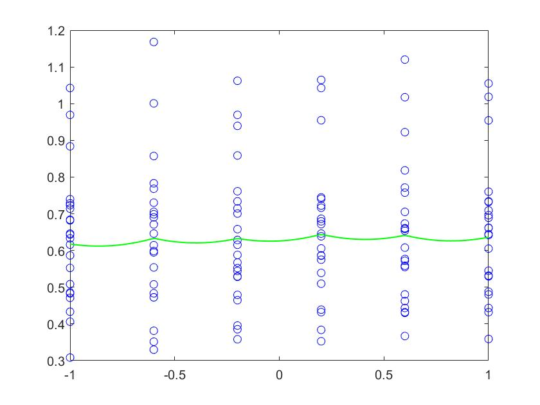
Q implementation results
Firstly we tried to find the function that describes the value of q in dependence of the matrix density with a non-linear regression method. Then we tried to find a correlation between KL-Divergence and q with a fixed density matrix.

Slide 10
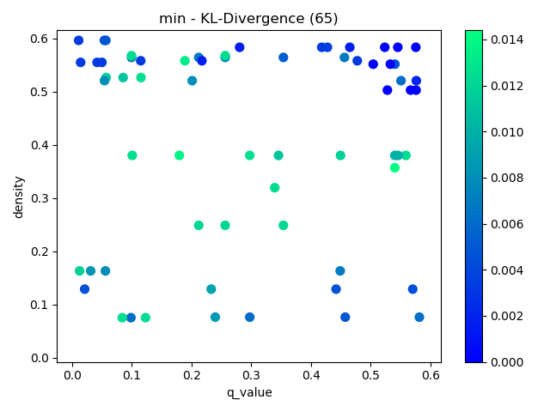
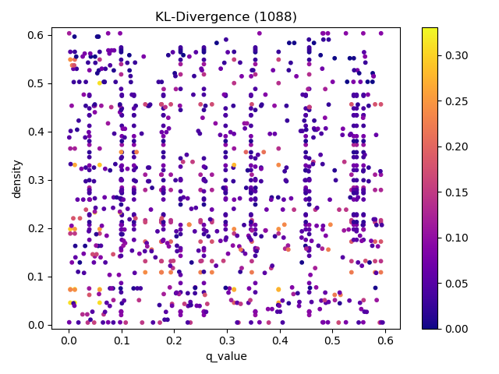
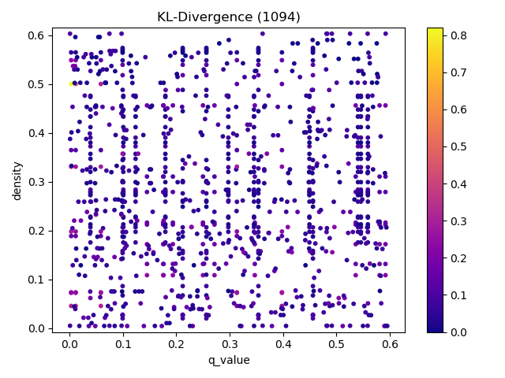
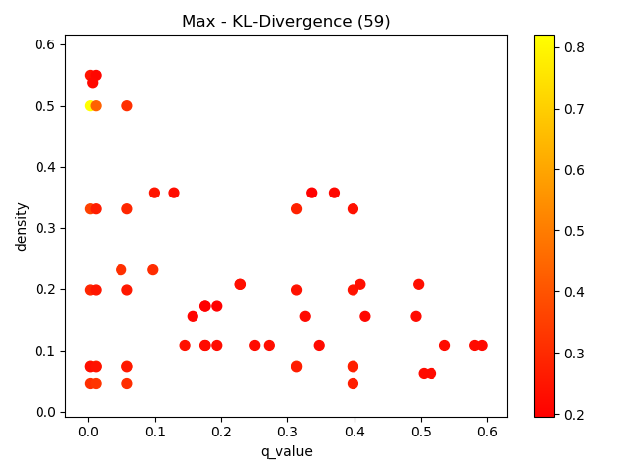
Q implementation results
We studied how the effectiveness of CAHD changes with the value of q, we modified on purpose the density of the matrix among 0 and 0,6. In those chart we progressively focused on the maximum and minimum values of KL-Divergence respect to q.

Slide 11
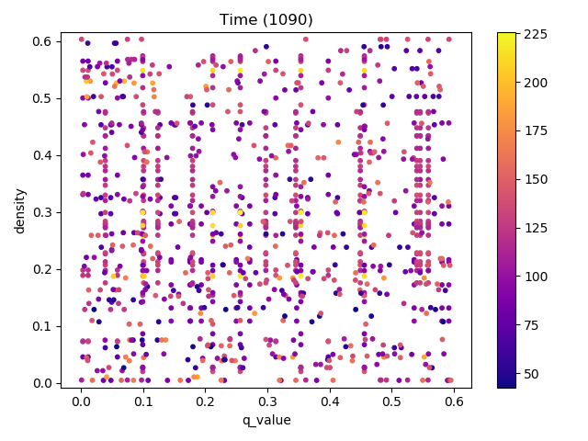
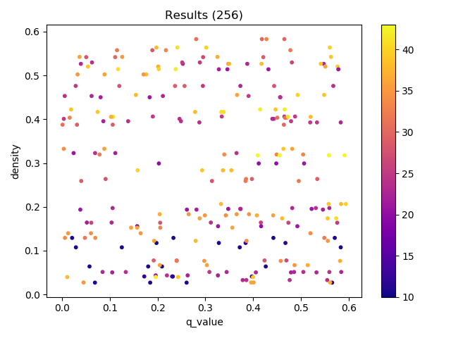
Q implementation results
We studied how the effectiveness of CAHD changes with the value of q, we modified on purpose the density of the matrix among 0 and 0,6. In those chart we progressively focused on the maximum and minimum values of KL-Divergence respect to q.

