Slide 1
Predicting the Age of Abalone from Physical Measurements
COSE281: Engineering Mathematics
Final Project
2015320143 Heeyeon Kang, 2016320128 Sumin Lee, 2018320250 Seung Ha Lee

Slide 2
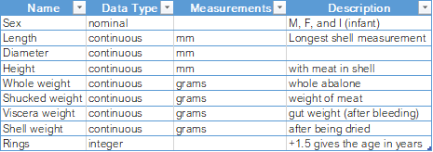
Introduction
Introduction & Research Question
Predicting the age of an abalone by counting the number of rings inside its shell is a tedious and time-consuming task. If physical characteristics that are more easily measured act as strong clues, a sufficiently good estimate of the age of abalone can be made.
By utilising what we learned throughout a semester of Engineering Mathematics, we implemented 2 different methods of prediction.
Dataset
The dataset, abalone.mat, consists of different types of measurements of 4177 abalones, for a total eight attributes. The attributes are as follows:
For our project, we only took continuous attributes into consideration.
Source: http://mlr.cs.umass.edu/ml/datasets/Abalone
The dataset was retrieved from the UCI Machine Learning Repository.
(Dua, D. and Graff, C. (2019)).

Slide 3
Methods
&
Algorithms
Multiple Linear Regression
Model Introduction Multiple Linear Regression
Algorithm The linear regression model finds 7 coefficients and a constant to act as weights to 7 different features and as the intercept in computing predictions for the age of abalone. Matrix division was used to solve for the coefficients through a linear system of equations manually.
Implementation Details
70% of data was used for regression 30% was used for cross-validation.
A comparison between MATLAB functions and manual calculation was made.
Results
The models produced an RMSE of 2.22. The difference in RMSEs between the models was minimal
Artificial Neural Network
Model Introduction Artificial Neural Network
Algorithm Two Artificial Neural Networks comprising three hidden layers of ten neurons and a single hidden layer of ten neurons respectively were made. The manually created ANN used mini-batch gradient descent along with a sigmoid activation function.
Implementation Details
70% of data was used for training 30% was used for testing.
Results
ANN implemented using MATLAB functions had an RMSE 2.22. ANN implemented manually had an average performance of RMSE 3.12.

Slide 4
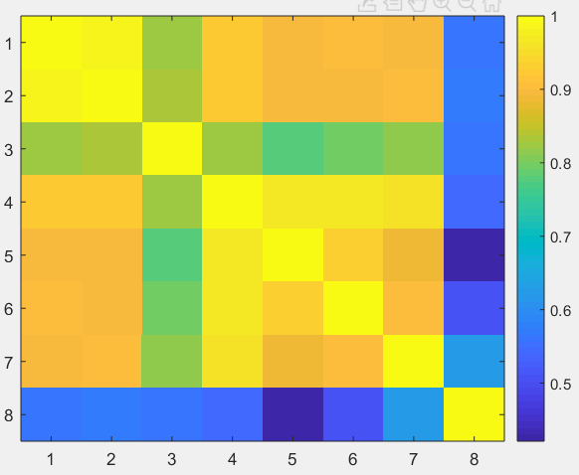
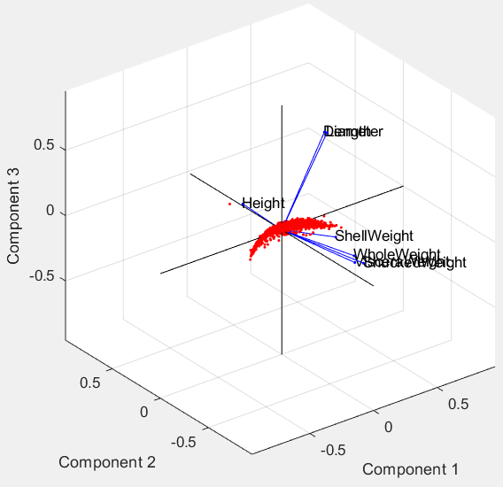
Additional
Analysis
The feature with the highest correlation to Rings (age of abalone = number of rings + 1.5 years) is ShellWeight, the weight of the abalone after being dried. It has the highest correlation value of 0.6276. Hence, the weight of the dried shell would be the most telling feature if other variables were unavailable.
The graph on the left is a PCA biplot using the first three principal components calculated using Singular Value Decomposition (SVD), which explain more than 97% of the variance. The first component alone explains over 90% of the variance, which means the dimensionality of the problem can be further reduced with minimal loss of information.

Slide 5
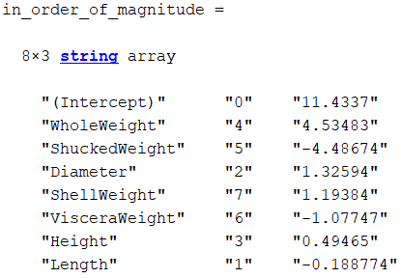
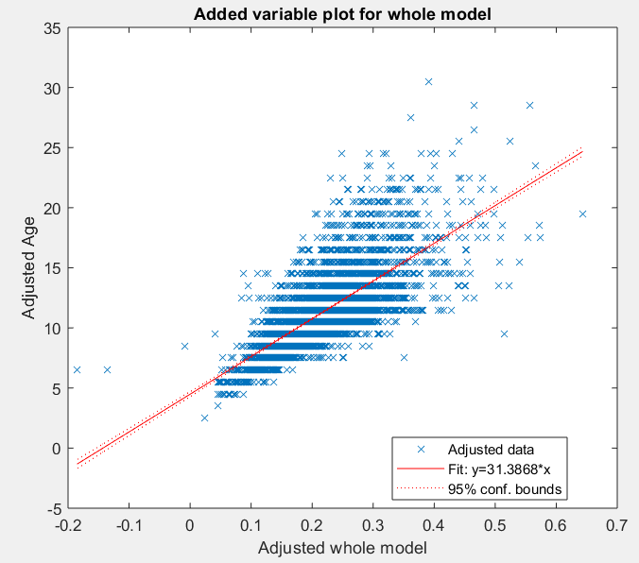
Conclusion
WholeWeight was the most important variable in predicting the age of abalone. The total weight of an abalone is the best predictor of its age when other variables are held constant (but measured)..
On the other hand, Length did not have a significant effect when predicting the age of abalone. The p-value was also very high (p = 0.39).
The difference in accuracy between the two methods were minimal, although the built-in ANN functions performed the best (RMSE = 2.14 years).
A single neuron could predict the age of abalone fairly well, which implies that the relationship is likely to be highly linear.
To improve prediction results, discovering and measuring better predictors (possibly those relating to the location where the abalone were found rather than those that focus on the abalone itself) is likely to be more helpful than increasing the amount of data, as our analysis shows.
Quick physical measurements that can be used to predict the age of abalone can be very useful as they save the time required to cut, stain and observe under a microscope the shells of abalone to determine the number of rings they have.

