Slide 1
Study the relationship of time needed to fix bugs by heroes and non-heroes
Project KUSER, subproject of KDE
Daniel Hanspeter
Thomas Schievenin

Slide 2
Contents
Motivation
Research question
Methods
Results
Implications
Future work
Summary

Slide 3
Motivation
New work on Repositories & Bug Trackers
Automated Hero recognizer tool
Automated Bug fixing analysis tool
Definition of Hero
Developer that EXCLUSIVELY edits/commits a number of files greater equal then percentage threshold α

Slide 4
Research Questions
RQ: do heroes take a shorter or a longer time to fix a bug than non-heroes?
H0: there is not difference in the amount of time required by heroes and non-hero developers to fix bugs
H1: there is a difference in the amount of time required by heroes and non-hero developers to fix a bug

Slide 5




Methods
Java software
Connection to SVN to retrieve heroes
Download all Bugs from Bugzilla (source modifying)
Adding of property “by Hero” to specific Bugs
Output as CSV ready for R
Statistical analysis using “Wilcoxon test”
SVNHandler
BugzillaComponent

Slide 6
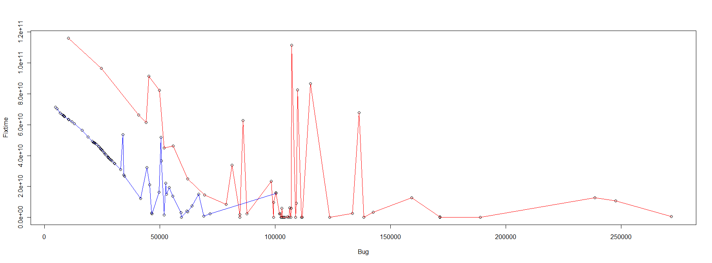
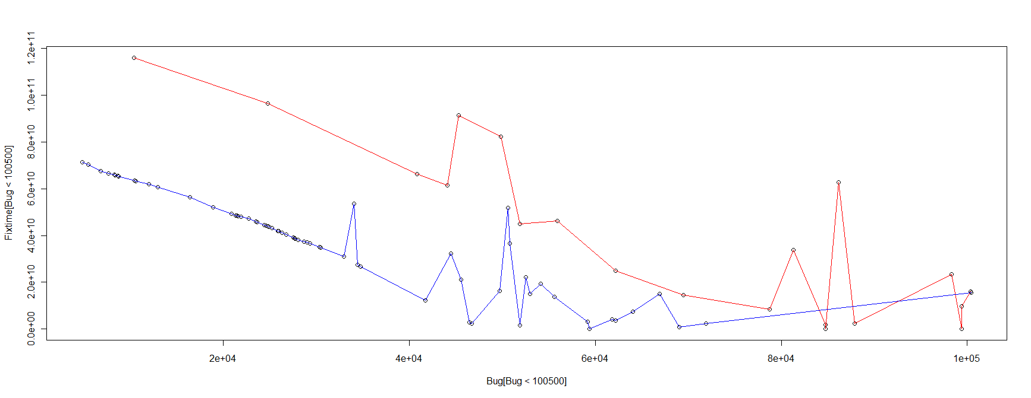
Results
Preliminary result: difference in time ➔ H0 rejected
After bug 100443 no more bugs fixed by non-heroes
So experiment restricted where fixes done by both
Final result:
With restriction, no difference ➔ H0 accepted

Slide 7
Implications
Long repository history fetch times
Solution
Analysis restricted on files currently in repository

Slide 8
Future Work
Threaded information retrieval
Direct invocation of R
Graphical interface

Slide 9
Summary
Identify heroes among developers
Time needed to fix bugs compared to non-heroes.
Usage of SVN & Bugzilla
Analysis through R
Response that there is no difference between those two

Slide 10
End
Thank you for your attention!
Questions?

