Slide 1
Apple Music Churn Prediction System
Predicting Customer Churn using Machine Learning Models
Presented by: Michael Duffy
Date: 5/1/2025

Slide 2
Problem Statement
Objective:
- Predict the likelihood of churn (cancellation) for Apple Music subscribers
- Provide actionable insights for marketing strategies, such as offering discounts or personalized recommendations to at-risk customers

Slide 3
Data Overview
Dataset Used:
- Apple Music Churn dataset, modified from the Telco Customer Churn dataset.
Key Features:
- Subscription Type
- Favorite Genre
- Monthly Subscription Cost
- Days Since Last Login
- Playlist Backup Enabled
- Device Sync Enabled
- Customer Demographics (Age, Subscription Age Group)

Slide 4
Machine Learning Models
Models Implemented:
- Logistic Regression
- Decision Tree Classifier
- Random Forest Classifier
Evaluation Metrics:
- Confusion Matrix
- Classification Report
- ROC Curve & AUC
- Precision-Recall Curve
- Learning Curves

Slide 5
Key Findings and Insights
Model Performance:
- Random Forest provided the best performance with an AUC of 0.85.
- Logistic Regression performed well, but slightly worse than Random Forest.
Key Features Affecting Churn:
- Subscription Type (e.g., Free Trial, Family Plan) significantly impacts churn.
- Days Since Last Login and Playlist Backup are also critical.
Actionable Insights:
- Send discount emails to users with high churn probabilities.
- Provide personalized music recommendations to keep users engaged.

Slide 6

Demonstration of System Functionality:

Slide 7
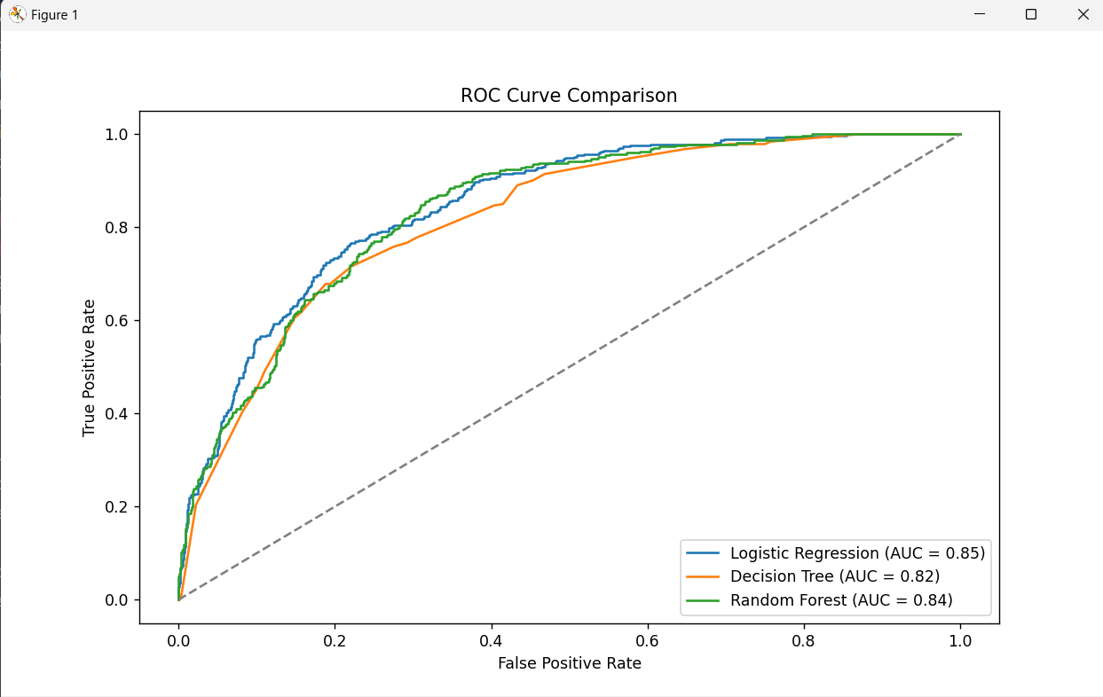
Visualizations

Slide 8
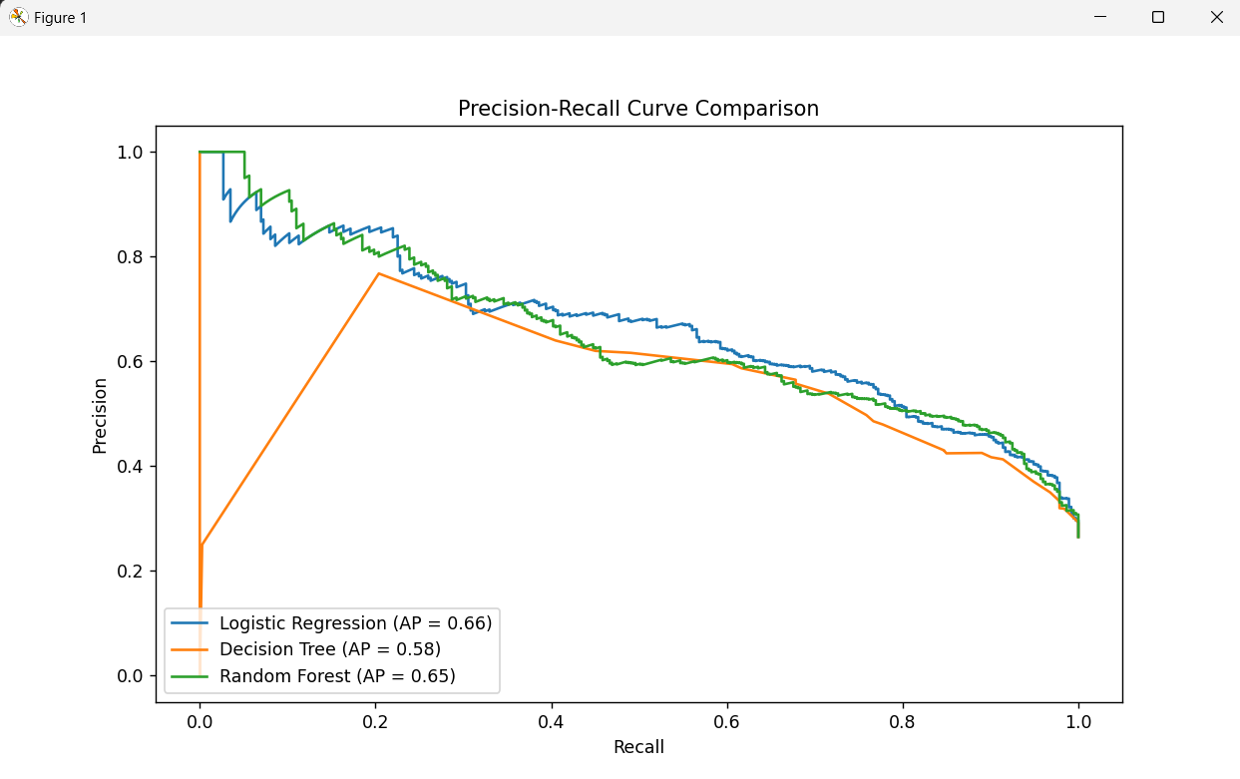

Slide 9
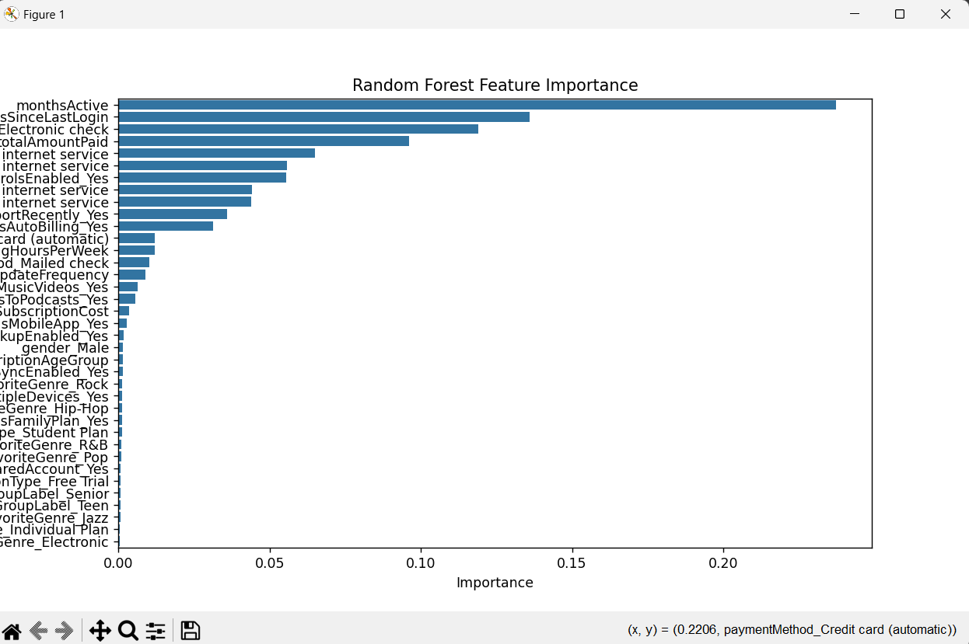

Slide 10
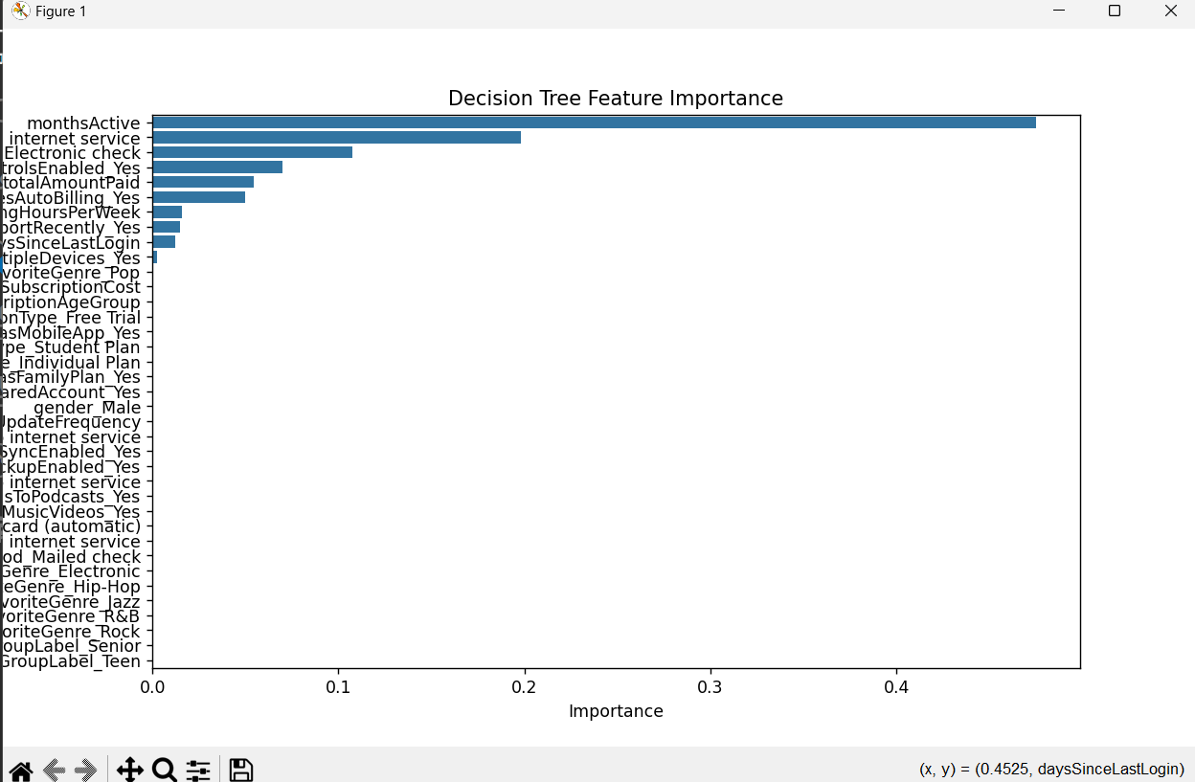

Slide 11
Conclusion
Summary:
- Churn prediction is an essential task for user retention in Apple Music.
- Machine learning models, especially Random Forest, can help predict churn and inform marketing strategies.
Next Steps:
- Implement model in a live environment for real-time churn predictions.
- Explore further features and improvements (e.g., deeper model tuning or additional data sources).

Slide 12

Questions and Discussion

