Slide 1
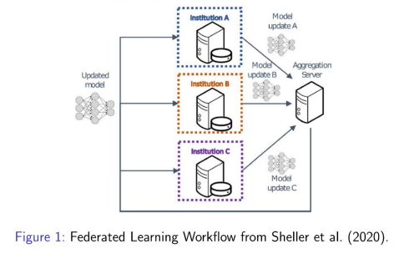
Goals
Simulation of power grid that allows for the training of ML model
Include the following parameters:
Three-month weather patterns in the local area and their impact on HVAC.
Quantity, wattage, use schedule, and variability of residential appliances.
Family parameters such as family size (1 – 6), composition, schedule, and activities (e.g.,telework, entertainment).
External events (e.g., anomalous weather
conditions →10-day forecast) that could
increase or decrease overall power needs.
Internal temperature settings on HVAC

Slide 2
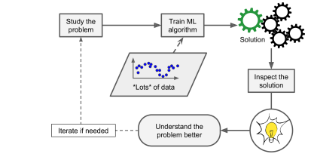
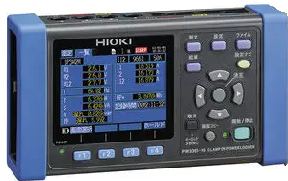
Next Steps
More data to accurately simulate model
Data must be localized to the area being simulated
Options
Data from on base (dorms or housing)
Data from students/faculty
Machine Learning Model from Géron (2019)

Slide 3
Works Cited
Géron, Aurelien. Hands-on Machine Learning with Scikit-Learn, Keras, and Tensorflow: Concepts, Tools and Techniques to Build Intelligent Systems. O'Reilly, 2019.
Sheller, M. J., Edwards, B., Reina, G. A., Martin, J., Pati, S., Kotrotsou, A., Milchenko, M., Xu, W., Marcus, D., Colen, R. R., et al. (2020). Federated learning in medicine: facilitating multi-institutional collaborations without sharing patient data. Scientific reports,10(1):1–12.

