Slide 1
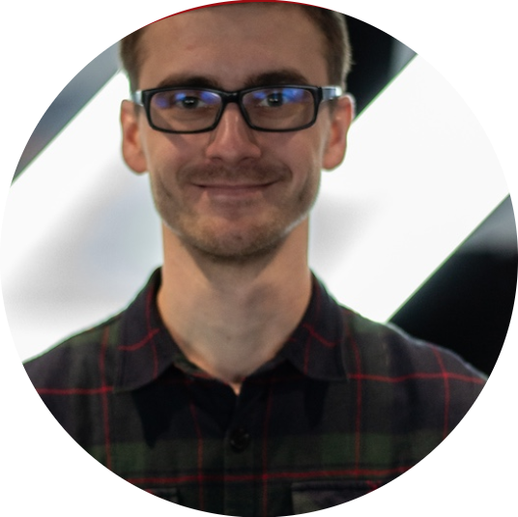
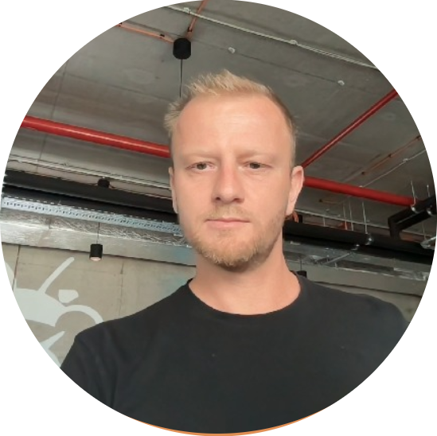
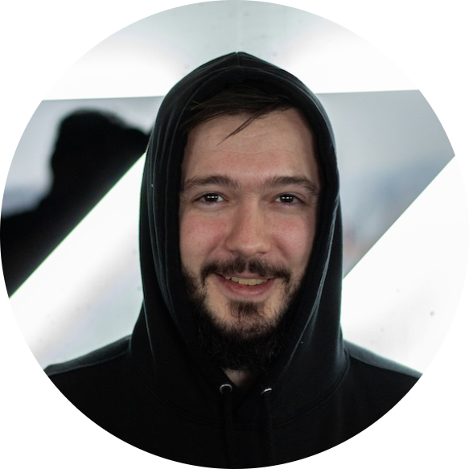

LazyEdu
Martin
Olda
Petr
Adi

Slide 2

Bad VIBES

Slide 3
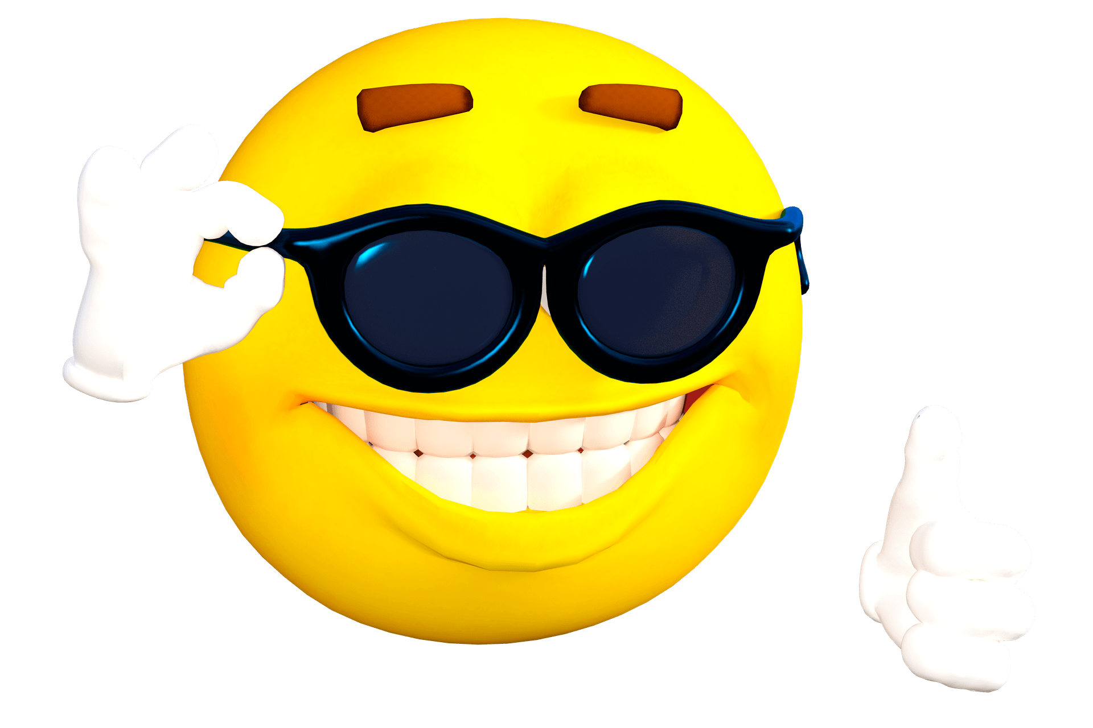
Good VIBES

Slide 4

Are you ready?

Slide 5
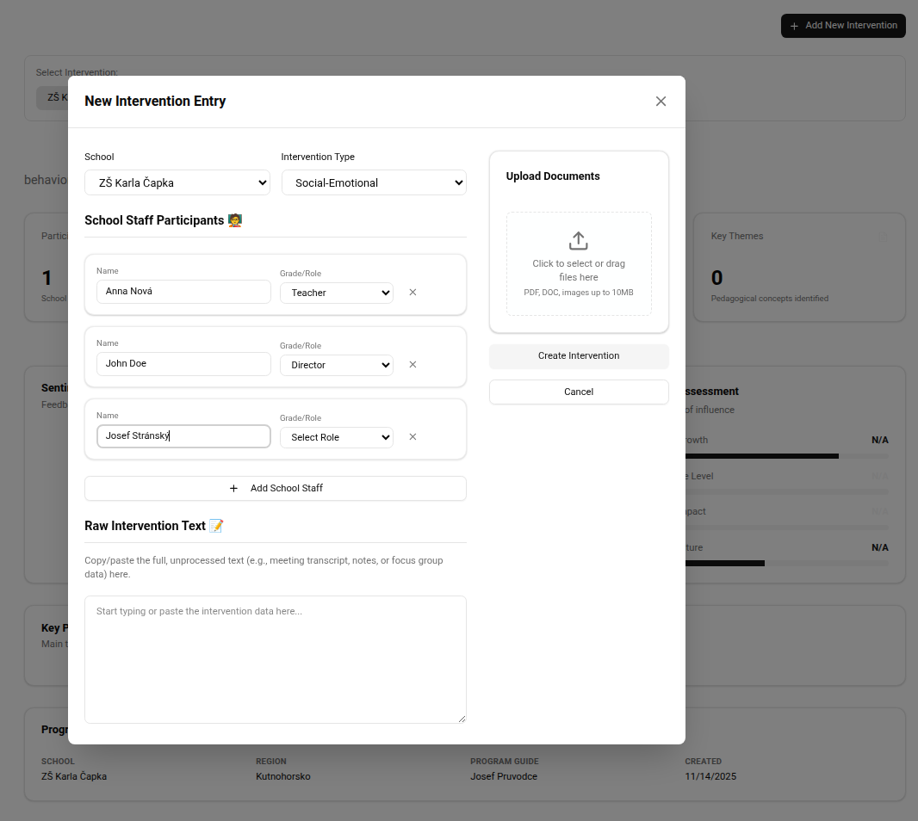
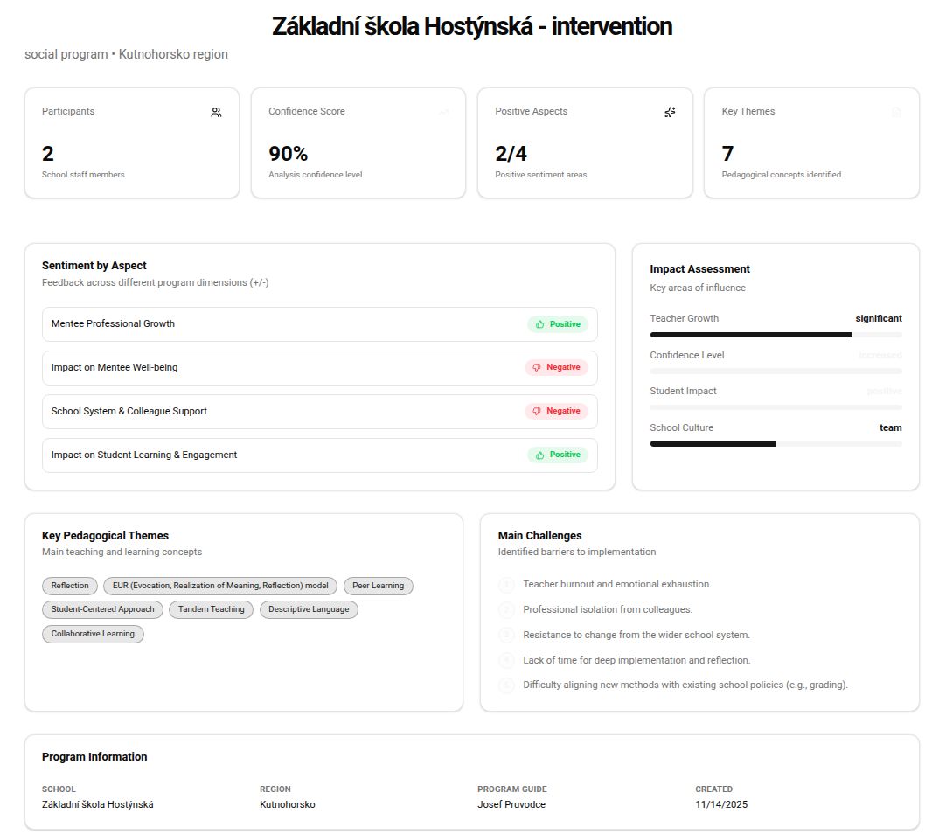
Vibe Checker for Teachers & Students

Slide 6

Thank you!!

