Slide 1



DigiEduHack 2025
It worked yesterday
Bešťák, Vojtěch - ML/AI
Dridzoň, Daniel - Backend + Frontend
Novotný, Vojtěch - Frontend

Slide 2

The problem
To create a infrastructure for handling unstructured data coming from different regions.
Challenges:
a lot of very diverse and unstructured data
cannot manually define the data structure
human error
scaleability

Slide 3

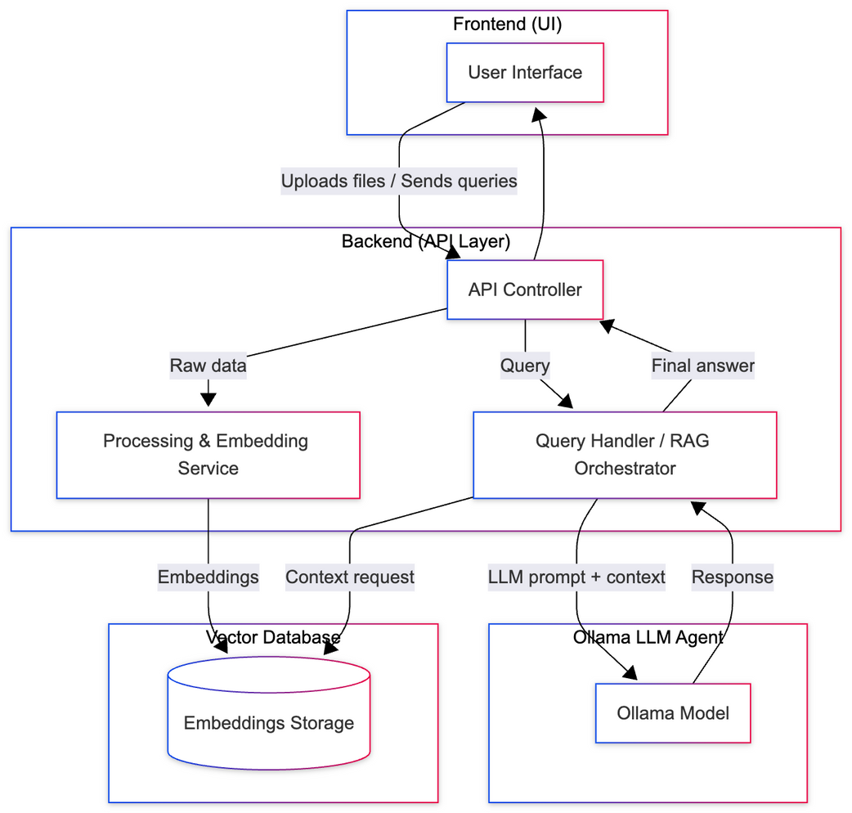

Slide 4
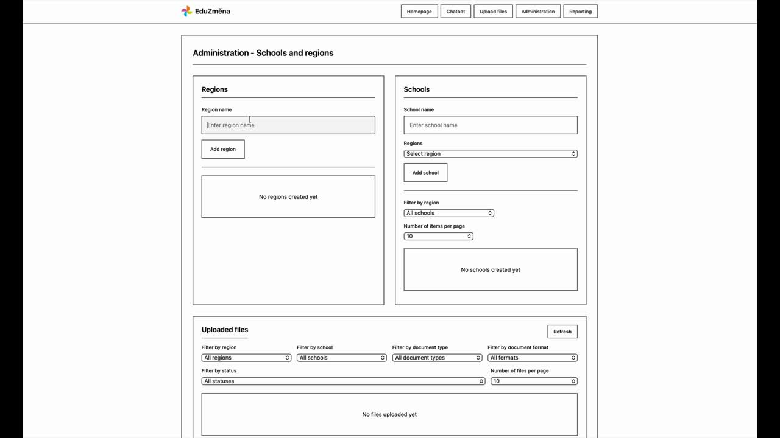

Slide 5

What’s more
speech2text
Converts uploaded audio files into text transcripts so the system can index, analyze, and use them in downstream processes.
Dashboards
Automatically transforms unstructured inputs into structured datasets and visualizes key insights through charts and summaries.
RAG pipeline
Uses locally stored unstructured documents as grounding context for the LLM agent, retrieving relevant information through embeddings and vector search.

Slide 6



What’s next
Deployment
Authentication
Improve LLM
Infra + Costs
Protect private sections
Tune the used models

Slide 7

Thank You
It Worked Yesterday

