Slide 1
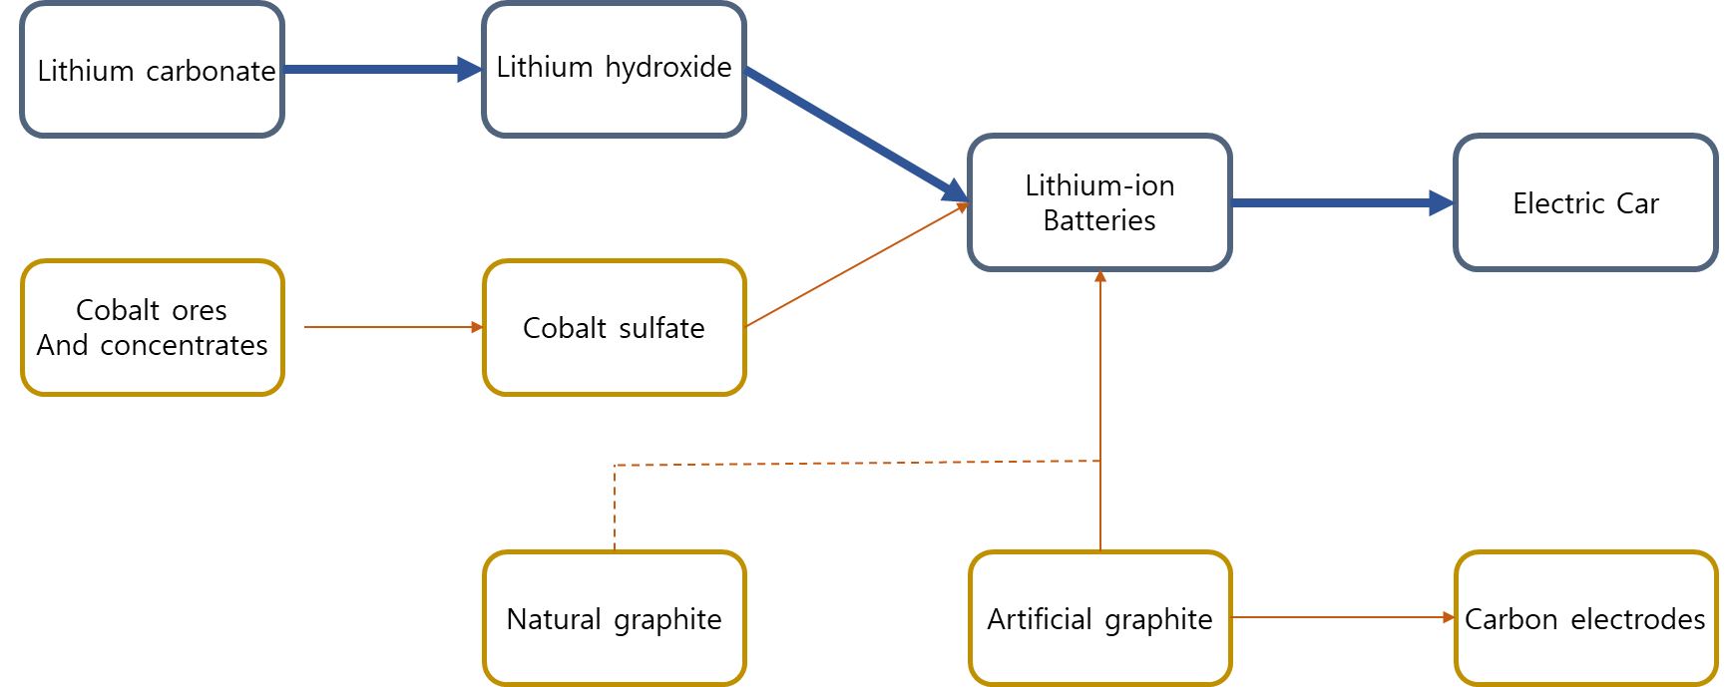
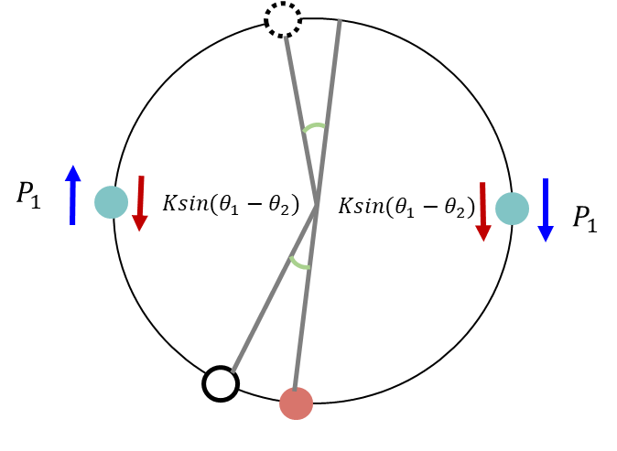
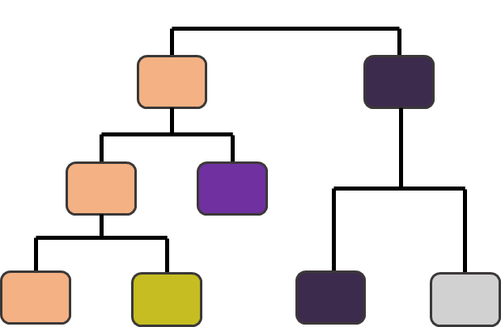
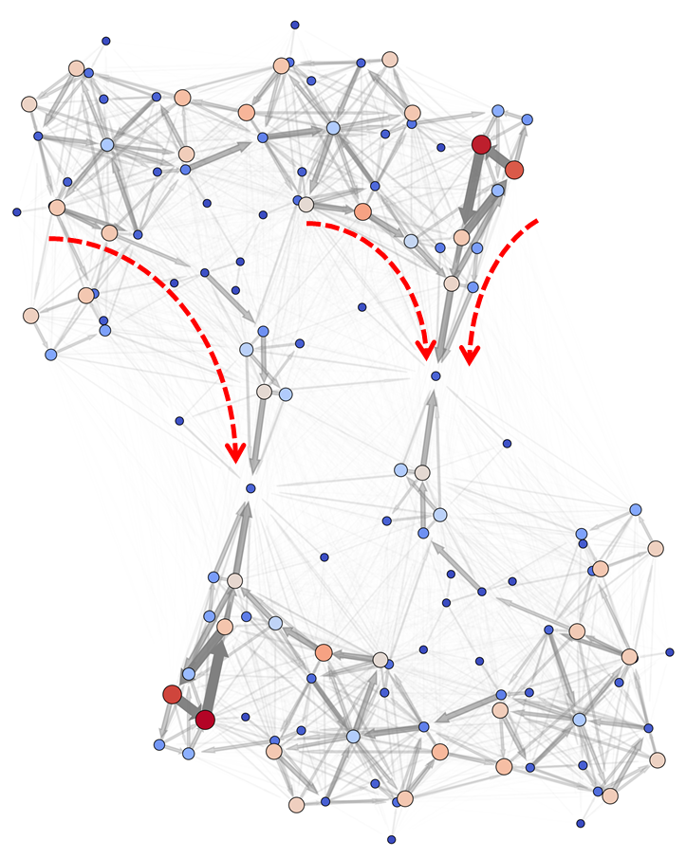
Supply chain analysis
Synchronization
Community structure
Biological network
Notes:
In my Ph.D course, I have focus on various topics of network science. Network is a specific form of data structure, which consist of nodes and edges betwwen them. Many studies have done in this area through the generalization from real network, and application of general network theory to real network.

Slide 2
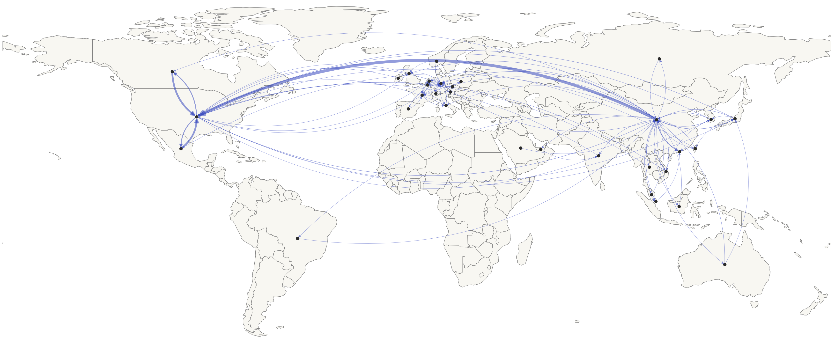
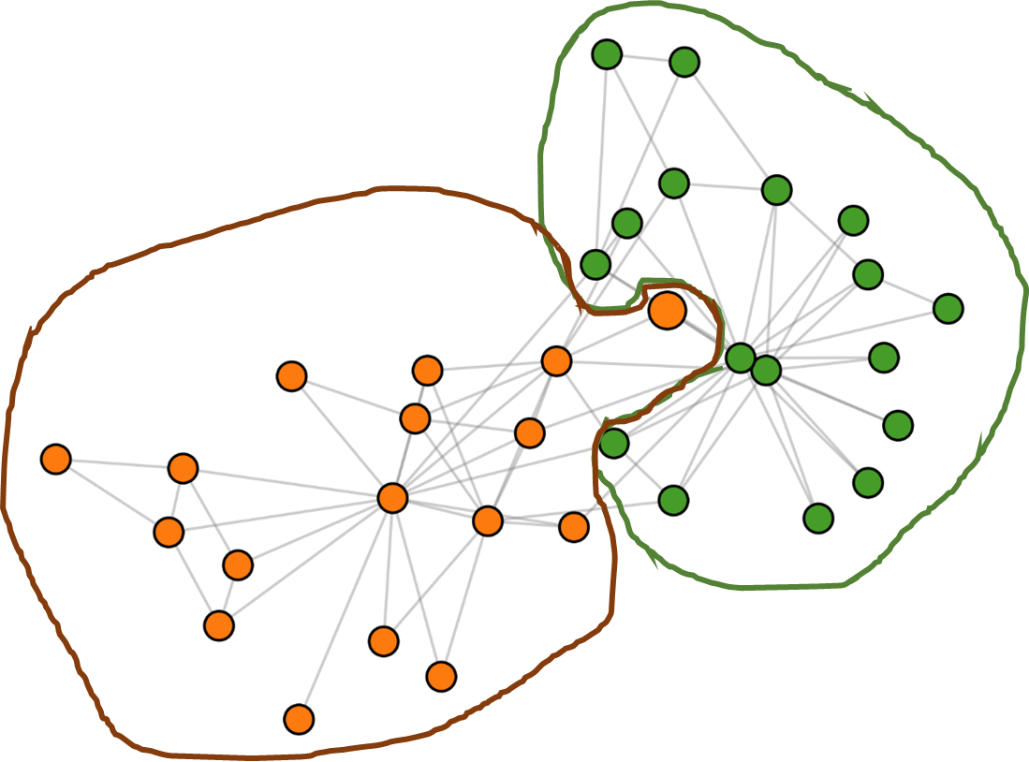
International trade network
Supply chain analysis
Synchronization
Community structure
Biological network
Notes:
In my Ph.D course, I have focus on various topics of network science. Network is a specific form of data structure, which consist of nodes and edges betwwen them. Many studies have done in this area through the generalization from real network, and application of general network theory to real network.

