Slide 1



Optimal Link addition in Kuramoto Model for Enhanced synchronization
Daekyung Lee, Jong-Min Park, Heetae Kim*
Notes:
안녕하세요. 저는 성균관대학교 통계물리연구실의 이대경입니다. 오늘 저는 네트워크의 커뮤니티 구조에 대해 다른 시각으로 접근한 연구를 발표하려고 합니다.

Slide 2
Link addition in oscillatory system
Introduction
Link addition
Topology
Better synchronization
Phase
Adding new links to the oscillator network generally promotes synchronization.
The degree of synchronization increases or decreases depending on the location of the new link.
How to locate new links on the target network to maximize synchronization?
Notes:
화살표를 호 화살표로 교체

Slide 3
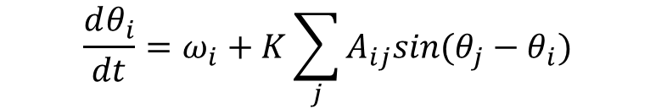
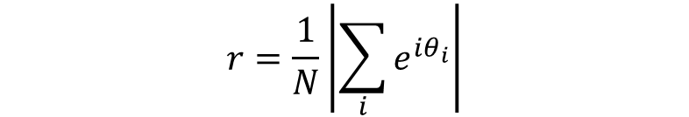

First-order Kuramoto model
Introduction
Order parameter
Angular velocity
Coupling constant
$$\frac{dθ_{i}}{dt}=ω_{i}+K\sum_{j}{A_{ij}sin⁡(θ_{j}−θ_{i}) }$$
$$r=0.85$$
Natural frequency
$$r=\frac{1}{N}\left|\sum_{i}{e^{iθ_{i}}}\right|$$
Interaction
Number of nodes
First-order Kuramoto model: The simplest model to describe the motion of an inertial oscillator.
Order parameter: Index measuring the degree of synchronization of the system (0~1)

Slide 4




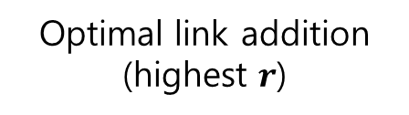

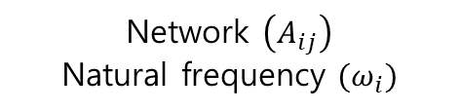


Stready state of the Kuramoto model
Method
$$0.3$$
$$0.7$$
$$0.3$$
$$0.7$$
Link addition
$$r=0.85$$
$$r=0.92$$
$$0.1$$
$$0.5$$
$$0.1$$
$$0.5$$
Network $\left(A_{ij}\right)$
Natural frequency $(ω_{i})$
Algorithm
or
Strategy
Optimal link addition
(highest $r$)
Goal: find optimal link additions using the network structure and natural frequencies
Metric: final order parameter $(r)$

Slide 5

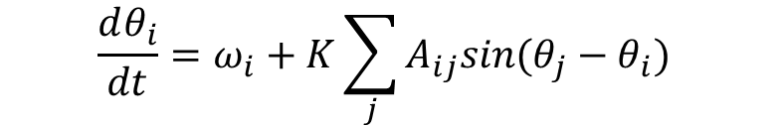


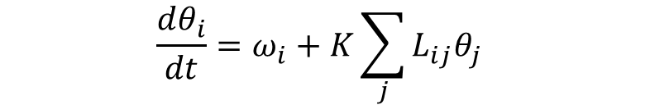
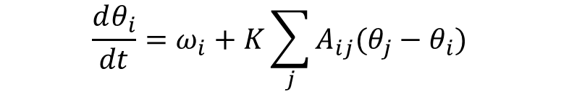
Stready state of the Kuramoto model
Method
$$\frac{dθ_{i}}{dt}=ω_{i}+K\sum_{j}{A_{ij}sin⁡(θ_{j}−θ_{i}) }$$
Strong coupling regime
$$\sin\left(θ\right)≈θ$$
$$\frac{dθ_{i}}{dt}=ω_{i}+K\sum_{j}{A_{ij}(θ_{j}−θ_{i}) }$$
Laplace matrix
$$L_{ij}=δ_{ij}k_{i}−A_{ij}$$
$k_{i}$ =i’s degree
$$\frac{dθ_{i}}{dt}=ω_{i}+K\sum_{j}{L_{ij}θ_{j} }$$
SAF method¹⁾: Find a function that corresponds to the network input and the order parameter of the system.
When the interaction is sufficiently strong, the Kuramoto model can be linearized and expressed in matrix form.
1) Lei et al. (2023), Chaos, Solitons & Fractals, 168.

Slide 6
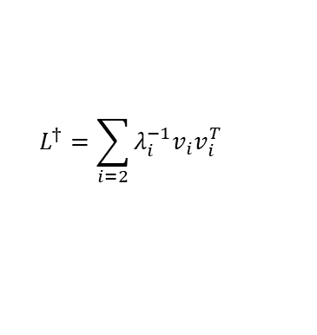



Stready state of the Kuramoto model
Method
Steady state $\left(\frac{dθ_{i}}{dt}=0\right)$
$$\frac{dθ_{i}}{dt}=ω_{i}+K\sum_{j}{A_{ij}sin⁡(θ_{j}−θ_{i}) }$$
$$0=ω+KLθ$$
Strong coupling regime
Moore-Penrose inverse
$$\sin\left(θ\right)≈θ$$
$$L^{†}=\sum_{i=2}{λ_{i}^{−1}v_{i}v_{i}^{T}}$$
$$\frac{dθ_{i}}{dt}=ω_{i}+K\sum_{j}{A_{ij}(θ_{j}−θ_{i}) }$$
Laplace matrix
$$θ^{∗}=\frac{1}{K}L^{†}ω$$
$$L_{ij}=δ_{ij}k_{i}−A_{ij}$$
$k_{i}$ =i’s degree
$$\frac{dθ_{i}}{dt}=ω_{i}+K\sum_{j}{L_{ij}θ_{j} }$$
Frequency vector (input)
Phase vector (output)
Network structure (input)
SAF method¹⁾: Find a function that corresponds to the network input and the order parameter of the system.
When the interaction is sufficiently strong, the Kuramoto model can be linearized and expressed in matrix form.
The phase vector of the system can be obtained from the input.
1) Lei et al. (2023), Chaos, Solitons & Fractals, 168.

Slide 7
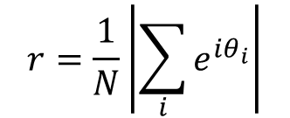

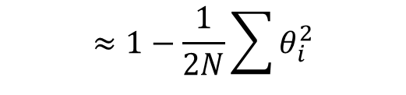
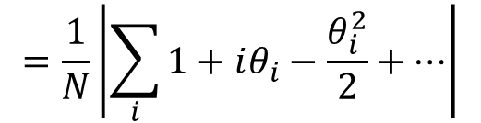
Synchrony Alignment Function (SAF)
Method
$$r=\frac{1}{N}\left|\sum_{i}{e^{iθ_{i}}}\right|$$
$$=\frac{1}{N}\left|\sum_{i}{1+iθ_{i}−\frac{θ_{i}^{2}}{2}+…}\right|$$
$$≈1−\frac{1}{2N}\sum{θ_{i}^{2}}$$
$$=1−\frac{1}{2N}θ^{T}θ$$
The order parameter of the system can also be approximated by a determinant in the strong coupling regime.

Slide 8

Synchrony Alignment Function (SAF)
Method
$$r=\frac{1}{N}\left|\sum_{i}{e^{iθ_{i}}}\right|$$
$$r=1−\frac{1}{2NK^{2}}ω{\left(L^{†}\right)}^{2}ω$$
$$=\frac{1}{N}\left|\sum_{i}{1+iθ_{i}−\frac{θ_{i}^{2}}{2}+…}\right|$$
Order parameter
(output)
Network structure (input)
$$≈1−\frac{1}{2N}\sum{θ_{i}^{2}}$$
Frequency vector (input)
$$θ^{∗}=\frac{1}{K}L^{†}ω$$
$$=1−\frac{1}{2N}θ^{T}θ$$
The order parameter of the system can also be approximated by a determinant in the strong coupling regime.
Summary by substituting steady state →Approximate expression for order parameter in steady state

Slide 9


Synchrony Alignment Function (SAF)
Method
$$r=\frac{1}{N}\left|\sum_{i}{e^{iθ_{i}}}\right|$$
$$r=1−\frac{1}{2NK^{2}}ω{\left(L^{†}\right)}^{2}ω$$
$$=\frac{1}{N}\left|\sum_{i}{1+iθ_{i}−\frac{θ_{i}^{2}}{2}+…}\right|$$
$$≈1−\frac{1}{2N}\sum{θ_{i}^{2}}$$
$$argmax\left(r\right)$$
$$=1−\frac{1}{2N}θ^{T}θ$$
$$=argmin\left(ω{\left(L^{†}\right)}^{2}ω\right)$$
The order parameter of the system can also be approximated by a determinant in the strong coupling regime.
Summary by substituting steady state →Approximate expression for order parameter in steady state
Link to maximizing the order parameter of the system = Problem of finding the minimum point of the SAF object function

Slide 10
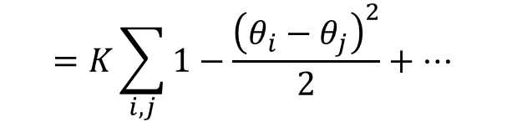
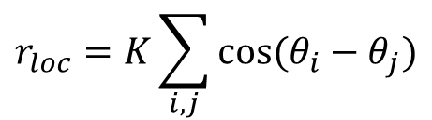
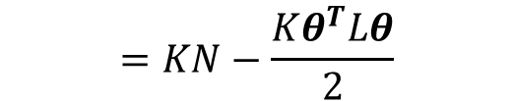
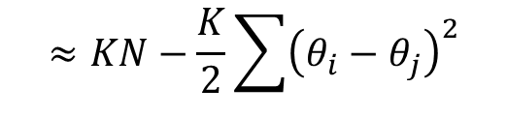
Adjusted Lyapnov Function (ALF)
Method
$$r_{loc}=K\sum_{i,j}{cos⁡(θ_{i}−θ_{j})}$$
$$=K\sum_{i,j}{1−\frac{{\left(θ_{i}−θ_{j}\right)}^{2}}{2}+… }$$
$$≈KN−\frac{K}{2}\sum{{\left(θ_{i}−θ_{j}\right)}^{2}}$$
$$=KN−\frac{Kθ^{T}Lθ}{2}$$
ALF function²⁾ : Similar to SAF, but uses local order parameter (total interaction energy)
Similar to SAF, but an object function whose order of Laplace matrix is 1
2) Skardal et al. (2014), Phys. Rev. Lett., 113(14), 144101.

Slide 11

Adjusted Lyapnov Function (ALF)
Method
$$r_{loc}=K\sum_{i,j}{cos⁡(θ_{i}−θ_{j})}$$
$$r_{loc}=KN−\frac{1}{2K}ωL^{†}ω$$
$$=K\sum_{i,j}{1−\frac{{\left(θ_{i}−θ_{j}\right)}^{2}}{2}+… }$$
Local Order parameter
(output)
Network structure (input)
$$≈KN−\frac{K}{2}\sum{{\left(θ_{i}−θ_{j}\right)}^{2}}$$
Frequency vector (input)
$$θ^{∗}=\frac{1}{K}L^{†}ω$$
$$=KN−\frac{Kθ^{T}Lθ}{2}$$
ALF function²⁾ : Similar to SAF, but uses local order parameter (total interaction energy)
Similar to SAF, but an object function whose order of Laplace matrix is 1
2) Skardal et al. (2014), Phys. Rev. Lett., 113(14), 144101.

Slide 12


Adjusted Lyapnov Function (ALF)
Method
$$r_{loc}=K\sum_{i,j}{cos⁡(θ_{i}−θ_{j})}$$
$$r_{loc}=KN−\frac{1}{2K}ωL^{†}ω$$
$$=K\sum_{i,j}{1−\frac{{\left(θ_{i}−θ_{j}\right)}^{2}}{2}+… }$$
$$≈KN−\frac{K}{2}\sum{{\left(θ_{i}−θ_{j}\right)}^{2}}$$
$$argmax\left(r_{loc}\right)$$
$$=argmin\left(ωL^{†}ω\right)$$
$$=KN−\frac{Kθ^{T}Lθ}{2}$$
ALF function²⁾ : Similar to SAF, but uses local order parameter (total interaction energy)
Similar to SAF, but an object function whose order of Laplace matrix is 1
2) Skardal et al. (2014), Phys. Rev. Lett., 113(14), 144101.

Slide 13






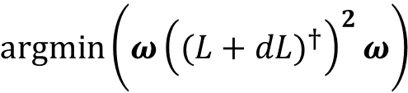



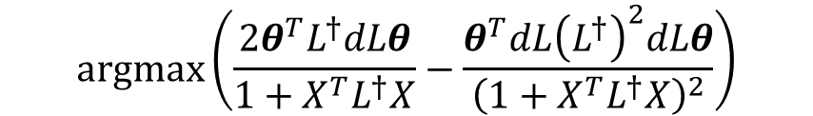

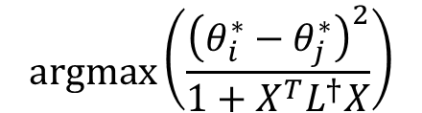

Prediction of synchrony enhancement
Method
$$argmin\left(ω{\left({(L+dL)}^{†}\right)}^{2}ω\right)$$
$$argmax\left(\frac{2θ^{T}L^{†}dLθ}{1+X^{T}L^{†}X}−\frac{θ^{T}dL{\left(L^{†}\right)}^{2}dLθ}{{\left(1+X^{T}L^{†}X\right)}^{2}}\right)$$
$$argmin\left(ω{\left(L^{†}\right)}^{2}ω\right)$$
SAF
$$dL$$
$$argmax\left(\frac{{\left(θ_{i}^{∗}−θ_{j}^{∗}\right)}^{2}}{1+X^{T}L^{†}X}\right)$$
$$argmin\left(ωL^{†}ω\right)$$
$$argmin\left(ω{(L+dL)}^{†}ω\right)$$
ALF
$$dL$$
$$i,j$$
$${{\left(L+dL\right)}^{†}=\left(L+X^{T}X\right)}^{†}=\left(L^{+}−\frac{L^{+}XX^{T}L^{+}}{\left(1+X^{T}L^{+}X\right)}\right)$$
As links are added to the network, the Laplace matrix changes. (dL)
The problem of finding a dL matrix that optimizes two types of object functions
The matrix sum is organized using the formula for Moore-Penrose inverse.
$$X_{k}=δ_{ik}−δ_{jk}$$
$$dL=X^{T}X$$
$$Ex) i=2,j=4$$
$$X=\left(\begin{matrix}0 & 1 & \begin{matrix}0 & −1 & 0\end{matrix}\end{matrix}\right)$$
13

Slide 14

Prediction of synchrony enhancement
Method
$$argmin\left(ω{\left({(L+dL)}^{†}\right)}^{2}ω\right)$$
$$argmax\left(\frac{2θ^{T}L^{†}dLθ}{1+X^{T}L^{†}X}−\frac{θ^{T}dL{\left(L^{†}\right)}^{2}dLθ}{{\left(1+X^{T}L^{†}X\right)}^{2}}\right)$$
$$argmin\left(ω{\left(L^{†}\right)}^{2}ω\right)$$
SAF
$$dL$$
distant nodes in phase space
$$argmax\left(\frac{{\left(θ_{i}^{∗}−θ_{j}^{∗}\right)}^{2}}{1+X^{T}L^{†}X}\right)$$
$$argmin\left(ωL^{†}ω\right)$$
$$argmin\left(ω{(L+dL)}^{†}ω\right)$$
ALF
$$dL$$
$$i,j$$
$${{\left(L+dL\right)}^{†}=\left(L+X^{T}X\right)}^{†}=\left(L^{+}−\frac{L^{+}XX^{T}L^{+}}{\left(1+X^{T}L^{+}X\right)}\right)$$
ALF's object function can be interpreted in a more intuitive sense.
Numerator: Connect nodes where the phase difference between steady states is as large as possible.
$$X_{k}=δ_{ik}−δ_{jk}$$
$$dL=X^{T}X$$
$$Ex) i=2,j=4$$
$$X=\left(\begin{matrix}0 & 1 & \begin{matrix}0 & −1 & 0\end{matrix}\end{matrix}\right)$$

Slide 15
Prediction of synchrony enhancement
Method
$$argmin\left(ω{\left({(L+dL)}^{†}\right)}^{2}ω\right)$$
$$argmax\left(\frac{2θ^{T}L^{†}dLθ}{1+X^{T}L^{†}X}−\frac{θ^{T}dL{\left(L^{†}\right)}^{2}dLθ}{{\left(1+X^{T}L^{†}X\right)}^{2}}\right)$$
$$argmin\left(ω{\left(L^{†}\right)}^{2}ω\right)$$
SAF
$$dL$$
$$argmax\left(\frac{{\left(θ_{i}^{∗}−θ_{j}^{∗}\right)}^{2}}{1+X^{T}L^{†}X}\right)$$
$$argmin\left(ωL^{†}ω\right)$$
$$argmin\left(ω{(L+dL)}^{†}ω\right)$$
ALF
$$dL$$
$$i,j$$
close nodes in network structure
$${{\left(L+dL\right)}^{†}=\left(L+X^{T}X\right)}^{†}=\left(L^{+}−\frac{L^{+}XX^{T}L^{+}}{\left(1+X^{T}L^{+}X\right)}\right)$$
ALF's object function can be interpreted in a more intuitive sense.
Numerator: Connect nodes where the phase difference between steady states is as large as possible.
Denominator: Connect nodes that are as close together as possible in the network structure.
$$X_{k}=δ_{ik}−δ_{jk}$$
$$dL=X^{T}X$$
$$Ex) i=2,j=4$$
$$X=\left(\begin{matrix}0 & 1 & \begin{matrix}0 & −1 & 0\end{matrix}\end{matrix}\right)$$

Slide 16
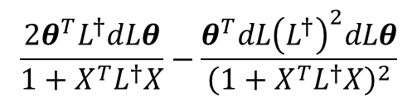


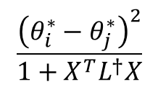
Prediction of synchrony enhancement
Method
$$\frac{2θ^{T}L^{†}dLθ}{1+X^{T}L^{†}X}−\frac{θ^{T}dL{\left(L^{†}\right)}^{2}dLθ}{{\left(1+X^{T}L^{†}X\right)}^{2}}$$
SAF
= Node pair that maximizes the order parameter
PDM
$${\left(θ_{i}^{∗}−θ_{j}^{∗}\right)}^{2}$$
= Node pair with the largest phase difference
DNC
$$X^{T}L^{†}X$$
= Node pair with the greatest structural distance
$$\frac{{\left(θ_{i}^{∗}−θ_{j}^{∗}\right)}^{2}}{1+X^{T}L^{†}X}$$
= Node pairs that maximize the local order parameter
= Pair with large phase difference but close distance
ALF
Separate the two terms to create a separate link addition strategy
Four strategies for adding links based on different aspects of your network

Slide 17
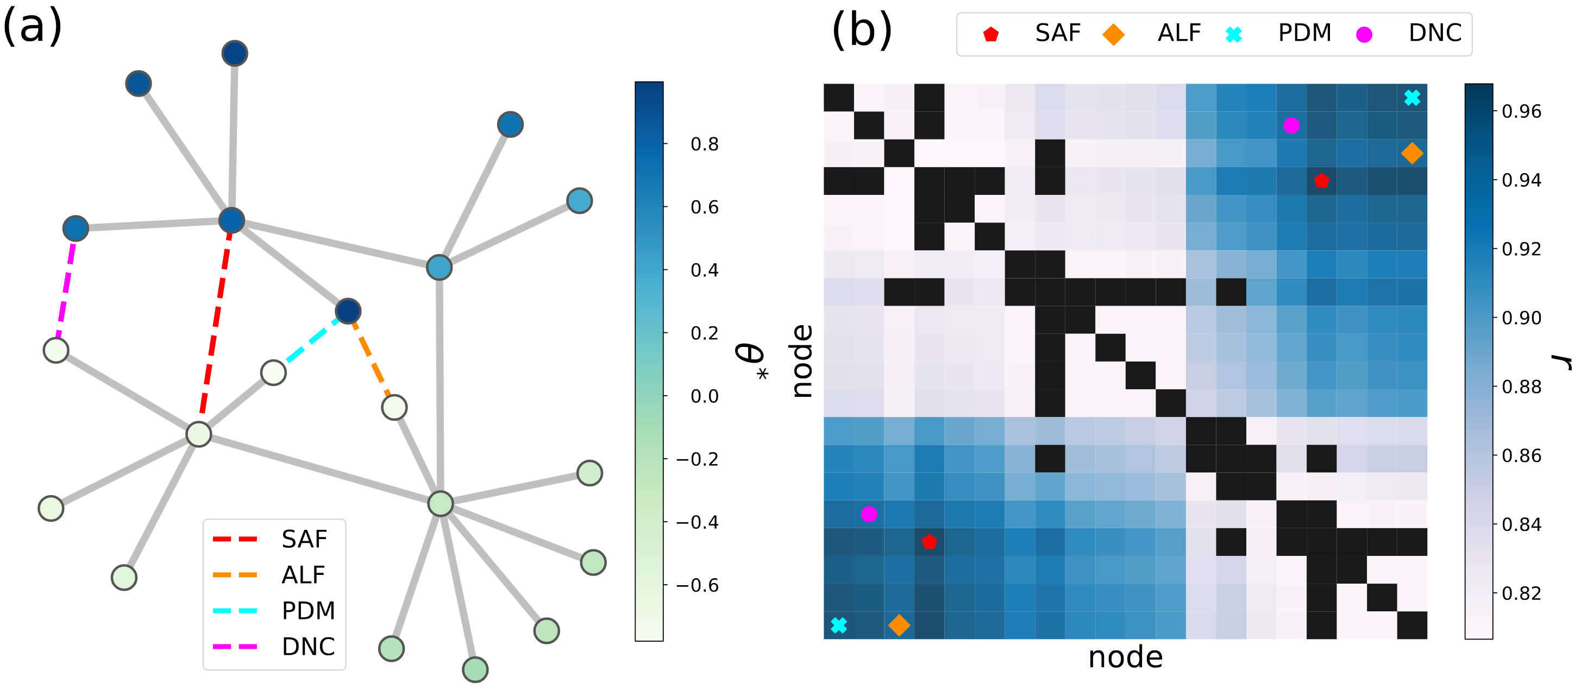
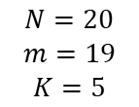
Prediction of synchrony enhancement
Result
$$N=20$$
$$m=19$$
$$K=5$$
Analysis of connection trends of each method in model network
DNC connects the farthest location
PDM connects the location with the largest phase difference
ALF connects the location with the largest phase difference but closer.
SAF, which directly maximizes the order parameter, shows the best performance.

Slide 18
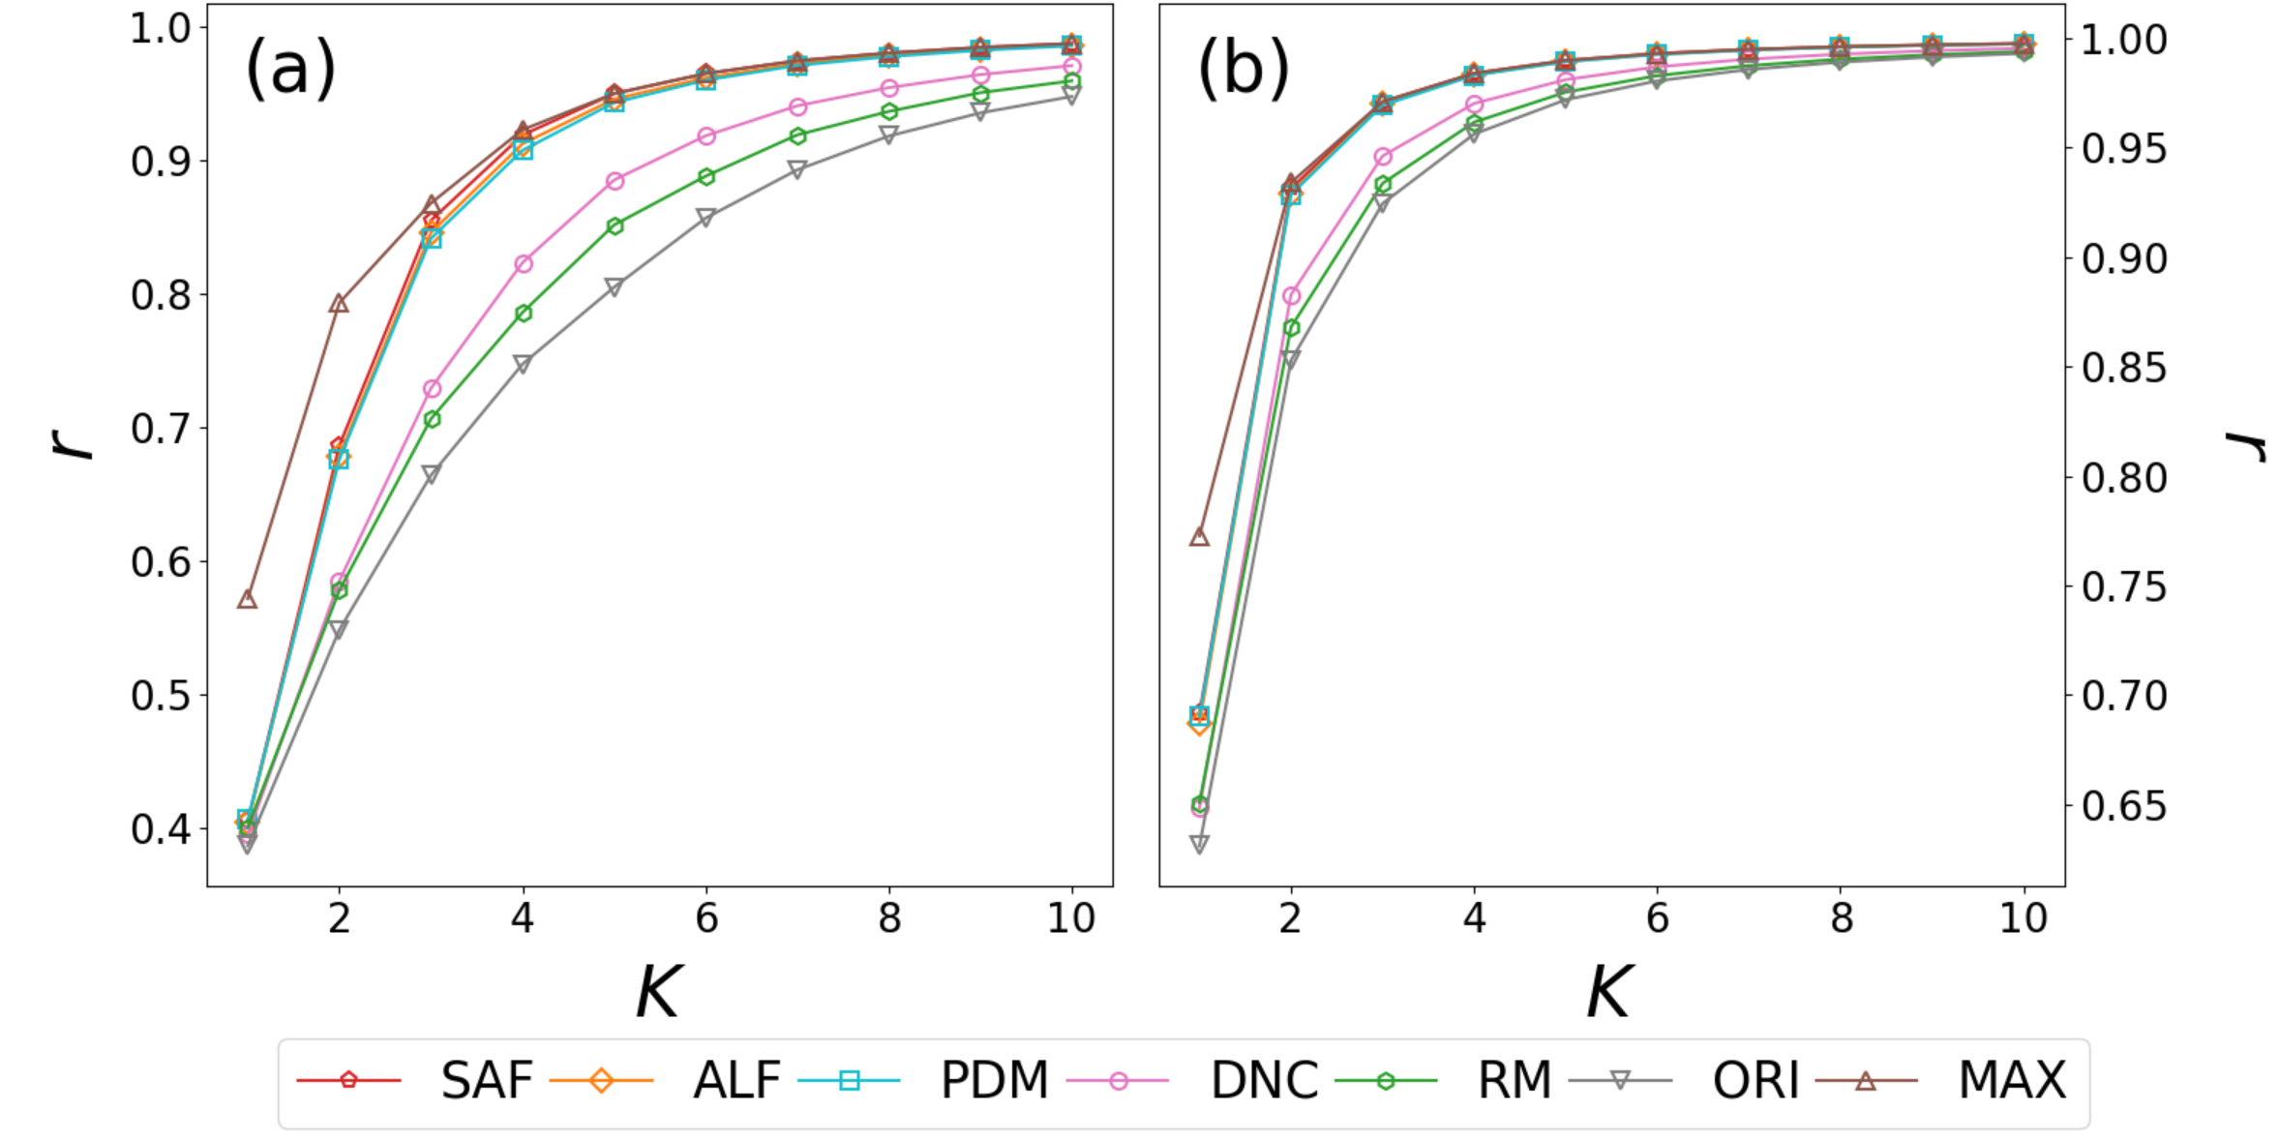


Prediction of synchrony enhancement
Result
$$N=30$$
$$m=29$$
$$N=30$$
$$m=45$$
Tree-like network
ER network
Performance comparison of four methods under various K and network structures
RM: random connection, ORI: original network, MAX: performance of optimal link obtained by brute force.
SAF is the best in all intervals, and is close to the correct answer when K is large.

Slide 19
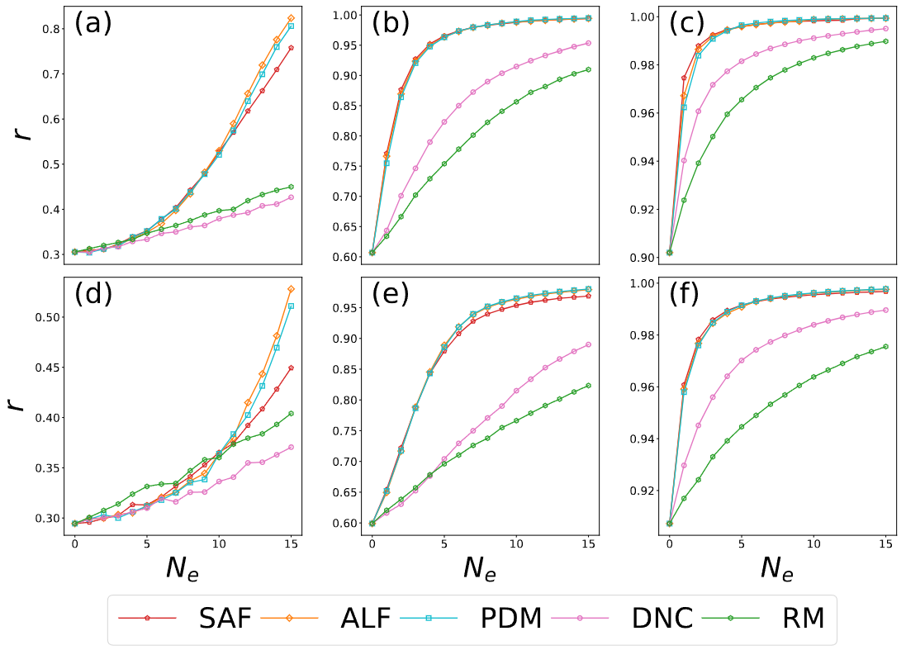





Prediction of synchrony enhancement
Result
$$r_{0}≈0.3$$
$$r_{0}≈0.6$$
$$r_{0}≈0.9$$
Tree-like network
$$N=30$$
$$m=29$$
ER network
$$N=30$$
$$m=45$$
Observing the trends with more links
SAF is still the best in most sections.
When K is low or the number of added links increases, ALF and PDM show better performance.

Slide 20

Energy-based approach to the power grid stability
Conclusion
Summary
Searching for links that most improve synchronization in oscillator networks
Using strategies that maximize different objective functions
SAF, which optimizes the order parameter, performs best
Reflecting both the topology and structural information of the network
Future work
What is the optimal strategy when two or more links are added?
Applied to optimization problems such as power grid systems

