Slide 1
FE630 Portfolio Theory & Applications Final Project
Yuwen Jin, Minghao Kang, Shiraz Bheda
December 22, 2020

Slide 2
Objective
Using a French Fama 3-factor model, build an investment strategy that maximizes portfolio return subject to a constraint of target beta and weekly portfolio rebalancing from March 2007 – November 2020.
In addition, evaluate portfolio sensitivity to variations in both target beta as well as length of estimators for expected returns and covariance matrix under different market scenarios.

Slide 3
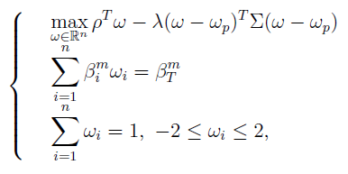
Assumptions
Investment Universe & Analysis Setup
Objective Function & Constraints
Investment Universe is composed of 12 ETFs (FXE, EWJ, GLD, QQQ, SPY, SHV, DBA, USO, XBI, ILF, EPP, FEZ)
Market returns are represented by SPY ETF
Analysis broken up into 3 market scenarios:
Pre-crisis (March 1, 2007 – March 31, 2008)
Crisis (April 1, 2008 –Sept 30, 2008)
Post-crisis (October 1, 2008 – June 30, 2020)
Target Beta
Expected Returns & Covariance
Empirical calculation of individual asset betas for all 3 market scenarios yielded a range from 0 to 1.5
Sequence used for testing target beta sensitivity: [0, 0.5, 1, 1.5]
Lack of assets with significant inverse correlations; individual betas mostly stable through all 3 market scenarios (slight exception: GLD turned negative during crisis, possibly due to investor fears at the time)
Term-structure of estimators is divided into three cases:
Short-term (<=40 days)
Long-term (>=120 days)
Medium-term

Slide 4
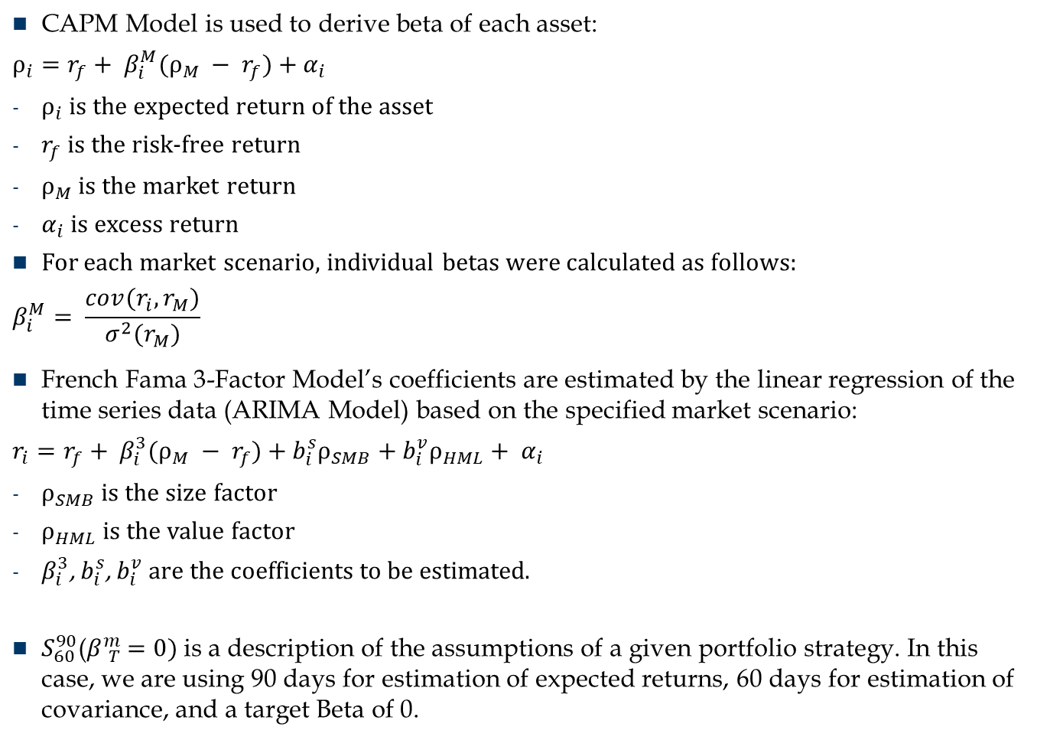
Notations
CAPM Model is used to derive beta of each asset:
$ρ_{i}=r_{f}+ β_{i}^{M}(ρ_{M} − r_{f}$) + $α_{i}$
$ρ_{i}$ is the expected return of the asset
$r_{f}$ is the risk-free return
$ρ_{M}$ is the market return
$α_{i}$ is excess return
For each market scenario, individual betas were calculated as follows:
$$β_{i}^{M}= \frac{cov(r_{i},r_{M})}{σ^{2}(r_{M})}$$
French Fama 3-Factor Model’s coefficients are estimated by the linear regression of the time series data (ARIMA Model) based on the specified market scenario:
$r_{i}=r_{f}+ β_{i}^{3}(ρ_{M} − r_{f}$) + $b_{i}^{s}ρ_{SMB}+{b_{i}^{v}ρ_{HML}+ α}_{i}$
$ρ_{SMB}$ is the size factor
$ρ_{HML}$ is the value factor
$β_{i}^{3}$, $b_{i}^{s}$, $b_{i}^{v}$ are the coefficients to be estimated.
$S_{60}^{90}$($β{}_{T}^{m}{ =0)}$is a description of the assumptions of a given portfolio strategy. In this case, we are using 90 days for estimation of expected returns, 60 days for estimation of covariance, and a target Beta of 0.

Slide 5
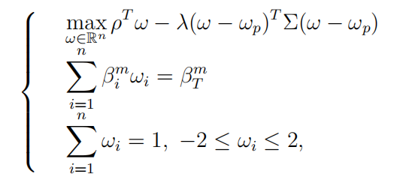

Workflow
Write a function to realize the optimization problem
Apply FF model to calculate covariance matrix with input of its look back period and the end date
With the FF model:
Write a trend estimator to predict expected returns.
Every time pass in the value: back period, end date, ticker symbol and variance, of a single ETF. Then the estimator will provide the expected return of the ETF in the coming week.
Beginning on the first day of the target period, update the strategy every week
Record daily returns of the portfolio during the target period, plot its cumulative return versus the that of SPY
Trend Estimator:
When building or updating the portfoli strategy, for each ETF, first run linear regression on specific look back period to find the 3 coefficients.
Then fit ARIMA model on all the 3 factors, one time for each
Use the predictions of the 3 factors, and the coefficients we just get from the linear regression, to get the expected return for the coming week.
Do the process above for 12 times and get the rho array for the whole universe. Then use the updated rho series to build the strategy accordingly
coefficients
factors
Notes:
I’ll introduce the work flow. Basically there are 3 steps: calculate big Sigma, which is the covariance matrix; get rho, which is a list(or an array, the same thing) of expected returns on each ETFs; predict expected returns every week when updating the strategy, regenerate betas of each ETF as well, and use optimizer for the updated weights. To evaluate the performance of the strategy, we calculate and output daily return of the portfolio based on our weights and the returns of the ETFs. Finally we plot the cumulative return of our portfolio versus that of SPY, and also a table of all statistics professor asked. Will show that later. Here is a formula show how we calculate cumulative returns, where r is single daily return inside the output return series, and each t stands for one day during the target period
One important part in our program is the trend estimator. In order not to use ‘future’ data to ‘predict’ future, which is actually meaningless, this is how I design this part:
Every time when we update our strategy, we run the estimator for 12 times (one time for each ETF). With the estimator, we first run linear regression on specific look back period to find the 3 coefficients of FF model. Then fit ARIMA model on all the 3 factors, one model for each. I use this time series model because first factors are time related series, also with ARIMA I can predict a factor with itself. Plus, I do stationary test before fitting the ARIMA model so we are fine with the ARIMA assumption. Then, after we get predictions for each factors, we use our predictions, together with the coefficients we get, we calculate the expected return for the coming week.
However, there is a problem. It takes more than 9 hours to simulate once for period 3, after the Crisis. Needs around 5 second for one time run of the estimator(on only one stock). And for previous periods which is around 1 year, it took about half an hour. Therefore we don’t have much results for that long period yet.
For the code part, we have an introduction of how to use it(where to set up parameters), and also put instructions with most function, like this. Then Minghao will show some results we have for now.

Slide 6
Overview of Model Parameters
All possible combinations of model parameters summarized below
Market scenarios | Target Beta | Covariance estimators (days) | Rho estimators (days)
04/01/2007 – 03/31/2008 | 1.0 | 30 | 30
04/01/2008 – 12/31/2008 | .5 | 60 | 60
1/1/2009 – 6/30/2020 | 0 | 90 | 90
04/01/2007 – 06/30/2020 | -.5 | 120 | 120
 | -1.0 | 150 | 150
Notes:
Also here is an overview of Model Parameters. Basically we are taking combinations of the 4 variables to design and attempt and record the portfolio performance. Target beta describes how relative our portfolio is going to be to the benchmark; Covariance estimators is the look back period of Sigma and Rho estimators is that of Rho.

Slide 7
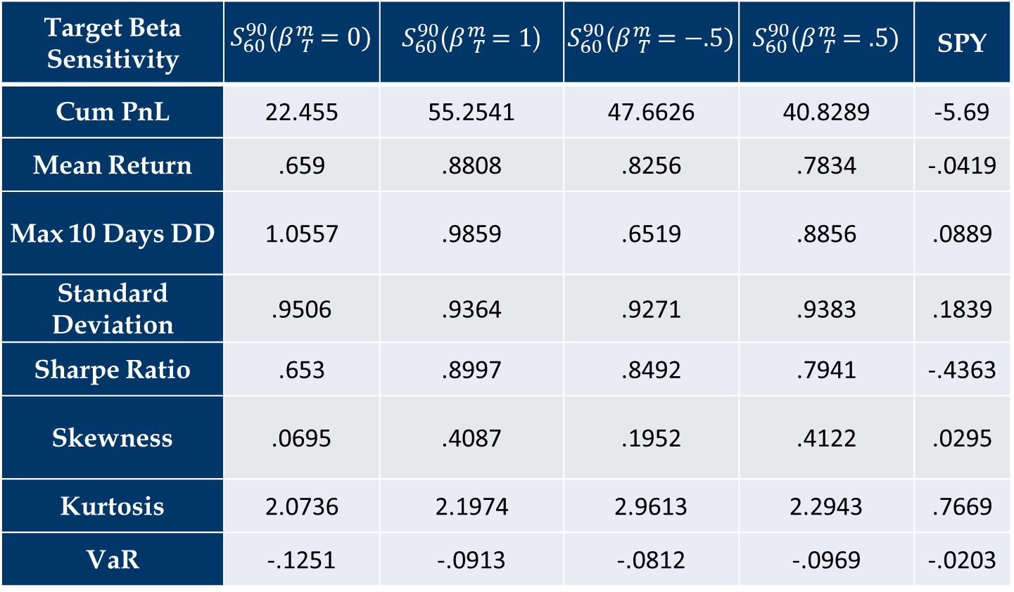
Sensitivity on target beta:
Market Scenario: 04/01/2007 – 03/31/2008
Target Beta Sensitivity |  |  |  |  | SPY
Cum PnL | 22.455 | 55.2541 | 47.6626 | 40.8289 | -5.69
Mean Return | .659 | .8808 | .8256 | .7834 | -.0419
Max 10 Days DD | 1.0557 | .9859 | .6519 | .8856 | .0889
Standard Deviation | .9506 | .9364 | .9271 | .9383 | .1839
Sharpe Ratio | .653 | .8997 | .8492 | .7941 | -.4363
Skewness | .0695 | .4087 | .1952 | .4122 | .0295
Kurtosis | 2.0736 | 2.1974 | 2.9613 | 2.2943 | .7669
VaR | -.1251 | -.0913 | -.0812 | -.0969 | -.0203

Slide 8
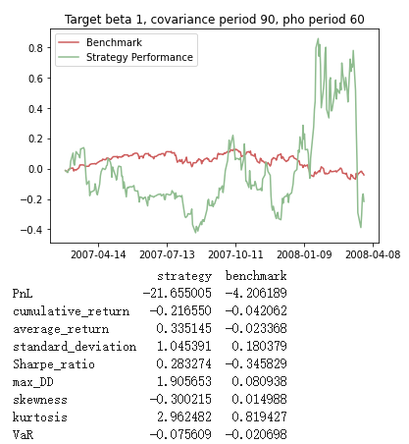
Some visualizations:

Slide 9
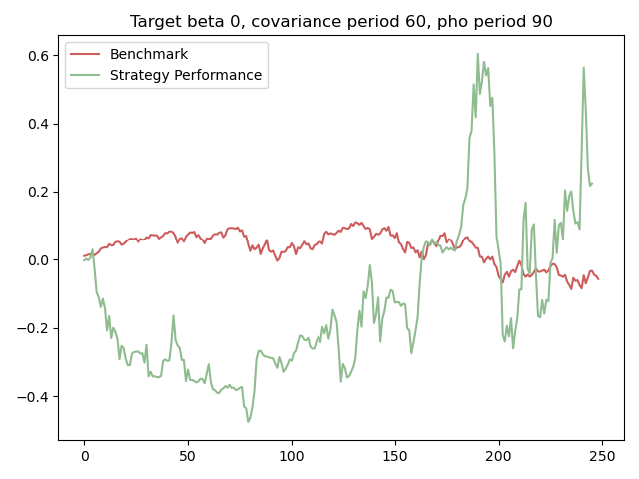
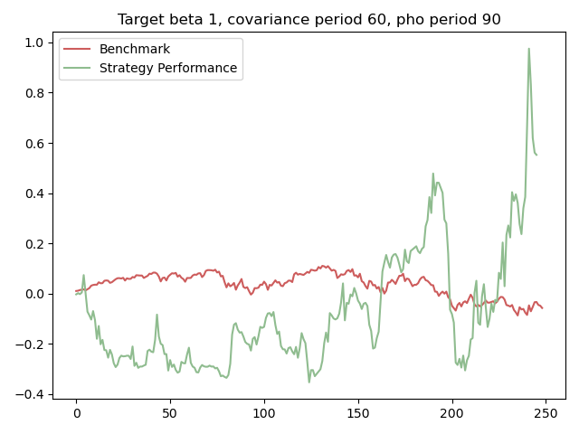
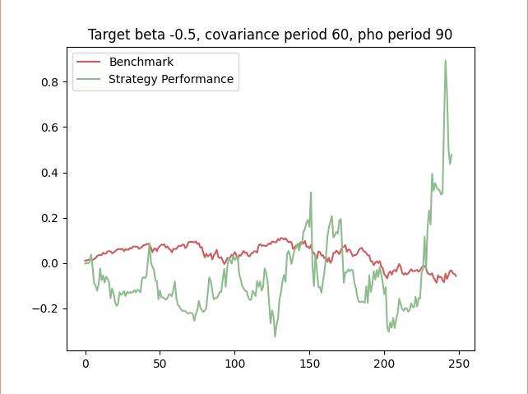
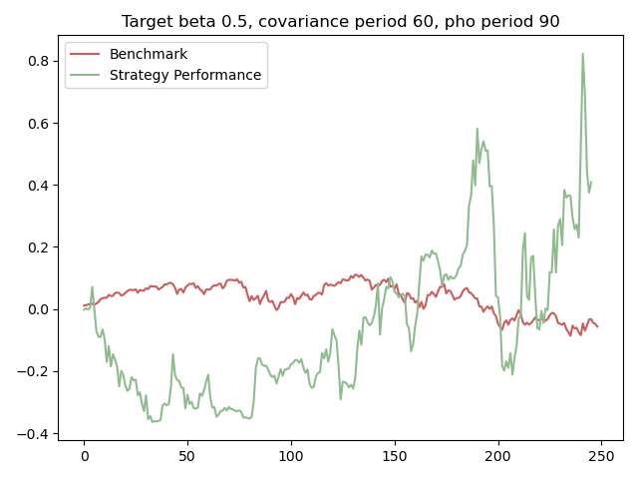
Some visualizations:

Slide 10
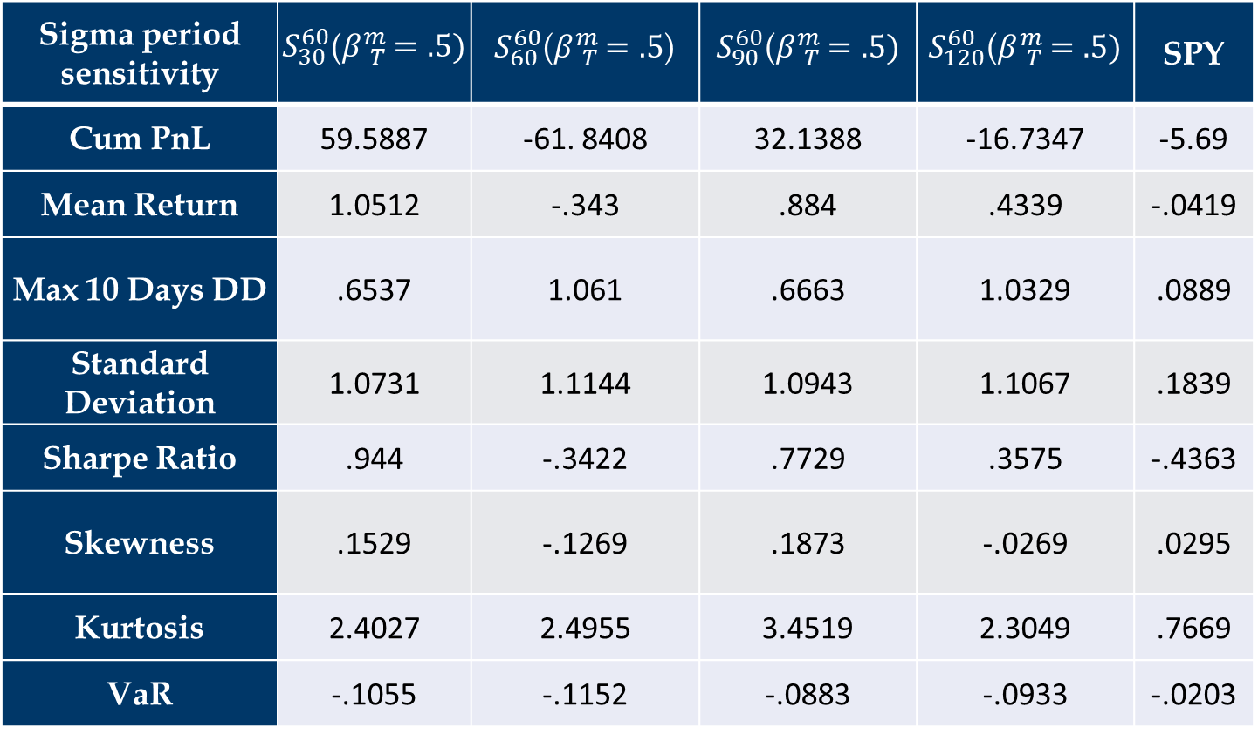
Sensitivity on look back period for covariance matrix :
Market Scenario: 04/01/2007 – 03/31/2008
Sigma period sensitivity |  |  |  |  | SPY
Cum PnL | 59.5887 | -61. 8408 | 32.1388 | -16.7347 | -5.69
Mean Return | 1.0512 | -.343 | .884 | .4339 | -.0419
Max 10 Days DD | .6537 | 1.061 | .6663 | 1.0329 | .0889
Standard Deviation | 1.0731 | 1.1144 | 1.0943 | 1.1067 | .1839
Sharpe Ratio | .944 | -.3422 | .7729 | .3575 | -.4363
Skewness | .1529 | -.1269 | .1873 | -.0269 | .0295
Kurtosis | 2.4027 | 2.4955 | 3.4519 | 2.3049 | .7669
VaR | -.1055 | -.1152 | -.0883 | -.0933 | -.0203

Slide 11
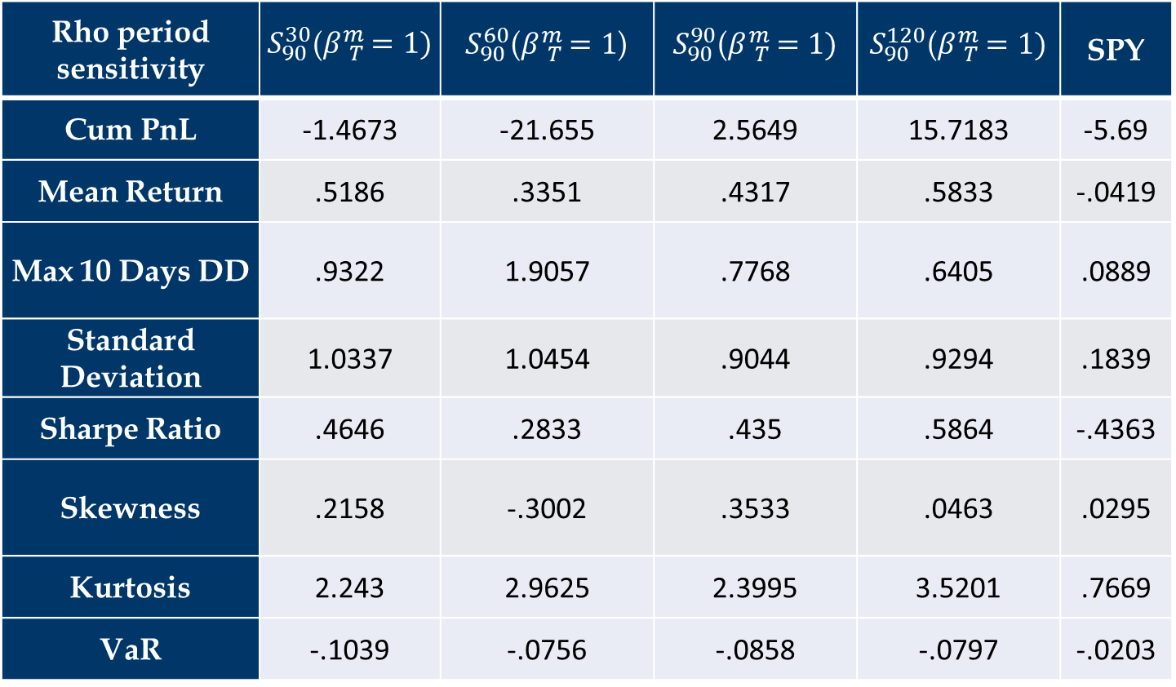
Sensitivity on look back period for expected return :
Market Scenario: 04/01/2007 – 03/31/2008
Rho period sensitivity |  |  |  |  | SPY
Cum PnL | -1.4673 | -21.655 | 2.5649 | 15.7183 | -5.69
Mean Return | .5186 | .3351 | .4317 | .5833 | -.0419
Max 10 Days DD | .9322 | 1.9057 | .7768 | .6405 | .0889
Standard Deviation | 1.0337 | 1.0454 | .9044 | .9294 | .1839
Sharpe Ratio | .4646 | .2833 | .435 | .5864 | -.4363
Skewness | .2158 | -.3002 | .3533 | .0463 | .0295
Kurtosis | 2.243 | 2.9625 | 2.3995 | 3.5201 | .7669
VaR | -.1039 | -.0756 | -.0858 | -.0797 | -.0203

Slide 12

Sensitivity on target beta:
Market Scenario: 04/01/2008 – 12/31/2008
Target Beta sensitivity |  |  |  |  | SPY
Cum PnL | -72.7936 | -16.0105 | 13.6613 | 16.3497 | -33.634
Mean Return | -.8655 | .6402 | 1.0628 | 1.0489 | -.4365
Max 10 Days DD | 1.3751 | 1.1447 | .7416 | .8209 | .3324
Standard Deviation | 1.3066 | 1.2998 | 1.3165 | 1.28 | .4538
Sharpe Ratio | -.6729 | .482 | .7969 | .8089 | -.9922
Skewness | -.0487 | -.3134 | -.281 | -.405 | .554
Kurtosis | .6593 | 2.5026 | 2.1897 | 1.8322 | 5.2836
VaR | -.1472 | -.1358 | -.1202 | -.1157 | -.0641

Slide 13

Sensitivity on look back period for covariance matrix :
Market Scenario: 04/01/2008 – 12/31/2008
Sigma period sensitivity |  |  |  |  | SPY
Cum PnL | 191.6674 | 16.3497 | -11.1577 | 71.9459 | -33.634
Mean Return | 2.3114 | 1.0489 | .6368 | 1.562 | -.4365
Max 10 Days DD | .8226 | .8209 | .8159 | 1.223 | .3324
Standard Deviation | 1.3044 | 1.2798 | 1.2388 | 1.2675 | .4538
Sharpe Ratio | 1.7615 | .8089 | .503 | 1.2215 | -.9922
Skewness | -.4331 | -.405 | -.4126 | -.5817 | .554
Kurtosis | 1.7074 | 1.8322 | 2.3022 | 1.9342 | 5.2836
VaR | -.0999 | -.1157 | -.1088 | -.1101 | -.0641

Slide 14

Sensitivity on look back period for expected return :
Market Scenario: 04/01/2008 – 12/31/2008
Rho period sensitivity |  |  |  |  | SPY
Cum PnL | -96.2156 | 277.8341 | 13.6613 | -2.0344 | -33.634
Mean Return | -2.8985 | 2.8366 | 1.0628 | .7809 | -.4365
Max 10 Days DD | 3.1765 | .9542 | .7416 | .6934 | .3324
Standard Deviation | 1.6171 | 1.5099 | 1.3165 | 1.2732 | .4538
Sharpe Ratio | -1.8009 | 1.8696 | .7969 | .6026 | -.9922
Skewness | -.3743 | 1.6171 | -.281 | .1957 | .554
Kurtosis | 5.355 | 8.2819 | 2.1897 | .8234 | 5.2836
VaR | -.1692 | -.1042 | -.1202 | -.1142 | -.0641

Slide 15
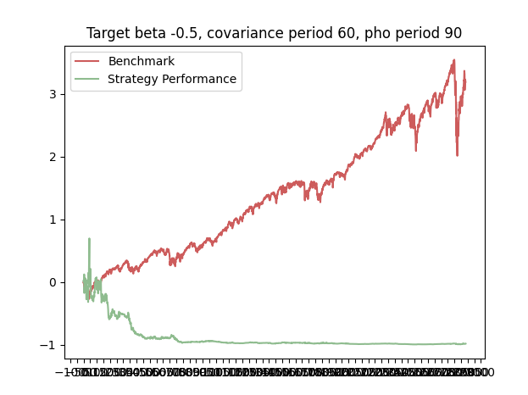
Performance Statistics
Market Scenario: 1/1/2009 – 6/30/2020

Slide 16
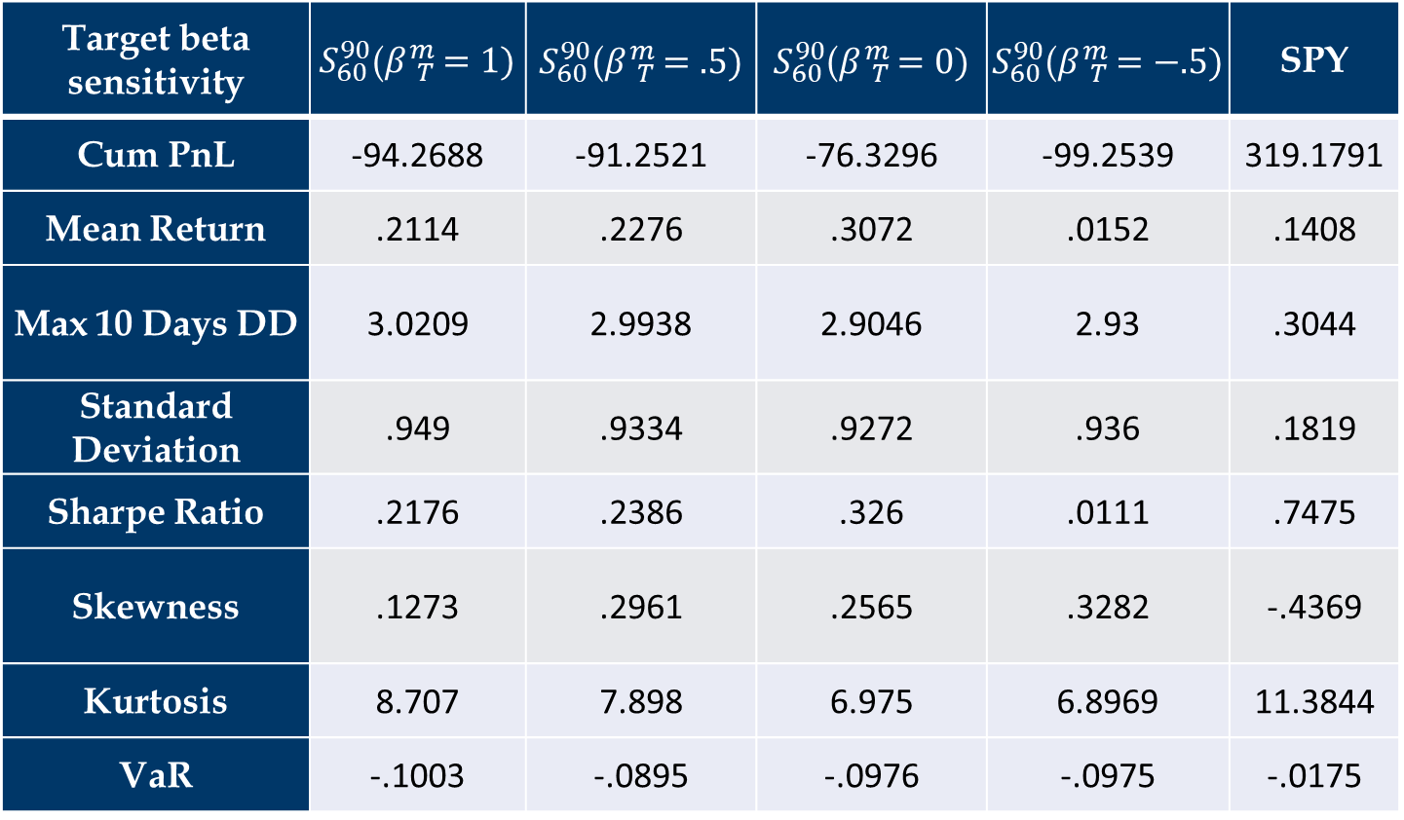
Performance Statistics
Market Scenario: 1/1/2009 – 6/20/2020
Target beta sensitivity |  |  |  |  | SPY
Cum PnL | -94.2688 | -91.2521 | -76.3296 | -99.2539 | 319.1791
Mean Return | .2114 | .2276 | .3072 | .0152 | .1408
Max 10 Days DD | 3.0209 | 2.9938 | 2.9046 | 2.93 | .3044
Standard Deviation | .949 | .9334 | .9272 | .936 | .1819
Sharpe Ratio | .2176 | .2386 | .326 | .0111 | .7475
Skewness | .1273 | .2961 | .2565 | .3282 | -.4369
Kurtosis | 8.707 | 7.898 | 6.975 | 6.8969 | 11.3844
VaR | -.1003 | -.0895 | -.0976 | -.0975 | -.0175

Slide 17
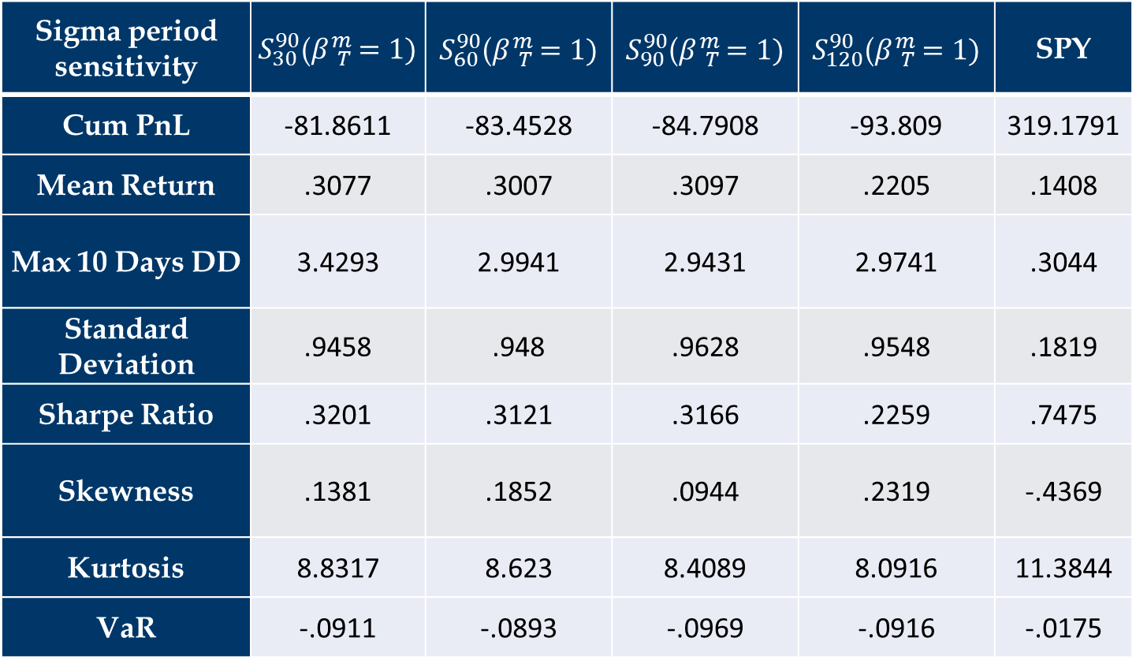
Performance Statistics
Market Scenario: 1/1/2009 – 6/20/2020
Sigma period sensitivity |  |  |  |  | SPY
Cum PnL | -81.8611 | -83.4528 | -84.7908 | -93.809 | 319.1791
Mean Return | .3077 | .3007 | .3097 | .2205 | .1408
Max 10 Days DD | 3.4293 | 2.9941 | 2.9431 | 2.9741 | .3044
Standard Deviation | .9458 | .948 | .9628 | .9548 | .1819
Sharpe Ratio | .3201 | .3121 | .3166 | .2259 | .7475
Skewness | .1381 | .1852 | .0944 | .2319 | -.4369
Kurtosis | 8.8317 | 8.623 | 8.4089 | 8.0916 | 11.3844
VaR | -.0911 | -.0893 | -.0969 | -.0916 | -.0175

Slide 18
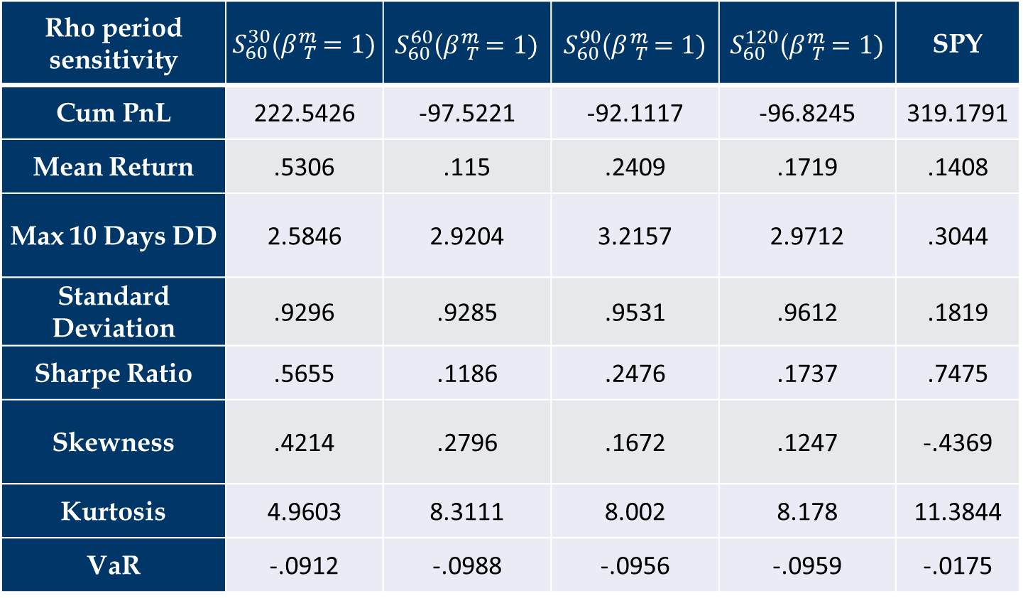
Performance Statistics
Market Scenario: 1/1/2009 – 6/20/2020
Rho period sensitivity |  |  |  |  | SPY
Cum PnL | 222.5426 | -97.5221 | -92.1117 | -96.8245 | 319.1791
Mean Return | .5306 | .115 | .2409 | .1719 | .1408
Max 10 Days DD | 2.5846 | 2.9204 | 3.2157 | 2.9712 | .3044
Standard Deviation | .9296 | .9285 | .9531 | .9612 | .1819
Sharpe Ratio | .5655 | .1186 | .2476 | .1737 | .7475
Skewness | .4214 | .2796 | .1672 | .1247 | -.4369
Kurtosis | 4.9603 | 8.3111 | 8.002 | 8.178 | 11.3844
VaR | -.0912 | -.0988 | -.0956 | -.0959 | -.0175

Slide 19
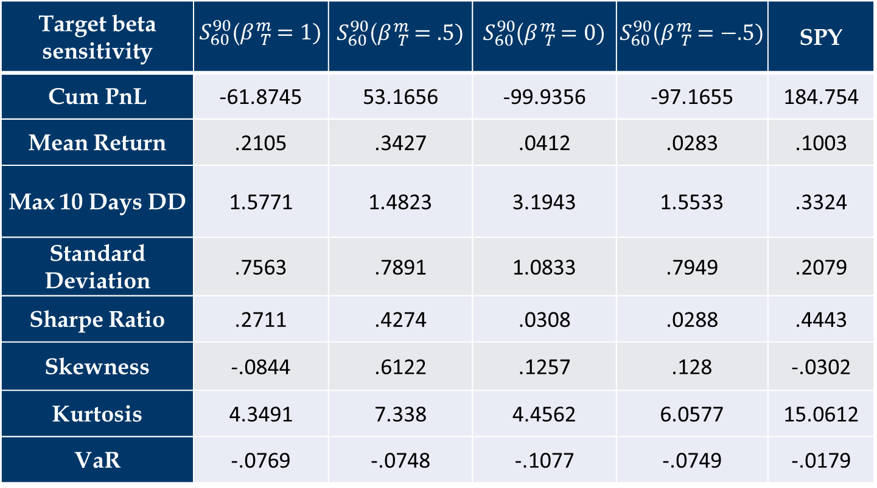
Performance Statistics
Market Scenario: 04/01/2007 – 06/30/2020
Target beta sensitivity |  |  |  |  | SPY
Cum PnL | -61.8745 | 53.1656 | -99.9356 | -97.1655 | 184.754
Mean Return | .2105 | .3427 | .0412 | .0283 | .1003
Max 10 Days DD | 1.5771 | 1.4823 | 3.1943 | 1.5533 | .3324
Standard Deviation | .7563 | .7891 | 1.0833 | .7949 | .2079
Sharpe Ratio | .2711 | .4274 | .0308 | .0288 | .4443
Skewness | -.0844 | .6122 | .1257 | .128 | -.0302
Kurtosis | 4.3491 | 7.338 | 4.4562 | 6.0577 | 15.0612
VaR | -.0769 | -.0748 | -.1077 | -.0749 | -.0179

Slide 20
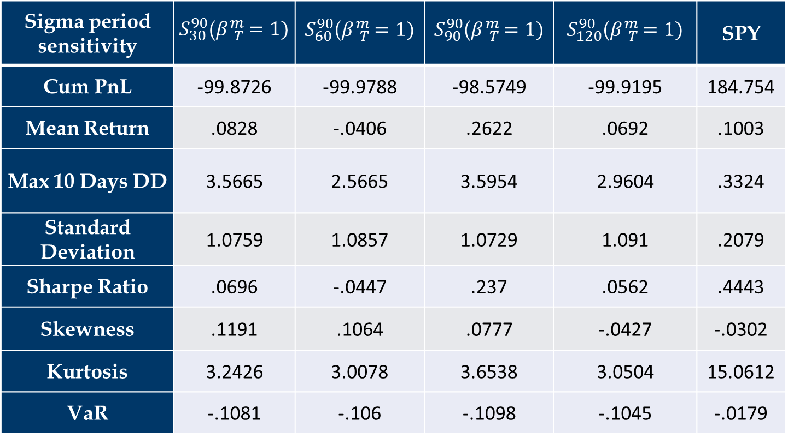
Performance Statistics
Market Scenario: 04/01/2007 – 06/30/2020
Sigma period sensitivity |  |  |  |  | SPY
Cum PnL | -99.8726 | -99.9788 | -98.5749 | -99.9195 | 184.754
Mean Return | .0828 | -.0406 | .2622 | .0692 | .1003
Max 10 Days DD | 3.5665 | 2.5665 | 3.5954 | 2.9604 | .3324
Standard Deviation | 1.0759 | 1.0857 | 1.0729 | 1.091 | .2079
Sharpe Ratio | .0696 | -.0447 | .237 | .0562 | .4443
Skewness | .1191 | .1064 | .0777 | -.0427 | -.0302
Kurtosis | 3.2426 | 3.0078 | 3.6538 | 3.0504 | 15.0612
VaR | -.1081 | -.106 | -.1098 | -.1045 | -.0179

Slide 21

Performance Statistics
Market Scenario: 04/01/2007 – 06/30/2020
Rho period sensitivity |  |  |  |  | SPY
Cum PnL | -99.9755 | -95.5482 | -99.8588 | -98.5892 | 184.754
Mean Return | -.0297 | .3459 | .126 | .2915 | .1003
Max 10 Days DD | 2.9030 | 2.9497 | 3.3108 | 3.2382 | .3324
Standard Deviation | 1.0799 | 1.0692 | 1.1065 | 1.0989 | .2079
Sharpe Ratio | -.0348 | .3161 | .1067 | .258 | .4443
Skewness | -.1157 | -.034 | .1045 | .0168 | -.0302
Kurtosis | 3.3687 | 3.4237 | 4.0425 | 3.477 | 15.0612
VaR | -.1124 | -.1057 | -.1167 | -.1075 | -.0179

Slide 22
Summary and Next Steps
Summary：
During normal periods, target beta should be close to the benchmark for best results. During times of crisis, the impact of beta is less clear; therefore, we do not recommend using target beta as an effective metric of portfolio performance during this time.
Changes in the covariance lookback period appears to have the greatest impact on PnL. Shorter covariance lookback periods appears to be optimal for short period portfolio strategy.
Investors can also choose which groups of look-back periods and beta to choose, based on their risk preference.
Next Steps:
Expanding the universe of asset such that the range of target betas is increased may provide greater insight into portfolio strategy.
Change the value of lambda in order to observe the impact on portfolio sensitivity analysis.
Try different models to predict factors which may lead to more efficient code.

Slide 23
Questions?

