Slide 1
MINI PROJECT
CS648
MEDIAN USING 1.5n+o(n) comparisons

Slide 2

Introduction

Slide 3
  Intuition

Slide 4

  Idea💡

Slide 5

Half Approximate Median
Using Half Approximate Median
Instead of randomly and uniformly selecting an element in each step, we can find a Half Approximate Median of the set of elements and use it to discard elements that are not
contenders for the median of the original set of elements.

Slide 6
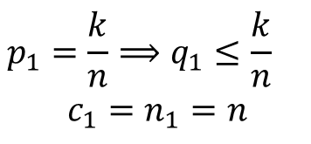
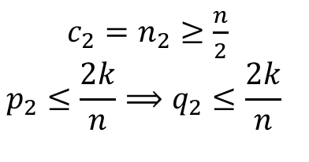
Analysis
Round 1
Round 2

Slide 7


Round 3
Therefore, this method is not efficient enough ☹️

Slide 8
Insight and New Idea 💡🧠
Towards designing efficient Algorithm

Slide 9





Analysis

Slide 10





Slide 11


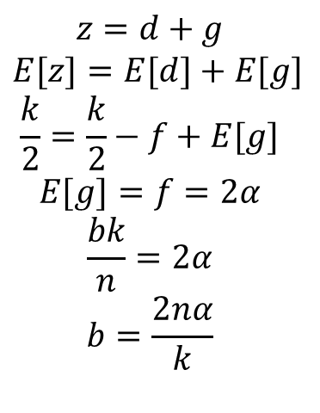

Therefore,

Slide 12





Therefore,

Slide 13



Slide 14
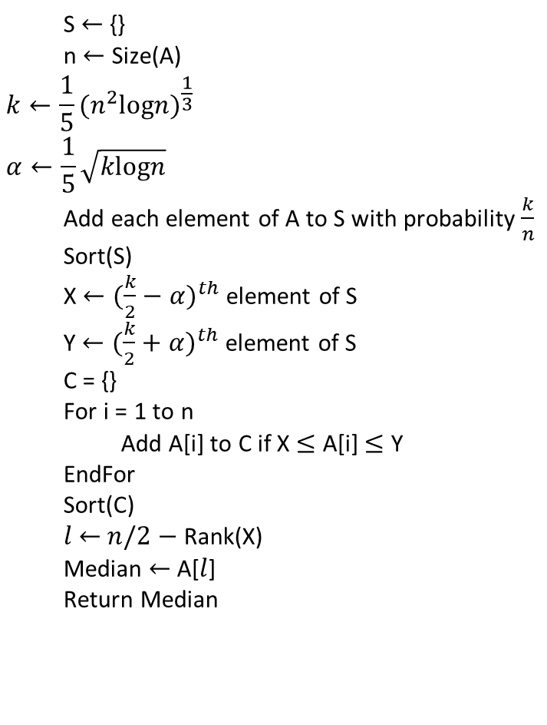
Finding Median(A):

Slide 15
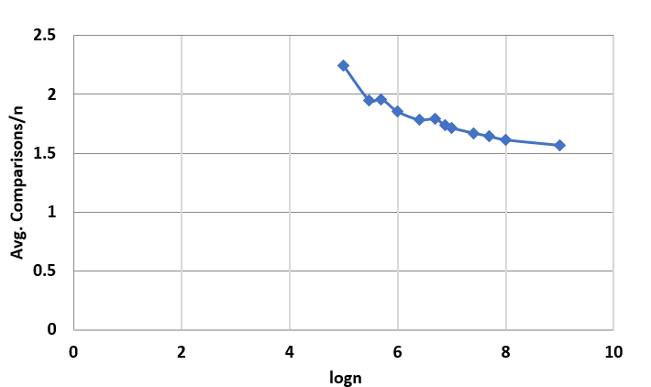
Monte Carlo to Las Vegas

