Slide 1
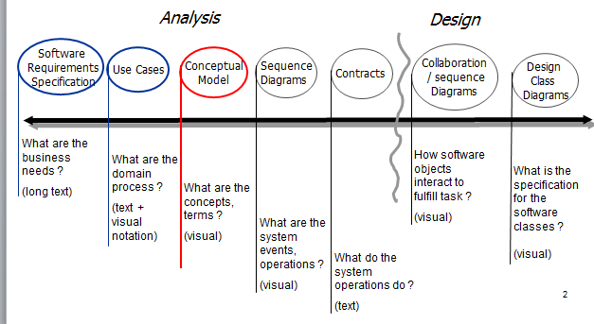
Analysis and Design: Robots communication Simulation

Slide 2
Design Class Diagrams
Simulation
Message
Air
_id_message :float
_id_source :float
_create_time :time
_sender_history :[]float
_version
_real_location :Point
_sender_estimated_location :Point
_mat_distance
_snn :[]float
_Air :Air
_Arena :Arena
_messages :[]Message
boolean Action(time)
sortRandomRobotsArray()
sendMessage()/static
Message getMessage(id)
boolean canSend(id)
bool equals(Message)
older (Message)
Point
Robot
_x :int
_y :int
_zone :float
_deviation :float
_id :int
_real_location
_estimated_location: Point
_can_move :boolean
_battery_status :int
_message_log : [] Message
_private_location_log :[] Point
_neighbors_loc : [] Point
_time :int
_current_zone :float
Arena
boolean Action(time)
Joint(point)
signalToDistance(singal)
_mat_robot_id :[][] float
_mat_zone :[][] float
_Robots :Robot
booleab[4] getEnv(id)
getCurrentZone(id) moveRobot(id,dir)
boolean doAction()
int[4] getEnv()
move(direction)
boolean SendNewMessage(Message)
message getMessage(message)
boolean forwardMessage (message)
Log
_file File
addLine(line)
close()

Slide 3
Use cases - 1
Use Case: Run simulation
Actors: Simulation
Purpose: Activated the Simulation
Description: Receiving requests from the robots and the response.

Slide 4
Use cases - 2
Use Case: Received & get messages and signals
Actors: Air
Purpose: Delivery of messages correctly
Description: Storing the messages sent, location, effective performance.

Slide 5
Use cases - 3
Use Case: Data analysis
Actors: Robot
Purpose: The best next step
Description: Robot analyze all the information collected (robots neighbors, the environment and message) to decide on the next action.

Slide 6
Use cases - 4
Use Case: Analysis received messages
Actors: Robot
Purpose: extraction of information from messages
Description: The robot analyzes the information received from a message (sender's location, snn, zone, historic neighbors) and using the information.

Slide 7
Conceptual Model
Not to do any action
Move
Making action
button
operating
Robot [i]
Send MSG
decision
N
The robot makes sure that the action is permitted
N
The Simulation makes sure that the action is permitted
Get MSG
Y
Y

