Slide 1

Microprocessor-based automatic door opener
Assalamu Alaikum

Slide 2

Team Member
Name | ID
Rafa Tasnim | 2019-1-60-081
Md. Huzaifa | 2019-1-60-079
Suraya Mamtaz Kamar | 2017-2-60-100

Slide 3

Introduction
1

Slide 4
Circuit Element
2
Sensor
Motor Controller
Microcontroller
Motor

Slide 5
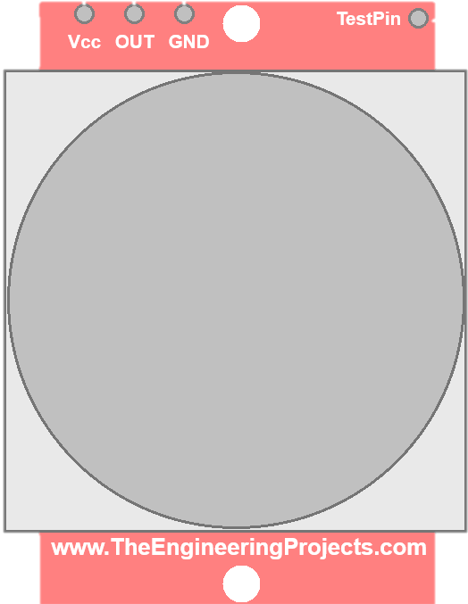
2
Circuit Element
Sensor
Motor Controller
Microcontroller
Motor

Slide 6
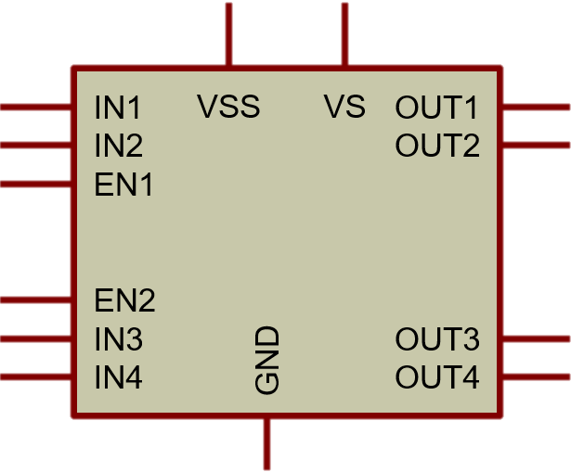
2
Circuit Element
Sensor
Motor Controller
Microcontroller
Motor

Slide 7
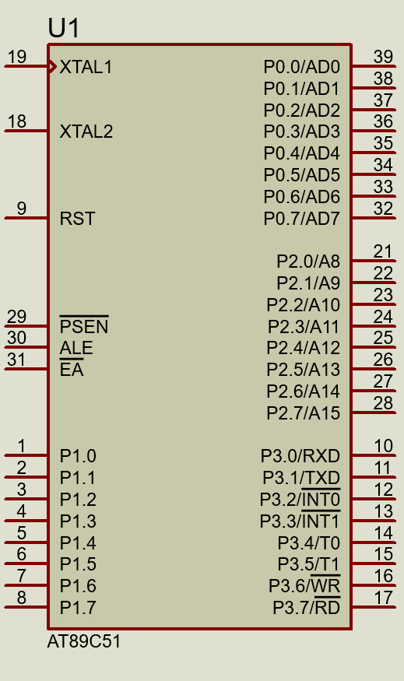
2
Circuit Element
Sensor
Motor Controller
Microcontroller
Motor

Slide 8
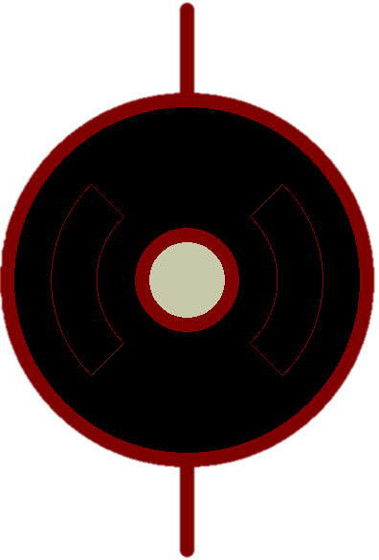
2
Circuit Element
Sensor
Motor Controller
Microcontroller
Motor

Slide 9

Design
3
Start
AT89C51
is sensor detect?
Sensor
Open the door
Microcontroller
PIR
Wait
Motor Controller
is sensor detect?
MOTOR
Close the Door
L293D
Motor
END

Slide 10
Advantage
4
Advantages of Microprocessor based automatic opened door:
• Effectively saves the contribution of energy.
• Reduce annual heating and cooling cost.
• Reduce physical effort for door opening and closing.
• Time saving for free entrance.
• To avoid vehicle queue.
• Helpful to advanced traffic system policy.

Slide 11
Disadvantage
5
Disadvantages of Microprocessor based automatic opened door:
• It is common thread for security system purpose.
• Infrared radiation is harmful for human body.
• Too much electrical energy consuming.

Slide 12
Application
6
Real life application of Microprocessor based automatic opened door:
• Car parking for common space.
• Shopping mall entrance.
• Hand free entrance in ICU in hospital.
• Entrance and exit into lift.
• Goods movement inside factory or industry.
• Advanced traffic system policy.

Slide 13
Limitation
7
Limitation of Microprocessor based automatic opened door:
• Unable to detect individually for restricted entrance and exit.
• No strong lock system for opening.
• Unable to detect individually goods or humans.
• Security issue is not applied properly.
• Waste energy where no entrance and exits.

Slide 14
Future Scope
8
Our project will be hopeful in future scope if we overcome some limitations:
• Check individually for each entrance and exit operations.
• Develop strong lock system.
• Auto on-off process to reduce energy waste.
• Develop strong security system such as password approaches.
• Add monitoring opportunities for record and restore data

Slide 15
Conclusion
9
Conclusively, it is a good system to make our daily life a bit easier and effectively reduce human physical effort activities. It will be more preferable in future.

Slide 16
T
h
a
n
k
Y
o
u

