Slide 1
Version Control Systems (VCS) / Source Code Manger (SCM)
IS-324 Modern Applications Development
Lab - Two

Slide 2
Version Control Systems
The main point of a version control system is to help you maintain a detailed history of the project as well as the ability to work on different versions of it. Having a detailed history of a project is important because it lets you see the progress of the project over time. If needed, you can also jump back to any point in the project to recover data or files.
we'll be using Git which is a distributed version control system. You might be surprised to discover that you're already using version control all the time!

Slide 3
1-Installing Git
Git is actually installed on MacOS, but we'll be reinstalling it so that we'll have the newest version:
go to https://git-scm.com/downloads
download the software for Mac
install Git choosing all of the default options
Once everything is installed, you should be able to run git on the command line. If it displays the usage information, then you're good to go!
If you run into any issues, please remember to take advantage of Knowledge and the community in your Student Hub.
Configuring Mac's Terminal
We're about to configure the Terminal to display helpful information when in a directory that's under version control. This is an optional step! You do not need to re-configure your terminal for Git to work. You can complete the entire course without reconfiguring it. However, reconfiguring the Terminal makes it significantly easier to use.
If you choose to configure your Terminal, here's what it should look like when you're finished.

Slide 4
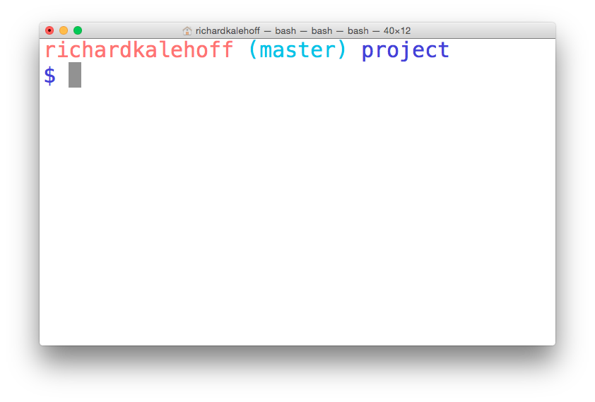
The terminal application on MacOS. The terminal has been configured to display version control information.
Configuration Steps
To configure the terminal, we'll perform the following steps:
download the zipped file from https://www.dropbox.com/s/jdwc0po7lka6cat/KSU-IS324.zip?dl=0
move the directory KSU-IS324 to your home directory and name it .KSU-IS324 (there's a dot at the front, now!)
move the bash_profile file to your home directory and name it .bash_profile (there's a dot at the front, now!)
if you already have a .bash_profile file in your home directory, transfer the content from the downloaded bash_profile to your existing .bash_profile
First Time Git Configuration
Before you can start using Git, you need to configure it. Run each of the following lines on the command line to make sure everything is set up.
# sets up Git with your name
git config --global user.name "<Your-Full-Name>"
# sets up Git with your email
git config --global user.email "<your-email-address>"
# makes sure that Git output is colored
git config --global color.ui auto
# displays the original state in a conflict
git config --global merge.conflictstyle diff3
git config –list
Git & Code Editor
The last step of configuration is to get Git working with your code editor. Below are three of the most popular code editors. If you use a different editor, then do a quick search on Google for "associate X text editor with Git" (replace the X with the name of your code editor).
Atom Editor Setup
git config --global core.editor "atom --wait"
Sublime Text Setup
git config --global core.editor "'/Applications/Sublime Text 2.app/Contents/SharedSupport/bin/subl' -n -w"
VSCode Setup
git config --global core.editor "code --wait"
If you have any questions, post them on the forum.

Slide 5
1-Installing Git
To download Git: go to https://git-scm.com/downloads
download the software for Windows
install Git choosing all of the default options
Once everything is installed, you should be able to run git on the command line. If it displays the usage information, then you're good to go!
If you run into any issues, please remember to take advantage of Knowledge and the community in your Study Group.
Configuring the Command Prompt on Windows
We're about to configure the Command Prompt to display helpful information when in a directory that's under version control. This is an optional step! You do not need to re-configure your Command Prompt for Git to work. You can complete the entire course without reconfiguring it. However, reconfiguring the Command Prompt makes it significantly easier to use.
If you choose to configure your Command Prompt, here's what it should look like when you're finished.

Slide 6
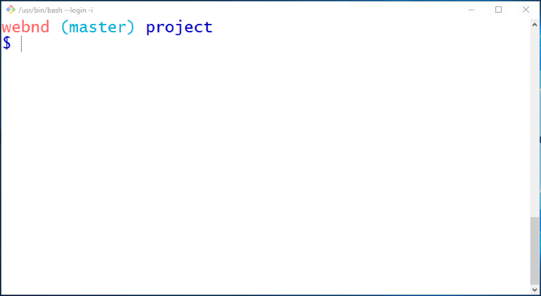
The Command Prompt application on Windows. The Command Prompt has been configured to display version control information.
First Time Git Configuration
Before you can start using Git, you need to configure it. Run each of the following lines on the command line to make sure everything is set up.
# sets up Git with your name
git config --global user.name "<Your-Full-Name>”
# sets up Git with your email
git config --global user.email "<your-email-address>”
# makes sure that Git output is colored
git config --global color.ui auto
# displays the original state in a conflict
git config --global merge.conflictstyle diff3
git config --list
Git & Code Editor
The last step of configuration is to get Git working with your code editor. Below are three of the most popular code editors. If you use a different editor, then do a quick search on Google for "associate X text editor with Git" (replace the X with the name of your code editor).
Atom Editor Setup
git config --global core.editor "atom --wait”
Sublime Text Setup
git config --global core.editor "'C:/Program Files/Sublime Text 2/sublime_text.exe' -n -w”
VSCode Setup
git config --global core.editor "code --wait"

Slide 7
Terminology
Version Control System / Source Code Manager
A version control system (abbreviated as VCS) is a tool that manages different versions of source code. A source code manager (abbreviated as SCM) is another name for a version control system.
Git is an SCM (and therefore a VCS!). The URL for the Git website is https://git-scm.com/ (see how it has "SCM" directly in its domain!).
Commit
Git thinks of its data like a set of snapshots of a mini filesystem. Every time you commit (save the state of your project in Git), it basically takes a picture of what all your files look like at that moment and stores a reference to that snapshot. You can think of it as a save point in a game - it saves your project's files and any information about them.
Everything you do in Git is to help you make commits, so a commit is the fundamental unit in Git.
Repository / repo
A repository is a directory which contains your project work, as well as a few files (hidden by default on Mac OS X) which are used to communicate with Git. Repositories can exist either locally on your computer or as a remote copy on another computer. A repository is made up of commits.
Working Directory
The Working Directory is the files that you see in your computer's file system. When you open your project files up on a code editor, you're working with files in the Working Directory.
This is in contrast to the files that have been saved (in commits!) in the repository.
When working with Git, the Working Directory is also different from the command line's concept of the current working directory which is the directory that your shell is "looking at" right now.
Checkout
A checkout is when content in the repository has been copied to the Working Directory.
Staging Area / Staging Index / Index
A file in the Git directory that stores information about what will go into your next commit. You can think of the staging area as a prep table where Git will take the next commit. Files on the Staging Index are poised to be added to the repository.
SHA
A SHA is basically an ID number for each commit. Here's what a commit's SHA might look like: e2adf8ae3e2e4ed40add75cc44cf9d0a869afeb6.
It is a 40-character string composed of characters (0–9 and a–f) and calculated based on the contents of a file or directory structure in Git. "SHA" is shorthand for "Secure Hash Algorithm".

Slide 8
Terminology (Cont.)
Branch
A branch is when a new line of development is created that diverges from the main line of development. This alternative line of development can continue without altering the main line.
Going back to the example of save point in a game, you can think of a branch as where you make a save point in your game and then decide to try out a risky move in the game. If the risky move doesn't pan out, then you can just go back to the save point. The key thing that makes branches incredibly powerful is that you can make save points on one branch, and then switch to a different branch and make save points there, too.
With this terminology in mind, let's take a high-level look at how we'll be using Git by looking at the typical workflow when working with version control.

Slide 9
How Create a Local Repository
To be able to store your projects, you need to create both remote and local GIT repositories.
So first to create a local repository:
Create a directory to contain the project.
Using the command line, go to the project’s directory. (using cd command).
Type: (”git init”) to create a local repository.
To add new files / make changes to existing files, you have to first add them into the staging area before making a commit:
Type: (“add filename.extension”) to add the file into the staging area.
Type: (“git commit -m "My message”). To create a snapshot, make sure you write an explanatory message to show the changes you made.

Slide 10
How connect to an online Repository
Go to github.
Log in to your account.
Click the new repository button in the top-right.
Click the “Create repository” button.
Type in the command line: (“git remote add origin https://github.com/user/repo.git”)
Make sure you setup your account in the command line first before adding the remote (link1, link2)
Type: (“git push -u origin master”) to push your commits or changes to the remote repository

Slide 11
How to Clone a Repo
You can clone a repository from GitHub to your local computer to make it easier to fix merge conflicts, add or remove files, and push larger commits. When you clone a repository, you copy the repository from GitHub to your local machine.
Type: (“git clone https://hostname.e/USERNAME/REPOSITORY”).

Slide 12
Useful Tips
The main tool you use to determine which files are in which state is (“git status”).
To create a local branch: (“git checkout -b branchname”).
To push a local branch to remote: (“git push -u origin branchname”).
to fetch all the remote branches for you. (“git fetch origin”).
Updating a local repository with changes from a Github repository (“git pull origin master”).
to merge branch to master (“git merge branchname”).
To show a list of all commits in a repository. This command shows everything about a commit, such as commit ID, author, date and commit message (“git log”). Also can add SHA at the end of the command to show only that commit’s details
To show list of commits showing only commit messages and changes (“git log -p”). To show list of commits by an author (“git log --author 'Author Name’ ”).
To show a list of commits in a repository in a more summarized way. This shows a shorter version of the commit ID and the commit message. (“git log --oneline”).
To see changes that have been made but haven't been committed, yet. (“git diff”).
To undo the changes that were made by the provided commit. (“git revert <SHA-of-commit-to-revert>”). This commands creates a new commit to record the change

Slide 13
Lab: using GitHub
You are required to create a local repository, add files to it, make some changes and commit them.
You have to show the log.
Create an online repo and push your files to it.
You have to show the link of your repo.
clone the existing repo from https://github.com/KSUIS324/Assignment1 to your local machine, make some changes to the files (add your name) then commit them.
You have to show the log of your local repo.

Slide 14
Lab: using GitHub
Submit your answers to the assignment page in LMS.
The log for part 1.
The link to your online repo.
The log for part 2.

