Slide 1
Capstone Project-2
Bike Sharing Demand Prediction Individual Project Ishwarya

Slide 2
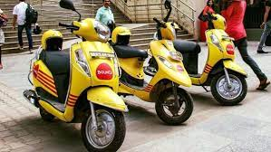
Content
Introduction
Problem Statement
Data Summary
Exploratory Data Analysis
Modelling Overview
Feature Importances
Challenges
Conclusion

Slide 3

Introduction
A bike rental or bike hire business rents out bicycles for short periods of time, Usually for a few hours. Most rentals are provided by bike shops as a sideline to their main businesses of sales and service, but some shops specialize in rentals.
As with car rental, bicycle rental shops primarily serve people who do not have access to vehicle, typically travellers and particularly tourists.
Bike rental shops rent by the day or week as well as by the hour, and these provide an excellent opportunity for those who would like to aoid shipping their own bikes, but would like to do a multi-day bike tour of a particular area.

Slide 4
Problem Statement
Predicting bike count required at each hour for the stable supply of rental bikes to make the rental bike will available and accessible to the public at the right time as it lessens the waiting time.

Slide 5
Data Summary
Date : year-month-day
Rented Bike count - Count of bikes rented at each hour
Hour - Hour of he day
Temperature-Temperature in Celsius
Humidity - %
Windspeed - m/s
Visibility - 10m
Dew point temperature - Celsius
Solar radiation - MJ/m2
Rainfall - mm
Snowfall – cm
Seasons - Winter, Spring, Summer, Autumn
Holiday - Holiday/No holiday
Functional Day - NoFunc(Non Functional Hours), Fun(Functional hours)

Slide 6
Data Analysis Steps
Import Libraries: In this part, we had imported require libraries to perform Exploratory Data Analysis for seoul Bike sharing demand prediction dataset
Descriptive Statistics: In this part, we start by looking at descriptive statistic parameters for the dataset. We will use describe() for this
Missing Value Imputation: We will now check for missing values in our dataset. In case there are any missing entries, we will impute them with appropriate values
Graphical Representation: We will start with Univariate Analysis. We will be using a bar graph for this purpose.

Slide 7
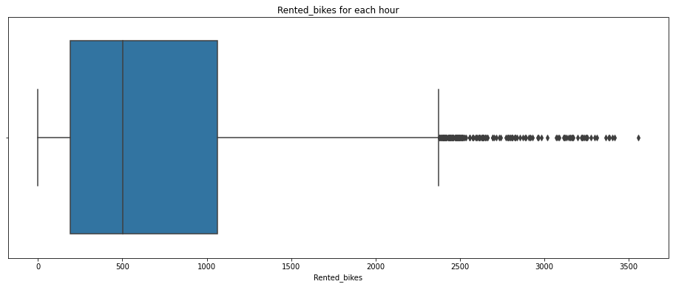
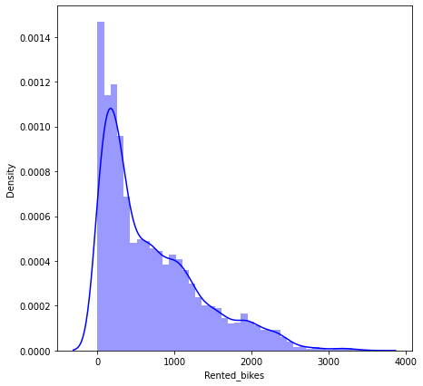
Exploratory Data Analysis Rented Bikes
From the above we can conclude that maximum rented bikes are 3556,minimum rented bikes are zero also existed

Slide 8
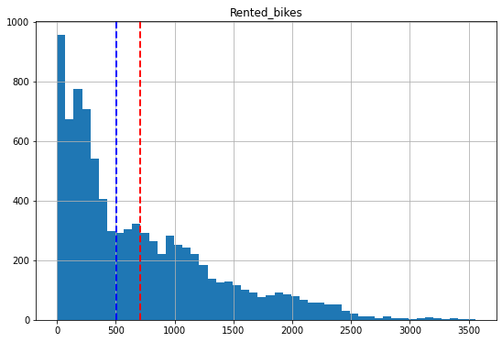
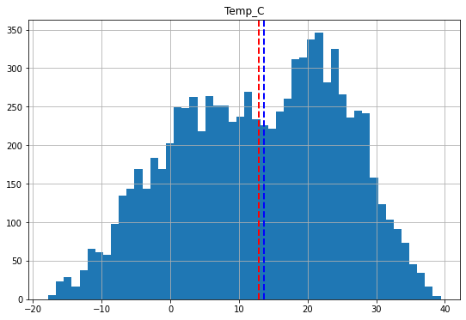
Exploring Numerical Variables
The above graph is about the exploring numerical variables for rented bikes and temp_c.

Slide 9
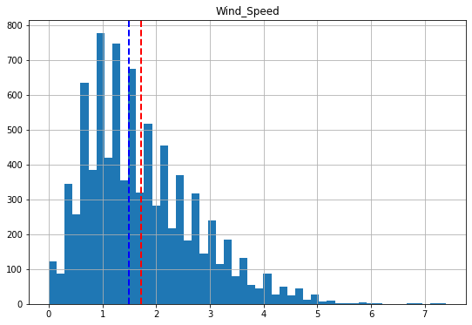
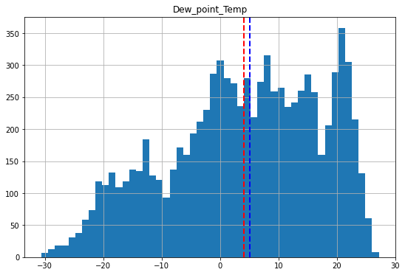
The above graph is about the exploring numerical variables for Wind_speed and dew_point_temp.

Slide 10
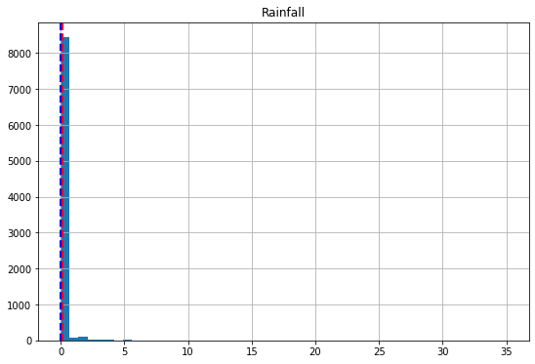
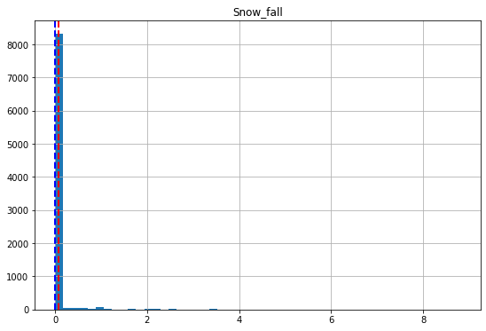
The above graph is about the exploring numerical variables for Rainfall and snow_fall

Slide 11
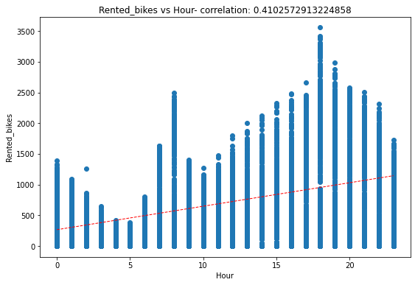
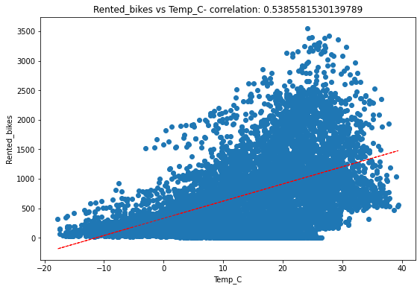
The rented bikes vs hour correlation is 0.4102572913224858 and remted bikes vs temp_c correlation is 0.5385581530139789.

Slide 12
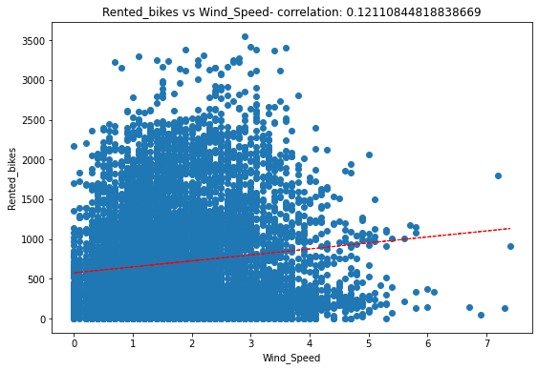
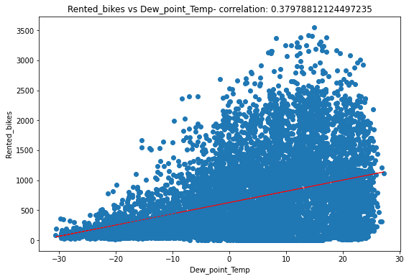
The rented_bikes vs wind_speed correlation is 0.12110844818838669 and recent_bikes vs dew_point_temp correlation is 0.37978812124497235.

Slide 13
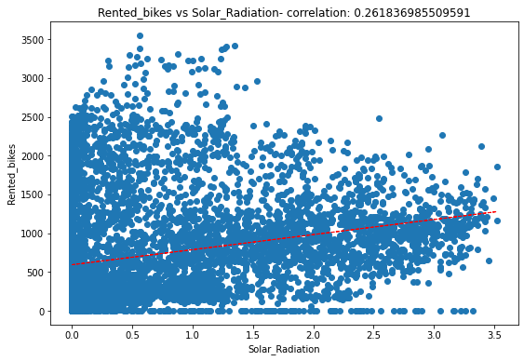
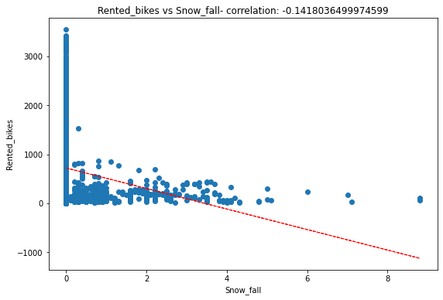
The rented bikes vs solar_radiation correlation 0.26183698550951 and rented_bikes vs snow_fall correlation is -0.1418036499974599.

Slide 14
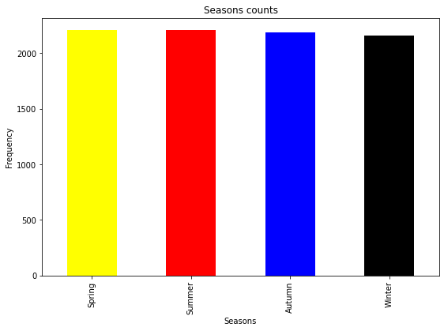
Season Counts
From the above data we can conclude that Summer 2208,Spring 2208,Autumn 2184,Winter 2160

Slide 15
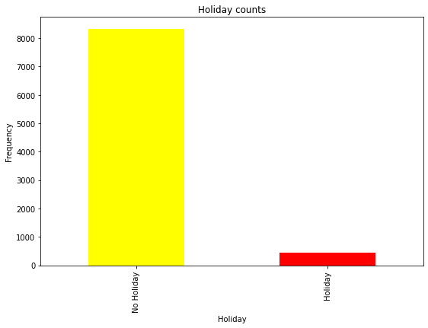
Holiday Counts
From the above data we can conclude No Holiday 8328,Holiday 432

Slide 16
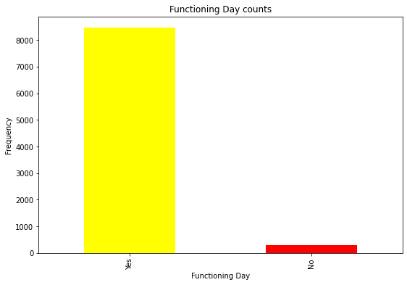
Functioning Day Counts
From the above data we conclude Yes 8465,No 295

Slide 17
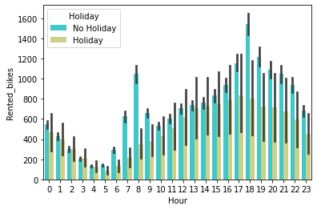
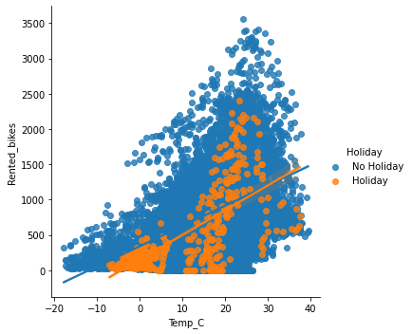
Rented_Bikes vs Hour
From the above conclude that Rented_bikes are took in Non-Holidays maximum bikes taken is 3,556 in 1 hour and Bikes not took by any one in 295 hours and the rented bikes worked when temperature above 20centigrades in Non-Holiday days

Slide 18
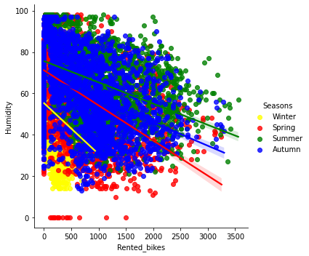
Rented_bikes vs Humidity
From the above data we can conclude that most of the rented bikes are taken when the Humidity is higher 20% ,all seasons have equal demand for Rental_bikes

Slide 19
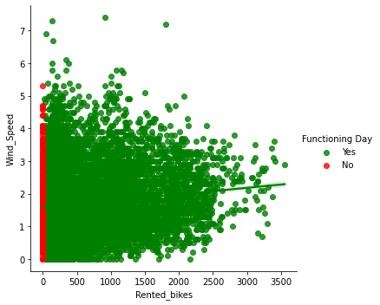
Rented_bikes vs Wind_Speed
From the above data we can conclude that Irresptive of Wind_speed all working days customers were taking bikes for Rent.

Slide 20
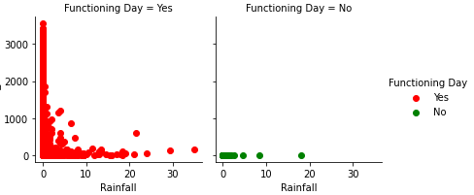
Rented_bikes vs Rainfall
From the above data we can conclude that In functional working day when ever Rainfall reaches 10mm then rented_bikes reducing and when Rainfall is high i.e more than 20mm renting bikes done rarely.

Slide 21
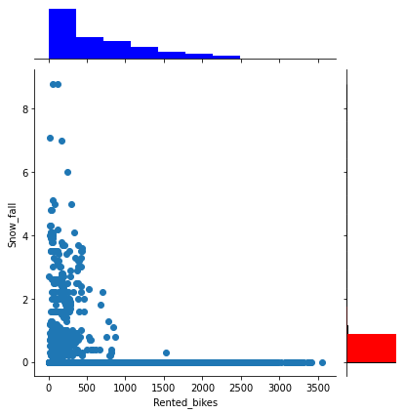
Rented_bikes vs Snow_fall
From the above data we can conclude that we ever snow_fall is zero the Rental_bikes high peack and when ever snow_fall is four or more then taking rental bikes less and sometimes Noone taking rental_bikes.

Slide 22
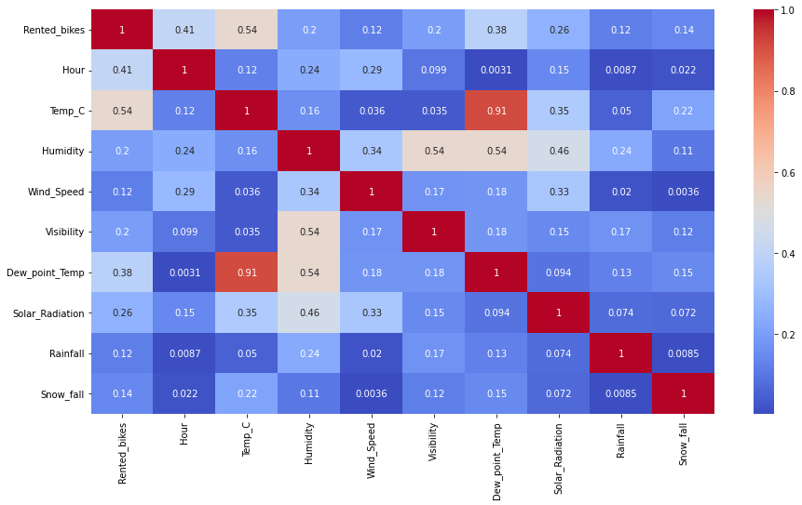
Heatmap Correlation
The above heatmap shows correlationship between each and every column

Slide 23
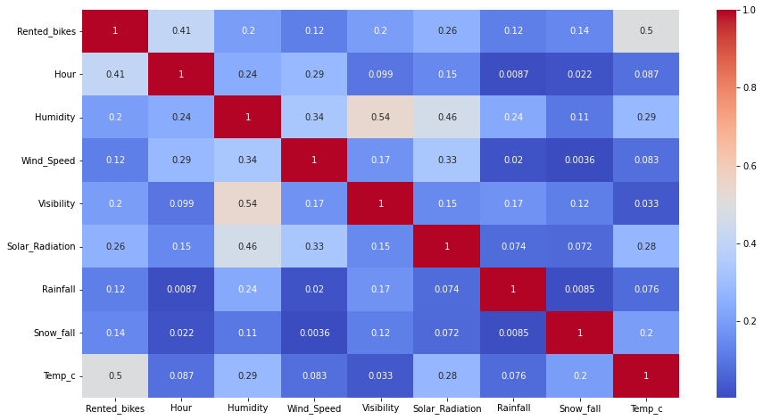
Collinear between Temperature and Dowe_point_temperature so this points have been removed and replaced with weights based temp_c.This heatmap is about after removing temp_c.

Slide 24
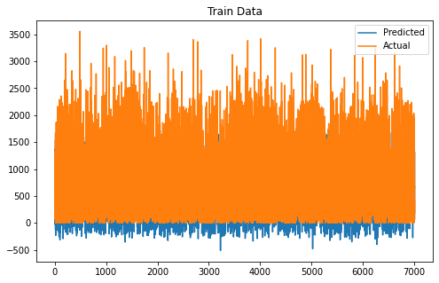
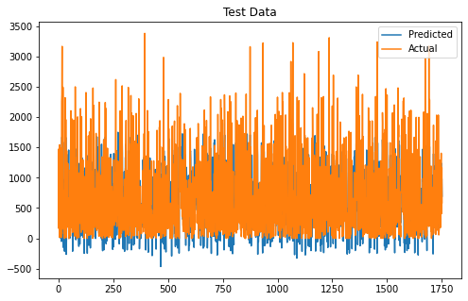
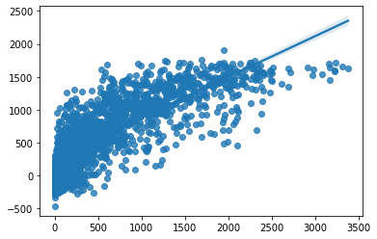
Linear Regression
training data prediction and acutal values comparision it's accuracy is approx 60% and testing data predicted achived values and actual values comparision ,it's accuracy approx 61%

Slide 25



Lasso Regression
training data prediction and acutal values comparision it's accuracy is approx 60% and testing data predicted achived values and actual values comparision ,it's accuracy approx 61%.

Slide 26
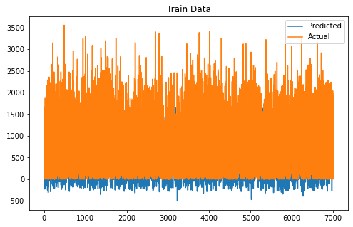

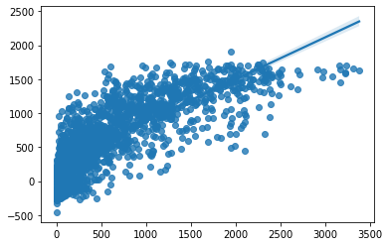
Ridge Regression
training data prediction and acutal values comparision it's accuracy is approx 60% and testing data predicted achived values and actual values comparision ,it's accuracy approx 61%

Slide 27
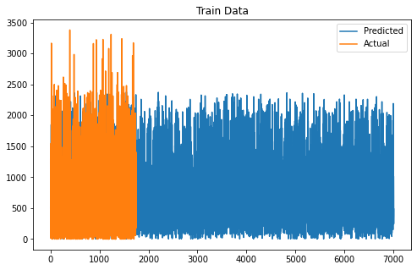
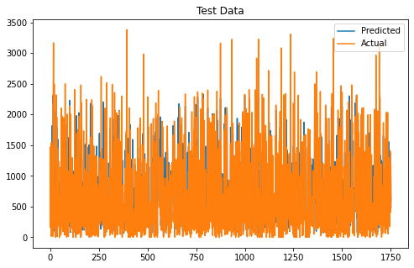
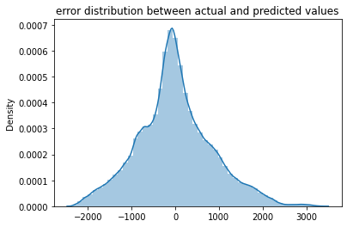
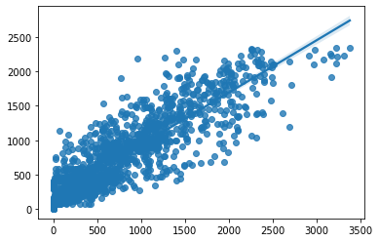
Random Forest Regressor
training data prediction and acutal values comparision it's accuracy is approx 82% and testing data predicted achived values and actual values comparision ,it's accuracy approx 79%.

Slide 28
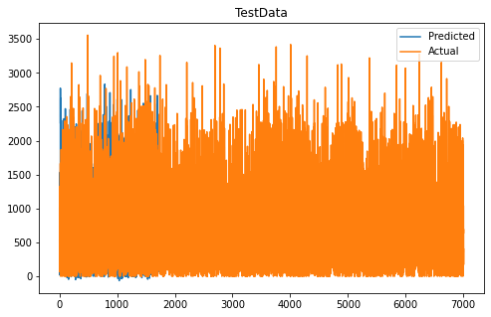
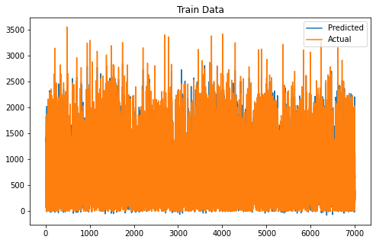
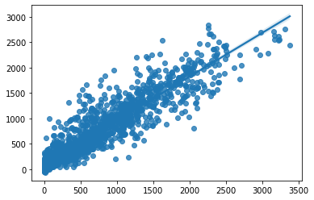
Gradient boosting regressor
training data prediction and acutal values comparision it's accuracy is approx 94% and testing data predicted achived values and actual values comparision ,it's accuracy approx 86%.

Slide 29
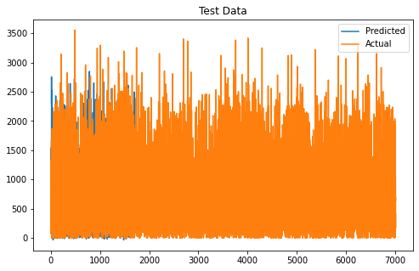
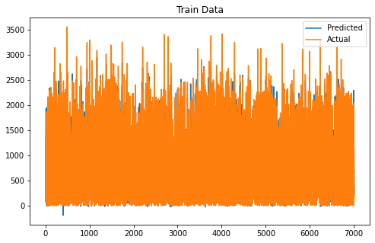
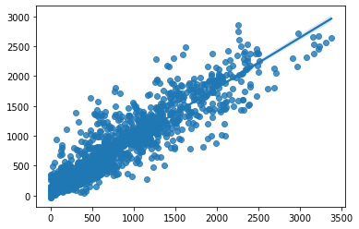
XG BOOST
training data prediction and acutal values comparision it's accuracy is approx 93% and testing data predicted achived values and actual values comparision ,it's accuracy approx 86%.

Slide 30
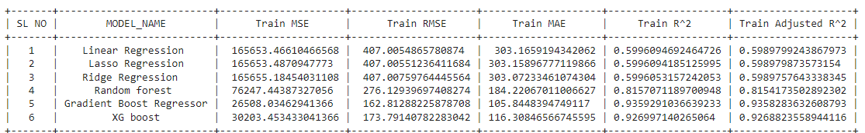
Model Summary for Train Data

Slide 31
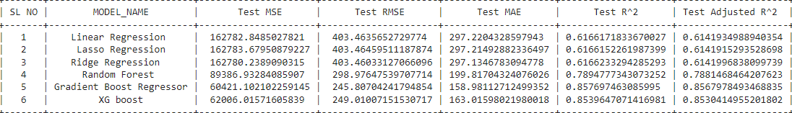
Model Summary for Test Data

Slide 32
Conclusion
We used diffent type of regression algorithms to train our model like, Linear Regression, Regularized linear regression (Ridge and Lasso),Random Forest Regressor, Gradient boosting Regressor, XGboost regresssor. and Also we tuned the parameters of Random forest regressor and XGboost regressor Out of them Gradient Boosting Regressor gave the best result.
MSE is approx 60421,
RMSE IS approx 245,
MAE is approx 159,
R2 is approx 86%,
Adj R2 approx 86%

