Slide 1
⌂
HACK MYSURU 1.0
SAMAGRA MYSURU
Civic Complaint & Governance Portal
TEAM MEMBERS
COLLEGE
HACKATHON
Manasa M N
Prerana L
Sahana M Singad
Sinchana
GSSSIETW
Dept. of CSE (AIML)
Hack Mysuru 1.0

Slide 2
PROBLEM STATEMENT
Domain: Civic Governance & Clean Mysuru
The Situation
Why is it important?
Mysuru generates around 550 to 600 tonnes of garbage every single day. There is a backlog of nearly 7 lakh tonnes of old, untreated waste. The city also produces over 150 tonnes of construction and demolition waste every day, and much of it is illegally dumped at night because it is hard to catch or identify who is doing it.
Because a complaint is useful only when it reaches the right authority. Incorrect or unclear routing can lead to:
Delays in taking action
Mysuru City Corporation is officially expanding — absorbing one City Municipal Council, four Town Panchayats and eight Gram Panchayats into one bigger body. Even the government is still sorting out who is responsible for what, and there have already been public disagreements between local leaders about which villages should come under which authority.
Complaints being redirected between offices
Confusion for citizens
Because of this, when a citizen reports a problem — a pothole, an overflowing bin, a broken streetlight — it can bounce between offices, or disappear with no update, while residents wonder if anyone is even looking at what they reported.
Difficulty for authorities in managing complaints
Poor visibility of which jurisdiction is receiving which type of complaints
This becomes especially important in Mysuru because of the changing jurisdiction structure in 2026.
“Right complaint + wrong authority = delayed action.”
SAMAGRA MYSURU
02

Slide 3
REAL WORLD STATISTICS
The scale of the problem, in numbers
550–600 t/day
~7 lakh t
65 wards
86.31→~341.44
Municipal waste generated
Reported waste backlog
Existing MCC ward structure
MCC area → proposed Greater Mysuru area (sq. km)
🗑️ Mysuru’s waste challenge
🏙️ Jurisdiction complexity
Mysuru generates approximately 550–600 tonnes of waste per day, with a reported backlog of nearly 7 lakh tonnes.
Mysuru’s existing MCC area is about 86.31 sq. km, while the proposed expanded Greater Mysuru area is approximately 341.44 sq. km. The expansion involves the existing 65 MCC wards along with surrounding local-government areas.
These numbers show why civic management and accurate jurisdiction-based routing matter.
SAMAGRA MYSURU
03

Slide 4
EXISTING SOLUTION GAPS
Why the current system falls short
1
Citizens may not know the correct authority
2
Complaint registration and routing are different problems
A civic problem can fall under MCC, CMCs, Town Panchayats or Gram Panchayats. A citizen may know the problem, but not which authority is responsible.
Submitting a complaint doesn’t solve the jurisdiction-routing problem. Our focus is: “Where should this complaint go?”
3
Location-based jurisdiction is complicated
4
Mysuru’s 2026 jurisdiction transition makes routing harder
A simple city/area name is not enough. Our system uses: Latitude + Longitude → Jurisdiction → Authority → Department.
Routing must distinguish current operating, notified/future, and historical jurisdiction — time-aware data, not a static list of areas.
5
Manual routing can create delays
Especially critical because
A wrong-office complaint needs redirecting before action: Citizen → Complaint → Wrong authority → Redirect / clarification → Correct authority → Action.
Mysuru’s planned Greater Mysuru expansion is happening now — which means jurisdiction data cannot be static; it needs to stay accurate as boundaries change.
SAMAGRA MYSURU
04

Slide 5
YOUR SOLUTION
SAMAGRA MYSURU
A location-aware civic complaint routing system
📍 WHERE
+
📝 WHAT
🏢 WHO
the problem occurs
the problem is
should handle it
“By combining WHERE the problem occurs with WHAT the problem is, our system determines WHO should handle it.”
◉
What our app/product does
⚙
How it solves the issue
✦
Main innovation
A citizen can report a problem such as garbage, road damage, drainage, or a streetlight issue. The system uses the complaint type and geographic location to determine where the complaint should be routed.
Combines location-based jurisdiction data with issue-to-department routing rules — covering 65 MCC wards, current authorities, localities, 2026 expansion information, issue categories and routing rules.
Jurisdiction-aware, location-based routing designed for Mysuru’s changing 2026 structure: geographic intelligence + authority intelligence + issue intelligence, combined.
SAMAGRA MYSURU
05

Slide 6
HOW IT WORKS
System architecture — six major layers
👤 CITIZEN / USER
Complaint + Photo + Location
📱 FRONTEND / UI
Complaint form • Location • Dashboard
⚙️ BACKEND / API
Complaint processing • Routing logic
🗺️ GEO DATA / GIS
🗄️ MYSQL DATABASE
GeoJSON boundaries • Ward boundaries
Location → Jurisdiction
Authorities • Wards • Localities
Issue Categories • Routing Rules
🎯 ROUTING ENGINE — WHERE + WHAT → WHO
🏢 AUTHORITY / DEPARTMENT → 📊 OFFICER DASHBOARD
“Our architecture combines geographic jurisdiction data with issue-based routing rules to determine the appropriate current authority and department for every civic complaint.”
SAMAGRA MYSURU
06

Slide 7
WORKFLOW
End-to-end complaint workflow
👤 CITIZEN
📱 Submit Civic Complaint
📸 Photo
📝 Issue (e.g. “Garbage”)
📍 Location (Latitude + Longitude)
⚙️ BACKEND
🗺️ Location processing
🏷️ Issue type processing
→ Jurisdiction / Ward / Locality
→ Department mapping
🗄️ MYSQL DB
🎯 ROUTING ENGINE
🏢 Responsible Authority + Department
📊 Dashboard → 👨‍💼 Officer / Authority
SAMAGRA MYSURU
07

Slide 8
KEY FEATURES • BUSINESS MODEL • MARKET OPPORTUNITY
Key features, business model & market opportunity
🔑 Key Features
💼 Business Model
🌍 Market Opportunity
Location-based routing Uses complaint location to identify the relevant jurisdiction.
B2G / SaaS for Local Governments
Municipal corporations & ULBs across India.
License the platform to municipal corporations, urban local bodies & local govt departments.
Automatic authority & department mapping Routes each issue to the appropriate responsible body.
Multiple overlapping jurisdictions or changing administrative boundaries — a strong use case.
Subscription SaaS annual/subscription-based, for routing, dashboards and database management.
2026 jurisdiction-aware database Accounts for Mysuru’s changing administrative boundaries.
Expand beyond Mysuru to waste, roads, drainage, streetlights, water & sanitation.
Issue-based routing Maps issues like waste, roads, drainage to relevant departments.
Implementation fees optional fees for integrating with existing government complaint systems.
Same framework, other cities adapted by replacing the jurisdiction and authority datasets.
Officer dashboard & analytics View complaints by authority, jurisdiction and issue category.
Maintenance services for changing jurisdictions and civic datasets.
Scalable architecture Can integrate with existing apps and expand to other cities.
Revenue: Government contracts + SaaS subscription + implementation/integration services
“We turn a citizen’s location and complaint into an actionable destination for the right government authority.”

Slide 9
COMPARED TO EXISTING SOLUTIONS
Traditional systems vs. Samagra Mysuru
Aspect
Existing / Traditional Solution
Samagra Mysuru
Complaint submission
Submitted through available civic channels/apps
Issue + location/photo submitted together
Routing method
Fixed categories, manual assignment
Auto-determines authority using location + issue type
Location awareness
Limited or not central to routing
Uses latitude/longitude and jurisdiction boundaries
Jurisdiction handling
Based on static administrative information
Handles Mysuru’s changing 2026 jurisdiction structure
Authority identification
Citizen/officer may need to know the authority
System identifies the current responsible authority
Department mapping
May need manual forwarding
Automatically maps issue → department → authority
Multiple authorities
Difficult to handle overlapping MCC/CMC/TP/GP areas
Database maintains authorities & jurisdiction relationships
Data structure
Basic complaint records
Wards, localities, authorities, departments, routing rules
Future jurisdiction changes
Static systems require manual updates
Includes jurisdiction history & transition information
Officer usability
Complaint may arrive and be redirected later
Provides a clear routing destination for the complaint
Scalability
Tied to one existing administrative setup
Adapted to other cities by updating jurisdiction data
Traditional systems mainly record and manage complaints; Samagra Mysuru adds a location-aware routing layer determining WHERE, WHAT and WHO.
SAMAGRA MYSURU
09

Slide 10
DATA SOURCES & DATABASE CONSTRUCTION
Five sources, one routing database
🏛️
🏢
🗺️
🏘️
🏙️
Mysuru District Administration, GoK
Mysuru City Corporation (MCC)
OpenCity / BharAtlas
District village/panchayat info
Greater Mysuru 2026 notification
Official 65 MCC ward numbers & names
Civic administration & ward-related services
Ward boundary GeoJSON for location-based routing
Village names, codes, Gram Panchayat localities
86.31 → 341.44 sq. km expansion mapping
Gov / Geo Sources
Ward + Locality + Jurisdiction
Authority Mapping
Issue Categories
MySQL Routing DB
65
119
15
27
MCC wards
Localities
Authorities
Issue categories
Plus: departments, authority–department mappings, jurisdiction history, 2026 expansion components, locality aliases, service contacts, officers, complaint & routing-log tables.
SAMAGRA MYSURU
10

Slide 11
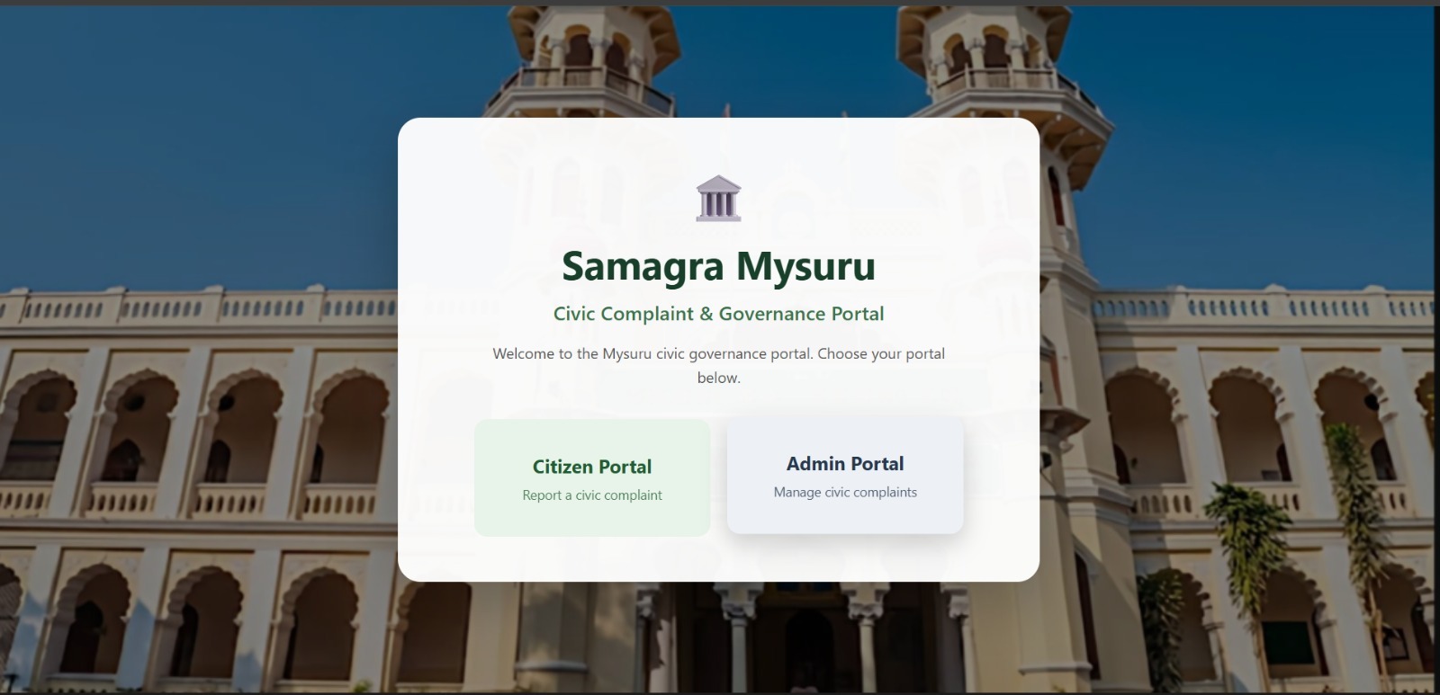
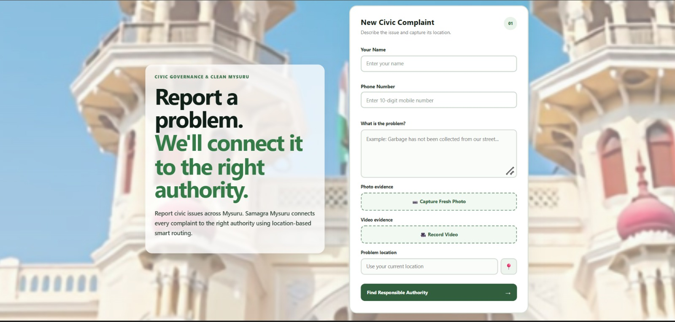
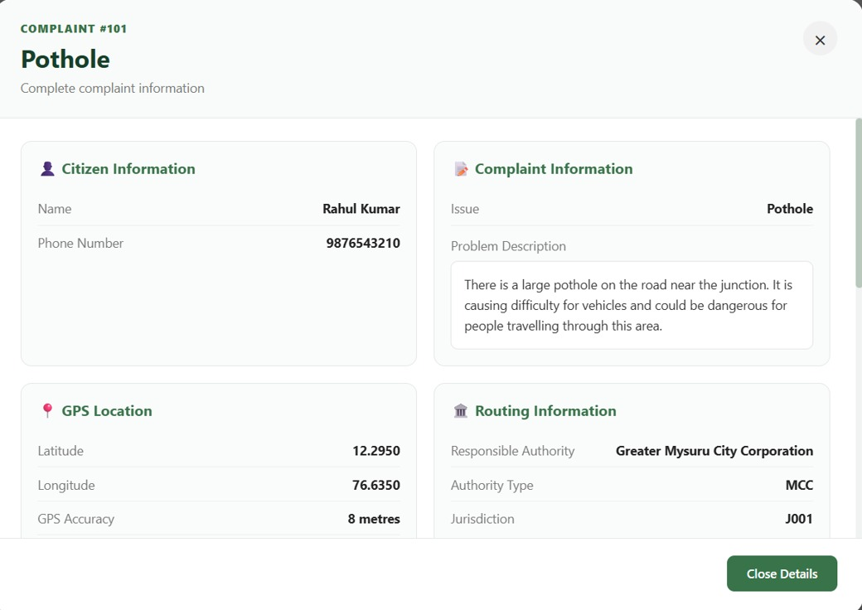
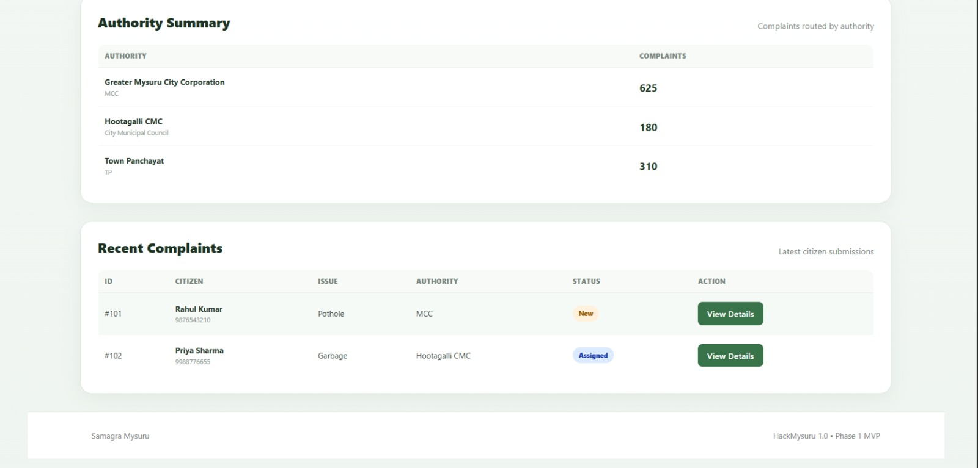
WEBSITE / PRODUCT
Samagra Mysuru — the platform
New complaint form
Complaint detail view
Officer analytics dashboard
Citizen & Admin portals — landing page
SAMAGRA MYSURU
11

Slide 12
⌂
THANK YOU
SAMAGRA MYSURU • Civic Complaint & Governance Portal
Manasa M N • Prerana L • Sahana M Singad • Sinchana
GSSSIETW • Dept. of CSE (AIML) • Hack Mysuru 1.0

