Slide 1

Version Control
MEOPAR 2015
Annual Scientific Meeting
MEOPeers Workshop
15-Jun-2015
Vancouver

Slide 2

Doug Latornell
djl@douglatornell.ca
@dlatornell

Slide 3
http://douglatornell.ca/training/meopeers-2015-06-15/

Slide 4
What Is Version Control (VC)?
Use software tools to keep a running record of 1 or more files.

Slide 5
What Is VC?
Use software tools to keep a running record of 1 or more files.
Why You Should Use VC?
Lets you revert to earlier versions of your work
Provides a record of what changed when
Lets you mark significant points in time
Allows you to play "what-if?"
Facilitates organized collaboration (with your future self, as well as with other people)

Slide 6
What You Should Use VC For
Model Code
Python, R, Matlab, etc. Scripts
Plotting Scripts
Processed Data Files & Scripts That Made Them
Complicated Marking Spreadsheets (especially if shared)
Thesis
Papers
ToDo List
...

Slide 7
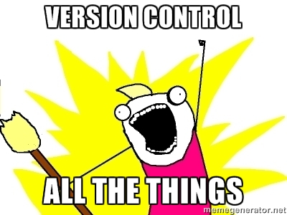
What You Should Use VC For
Model Code
Python, R, Matlab, etc. Scripts
Plotting Scripts
Processed Data Files & Scripts That Made Them
Complicated Marking Spreadsheets (especially if shared)
Thesis
Papers
ToDo List
...

Slide 8
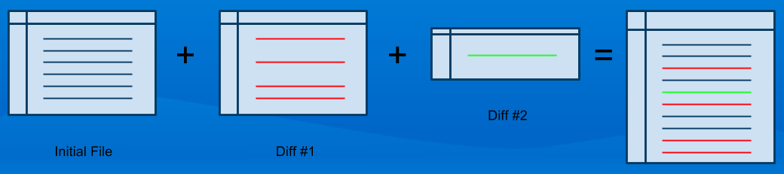
Key Concept
Data Differencing
Given a file, and a complete set of diffs between 1 state and another, any intermediate state for which there is a diff can be reconstructed.

Slide 9
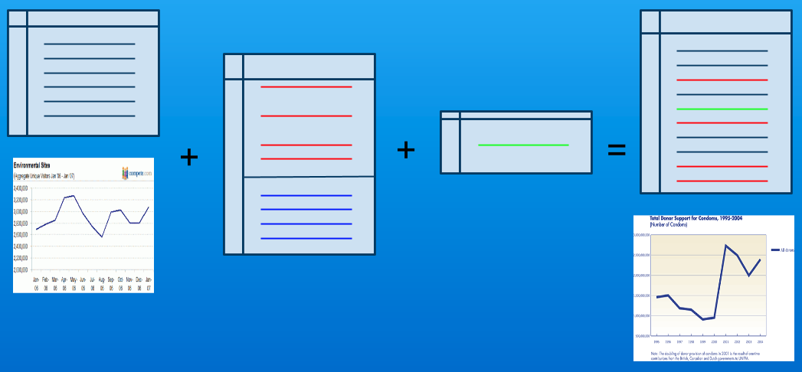

Slide 10
Version Control Tools
https://en.wikipedia.org/wiki/Revision_control

Slide 11

Ad hoc

Slide 12
Version Control Tools
Ad hoc
thesis2.tex, JFM-21mar.doc
pooh.txt, ...
Mists of time...
SCCS
RCS

Slide 13
Version Control Tools
Ad hoc
thesis2.tex, JFM-21mar.doc
pooh.txt, ...
Mists of time...
SCCS
RCS
Proprietary
Visual SourceSafe
Perforce
BitKeeper

Slide 14
Version Control Tools
Ad hoc
thesis2.tex, JFM-21mar.doc
pooh.txt, ...
Mists of time...
SCCS
RCS
Proprietary
Visual SourceSafe
Perforce
BitKeeper
Old School (Client/Server)
CVS (Concurrent Versions System)
SVN (Subversion)

Slide 15
Version Control Tools
Ad hoc
thesis2.tex, JFM-21mar.doc
pooh.txt, ...
Mists of time...
SCCS
RCS
Proprietary
Visual SourceSafe
Perforce
BitKeeper
Old School (Client/Server)
CVS (Concurrent Versions System)
SVN (Subversion)
Distributed & Open Source
GNU arch
Darcs
Monotone
Bazaar
Git
Mercurial

