Slide 1

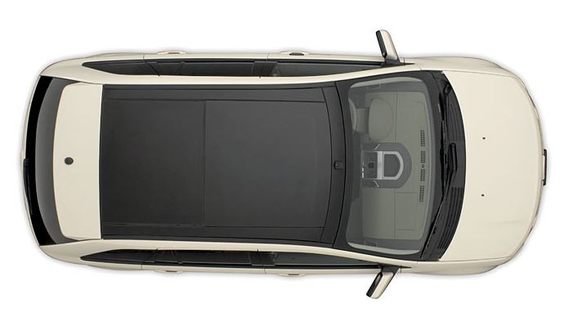
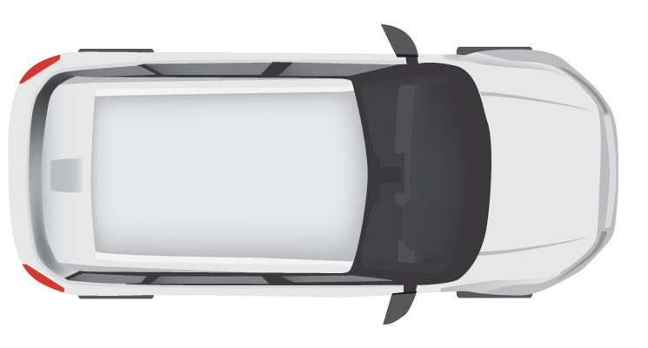
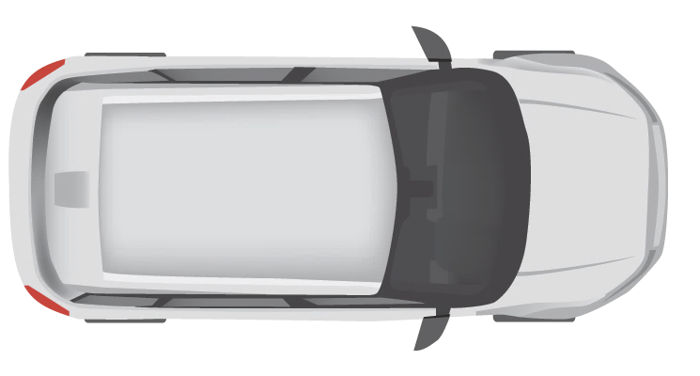
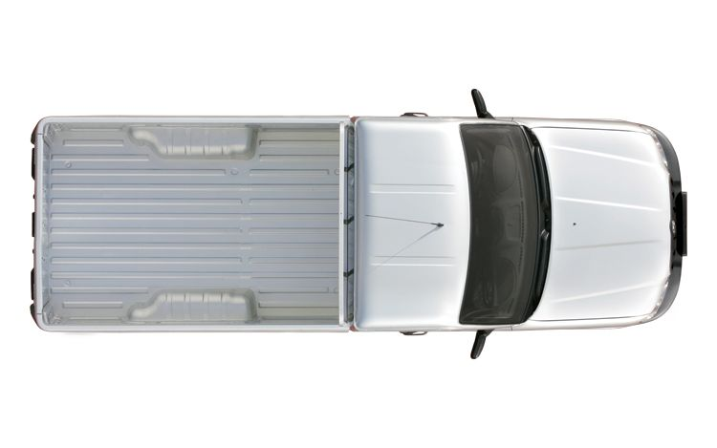
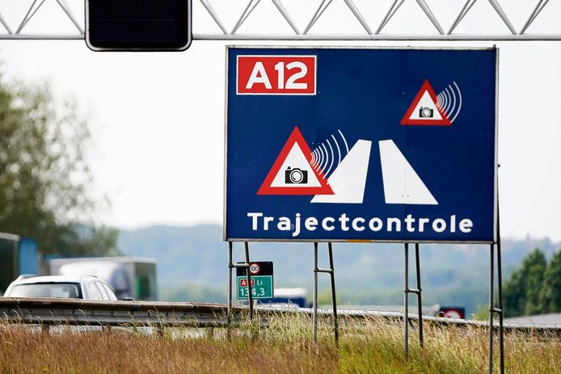


10 km
Entry Cam 1
Exit Cam 1
Entry Cam 2
Exit Cam 2
Entry Cam 3
Exit Cam 3
Department Of
Motor Vehicles (DMV)
Central Fine Collection Agency

Slide 2
Camera
Simulation
Traffic
Control
Service
Fine
Collection
Service
Vehicle
Registration
Service
EntryCam
CollectFine
GetOwnerInfo
ExitCam

Slide 3
Camera Simulation
Traffic Control
Service
Fine Collection Service
Vehicle Registration Service
Camera
Simulation
Entry Cam
Exit Cam
Collect Fine
Get
Owner
Info
VehicleRegistered
Store VehicleState
VehicleRegistered
Get VehicleState
Calculate Average Speed
[AvgSpeedOverLimit]
CollectFine
Calculate Fine
GetOwnerInfo
Send Email

Slide 4






Camera
Simulation
MQTT
Sidecar
Traffic
Control
Service
5
5
5
EntryCam
5
ExitCam
2
3
Redis
3
RabbitMQ
2
Sidecar
Fine
Collection
Service
2
2
CollectFine
1
4
6
SMTP
4
1
Sidecar
Vehicle
Registration
Service
Secrets
1
GetOwnerInfo
6
1
Service invocation
3
State management
5
Input binding
2
Publish / subscribe
4
Output binding
6
Secrets management

Slide 5
Camera Simulation
Traffic Control
Service
Fine Collection Service
Vehicle Registration Service
Camera
Simulation
MQTT
Entry Cam
Exit Cam
Redis
RabitMQ
Collect Fine
Get
Owner
Info
SMTP
VehicleRegistered
VehicleRegistered
Store VehicleState
VehicleRegistered
VehicleRegistered
Get VehicleState
Calculate Average Speed
[AvgSpeedOverLimit]
CollectFine
CollectFine
Calculate Fine
GetOwnerInfo
Send email

