Slide 1

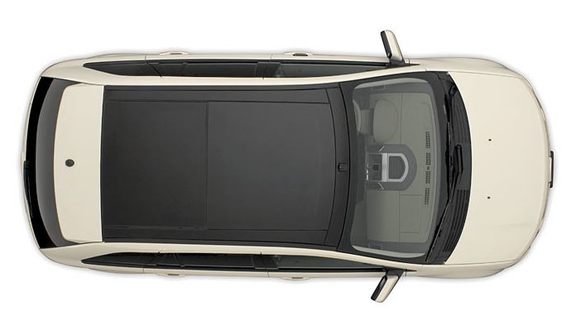
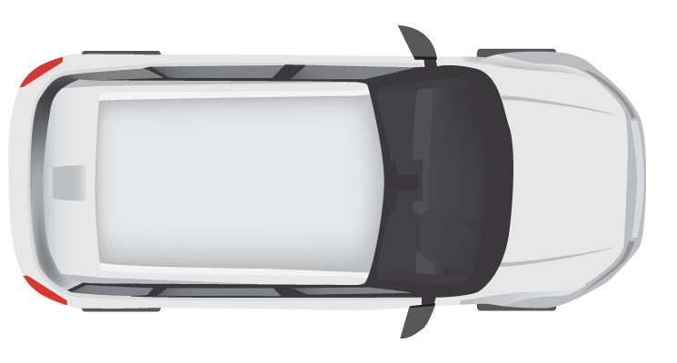
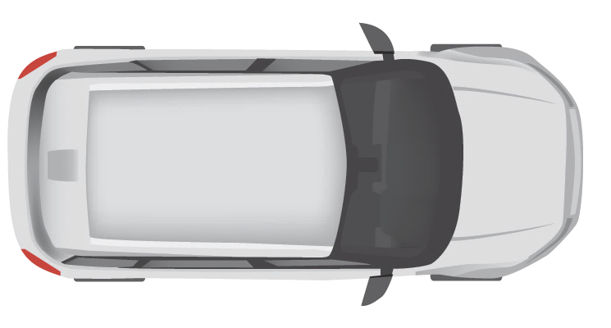
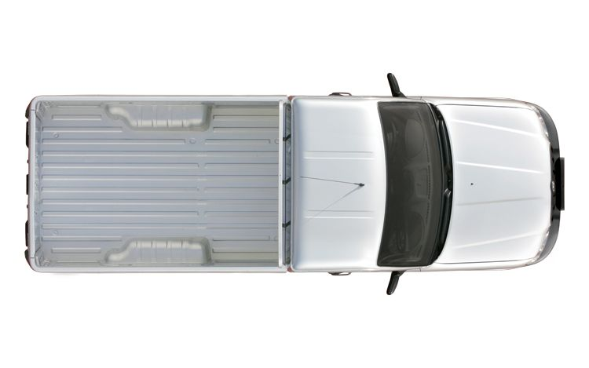


10 km
Entry Cam 1
Exit Cam 1
Entry Cam 2
Exit Cam 2
Entry Cam 3
Exit Cam 3
Department Of
Motor Vehicles (DMV)
Central Fine Collection Agency

Slide 2
Simulation
TrafficControl
Service
Government
Service
EntryCam
RDW
ExitCam
CJIB

Slide 3



Simulation
Sidecar
1
1
Redis
1
1
3
Traffic Control
Service
Sidecar
Sidecar
Government
Service
Entry Cam
2
RDW
Exit Cam
CJIB
Secrets
4
1
Pub/Sub
2
Service Invocation
3
State Management
4
Secrets Management

Slide 4



Simulation
Sidecar
1
1
Redis
1
1
3
Traffic Control
Service
Sidecar
Sidecar
Government
Service
Entry Cam
2
RDW
Exit Cam
CJIB
Secrets
4
1
Pub/Sub
2
Service Invocation
3
State Management
4
Secrets Management

Slide 5
TrafficControl Service
Government Service
Simulation
Redis
Server
Entry Cam
Exit Cam
State
Store
RDW
CJIB
VehicleRegistered
VehicleRegistered
GetVehicleInfo
Store VehicleState
VehicleRegistered
VehicleRegistered
Get VehicleState
Calculate Average Speed
[AvgSpeedOverLimit]
SpeedingViolationDetected
SpeedingViolationDetected
Calculate Fine
Send Fine

