Slide 1

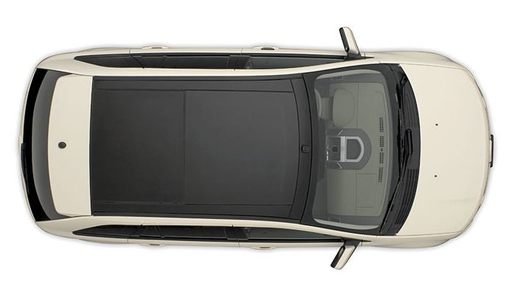
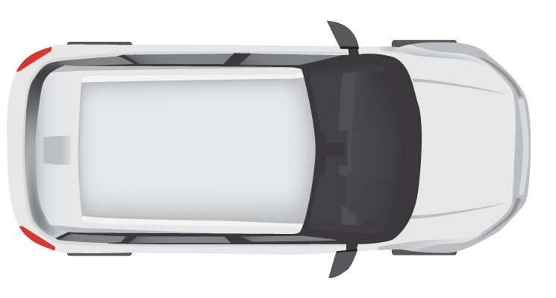
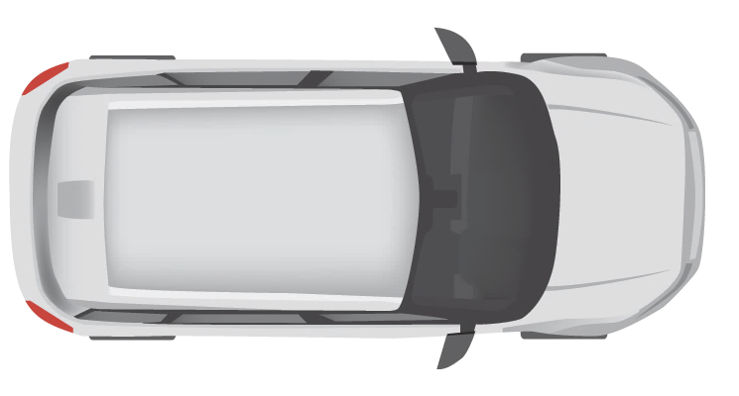
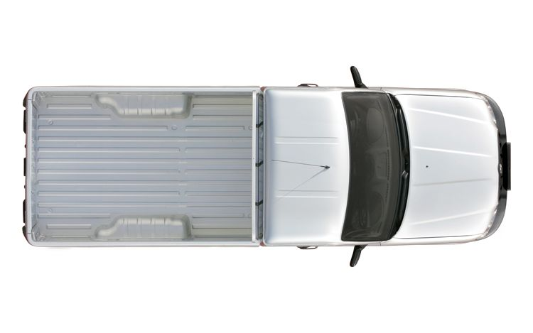


10 km
Entry Cam 1
Exit Cam 1
Entry Cam 2
Exit Cam 2
Entry Cam 3
Exit Cam 3
Department Of
Motor Vehicles (DMV)
Central Fine Collection Agency

