Slide 1

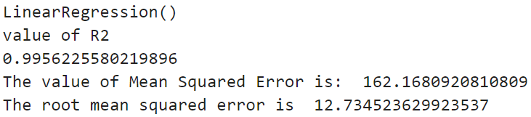
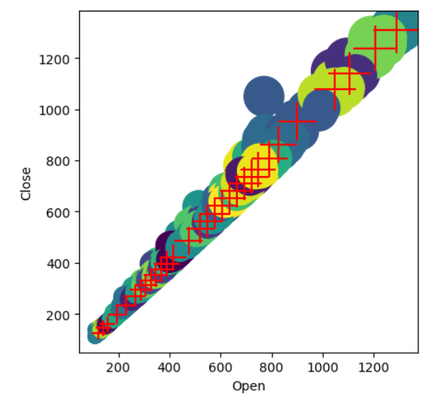
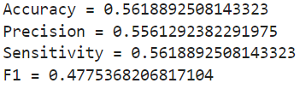
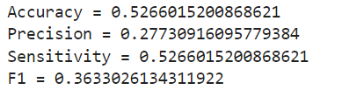
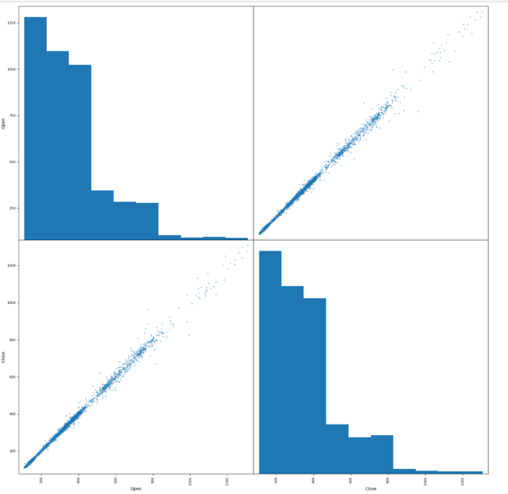
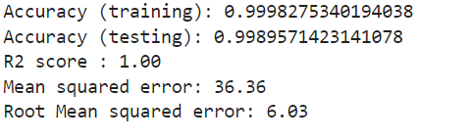
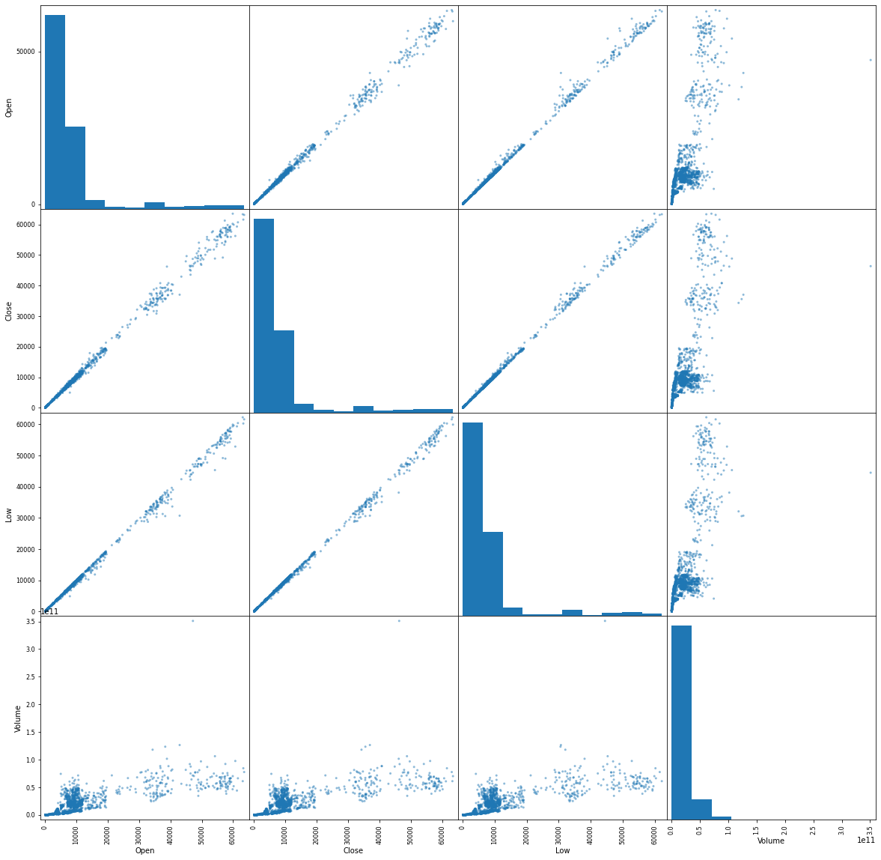

Predicting Adani Port Close Price With Respect To The Open Price
Ganga Prasanna Mogaparthi
School of Computer Science and Information Systems, Northwest Missouri State University
Model Outputs
Interpretation and Conclusion
Dataset Introduction and Goals
Dataset obtained from Kaggle.
3323 Rows and 15 Columns.
Data from 2007 to 2021
Numeric Features include Prev Close, Open, High, Low, Last, Close, VWAP, Volume, Turnover, Trades, Deliverable Volume and %Deliverable.
Replaced null values in Trades column with 0.
Goal: Predicting the Close price based on the Open price.
Linear Regression
A high R2 value of 0.99 for linear regression suggests an excellent fit and shows strong relationship between Open and Close price.
Performance of Decision tree is low with only 52% of accuracy.
SVM metrics also seem to be poor. It could be because the dataset is imbalanced, or the kernel choice was not the best.
Random Forest metrics appeared to be good when compared to other models.
SVM model with different kernel can be employed in the future in order to verify if the metrics are improved.
Decision Tree Test Data
SVM Test Set
Random Forest
Models Used
Discussion and Results
Supervised Learning: The dataset was split into 75% training and 25% test set.
Linear Regression Model
Decision Trees
SVM
Random Forest
Clustering
Neural Nets
Evaluate
Linear Regression Results:
Linear Regression R2 value is 0.99 shows a strong relationship.
Decision Tree
Decision Tree has slight increase in performance on the test set with accuracy from 52% to 56%.
F1 score dropped to 47% from 55% on the test set.
SVM
SVM accuracies are in the range of 52% which performs similar to decision trees.
Random Forest
Metrics are very good with a R2 score of 1.0
Additional Resources
Acknowledgements
Repository
https://www.kaggle.com/datasets/rohanrao/nifty50-stock-market-data?select=ADANIPORTS.csv
https://github.com/44-566-Machine-Learning-S24/ml-s24-project-MogaparthiGanga
Kaggle.com
Dr. Charles Hoot
https://github.com/44-566-Machine-Learning-S24/ml-s24-project-MogaparthiGanga

