Slide 1
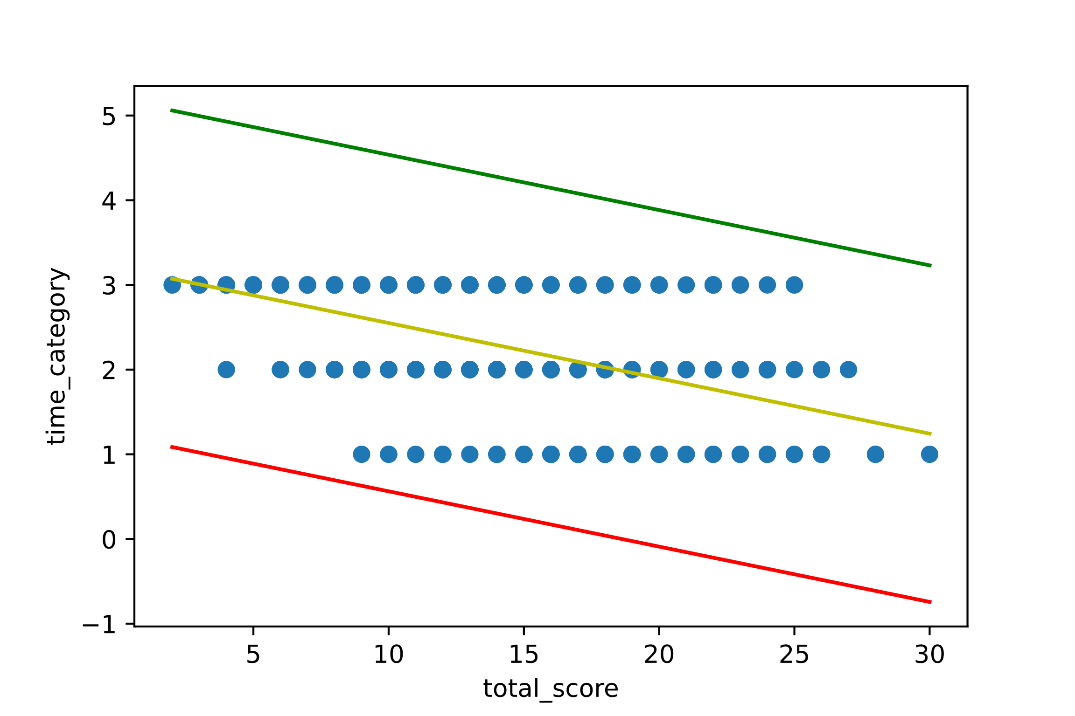

Finding the factors that directly affect time for passion
Guan Ming Chee
Machine Learning Final Project
What I found
Introduction
Exploration of the Data
This project is trying to see the factors that are related to free time for passion.
There are several features such as “flow”, “social network” and “live vision” being used to test the correlation with the time factor.
Rbf kernel
Cross validation confusion matrix are: [array([[ 0, 7],
[ 0, 21]], dtype=int64), array([[ 0, 5],
[ 0, 23]], dtype=int64), array([[ 1, 3],
[ 0, 24]], dtype=int64), array([[ 0, 4],
[ 0, 23]], dtype=int64), array([[ 0, 6],
[ 0, 21]], dtype=int64)]
Cross validation accuracies are: [0.75, 0.8214285714285714, 0.8928571428571429, 0.8518518518518519, 0.7777777777777778]
Cross validation f1 scores are: [0.6428571428571429, 0.7408963585434174, 0.8638655462184873, 0.7837037037037037, 0.6805555555555557]
It can be understood that you need to get into the flow if you are doing something you are passionate about, and a well-planned life (life vision) helps to fulfilling your passion
I used several kernels and RBF is the best among all. Decision Tree is suspected to be overfitting.
The graph do not behave linearly or in polynomial shape as there are always exceptions/outliers among humans that makes prediction flawed.
Decision Tree
Cross validation confusion matrix are: [array([[ 7, 7],
[12, 39]], dtype=int64), array([[ 4, 11],
[12, 37]], dtype=int64), array([[ 6, 7],
[ 9, 42]], dtype=int64), array([[ 2, 8],
[13, 41]], dtype=int64), array([[ 3, 6],
[ 9, 46]], dtype=int64)]
Cross validation accuracies are: [0.7076923076923077, 0.640625, 0.75, 0.671875, 0.765625]
Cross validation f1 scores are: [0.7223031264268378, 0.6445689225141338, 0.7564285714285713, 0.6967233009708739, 0.7790804405874497]
Data
FLOW: mental state, in which you are fully immersed in performing an activity.
SOCIAL NETWORK: close family and friends ready to provide you with a long-term unconditional support.
LIVE VISION: vision board, detailed in a personal journal or openly discussed with your spouse or close friends.
TIME FOR PASSION: Daily hours spent doing what you are passionate
SOURCE: http://www.authentic-happiness.com/your-life-satisfaction-score
“FLOW”, “SOCIIAL NETWORK” “LIVE VISION” AND “TIME FOR PASSION” are what I found to be correlated although the correlation are not strong.
No data-cleaning is needed as the survey requires all fields to be filled.
However, some datatypes needed to be changed because they do not belong to integer (int64) so comparison between numbers cannot be done.
Poster Repository
Future Directions, Challenges and solutions
More features can be added (CORE_CIRCLE, SUPPORTING_OTHERS, PERSONAL_AWARDS and ACHIEVEMENT)
Newly added features tend to have weaker correlations which may drop the metrics score but we can try to limit the range (age) so that non-adults will not be affecting the prediction.
Overall, human possess infinite possibilities so there will always be exceptions that is hard to tell and predict.
44-599-MachineLearning-S21/project-machine-learning-s21-GuanMingChee

