Slide 1

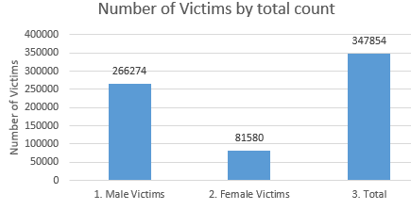
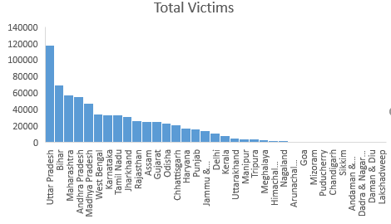
Murder Victims in India Venkatayashwanth Damera| Advisor Dr. Charles Hoot Applied Computer Science| North West Missouri State University
The crime rate in India is rapidly increasing day-by-day. Which motivated me to analyze the murder rates with respect to age and place.
Predicting more number of victims by gender based and which place consists of more number of victims
Bar Graph 1 shows the number
Number of victims to gender.
While Bar graph 2 shows the
Number of total victims to the
Area.
Evaluate the minimum number victims.
The Bar Graph 1 representation show that as there are more number of male victims than female victims
Using Random Forest Classifier accuracy of 98% is obtained.
Accuracy of 92% is achieved with decision tree classifier which indicates good model.
Bar Graph 2
Bar Graph 1
Data Preprocessing: dropna() – clears out all null values.
Prediction: LinearRegression() and for evaluating this, RMS Error.
Classification: DecisionTreeClassifier() and RandomForestClassifier().
Clustering: Kmeans(n_clusters=2) and PCA for dimensional analysis.
IDE and Tool used - Jupyter Notebook
Data Source – Kaggle - https://www.kaggle.com/rajanand/crime-in-india?select=32_Murder_victim_age_sex.csv
Python Model References - https://scikit-learn.org/stable/
I thank Dr. Hoot for giving me proper guidance through out this project.
https://github.com/44-599-MachineLearning-S21/project-machine-learning-s21-Yashwanth-Damera

