Slide 1

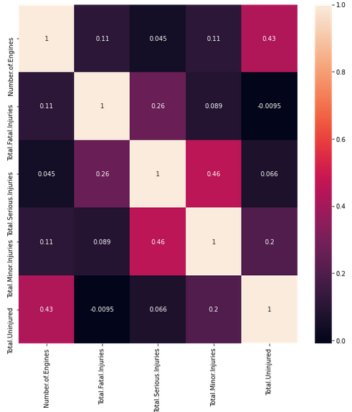
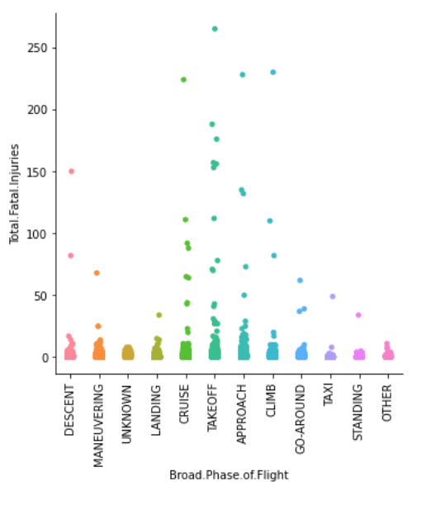
Aviation data analysis and prediction
Sai Krishna Emmadishetty| Advisor Dr.. Charles Hoot
Computer Science and Information Systems | North West Missouri State University
Introduction
Results
Conclusion
Predicted ratio of fatal injuries in Aircraft crashes for Aviation Dataset obtained from kaggle.
Classified aviation related events as accident/incident using meta-data related to the flight and the event.
Evaluate the minimum number nights of Aviation dataset.
The Graphical representation show that highest number of the fatal injuries occur in accidents at takeoff time
Using Random Forest Classifier accuracy of 99.44% is obtained.
Model score of 0.936 is achieved with gradient boosting regression for the fatal injuries prediction
We can avoid over-fitting by regularizing data and using ensemble technique.
Materials
Features: 1. Data related to Aircraft
2. Details about the flight and injuries count if any.
Performed multiple Regression techniques including RF, gradient boosting and linear regression to train the model for regression problem.
Used SVM, decision tree and RF with grid search for event classification.
Fig2: relation between fatal injuries count and flight phase
Fig1: Correlation between features along with label
Aircraft crashes happened during takeoff account for the highest number of fatal Injuries
We find a correlation between Number of air craft engines and fatal injuries which explains that large air crafts if crashed would cause more loss.
Additional Recourses
Acknowledgment
Further Information
https://scikit-learn.org/stable/modules/svm.html
www.kaggle.com/khsamaha/aviation-accident-database-synopses
Dr.Charles Hoot
https://github.com/44-599-MachineLearning-S21/project-machine-learning-s21-Saikrishna1545

