Slide 1
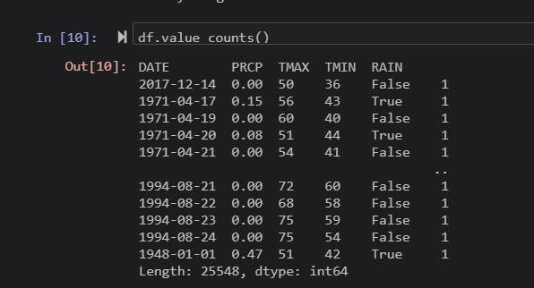
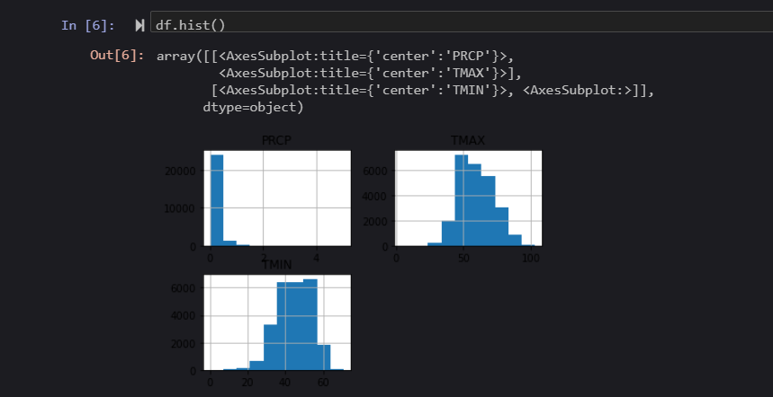
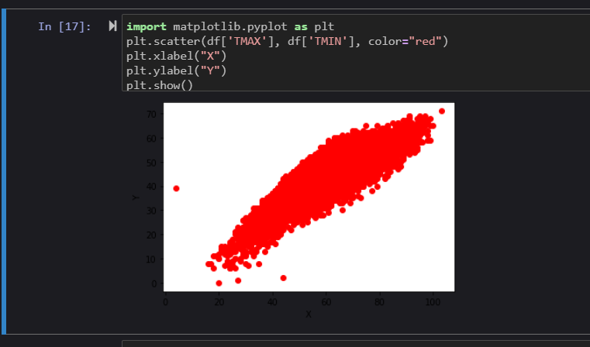
Caleb Gilmore
Data
The data has four features
-Precipitation
-TMAX, the maximum temperature
-TMIN, the minimum temperature
-RAIN, shows a true or false if it rained that day or not
Results
Conclusions
As previously state, we have a better chance of predicting rain when the temperature is around 50.
However, I also noticed that we have a greater chance of getting rain when there is higher temperature as compared to lower.
The image on the left is just some generic dates. Although, we can see that the only times when it rains is when the temperature is around 40 to 50.
Cleaning
There weren’t really any null or missing values, presumably because the dataset was updated daily.
However, I did think about deleting the 0’s, or in other terms, days when it didn’t rain. My thought process was, this will let us focus solely on the days that it rain and allow us to maybe figure out why it rained.
But I decided against it because of the variables that keep it from raining.
The graph on the right shows a pretty similar output. When the temperature is around 50, it rain significantly more.
This is just an extra graph to show the different temperatures of the days throughout the years.
Source:
https://www.kaggle.com/rtatman/did-it-rain-in-seattle-19482017

