Slide 1
Machine Learning Project
Reece Kramer

Slide 2

Goals and Data
My goal with this project was to see if I could find a clear correlation between video game sales and the game genre and development location
I found my data here
https://www.kaggle.com/gregorut/videogamesales

Slide 3
Features
The features that came with the data set is the Rank which sorts the games by highest selling, name which is the name of the game, platform which is the console/platform the game was released on, year which is the year the game was released, genre which is the genre of the game, publisher which is the company that published the game, then NA, EU, JP, Other, and Total Sales.
I decided to remove the platform, name, and year features as they are not features needed to answer my opening question

Slide 4
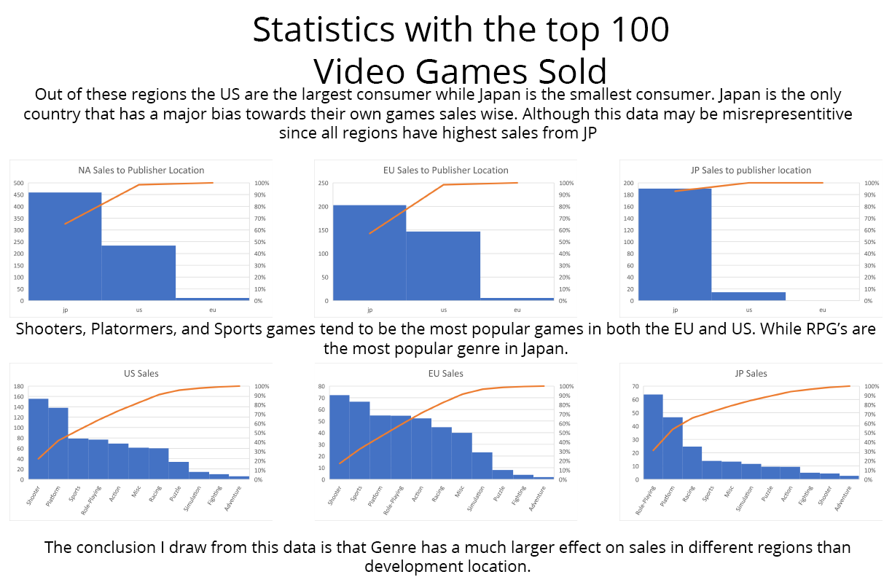
Data Poster and Conclusions
The data I pulled comes from the 100 highest selling games in the dataset

