Slide 1

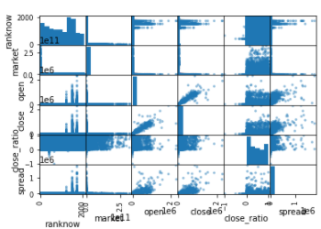
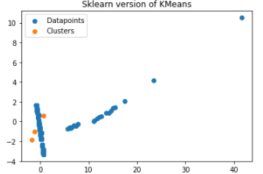
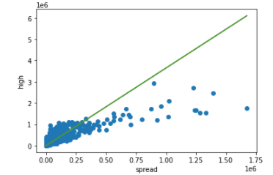
Cryptocurrency Analysis and Prediction
Rajeshwari Rudravaram | Advisor: Dr.Charles Hoot
School of Computer Science and Information Systems, Northwest Missouri State University
Introduction
Results
Conclusions
A cryptocurrency is a digital currency that can be used to buy goods or services across the world.
Any person can buy a cryptocurrency, if they have a “Wallet”(online app) with them.
Predicting the closing values of next day of cryptocurrency with the given features.
Calculated the Close value for the next day of the cryptocurrency.
From the graphs, we can conclude that the value of cryptocurrency is increasing in the market.
In neural nets, using Multi Layer Perceptron the accuracy of model obtained as 96% which indicates that the model is perfect.
I can say that people can start investing their money in Cryptocurrencies as it has a huge profit in future.
This graph represents the cross co-relations between each features in the dataset.
It shows that there is a perfect correlation between Close ratio and Market value which says that the value of cryptocurrencies increases with respect to the Market value.
Materials
Features:
Spread
Low value
Open value
Close Ratio
High
Performed all types of Classifications.
Used Neural Nets to verify the trained model
Evaluate
Challenges and Solutions
Had few issues with the selection of dimensions for X and Y values to train the model as the results obtained for parameters of the model were very low and the cross validations of each model were not effective.
Resolved it by removing unwanted features and then added new features based on given data.
Converted the non-numerical data into numerical using “Label Encoder”.
Above graph represents the number of Clusters and Data points obtained for the dataset.
This graph states that the High value increases as the Spread value increases.
Additional Resources
Acknowledgement
Further Information
https://www.kaggle.com/jessevent/all-crypto-currencies
https://scikit-learn.org/stable/modules/svm.html
Dr. Charles Hoot
https://github.com/44-599-MachineLearning-S21/project-machine-learning-s21-Rajeshwari-Rudra

