Slide 1

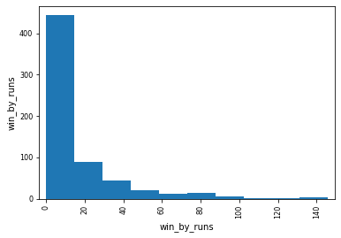
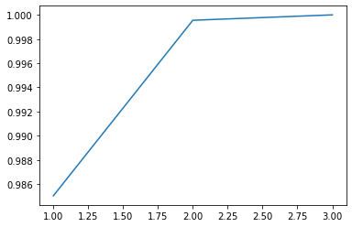
IPL Analysis and Prediction
Bhanuprakash Thota| Advisor Dr.. Charles Hoot
Applied Computer Science | NorthWest Missouri State University
Introduction & Goals
Results
Conclusion
IPL is an India Premier League cricket match that occurs every year which results in high income gain for the BCCI.
Predicting the next IPL winner by taking the data from past 10 years.
This graph is a bar graph
Comparing win by runs and
Win by wickets of a teams.
This graph is a line graph with
Dimensional analysis between
Winner and toss decision.
Predicted the next year IPL winner before auction among all the teams.
The Graphical representation show that most teams has won batting first and they will win by x amount of wickets.
Using Random Forest Classifier accuracy of 86 % is obtained.
Accuracy of 70 % is achieved with neural nets which indicates good model.
Materials
Features:
1. Team1 2. Team2
3. winner 4. toss_decision
I performed multiple regression techniques including RF, gradient and Linear Regression to train the model.
Used SVM with grid search for event classification.
Additional Resources
Acknowledgment
Further Information
https://www.kaggle.com/aadilmalik94/ipl-cricket-dataset?select=matches.csv
https://www.kaggle.com/aadilmalik94/ipl-cricket-dataset?select=matches1234.csv
Dr.. Charles Hoot
https://github.com/44-599-MachineLearning-S21/project-machine-learning-s21-BhanuprakashThota

