Slide 1
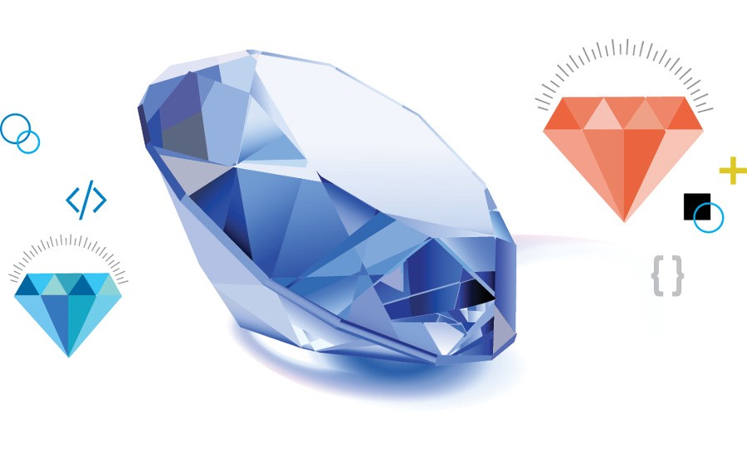
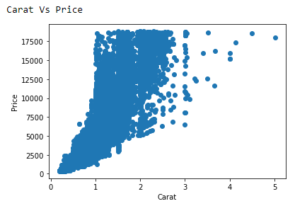
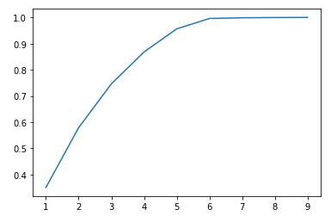
Diamonds Data Analysis and Prediction
Vishal Reddy Vennavaram S538349@NWMISSOURI.EDU
Northwest Missouri State University
Introduction
Results
Conclusion
Diamond's dataset contains various features line cut, clarity, carat etc.
Using this dataset, I would like to predict the price of the diamond based on carat, clarity and cut.
Cleaning and dimension reduction has been to remove the unused features.
The graph shown gives the
Information about the relation
between carat price.
The graph shown is a line graph
between carat and price which shows
that as the carat value increases
the price of the diamond also increases.
Found the relation between the price and various features like carat, clarity, cut.
The Graphical representation shows that as the clarity of the diamond increases the price of the diamonds also increases.
Accuracy of 99% has been obtained using a random forest classifier and the resultant f1_score value obtained is 0.99.
The results are slightly better in the train set compared to that of test set which may be due to the overfitting of the data.
Overfitting of the data can be avoided by using regularized data.
Challenges:
Performing analysis on continuous data is really difficult. So, I divided the data into categories by setting a range for the data.
Having string values in the dataset makes it difficult to perform various operations. So, I have converted them into integer values by setting values.
Materials
Features:
1. Data related to diamonds is used.
2. Information about diamonds like price, carat, clarity are used.
Performed Linear Regression to train the model.
Used SVM, decision tree for classification.
Additional Recourses
Acknowledgment
Further Information
https://scikit-learn.org/stable/modules/generated/sklearn.linear_model.LinearRegression.html
https://www.kaggle.com/shivam2503/diamonds
https://scikit-learn.org/stable/modules/generated/sklearn.model_selection.train_test_split.html
Mentor : Dr. Charles Hoot
https://github.com/44-599-MachineLearning-S21/project-machine-learning-s21-Vishalreddy114

