Slide 1
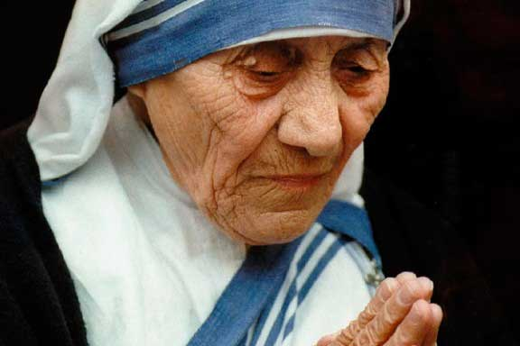
Mother Teresa

Slide 2
Who was Mother Teresa
Mother Teresa was born in Skopje, Macedonia on 26 August.
She was given the name Agnes Gonxha Bojaxhiu.
Her family was dedicated to God and they did a lot to help the less fortunate in the community.
This serving and helping nature helped shape Mother Teresa’s life.

Slide 3
How did she become a nun?
Becoming a nun is a very drastic step in ones life as you have to let go of all the normal things, luxury life and our possessions which we use in our day to day life.
Mother Teresa at the age of 18 left her home and moved to Ireland to become a nun. This was in September 1928.
She joined the Lereto Convent in Rathfarnam and there she was named Sister Teresa.

Slide 4
Mission in India and her contribution
In 1929 , 16th January, Sister Teresa was sent to India.
She arrived in Calcutta and made her way to Darjeeling.
She had wanted to become a teacher and began working in St. Mary’s High School for girls.
The convent was dedicated to teaching the girls of some of the poorest Bengali people.
Sister Teresa learnt both Hindi and Bengali to teach.

Slide 5
How did she become Mother Teresa?
In 1937, she took her final vows and dedicated herself to life of poverty.
Then she was given the title the ‘Mother’ and hence called as Mother Teresa.
In 1944, due to her kindness and dedication towards the girls, she became the principal.

Slide 6
What changed her life?
It was 1946, 26th September, Mother Teresa was on a train journey from Calcutta to Darjeeling .
She then received a call within a call .
During the train journey she was called by God to leave school and go to work with the poor.
She needed permission to leave school because of the vows she made.

Slide 7
Working in the slums
Mother Teresa spent half a year doing medical and first aid training to prepare for her new calling.
She then went to work in the slums to help the people who are often uncared for and overlooked by the rest of the society.
In December 1948, she started a school for the poor, then in 1957 she opened an orphanage for homeless children.
In between 1950-60, she also setup a leper colony, several clinics, a family clinic and a nursing home.
Leper – A person suffering from a disease leprosy

Slide 8
What happened to Mother Teresa
During 1980-90, she travelled around the world helping other women to do projects like her.
She died on 5th September 1997, her death was mourned around the world

Slide 9
What happened after her death
In 2003, Pope John Paul II started proceedings to have Mother Teresa beatified.
In July 2016, Pope Francis declared that Mother Teresa was to become a Saint.

Slide 10
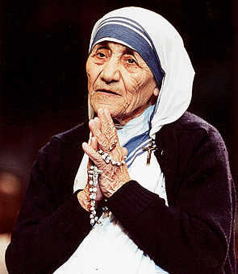
Saint Teresa
She is now known as Saint Teresa of Calcutta

