Slide 1
Computer Arch. & AI Chip Lecture 10: Cache Coherence and Cache Consistency
Prof. Zeke Wang
Zhejiang University
7 May 2026

Slide 2
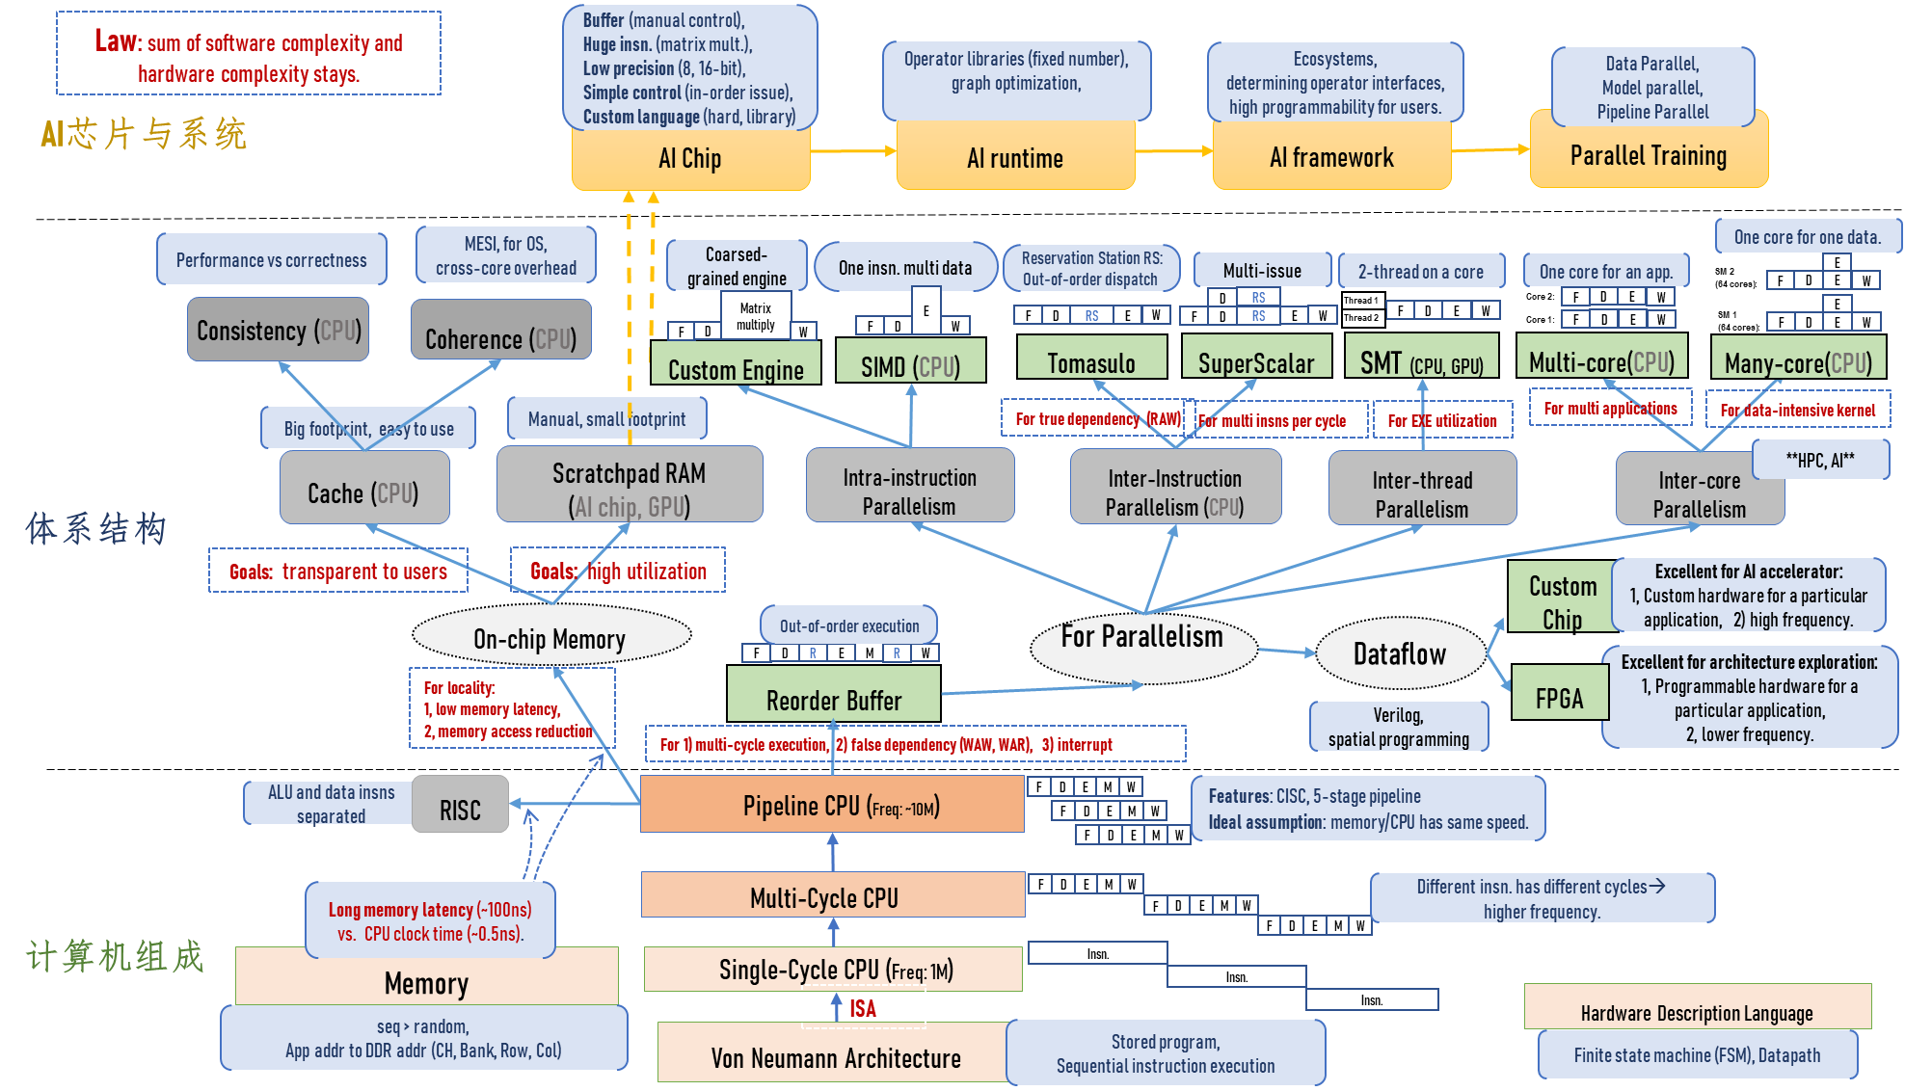
Where Are We?

Slide 3
Recall: One Implementation of LRU
Pseudo LRU for 8-way set-associated cache:
Assume 8 blocks (L0~L7) for a set, 7 bits for rule (B0~B6).
PLRU Replacement Way Selection: choosing the suitable way (L0~L7) based on the PLRU bits.
PLRU Bits Updating Rule: updating PLRU bits after replacing the way (L0~L7).
PLRU Replacement Way Selection:
PLRU Bits Updating Rule:

Slide 4
Recall: Cache Replacement Policy
LRU vs. Random: LRU is not always better.
Example: 4-way cache, cyclic references to A, B, C, D, E
0% hit rate with LRU policy
Set thrashing: When the “program working set” in a set is larger than set associativity
Random replacement policy is better when thrashing occurs
Which one is better in practice?
Depends on workload
Average hit rate of LRU and Random are similar
Best of both Worlds: Hybrid of LRU and Random
How to choose between the two?
Intel CPU uses the hybrid approach.

Slide 5
Recall: Cache Policies: Memory Write
Where should you write the result of a store? One policy for each step.
Step 1: store insn. → cache, either policy works:
Write-allocate policy (default):
Allocate the cache line (put it in the cache).
Issue: Read an entire cache block from memory
Write-no-allocate policy (PCIe/IO):
Write it directly to memory without allocation in cache.
Ignore cache.
Step 2: cache → memory, either policy works:
Write-back policy (default):
Writes it to the cache and wait until the cache kicks the cache block out
Write-through policy (streaming write instruction):
Writes it to the cache and memory right away
Notes:
4 combinations…

Slide 6
Recall: Instruction vs. Data Caches
Core question: Separate or Unified?
Pros and Cons of Unified Cache:
+ Dynamic sharing of cache space: no overprovisioning that might happen with static partitioning (i.e., separate I and D caches)
-- Instructions and data can thrash each other (i.e., no guaranteed space for either)
-- I and D are accessed in different places in the pipeline. Where do we place the unified cache for fast access?
Modern CPU:
First level caches are almost always split
Higher level caches are almost always unified

Slide 7
Recall: Classification of Cache Misses
Compulsory miss
Defined as the first reference to an address (block), always resulting in a miss
Capacity miss
defined as the misses that would occur even in a fully-associative cache (with optimal replacement) of the same capacity
Cause: cache is too small to hold everything needed
Conflict miss
defined as any miss that is neither a compulsory nor a capacity miss

Slide 8
Recall: How to Reduce Each Miss Type
Compulsory miss
Caching cannot help
Prefetching can: Anticipate which blocks will be needed soon
Conflict miss
More associativity
Other ways to get more associativity without making the cache associative
Victim cache
Better, randomized indexing
Software hints?
Capacity miss
Utilize cache space better: keep blocks that will be referenced
Software management: divide working set and computation such that each “computation phase” fits in cache

Slide 9
Recall: Block Size
Block size is the data that is associated with an address tag
Too small blocks
don’t exploit spatial locality well
have larger tag overhead
Too large blocks
too few total # of blocks → less
temporal locality exploitation
waste of cache space and bandwidth/energy
if spatial locality is not high
hit rate
block
size

Slide 10
Recall: Associativity
How many blocks can be present in the same index (i.e., set)?
Larger associativity
Lower miss rate (reduced conflicts)
Higher hit latency and area cost (plus diminishing returns)
Smaller associativity
Lower hit rate
Lower cost
Lower hit latency
Especially important for L1 caches
hit rate
associativity

Slide 11
Memory Consistency vs. Cache Coherence
Coherence is about ordering of operations from different processors to the same memory location
Local ordering of accesses to each cache block
Consistency is about ordering of all memory operations from different processors (i.e., to different memory locations)
Global ordering of accesses to all memory locations
Notes:
Coherence;一致性
Consistency:连贯性

Slide 12
Cache Coherence

Slide 13
Features of Cache Coherence
Cache Coherence: Multiple cores have a consistent state of the last written value from any core to a memory address.
Program order preservation: core C writes to the address and then reads from the same address, C gets value written.
Coherent memory view: if C1 performs “mem[X] = 1”, after a sufficient time, C2 will read 1 from “mem[X]”.
Write serialization: writes to the same address by different processors are seen in same order by all processors.
Write 1
C
Memory
Read 1
Write 1
C1
Memory
Read 1
C2
Write 1
C1
Memory
Write 2
C2

Slide 14
Recall: Hardware Arch. for Cache Coherence
Hardware architecture for Cache Coherence:
Cores, caches, interconnect, memory work together to achieve cache coherence from core’s point of view.
Cache Tags: MESI (CPU action → Bus action, Tags)
Cache Updating: invl./update (Bus action)
Interconnect: Bus/Switch
Core
Core
Core
CPU action
CPU action
Cache blocks
Tags
Cache blocks
Tags
Cache
Bus action
Bus action
R: read
W:write
I: invalidate
U: update
Interconnection Network
Interconnect
Main Memory
Memory

Slide 15
Recall: Cache Coherence: Cache Tags
Hardware architecture for Cache Coherence:
Cores, caches, interconnect, memory work together to achieve cache coherence from core’s point of view.
Cache Tags: MESI (CPU action → Bus action, Tags)
Cache Updating: invl./update (Bus action)
Interconnect: Bus/Switch
Core
Core
Core
CPU action
CPU action
Cache blocks
Tags
Cache blocks
Tags
Cache
Bus action
Bus action
R: read
W:write
I: invalidate
U: update
Interconnection Network
Interconnect
Main Memory
Memory
Notes:
Singe Core? Valid bit, tag…

Slide 16
Cache Coherence: Cache Tags
MSI Protocol: safely update replicated data in caches (goal).
I(nvalid): block is not in cache, need to fetch from memory or other cache
S(hared): in >=1 caches, clean, local cores can read it w/o bus action
M(odified): in 1 cache, core can read/write it w/o bus action
Input:
CPU action of one requested core
Output:
Bus action of one requested core
Changed States:
Modified cache tag
Core
Core
CPU action
CPU action
Cache blocks
Tags
Cache blocks
Tags
Bus action
Bus action
Bus (one trans. A time)
Main Memory
Notes:
大三有很多课，假如10门课，你跟你室友都选了人工智能芯片与系统专业课，这样人工智能专业课的信息大家有兴趣去了解（update比较好）；但有选修课，不是所有人都选了，这个时候update就不好，invalidate就比较好。

Slide 17
Recall: Single Core’s Cache
Address
Tag Store
(Valid bit +
Address tag +
Replacement policy bits)
Data Store
(stores
memory
blocks)
Hit/miss?
Data
Notes:
Reducing AMAT is not always beneficial for performance. The direct metric is instruction throughput, which might be orthogonal to latency.

Slide 18
State Diagrams for CPU and Bus Requests
Core’s memory read/write → Cache states, Bus action:
1, Miss in local cache
2, Hit in local cache
Bus action → Cache states:
1, Invalidate
2, Write miss
3, Read miss
Core read hit
Read miss
I
Core read miss
S
I
Invalidate/Write miss
S
Read miss on bus
Write miss on bus
Invalidate/ Write miss
Write back block to requesting cache and memory
Read miss
Core write miss
Core write hit
Write back block to requesting cache and memory
Invalidate on bus
M
M
Core read hit
Core write hit
Starter
Core
Starter
Cache blocks
CPU action
Tags
Cache
Cache blocks
Tags
Cache response
Bus action
Bus action
Notes:
CPU request → Cache states → Bus request

Slide 19
Recall: The Problem with MSI
A block is not in cache at the beginning. On a read, the block immediately goes to the “Shared” state.
Problem: Core issues a bus action “invalidate” before writing the block to cache, even when only one cache copy exists.
Time | P1 op. | P2 op. | State A in P1 | State B in P2 | Bus action
t0 |  |  | I | I
t1 | Read A |  | S | I | Read miss A
t2 | Write A |  | M | I | Invalidate
t3 |  | Read B | M | S | Read miss B
t4 |  | Write B | M | M | Invalidate

Slide 20
Recall: MESI Protocol
MESI Protocol: Illinois protocol (ISCA, 84)
I(nvalid): block is not in cache, need to fetch from memory or other cache
S(hared): in >1 caches, clean, local cores directly reads it w/o bus action
M(odified): in 1 cache, local core can read/write it w/o bus action
E(xclusive): in 1 cache, clean, local core reads/writes it w/o bus action
Key Differences from MSI Protocol:
Local core reads block in state E, the state holds
Local core writes block in state E → state M, without bus action
Remote core reads, via read miss on bus, block in state E → state S
Remote core writes, via write miss on bus, block in state E → state I
Papamarcos, “A low-overhead coherence solution for multiprocessors with private cache memories,” ISCA 1984.
Notes:
大三有很多课，假如10门课，你跟你室友都选了人工智能芯片与系统专业课，这样人工智能专业课的信息大家有兴趣去了解（update比较好）；但有选修课，不是所有人都选了，这个时候update就不好，invalidate就比较好。

Slide 21
Recall: MESI over MSI
Time | P1 op. | P2 op. | State A in P1 | State B in P2 | Bus action
t0 |  |  | I | I
t1 | Read A |  | S | I | Read miss A
t2 | Write A |  | M | I | Invalidate
t3 |  | Read B | M | S | Read miss B
t4 |  | Write B | M | M | Invalidate
MSI:
Time | P1 op. | P2 op. | State A in P1 | State B in P2 | Bus action
t0 |  |  | I | I
t1 | Read A |  | E | I | Read miss A
t2 | Write A |  | M | I
t3 |  | Read B | M | E | Read miss B
t4 |  | Write B | M | M
MESI:

Slide 22
Cache Coherence Protocols
Cache Coherence
Snoop: [Goodman ISCA 1983]
Bus-based, each bus action broadcasts on the bus, one action at a time.
Each to implement
Single point of serialization for all memory requests.
Core
Core
CPU action
CPU action
Cache blocks
Tags
Cache blocks
Tags
Bus action
Bus action
Bus (one trans. A time)
Main Memory

Slide 23
Snoop-Based Cache Coherence

Slide 24
Cache Snoop Protocol
Core
Core
CPU action
CPU action
Cache blocks
Tags
Cache blocks
Tags
Bus action
Bus action
Bus (One trans. a time)
Main Memory
Snoop: [Goodman ISCA 1983]
Single point of serialization for all memory requests
One outstanding memory request per processor
System interconnect is an atomic shared bus (one cache communicates at a time)

Slide 25
Example: How Snoop/Direct Works?
C1
C2
C3
C4
…
X: I
X:
I
X: S
X: S
Interconnect
Initial states:
X is only shared by C3 and C4
Operations:
C1:X=888
C3: reads X

Slide 26
How Snoop Works? (C1: X = 888)
C1
C2
C3
C4
…
X: I
X: S
X: I
X: I
X:
M, 888
X: S
I
Bus (One transaction active at a time)
C1(local) Bus C3(remote) C4(remote) …
GetEx X
Invalidate X
Invalidate X
Ack
Ack
X = 888
Notes:
Bus also broadcasts to C2…

Slide 27
How Bus Works? (C3 reads X)
C1
C2
C3
C4
…
X: I
X: S
X: I
X:
S, 888
X: I
M, 888
Bus (One transaction active at a time)
C1(M) Bus C3(local) C4(remote)
GetS X
GetS X
GetS X
Write X to memory
Ack
Reply X=888

Slide 28
Why Needing a Bus?
Ordering
Bus serializes requests, ordering some before others.
However: coherence does not require ordering of requests to different address.
Communication
Simple, fast broadcast medium
However: coherence does not require broadcast
Only need to communicate with sharers
Observation: most data is not shared by every cache.

Slide 29
Cache Coherence Protocols
Cache Coherence
Snoop: [Goodman ISCA 1983]
Bus-based, each bus action broadcasts on the bus, one action at a time.
Single point of serialization for all memory requests.
Directory:[Censier, ToC 1978]
Cores make explicit requests for blocks
Directory tracks which caches have each block
Directory coordinates invalidation and updates
Single point of serialization per block, distributed among nodes
Long processing latency
Core
Core
CPU action
CPU action
Cache blocks
Tags
Cache blocks
Tags
Dict.
Dict.
Bus action
Bus action
Switch (peer to peer)
Main Memory

Slide 30
Directory-Based Cache Coherence

Slide 31
Directory Based Coherence: Goal and Idea
Goal: address the lack of scalability of snooping protocols.
All-to-all broadcast will not scale
Idea: A logically-central directory keeps track of where the copies of each cache block reside. Caches consult this directory to ensure coherence.
Coherence still requires single point of serialization (for write serialization)
Serialization location can be different for every block (striped across nodes/memory-controllers)

Slide 32
Directory: Node Definition
C1
C2
C3
C4
…
Cache
Cache
Cache
Cache
Switch (peer to peer)
Regarding a cache block:
Home Node: the node owns the corresponding directory, each cache block can have different home node.
Local Node: the node initiates the cache read/write requests
Remote Node: the node passively responses to the action from the home node

Slide 33
Directory: Basic Operations
Local node:
On a bus read: send out getS request to home node, after receiving the data, set the cache’s bit.
On a bus write: send out getEx request to home node
invalidate all caches that have the block and reset their bits
Have an “exclusive bit” associated with each block in each cache
Directory node:
1, Receives getS, getEx requests from nodes
2, Based on different cache states:
2a, Sends Invalidate messages to sharers if “Shared”
2b, Forwards request to memory if “Not valid”
3, Replies to requestor and updates sharing states
Notes:
Protocol design is flexible
Exact forwarding paths depend on implementation
For example, do cache-to-cache transfer?

Slide 34
Directory for Each Cache Line
2-bit log2N-bit N-bit
states | Owner | Sharer list (one-hot bit vector)
Detailed directory for each cache line:
Each cache block needs N+log2N + 2 bits for its directory, which resides at the home node.
2-bit cache states: a block is owned by the directory unless the block is in a cache in state M. State M means a node writes to it.
One shared bit for each cache: indicating whether the block is shared in a cache
log2N owner bit: indicates that the cache that has the only copy of the block and can update it without notifying others

Slide 35
How Directory Works?
C1
C2
C3
C4
…
X: S{C3, C4}
X:
I
X: S
X: S
Switch (peer to peer)
Initial states:
Directory stays in C2
X is only shared by C3 and C4
Operations:
C1:X=888
C3: reads X

Slide 36
How Directory Works? (C1: X = 888)
C1
C2
C3
C4
…
X: S{C3, C4}
X: E{C1}
X: S
X: I
X: I
X:
M, 888
X: S
I
Switch (peer to peer)
C1(local) C2(home) C3(remote) C4(remote)
GetEx X
Invalidate X
Invalidate X
Ack
Ack
Reply X=111
X = 888

Slide 37
How Directory Works? (C3 reads X)
C1
C2
C3
C4
…
X: S{C1, C3}
X: E{C1}
X: S
X: I
X:
S, 888
X: I
M, 888
Switch (peer to peer)
C1(owned) C2(home) C3(local) C4(remote)
GetS X
Fwd-GetS X to C1
Ack
Write X to memory
Reply X=888

Slide 38
Memory Consistency vs. Cache Coherence
Coherence is about ordering of operations from different processors to the same memory location
Local ordering of accesses to each cache block
Write serialization: all cores see the same write ordering
Consistency is about ordering of all memory operations from different processors (i.e., to different memory locations).
Global ordering of accesses to all memory locations
Notes:
Coherence;一致性
Consistency:连贯性

Slide 39
Cache Consistency

Slide 40
Ordering of Operations
Operations: A, B, C, D
In what order should the hardware execute (and report the results of) these operations?
Consistency： A contract between programmer and microarchitect.
Preserving an “expected” (more accurately, “agreed upon”) order simplifies programmer’s life
Ease of debugging; ease of state recovery, exception handling
Preserving an “expected” order usually makes the hardware designer’s life difficult
Especially if the goal is to design a high performance processor: Recall load-store queues in out of order execution and their complexity

Slide 41
Memory Ordering in a Single Processor
Specified by the von Neumann model
Sequential order
Hardware executes the load and store operations in the order specified by the sequential program
Out-of-order execution does not change the semantics
Hardware retires (reports to software the results of) the load and store operations in the order specified by the sequential program
Advantages: 1) Architectural state is precise within an execution. 2) Architectural state is consistent across different runs of the program → Easier to debug programs.
Disadvantage: Preserving order adds overhead, reduces performance, increases complexity, reduces scalability

Slide 42
Memory Ordering in a MIMD Processor
Each processor’s memory operations are in sequential order with respect to the “thread” running on that processor (assume each processor obeys the von Neumann model)
Multiple processors execute memory operations concurrently
How does the memory see the order of operations from all processors?
In other words, what is the ordering of operations across different processors?

Slide 43
Example of Multi-threaded Program
A = B = 0 initially.
Core 1:
(1) A = 1
if (B == 0)
（2） print “Hello”: <critical section>
Core 2:
(3) B = 1
if (A == 0)
(4) print “ZJU” : <critical section>
Is it possible for both cores to enter critical section and to print “Hello” and “ZJU” on real hardware?
Notes:
有可能的哈。

Slide 44
The Challenge
Challenge: The two processors did NOT see the same order of operations to memory
The “happened before” relationship between multiple updates to memory was inconsistent between the two processors’ points of view
As a result, each processor thought the other was not in the critical section

Slide 45
Four Types of Memory Barrier
Load-Load:
Effectively prevents ordering of loads performed before the barrier with loads performed after the barrier
Load-Store:
Effectively prevents ordering of loads performed before the barrier with writes performed after the barrier
Store-Store:
Effectively prevents ordering of stores performed before the barrier with stores performed after the barrier
Store-Load:
Effectively prevents ordering of stores performed before the barrier with loads performed after the barrier

Slide 46
Four Memory Barriers vs. Consistence Model
Load-Load | Load-Store | Store-Store | Store-Load | Consistence Model | CPU
√ | √ | √ | √ | Sequential Consistency | Dual 386
√ | √ | √ |  | Total Store Order | X86/64
√ | √ |  |  | Partial Store Order | Arm
 |  |  |  | Really weak memory model | DEC Alpha
Comparison of memory models:
The stronger memory model leads to lower performance/higher overhead
The stronger memory model makes programmers’ life easier

Slide 47
Sequential Consistency
Sequential Consistency:
Load-Load
Load-Store
Store-Store
Store-Load
Sequential Consistency in a multiprocessor system if:
In uniprocessor: the operations of each individual processor appear in this sequence in the order specified by its program
AND
In multiprocessor: the result of any execution is the same as if the operations of all the processors were executed in some sequential order, as if they were manipulating a single shared memory
Lamport, “How to Make a Multiprocessor Computer That Correctly Executes Multiprocess Programs,” IEEE Transactions on Computers, 1979

Slide 48
Sequential Consistency
P1
P2
P3
Pn
MEMORY
Sequential Consistency: Memory is a switch that services one load or store at a time from any processor
All processors see the currently serviced load or store at the same time
Each processor’s operations are serviced in program order

Slide 49
Example under Sequential Consistency
A = B = 0 initially.
Core 1:
(1) A = 1
if (B == 0)
（2） print “Hello”: <critical section>
Core 2:
(3) B = 1
if (A == 0)
(4) print “ZJU” : <critical section>
What is the reasonable execution order?
(1) → (2) → (3) → (4) “Hello”
(3) → (4) → (1) → (2) “ZJU”
(1) → (3) → (2) → (4) or (1) → (3) → (4) → (2)
(3) → (1) → (2) → (4) or (3) → (1) → (4) → (2)
Is it possible to print “Hello” and “ZJU” on real hardware?
Notes:
有可能的哈。

Slide 50
Problem of Sequential Consistency
P1
P2
P3
Pn
MEMORY
Problem of Sequential Consistency: low performance
Two instructions do not conflict, but the second instruction still needs have to wait for the first one to finish before executing.
Writing to memory is really slow, e.g., 100 cycles

Slide 51
Four Memory Barriers vs. Consistence Model
Load-Load | Load-Store | Store-Store | Store-Load | Consistence Model | CPU
√ | √ | √ | √ | Sequential Consistency | Dual 386
√ | √ | √ |  | Total Store Order | X86/64
√ | √ |  |  | Partial Store Order | Arm
 |  |  |  | Really weak memory model | DEC Alpha
Comparison of memory models:
The stronger memory model leads to lower performance/higher overhead
The stronger memory model makes programmers’ life easier

Slide 52
Total Store Order
Total Store Order:
Load-Load
Load-Store
Store-Store
Total Store Order == SC + Store buffer
Committing a store instruction means the data is stored in store buffer, rather than cache hierarchy.
The store instruction writes in a local store buffer and then proceed to next instruction (e.g., load) immediately.
The cache will pull writes out of the store buffer when ready.
Store-load order is not preserved.
C1
X:
I

Slide 53
Store Buffer
C1
Reads
Writes
store buffer
Cache
Idea of store buffer
Overlap memory accesses with other accesses and computation.
Hide long write latency in the core
Reordering read before store

Slide 54
Example under Total Store Order
A = B = 0 initially.
Core 1:
(1) A = 1
if (B == 0)
（2） print “Hello”: <critical section>
Core 2:
(3) B = 1
if (A == 0)
(4) print “ZJU” : <critical section>
What is the reasonable execution order?
(1) → (2) → (3) → (4) “Hello”
(3) → (4) → (1) → (2) “ZJU”
(1) → (3) → (2) → (4) or (1) → (3) → (4) → (2)
(3) → (1) → (2) → (4) or (3) → (1) → (4) → (2)
Is it possible to print “Hello” and “ZJU” on real hardware?
(2) → (4) → (3) → (1) or (2) → (4) → (1) → (3)
Notes:
有可能的哈。<critical section>

Slide 55
Four Memory Barriers vs. Consistence Model
Load-Load | Load-Store | Store-Store | Store-Load | Consistence Model | CPU
√ | √ | √ | √ | Sequential Consistency | Dual 386
√ | √ | √ |  | Total Store Order | X86/64
√ | √ |  |  | Partial Store Order | Arm
 |  |  |  | Really weak memory model | DEC Alpha
Comparison of memory models:
The stronger memory model leads to lower performance/higher overhead
The stronger memory model makes programmers’ life easier

Slide 56
Partial Store Order
Total Store Order:
Load-Load
Load-Store
Partial Store Order == Total Store Order + Write coalescing
Write coalescing: merge writes to the same cache line inside the write buffer to save memory bandwidth
Store-store order is not preserved.

Slide 57
Intuitive Example of Write Coalescing
Code:
A[0] = 8
A[5] = 8
A[11] = 8
Write buffer:
Executed:
A[0] = 8
A[0] = 8
A[5] = 8
A[5] = 8
A[11] = 8
A[11] = 8
Code:
A[0] = 8
A[5] = 8
A[3] = 8
Write buffer:
Executed:
A[0] = 8
A[3] = 8
A[0] = 8
A[5] = 8
A[3] = 8
A[5] = 8
Writing to A[3] and A[5] is re-ordered

Slide 58
Example under Partial Store Order
A = B = 0 initially.
Core 1:
(1) A = 1
if (B == 0)
（2） print “Hello”: <critical section>
Core 2:
(3) B = 1
if (A == 0)
(4) print “ZJU” : <critical section>
What is the reasonable execution order?
(1) → (2) → (3) → (4) “Hello”
(3) → (4) → (1) → (2) “ZJU”
(1) → (3) → (2) → (4) or (1) → (3) → (4) → (2)
(3) → (1) → (2) → (4) or (3) → (1) → (4) → (2)
Is it possible to print “Hello” and “ZJU” on real hardware?
(2) → (4) → (3) → (1) or (2) → (4) → (1) → (3)
Notes:
有可能的哈。

Slide 59
Why Cache Consistency Even Matter?
Ease of debugging
It is nice to have the same execution done at different times to have the same order of execution → Repeatability
Correctness
Can we have incorrect execution if the order of memory operations is different from the point of view of different processors?
Performance and overhead
Enforcing a strict “sequential ordering” can make life harder for the hardware designer in implementing performance enhancement techniques (e.g., OoO execution, caches)

Slide 60
When Could Order Affect Correctness?
When protecting shared data

Slide 61
Protecting Shared Data
Threads are not allowed to update shared data concurrently
For correctness purposes
Accesses to shared data are encapsulated inside critical sections or protected via synchronization constructs (locks, semaphores, condition variables)
Mutual exclusion principle: Only one thread can execute a critical section at a given time.
A multiprocessor should provide the correct execution of synchronization primitives to enable the programmer to protect shared data

Slide 62
Supporting Mutual Exclusion
Programmer relies on hardware primitives to support correct synchronization
If hardware primitives are not correct (or unpredictable), programmer’s life is tough
If hardware primitives are correct but not easy to reason about or use, programmer’s life is still tough
Programmer needs to make sure mutual exclusion (synchronization) is correctly implemented
But, correct parallel programming is an important topic
Coherence is cheaper than OS-level barrier

Slide 63
Memory Model in the GPU Architecture
SM
SM
SM
Registers
Registers
Registers
Core
Core
Core
Core
Core
Core
Core
Core
…
Core
Core
Core
Core
Core
Core
Core
Core
Core
Core
Core
Core
Core
Core
Core
Core
≈5 cycles
Shared Memory
L1 Cache
Shared Memory
L1 Cache
Shared Memory
L1 Cache
≈5 cycles
L2 Cache
≈500 cycles
Global Memory
Cache Consistency Issue
Each SM writes data to its L1 cache, which does not affect shared L2 cache immediately.
Manually use PTX instructions to write data to L2 or global memory.
Slide credit: Izzat El Hajj
Notes:
HBM3 memory subsystem provides nearly a 2x bandwidth increase over the previous generation. The H100 SXM5 GPU is the world’s first GPU with HBM3 memory delivering a class-leading 3 TB/sec of memory bandwidth.
50 MB L2 cache architecture caches large portions of models and datasets for repeated access, reducing trips to HBM3.
SM： streaming multiprocessor

Slide 64
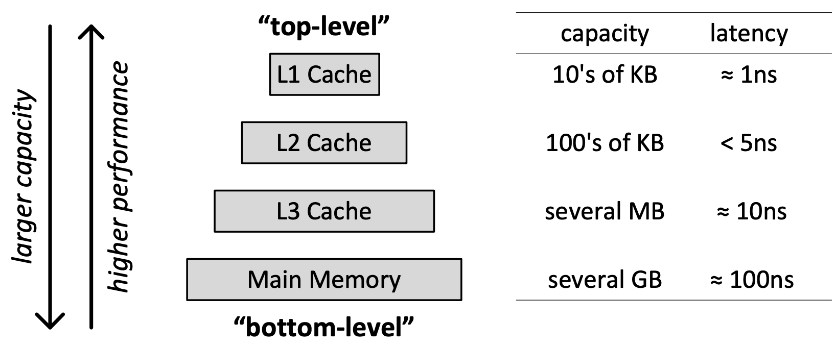
Recall: Cache Hierarchy
Kim & Mutlu, “Memory Systems,” Computing Handbook, 2014
https://people.inf.ethz.ch/omutlu/pub/memory-systems-introduction_computing-handbook14.pdf

Slide 65
Multi-level Caching in a Pipelined Design
First-level caches (instruction and data)
Decisions very much affected by cycle time
Small, lower associativity; latency is critical
Tag store and data store usually accessed in parallel
Second-level caches
Decisions need to balance hit rate and access latency
Usually large and highly associative; latency not as important
Tag store and data store can be accessed serially
Serial vs. Parallel access of levels
Serial: Second level cache accessed only if first-level misses
Second level does not see the same accesses as the first
First level acts as a filter (filters some temporal and spatial locality)
Management policies are therefore different

Slide 66
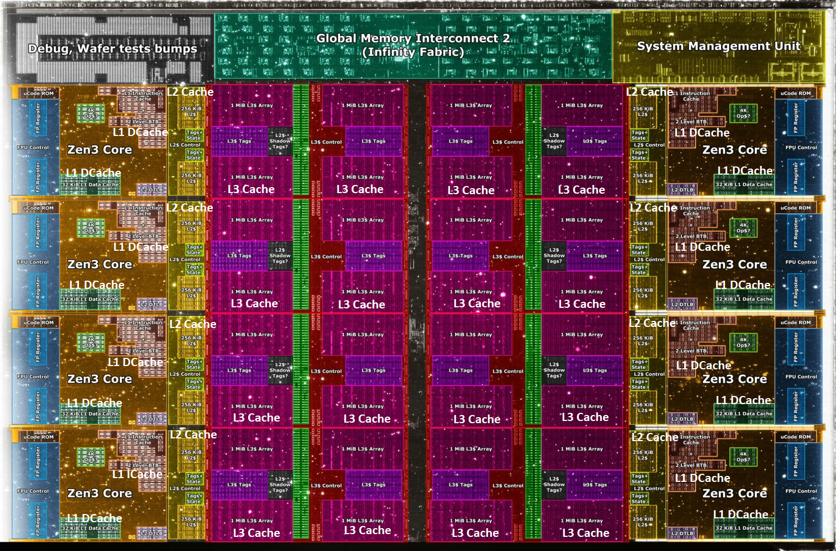
Deeper and Larger Cache Hierarchies
Core Count:
8 cores/16 threads
L1 Caches:
32 KB per core
L2 Caches:
512 KB per core
L3 Cache:
32 MB shared
AMD Ryzen 5000, 2020
https://wccftech.com/amd-ryzen-5000-zen-3-vermeer-undressed-high-res-die-shots-close-ups-pictured-detailed/

Slide 67
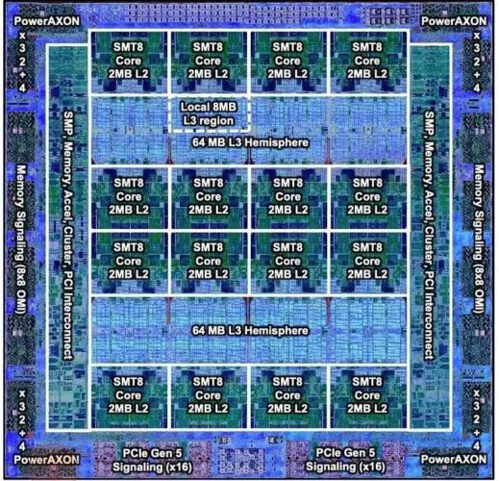
Deeper and Larger Cache Hierarchies
IBM POWER10,
2020
Cores:
15-16 cores,
8 threads/core
L2 Caches:
2 MB per core
L3 Cache:
120 MB shared
https://www.it-techblog.de/ibm-power10-prozessor-mehr-speicher-mehr-tempo-mehr-sicherheit/09/2020/

Slide 68
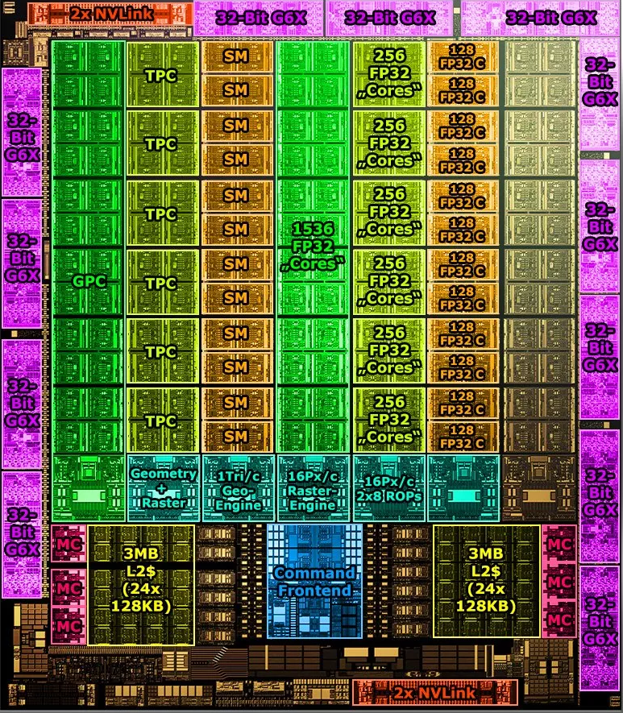
Deeper and Larger Cache Hierarchies
Cores:
128 Streaming Multiprocessors
L1 Cache or Scratchpad:
192KB per SM
Can be used as L1 Cache and/or Scratchpad
L2 Cache:
40 MB shared
Nvidia Ampere, 2020
https://www.tomshardware.com/news/infrared-photographer-photos-nvidia-ga102-ampere-silicon

