Slide 1
Computer Arch. & AI System Lecture 14: Parallel Training
Prof. Zeke Wang
Zhejiang University
June 8 2026

Slide 2
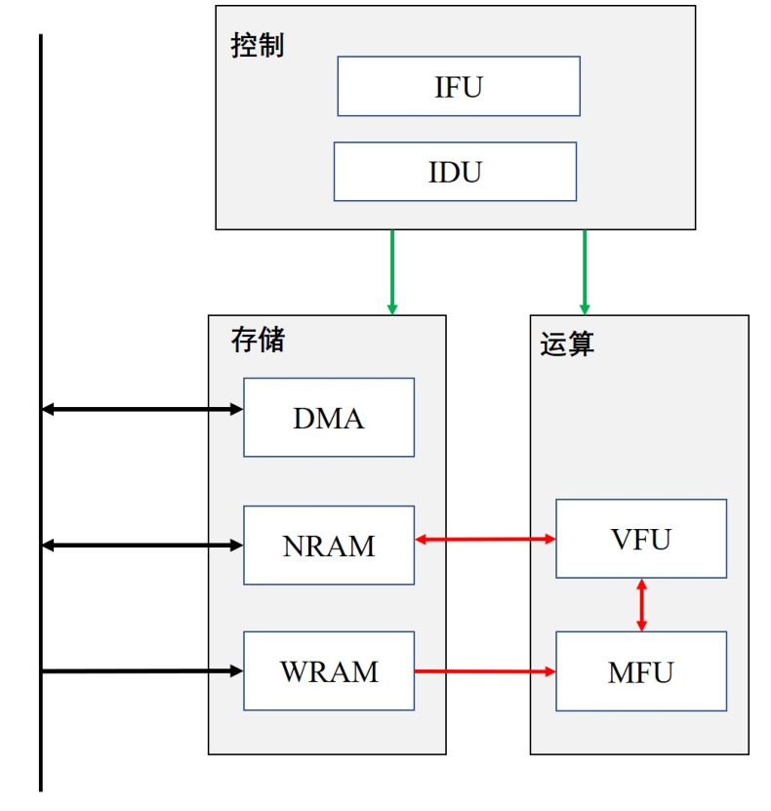
Recall: Overall Architecture of DLP-S
Control Module
IFU (Instruction Fetch Unit)
IDU (Instruction Decode Unit)
Compute Unit
VFU (Vector Function Unit)
MFU (Matrix Function Unit)
SRAM Unit
WRAM (Weight RAM)
NRAM (Neuron RAM)
DMA (Direct Memory Access)

Slide 3
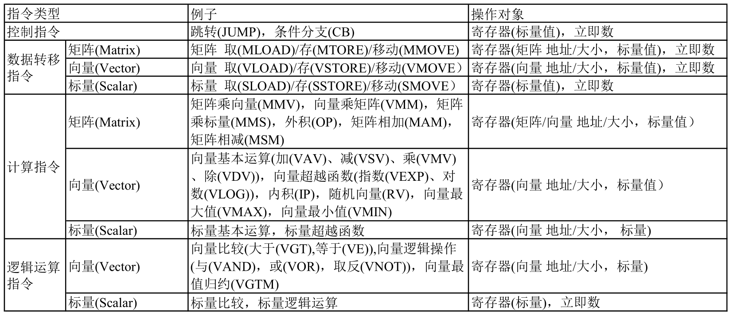
Recall: Cambricon DLP ISA

Slide 4
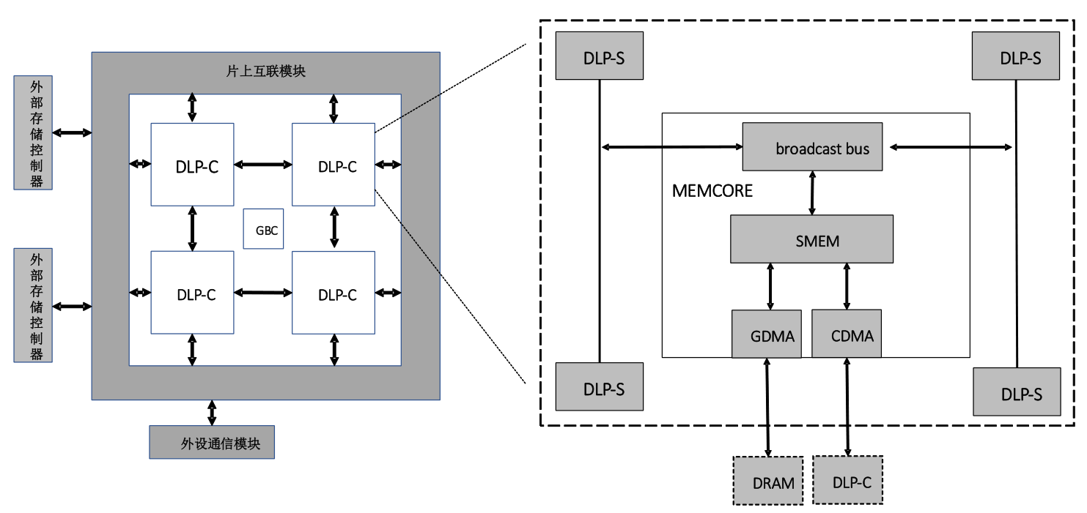
Recall: DLP-M Architecture
DLP-M
DLP-C
多核处理器分层结构设计
一个DLP-M由多个DLP-C构成
一个DLP-C由多个DLP-S构成

Slide 5
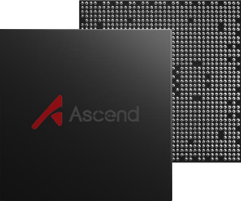

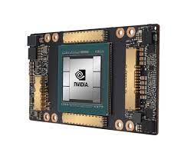
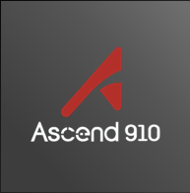
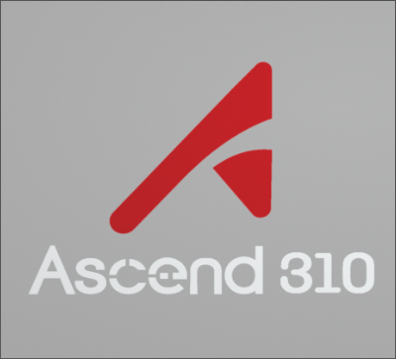
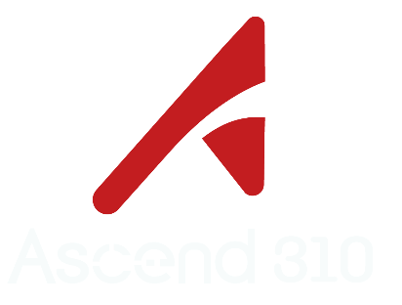
Recall: AI Architecture
Parallel
Training
Hybrid parallel
Data parallel
Model parallel
Pipeline parallel
模型训练和推理框架
AI Framework
MindSpore
TensorFlow
PyTorch
PaddlePaddle
…
计算加速库、芯片算子库和高度自动化的算子开发工具
AI Runtime
CANN*
CUDA*
Compute Architecture for Neural Network
Compute Unified Device Architecture
AI IP和芯片
AI Chip
Ascend
Notes:
全流程服务，分层API和预集成方案
降低核心代码量20%,效率提升50%以上
应对算子多样性，开发效率提升3倍

Slide 6
Recall: MindSpore
Model Zoo
MindSpore Extend
GNN/深度概率编程/强化学习/微分方程
自动并行：整图切分，感知集群拓扑，实现通信开销最小，融合数据并行与模型并行；
二阶优化：利用二阶计算修正梯度更新方向，找到训练梯度最优下降路径，从而加速训练收敛过程；
动静态图结合：统一自动微分引擎支持动静态图，一行代码完成模式切换，兼顾模型开发和执行效率；
AI+科学计算，场景应用创新，拓展MindSpore的边界
Mind
Armour
MindData
MindExpression
仓颉
前端
Mind
Insight
密态AI
网络调试
可信AI
MindCompiler
精度调优
类型推导
自动微分
自动并行
二阶优化
量化/剪枝/….
内存优化
图算融合
流水线执行
性能调优
MindIR
硬件相关优化
MindAKG(算子自动生成)
MindRT
MindRT(分布式DAG并行执行)
MindRT Lite/Micro
CANN昇腾
CUDA
Eigen
Android
iOS

Slide 7
Recall: 关键技术4：AI+科学计算
科学计算近况：
科学计算核心问题是微分方程求解，算力消耗巨大，大规模求解器垄断历年戈登贝尔奖，近年来结合AI方法成为趋势。
传统数值方法
高维微分方程求解，计算量大
边界条件复杂，求解不稳定
AI方法求解
非线性拟合，无需解高维方程
神经网络模拟，不需要处理边界条件
业界AI+科学计算现状：
TF：众筹方式构建AI求解模型，典型应用领域取得突破；面向DNN设计的自动微分，计算高阶微分时效率低下；
Nvidia：支持高精度计算；构筑cuBLAS、cuFFT等基础数学库；上层框架依赖TensorFlow，继承TF缺点

Slide 8
Where Are We?

Slide 9
AI System: Four Components
Computing
Model
Training
Storage
Networking
Compiling

Slide 10
Neural Network Training: An Example
Input
Linear
Linear
Linear
1, Start with randomly initialized weights
2, Iterate through your data a mini-batch of training data samples at a time:
Forward pass
Backward pass
Weight update
[Micikevicius, Fundamentals of Scaling Out DL Training, 2020]

Slide 11
An example: Network of 3 Linear Layers
Input
Linear
Linear
Linear
Each layer:
Input: vector
Output: vector
Learned parameters (weights): projection matrix
Operations:
1, Multiply the input vector with the matrix
2, Apply a point-wise nonlinearity, say, ReLU
[Micikevicius, Fundamentals of Scaling Out DL Training, 2020]

Slide 12
Network of 3 Linear Layers: Forward Pass
Linear
Linear
Linear
Each layer:
Input: vector
Output: vector
Learned parameters (weights): projection matrix
Operations:
1, Multiply the input vector with the matrix
2, Apply a point-wise nonlinearity, say, ReLU
[Micikevicius, Fundamentals of Scaling Out DL Training, 2020]

Slide 13
Network of 3 Linear Layers: Forward Pass
Linear
Linear
Linear
Each layer:
Input: vector
Output: vector
Learned parameters (weights): projection matrix
Operations:
1, Multiply the input vector with the matrix
2, Apply a point-wise nonlinearity, say, ReLU
[Micikevicius, Fundamentals of Scaling Out DL Training, 2020]

Slide 14
Network of 3 Linear Layers: Forward Pass
Output
Linear
Linear
Linear
Each layer:
Input: vector
Output: vector
Learned parameters (weights): projection matrix
Operations:
1, Multiply the input vector with the matrix
2, Apply a point-wise nonlinearity, say, ReLU
[Micikevicius, Fundamentals of Scaling Out DL Training, 2020]

Slide 15
Forward Pass: A Minibatch of 2 Samples
Matrix-vector multiplies
→ Matrix-matrix multiplies
A minibatch of 1 sample
Input
Output
Linear
Linear
Linear
[Micikevicius, Fundamentals of Scaling Out DL Training, 2020]

Slide 16


Forward Pass: A Minibatch of 2 Samples
Input
Output
Linear
Linear
Linear
W
X
Y
Matrix-matrix multiplies
× =
Weights
Output Activations
Input Activations
[Micikevicius, Fundamentals of Scaling Out DL Training, 2020]

Slide 17

Forward Pass: Compute Loss
Input
Linear Linear _{Linear}
Output
Loss Value
Loss
Function
Ground Truth
Loss function:
Produces a loss value that indicates how “wrong” the network was
Compares the output to the ground truth for each sample
Exact function math varies by task
Goal of training: minimize the loss value
Update network weights so the predicted output closely matches ground truth
[Micikevicius, Fundamentals of Scaling Out DL Training, 2020]

Slide 18
Backward Pass
Linear
Linear
Linear
Loss Value
Loss Function
Goal: compute the gradients to the layer weights
Implementation: “back propagating” the loss through layers
Each layer computes weight gradient, used to update the weights
Each layer computes activation gradient, to be backpropagated to preceding layer
[Micikevicius, Fundamentals of Scaling Out DL Training, 2020]

Slide 19

Backward Pass: Compute dW
X
W
Y
Linear
Linear
Linear
Loss Value
Loss Function
Compute the weight gradient dw
dW: weight gradient (to update weights)
dY: incoming activation gradient
X: input activations (from fwd pass)
Compute the activation gradient dx
dX: output activation gradient
to backpropagate to the preceding layer
dY
_{X} T
dW
×
=
_{W} T
dY
dX
× =
[Micikevicius, Fundamentals of Scaling Out DL Training, 2020]

Slide 20
Weight Update
Weight update (SGD)
Input: Weight W, gradient dW
Output: updated weight
Operation:
Increment each weight with the corresponding gradient value
SGD
W
dW
W
-
lr×
=
Weight update (Momentum)
Input: Weight W, gradient dW
States: 1 momenta (～model)
Output: updated weight
Operation:
Update internal state with weight gradient, then update weights using internal state
SGD with momentum
v
dW
v
µ×
-
lr×
=
W
v
W
+
=
Weight update (Adam)
States: 1 momenta, 1 variance
(reading and updating momenta/variance/parameters)
[Micikevicius, Fundamentals of Scaling Out DL Training, 2020]
Notes:
Usually fp32 in reduced precision (FP16/BF16) training
Optimizer may need 2-6x more memory than just the model

Slide 21

One Iteration for a Layer
One iteration:
Backward pass:
Its compute is ~2x of forward
requires activations computed during the fwd pass
W
X
Y
1, Forward Pass:
×
=
2, Backward Pass:
weight gradients
dY
_{X} T
dW
×
=
_{W} T
Read After Write (RAW) Dependency Regarding the Model w
dY
dX
2, Backward Pass:
activation gradients
× =
W
dW
W
3, Weight update:
+
+ … =
[Micikevicius, Fundamentals of Scaling Out DL Training, 2020]

Slide 22
Outline
Why Distributed Training？
Data Parallelism
Model Parallelism
Pipeline
Intra-layer
Communication Pattern Review
Summary

Slide 23
Why Distributed Training?
Challenge from Model Side: Larger models
Language models (GPT-3): 175B parameters
Recommender models: largest ones are reaching O(1B) parameters
Vision models: deeper and wider Resnets and ResNeXTs
Challenge from Dataset Side: Larger datasets
Recommender data (user behavior): terabytes to petabytes
Image data: 1B Instagram dataset, JFT (300M images)
Challenge from System Side:
The memory size of a single accelerator, e.g., GPU, is 80GB.

Slide 24
Why GPU memory size is 80GB?
Notes:
内存的速度跟容量只能要一个。。。

Slide 25
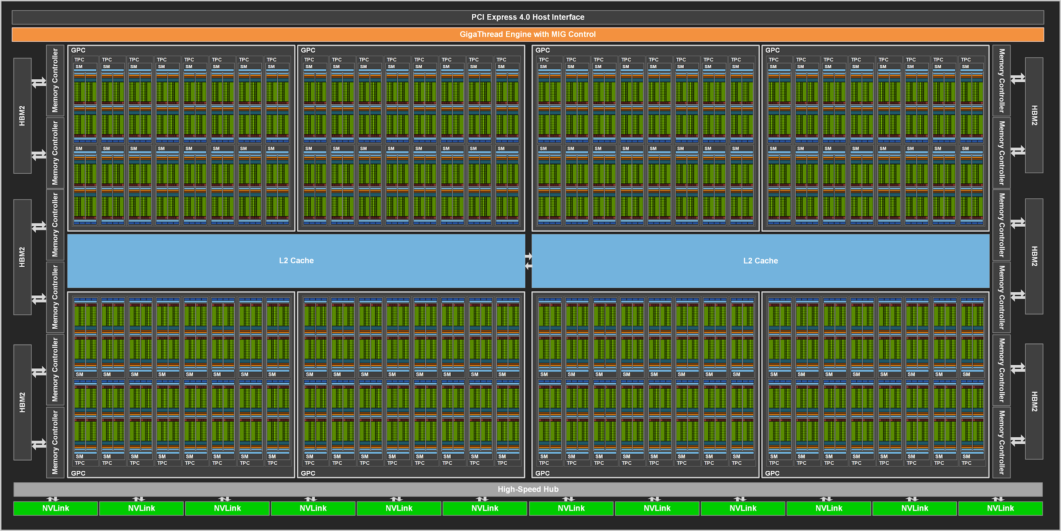
NVIDIA A100 Block Diagram
https://developer.nvidia.com/blog/nvidia-ampere-architecture-in-depth/
108 cores on the A100
(Up to 128 cores in the full-blown chip)
40MB L2 cache
Notes:
The A100 GPU includes 40 MB of L2 cache, which is 6.7x larger than V100 L2 cache.The L2 cache is divided into two partitions to enable higher bandwidth and lower latency memory access. Each L2 partition localizes and caches data for memory accesses from SMs in the GPCs directly connected to the partition. This structure enables A100 to deliver a 2.3x L2 bandwidth increase over V100 (see https://developer.nvidia.com/blog/nvidia-ampere-architecture-in-depth/).

Slide 26
Why Distributed Training?
Challenge from Model Side: Larger models
Language models: in the past 2 years grew from 340M (BERT-large) to 175B (GPT-3) parameters
Recommender models: largest ones are reaching O(1B) parameters
Vision models: deeper and wider Resnets and ResNeXTs
Challenge from Dataset Side: Larger datasets
Recommender data (user behavior): terabytes to petabytes
Image data: 1B Instagram dataset, JFT (300M images)
Challenge from System Side:
The memory size of a single accelerator, e.g., GPU, is 40GB.
Solution: scale out computing

Slide 27
Outline
Why Distributed Training？
Data Parallelism
Model Parallelism
Pipeline Parallelism
Tensor Parallelism
Communication Pattern Review
Summary

Slide 28
Parallelism Taxonomy
Parallel Training
Data Parallel
Model Parallel
Intra Layer/
Tensor
Inter Layer/
Pipeline
[Micikevicius, Fundamentals of Scaling Out DL Training, 2020]

Slide 29
Data Parallel Training
Each worker:
Model: has a copy of the entire neural network model
Dataset: responsible for compute of a portion of data (training minibatch)
[Micikevicius, Fundamentals of Scaling Out DL Training, 2020]

Slide 30
Data Parallel: Forward Pass
Whole Model
Partial dataset
W
X
Y
Worker 0:
×
=
Forward pass:
Computes output activations for its portion of minibatch
No communication is needed
Worker 1:
×
=
Worker 2:
×
=
X : input activations
W : model
Y : output activations
Worker 3:
×
=
[Micikevicius, Fundamentals of Scaling Out DL Training, 2020]

Slide 31
Data Parallel: Backward Pass
dY
_{X} T
dW1
Worker 0:
×
=
Backward pass:
Computes activation gradients for its portion of minibatch
Computes contribution to the weight gradient based on its portion of minibatch
All workers’ contributions must be summed before weight update
dW2
Worker 1:
×
=
dW3
Worker 2:
×
=
dW4
×
=
X : input activations
W : model
Y : output activations
Worker 3:
[Micikevicius, Fundamentals of Scaling Out DL Training, 2020]

Slide 32

Data Parallel Training: Weight Update
Weight update:
1, Each of N workers accumulates gradients:
Summing 1/N gradients collected from (N – 1) peers
2, Each worker updates its model:
Each worker updates its copy of the model with combined gradients from all 4 workers
Worker a
Worker b
(a+b+c+d)/4
Worker d
Worker c
[Micikevicius, Fundamentals of Scaling Out DL Training, 2020]

Slide 33
AI System: Four Components
Computing
Model
Training
Storage
Networking
Compiling

Slide 34
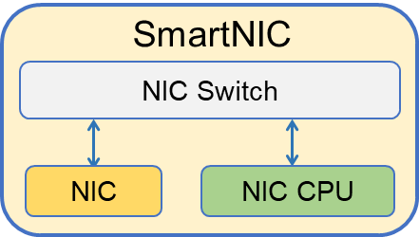
AI System: Network
NCCL
Scale Up
Network
Collective primitive
In-network computing
Application Layer
Scale Out
Network
Offloaded NCCL
1us
900GBps
Process on NIC
NVLink
Differential Signaling
Serialization/Deserialization
On-NIC Stack
RDMA
RDMA engine or TCP offload engine, usually programmed by IB Verbs
3us
400Gbps
CXL based on PCIe, can direct LD/ST remote device memory, even can cross Node by CXL Switch
CXL
Transaction Layer
PCIe
Userspace
TCP/UDP
10us
100Gbps
1us
512Gbps
Serial Bus, endpoint to endpoint transfer, provide up to 32Gbit/s serial data rate per lane
Programmed by DPDK, running network stack in userspace program
Process on CPU
eBPF
Kernel Stack
TCP/UDP
100us
10Gbps
PCI
Parallels Bus, transfer 64 bit data in a clock cycle, bandwidth limited by frequent (33MHZ)
Programmed by Unix Socket
2us
4Gbps
Network
Layer
IP/ARP/ICMP
Data Link Layer
MAC/CSMA

Slide 35
AllReduce Implementation Choices
“Ring” AllReduce (Baidu)
For any topology that contains a 1D torus (ring)
Each worker communicates with 2 neighbors
2(N – 1) steps, worker sends/receives 1/N of all bytes
Each step requires a synchronization -> 2(N – 1) syncs total
Each worker needs CPU and GPU cycles to do ring AllReduce
[Micikevicius, Fundamentals of Scaling Out DL Training, 2020]

Slide 36
“Ring” AllReduce: Initial States
GPU0
a0
b0
c0
d0
GPU1
a1
b1
c1
d1
GPU2
a2
b2
c2
d2
GPU3
a3
b3
c3
d3
[https://zhuanlan.zhihu.com/p/69797852, 2020]

Slide 37
“Ring” AllReduce: Results
GPU0
a0+a1+a2+a3
b0+b1+b2+b3
c0+c1+c2+c3
d0+d1+d2+d3
GPU1
a0+a1+a2+a3
b0+b1+b2+b3
c0+c1+c2+c3
d0+d1+d2+d3
GPU2
a0+a1+a2+a3
b0+b1+b2+b3
c0+c1+c2+c3
d0+d1+d2+d3
GPU3
a0+a1+a2+a3
b0+b1+b2+b3
c0+c1+c2+c3
d0+d1+d2+d3
[https://zhuanlan.zhihu.com/p/69797852, 2020]

Slide 38
“Ring” AllReduce
GPU0
GPU3
GPU1
GPU2
“Ring” AllReduce (Baidu) has two stages:
1, Reduce_scatter: N-1 rounds, M/N data per round
2, Allgather: N-1 rounds, M/N data per round
N: number of GPUs (4), M: data size
[https://zhuanlan.zhihu.com/p/69797852, 2020]

Slide 39
“Ring” AllReduce: Initial States
GPU0
a0
b0
c0
d0
GPU1
a1
b1
c1
d1
GPU2
a2
b2
c2
d2
GPU3
a3
b3
c3
d3
Partitioning of an array into N=4 chunks
[https://zhuanlan.zhihu.com/p/69797852, 2020]

Slide 40
“Ring” AllReduce: Reduce_scatter iter. 0
GPU0
a0
b0
c0
d0
GPU1
a1
b1
c1
d1
GPU2
a2
b2
c2
d2
GPU3
a3
b3
c3
d3
[https://zhuanlan.zhihu.com/p/69797852, 2020]

Slide 41
“Ring” AllReduce: Reduce_scatter iter. 1
GPU0
a0
b0
c0
d0+d3
GPU1
a0+a1
b1
c1
d1
GPU2
a2
b1+b2
c2
d2
GPU3
a3
b3
c2+c3
d3
[https://zhuanlan.zhihu.com/p/69797852, 2020]

Slide 42
“Ring” AllReduce: Reduce_scatter iter. 2
GPU0
a0
b0
c0+c2+c3
d0+d3
GPU1
a0+a1
b1
c1
d0+d1+d3
GPU2
a0+a1+a2
b1+b2
c2
d2
GPU3
a3
b1+b2+b3
c2+c3
d3
[https://zhuanlan.zhihu.com/p/69797852, 2020]

Slide 43
“Ring” AllReduce: Reduce_scatter iter. 3
GPU0
a0
b0+b1+b2+b3
c0+c2+c3
d0+d3
GPU1
a0+a1
b1
c0+c1+c2+c3
d0+d1+d3
GPU2
a0+a1+a2
b1+b2
c2
d0+d1+d2+d3
GPU3
a0+a1+a2+a3
b1+b2+b3
c2+c3
d3
[https://zhuanlan.zhihu.com/p/69797852, 2020]

Slide 44
“Ring” AllReduce: Allgather iter. 0
GPU0
a0
b0+b1+b2+b3
c0+c2+c3
d0+d3
GPU1
a0+a1
b1
c0+c1+c2+c3
d0+d1+d3
GPU2
a0+a1+a2
b1+b2
c2
d0+d1+d2+d3
GPU3
a0+a1+a2+a3
b1+b2+b3
c2+c3
d3
[https://zhuanlan.zhihu.com/p/69797852, 2020]

Slide 45
“Ring” AllReduce: Allgather iter. 1
GPU0
a0+a1+a2+a3
b0+b1+b2+b3
c0+c2+c3
d0+d3
GPU1
a0+a1
b0+b1+b2+b3
c0+c1+c2+c3
d0+d1+d3
GPU2
a0+a1+a2
b1+b2
c0+c1+c2+c3
d0+d1+d2+d3
GPU3
a0+a1+a2+a3
b1+b2+b3
c2+c3
d0+d1+d2+d3
[https://zhuanlan.zhihu.com/p/69797852, 2020]

Slide 46
“Ring” AllReduce: Allgather iter. 2
GPU0
a0+a1+a2+a3
b0+b1+b2+b3
c0+c2+c3
d0+d1+d2+d3
GPU1
a0+a1+a2+a3
b0+b1+b2+b3
c0+c1+c2+c3
d0+d1+d3
GPU2
a0+a1+a2
b0+b1+b2+b3
c0+c1+c2+c3
d0+d1+d2+d3
GPU3
a0+a1+a2+a3
b1+b2+b3
c0+c1+c2+c3
d0+d1+d2+d3
[https://zhuanlan.zhihu.com/p/69797852, 2020]

Slide 47
“Ring” AllReduce: Allgather iter. 3
GPU0
a0+a1+a2+a3
b0+b1+b2+b3
c0+c1+c2+c3
d0+d1+d2+d3
GPU1
a0+a1+a2+a3
b0+b1+b2+b3
c0+c1+c2+c3
d0+d1+d2+d3
GPU2
a0+a1+a2+a3
b0+b1+b2+b3
c0+c1+c2+c3
d0+d1+d2+d3
GPU3
a0+a1+a2+a3
b0+b1+b2+b3
c0+c1+c2+c3
d0+d1+d2+d3
[https://zhuanlan.zhihu.com/p/69797852, 2020]

Slide 48
“Ring” AllReduce: Results
GPU0
a0+a1+a2+a3
b0+b1+b2+b3
c0+c1+c2+c3
d0+d1+d2+d3
GPU1
a0+a1+a2+a3
b0+b1+b2+b3
c0+c1+c2+c3
d0+d1+d2+d3
GPU2
a0+a1+a2+a3
b0+b1+b2+b3
c0+c1+c2+c3
d0+d1+d2+d3
GPU3
a0+a1+a2+a3
b0+b1+b2+b3
c0+c1+c2+c3
d0+d1+d2+d3
[https://zhuanlan.zhihu.com/p/69797852, 2020]

Slide 49
AllReduce Implementation Choices
“Ring” AllReduce (Baidu)
For any topology that contains a 1D torus (ring)
Each worker communicates with 2 neighbors
2(N – 1) steps, worker sends/receives 1/N of all bytes
Each step requires a synchronization -> 2(N – 1) syncs total
“In-switch” AllReduce
Each worker communicates with the switch
Only one step, a worker sends/receives N of all bytes
All workers work in a lock step.
[Micikevicius, Fundamentals of Scaling Out DL Training, 2020]

Slide 50
Data Parallel: Challenges
Strong scaling (increase the number of workers, keep minibatch size constant)
Certain layers require minimum minibatch sizes to properly operate
Example: batch normalization (BN) generally requires 16+ samples
Maybe lower GPU utilization
Weak scaling (increase the number of workers, increase minibatch size)
Training networks with large minibatches requires hyper-parameter adjustment
Learning rate schedule, BN decay, …
Example: R50 (SGD up to bs=16K, LARS above 16K, …)
Often increase the amount of work required to reach the same model accuracy
[Micikevicius, Fundamentals of Scaling Out DL Training, 2020]

Slide 51
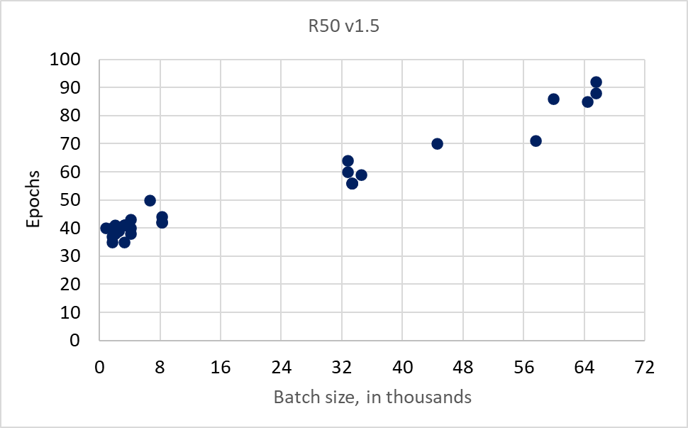
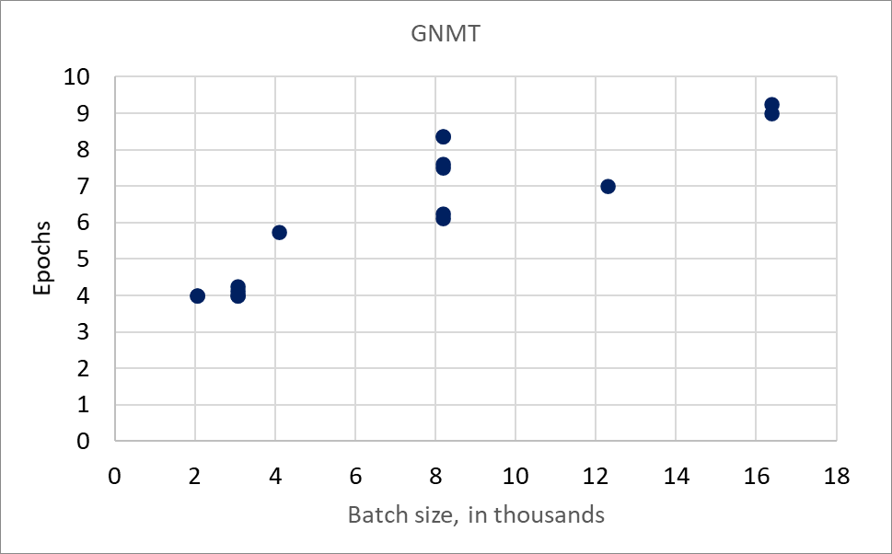
Workload Increasing with Batch Size
Epochs to reach the same model accuracy (from various submissions to MLPerf v0.7)
Epoch = 1 processing pass through entire dataset
[Micikevicius, Fundamentals of Scaling Out DL Training, 2020]

Slide 52
Workload Increasing with Batch Size
Epochs to reach the same model accuracy (from various submissions to MLPerf v0.7)
Epoch = 1 processing pass through entire dataset
[Micikevicius, Fundamentals of Scaling Out DL Training, 2020]

Slide 53
Outline
Why Distributed Training？
Data Parallelism
Model Parallelism
Pipeline
Intra-layer
Communication Pattern Review
Summary

Slide 54
Parallelism Taxonomy
Parallel Training
Data Parallel
Model Parallel
Intra Layer
Inter Layer/
Pipeline
[Micikevicius, Fundamentals of Scaling Out DL Training, 2020]

Slide 55
Model Parallel Training
Worker 0
Worker 1
Worker 2
Inter-layer Parallel (aka Pipeline Parallel):
A worker is responsible for its portion of the layers
Layer 1
Layer 2
Layer 3
Layer 4
Layer 5
Worker 0
Intra-layer Parallel
(aka Tensor Parallel):
A worker is responsible for its portion of each layer
Worker 1
Layer 1
Layer 2
Layer 3
Layer 4
Layer 5
Worker 2
[Micikevicius, Fundamentals of Scaling Out DL Training, 2020]

Slide 56
Pipeline Parallel Training
Time
Layer 1 Layer 2 | Worker | 0
Layer 3 Layer 4 | Worker | 1
Layer 5 | Worker | 2
Forward
Loss
Backward
[Micikevicius, Fundamentals of Scaling Out DL Training, 2020]

Slide 57
Pipeline Parallel Training
Time
Layer 1 Layer 2 | Worker | 0
Layer 3 Layer 4 | Worker | 1
Layer 5 | Worker | 2
Forward
Loss
Backward
[Micikevicius, Fundamentals of Scaling Out DL Training, 2020]

Slide 58

Pipeline Parallel Training
Time
Layer 1 Layer 2 | Worker | 0
Layer 3 Layer 4 | Worker | 1
Layer 5 | Worker | 2
Forward
Loss
Backward
[Micikevicius, Fundamentals of Scaling Out DL Training, 2020]

Slide 59


Pipeline Parallel Training
Time
Layer 1 Layer 2 | Worker | 0
Layer 3 Layer 4 | Worker | 1
Layer 5 | Worker | 2
Forward
Loss
Backward
[Micikevicius, Fundamentals of Scaling Out DL Training, 2020]

Slide 60


Pipeline Parallel Training
Time
Layer 1 Layer 2 | Worker | 0
Layer 3 Layer 4 | Worker | 1
Layer 5 | Worker | 2
Forward
Loss
Backward
[Micikevicius, Fundamentals of Scaling Out DL Training, 2020]

Slide 61


Pipeline Parallel Training
Time
Layer 1 Layer 2 | Worker | 0
Layer 3 Layer 4 | Worker | 1
Layer 5 | Worker | 2
Forward
Loss
Backward
[Micikevicius, Fundamentals of Scaling Out DL Training, 2020]

Slide 62
Pipeline Parallel Training
Time
Layer 1 Layer 2 | Worker | 0
Layer 3 Layer 4 | Worker | 1
Layer 5 | Worker | 2
Forward
Loss
Backward
Idle bubbles:
67%: 12/18 step-slots
For N workers:
(N – 1)/N idle slots
[Micikevicius, Fundamentals of Scaling Out DL Training, 2020]
Notes:
N: number of workers, devices.

Slide 63






Pipeline Parallel Training: GPipe
Key Idea: Subminibatches
Layer 1 Layer 2 | Worker | 0
Layer 3 Layer 4 | Worker | 1
Layer 5 | Worker | 2
Forward
Loss
Backward
2 subminibatches
2x more steps
Each step is ½ compute
Idle bubbles: 50%
12/24 steps-slots
[Micikevicius, Fundamentals of Scaling Out DL Training, 2020]

Slide 64
Pipeline Parallel Training: GPipe
Layer 1 Layer 2 | Worker | 0
Layer 3 Layer 4 | Worker | 1
Layer 5 | Worker | 2
Forward
Loss
Backward
N workers, K subminibatches:
As N grows:
2(N + K – 1) steps for fwd/bwd
Total step-slots: 2N(N + K – 1)
Idle step-slots: 2N(N – 1)
Fraction of idle slots: (N – 1)/(N + K – 1)
K = N → 50% idle slots
K = 4N → 20% idle slots
[Micikevicius, Fundamentals of Scaling Out DL Training, 2020]

Slide 65
Pipeline Parallel: Communication
A worker communicates with its 2 neighbors
1D mesh topology
1D torus when interleaving layers
Communication in each step of the fwd and bwd pass
Activations in fwd, activation gradients in bwd
Overlap communication with computation
Very hard
[Micikevicius, Fundamentals of Scaling Out DL Training, 2020]

Slide 66
Pipeline Parallel: Challenges
Load balancing workload across workers is difficult
Different layers of a network can take different amounts of time
Leads to even busy slots for other workers idling for portions of time
Lots of computation to hide communication
Idle slots reduce scaling efficiency
Many subminibatches help with this, but run into the same problems as strong-scaling of data-parallel.
[Micikevicius, Fundamentals of Scaling Out DL Training, 2020]

Slide 67
Outline
Why Distributed Training？
Data Parallelism
Model Parallelism
Pipeline
Tensor Parallelism
Communication Pattern Review
Summary

Slide 68
Tensor Parallel
Worker 0
Worker 1
Layer 1
Layer 2
Layer 3
Layer 4
Layer 5
Worker 2
Partition a given layer’s weights among the workers
Addresses some of the Pipeline Parallel challenges
Idle slots, load imbalance
Two variants:
Row-wise partitioning
Column-wise partitioning
Row-wise partitioning:
Column-wise partitioning:
×
×
[Micikevicius, Fundamentals of Scaling Out DL Training, 2020]

Slide 69
Row-wise Partitioning: Allgather between Layers
W
X
Y
Worker 0
× =
× =
Worker 1
× =
× =
Worker 2
× =
× =
Layer K fwd
Fwd communication: Allgather
Layer (K + 1) fwd
Each worker:
W: Has a portion of weight rows
X: All of input activations X
Y: Computes a portion of output activations
[Micikevicius, Fundamentals of Scaling Out DL Training, 2020]

Slide 70










Column-wise Partitioning: ReduceScatter between Layers
W
X
Y
+
Worker 0
× =
× =
Worker 1
× =
+
× =
Worker 2
× =
× =
+
Layer K fwd
Fwd communication: ReduceScatter
Layer (K + 1) fwd
Each worker:
W: Has a portion of weight rows
X: All of input activations X
Y: Computes a portion of output activations
[Micikevicius, Fundamentals of Scaling Out DL Training, 2020]
Notes:
Fwd communication:
Reduce_scatter: each worker needs partial activations at next layer

Slide 71









Reducing Synchronization By Alternating Partitioning
Row-wise partitioning Column-wise partitioning
Worker 0
× =
× =
Worker 1
× =
× =
Worker 2
× =
× =
W
W
Layer K fwd
Layer (K + 1) fwd
Note: no communication is needed for two matrices
Worker i produces output, which is its input for the next layer
[Micikevicius, Fundamentals of Scaling Out DL Training, 2020]
Notes:
Fwd communication:
Reduce_scatter: each worker needs partial activations at next layer

Slide 72
Reducing Synchronization By Alternating Partitioning
Row-wise partitioning Column-wise partitioning
Worker 0
× =
× =
Worker 1
× =
× =
+Next two?
Worker 2
× =
× =
W
W
Layer K fwd
Layer (K + 1) fwd
Note: no communication is needed for two matrices
Worker i produces output, which is its input for the next layer
[Micikevicius, Fundamentals of Scaling Out DL Training, 2020]
Notes:
Fwd communication:
Reduce_scatter: each worker needs partial activations at next layer

Slide 73
Reducing Synchronization By Alternating Partitioning
Row-wise partitioning Column-wise partitioning Row-wise partitioning
+
Worker 0
× =
× =
× =
Worker 1
× =
× =
+
× =
Worker 2
× =
× =
× =
+
Layer K fwd
Layer (K + 1) fwd
Communication: Allreduce
Layer (K + 2) fwd
[Micikevicius, Fundamentals of Scaling Out DL Training, 2020]
Notes:
Fwd communication:
Reduce_scatter: each worker needs partial activations at next layer

Slide 74
Intra-Layer Parallel: Communication
Row-wise in forward becomes Col-wise in backward
Col-wise in forward becomes Row-wise in backward
Row-wise:
Fwd: allgather
Bwd: reduce_scatter
Col-wise:
Fwd: reduce_scatter
Bwd: allgather
When row- and col- are alternated:
Allreduce every two layers, in fwd and bwd
Halves the synchronizations compared to not alternating
[Micikevicius, Fundamentals of Scaling Out DL Training, 2020]
Notes:
Fwd communication:
Reduce_scatter: each worker needs partial activations at next layer

Slide 75
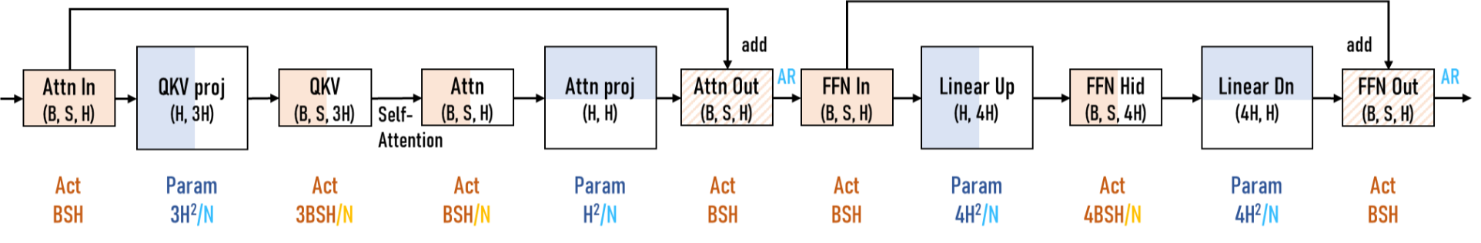
Tensor Parallelism for Transformer Block
Column-wise
Row-wise
Column-wise
Row-wise
Tensor Parallelism:
Attention: column-wise + row-wise.
MLP: column-wise + row-wise.
[Micikevicius, Fundamentals of Scaling Out DL Training, 2020]

Slide 76
Outline
Why Distributed Training？
Data Parallelism
Model Parallelism
Pipeline
Intra-layer
Communication Pattern Review
Summary

Slide 77
Communication Pattern Summary
Data Parallel:
Allreduce of weights
Can be overlapped with computation
Pipeline Parallel:
Point-wise communication of activations and activation gradients
Hard to overlap with computation
Hard to load-balance
Tensor Parallel:
Allgather, Reduce_scatter of activations and activation gradients
Allreduce if row-wise and col-wise partitioning is alternated
Hard to overlap with computation

Slide 78
Memory Size for a Huge Model
Memory Size Needed when Training GPT3-175B
Optimizer: 3259 GB
Parameters
Gradients
Optimizer states
Activation (without checkpoint): 360 GB （seq=1024，bsz=8）
Activation (with checkpoint): 3.75 GB （seq=1024，bsz=8， each block ）

Slide 79
基于transformer的模型的显存占用
Transformer layer
param : 12 * hid * hid
activation : 20 * bsz * seq * hid + n_h * bsz * seq * seq （QK乘积）
Embedding
param : voc * hid
activation : bsz * seq * hid
混合精度训练： FP32的参数，梯度和优化器参数（动量，方差） 4 * 4(byte)
FP16的参数和梯度 2 * 2(byte)
activation都是FP16的

Slide 80
AI System: Four Components
Computing
Model
Training
Storage
Networking
Compiling

Slide 81
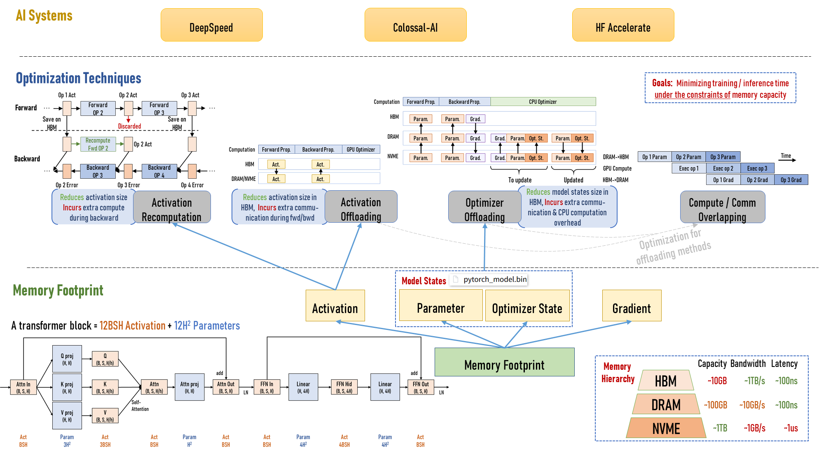
AI System: Storage

Slide 82
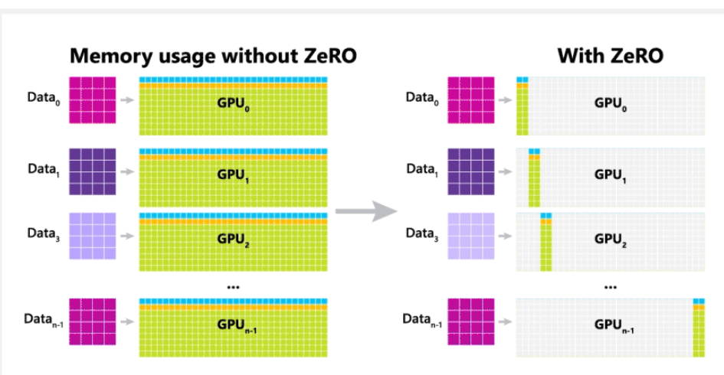
ZeRO: Zero Redundancy Optimizer
Key Idea:
Each GPU stores a subset of optimizer states, rather than the whole states like data parallel.

Slide 83
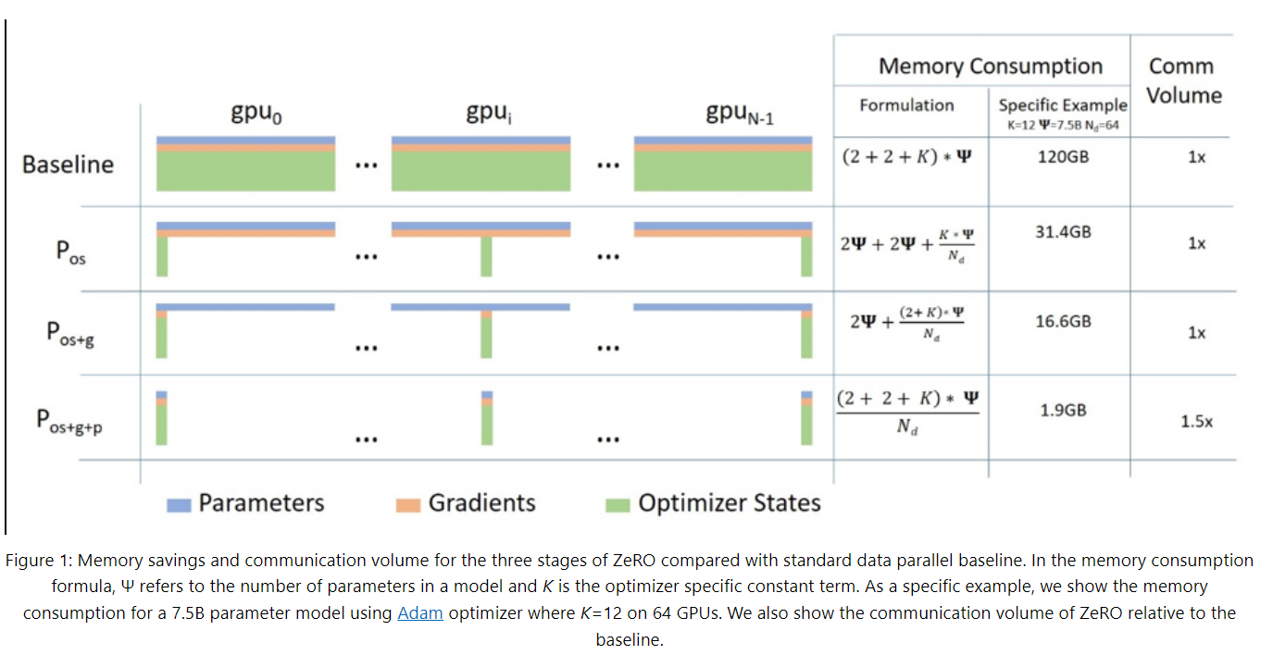
ZeRO: Zero Redundancy Optimizer
Benefit:
Training a larger model.

Slide 84
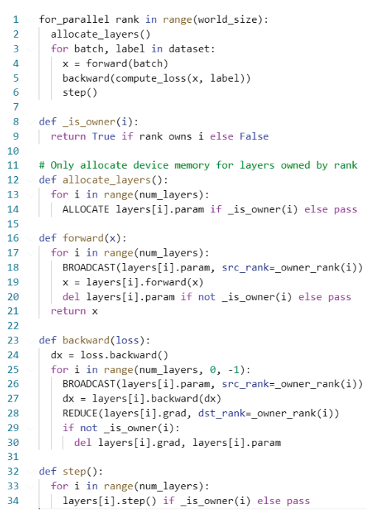
Overhead of ZeRO: More Communication
Typical PyTorch step:
Overhead: more collectives
Forward:
Backward:
Optimizer:

Slide 85
Summary
Networks and dataset are getting larger to set new state of art results
Scale-out enables these neural networks to be trained
Success requires many optimized components:
Hardware:
Fast accelerators for DL
High-bandwidth, low-latency interconnects
Topologies matter (must match communication patterns)
Network switches with math capabilities free up DL accelerators to do compute
SmartNIC for offloaded compression/decompression
Software:
Math libraries (CUDNN, CUBLAS, MKL, CANN …)
Collective communication libraries (NCCL, Horovod, …)
Training frameworks (MindSpore, PyTorch, TensoFlow, HugeCTR, …)
Proper choice of parallelism (manual, MeshTensorFlow, Gshard, ZeRO)

Slide 86
Batch Size Limitation of LLM Training
Batch Size Limitation of LLM Training
Llama: 4M token,
Seq length: 4K,
Batch size: 1K
How to choose the parallel training strategy?
When you have 1K NPU/GPU?
When you have 10K NPU/GPU?

