Slide 1
Computer Arch. & AI Chip Lecture 15: Flash Attention
Prof. Zeke Wang
Zhejiang University
June 1 2026

Slide 2
Outline
Zero
FlashAttention

Slide 3
AI System: Four Components
Computing
Model
Training
Storage
Networking
Compiling

Slide 4
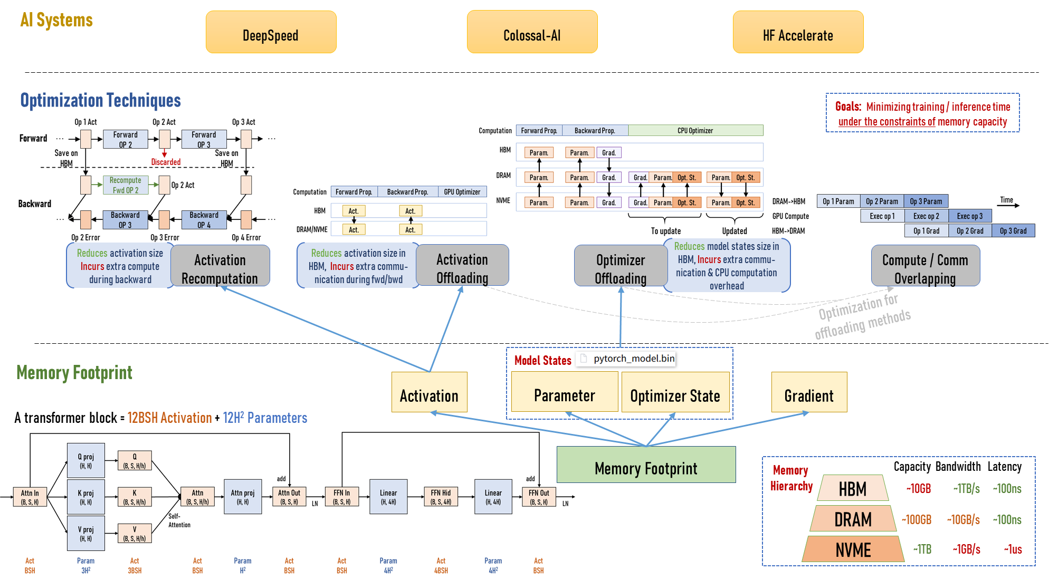
AI System: Storage

Slide 5
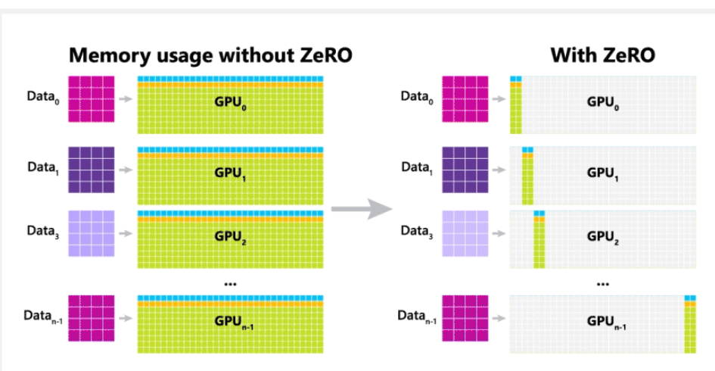
ZeRO: Zero Redundancy Optimizer
Key Idea:
Each GPU stores a subset of optimizer states, rather than the whole states like data parallel.

Slide 6
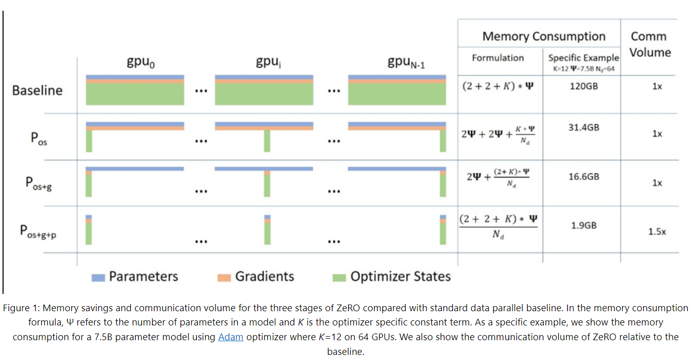
ZeRO: Zero Redundancy Optimizer
Benefit:
Training a larger model.

Slide 7
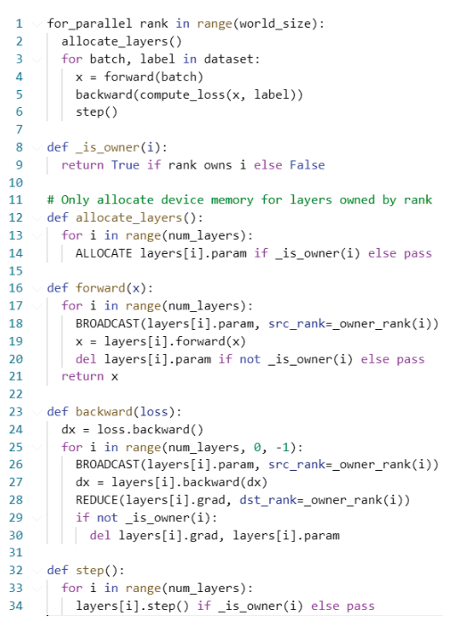
Overhead of ZeRO: More Communication
Typical PyTorch step:
Overhead: more collectives
Forward:
Backward:
Optimizer:

Slide 8
Summary
Networks and dataset are getting larger to set new state of art results
Scale-out enables these neural networks to be trained
Success requires many optimized components:
Hardware:
Fast accelerators for DL
High-bandwidth, low-latency interconnects
Topologies matter (must match communication patterns)
Network switches with math capabilities free up DL accelerators to do compute
SmartNIC for offloaded compression/decompression
Software:
Math libraries (CUDNN, CUBLAS, MKL, CANN …)
Collective communication libraries (NCCL, Horovod, …)
Training frameworks (MindSpore, PyTorch, TensoFlow, HugeCTR, …)
Proper choice of parallelism (manual, MeshTensorFlow, Gshard, ZeRO)

Slide 9
Batch Size Limitation of LLM Training
Batch Size Limitation of LLM Training
Llama: 4M token,
Seq length: 4K,
Batch size: 1K
How to choose the parallel training strategy?
When you have 1K NPU/GPU?
When you have 10K NPU/GPU?

Slide 10
Outline
Zero
FlashAttention

Slide 11
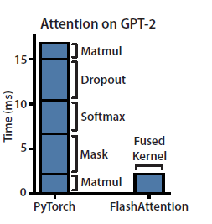
Why FlashAttention？
Why FlashAttention？
Normal attention is bound by IO
GPU utilization is low
Notes:
这里只有在第三步是实实在在的计算动作，其余步骤都是在为计算做准备工作。
在性能优化工作中，宏观角度通常是通过更好的算法、数学方法来减少总计算量。
而在微观角度上，则是尽可能的使处理器的计算单元“忙”起来，即增大计算单元的计算时间占总运行时间的比重。

Slide 12
Naïve Attention
Q
(S x D)
K
(S x D)
A = QK^{T}
(S x S)
A = softmax(A)
(S x S)
V
(S x D)
O = AV
(S x D)
Naïve Attention O = Softmax(QK^{T}) V
1, A = QK^{T} A: Load Q K from HBM, compute A, write A to HBM
2, A = Softmax (A) : Load A from HBM, compute A, write A to HBM
3, O = AV: Load A V from HBM, compute O, write O to HBM

Slide 13
Two Issues of Naïve Attention
Q
(S x D)
K
(S x D)
A = QK^{T}
(S x S)
A = softmax(A)
(S x S)
V
(S x D)
O = AV
(S x D)
Two Issues of Naïve Attention
Large intermediate results O(S²) with a long sequence
Repeated reads/writes from GPU device memory

Slide 14
Two Challenges of Naïve Attention
Q
(S x D)
K
(S x D)
A = QK^{T}
(S x S)
A = softmax(A)
(S x S)
V
(S x D)
O = AV
(S x D)
Two Challenges of Naïve Attention
Low precision of the fp16 elements of A easily overflow
→ Safe Softmax
A = softmax(A) is not a streaming algorithm
→ Online Softmax

Slide 15
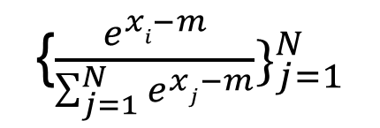
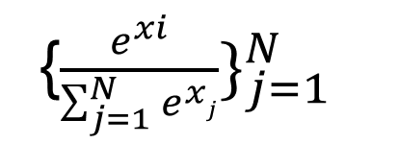
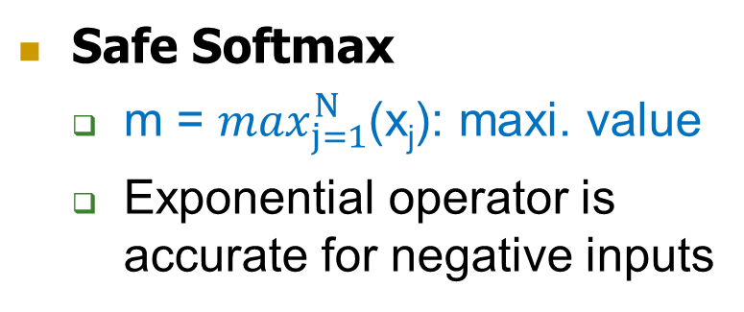
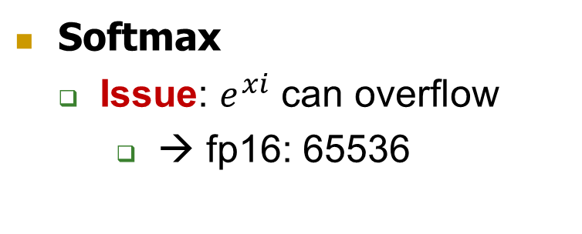
Softmax → Safe Softmax
Given a row of {x₁, x₂, …, x_{N}}), Softmax({x₁, x₂, …, x_{N}}) =
{$\frac{e^{xi}}{\sum_{j=1}^{N}{e^{xj}}}\}_{j=1}^{N}$
{$\frac{e^{xi−m}}{\sum_{j=1}^{N}{e^{xj−m}}}\}_{j=1}^{N}$
Softmax
Issue: $e^{xi}$ can overflow
→ fp16: 65536
Safe Softmax
m = $\max_{j=1}^{N}$(x_{j}): maxi. value
Exponential operator is accurate for negative inputs

Slide 16
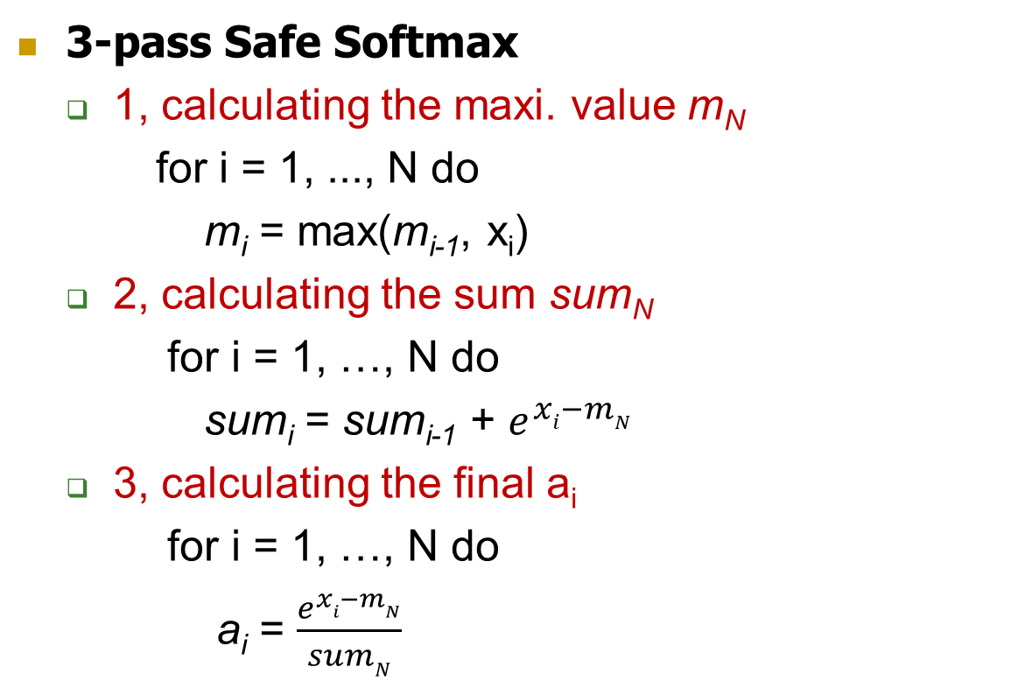
Details of Safe Softmax
Goal: Given a row of {x₁, x₂, …, x_{N}}), Softmax({x₁, x₂, …, x_{N}}) = ({a₁, a₂, …, a_{N}})
3-pass Safe Softmax
1, calculating the maxi. value m_{N}
for i = 1, ..., N do
m_{i} = max(m_{i-1}, x_{i})
2, calculating the sum sum_{N}
for i = 1, …, N do
sum_{i} = sum_{i-1} + $e^{xi−mN}$
3, calculating the final a_{i}
for i = 1, …, N do
a_{i} = $\frac{e^{xi−mN}}{sumN}$

Slide 17
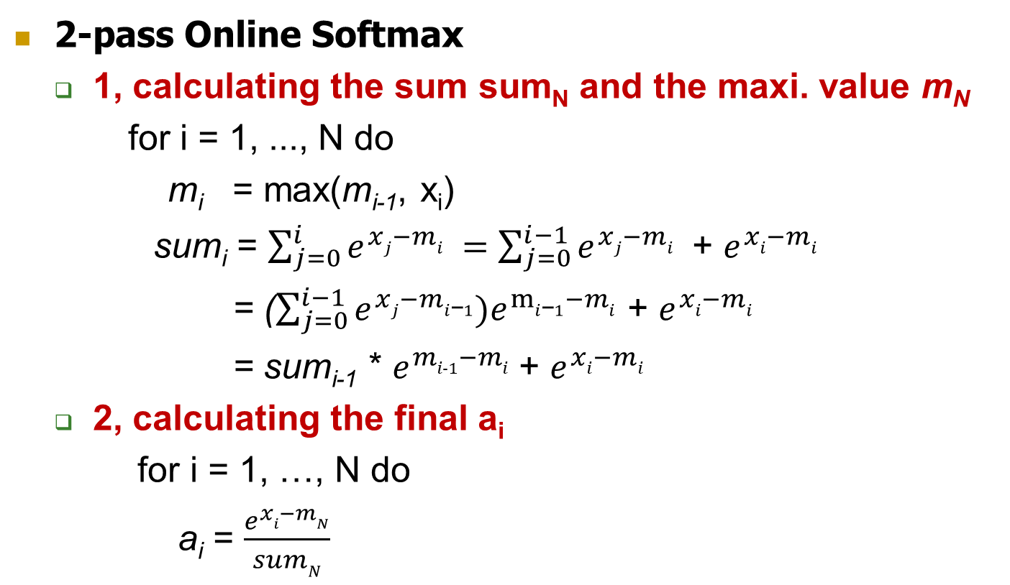
Details of Online Softmax
Goal: Given a row of {x₁, x₂, …, x_{N}}), Softmax({x₁, x₂, …, x_{N}}) = ({a₁, a₂, …, a_{N}})
2-pass Online Softmax
1, calculating the sum sum_{N} and the maxi. value m_{N}
for i = 1, ..., N do
m_{i} = max(m_{i-1}, x_{i})
sum_{i} = $\sum_{j=0}^{i}{e^{xj−mi} }=$ $\sum_{j=0}^{i−1}{e^{xj−mi} }$ + $e^{xi−mi}$
= ($\sum_{j=0}^{i−1}{e^{xj−mi\text{−}1})e^{mi\text{−}1−mi}}$ + $e^{xi−mi}$
= sum_{i-1} * $e^{mi-1−mi}$+ $e^{xi−mi}$
2, calculating the final a_{i}
for i = 1, …, N do
a_{i} = $\frac{e^{xi−mN}}{sumN}$

Slide 18
FlashAttention -1
Two key ideas of FlashAttention-1
1, Tiling: Compute the attention weights block by block so that we don’t have to load everything into SRAM at once
2, Recomputation: don’t ever store the full attention matrix, but just recompute the parts of it you need during the backward pass

Slide 19
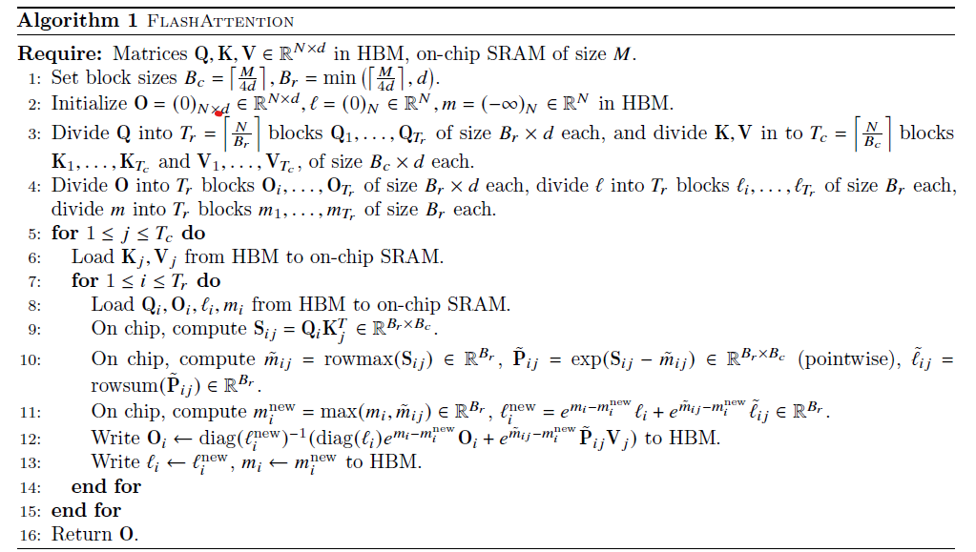
FlashAttention -1
Outer loop
Inner loop
Inter-Tile: parallelize over batch size and heads → low parallelism
Intra-Tile: → extra access to HBM from O
Outer loop: K V
Inner loop: Q

Slide 20
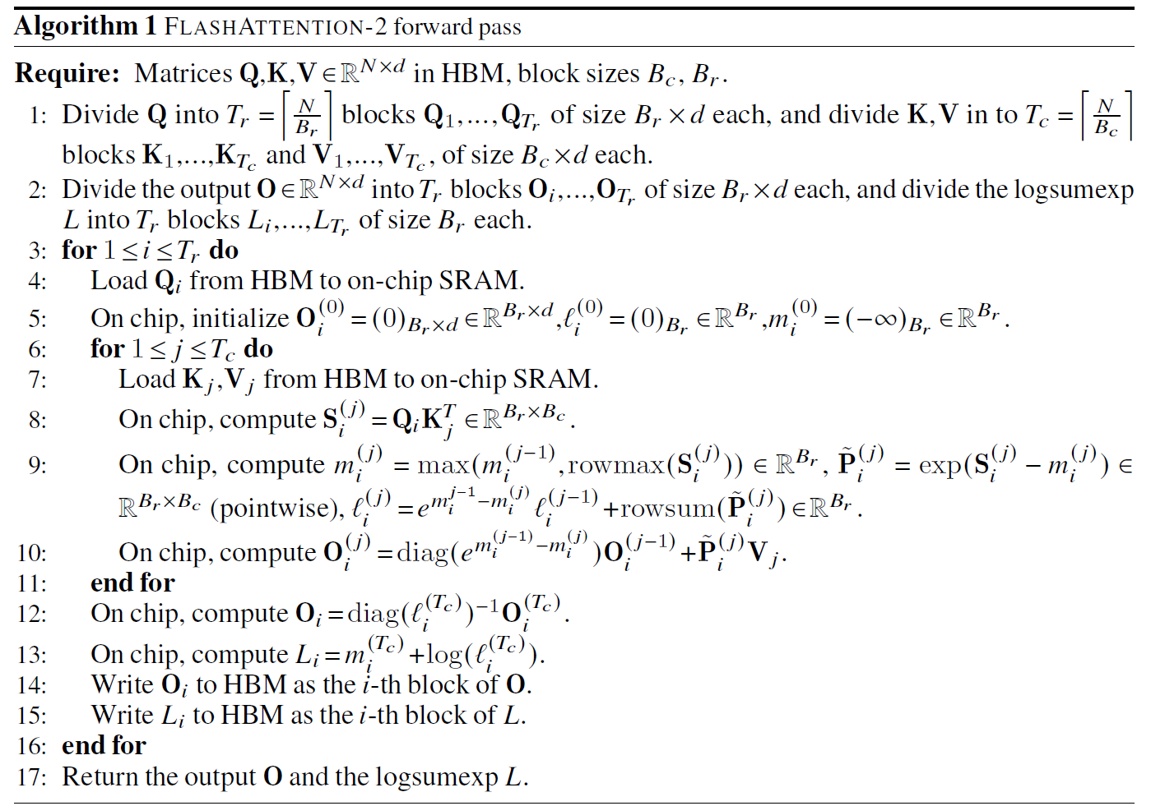
FlashAttention -2
Outer loop
Inner loop
Inter-Tile: parallelize over Q and batch size → high parallelism
Intra-Tile: → no extra access to HBM from O
Outer loop: Q
Inner loop: K V

Slide 21
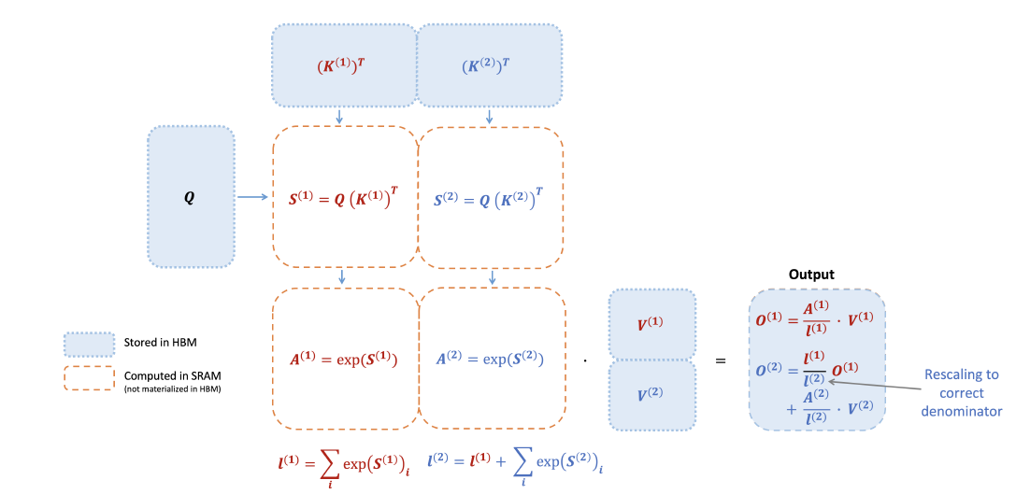
FlashAttention -2
Iterate over K and V
One thread block
for a subset of Q
Accumulate to O
Inter-Tile: parallelize over Q and batch size → high parallelism
Intra-Tile: → no extra access to HBM from O
Outer loop: Q
Inner loop: K V

Slide 22
FlashAttention -3
Issues of FlashAttention-2
Serial Execution of GEMM, softmax, and HBM
Low GPU utilizaton
Two key ideas of FlashAttention-3
Optimized for Hopper GPU
1, Warp Specialization: _{producer consumer model}
2, Intra-warpgroup overlapping: _{overlap softmax and GEMM}

Slide 23
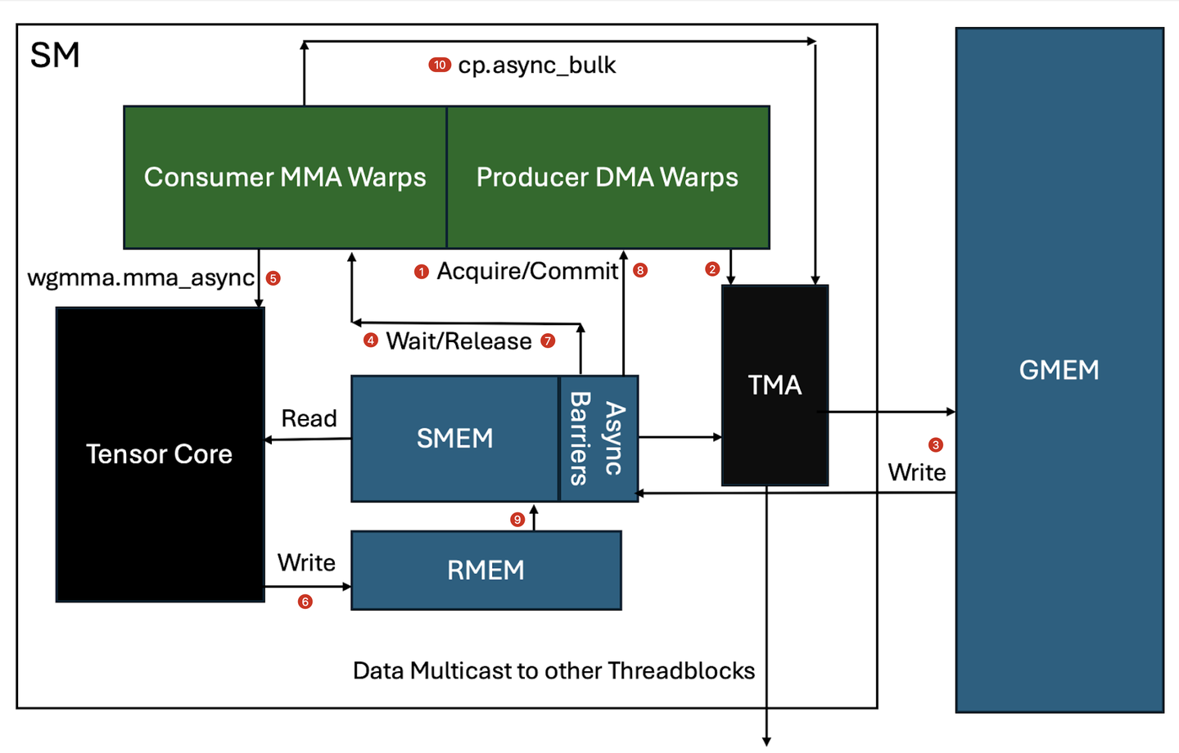
Producer and Consumer Model
One key idea of FlashAttention-3
1, Warp Specialization: _{producer consumer model}
Due to async memory access (DMA)

Slide 24
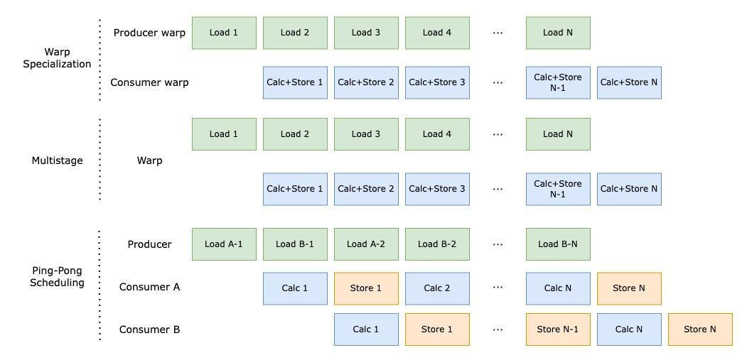
Intra-warpgroup overlapping
One key idea of FlashAttention-3
Intra-warpgroup overlapping: _{overlap softmax and GEMM}

Slide 25
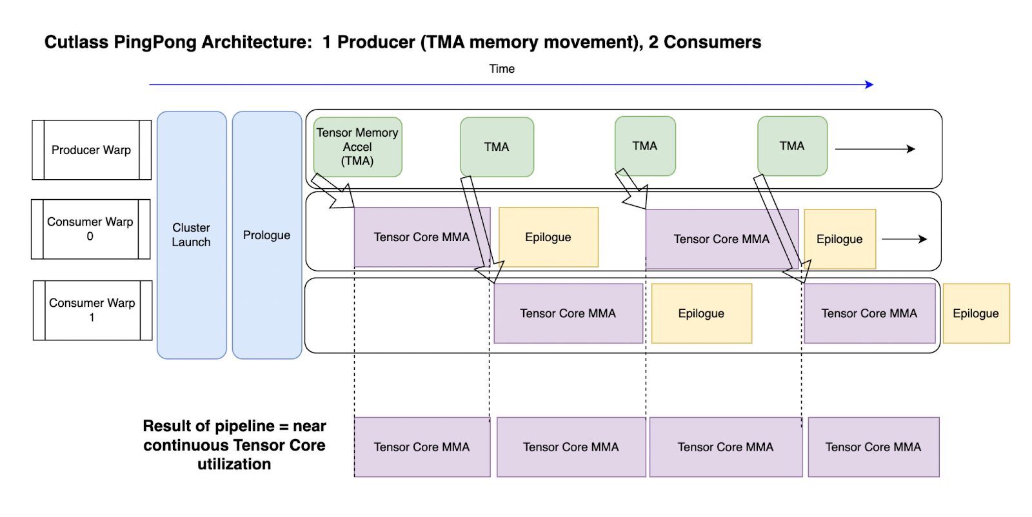
FlashAttention -3
Real Mapping of FlashAttention-3
Epilogue is softmax

Slide 26
FlashAttention -4
Issues of FlashAttention-2
Unaware of Blackwell GPU
Two key ideas of FlashAttention-4
Goal: Optimized for Blackwell GPU
1, Deeper Warp Specialization

Slide 27
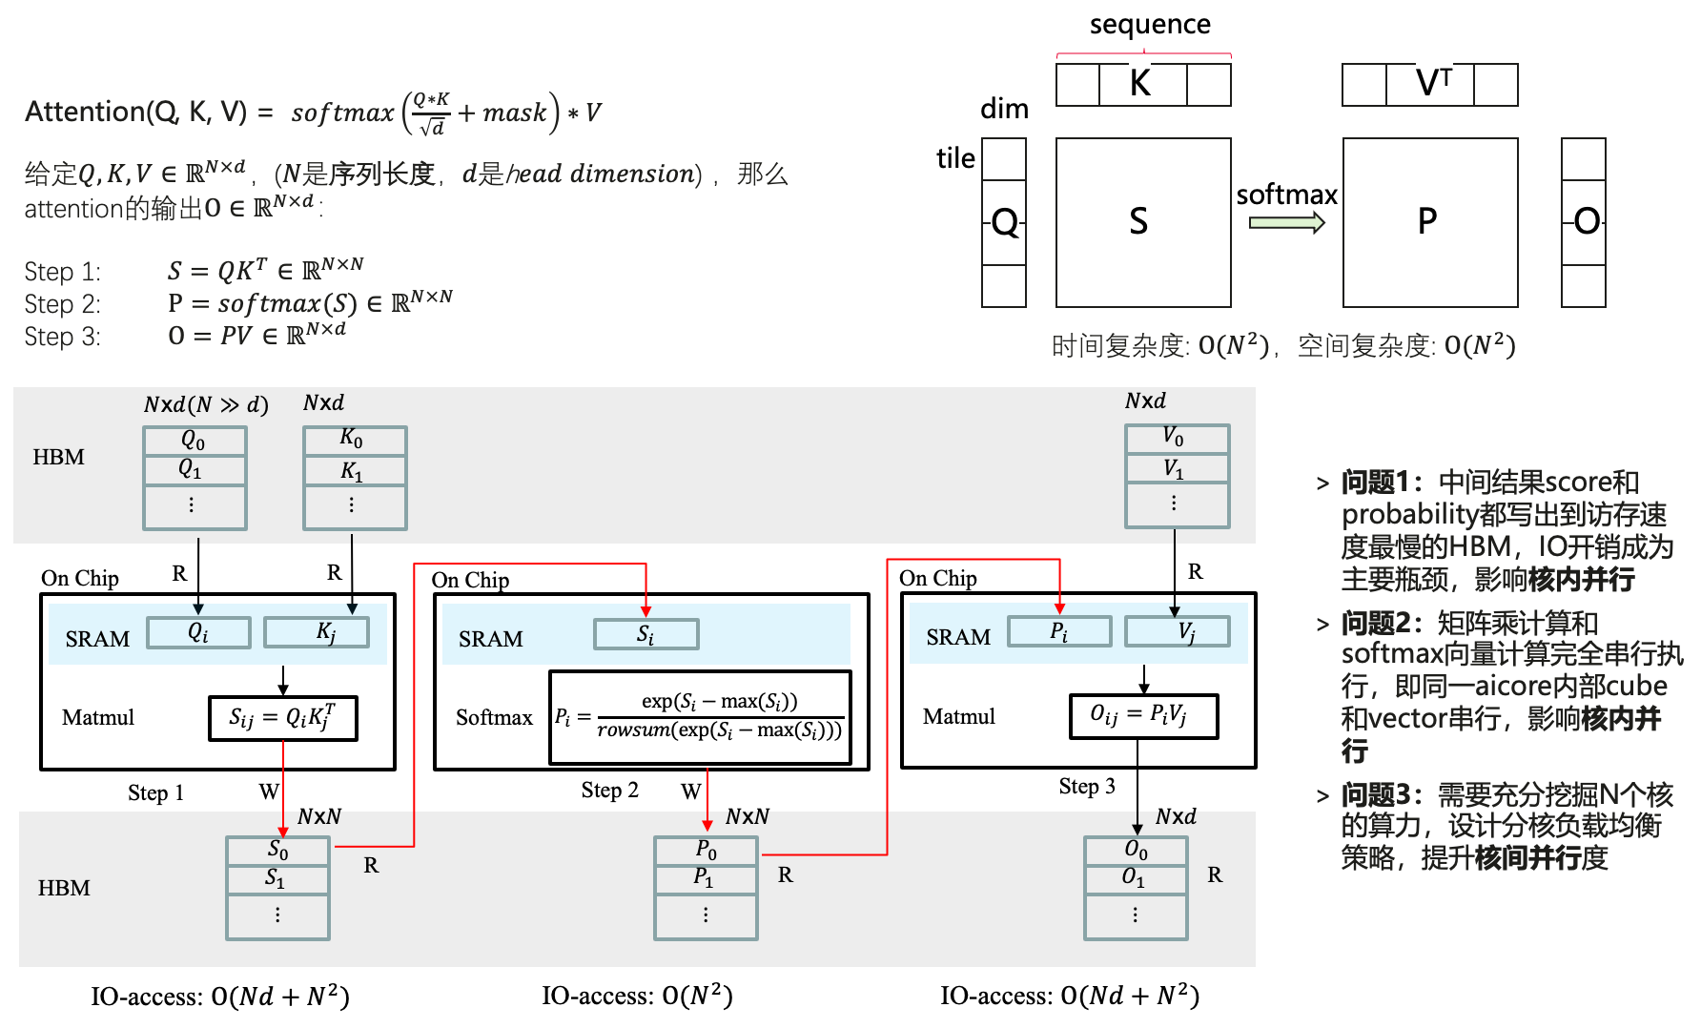
算子融合-PyTorch版Attention
Notes:
这里只有在第三步是实实在在的计算动作，其余步骤都是在为计算做准备工作。
在性能优化工作中，宏观角度通常是通过更好的算法、数学方法来减少总计算量。
而在微观角度上，则是尽可能的使处理器的计算单元“忙”起来，即增大计算单元的计算时间占总运行时间的比重。

